Slide 1
ODE of the first order: Decay Equation
1. Separable Function
2. Integrating Factor
ODE of the second order: Simple Harmonic Motion Equation
Complex number method

Slide 2
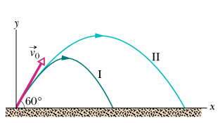
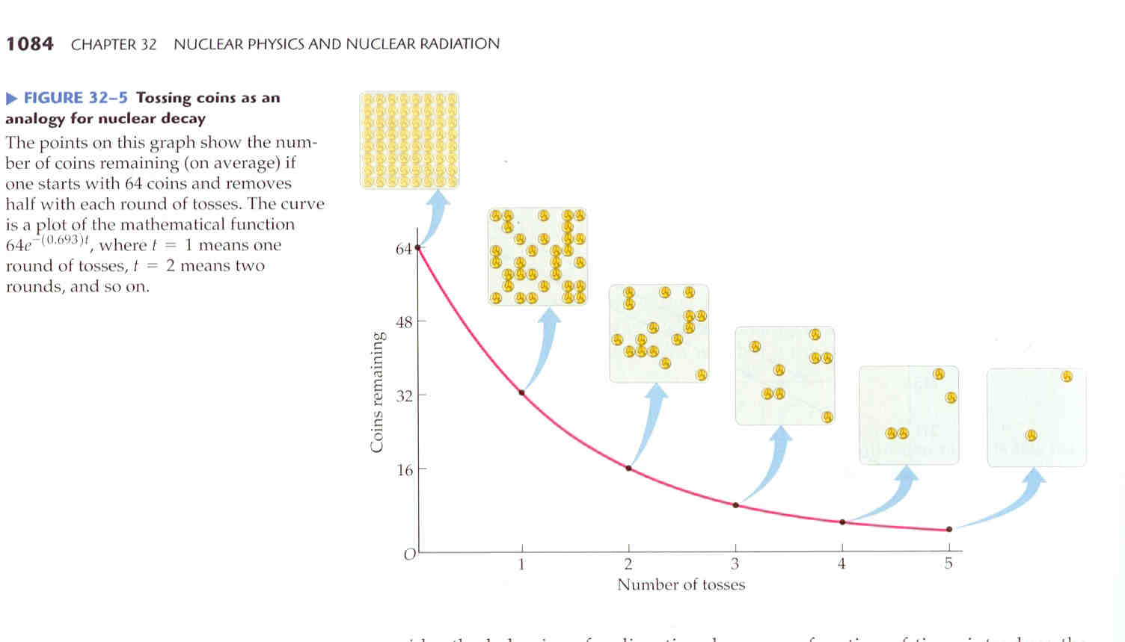
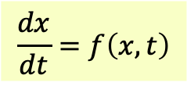

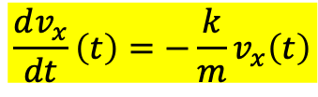
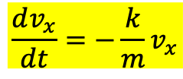


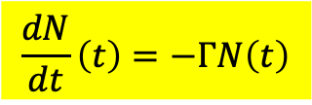



水平速度的速度分量$v_{x}$
$$\frac{dv_{x}}{dt}=−\frac{k}{m}v_{x}$$
$$\frac{dx}{dt}=f\left(x,t\right)$$
$v_{x}$的一次微分與$v_{x}$成正比！
This is a first order ordinary differential equation of function $v_{x}\left(t\right)$.
這個微分方程式，與放射性原子核數目$N$的衰變方程式完全一樣！
This differential equation is identical to the decay equation of radioactive atomic nuclei.
$$N$$
$$t$$
$$\frac{dv_{x}}{dt}\left(t\right)=−\frac{k}{m}v_{x}\left(t\right)$$
$$\frac{dN}{dt}\left(t\right)=−ΓN\left(t\right)$$
$v_{x}$的微分與$v_{x}$成正比！
$N$的微分，與$N$成正比。
兩者的物理完全無關，但數學方程式完全相同，解就完全一樣！
The physics is different. But since the equations are identical, the solutions are the same.

Slide 3
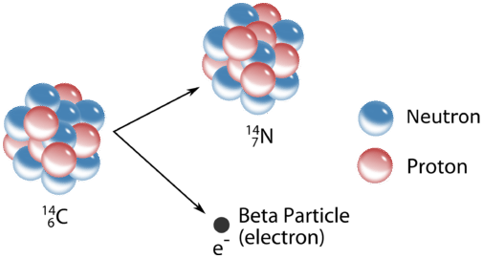




放射性原子核衰變，例如同位素碳衰變為氮：
$${}_{6}^{14}{\text{C}}→{}_{7}^{14}{\text{N}}+e^{−}+{\overline{ν}}_{e}$$
The probability for a nucleus to decay per second is usually a constant: call it $Γ$.
一個原子核每秒衰變的機率通常是固定的：$Γ$。
For every identical nucleus, this probability per second $Γ$ is the same.
對每一個相同的原子核，$Γ$都相等。
The original nucleus disappears with probability: $Γ$.
$$Γ$$
$$1−Γ$$
The original nucleus stays with probability: $1−Γ$.
一秒後 after one second

Slide 4
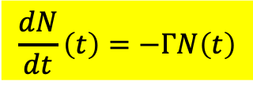



Probability can not tell us whether a certain nucleus will decay or not.
But if we are observing a large number of nuclei,
probability can predict how many of them will decay and the surviving number $N$.
如果是觀測一大群原子核：
機率使我們可以預測有多少原子核發生，及留存的數量$N$。
$$N$$
$$t$$
$Γ$ 是一個原子核每秒衰變的機率。
The probability for a nucleus to decay per second is $Γ$.
$ΓN$ 即是一群$N$個原子核，每秒衰變發生的次數。
$$\frac{dN}{dt}\left(t\right)=−ΓN\left(t\right)$$
$ΓN$ is how many times decay happens per second for $N$ nuclei。
每衰變一次，數目就減1。 $−ΓN$ 等於數目變化率$\frac{dN}{dt}$。
Decay decreases $N$ by $1$. $−ΓN$ equals the rate of number decrease $\frac{dN}{dt}$:

Slide 5

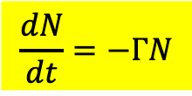

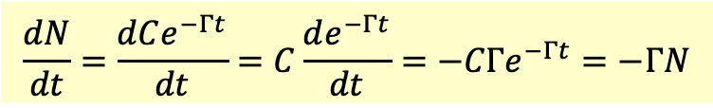

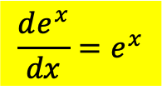
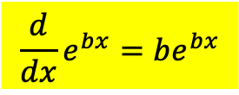
$$\frac{de^{x}}{dx}=e^{x}$$
$$\frac{d}{dx}e^{bx}=be^{bx}$$
$$\frac{dN}{dt}=−ΓN$$
$$N=e^{−Γt}$$
取常數$b$為$−Γ$，即得到一個解！
Pick the constant $b$ as $−Γ$, and we get a solution！
但我可以在這個解的前面乘上任一個常數$C$，解仍成立
$$N=Ce^{−Γt}$$
But I can always multiply the above $e^{−Γt}$ by a constant and it is still a solution.
$$\frac{dN}{dt}=\frac{dCe^{−Γt}}{dt}=C\frac{de^{−Γt}}{dt}=−CΓe^{−Γt}=−ΓN$$
一次微分方程式的解會有一個未確定的常數！
There is always an unspecified constant in the solution we can get.
注意常數$C$可以是任意數，我們似乎得到了無限多組解。
Since $C$ could be any number except for $0$, we have an infinite number of solutions.

Slide 6




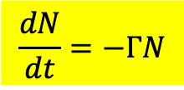

$$N$$
$$t$$
$$\frac{dN}{dt}=−ΓN$$
微分方程式只規定變化率與數量正比，
此規定的漏洞是無法禁止等比例增減，也就是將數量乘常數$C$！
But we haven't input the initial number $N_{0}$, so called initial condition.
$$N=Ce^{−Γt}$$
但也因有$C$我們才能引入起始數目$N_{0}$，否則起始數量只是$1$。
$$N\left(0\right)=C=N_{0}$$
$$N=N_{0}e^{−Γt}$$
如果沒有引入起始的條件$N_{0}$，微分方程式有無限多個解。
Without initial condition, 1st order ODEquation have an infinite number of solutions.
引入適當的起始條件，微分方程式就只有唯一解。
With appropriate initial condition, ODE’s have just one solution.

Slide 7
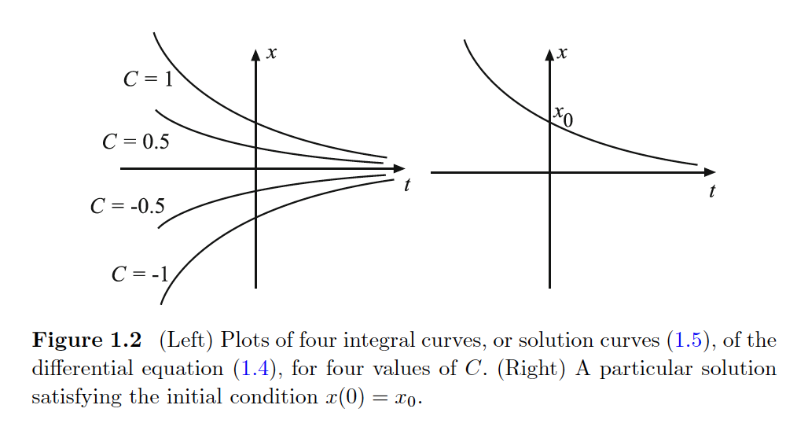
幾何上的意義
常數$C$可以是任意數，我們得到了無限多組解，對應無限多組線。。
Amongst infinite number of exponential lines that satisfy the equation, only one will pass through the initial condition.
引入適當的起始條件，只有一條線能通過起始條件代表的點。
這個結果幾乎適用於所有的微分方程式。

Slide 8


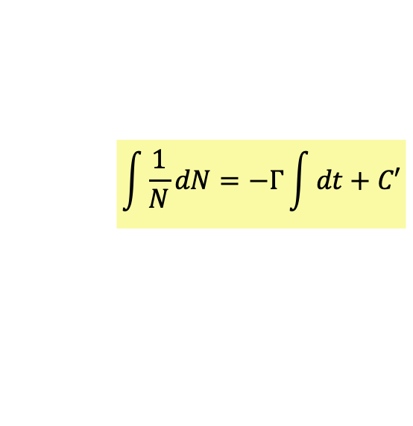
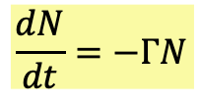
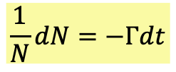


Method 1 (Separable Function)
比較可以普遍適用的求解法！
以積分來進行解微分方程式的技巧：
$$\frac{dN}{dt}=−ΓN$$
可以把所有$N$的Factor集中左邊，$t$集中右邊。
$$\frac{1}{N}dN=−Γdt$$
函數的微小變化$dN$與變數的微小變化$dt$的關係。
兩邊都取積分(即是微小變化累加)，注意可以加上一個未決定的常數$C′$：
$$\int{\frac{1}{N}dN}=−Γ\int{dt}+C′$$
$$\ln{N}=−Γt+C′$$
兩邊都取指數：
$$N\left(t\right)=Ce^{−Γt}$$
注意常數$C$可以是任意數，我們似乎得到了無限多組解。
引入適當的起始條件，微分方程式就只有唯一解。
$$N\left(0\right)=C=N_{0}$$
$$N\left(t\right)=N_{0}e^{−Γt}$$

Slide 9
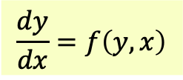


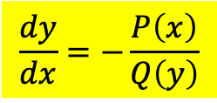

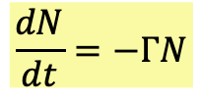
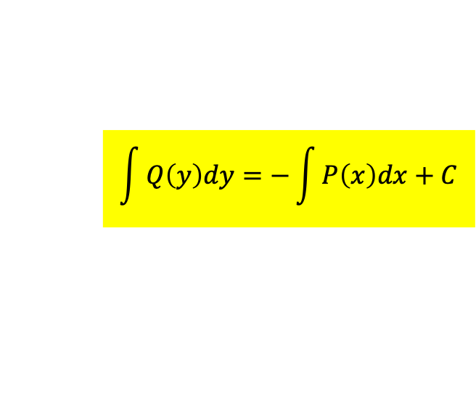
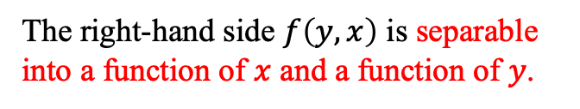
P331
Separable equation. Method 1 in general!
$$\frac{dy}{dx}=f\left(y,x\right)$$
Method 1
$$\frac{dy}{dx}=−\frac{P\left(x\right)}{Q\left(y\right)}$$
The right-hand side $f\left(y,x\right)$ is separable into a function of $x$ and a function of $y$.
$$\frac{dN}{dt}=−ΓN$$
$$Q\left(y\right)dy=−P\left(x\right)dx$$
$$\frac{1}{N}dN=−Γdt$$
$$\int{Q\left(y\right)dy}=−\int{P\left(x\right)dx}+C$$
$$\int{\frac{1}{N}dN}=−Γ\int{dt}+C′$$
Solving DE is doing integration, the inverse operation of differentiation.
This gives a relation between $y\left(x\right)$ and $x$ and could be solved to get solution $y\left(x\right)$.
Again, there is an undetermined constant $C$ in the solution!
To determined the constant $C$ , initial condition $y_{0}=y\left(x_{0}\right)$ is needed.

Slide 10
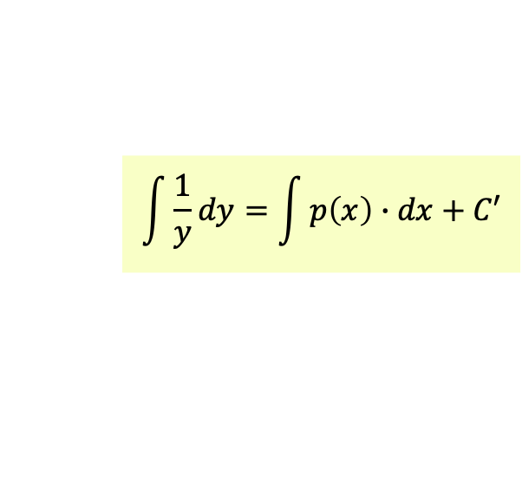
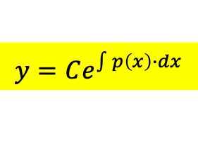
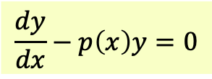
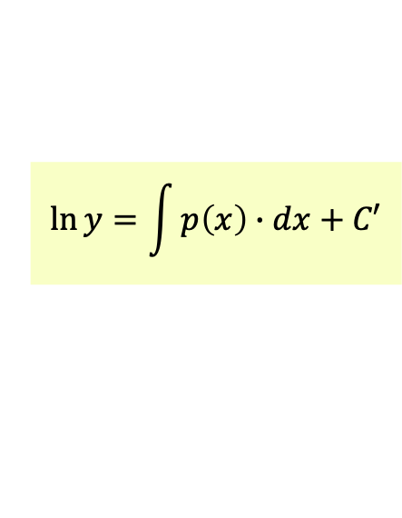

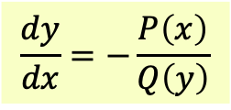
Example 1:
$$\frac{dy}{dx}−p\left(x\right)y=0$$
$$\frac{dy}{dx}=−\frac{P\left(x\right)}{Q\left(y\right)}$$
$$\int{\frac{1}{y}dy}=\int{p\left(x\right)∙dx}+C′$$
$$\int{Q\left(y\right)dy}=−\int{P\left(x\right)dx}+C$$
$$\ln{y}=\int{p\left(x\right)∙dx}+C′$$
$$y=Ce^{\int{p\left(x\right)∙dx}}$$
等一下有用

Slide 11
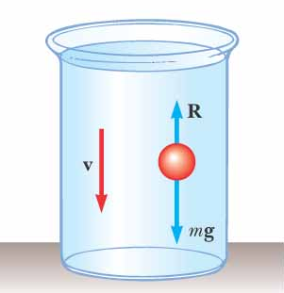
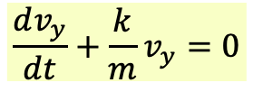
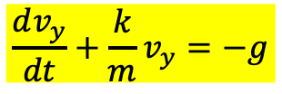
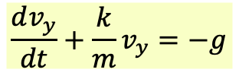
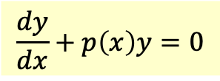

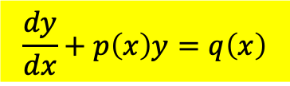
速度垂直分量$v_{y}$
$$\frac{dv_{y}}{dt}+\frac{k}{m}v_{y}=−g$$
This is one of the Linear First order ODE
$$\frac{dy}{dx}+p\left(x\right)y=q\left(x\right)$$
with a derivative of first order, first power of $y$and a known function $q\left(x\right)$。
It is called an Inhomogeneous Equation.
If $q\left(x\right)$ (called source term) equals zero, it is called the Homogeneous Version.
$$\frac{dy}{dx}+p\left(x\right)y=0$$
The solutions of Inhomogeneous Equation are highly related to the Homogeneous version.
For Inhomogeneous Decay Equation we are solving, $q\left(x\right)=−g：$
$$\frac{dv_{y}}{dt}+\frac{k}{m}v_{y}=−g$$
Without $q\left(x\right)$, the Homogeneous version is identical to the decay equation.
$$\frac{dv_{y}}{dt}+\frac{k}{m}v_{y}=0$$

Slide 12
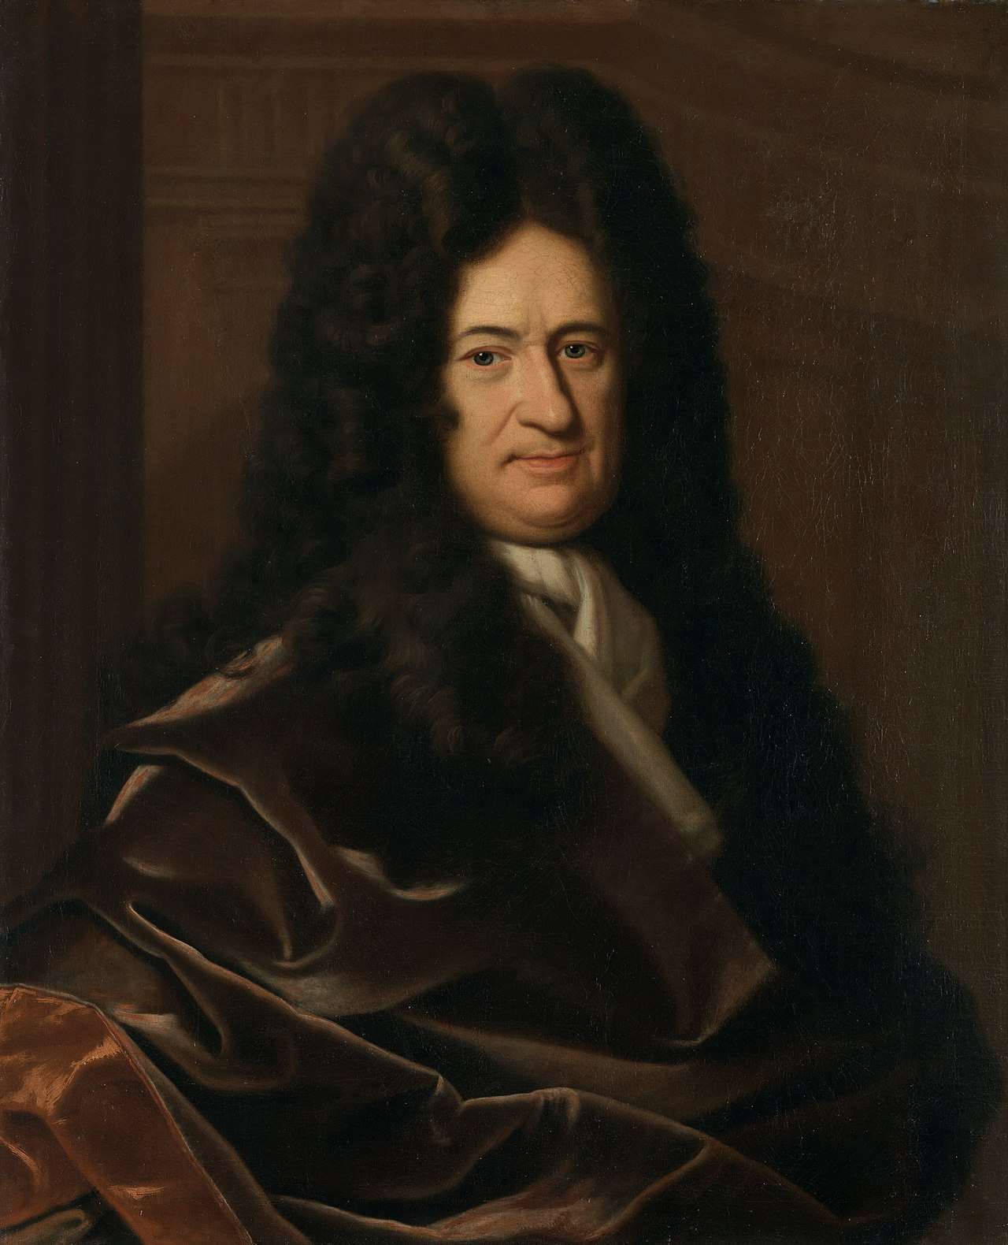
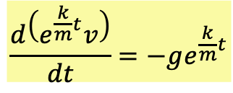

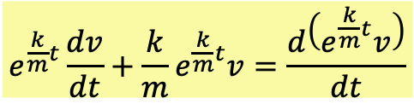
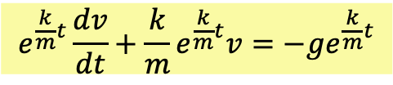
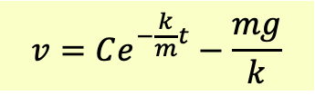
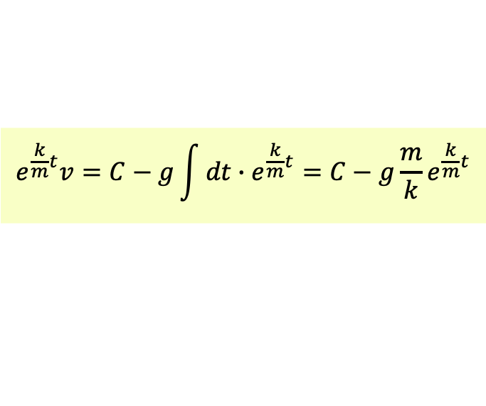
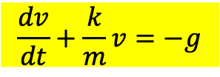
Method 2 (Integrating Factor), Let’s drop the subscript $y$ for simplicity. But this $v$ is $v_{y}$.
$$\frac{dv}{dt}+\frac{k}{m}v=−g$$
Multiply both sides by $e^{\frac{k}{m}t}$, called integrating factor!
$$e^{\frac{k}{m}t}\frac{dv}{dt}+\frac{k}{m}e^{\frac{k}{m}t}v=−ge^{\frac{k}{m}t}$$
$$e^{\frac{k}{m}t}\frac{dv}{dt}+\frac{k}{m}e^{\frac{k}{m}t}v=\frac{d\left(e^{\frac{k}{m}t}v\right)}{dt}$$
The left-hand side is equal to the derivative of $e^{\frac{k}{m}t}v$！
$$\frac{d\left(e^{\frac{k}{m}t}v\right)}{dt}=−ge^{\frac{k}{m}t}$$
The right-hand side is a known function.
We can then integrate both sides:
$$e^{\frac{k}{m}t}v=C−g\int{dt∙e^{\frac{k}{m}t}}=C−g\frac{m}{k}e^{\frac{k}{m}t}$$
Leibniz (1645-1716)
$$v=Ce^{−\frac{k}{m}t}−\frac{mg}{k}$$
With an unspecified constant $C$ we again arrive at an infinite number of solutions.
The constant can be used to fit the initial condition!

Slide 13
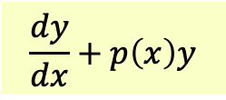
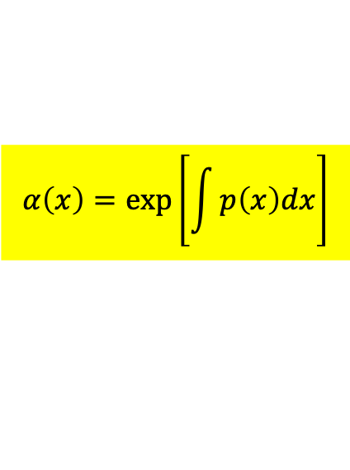
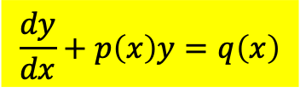
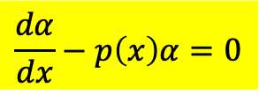
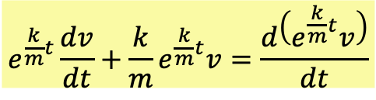
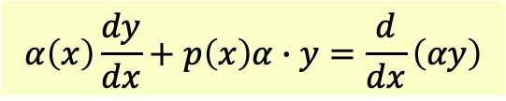
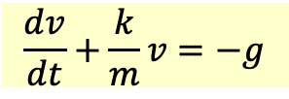
積分因子法 Integrating factor，method 2 in general!
P336
The above method can be generalized to the following equations:
$$\frac{dy}{dx}+p\left(x\right)y=q\left(x\right)$$
$$\frac{dv}{dt}+\frac{k}{m}v=−g$$
The idea: multiply the left-hand side by an integrating factor $α\left(x\right)$:
So that it becomes the derivative of the function $αy\left(x\right)$.
Leibniz (1645-1716)
$$\frac{dy}{dx}+p\left(x\right)y$$
$$α\left(x\right)\frac{dy}{dx}+p\left(x\right)α∙y=\frac{d}{dx}\left(αy\right)$$
$$e^{\frac{k}{m}t}\frac{dv}{dt}+\frac{k}{m}e^{\frac{k}{m}t}v=\frac{d\left(e^{\frac{k}{m}t}v\right)}{dt}$$
By chain rule, the condition is:
$$\frac{dα}{dx}−p\left(x\right)α=0$$
This is a separable ODE which we already know how to solve!
$$α\left(x\right)=\text{exp}\left[\int{p\left(x\right)dx}\right]$$

Slide 14
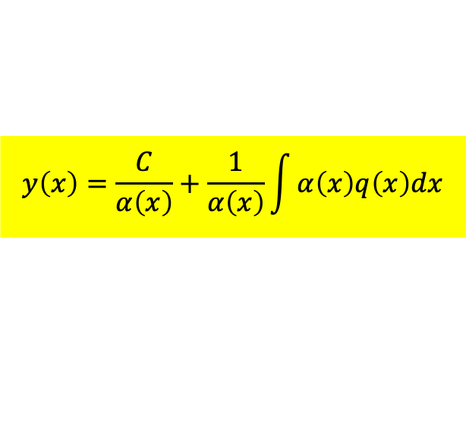
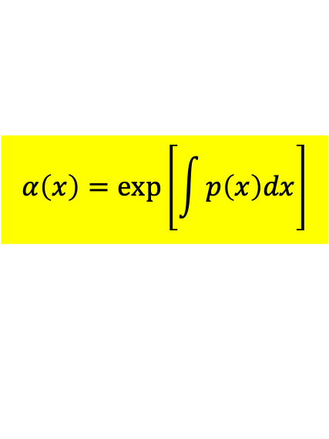





Multiply the whole equation by the integrating factor $α\left(x\right)$:
$$\frac{dy}{dx}+p\left(x\right)y=q\left(x\right)$$
$$α\frac{dy}{dx}+αpy=αq$$
$$α\left(x\right)=\text{exp}\left[\int{p\left(x\right)dx}\right]$$
$$α\frac{dy}{dx}+αpy=\frac{d\left(αy\right)}{dx}$$
The equation is simplified:
$$\frac{d\left(αy\right)}{dx}=αq$$
We can then integrate both sides to get solutions!
$$αy=\int{αq\left(x\right)dx}+C$$
$$y\left(x\right)=\frac{C}{α\left(x\right)}+\frac{1}{α\left(x\right)}\int{α\left(x\right)q\left(x\right)dx}$$
Again, there is an undetermined constant $C$ in the solution as expected.

Slide 15



Note that there is one interesting thing that will have long term consequences.
The solution of $v_{y}$ contains two terms: they are familiar terms we have discussed.
$$v_{y}\text{(}\text{t}\text{)}=Ce^{−\frac{k}{m}t}−g{e^{−\frac{k}{m}t}∙\frac{m}{k}e}^{\frac{k}{m}t}=Ce^{−\frac{k}{m}t}−\frac{mg}{k}$$
The first term $Ce^{−\frac{k}{m}t}$is the solution of the homogeneous version.
$$\frac{dv_{y}}{dt}+\frac{k}{m}v_{y}=0$$
Decay Equation
The second term is equal speed solution, one of the solutions of the whole inhomogeneous version of equation.
Equal speed solution is unable to satisfy most initial condition.
Adding the the first term $Ce^{−\frac{k}{m}t}$helps it accomplish the task.
Solutions of Linear inhomogeneous ODE equals one solution of the inhomogeneous ODE plus the solution of the homogeneous ODE.

Slide 16






This observation even applies to the general case:
$$\frac{dy}{dx}+p\left(x\right)y=q\left(x\right)$$
Condition for integrating factor:
$$\frac{dα}{dx}−p\left(x\right)α=0$$
$$α\left(x\right)=\text{exp}\left[\int{p\left(x\right)dx}\right]$$
This condition for integrating factor is the Homogeneous version of the Eq we are solving, but with $−p\left(x\right)$ replacing $p\left(x\right)$.
$$\frac{dy}{dx}+p\left(x\right)y=0$$
$$\text{exp}\left[−\int{p\left(x\right)dx}\right]=\frac{1}{α\left(x\right)}$$
The solution to this version is:
The integrating factor $α$ equals the inverse of the solution of the Homogeneous version.

Slide 17




$$\frac{dy}{dx}+p\left(x\right)y=q\left(x\right)$$
$$y=\frac{C}{α\left(x\right)}+\frac{1}{α\left(x\right)}\int{α\left(x\right)q\left(x\right)dx}≡y_{1}+y_{2}$$
$$\frac{1}{α\left(x\right)}=\text{exp}\left[−\int{p\left(x\right)dx}\right]$$
$$\frac{dy}{dx}+p\left(x\right)y=0$$
The first term $\frac{C}{α\left(x\right)}$ is the solution of the homogeneous ODE.
The integrating factor $α\left(x\right)$ equals the inverse of the solution of the Homogeneous Eq.
The second term is one of the solutions of the inhomogeneous ODE.
This is a general property of all linear ODE’s.

Slide 18







Solutions $y$of Linear inhomogeneous ODE equals one solution $y_{2}$of the inhomogeneous ODE plus the solution $y_{1}$ of the homogeneous ODE.
The difference between any two solutions $y−y_{2}$ of a Linear inhomogeneous ODE equals a solution of the homogeneous ODE.
$$\frac{dy}{dx}+p\left(x\right)y=q\left(x\right)$$
$$−$$
$$\frac{dy_{2}}{dx}+p\left(x\right)y_{2}=q\left(x\right)$$
$$\frac{d\left(y−y_{2}\right)}{dx}+p\left(x\right)\left(y{−y}_{2}\right)=0$$
$y−y_{2}$ equals a solution $y_{1}$ of the homogeneous ODE.
$$y=y_{1}+y_{2}$$

Slide 19







Equation of motion of SHM
$$F=−kx$$
$$ω=\sqrt{\frac{k}{m}}$$
$$m\frac{d^{2}x}{dt^{2}}=−kx$$
$$\frac{d^{2}x}{dt^{2}}=−\frac{k}{m}x=−ω^{2}x$$
$$\frac{d^{2}x}{dt^{2}}+ω^{2}x=0$$
This is a Homogeneous 2nd order Linear ODE.
$$y^{′′}+a_{1}y^{′}+a_{0}y=f\left(x\right)$$

Slide 20








Let’s first start with Homogeneous Linear ODE：
$$y^{′′}+P\left(x\right)y^{′}+Q\left(x\right)y=0$$
It is called linear because of this theorem：
If we could find two function $y_{1}\left(x\right),y_{2}\left(x\right)$ satisfying
$$y^{′′}+P\left(x\right)y^{′}+Q\left(x\right)y=0$$
any linear combination
would also satisfy the equation.
$$C_{1}y_{1}\left(x\right)+C_{2}y_{2}\left(x\right)$$
$$C_{1}$$
$$y_{1}^{′′}+P\left(x\right)y_{1}^{′}+Q\left(x\right)y_{1}=0$$
$$+$$
$$C_{2}$$
$$y_{2}^{′′}+P\left(x\right)y_{2}^{′}+Q\left(x\right)y_{2}=0$$
$${\left(C_{1}y_{1}+C_{2}y_{2}\right)}^{′′}+P\left(x\right){\left(C_{1}y_{1}+C_{2}y_{2}\right)}^{′}+Q\left(x\right)\left(C_{1}y_{1}+C_{2}y_{2}\right)=0$$
QED
如果已找到兩個函數$y_{1}\left(x\right),y_{2}\left(x\right)$都滿足方程式，我們就得到無限多個解！
If we could find two function $y_{1}\left(x\right),y_{2}\left(x\right)$, we get infinite number of solutions.
微分方程式的解需要讓自己挪出足夠的空間，這樣才能滿足起始條件。
That is natural. Then we can fit the initial condition.

Slide 21






簡諧運動的運動方程式 Equation of Motion for SHM
$$F=−kx$$
$$ω=\sqrt{\frac{k}{m}}$$
$$m\frac{d^{2}x}{dt^{2}}=−kx$$
$$\frac{d^{2}x}{dt^{2}}=−\frac{k}{m}x=−ω^{2}x$$
$$\frac{d^{2}x}{dt^{2}}=−ω^{2}x$$
一個簡諧運動，完全由一個特徵常數ω（角頻率）決定！
A SHM is completely determined by a characteristic number ω.
具有相同的ω的簡諧運動，運動方程式的解就完全一樣。
Any SHM with identical angular frequency ω has identical solution.
This is a Homogeneous 2nd order Linear ODE with constant coefficients.
$$y^{′′}+a_{1}y^{′}+a_{0}y=0$$

Slide 22










簡諧運動的運動方程式求解 Solving Equation of Motion for SHM
$$\frac{d^{2}x}{dt^{2}}=−ω^{2}x$$
It states the second derivative of $x$ is proportional to itself.
位置函數的兩次微分與自己成正比：多項式不符合。Polynomials could fit.
因式中的負號，指數函數也不行！Neither could Exponential due to the minus sign.
正弦函數正好具有這樣的性質！Sine function does fit.
$$x^{n}$$
微分
微分
$$x^{n−1}$$
微分
微分
微分
$$e^{−x}$$
$$\sin{x}$$
$$\cos{x}$$
$$⋮$$
$$x$$
微分
$$1$$

Slide 23




$$\frac{d^{2}x}{dt^{2}}=−ω^{2}x$$
It states the second derivative of $x$ is proportional to itself.
正弦函數正好具有這樣的性質！Sine function does fit.
$$\frac{d\left(\sin{ωt}\right)}{dt}=\frac{d\sin{ωt}}{d\left(ωt\right)}∙\frac{d}{dt}\left(ωt\right)＝ω\cos{ωt}$$
$$ω\frac{d\left(\cos{ωt}\right)}{dt}=−ω^{2}\sin{ωt}$$
$$\frac{d^{2}\left(\sin{ωt}\right)}{dt^{2}}=−ω^{2}\sin{ωt}$$

Slide 24




簡諧運動的解
$$\frac{d^{2}x}{dt^{2}}=−ω^{2}x$$
很容易就找到兩個解。We found two solutions:
$$x_{1}=\sin{ωt}$$
$$x_{2}=\cos{ωt}$$
那麼任一線性組合也是解！Any linear combinations would be solutions too.
$$x=a\cos{ωt}+b\sin{ωt}$$
我們得到無限多個解！We found infinite number of solutions.

Slide 25






$$x=a\cos{ωt}+b\sin{ωt}$$
$$v=−ωa\sin{ωt}+ωb\cos{ωt}$$
$a,b$由起始條件決定。$a,b$ would be determined by initial conditions$v\left(0\right),x\left(0\right)$.
$$x\left(0\right)=a=x_{0}$$
$$v\left(0\right)=ωb=v_{0}$$
$$b=\frac{v_{0}}{ω}$$
$$x=x_{0}\cos{ωt}+\frac{v_{0}}{ω}\sin{ωt}$$
這個函數同時滿足運動方程式以及兩個起始條件，因此是唯一的解！
This one solution satisfies both the Equation of motion and initial condition.
不用再找了！It cold be proven that there is only one such function.

Slide 26




Damped Oscillation 阻尼震盪
$$m\frac{d^{2}x}{dt^{2}}=−b\frac{dx}{dt}−kx$$
$$\frac{d^{2}x}{dt^{2}}+\frac{b}{m}\frac{dx}{dt}+ω^{2}x=0$$
This is a Homogeneous 2nd order Linear ODE with constant coefficients.
$$y^{′′}+a_{1}y^{′}+a_{0}y=0$$
單一個正弦或餘弦函數似乎不能滿足此式。
Pure Sine (Cosine) function can not satisfy the equation since the first derivative would generate a Cosine (Sine) function.

Slide 27




$$x\left(t\right)=x_{m}∙e^{−\frac{b}{2m}t}∙\cos\left(ω^{′}t+φ\right)$$
There are two unspecified constants $x_{m},φ$.
We can use the two initial conditions $x\left(0\right),x′\left(0\right)$ to specify them.
振幅對時間呈現指數衰減！
$$x_{m}\sim x_{m}e^{−\frac{b}{2m}t}$$
The amplitude decays exponentially.
$$ω^{′}=\sqrt{\frac{k}{m}−\frac{b^{2}}{4m^{2}}}=\sqrt{ω^{2}−\frac{b^{2}}{4m^{2}}}$$
角頻率會比無阻力時稍低。
Angular Frequency is smaller than dampless SHM.

Slide 28


$$ω^{′}=\sqrt{ω^{2}−\frac{b^{2}}{4m^{2}}}$$
振動角頻率減小！周期增加。

Slide 29


簡諧運動會因阻尼而使振幅減小，必須施力使它繼續振動
若施予一個常數力，所做的功在一個週期內會彼此抵消！
想使彈簧繼續振盪，必須施以一周期性的外力。
We can exert an external periodic force to keep the oscillation going.

Slide 30

以複數解簡諧運動的運動方程式
Ordinary Differential Equation with constant coefficients
$$\sum_{n}{a_{n}∙\frac{d^{n}x}{dt^{n}}}=f(t)$$
Arfken 7.3

Slide 31






$$e^{iθ}≡\cos{θ}+i\sin{θ}$$
Euler’s Formula
虛數的指數函數，如果這樣定義：
$$\frac{d}{dθ}e^{iθ}=−\sin{θ}+i\cos{θ}=ie^{iθ}$$
$$\frac{d^{2}}{dθ^{2}}e^{iθ}=−\cos{θ}−i\sin{θ}=−e^{iθ}=i^{2}e^{iθ}$$
Carl Friedrich Gauss (1777–1855)
正好是我們期待指數函數必須滿足的微分關係。
$$\frac{d^{n}}{dx^{n}}e^{iαx}={\left(iα\right)}^{n}∙e^{iαx}$$
$$e^{iα}∙e^{iβ}=\left(\cos{α}+i\sin{α}\right)∙\left(\cos{β}+i\sin{β}\right)=$$
$$\left(\cos{α}\cos{β}−\sin{α}\sin{β}\right)+i\left(\sin{α}\cos{β}+\cos{α}\sin{β}\right)=$$
$$\cos\left(α+β\right)+i\sin\left(α+β\right)=e^{i\left(α+β\right)}$$
正好是我們期待指數函數必須滿足的乘積關係。
此定義滿足指數函數所有重要性質！

Slide 32






另一個推導：
三角函數的泰勒展開：
$$\cos{θ}=1−\frac{1}{2!}θ^{2}+\frac{1}{4!}θ^{4}+⋯$$
$$\sin{θ}=θ−\frac{1}{3!}θ^{3}+\frac{1}{5!}θ^{5}+⋯$$
指數函數的泰勒展開：
$$e^{x}=1+x+\frac{1}{2!}x^{2}+\frac{1}{3!}x^{3}+\frac{1}{4!}x^{4}+⋯$$
要求指數函數的泰勒展開對虛變數還是對的：
$$e^{iθ}=1+iθ−\frac{1}{2!}θ^{2}−i\frac{1}{3!}θ^{3}+\frac{1}{4!}θ^{4}+⋯$$
$$=1−\frac{1}{2!}θ^{2}++\frac{1}{4!}θ^{4}+⋯+i\left(θ−\frac{1}{3!}θ^{3}+⋯\right)$$
$$=\cos{θ}+i\sin{θ}$$

Slide 33








我們可以更進一步定義複數$α=a+iθ$的指數函數：
$$e^{α}=e^{a+iθ}=e^{a}e^{iθ}=e^{a}\left(\cos{θ}+i\sin{θ}\right)$$
$$\left|e^{iθ}\right|=1$$
$e^{α}$在複數平面上表示，$e^{a}$就是絕對值$\left|e^{α}\right|$，$θ$就是幅角
$$\left|e^{a+iθ}\right|=e^{a}$$
Any complex number $z$ can be expressed this way:
$$z=\left|z\right|∙e^{iθ}$$
$$\left|mn\right|=\left|m\right|∙\left|n\right|$$
$$Im α$$
$$e^{a}=\left|e^{α}\right|$$
$$θ$$
$$Re α$$

Slide 34








$$Im α$$
$$e^{a}$$
$$θ$$
$$Re α$$
$$\frac{d}{dx}e^{αx}=\frac{d}{dx}\left(e^{ax}e^{iθx}\right)$$
$$=\left(ae^{ax}\right)e^{iθx}+e^{ax}\left(iθe^{iθx}\right)$$
$$=\left(a+iθ\right)e^{a+iθ}=αe^{αx}$$
The derivative of a complex exponential equals the coefficient times the exponential.
$$\frac{d^{n}}{dx^{n}}e^{αx}={\left(α\right)}^{n}∙e^{αx}$$
可以證明：
所以，複數的指數函數，所有的微分都與自己成正比！
The derivative of $n$th order equals the coefficient to the $n$th power times the exponential.

Slide 35







簡諧振盪器，以複數方法求解 SHO by complex number method：
$$\frac{d^{2}x}{dt^{2}}+ω^{2}x=0$$
首先將這個式子裡的 $x$ 推廣為一個複數 $z$。
First elevate the real function $x$ into a complex number function $z\left(t\right)$。
$$\frac{d^{2}z}{dt^{2}}+ω^{2}z=0$$
複數 z 包含實數部$Re z$與虛數部$Im z$。
Complex z consist of real part $Re z$ and imaginary part $Im z$。
$$\frac{d^{2}\left(Re z+iIm z\right)}{dt^{2}}+ω^{2}\left(Re z+iIm z\right)=0+i0$$
因為方程式是線性的，$z$的實數部與虛數部也同時滿足原來$x$滿足的方程式！
Since the equation is linear, both the real and imaginary part satisfy the Eq.
$$\frac{d^{2}\left(Im z\right)}{dt^{2}}+ω^{2}\left(Im z\right)=0$$
$$\frac{d^{2}\left(Re z\right)}{dt^{2}}+ω^{2}\left(Re z\right)=0$$
如果能解出複數$z$，再取其實數部或虛數部，即可得到原方程式的實數解 x。
If we solve complex $z$, $Re z$ and $Im z$would be solutions x of the real Eq.

Slide 36











$$\frac{d^{2}z}{dt^{2}}+ω^{2}z=0$$
我們大膽地猜，解正比於一個複數指數函數：
Guess:
$$z=z_{0}e^{αt}$$
$$α^{2}z+ω^{2}z=0$$
上式所有項都正比於$z：$
Both terms are proportional to $z$.
$$\frac{d^{n}}{dt^{n}}z=α^{n}z$$
微分的次數對應$α$的冪次。
Orders of derivatives corresponds to powers of $α$.
$$α^{2}+ω^{2}=0$$
原來的微分方程式現在一項對一項地轉化為未知的𝛼滿足之代數方程式。
The original differential Equation can be transformed into an Algebraic Equation.
α 可被解出： α can solved
$$α_{±}=±iω$$
解出複數解$z$：The complex solutions are:
$$z_{±}=z_{0}e^{\text{±}iωt}$$

Slide 37









$z_{0}$是一個複數常數，因此可以寫成：
The constant $z_{0}$ can be written by its Absolute value $A$ and argument $φ$:
$$z_{0}=Ae^{iφ}$$
$A,φ$是兩個實數常數。
$$Im$$
$$z_{+}=Ae^{i\left(ωt+φ\right)}=A\cos\left(ωt+φ\right)+iA\sin\left(ωt+φ\right)$$
$$Ae^{i\left(ωt+φ\right)}$$
$$A$$
這就是簡諧運動的複數解！The is the complex solution.
$$\left(ωt+φ\right)$$
$$Re$$
假想圓就是此複數解$Ae^{i\left(ωt+φ\right)}$在其複數平面上的表現！
取其實數部，就得到簡諧運動的實數解！
Pick the real part of $z_{+}$, we arrive at real solutions x.
$$A\cos\left(ωt+φ\right)=Re\left[Ae^{i\left(ωt+φ\right)}\right]$$
這個解有兩個未定常數，因此就是最普遍的解了。
The general solution contains two unknown constants $A,φ$ just to fit two initial conditions.
The final function will be the unique solution to both satisfy the Eq. and initial Conditions.

Slide 38







有阻力的簡諧振盪器，以複數方法求解：
$$\frac{d^{2}x}{dt^{2}}+\frac{b}{m}\frac{dx}{dt}+ω^{2}x=0$$
首先將這個式子裡的 $x$ 推廣為一個複數 $z$。
First elevate the real $x$ into a complex $z\left(t\right)$。
$$\frac{d^{2}z}{dt^{2}}+\frac{b}{m}\frac{dz}{dt}+ω^{2}z=0$$
注意複數 z 包含實數部$Re z$與虛數部$Im z$。
$$\frac{d^{2}\left(Re z+iIm z\right)}{dt^{2}}+\frac{b}{m}\frac{d\left(Re z+iIm z\right)}{dt}+ω^{2}\left(Re z+iIm z\right)=0+i0$$
因為方程式是線性的，$z$的實數部與虛數部也同時滿足原來$x$滿足的方程式！
Since the equation is linear, both the real and imaginary part satisfy the Eq.
如果能解出複數$z$，再取其實數部或虛數部，即可得到原方程式的實數解 x。
If we solve complex $z$, $Re z$ and $Im z$would be solutions x of the real Eq.
$$\frac{d^{2}\left(Im z\right)}{dt^{2}}+\frac{b}{m}\frac{d\left(Im z\right)}{dt}+ω^{2}\left(Im z\right)=0$$
$$\frac{d^{2}\left(Re z\right)}{dt^{2}}+\frac{b}{m}\frac{d\left(Re z\right)}{dt}+ω^{2}\left(Re z\right)=0$$

Slide 39











$$\frac{d^{2}z}{dt^{2}}+\frac{b}{m}\frac{dz}{dt}+ω^{2}z=0$$
如果我們大膽地猜，解正比於一個複數指數函數：
Guess:
$$z=z_{0}e^{αt}$$
上式所有項都正比於$z：$
$$\frac{d^{n}}{dt^{n}}z=α^{n}z$$
$$α^{2}z+\frac{b}{m}αz+ω^{2}z=0$$
all terms are proportional to $z$.
微分的次數對應$α$的冪次。
Orders of derivatives corresponds to powers of $α$.
$$α^{2}+\frac{b}{m}α+ω^{2}=0$$
This is called Characteristic Equation.
原來的微分方程式現在一項對一項地轉化為未知的𝛼滿足之代數方程式。
The original differential Equation is transformed into an Algebraic Equation of 𝛼.
α 可被解出： α can solved
These are called Eigenvalues of the SHO.
$$α_{±}=−\frac{b}{2m}±i\sqrt{ω^{2}−{\left(\frac{b}{2m}\right)}^{2}}≡−\frac{b}{2m}±iω^{′}$$
$$ω^{′}≡\sqrt{ω^{2}−\frac{b^{2}}{4m^{2}}}$$

Slide 40







$$ω>\frac{b}{2m}$$
通常我們得到兩個複數解
$$α_{±}=−\frac{b}{2m}±iω^{′}$$
若阻力不大
The two complex solutions are:
$$z_{±}≡z_{0}e^{α_{±}t}=z_{0}e^{−\frac{b}{2m}t}∙e^{±iω^{′}t}$$
$$z_{0}=Ae^{iφ}$$
The constant $z_{0}$ can be written in terms of Absolute value $A$ and argument $φ$:
$$=Ae^{iφ}{∙e}^{−\frac{b}{2m}t}e^{±iω^{′}t}=Ae^{−\frac{b}{2m}t}e^{±i\left(ω^{′}t∓φ\right)}$$
$$=Ae^{−\frac{b}{2m}t}∙\left[cos\left(ω^{′}t∓φ\right)±isin\left(ω^{′}t∓φ\right)\right]$$
取複數解$z_{+}$的實數部，即可得到原方程式的實數解 x。
Pick the real part of the complex solution $z_{+}$, we arrive at real solutions x of the Eq.
$$x=Re\left[z_{+}\right]=A{∙e}^{−\frac{b}{2m}t}\left[\cos\left(ω^{′}t+φ\right)\right]$$
此一般解有兩個尚未決定的常數：$A,φ$。而我們正好有兩個起始條件決定$A,φ$，
The general solution contains two unknown constants $A,φ$ just to fit two initial conditions.
所得到就是方程式的唯一解。
The final function will be the unique solution to both satisfy the Eq. and initial Conditions.

Slide 41







若阻力很大
$$ω<\frac{b}{2m}$$
$α$得到兩個實數解：$α$ has two real solutions:
$$α_{±}=−\frac{b}{2m}±i\sqrt{ω^{2}−{\left(\frac{b}{2m}\right)}^{2}}$$
$$α_{±}=−\frac{b}{2m}±\sqrt{{\left(\frac{b}{2m}\right)}^{2}−ω^{2}}$$
$α_{±}$都是負的，兩個解都是隨時間指數遞減，而沒有振盪！
Both solutions $α_{±}$ are negative, the solution $z_{1,2}$ of Eq. is exponentially decaying.
$$z_{1}≡e^{−\left[\frac{b}{2m}−\sqrt{{\left(\frac{b}{2m}\right)}^{2}−ω^{2}}\right]t}$$
$$z_{2}≡e^{−\left[\frac{b}{2m}+\sqrt{{\left(\frac{b}{2m}\right)}^{2}−ω^{2}}\right]t}$$
There is no oscillation in this case.
如果 $\frac{b}{2m}$大於$ω$，那就根本沒有振動了！阻尼可以大到連一次震盪都未完成！

Slide 42







以上的解法很容易地就可以推廣到任意的齊次微分方程式
$$\sum_{n=0}^{N}{a_{n}∙\frac{d^{n}x}{dt^{n}}}=0$$
The above can be generalized to ODE of arbitrary order $N$.
先推廣為複數 elevated to complex number.
$$\sum_{n=0}^{N}{a_{n}∙\frac{d^{n}z}{dt^{n}}}=0$$
$$\frac{d^{2}x}{dt^{2}}+\frac{b}{m}\frac{dx}{dt}+ω^{2}z=0$$
猜解並代入 guess and plug in
$$z=z_{0}e^{αt}$$
$$\sum_{n=0}^{N}{a_{n}∙α^{n}z}=0$$
$$\sum_{n=0}^{N}{a_{n}∙α^{n}}=0$$
$$α^{2}+\frac{b}{m}α+ω^{2}=0$$
微分方程式被轉化為未知數α的代數方程式：ODE into Algebraic Eq.
代數方程式中的有$N$個解$α_{1,2,3⋯N}$： Algebraic Eq of order $N$ has $N$ solutions.

Slide 43














$$z=z_{0}e^{αt}$$
If $α$ is imaginary,
$$z=z_{0}e^{iωt}$$
$$=Ae^{i\left(ωt+φ\right)}=A\cos\left(ωt+φ\right)+iA\sin\left(ωt+φ\right)$$
$$Re\left[z\right]=A\cos\left(ωt+φ\right)$$
The solution is oscillating SHM.
If $α$ is real,
$$z=z_{0}e^{±bt}$$
$$Re\left[z\right]=Ae^{±bt}$$
The solution is exponentially decreasing or increasing.
If $α$ is complex,
$$z=z_{0}e^{±bt+iωt}=Ae^{±bt}∙e^{i\left(ωt+φ\right)}$$
$$Re\left[z\right]=Ae^{±bt}∙\cos\left(ωt+φ\right)$$
The solution is a oscillation with exponentially decreasing amplitude.
General solutions are linear combinations
$$z=c_{1}e^{α_{1}t}+c_{2}e^{α_{2}t}+⋯c_{N}e^{α_{N}t}$$
最後取實數部即可得實數解 Pick the real part
$$x=Re z$$
有$N個解$就有$N$個未知數，因此就需要$N$個起始條件，fit initial conditions.
一般就是起始值及起始$N$次以下微分。Initial condition contains initial value and initial derivatives of order smaller than $N$.

Slide 44






周期外力下，有阻力的簡諧振盪器，也可以複數方法求解。
$$\frac{d^{2}x}{dt^{2}}＋\frac{b}{m}\frac{dx}{dt}+ω^{2}x=\frac{F_{0}}{m}\cos{ω_{D}t}$$
非齊次微分方程式
將它先推廣為複數的微分方程式，注意右手邊的技巧：
Elevate the real $x$ into a complex $z\left(t\right)$ with $e^{iω_{D}t}$ replacing $\cos{ω_{D}t}$.
$$\frac{d^{2}z}{dt^{2}}＋\frac{b}{m}\frac{dz}{dt}+ω^{2}z=\frac{F_{0}}{m}e^{iω_{D}t}$$
$$e^{iω_{D}t}=\cos{ω_{D}t}+i\sin{ω_{D}t}$$
取此複數的微分方程式的實數部，果然$Re\left(z\right)$滿足原來的方程式：
Take the real part of the whole equation and we recover the original ODE.
$$\frac{d^{2}Re\left(z\right)}{dt^{2}}＋\frac{b}{m}\frac{dRe\left(z\right)}{dt}+ω^{2}Re\left(z\right)=\frac{F_{0}}{m}Re\left(e^{iω_{D}t}\right)=\frac{F_{0}}{m}\cos{ω_{D}t}$$
with solutions which are the real part of 𝑧.
$$x=Re\left(z\right)$$

Slide 45









$$\frac{d^{2}z}{dt^{2}}＋\frac{b}{m}\frac{dz}{dt}+ω^{2}z=\frac{F_{0}}{m}e^{iω_{D}t}$$
Again, postulate the solution is an exponential function of complex variable.
我們可以依舊猜解為
$$z=z_{0}e^{αt}$$
代入上式
$$\left(α^{2}+\frac{b}{m}α+ω^{2}\right)z_{0}e^{αt}=\frac{F_{0}}{m}e^{iω_{D}t}$$
未知數α只有一種可能
$$α=iω_{D}$$
此解與外力以同樣頻率震盪！
$α$ could only have one possibility.
$$\left(−ω_{D}^{2}+\frac{ib}{m}ω_{D}+ω^{2}\right)z_{0}e^{−iω_{D}t}=\frac{F_{0}}{m}e^{−iω_{D}t}$$
$z_{0}$也只有一種可能
$z_{0}$ could only have one possibility, too.
$$z_{0}=\frac{F_{0}}{m}\frac{1}{\left(ω^{2}−ω_{D}^{2}+\frac{ib}{m}ω_{D}\right)}$$
於是我得到一個特別解。I get one particular solution!

Slide 46






以絕對值$A$及幅角$φ$表示$z_{0}$最為方便:
$$z_{0}=\frac{F_{0}}{m}\frac{1}{\left(ω^{2}−ω_{D}^{2}+\frac{ib}{m}ω_{D}\right)}=\frac{F_{0}}{m}\frac{\left(ω^{2}−ω_{D}^{2}\right)−\frac{ib}{m}ω_{D}}{{\left(ω^{2}−ω_{D}^{2}\right)}^{2}+{\left(\frac{{bω}_{D}}{m}\right)}^{2}}$$
$$≡Ae^{iφ}=A\left(\cos{φ}+i\sin{φ}\right)$$
$$A=\frac{F_{0}}{m}\frac{1}{\sqrt{{\left(ω^{2}−ω_{D}^{2}\right)}^{2}+{\left(\frac{{bω}_{D}}{m}\right)}^{2}}}$$
$$\tan{φ}=−\frac{\frac{{bω}_{D}}{m}}{\left(ω^{2}−ω_{D}^{2}\right)}$$
This particular solution can be written as:
$$z=z_{0}e^{−iω_{D}t}=Ae^{−i\left(ω_{D}t+φ\right)}$$
Please note that $A,φ$ are both fixed.
其實數部即原方程式實數解 Its real part is a real solution.
$$Re z=Re Ae^{−i\left(ω_{D}t+φ\right)}=A\cos\left(ω_{D}t+φ\right)≡x_{r}$$
這個就稱為共振解，並沒有任何自由度可以附合起始條件。
This is the so-called resonance solution, with no freedom to fit initial conditions..

Slide 47







考慮阻尼後 After adding a damping:
$$\frac{d^{2}x}{dt^{2}}+\frac{b}{m}\frac{dx}{dt}+ω^{2}x=\frac{F_{0}}{m}\cos{ω_{D}t}$$
振幅的分母會多一個與阻力有關的項！
There will be one more term in the denominator.
$$A=\frac{F_{0}}{m\sqrt{{\left(ω^{2}−ω_{D}^{2}\right)}^{2}+{\left(\frac{b}{m}ω\right)}^{2}}}$$
$$x_{r}=A\cos\left(ω_{D}t+φ\right)$$
振幅極大值在 ω_{D}= ω 附近，但已不再是無限大！
The maximum amplitude is no longer infinite.
$$A^{2}$$
$$\frac{b}{m}$$
$$ω$$
$$ω_{D}$$
共振曲線的寬度現在與阻力大小成正比。
The width of the resonance curve is proportional to damping $b$.

Slide 48







在外力驅動下，簡諧振盪器的運動依舊是一個週期性振盪:
Resonance curves for various $b$.
$$x_{r}=A\cos\left(ω_{D}t+φ\right)$$
$$A=\frac{F_{0}}{m\sqrt{{\left(ω^{2}−ω_{D}^{2}\right)}^{2}+{\left(\frac{b}{m}ω\right)}^{2}}}$$
$$\tan{φ}=−\frac{\frac{b}{m}ω}{ω^{2}−ω_{D}^{2}}$$
前面忽略阻尼時，得到的特性還是成立。
Basic features of the resonance solution without damping remain true here.
以外力的頻率$ω_{D}$來振盪，而不是彈簧的自然頻率$ω$！
It oscillates in the frequency of external force ω_{D}, instead of the spring ω.
外力頻率越接近彈簧的自然頻率，振盪振幅也就越大！
$$ω_{D}→ω$$
$$A↑$$
The closer ω_{D} is to $ω$, the larger the amplitude. But it falls off rapidly away from resonance
共振曲線的寬度與阻力大小成正比，阻力會削弱共振的現象！
The width of the resonance curve is proportional to $b$. Damping weakens resonance.

Slide 49







Resonance solution $x_{r}$ is one solution of inhomogeneous SHM.
It could not always fit the initial conditions.
The difference $x−x_{r}$ between any solutions of a Linear inhomogeneous ODE and this particular one $x_{r}$ equals a solution $x_{s}$ of the homogeneous ODE.
$$\frac{d^{2}x}{dt^{2}}+\frac{b}{m}\frac{dx}{dt}+ω^{2}x=\frac{F_{0}}{m}\cos{ω_{D}t}$$
$$−$$
$$\frac{d^{2}x_{r}}{dt^{2}}+\frac{b}{m}\frac{dx_{r}}{dt}+ω^{2}x_{r}=\frac{F_{0}}{m}\cos{ω_{D}t}$$
$$\frac{d^{2}\left(x−x_{r}\right)}{dt^{2}}+\frac{b}{m}\frac{d\left(x−x_{r}\right)}{dt}+ω^{2}\left(x−x_{r}\right)=0$$
$$\frac{d^{2}x}{dt^{2}}+\frac{b}{m}\frac{dx}{dt}+ω^{2}x=0$$
$\left(x−x_{r}\right)$ equals a solution $x_{s}$ of the homogeneous version of ODE.
Remember there are an infinite number of $x_{s}$.
Therefore, we get an infinite number of general solutions $x$.
$$x=x_{r}+x_{s}$$
One of them will satisfy initial conditions.

Slide 50




Solutions of damping SHM
Resonance solution of inhomogeneous SHM
$$x_{s}=x_{m}∙e^{−\frac{b}{2m}t}∙\cos\left(ω^{′}t+φ\right)$$
$$x_{r}=\frac{F_{0}}{m\sqrt{{\left(ω^{2}−ω_{D}^{2}\right)}^{2}+{\left(\frac{b}{m}ω\right)}^{2}}}\cos\left(ω_{D}t+φ\right)$$
$$x=x_{r}+x_{s}$$
滿足原來 x_{r} 所滿足的外力下簡諧運動的微分方程式：
$$\frac{d^{2}x}{dt^{2}}+\frac{b}{m}\frac{dx}{dt}+ω^{2}x=\frac{F_{0}}{m}\cos{ω_{D}t}$$
$x$ is the general solutions of inhomogeneous SHM:
While $x_{r}$ is totally fixed by ODE, there are two unspecified constants $x_{m},φ$ in $x_{s}$.
We can choose them to satisfy the two initial conditions $x\left(0\right),x′\left(0\right)$.
這個函數同時滿足運動方程式以及兩個起始條件，因此是唯一的解！
The function we get satisfies inhomogeneous SHM ODE and initial condition simultaneously.
It is the unique solution.

Slide 51



$$x=x_{m}∙e^{−\frac{b}{2m}t}∙\cos\left(ω^{′}t+φ\right)+\frac{F_{0}}{m\sqrt{{\left(ω^{2}−ω_{D}^{2}\right)}^{2}+{\left(\frac{b}{m}ω\right)}^{2}}}\cos\left(ω_{D}t+φ\right)$$
注意非共振解$x_{s}$是以彈簧自然頻率$ω$震盪，而不是$ω_{D}$。
Nonresonance $x_{s}$ oscillates in the damped frequency of the spring $ω′$ instead of $ω_{D}$ like $x_{r}$。
但隨時間振幅會變小，長期來說可以忽略。
As time progresses, amplitude decreases exponentially. In the long term, it can be ignored
$$x=x_{r}+x_{s}→x_{r}$$
長期而言，只有共振解是重要的，起始條件無關緊要
In the long term, only resonance solution survive. Initial conditions do not matter.
愛拼才會贏定律

