Slide 1
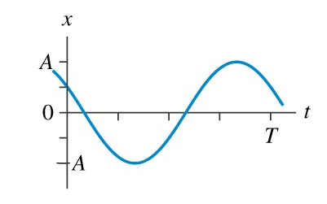
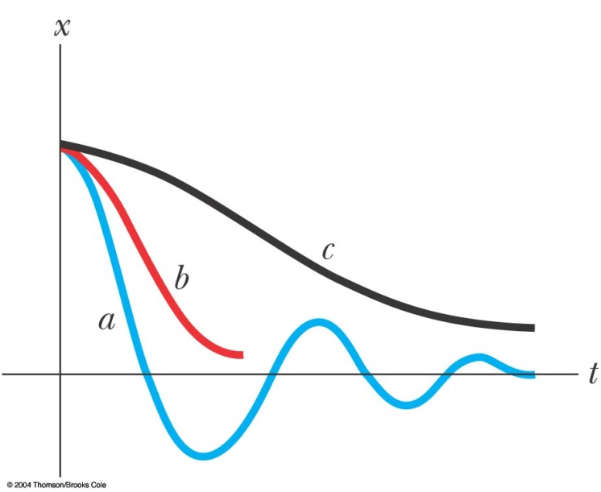












$$z=z_{0}e^{αt}$$
If $α$ is imaginary,
$$z=z_{0}e^{iωt}$$
$$=Ae^{i\left(ωt+φ\right)}=A\cos\left(ωt+φ\right)+iA\sin\left(ωt+φ\right)$$
$$Re\left[z\right]=A\cos\left(ωt+φ\right)$$
The solution is oscillating SHM.
If $α$ is real,
$$z=z_{0}e^{±bt}$$
$$Re\left[z\right]=Ae^{±bt}$$
The solution is exponentially decreasing or increasing.
If $α$ is complex,
$$z=z_{0}e^{±bt+iωt}=Ae^{±bt}∙e^{i\left(ωt+φ\right)}$$
$$Re\left[z\right]=Ae^{±bt}∙\cos\left(ωt+φ\right)$$
The solution is a oscillation with exponentially decreasing amplitude.
General solutions are linear combinations
$$z=c_{1}e^{α_{1}t}+c_{2}e^{α_{2}t}+⋯c_{N}e^{α_{N}t}$$
最後取實數部即可得實數解 Pick the real part
$$x=Re z$$

Slide 2
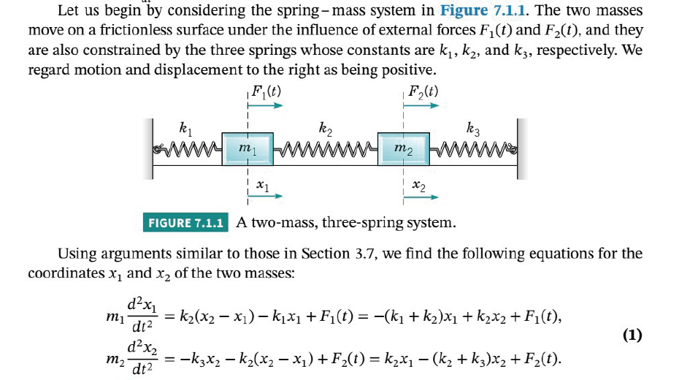

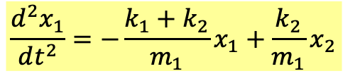

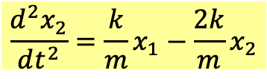
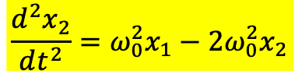
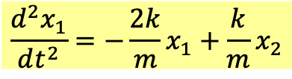
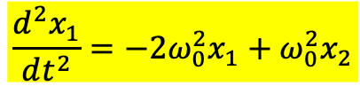
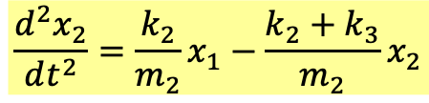
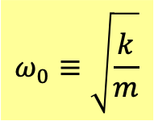
$$\frac{d^{2}x_{1}}{dt^{2}}=−\frac{k_{1}+k_{2}}{m_{1}}x_{1}+\frac{k_{2}}{m_{1}}x_{2}$$
$$\frac{d^{2}x_{2}}{dt^{2}}=\frac{k_{2}}{m_{2}}x_{1}−{\frac{k_{2}+k_{3}}{m_{2}}x}_{2}$$
For simplicity of discussion, assume that：
$${k_{1}=k}_{2}=k$$
$${m_{1}=m}_{2}=m$$
$$\frac{d^{2}x_{1}}{dt^{2}}=−\frac{2k}{m}x_{1}+\frac{k}{m}x_{2}$$
$$\frac{d^{2}x_{1}}{dt^{2}}=−2ω_{0}^{2}x_{1}+ω_{0}^{2}x_{2}$$
$$ω_{0}≡\sqrt{\frac{k}{m}}$$
$$\frac{d^{2}x_{2}}{dt^{2}}=\frac{k}{m}x_{1}−{\frac{2k}{m}x}_{2}$$
$$\frac{d^{2}x_{2}}{dt^{2}}=ω_{0}^{2}x_{1}−{2ω_{0}^{2}x}_{2}$$
This is a System of 2nd order linear ODE.

Slide 3



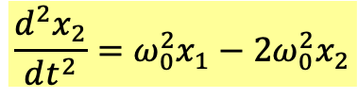


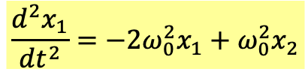
$$\frac{d^{2}x_{1}}{dt^{2}}=−2ω_{0}^{2}x_{1}+ω_{0}^{2}x_{2}$$
$$\frac{d^{2}x_{2}}{dt^{2}}=ω_{0}^{2}x_{1}−{2ω_{0}^{2}x}_{2}$$
Method 0
先設$x_{1,2}$為複數，猜想其解如簡諧運動也可以寫成虛數的指數函數：
First elevate the real $x^{′}s$ into complex function.
And guess the solution is a complex number exponential function.
We will prove in the future that exponential functions of imaginary number work:
$$x_{1}=a_{1}∙e^{iωt}$$
$$x_{2}=a_{2}∙e^{iωt}$$
$ω$ is a real unknown to be solved.
注意此猜想中，$x_{1,2}$是以同樣的方式一起隨時間振盪：$e^{iωt}$。
Note that in this guess, $x_{1,2}$ oscillate with time in identical manner:$e^{iωt}$.
將解代入方程式 Plug the above formula into the equation:
$$ω^{2}e^{iωt}a_{1}=2ω_{0}^{2}e^{iωt}a_{1}−ω_{0}^{2}e^{iωt}a_{2}$$
$$2ω_{0}^{2}a_{1}−ω_{0}^{2}a_{2}=ω^{2}a_{1}$$
$$ω^{2}e^{iωt}a_{2}=−ω_{0}^{2}e^{iωt}a_{1}+2ω_{0}^{2}e^{iωt}a_{2}$$
$$−ω_{0}^{2}a_{1}+2ω_{0}^{2}a_{2}=ω^{2}a_{2}$$
微分方程組被轉化為$a_{1},a_{2}$的一次代數方程組。
The original system of ODE is transformed into a system of algebraic Eq of $a_{1},a_{2}$.

Slide 4



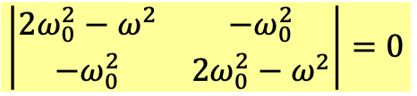





$$2ω_{0}^{2}a_{1}−ω_{0}^{2}a_{2}=ω^{2}a_{1}$$
$$−ω_{0}^{2}a_{1}+2ω_{0}^{2}a_{2}=ω^{2}a_{2}$$
Move all the terms to the left-hand side.
$$\left(2ω_{0}^{2}−ω^{2}\right)a_{1}−ω_{0}^{2}a_{2}=0$$
$$−ω_{0}^{2}a_{1}+\left(2ω_{0}^{2}−ω^{2}\right)a_{2}=0$$
This is a homogeneous system of algebraic equation of $a_{1},a_{2}$.
$a_{1}=a_{2}=0$ is a solution, but we want non-zero $a_{1},a_{2}$ solution
According to Crammer’s Rule, it has non-zero solution only if the determinant is zero!
$$\left|\begin{matrix}2ω_{0}^{2}−ω^{2} & −ω_{0}^{2} \\ −ω_{0}^{2} & 2ω_{0}^{2}−ω^{2}\end{matrix}\right|=0$$
Arfken p83-85, 88
$${\left(ω^{2}−2ω_{0}^{2}\right)}^{2}−{\left(ω_{0}^{2}\right)}^{2}=0$$
$$ω^{2}=ω_{0}^{2},3ω_{0}^{2}$$
未知數$ω^{2}應該只有$兩個可能！The unknown $ω^{2}$ has only two options!
$$ω=ω_{1}≡ω_{0}$$
$$ω=ω_{2}≡\sqrt{3}ω_{0}$$
Only in these two cases is there non-zero $a_{1},a_{2}$ solution.
Arfken p88-91
When the determinant is zero, the two equations are linearly dependent.
They are essentially the same since one can be written as a multiple of the other.

Slide 5
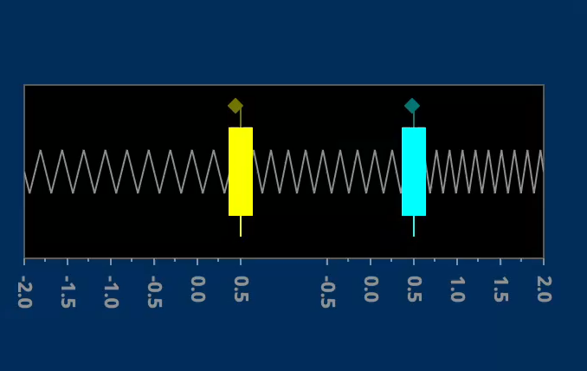
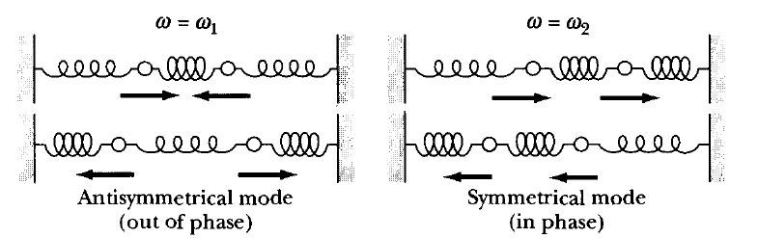












對特定的$ω$，我們可以解出對應的$a_{1},a_{2}$ Let’s find $a_{1},a_{2}$ for specific $ω$.
$$ω=ω_{1}=ω_{0}$$
Plug in
$$\left(2ω_{0}^{2}−ω^{2}\right)a_{1}−ω_{0}^{2}a_{2}=0$$
$$\left(2ω_{0}^{2}−ω_{0}^{2}\right)a_{1}−ω_{0}^{2}a_{2}=0$$
$$ω_{0}^{2}a_{1}−ω_{0}^{2}a_{2}=0$$
$$a_{1}−a_{2}=0$$
$$−ω_{0}^{2}a_{1}+\left(2ω_{0}^{2}−ω^{2}\right)a_{2}=0$$
$$−ω_{0}^{2}a_{1}+\left(2ω_{0}^{2}−ω_{0}^{2}\right)a_{2}=0$$
$$−ω_{0}^{2}a_{1}+ω_{0}^{2}a_{2}=0$$
$$−a_{1}+a_{2}=0$$
The second equation is minus the first one.
$$a_{1}=a_{2}≡C_{1}=A_{1}e^{iφ_{1}}$$
This satisfies both equation.
Therefore, we find that the solution is:
$$x_{1}=a_{1}∙e^{iω_{1}t}=C_{1}∙e^{iω_{0}t}=A_{1}e^{i\left(ω_{0}t+φ_{1}\right)}$$
$$x_{2}=C_{1}∙e^{iω_{0}t}=A_{1}e^{i\left(ω_{0}t+φ_{1}\right)}$$
取實數部，就得到原方程組的解：Take the real part:
$$x_{1}=x_{2}=Re A_{1}e^{i\left(ω_{0}t+φ_{1}\right)}=A_{1}\cos\left(ω_{0}t+φ_{1}\right)$$
$$x_{1}^{′}=x_{2}^{′}=−ω_{0}A_{1}\sin\left(ω_{0}t+φ_{1}\right)$$
The two move and oscillatetogether! $x_{1}=x_{2}$。
這樣的運動就稱為一個模式，對稱模式。
This is called a mode: in this case Symmetric mode.
If initial condition is symmetric：$x_{1}\left(0\right)=x_{2}\left(0\right)$, $x_{1}^{′}\left(0\right)=x_{2}^{′}\left(0\right)$，
symmetric mode will ensue and continue.

Slide 6
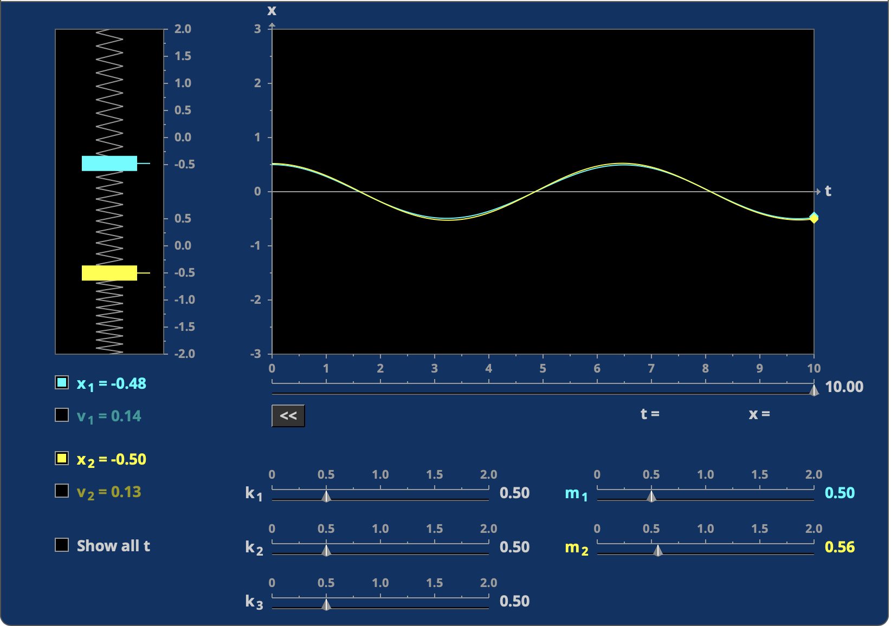
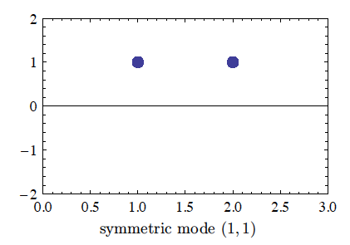



此模式是由$a_{1},a_{2}$標定，畫出 $a_{1},a_{2}$可以代表此模式。
This mode is designated by $a_{1},a_{2}$. You can draw $a_{1},a_{2}$ to represent the mode.
兩個粒子$x_{1},x_{2}$是以$a_{1},a_{2}$為振幅一起作同步(同$ω$)的簡諧運動。
In the mode, the two particles take $a_{1},a_{2}$ as amplitudes, oscillate together (same $ω$).
$$a_{1}=a_{2}$$
$$x_{1}=a_{1}∙A_{1}\cos\left(ω_{0}t+φ_{1}\right)$$
$$x_{2}=a_{2}∙A_{1}\cos\left(ω_{0}t+φ_{1}\right)$$

Slide 7
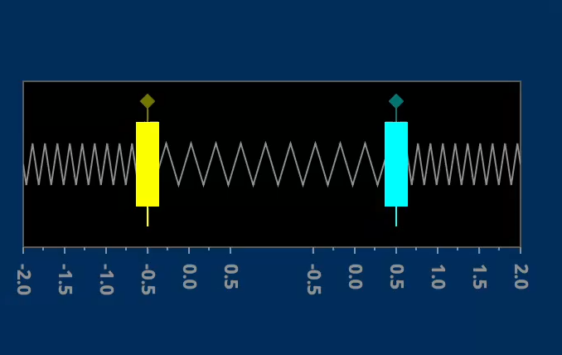













$$ω=ω_{2}=\sqrt{3}ω_{0}$$
$$\left(2ω_{0}^{2}−3ω_{0}^{2}\right)a_{1}−ω_{0}^{2}a_{2}=0$$
$$−ω_{0}^{2}a_{1}−ω_{0}^{2}a_{2}=0$$
$$a_{1}+a_{2}=0$$
$$−ω_{0}^{2}a_{1}+\left(2ω_{0}^{2}−3ω_{0}^{2}\right)a_{2}=0$$
$$−ω_{0}^{2}a_{1}−ω_{0}^{2}a_{2}=0$$
$$a_{1}+a_{2}=0$$
The second equation is the same as the first one.
$$a_{1}=−a_{2}≡C_{2}=A_{2}e^{iφ_{2}}$$
The solution is:
$$x_{1}=a_{1}e^{iω_{2}t}=C_{2}e^{i\sqrt{3}ω_{0}t}=A_{2}e^{i\left(\sqrt{3}ω_{0}t+φ_{2}\right)}$$
$$x_{2}=−x_{1}=A_{2}e^{i\left(\sqrt{3}ω_{0}t+φ_{2}\right)}$$
Now taking the real part would give us the solution.
$$x_{1}=Re A_{2}e^{i\left(\sqrt{3}ω_{0}t+φ_{2}\right)}=A_{2}\cos\left(\sqrt{3}ω_{0}t+φ_{2}\right)$$
$$x_{2}=−x_{1}=−A_{2}\cos\left(\sqrt{3}ω_{0}t+φ_{2}\right)$$
$$x_{1}^{′}=−x_{2}^{′}=\sqrt{3}ω_{0}A_{2}\sin\left(\sqrt{3}ω_{0}t+φ_{1}\right)$$
The two move opposite! $x_{2}=−x_{1}$。
這樣的運動就稱為反對稱模式。This is called Antisymetric Mode.
If initial condition is symmetric $x_{1}\left(0\right)=−x_{2}\left(0\right)$, $x_{1}^{′}\left(0\right)=−x_{2}^{′}\left(0\right)$
antisymmetric mode will ensue and continue.

Slide 8
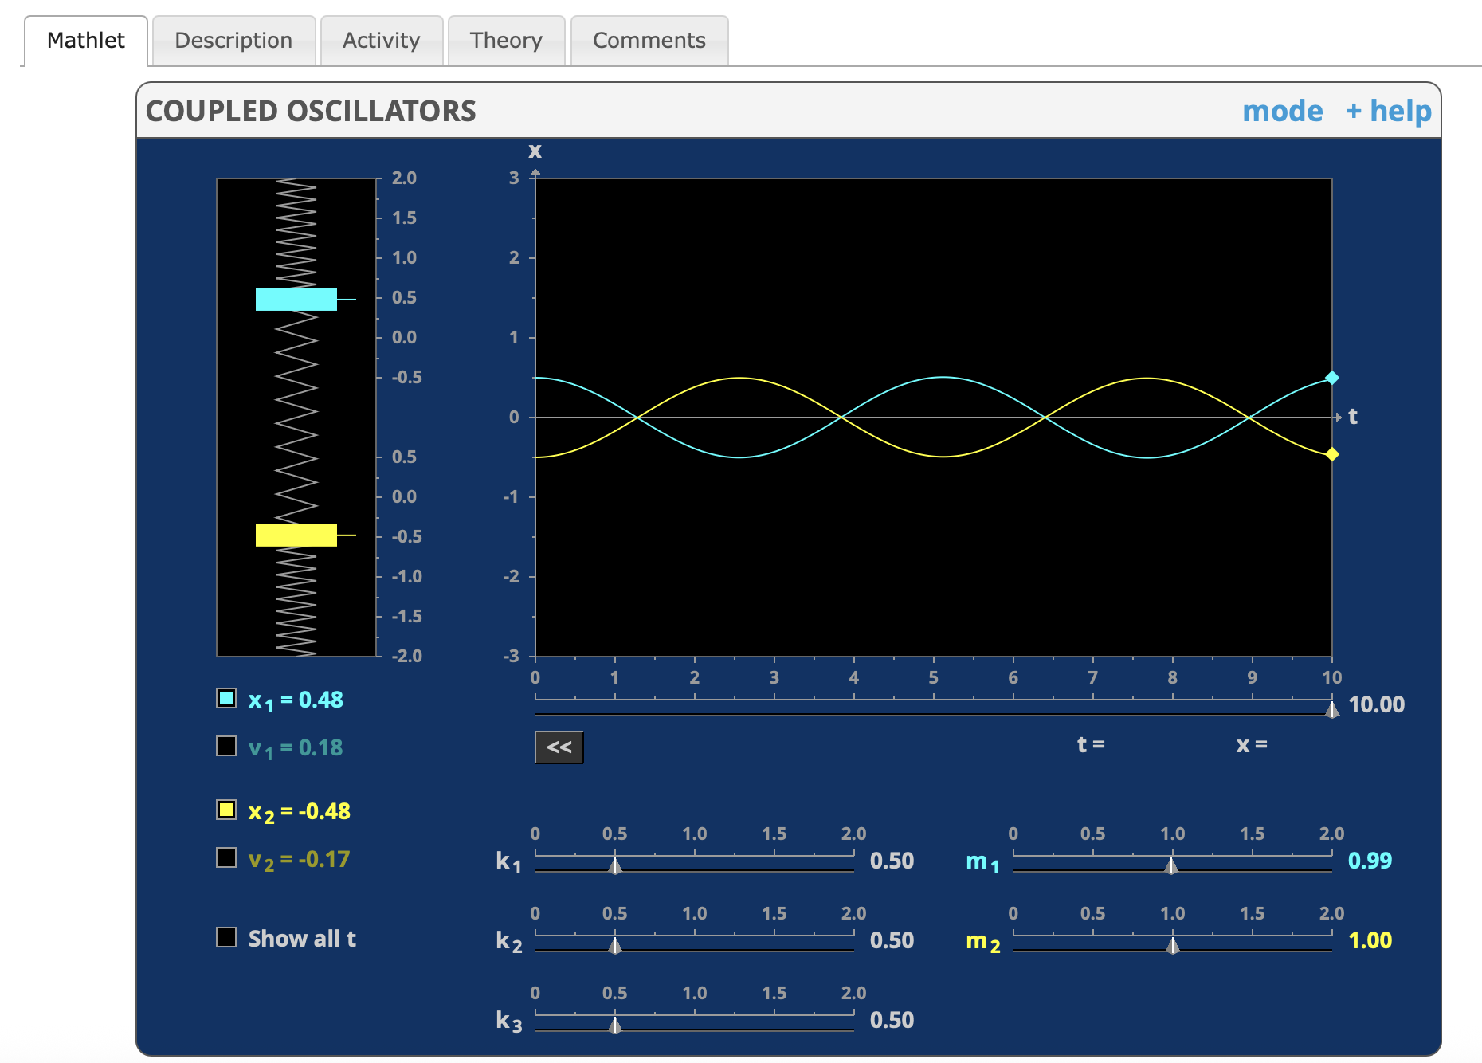
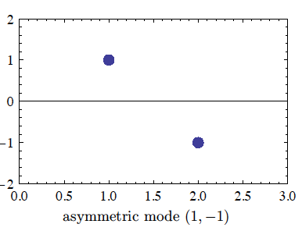




兩個粒子$x_{1},x_{2}$是以$a_{1},a_{2}$為振幅一起作同步(同$ω$)的簡諧運動。
$a_{1},a_{2}$一正一負，因此$x_{1},x_{2}$的振盪有相角差$π$。
$$a_{1}={−a}_{2}$$
$$x_{1}=a_{1}∙A_{2}\cos\left(\sqrt{3}ω_{0}t+φ_{2}\right)$$
$$x_{2}=a_{2}∙A_{2}\cos\left(\sqrt{3}ω_{0}t+φ_{2}\right)$$
$$=−a_{1}∙A_{2}\cos\left(\sqrt{3}ω_{0}t+φ_{2}\right)$$

Slide 9



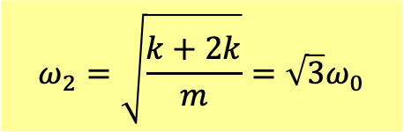
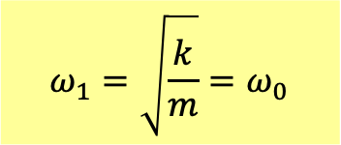



$$x_{1}=−x_{2}=A_{1}\cos\left(ω_{0}t+φ_{1}\right)$$
$$x_{1}=x_{2}=A_{1}\cos\left(ω_{0}t+φ_{1}\right)$$
$$ω_{2}=\sqrt{3}ω_{0}$$
$$ω_{1}=ω_{0}$$
$x_{1}\left(0\right)=−x_{2}\left(0\right)$, $x_{1}^{′}\left(0\right)=−x_{2}^{′}\left(0\right)$
$x_{1}\left(0\right)=x_{2}\left(0\right)$, $x_{1}^{′}\left(0\right)=x_{2}^{′}\left(0\right)$
中間的彈簧的中點沒有移動，等同固定。
中間的彈簧並沒有長度的變化。
粒子都只受一條加上半條彈簧的力，
所以兩個粒子都只受一條彈簧的力，
$$ω_{2}=\sqrt{\frac{k+2k}{m}}=\sqrt{3}ω_{0}$$
$$ω_{1}=\sqrt{\frac{k}{m}}=ω_{0}$$

Slide 10
A general solution is a sum of the two modes.
一般起始條件下，彈簧組運動就是兩種模式的疊加！
There are four undetermined constants $A_{1,2},φ_{1,2}$.
$$x_{1}=A_{1}\cos\left(ω_{0}t+φ_{1}\right)+A_{2}\cos\left(\sqrt{3}ω_{0}t+φ_{2}\right)$$
$$x_{2}=A_{1}\cos\left(ω_{0}t+φ_{1}\right)−A_{2}\cos\left(\sqrt{3}ω_{0}t+φ_{2}\right)$$
There are also four i$nitial conditions{ x}_{1,2}\left(0\right),x_{1,2}^{′}\left(0\right)$.
It would be the one unique solution.

Slide 11


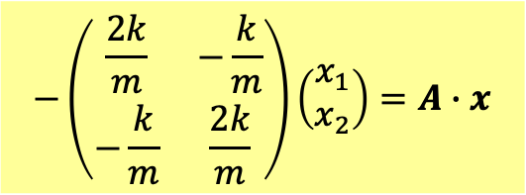
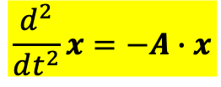
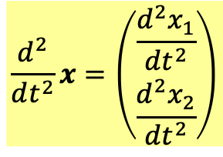
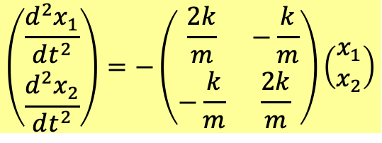
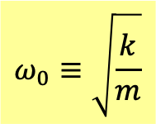
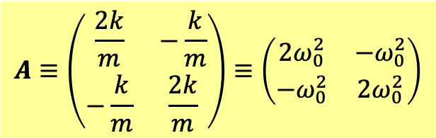
$$\left(\begin{matrix}\frac{d^{2}x_{1}}{dt^{2}} \\ \frac{d^{2}x_{2}}{dt^{2}}\end{matrix}\right)=−\left(\begin{matrix}\frac{2k}{m} & −\frac{k}{m} \\ −\frac{k}{m} & \frac{2k}{m}\end{matrix}\right)\left(\begin{matrix}x_{1} \\ x_{2}\end{matrix}\right)$$
We can use simplified notations to write the equation.
行向量 Column vector
矩陣 Matrix
$$x≡\left(\begin{matrix}x_{1} \\ x_{2}\end{matrix}\right)$$
$$A≡\left(\begin{matrix}\frac{2k}{m} & −\frac{k}{m} \\ −\frac{k}{m} & \frac{2k}{m}\end{matrix}\right)≡\left(\begin{matrix}2ω_{0}^{2} & −ω_{0}^{2} \\ −ω_{0}^{2} & 2ω_{0}^{2}\end{matrix}\right)$$
$$ω_{0}≡\sqrt{\frac{k}{m}}$$
兩粒子位置自然組成一行向量。
$$\frac{d^{2}}{dt^{2}}x=\left(\begin{matrix}\frac{d^{2}x_{1}}{dt^{2}} \\ \frac{d^{2}x_{2}}{dt^{2}}\end{matrix}\right)$$
$$−\left(\begin{matrix}\frac{2k}{m} & −\frac{k}{m} \\ −\frac{k}{m} & \frac{2k}{m}\end{matrix}\right)\left(\begin{matrix}x_{1} \\ x_{2}\end{matrix}\right)=A∙x$$
$$\frac{d^{2}}{dt^{2}}x=−A∙x$$

Slide 12

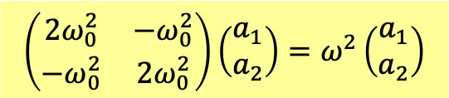



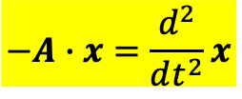



$$−A∙x=\frac{d^{2}}{dt^{2}}x$$
Elevate the real $x^{′}s$ into complex function. Guess the solutions are the same exponential:
The solution can be written as a constant column vector $a$ times the usual $e^{iωt}.$
$ω$ and $a$ are to be determined.
$$x≡\left(\begin{matrix}x_{1} \\ x_{2}\end{matrix}\right)=ae^{iωt}$$
$$a≡\left(\begin{matrix}a_{1} \\ a_{2}\end{matrix}\right)$$
$$x_{1}=a_{1}e^{iωt}$$
$$x_{2}=a_{2}e^{iωt}$$
Key idea is the two particle oscillate with one frequency.
Plug the guess into Eq.
$$−A∙ae^{iωt}=−ω^{2}ae^{iωt}$$
$$\left(\begin{matrix}2ω_{0}^{2} & −ω_{0}^{2} \\ −ω_{0}^{2} & 2ω_{0}^{2}\end{matrix}\right)\left(\begin{matrix}a_{1} \\ a_{2}\end{matrix}\right)=ω^{2}\left(\begin{matrix}a_{1} \\ a_{2}\end{matrix}\right)$$
$$A∙a=ω^{2}a$$
The differential Equation of $x(t)$ is transformed into algebraic equation of $a$.
This is the eigenvalue problem of Matrix $A$.${ ω}^{2}$ is the eigenvalue while $a$ the eigenvector.
微分方程組被轉化為矩陣$A$的本徵值$ω$問題，$a$稱為本徵向量 。

Slide 13
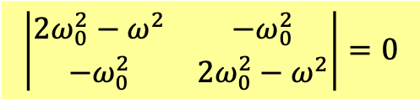

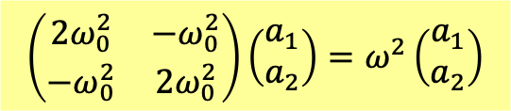


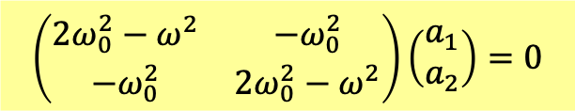




To solve eigenvalue problem:
$$\left(\begin{matrix}2ω_{0}^{2} & −ω_{0}^{2} \\ −ω_{0}^{2} & 2ω_{0}^{2}\end{matrix}\right)\left(\begin{matrix}a_{1} \\ a_{2}\end{matrix}\right)=ω^{2}\left(\begin{matrix}a_{1} \\ a_{2}\end{matrix}\right)$$
$$A∙a=ω^{2}a$$
$$\left(\begin{matrix}2ω_{0}^{2}−ω^{2} & −ω_{0}^{2} \\ −ω_{0}^{2} & 2ω_{0}^{2}−ω^{2}\end{matrix}\right)\left(\begin{matrix}a_{1} \\ a_{2}\end{matrix}\right)=0$$
$$\left(A−ω^{2}I\right)∙a=0$$
If the matrix $\left(A−ω^{2}\right)$ has an inverse matrix ${\left(A−ω^{2}\right)}^{−1}$, $a$ equals 0.
$$a={\left(A−ω^{2}\right)}^{−1}\left(\begin{matrix}0 \\ 0\end{matrix}\right)=\left(\begin{matrix}0 \\ 0\end{matrix}\right)$$
This is not what we want.
Unless, determinant $\left|A−ω^{2}\right|=0.$ Then inverse matrix ${\left(A−ω^{2}\right)}^{−1}$ does not exist.
Only in this case would $a$ have nontrivial solutions.
$$\left|\begin{matrix}2ω_{0}^{2}−ω^{2} & −ω_{0}^{2} \\ −ω_{0}^{2} & 2ω_{0}^{2}−ω^{2}\end{matrix}\right|=0$$
$$\left|A−ω^{2}I\right|=0$$
$${\left(ω^{2}−2ω_{0}^{2}\right)}^{2}−{\left(ω_{0}^{2}\right)}^{2}=0$$
$$ω^{2}−2ω_{0}^{2}=±ω_{0}^{2}$$
$$ω^{2}=ω_{0}^{2},3ω_{0}^{2}$$

Slide 14
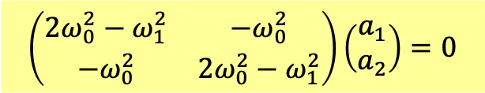

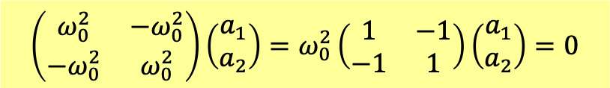






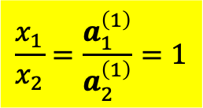



$$ω^{2}=ω_{0}^{2},3ω_{0}^{2}$$
本徵值$ω^{2}$有兩個，各自對應一本徵向量$a$。
Two eigenvalues $ω^{2}$, each corresponding to one eigenvetor $a$, determined by this formula:
For
$$ω^{2}=ω_{0}^{2}$$
$$ω=ω_{1}≡ω_{0}$$
$$\left(\begin{matrix}2ω_{0}^{2}−ω_{1}^{2} & −ω_{0}^{2} \\ −ω_{0}^{2} & 2ω_{0}^{2}−ω_{1}^{2}\end{matrix}\right)\left(\begin{matrix}a_{1} \\ a_{2}\end{matrix}\right)=0$$
$$\left(\begin{matrix}ω_{0}^{2} & −ω_{0}^{2} \\ −ω_{0}^{2} & ω_{0}^{2}\end{matrix}\right)\left(\begin{matrix}a_{1} \\ a_{2}\end{matrix}\right)=ω_{0}^{2}\left(\begin{matrix}1 & −1 \\ −1 & 1\end{matrix}\right)\left(\begin{matrix}a_{1} \\ a_{2}\end{matrix}\right)=0$$
$$a_{1}−a_{2}=0$$
$$a^{\left(1\right)}=a_{1}\left(\begin{matrix}1 \\ 1\end{matrix}\right)$$
Index to denote the first mode
$$x=a^{\left(1\right)}e^{iω_{1}t}=\left(\begin{matrix}1 \\ 1\end{matrix}\right){a_{1}e}^{iω_{0}t}=\left(\begin{matrix}1 \\ 1\end{matrix}\right)A_{1}e^{i\left(ω_{0}t+φ_{1}\right)}$$
$$a_{1}≡A_{1}e^{iφ_{1}}$$
Take the real part:
$$x=\left(\begin{matrix}x_{1} \\ x_{2}\end{matrix}\right)=\left(\begin{matrix}1 \\ 1\end{matrix}\right)A_{1}\cos\left(ω_{0}t+φ_{1}\right)=\left(\begin{matrix}1 \\ 1\end{matrix}\right)\left[f_{1}cos\left(ω_{0}t\right)+g_{1}sin\left(ω_{0}t\right)\right]$$
$$x_{1}=A_{1}\cos\left(ω_{0}t+φ_{1}\right)$$
$$x_{2}=x_{1}{=A}_{1}\cos\left(ω_{0}t+φ_{1}\right)$$
$$\frac{x_{1}}{x_{2}}=\frac{a_{1}^{\left(1\right)}}{a_{2}^{\left(1\right)}}=1$$
This mode is designated by$a_{1}^{\left(1\right)},a_{2}^{\left(1\right)}$.
Note that in this mode, the ratio of $\frac{x_{1}}{x_{2}}$ at any time equals the ratio of $\frac{a_{1}^{\left(1\right)}}{a_{2}^{\left(1\right)}}$.

Slide 15
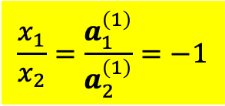





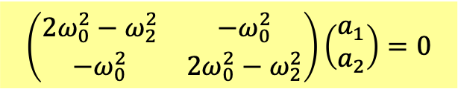
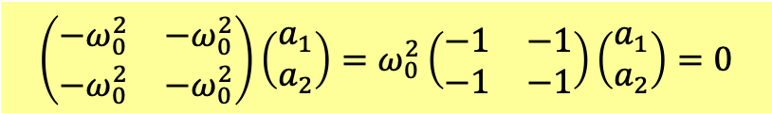



$$ω^{2}=3ω_{0}^{2}$$
$$ω=ω_{2}≡\sqrt{3}ω_{0}$$
$$\left(\begin{matrix}2ω_{0}^{2}−ω_{2}^{2} & −ω_{0}^{2} \\ −ω_{0}^{2} & 2ω_{0}^{2}−ω_{2}^{2}\end{matrix}\right)\left(\begin{matrix}a_{1} \\ a_{2}\end{matrix}\right)=0$$
$$\left(\begin{matrix}−ω_{0}^{2} & −ω_{0}^{2} \\ −ω_{0}^{2} & −ω_{0}^{2}\end{matrix}\right)\left(\begin{matrix}a_{1} \\ a_{2}\end{matrix}\right)=ω_{0}^{2}\left(\begin{matrix}−1 & −1 \\ −1 & −1\end{matrix}\right)\left(\begin{matrix}a_{1} \\ a_{2}\end{matrix}\right)=0$$
$$a_{1}+a_{2}=0$$
$$a^{\left(2\right)}=a_{2}\left(\begin{matrix}1 \\ −1\end{matrix}\right)$$
Index to denote the second mode
$$\text{x}\text{=}a^{\left(2\right)}e^{iω_{2}t}=\left(\begin{matrix}1 \\ −1\end{matrix}\right){a_{1}e}^{i\sqrt{3}ω_{0}t}=\left(\begin{matrix}1 \\ −1\end{matrix}\right){A_{2}e}^{i\left(\sqrt{3}ω_{0}t+φ_{2}\right)}$$
$$a_{1}≡A_{2}e^{iφ_{2}}$$
Take the real part:
$$x=\left(\begin{matrix}x_{1} \\ x_{2}\end{matrix}\right)=\left(\begin{matrix}1 \\ −1\end{matrix}\right)A_{2}\cos\left(\sqrt{3}ω_{0}t+φ_{2}\right)=\left(\begin{matrix}1 \\ −1\end{matrix}\right)\left[f_{2}cos\left(\sqrt{3}ω_{0}t\right)+g_{2}sin\left(\sqrt{3}ω_{0}t\right)\right]$$
$$x_{1}=A_{2}\cos\left(\sqrt{3}ω_{0}t+φ_{2}\right)$$
$$x_{2}=−x_{1}=−A_{2}\cos\left(\sqrt{3}ω_{0}t+φ_{2}\right)$$
$$\frac{x_{1}}{x_{2}}=\frac{a_{1}^{\left(1\right)}}{a_{2}^{\left(1\right)}}=−1$$
In this mode, the ratio of $\frac{x_{1}}{x_{2}}$ at any time equals the ratio of $\frac{a_{1}^{\left(1\right)}}{a_{2}^{\left(1\right)}}=−1$.

Slide 16

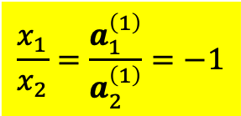

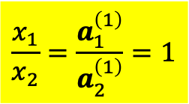




一個本徵向量就對應一個可獨立振盪的模式。
One eigenvalue $ω^{2}$ with one eigenvector $a$ corresponds to one oscillating mode.
We have found two oscillating solutions for Coupled system.
In these modes, the ratio of $\frac{x_{1}}{x_{2}}$ at any time equals the ratio of $\frac{a_{1}^{\left(1,2\right)}}{a_{2}^{\left(1,2\right)}}$.
We can plot $a$ as follows to represent a mode:
$$a_{1}^{\left(2\right)}$$
$$a_{1}^{\left(1\right)}$$
$$a_{2}^{\left(1\right)}$$
$$a_{2}^{\left(2\right)}$$
$$ω_{2}=\sqrt{3}ω_{0}$$
$$ω_{1}=ω_{0}$$
$$\frac{x_{1}}{x_{2}}=\frac{a_{1}^{\left(1\right)}}{a_{2}^{\left(1\right)}}=−1$$
$$\frac{x_{1}}{x_{2}}=\frac{a_{1}^{\left(1\right)}}{a_{2}^{\left(1\right)}}=1$$

Slide 17

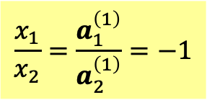
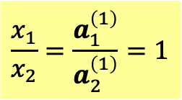
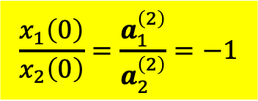

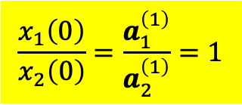
We have found two oscillating solutions for Coupled system.
$$\frac{x_{1}}{x_{2}}=\frac{a_{1}^{\left(1\right)}}{a_{2}^{\left(1\right)}}=−1$$
$$ω_{2}=\sqrt{3}ω_{0}$$
$$ω_{1}=ω_{0}$$
$$\frac{x_{1}}{x_{2}}=\frac{a_{1}^{\left(1\right)}}{a_{2}^{\left(1\right)}}=1$$
If initial conditions follow the condition of the mode,
$$\frac{x_{1}\left(0\right)}{x_{2}\left(0\right)}=\frac{a_{1}^{\left(2\right)}}{a_{2}^{\left(2\right)}}=−1$$
$$\frac{x_{1}\left(0\right)}{x_{2}\left(0\right)}=\frac{a_{1}^{\left(1\right)}}{a_{2}^{\left(1\right)}}=1$$
the system will continue oscillating as SHM according to the mode!
We usually say: one mode is excited while the other is not.
Is it possible both modes are excited in the beginning? Of course.

Slide 18
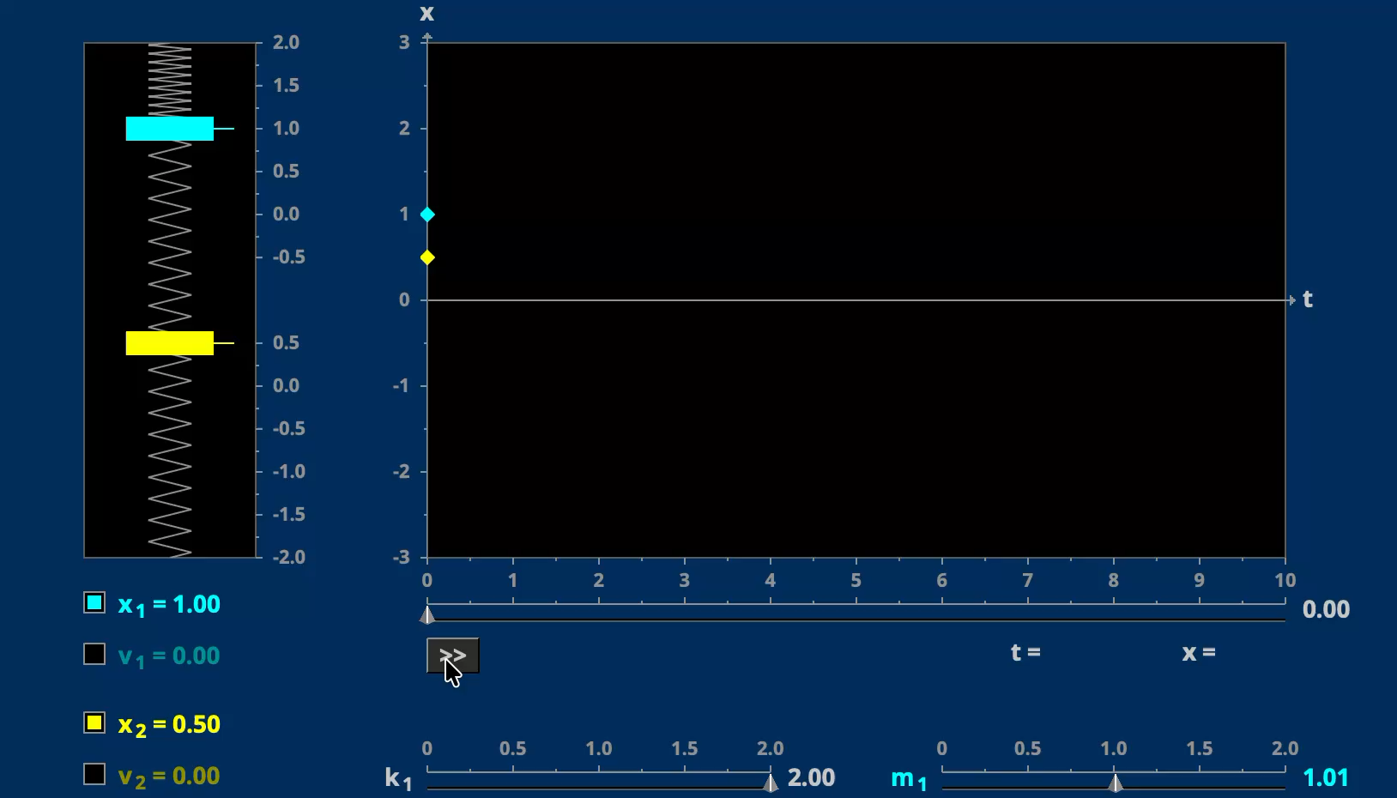

$x_{1}\left(0\right)=2x_{2}\left(0\right)$, $x_{1}^{′}\left(0\right)=x_{2}^{′}\left(0\right)=0$

Slide 19
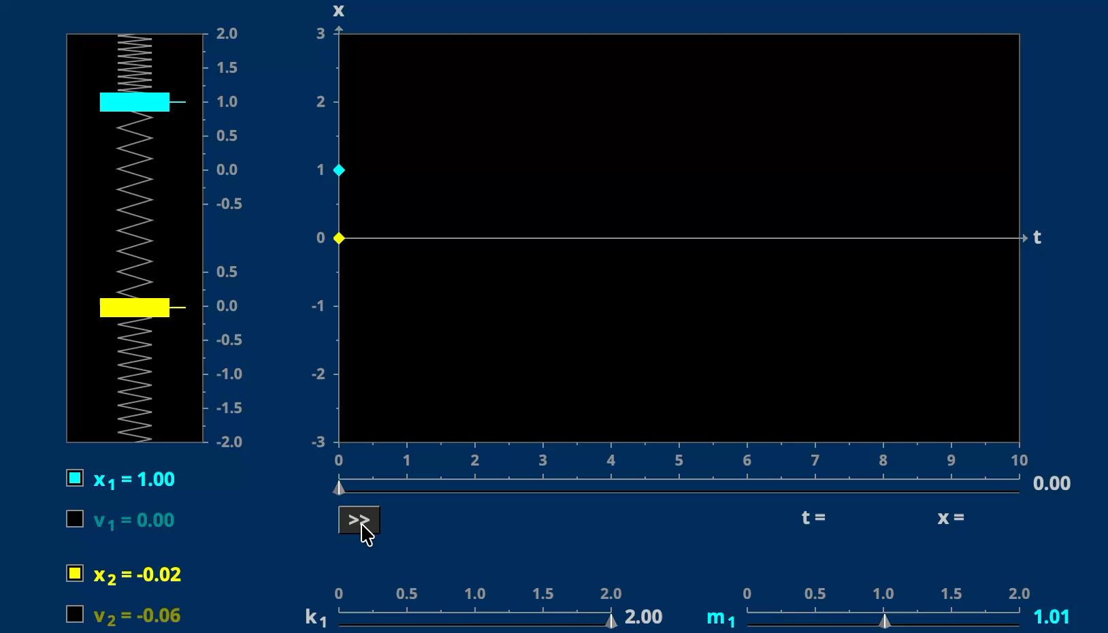
$x_{1}\left(0\right)=A,x_{2}\left(0\right)=0$, $x_{1}^{′}\left(0\right)=x_{2}^{′}\left(0\right)=0$

Slide 20
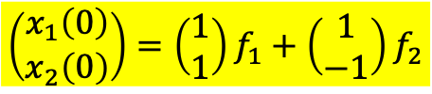


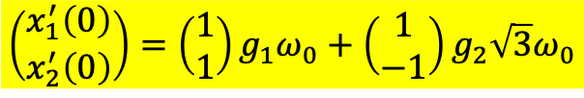


有了以上兩個模式的解，一般解將是兩者的線性組合：
With two mode solutions, any linear combinations of the two modes are also solutions of the system of linear ODE. There are four unspecified constants $f_{1,2},g_{1,2}.$
$$\left(\begin{matrix}x_{1} \\ x_{2}\end{matrix}\right)=\left(\begin{matrix}1 \\ 1\end{matrix}\right)\left[f_{1}cos\left(ω_{0}t\right)+g_{1}sin\left(ω_{0}t\right)\right]+\left(\begin{matrix}1 \\ −1\end{matrix}\right)\left[f_{2}cos\left(\sqrt{3}ω_{0}t\right)+g_{2}sin\left(\sqrt{3}ω_{0}t\right)\right]$$
四個未定常數將由四個起使條件決定。例如：
The four unspecified constants will be determined by four initial conditions.
$$\left(\begin{matrix}x_{1}\left(0\right) \\ x_{2}\left(0\right)\end{matrix}\right)=\left(\begin{matrix}1 \\ 1\end{matrix}\right)f_{1}+\left(\begin{matrix}1 \\ −1\end{matrix}\right)f_{2}$$
$$x_{1}\left(0\right)=f_{1}+f_{2}$$
$$x_{2}\left(0\right)=f_{1}−f_{2}$$
因此$f_{1,2}$可以唯一決定。 $f_{1,2}$ will now be uniquely specified.
$$\left(\begin{matrix}x_{1}^{′}\left(0\right) \\ x_{2}^{′}\left(0\right)\end{matrix}\right)=\left(\begin{matrix}1 \\ 1\end{matrix}\right)g_{1}ω_{0}+\left(\begin{matrix}1 \\ −1\end{matrix}\right)g_{2}\sqrt{3}ω_{0}$$
$$x_{1}^{′}\left(0\right)=g_{1}ω_{0}+g_{2}\sqrt{3}ω_{0}$$
$$x_{2}^{′}\left(0\right)=g_{1}ω_{0}−g_{2}\sqrt{3}ω_{0}$$
$g_{1,2}$也可以唯一決定。 $g_{1,2}$ will also be uniquely specified.
Note that $g_{1,2}$ will vanish if initial velocities $x_{1,2}^{′}\left(0\right)$ are both zero.
於是微分方程組加起始條件，求解完成。
Our result satisfy both system of ODE and initial condition. It is the unique solution.

Slide 21




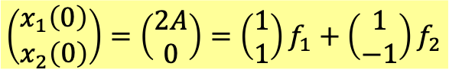




For example: if
$x_{1}\left(0\right)=2A,x_{2}\left(0\right)=0$, $x_{1}^{′}\left(0\right)=x_{2}^{′}\left(0\right)=0$
$$g_{1}=g_{2}=0$$
$$\left(\begin{matrix}x_{1}\left(0\right) \\ x_{2}\left(0\right)\end{matrix}\right)=\left(\begin{matrix}2A \\ 0\end{matrix}\right)=\left(\begin{matrix}1 \\ 1\end{matrix}\right)f_{1}+\left(\begin{matrix}1 \\ −1\end{matrix}\right)f_{2}$$
$$f_{1}+f_{2}=2A$$
$$f_{1}=f_{2}=A$$
$$f_{1}−f_{2}=0$$
$$\left(\begin{matrix}x_{1} \\ x_{2}\end{matrix}\right)=\left(\begin{matrix}1 \\ 1\end{matrix}\right)\left[Acos\left(ω_{0}t\right)\right]+\left(\begin{matrix}1 \\ −1\end{matrix}\right)\left[Acos\left(\sqrt{3}ω_{0}t\right)\right]$$
$$x_{1}=A\left[cos\left(ω_{0}t\right)+cos\left(\sqrt{3}ω_{0}t\right)\right]$$
$$x_{2}=A\left[cos\left(ω_{0}t\right)−cos\left(\sqrt{3}ω_{0}t\right)\right]$$

Slide 22







This formalism could be easily extended to the more general cases.
The force constants $k_{1},k_{2},k_{3}$ could be different.
$$\frac{d^{2}x_{1}}{dt^{2}}=−\frac{k_{1}+k_{2}}{m_{1}}x_{1}+\frac{k_{2}}{m_{1}}x_{2}$$
$$x≡\left(\begin{matrix}x_{1} \\ x_{2}\end{matrix}\right)$$
行向量 Column vector
矩陣 Matrix
$$\frac{d^{2}x_{2}}{dt^{2}}=\frac{k_{2}}{m_{2}}x_{1}−{\frac{k_{2}+k_{3}}{m_{2}}x}_{2}$$
$$S≡\left(\begin{matrix}\frac{k_{1}+k_{2}}{m} & −\frac{k_{2}}{m} \\ −\frac{k_{2}}{m} & \frac{k_{2}+k_{3}}{m}\end{matrix}\right)≡\left(\begin{matrix}S_{11} & S_{12} \\ S_{21} & S_{22}\end{matrix}\right)$$
$$\frac{d^{2}}{dt^{2}}x=\left(\begin{matrix}\frac{d^{2}x_{1}}{dt^{2}} \\ \frac{d^{2}x_{2}}{dt^{2}}\end{matrix}\right)=−\left(\begin{matrix}\frac{k_{1}+k_{2}}{m} & −\frac{k_{2}}{m} \\ −\frac{k_{2}}{m} & \frac{k_{2}+k_{3}}{m}\end{matrix}\right)\left(\begin{matrix}x_{1} \\ x_{2}\end{matrix}\right)≡S∙x$$
$$\frac{d^{2}}{dt^{2}}x=−S∙x$$
$S$ is a symmetric Matrix.

Slide 23









$$−S∙x=\frac{d^{2}}{dt^{2}}x$$
Method I
Elevate the real $x^{′}s$ into complex function. Guess the solutions are the same exponential:
The solution can be written as a constant column vector $a$ times the usual $e^{iωt}.$
$ω$ and $a$ are to be determined.
$$x≡\left(\begin{matrix}x_{1} \\ x_{2}\end{matrix}\right)=ae^{iωt}$$
$$a≡\left(\begin{matrix}a_{1} \\ a_{2}\end{matrix}\right)$$
$$\left(\begin{matrix}\frac{k_{1}+k_{2}}{m} & −\frac{k_{2}}{m} \\ −\frac{k_{2}}{m} & \frac{k_{2}+k_{3}}{m}\end{matrix}\right)\left(\begin{matrix}a_{1} \\ a_{2}\end{matrix}\right)=ω^{2}\left(\begin{matrix}a_{1} \\ a_{2}\end{matrix}\right)$$
Plug the guess into Eq.
$$−S∙ae^{iωt}=−ω^{2}ae^{iωt}$$
$$\left(\begin{matrix}\frac{k_{1}+k_{2}}{m}−ω^{2} & −\frac{k_{2}}{m} \\ −\frac{k_{2}}{m} & \frac{k_{2}+k_{3}}{m}−ω^{2}\end{matrix}\right)\left(\begin{matrix}a_{1} \\ a_{2}\end{matrix}\right)=0$$
$$S∙a=ω^{2}a$$
$$\left(S−ω^{2}I\right)∙a=0$$
This is the eigenvalue problem of Matrix $S$.${ ω}^{2}$ is the eigenvalue while $a$ the eigenvector.

Slide 24









$$\left(\begin{matrix}\frac{k_{1}+k_{2}}{m}−ω^{2} & −\frac{k_{2}}{m} \\ −\frac{k_{2}}{m} & \frac{k_{2}+k_{3}}{m}−ω^{2}\end{matrix}\right)\left(\begin{matrix}a_{1} \\ a_{2}\end{matrix}\right)=0$$
$$\left(S−ω^{2}I\right)∙a=0$$
Unless, determinant $\left|S−ω^{2}\right|=0.$ Then inverse matrix ${\left(S−ω^{2}\right)}^{−1}$ does not exist.
Only in this case would $a$ have nontrivial solutions.
$$\left|\begin{matrix}\frac{k_{1}+k_{2}}{m}−ω^{2} & −\frac{k_{2}}{m} \\ −\frac{k_{2}}{m} & \frac{k_{2}+k_{3}}{m}−ω^{2}\end{matrix}\right|=0$$
$$\left|S−ω^{2}I\right|=0$$
This is a second order equation for $ω^{2}$ usually with two solutions $ω_{1}^{2},ω_{2}^{2}$.
Plug$ω^{2}=ω_{1}^{2},ω_{2}^{2}$ into
$$\left(S−ω^{2}I\right)∙a=0$$
to solve the two columns vector $a$:
$$a^{\left(1\right)}=\left(\begin{matrix}a_{1}^{\left(1\right)} \\ a_{2}^{\left(1\right)}\end{matrix}\right)$$
$$a^{\left(2\right)}=\left(\begin{matrix}a_{1}^{\left(2\right)} \\ a_{2}^{\left(2\right)}\end{matrix}\right)$$

Slide 25






We have found two oscillating mode solutions for the coupled system.
$$a^{\left(1\right)}e^{iω_{1}t}=\left(\begin{matrix}a_{1}^{\left(1\right)} \\ a_{2}^{\left(1\right)}\end{matrix}\right)e^{iω_{1}t}$$
$$a^{\left(2\right)}e^{iω_{2}t}=\left(\begin{matrix}a_{1}^{\left(2\right)} \\ a_{2}^{\left(2\right)}\end{matrix}\right)e^{iω_{2}t}$$
Since the ODE’s are linear, any linear combinations of the two modes are solutions.
$$x=\left(\begin{matrix}a_{1}^{\left(1\right)} \\ a_{2}^{\left(1\right)}\end{matrix}\right)∙e^{iω_{1}t}∙\left(c_{1}e^{iφ_{1}}\right)+\left(\begin{matrix}a_{1}^{\left(2\right)} \\ a_{2}^{\left(2\right)}\end{matrix}\right)∙e^{iω_{2}t}∙\left(c_{2}e^{iφ_{2}}\right)$$
Take the real part.
Two complex coefficients
$$x=\left(\begin{matrix}x_{1} \\ x_{2}\end{matrix}\right)=\left(\begin{matrix}a_{1}^{\left(1\right)} \\ a_{2}^{\left(1\right)}\end{matrix}\right)c_{1}cos\left(ω_{1}t+φ_{1}\right){+}\left(\begin{matrix}a_{1}^{\left(2\right)} \\ a_{2}^{\left(2\right)}\end{matrix}\right)c_{2}cos\left(ω_{2}t+φ_{2}\right)$$
It is clear that, for example:
$$\left[f_{2}cos\left(ω_{2}t\right)+g_{2}sin\left(ω_{2}t\right)\right]$$
$$x_{1}=a_{1}^{\left(1\right)}c_{1}cos\left(ω_{1}t+φ_{1}\right){+}a_{1}^{\left(2\right)}c_{2}cos\left(ω_{2}t+φ_{2}\right)$$
$$x_{2}=a_{2}^{\left(1\right)}c_{1}cos\left(ω_{1}t+φ_{1}\right){+}a_{2}^{\left(2\right)}c_{2}cos\left(ω_{2}t+φ_{2}\right)$$
Again, four unspecified constants $c_{1,2},φ_{1,2}$ will be determined by four initial conditions:
$x_{1}\left(0\right)$,$x_{2}\left(0\right),$ $x_{1}^{′}\left(0\right),x_{2}^{′}\left(0\right)$
We have solved the coupled oscillation problem for two particles.

Slide 26






It is easier to fit initial conditions by another form of cosine and sine solution.
$$x=\left(\begin{matrix}x_{1} \\ x_{2}\end{matrix}\right)=\left(\begin{matrix}a_{1}^{\left(1\right)} \\ a_{2}^{\left(1\right)}\end{matrix}\right)\left[f_{1}cos\left(ω_{0}t\right)+g_{1}sin\left(ω_{0}t\right)\right]{+}\left(\begin{matrix}a_{1}^{\left(2\right)} \\ a_{2}^{\left(2\right)}\end{matrix}\right)\left[f_{2}cos\left(\sqrt{3}ω_{0}t\right)+g_{2}sin\left(\sqrt{3}ω_{0}t\right)\right]$$
四個未定常數將由四個起使條件決定。例如：
The four unspecified constants will be determined by four initial conditions.
$$\left(\begin{matrix}x_{1}\left(0\right) \\ x_{2}\left(0\right)\end{matrix}\right)=\left(\begin{matrix}a_{1}^{\left(1\right)} \\ a_{2}^{\left(1\right)}\end{matrix}\right)f_{1}+\left(\begin{matrix}a_{1}^{\left(2\right)} \\ a_{2}^{\left(2\right)}\end{matrix}\right)f_{2}$$
$$x_{1}\left(0\right)=a_{1}^{\left(1\right)}f_{1}+a_{1}^{\left(2\right)}f_{2}$$
$$x_{2}\left(0\right)=a_{2}^{\left(1\right)}f_{1}−a_{2}^{\left(2\right)}f_{2}$$
因此$f_{1,2}$可以唯一決定。 $f_{1,2}$ will now be uniquely specified.
$$\left(\begin{matrix}x_{1}^{′}\left(0\right) \\ x_{2}^{′}\left(0\right)\end{matrix}\right)=\left(\begin{matrix}a_{1}^{\left(1\right)} \\ a_{2}^{\left(1\right)}\end{matrix}\right)g_{1}ω_{0}+\left(\begin{matrix}a_{1}^{\left(2\right)} \\ a_{2}^{\left(2\right)}\end{matrix}\right)g_{2}\sqrt{3}ω_{0}$$
$$x_{1}^{′}\left(0\right)=a_{1}^{\left(1\right)}g_{1}ω_{0}+a_{1}^{\left(2\right)}g_{2}\sqrt{3}ω_{0}$$
$$x_{2}^{′}\left(0\right)=a_{2}^{\left(1\right)}g_{1}ω_{0}−a_{2}^{\left(2\right)}g_{2}\sqrt{3}ω_{0}$$
$g_{1,2}$也可以唯一決定。 $g_{1,2}$ will also be uniquely specified.
Note that $g_{1,2}$ will vanish if initial velocities $x_{1,2}^{′}\left(0\right)$ are both zero.
於是微分方程組加起始條件，求解完成。
Our result satisfy both system of ODE and initial condition. It is the unique solution.

Slide 27



$A$ times the eigenvector will produce a vector in the same direction.
$$A∙a^{\left(1\right)}=\left(\begin{matrix}0.8 & 0.3 \\ 0.2 & 0.7\end{matrix}\right)∙\left(\begin{matrix}0.6 \\ 0.4\end{matrix}\right)=1\left(\begin{matrix}0.6 \\ 0.4\end{matrix}\right)$$
$$A∙a^{\left(2\right)}=\left(\begin{matrix}0.8 & 0.3 \\ 0.2 & 0.7\end{matrix}\right)∙\left(\begin{matrix}1 \\ −1\end{matrix}\right)=\frac{1}{2}\left(\begin{matrix}1 \\ −1\end{matrix}\right)$$
For the two special eigenvectors, matrix multiplication is just a number product.

Slide 28







Solving eigenvalue problem of matrix
我們再試一個矩陣，這次是一對稱矩陣！
$$S=\left(\begin{matrix}9 & 3 \\ 3 & 1\end{matrix}\right)$$
$$S∙u=λu$$
$$\left(S−λI\right)∙u=0$$
If it has an inverse, the vector $u$ can only be zero:
$$u={\left(S−λI\right)}^{−1}∙0=0$$
For $λ$ to be an eigenvalue, the condition is $S−λI$ has no inverse
and hence the determinant of $S−λI$ is zero.
det $\left(S−λI\right)=0$
det $\left(S−λI\right)=\text{det}\left[\begin{matrix}9−λ & 3 \\ 3 & 1−λ\end{matrix}\right]=λ^{2}−10λ=λ\left(λ−10\right)=0$
$$λ=λ_{1}=0 or λ_{2}=10$$
are eigenvalues.

Slide 29










對特定的$λ$，我們可以解出對應的$u^{\left(1\right)},u^{\left(2\right)}$
$$u^{\left(1\right)}≡\left(\begin{matrix}u_{1}^{\left(1\right)} \\ u_{2}^{\left(1\right)}\end{matrix}\right)$$
$$λ=λ_{1}=0$$
$$\left(S−λI\right)∙u^{\left(1\right)}=\left(\begin{matrix}9 & 3 \\ 3 & 1\end{matrix}\right)∙\left(\begin{matrix}u_{1}^{\left(1\right)} \\ u_{2}^{\left(1\right)}\end{matrix}\right)=0$$
$$3u_{1}^{\left(1\right)}=−u_{2}^{\left(1\right)}$$
Eigenvector has one undetermined constant.
$$u^{\left(1\right)}=c_{1}\left(\begin{matrix}1 \\ −3\end{matrix}\right)$$
同理：
$$λ=λ_{2}=10$$
$$\left(S−λI\right)∙u^{\left(2\right)}=\left(\begin{matrix}9−10 & 3 \\ 3 & 1−10\end{matrix}\right)∙\left(\begin{matrix}u_{1}^{\left(2\right)} \\ u_{2}^{\left(2\right)}\end{matrix}\right)=\left(\begin{matrix}−1 & 3 \\ 3 & −9\end{matrix}\right)\left(\begin{matrix}u_{1}^{\left(2\right)} \\ u_{2}^{\left(2\right)}\end{matrix}\right)=0$$
$$u_{1}^{\left(2\right)}=3u_{2}^{\left(2\right)}$$
$$u^{\left(2\right)}=c_{2}\left(\begin{matrix}3 \\ 1\end{matrix}\right)$$

Slide 30






Theorem: All vectors can be written as the linear combination of eigenvectors $a^{\left(1\right)}$and $a^{\left(2\right)}$.
$$X=c_{1}a^{\left(1\right)}+c_{2}a^{\left(2\right)}$$
These are two equations for two unknowns $c_{1,2}$.
As long as $a^{\left(1\right)}$and $a^{\left(2\right)}$ are not in the same directions, $c_{1,2}$ can be solved.
$$X=\left(\begin{matrix}0.8 \\ 0.2\end{matrix}\right)=c_{1}\left(\begin{matrix}0.6 \\ 0.4\end{matrix}\right)+c_{2}\left(\begin{matrix}1 \\ −1\end{matrix}\right)$$
$$c_{1}=1, c_{2}=0.2$$
$$X=a^{\left(1\right)}+2a^{\left(2\right)}$$
Then the action of $A$ on any vector $X$ can be easily written down:
$$AX=A\left(c_{1}a^{\left(1\right)}+c_{2}a^{\left(2\right)}\right)=c_{1}Aa^{\left(1\right)}+c_{2}Aa^{\left(2\right)}=c_{1}λ_{1}a^{\left(1\right)}+c_{2}λ_{2}a^{\left(2\right)}$$
For example:
$$AX=\left(\begin{matrix}0.8 & 0.3 \\ 0.2 & 0.7\end{matrix}\right)∙\left(\begin{matrix}0.8 \\ 0.2\end{matrix}\right)=A∙a^{\left(1\right)}+2A∙a^{\left(2\right)}$$
$$=1\left(\begin{matrix}0.6 \\ 0.4\end{matrix}\right)+0.2∙\frac{1}{2}\left(\begin{matrix}1 \\ −1\end{matrix}\right)=\left(\begin{matrix}0.7 \\ 0.3\end{matrix}\right)$$
The information in the eigenvectors and eigenvalues alone can represent the matrix!
一個矩陣的本徵值與本徵向量就足夠能代表該矩陣。

Slide 31




Theorem: The eigenvectors $a$ of $A$ are also eigenvectors of $A^{n}$ with the eigenvalue $λ^{n}$.
$$A∙a=λa$$
$$A^{n}∙a=λ^{n}a$$
$$A^{n}a=A^{n−1}Aa=A^{n−1}∙λa=λA^{n−2}∙Aa=λA^{n−2}∙λa⋯=λ^{n}a$$
The action of $A^{n}$ on any vector $X$ can also be written down similarly:
$$A^{n}X=c_{1}A^{n}a^{\left(1\right)}+c_{2}A^{n}a^{\left(2\right)}=c_{1}λ_{1}^{n}a^{\left(1\right)}+c_{2}λ_{2}^{n}a^{\left(2\right)}$$
$$A^{100}\left(\begin{matrix}0.8 \\ 0.2\end{matrix}\right)=1^{100}\left(\begin{matrix}0.6 \\ 0.4\end{matrix}\right)+{\left(\frac{1}{2}\right)}^{100}0.2∙\left(\begin{matrix}1 \\ −1\end{matrix}\right)\sim \left(\begin{matrix}0.6 \\ 0.4\end{matrix}\right)$$
This matrix is called a Markov matrix, with an eigenvalue $=1$, the other $<1$.
The repeated action of a Markov matrix will push any vector into the eigenvector with $λ=1$.

Slide 32






Diagonalizing a matrix 對角化
$$A∙a^{\left(1\right)}=λ_{1}a^{\left(1\right)}$$
$$A∙a^{\left(2\right)}=λ_{2}a^{\left(2\right)}$$
$a_{1},a_{2}$ are column vectors and we can use them to form a matrix.
$$U≡\left(\begin{matrix}a^{\left(1\right)} & a^{\left(2\right)}\end{matrix}\right)=\left(\begin{matrix}\left(\begin{matrix}a_{1}^{\left(1\right)} \\ a_{2}^{\left(1\right)}\end{matrix}\right) & \left(\begin{matrix}a_{1}^{\left(2\right)} \\ a_{2}^{\left(2\right)}\end{matrix}\right)\end{matrix}\right)=\left(\begin{matrix}a_{1}^{\left(1\right)} & a_{2}^{\left(2\right)} \\ a_{2}^{\left(1\right)} & a_{2}^{\left(2\right)}\end{matrix}\right)≡\left(\begin{matrix}a_{11} & a_{12} \\ a_{21} & a_{22}\end{matrix}\right)$$
$$AU=\left(\begin{matrix}A_{11} & A_{12} \\ A_{21} & A_{22}\end{matrix}\right)\left(\begin{matrix}\left(\begin{matrix}a_{11} \\ a_{21}\end{matrix}\right) & \left(\begin{matrix}a_{12} \\ a_{22}\end{matrix}\right)\end{matrix}\right)=\left(\begin{matrix}{Aa}^{\left(1\right)} & Aa^{\left(2\right)}\end{matrix}\right)=\left(λ_{1}\begin{matrix}a^{\left(1\right)} & λ_{2}a^{\left(2\right)}\end{matrix}\right)$$
$$=\left(\begin{matrix}{λ_{1}a}_{11} & λ_{2}a_{12} \\ λ_{1}a_{21} & λ_{2}a_{22}\end{matrix}\right)=\left(\begin{matrix}a_{11} & a_{12} \\ a_{21} & a_{22}\end{matrix}\right)\left(\begin{matrix}λ_{1} & 0 \\ 0 & λ_{2}\end{matrix}\right)=U∙Λ$$
$$AU=UΛ$$
兩邊左乘$U$的反矩陣$U^{−1}$ Multiply both sides on the left by $U^{−1}$：
$$U^{−1}∙A∙U=Λ=\left(\begin{matrix}λ_{1} & 0 \\ 0 & λ_{2}\end{matrix}\right)$$
is diagonal with eigenvalues as diagonal elements.
$U^{−1}AU$是一個對角矩陣，矩陣元素就是本徵值！

Slide 33



$$AU=UΛ$$
兩邊右乘$U^{−1}$ Multiply both sides on the right by $U^{−1}$：
$$A=UΛU^{−1}=U\left(\begin{matrix}λ_{1} & 0 \\ 0 & λ_{2}\end{matrix}\right)U^{−1}$$
Any Matrix can be decomposed into 3 factors,
involving just eigenvalues and eigenvectors.
Info. of eigenvalues
Info. of eigenvectors
$$\left[\begin{matrix}0.8 & 0.3 \\ 0.2 & 0.7\end{matrix}\right]=\left[\begin{matrix}0.6 & 1 \\ 0.4 & −1\end{matrix}\right]\left[\begin{matrix}1 & 0 \\ 0 & 0.5\end{matrix}\right]\left[\begin{matrix}1 & 1 \\ 0.4 & −0.6\end{matrix}\right]$$
一個矩陣的本徵值與本徵向量就足夠能代表該矩陣。

Slide 34






對角矩陣的冪次很容易計算 It is easy to compute the powers of a diagonal matrix:
$${\left(\begin{matrix}λ_{1} & 0 \\ 0 & λ_{2}\end{matrix}\right)}^{k}=\left(\begin{matrix}λ_{1}^{k} & 0 \\ 0 & λ_{2}^{k}\end{matrix}\right)$$
$$A=UΛU^{−1}$$
This formula is useful for the following calculation!
$$A^{k}=UΛU^{−1}∙UΛU^{−1}∙⋯∙UΛU^{−1}=UΛ^{k}U^{−1}=U\left(\begin{matrix}λ_{1}^{k} & 0 \\ 0 & λ_{2}^{k}\end{matrix}\right)U^{−1}$$
矩陣的指數函數很容易定義。We can define the exponential function of a matrix.
$$e^{A}=I+A+\frac{A^{2}}{2!}+\frac{A^{3}}{3!}+⋯$$
$$=U\left(\begin{matrix}1+λ_{1}^{1}+\frac{λ_{1}^{2}}{2!}+\frac{λ_{1}^{3}}{3!}+⋯ & 0 \\ 0 & 1+λ_{2}^{1}+\frac{λ_{2}^{2}}{2!}+\frac{λ_{2}^{3}}{3!}+⋯\end{matrix}\right)U^{−1}=U\left(\begin{matrix}e^{λ_{1}} & 0 \\ 0 & e^{λ_{2}}\end{matrix}\right)U^{−1}$$
$$e^{A}=U\left(\begin{matrix}e^{λ_{1}} & 0 \\ 0 & e^{λ_{2}}\end{matrix}\right)U^{−1}$$

Slide 35




對稱矩陣
定理：一個對稱矩陣的本徵值都是實數，且不同本徵值的本徵向量彼此正交。
All $n$ eigenvalues $λ$ of a symmetric matrix $S$ are real.
The $n$ eigenvectors $u$ can be chosen to be orthogonal.
反例：$\left[\begin{matrix}0.8 & 0.3 \\ 0.2 & 0.7\end{matrix}\right]$.
$$a^{\left(1\right)}=c_{1}\left[\begin{matrix}0.6 \\ 0.4\end{matrix}\right]$$
$$a^{\left(2\right)}=c_{2}\left[\begin{matrix}1 \\ −1\end{matrix}\right]$$
$$a^{\left(1\right)}∙a^{\left(2\right)}≠0$$

Slide 36







展開定理
定理：若有兩個orthonormal的向量，任何向量都可展開成他們的線性組合，
With two orthonormal vectors , any vector can be written as their linear combination.
且係數很容易寫下！with the coefficients easily computed.
給定任一向量：$v$，若展開可以如下：
$$v=c_{1}u^{\left(1\right)}+c_{2}u^{\left(2\right)}$$
取向量$v$與本徵向量$u_{1}$的內積：
$$u^{\left(1\right)T}v=u^{\left(1\right)T}\left(c_{1}u^{\left(1\right)}+c_{2}u^{\left(2\right)}\right)=c_{1}u^{\left(1\right)T}u^{\left(1\right)}+c_{2}u^{\left(1\right)T}u^{\left(2\right)}$$
代入正交關係：
$$u^{\left(1\right)T}u^{\left(2\right)}=0$$
$$u^{\left(1\right)T}u^{\left(1\right)}=1$$
$$u^{\left(1\right)T}v=u^{\left(1\right)}∙v=c_{1}$$
同理：
$$u^{\left(2\right)T}v=u^{\left(2\right)}∙v=c_{2}$$

Slide 37


要確定$ω$有兩個實數解，本徵值$λ$必須是正實數才行！
To be sure that $ω$ has two real solutions, eigenvalue $λ$ must be positive.
若Quadratic form 二次型 $x^{T}Sx$ 恆為正值，此矩陣$S$為正定矩陣。
If Quadratic form $x^{T}Sx$ is always positive, the matrix $S$ is Positive Definite 正定.
Theorem: if $S$ is positive definite, all the eigenvalues are positive.
Pick $x=u_{1}$. $u_{1}^{T}Su_{1}$ is known to be positive。
$$u^{\left(1\right)T}Su^{\left(1\right)}=λ_{1}u^{\left(1\right)T}u^{\left(1\right)}=λ_{1}$$
$λ_{1}$ is positive and so is $λ_{2}$.
彈簧組位能恆為正，因此$S$為正定矩陣：本徵值$λ$都是正數。
For coupled oscillation, potential is alwayspositive and hence $S$ is positive definite.
$$V=\frac{1}{2}k_{2}{\left(x_{2}−x_{1}\right)}^{2}+\frac{1}{2}k_{1}x_{1}^{2}+\frac{1}{2}k_{3}x_{2}^{2}=m x^{T}Sx$$
Both eigenvalues are positive. $ω=\sqrt{λ}$ are both real.
模式頻率：$ω=\sqrt{λ}$ 都是實數。

Slide 38



Let’s start from the definition:
電位差$∆V$是電場$\vec{E}$的線積分！
Electric potential difference equals the line integral of the electric field.
$$∆V=−\int_{P_{1}}^{P_{2}}{\vec{E}∙d\vec{s}}$$
路徑可以任選。

Slide 39









考慮圖中很靠近的$P_{1}$與$P_{2}$： If $P_{1}$ and $P_{2}$are very close:
兩點的位移：Displacement:
$$∆\vec{R}=\left(∆x,∆y,∆z\right)$$
因為兩點很靠近，電場變化不大，可視為常數：
Since $P_{1},P_{2}$ are very close, $\vec{E}$ does not change much.
兩點間的電位差：
Electric potential difference between two points equals
$$∆V=−\int_{P_{1}}^{P_{2}}{\vec{E}∙d\vec{s}}$$
$$\sim −\vec{E}∙∆\vec{R}=−E_{x}∆x−E_{y}∆y−E_{z}∆z$$
但$V\left(x,y,x\right)$是一個多變數函數，函數變化可以以偏微分表示：
Multivariable function difference can be written in terms of partial derivatives.
$$∆V=\frac{∂V}{∂x}∆x+\frac{∂V}{∂y}∆y+\frac{∂V}{∂z}∆z$$
$$E_{x}=−\frac{∂V}{∂x}$$
$$E_{y}=−\frac{∂V}{∂y}$$
$$E_{z}=−\frac{∂V}{∂z}$$
比較兩式得到電位與電場的關係：
Comparing the tow formula, we find:
$$\vec{E}=\left(\frac{∂V}{∂x},\frac{∂V}{∂y},\frac{∂V}{∂z}\right)$$
這顯示這三個微分真是向量的三個分量：
The three partial derivatives are indeed components of a vector.

Slide 40


梯度 Gradient
$$\vec{A}=−\left(\frac{∂φ}{∂x},\frac{∂φ}{∂y},\frac{∂φ}{∂z}\right)=−\left(\frac{∂}{∂x},\frac{∂}{∂y},\frac{∂}{∂z}\right)φ≡−\vec{∇}φ$$
對任意$φ$，$\vec{∇}φ$都是一個向量！For any scalar field $φ$，$\vec{∇}φ\left(x,y,z\right)$ is a vector field!
這個事實適用於任何純量場$φ$，我們根本可以把$\vec{∇}$這個運算本身，就視為向量！
We simply treat the operation $\vec{∇}$ as a vector as the notation indicate.
$$\vec{∇}=\left(\frac{∂}{∂x},\frac{∂}{∂y},\frac{∂}{∂z}\right)$$
但梯度是一個運算，最終還是要作用於一個函數上。
But $\vec{∇}$ is an operation after all and it must act on a field.

Slide 41



一置於原點的固定電荷Q旁的電位：
Electric Potential of a point charge:
$$V\left(\vec{r}\right)=\frac{1}{4πε_{0}}\frac{Q}{r}$$
$$\vec{E}=−\vec{∇}V=\frac{1}{4πε_{0}}\frac{Q}{r^{2}}\hat{r}$$

Slide 42




$$Φ_{E}=\oint{\vec{E}∙d\vec{a}}=\frac{q}{ε_{0}}$$
高斯定律 Gauss’s Law
一個封閉曲面的電場面積分：通量，正比於曲面所包圍的總淨電荷量。
But Gauss’s Law in this integration formulation is hard to use.
We will now calculate flux on surface using divergence inside surface.
The law will then be converted it into a differential formulation.
$$\vec{∇}∙\vec{E}=\frac{ρ}{ε_{0}}$$

Slide 43





The key observation:
When a volume is divided into two parts:
$$a+b$$
the electric flux through $a+b$ equals the sum of flux through the two parts $a,b$.
$$Φ_{a+b}=Φ_{a}+Φ_{b}$$
This is because when adding up, the contributions from interior faces $S_{ab}$ cancel out.
The outward normal direction of $S_{ab}$ from part $b$ is opposite the direction from $a$.
$$a$$
$$b$$

Slide 44


If we divide the inner space $V$ of a Gaussian Surface into small cubes $dV$,
The sum of all the flux through the cubes equals the flux through $V$,
since the contributions from interior faces cancel out.
Let’s calculate the flux through a small cube:

Slide 45













$$\vec{E}\left(x\right)$$
$$\vec{E}\left(x+∆x\right)$$
$$d\vec{a}$$
$$d\vec{a}$$
Flux through a small cube:
x$x$x
$$xx+Δx$$
The flux on the two surfaces (right, left) perpendicular to $x$ axis:
$$\vec{E}∙d\vec{a}\sim E_{x}∙da$$
$$E_{x}\left(x+∆x\right)∙∆y∆z−E_{x}\left(x\right)∙∆y∆z=\left(\frac{∂E_{x}}{∂x}\right)∆x∙∆y∆z$$
$$E_{x}\left(x+∆x\right)∙∆y∆z−E_{x}\left(x\right)∙∆y∆z$$
The change in $E_{x}$ as only $x$ change by $∆x$ equals partial derivative $\frac{∂E_{x}}{∂x}∆x$:
$$\left(\frac{∂E_{y}}{∂y}\right)∙∆x∆y∆z$$
Flux on two surfaces (top, bottom) perpendicular to the $y$ axis:
$$Φ_{E}=\left(\frac{∂E_{x}}{∂x}+\frac{∂E_{y}}{∂y}+\frac{∂E_{z}}{∂z}\right)∙∆x∆y∆z=\left(\vec{∇}∙\vec{E}\right)∙∆v$$
Total flux:
$$\vec{∇}∙\vec{E}=\frac{Φ_{E}}{∆v}$$
The physical meaning of divergence is the flux of the vector field per unit volume!

Slide 46





$$∆v_{i}$$
Flux through a small cube equals the divergence at the cube times its volume.
$$∆Φ_{E}=\left(\vec{∇}∙\vec{E}\right)∙∆v$$
The flux through $V$ equals the sum of all the flux through the cubes.
$$Φ_{E}=\sum_{i}{∆Φ_{iE}}=\sum_{i}{\left(\vec{∇}∙{\vec{E}}_{i}\right)∙∆v_{i} }→\int{\left(\vec{∇}∙\vec{E}\right)dv}$$
Flux through a surface equals volume integral of divergence inside the surface.
$$\oint_{S}{\vec{E}∙d\vec{a}}=\int_{V}{\left(\vec{∇}∙\vec{E}\right)dv}$$

Slide 47



物理：Now Physics:
Apply the integral formulation of Gauss’s Law to this small cube:
Electric flux equals the enclosed charge.
$$\oint{\vec{E}∙d\vec{a}}=\left(\vec{∇}∙\vec{E}\right)∙∆v=\frac{q}{ε_{0}}=\frac{ρ∙∆v}{ε_{0}}$$
$ρ$ is the charge density inside the cube, approximately a constant for small cube.
We get the differential formulation of Gauss’s Law.
$$\vec{∇}∙\vec{E}=\frac{ρ}{ε_{0}}$$
$$\vec{∇}∙\vec{E}\left(\vec{r}\right)=\frac{ρ\left(\vec{r}\right)}{ε_{0}}$$
This is an equation true for every point in space.
Electric line accumulation of in unit volume is proportional to charge density.

Slide 48



In reverse, take the differential formulation of Gauss’s law.
$$\vec{∇}∙\vec{E}=\frac{ρ}{ε_{0}}$$
Plug it into the divergence Theorem:
$$\oint{\vec{E}∙d\vec{a}}=\int{\left(\vec{∇}∙\vec{E}\right)dv}$$
We get the integral formulation of Gauss’s law.
$$\oint{\vec{E}∙d\vec{a}}=\int{\left(\frac{ρ}{ε_{0}}\right)dv}=\frac{q}{ε_{0}}$$
Integral formulation of Gauss’s law is equivalent to differential formulation.

Slide 49








Maxwell Equations
$$\oint{\vec{E}∙d\vec{a}}=\frac{q}{ε_{0}}$$
$$\vec{∇}∙\vec{E}=\frac{ρ}{ε_{0}}$$
$$\oint{\vec{B}∙d\vec{a}}=0$$
$$\vec{∇}∙\vec{B}=0$$
$$\oint{\vec{E}∙d\vec{s}}=−\frac{dΦ_{B}}{dt}$$
$$\vec{∇}×\vec{E}=−\frac{d\vec{B}}{dt}$$
$$\oint{\vec{B}∙d\vec{s}}=μ_{0}i+μ_{0}ε_{0}\frac{dΦ_{E}}{dt}$$
$$\vec{∇}×\vec{B}=μ_{0}\vec{j}+μ_{0}ε_{0}\frac{∂\vec{E}}{∂t}$$

Slide 50



Magnetic Gauss’s law can also be converted into differential formulation.
$$\oint{\vec{B}∙d\vec{a}}=0$$
Divergence Theorem
$$\oint{\vec{B}∙d\vec{a}}=\int{\left(\vec{∇}∙\vec{B}\right) dv}$$
Differential formulation: Divergence of the magnetic field is always zero.
$$\vec{∇}∙\vec{B}=0$$

Slide 51







Within a uniform charge distribution：$r<R$
Charge density: $ρ$。
$$E∙4πr^{2}=\frac{ρ\frac{4}{3}πr^{3}}{ε_{0}}$$
$$E=\frac{ρ}{3ε_{0}}r$$
Electric flux inside the ball:
$$\vec{∇}∙\vec{E}=\frac{ρ}{3ε_{0}}\vec{∇}∙\vec{r}=\frac{ρ}{3ε_{0}}\left(\frac{∂x}{∂x}+\frac{∂y}{∂y}+\frac{∂z}{∂z}\right)=\frac{ρ}{ε_{0}}$$

Slide 52





Electric Field of a point charge
$$\vec{∇}∙\vec{E}=\frac{Q}{4πε_{0}}\vec{∇}∙\left(\frac{1}{r^{2}}\hat{r}\right)=0$$
except for $r=0$.

