Slide 1
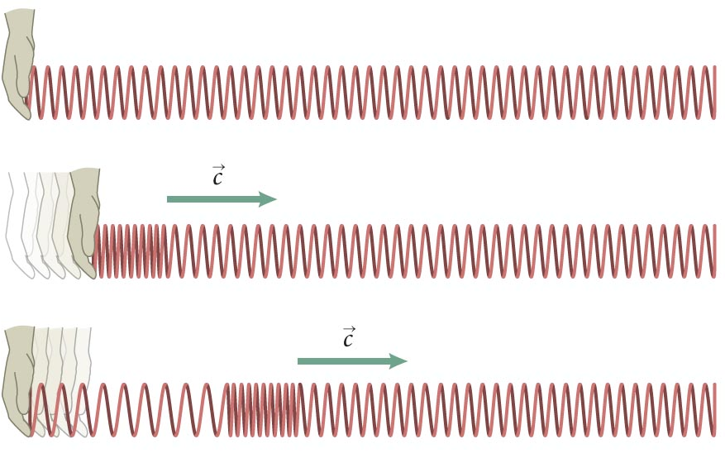
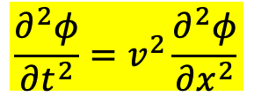
Wave Equation for continuous medium
$$\frac{∂^{2}φ}{∂t^{2}}=v^{2}\frac{∂^{2}φ}{∂x^{2}}$$

Slide 2
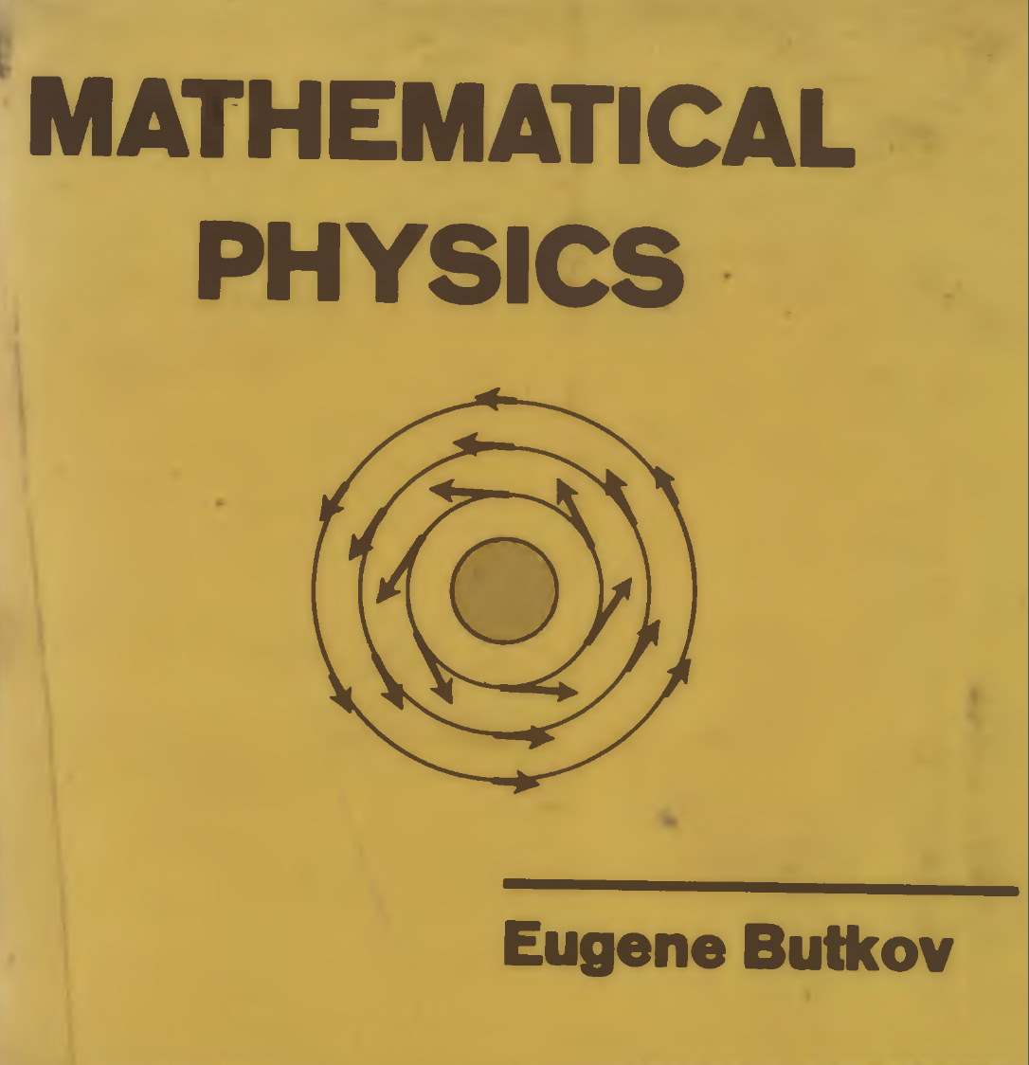

Slide 3
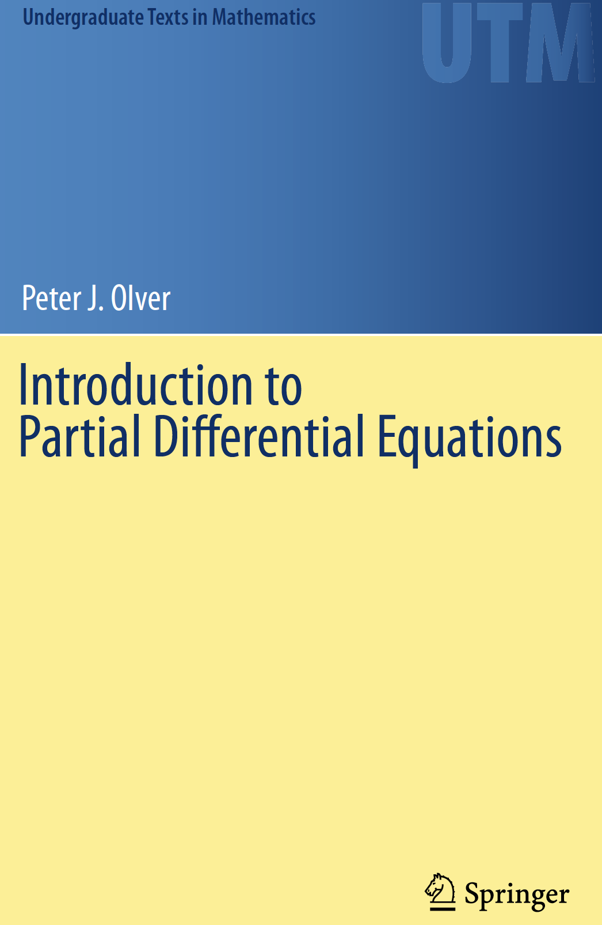

Slide 4
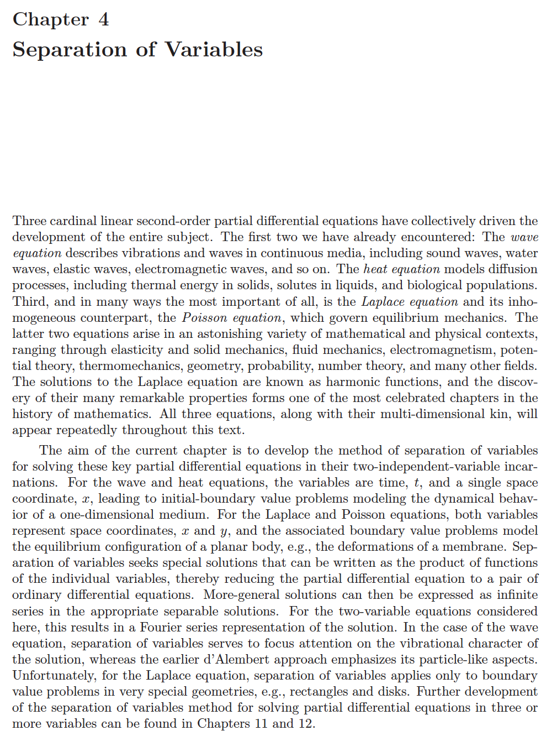

Slide 6
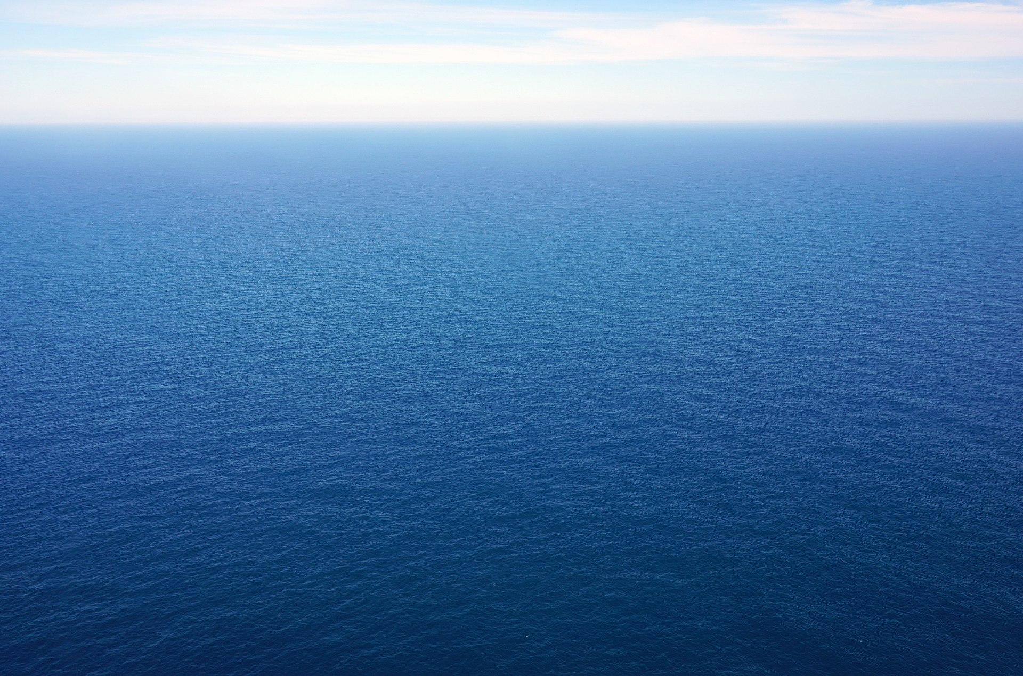

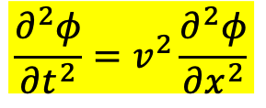
$$\frac{∂^{2}φ}{∂t^{2}}=v^{2}\frac{∂^{2}φ}{∂x^{2}}$$
Wave Equation
If the size of the medium is infinite or its boundaries are far away,
we have already d'Alembert solution of a travelling or propagating wave from：
$$φ\left(x,t\right)=f\left(x−vt\right)+g\left(x+vt\right)$$

Slide 7
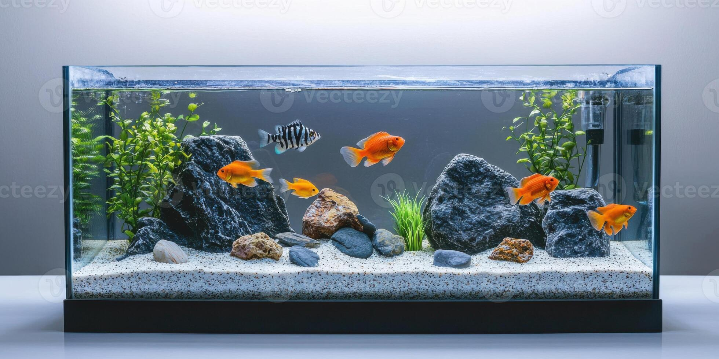
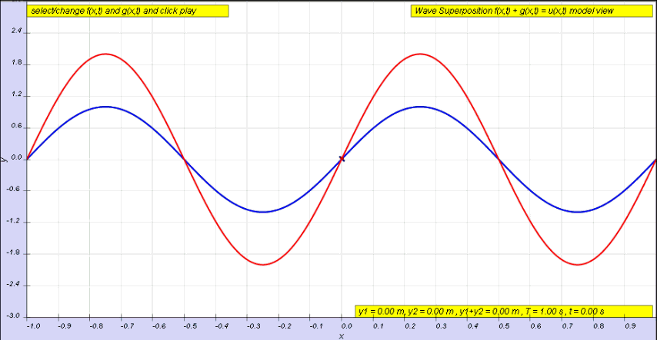
If the size of the medium is finite, its boundaries are nearby.
Reflection from boundaries would make wave behave more like vibrations!
It resembles a system of coupled springs!

Slide 8
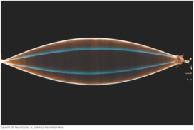
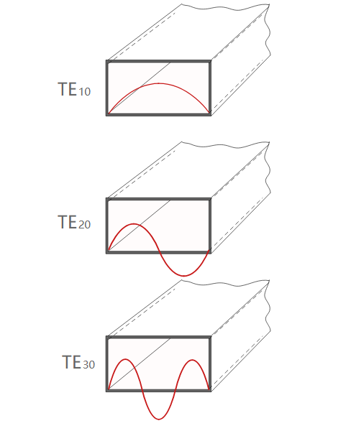

The medium with finite size usually comes with Boundary Condition 邊界條件, such as:
$$φ\left(0,t\right)=φ\left(L,t\right)=0$$
Conducting boundaries impose the same condition on $\vec{E}$.

Slide 9
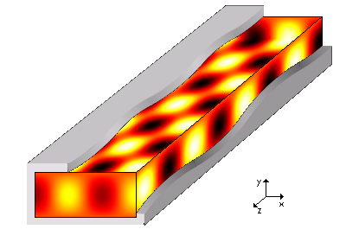
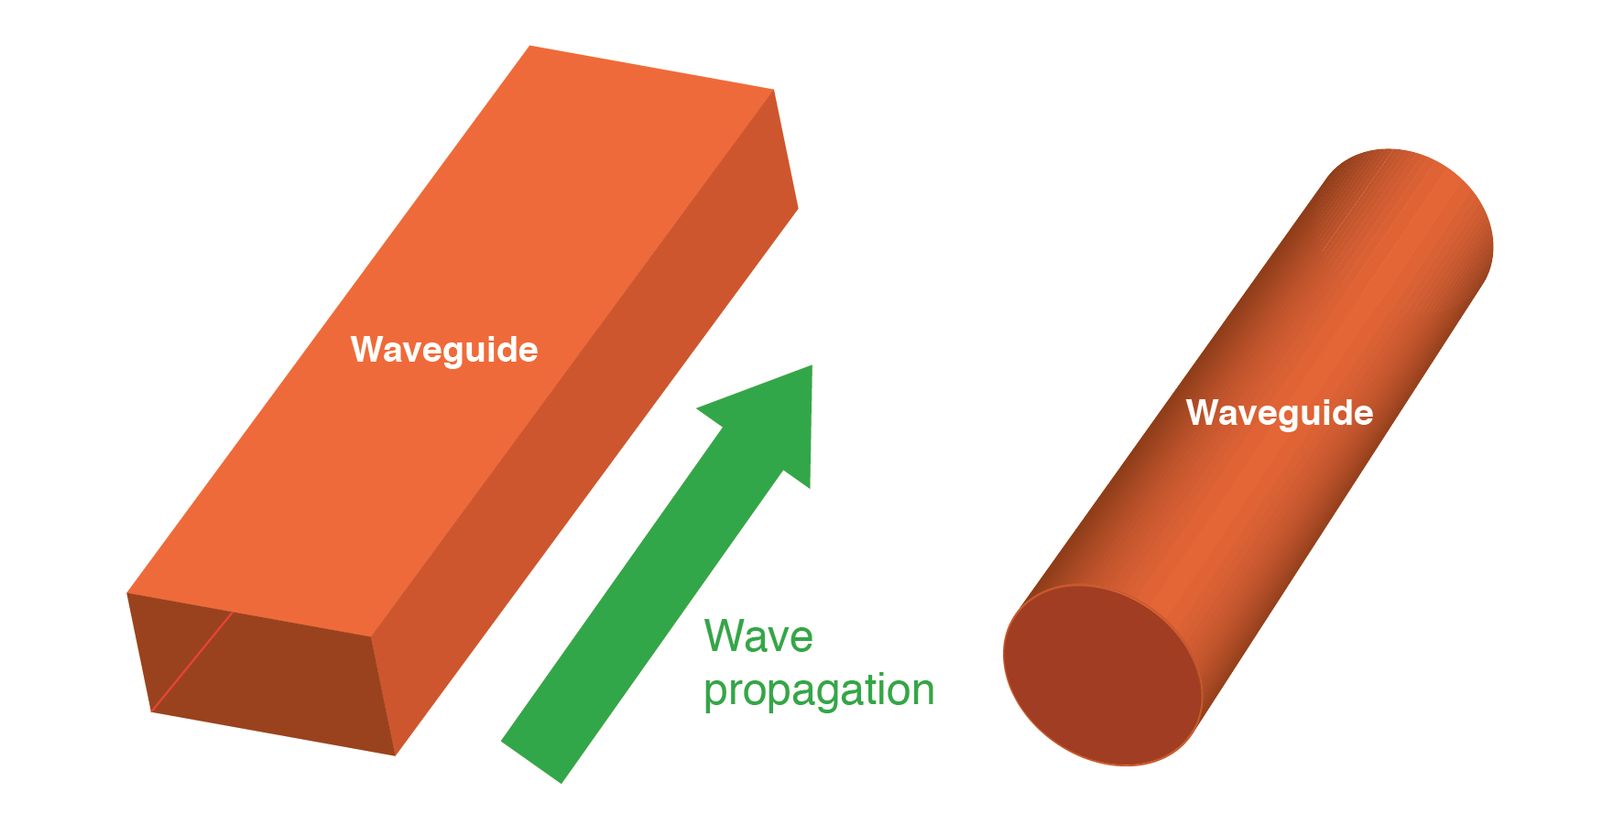
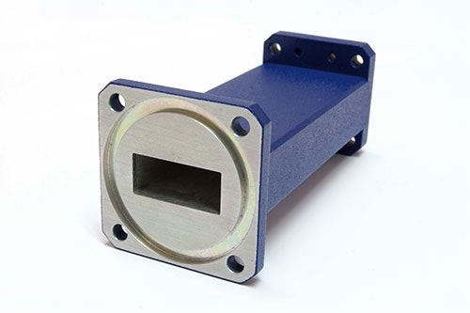
For 3D medium, boundaries could come in different shapes.
It could be rectangular, cylinder, sphere etc. Vibrating waves are very different.

Slide 10
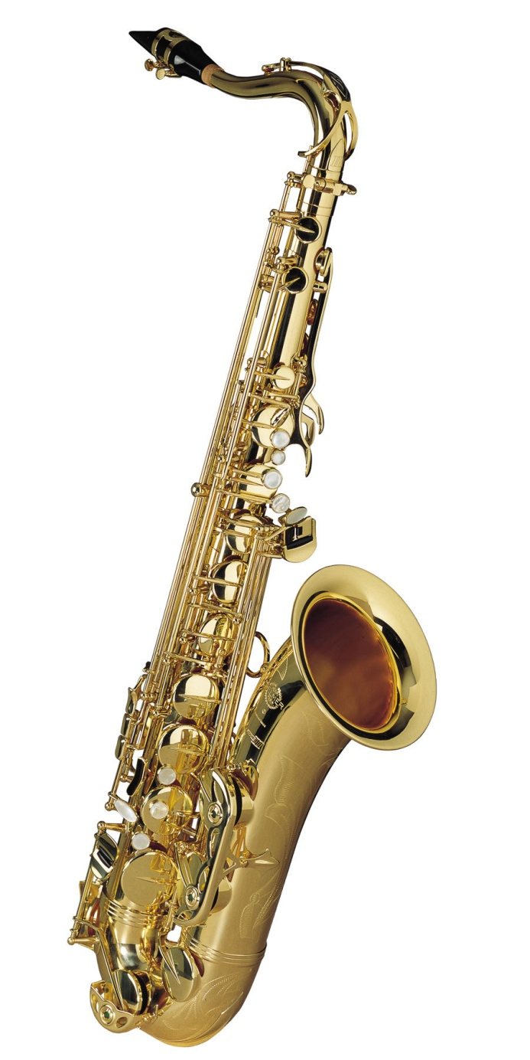
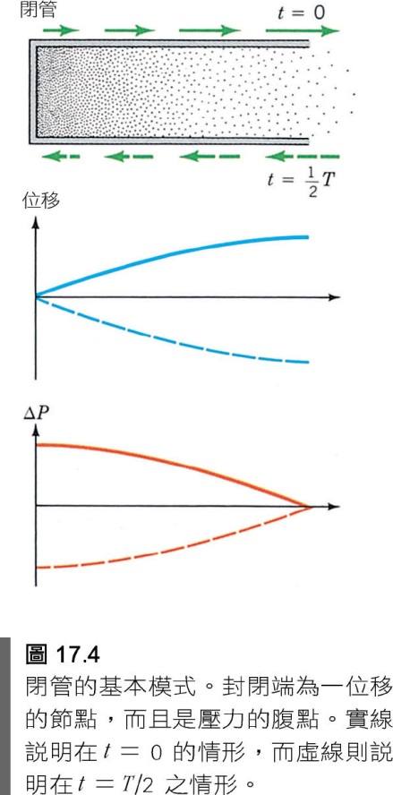
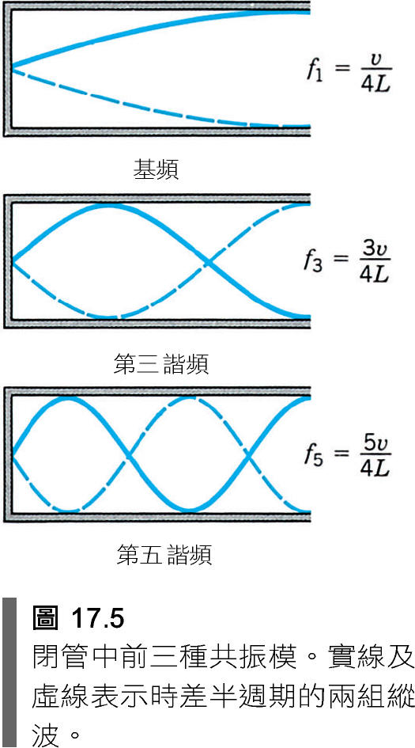
樂器空腔內的空氣的振盪就是邊界條件下的模式。

Slide 11
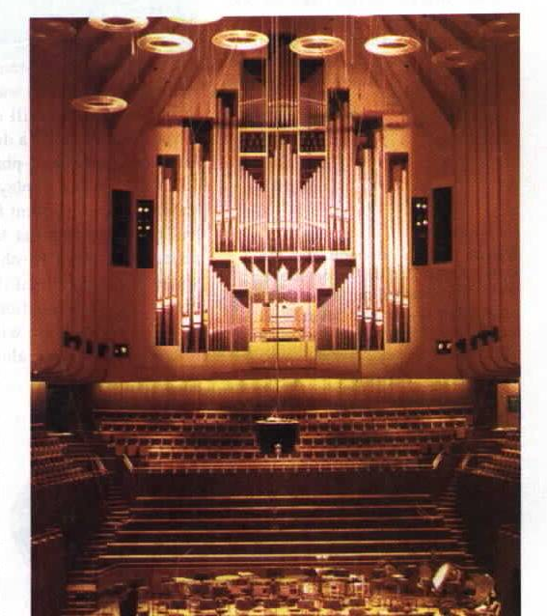
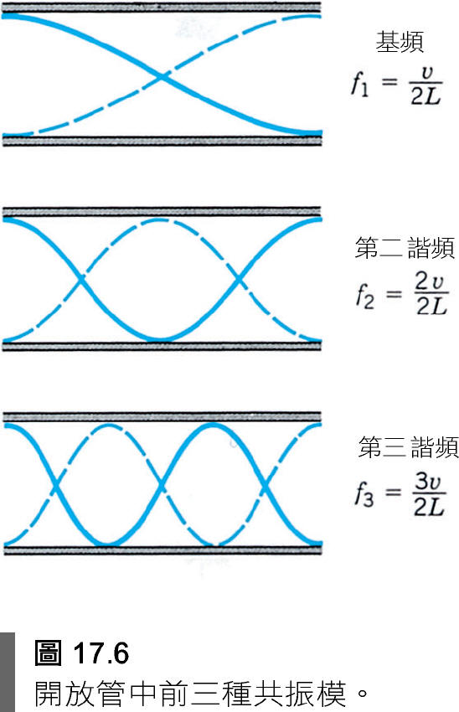
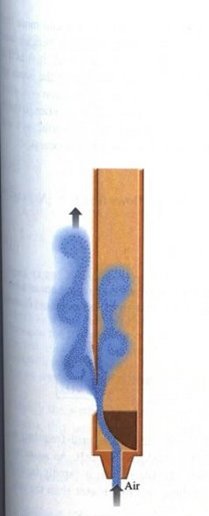

Slide 12
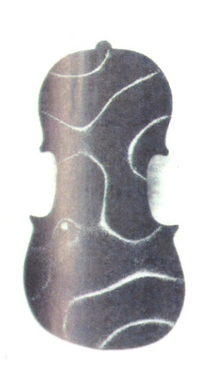
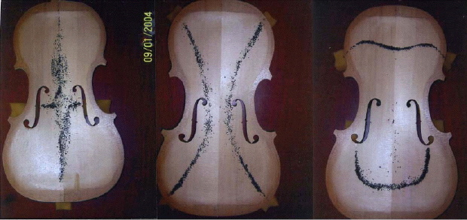
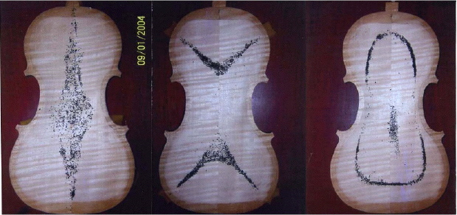
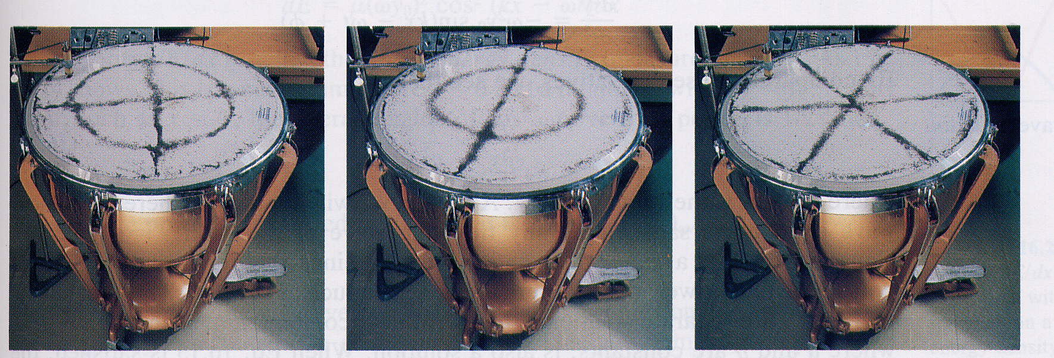
樂器空腔內的空氣的振盪就可以是三度空間邊界條件下的模式。

Slide 13
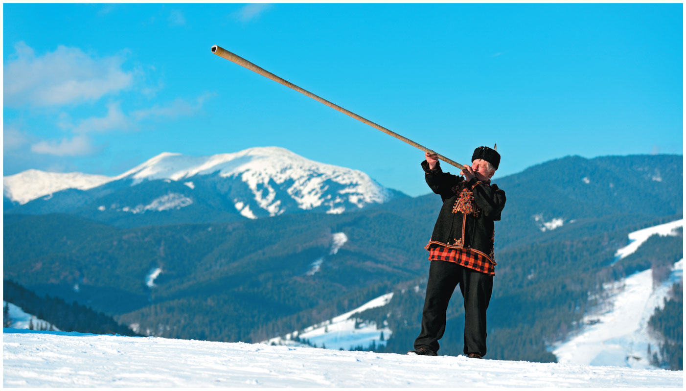
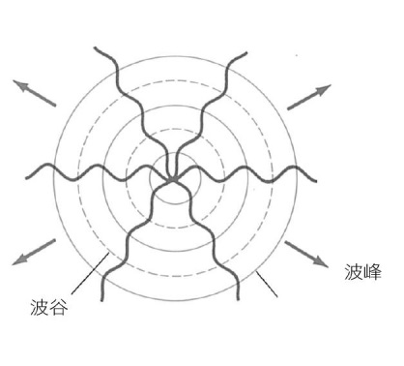
廣大空間的聲音，就是無邊界的聲波傳播。
樂器空腔內的空氣的振盪就是邊界條件下的模式。

Slide 14
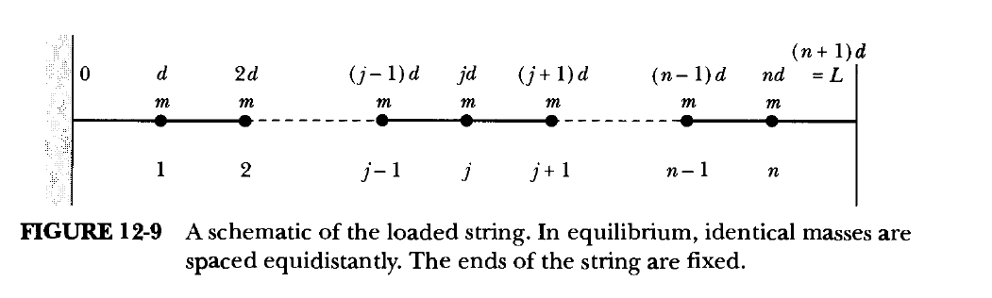
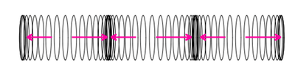




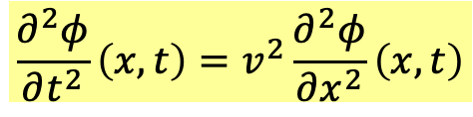
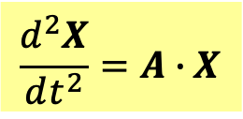

Solving wave equation with boundary conditions
對照表：Wave system is continuous limit of coupled spring system.
The solution here also applies to electromagnetic wave in vacuum.
$$dj$$
$$x$$
$$N→∞,d→0$$
$$x_{j}\left(t\right)$$
Continuous limit
$$φ\left(dj,t\right)=φ\left(x,t\right)$$
Wave function
Equations of Motion
Wave Equation
$$\frac{d^{2}X}{dt^{2}}=A∙X$$
$$\frac{∂^{2}φ}{∂t^{2}}\left(x,t\right)=v^{2}\frac{∂^{2}φ}{∂x^{2}}\left(x,t\right)$$
System of Ordinary Differential E.
This is a partial differential equation PDE.
Solutions: Sum of Oscillation Modes
?
Let’s first review Oscillation Modes for $N=3$.

Slide 15
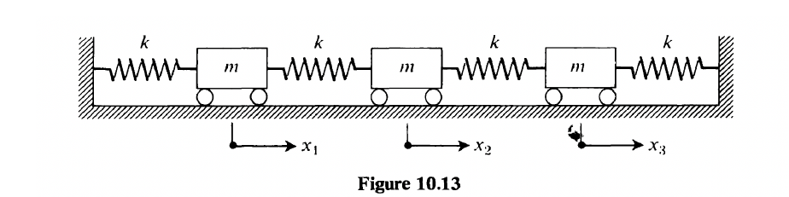
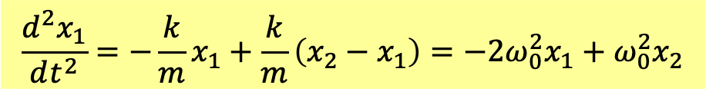
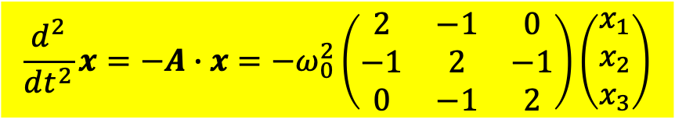
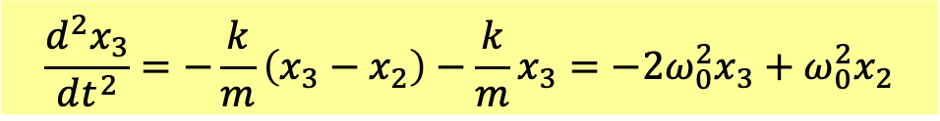
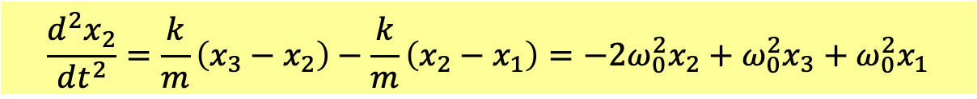
The concept of Oscillation Modes could be extended to more than two masses.
Equations of motion can be written as:
$$\frac{d^{2}x_{1}}{dt^{2}}=−\frac{k}{m}x_{1}+\frac{k}{m}\left(x_{2}−x_{1}\right)=−2ω_{0}^{2}x_{1}+ω_{0}^{2}x_{2}$$
$$\frac{d^{2}x_{2}}{dt^{2}}=\frac{k}{m}\left(x_{3}−x_{2}\right)−\frac{k}{m}\left(x_{2}−x_{1}\right)=−2ω_{0}^{2}x_{2}+ω_{0}^{2}x_{3}+ω_{0}^{2}x_{1}$$
$$\frac{d^{2}x_{3}}{dt^{2}}=−\frac{k}{m}\left(x_{3}−x_{2}\right)−\frac{k}{m}x_{3}=−2ω_{0}^{2}x_{3}+ω_{0}^{2}x_{2}$$
Define column vector $x$ and matrix $A$. Equations of motion is a system of ODEs:
$$\frac{d^{2}}{dt^{2}}x=−A∙x=−ω_{0}^{2}\left(\begin{matrix}2 & −1 & 0 \\ −1 & 2 & −1 \\ 0 & −1 & 2\end{matrix}\right)\left(\begin{matrix}x_{1} \\ x_{2} \\ x_{3}\end{matrix}\right)$$

Slide 16

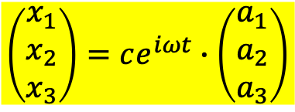


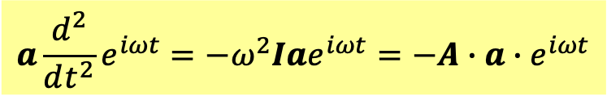
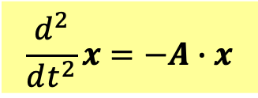
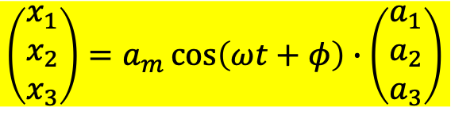
Assume there are mode solutions. Their time dependence is a factor $e^{iωt}$ as SHM.
$$x=ce^{iωt}∙a$$
$$\left(\begin{matrix}x_{1} \\ x_{2} \\ x_{3}\end{matrix}\right)=ce^{iωt}∙\left(\begin{matrix}a_{1} \\ a_{2} \\ a_{3}\end{matrix}\right)$$
Since the time factor can be separated, these are called separable solutions.
We understand, eventually we will only keep real part of this complex form.
$$x=Re ce^{iωt}∙a=a_{m}\cos\left(ωt+φ\right)∙a$$
$$\left(\begin{matrix}x_{1} \\ x_{2} \\ x_{3}\end{matrix}\right)=a_{m}\cos\left(ωt+φ\right)∙\left(\begin{matrix}a_{1} \\ a_{2} \\ a_{3}\end{matrix}\right)$$
Take this form as a guess and plug it into the equation:
$$\frac{d^{2}}{dt^{2}}x=−A∙x$$
We keep complex number form because exponentials are easier to differentiate.
$$a\frac{d^{2}}{dt^{2}}e^{iωt}=−ω^{2}Iae^{iωt}=−A∙a∙e^{iωt}$$
$$\left(A−ω^{2}I\right)∙a=0$$

Slide 17

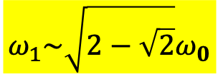





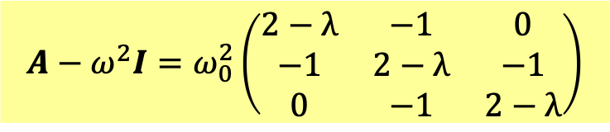


$$\left(A−ω^{2}I\right)∙a=0$$
We transform system of ODE into system of algebraic equations for unknown $a_{1,2,3}$.
It has nonzero solutions only when the determinant equals zero.
$$\left|A−ω^{2}I\right|=0$$
This is called characteristic equation CE.
Only certain $ω^{2}$’s that satisfy this CE will allow a solution for unknown $a_{1,2,3}$.
To find these $ω^{2}$’s :
$$ω^{2}≡λω_{0}^{2}$$
$$A−ω^{2}I=ω_{0}^{2}\left(\begin{matrix}2−λ & −1 & 0 \\ −1 & 2−λ & −1 \\ 0 & −1 & 2−λ\end{matrix}\right)$$
$$\left|A−ω^{2}I\right|=0$$
$${\left(2−λ\right)}^{3}−2\left(2−λ\right)=\left(2−λ\right)\left(2−4λ+λ^{2}\right)=0$$
$λ$ has three solutions. Order and label the solutions of $ω$ from small to large.
$$ω_{1}\sim \sqrt{2−\sqrt{2}}ω_{0}$$
$$ω_{3}\sim \sqrt{2+\sqrt{2}}ω_{0}$$
$$ω_{2}\sim \sqrt{2}ω_{0}$$
$ω_{1,2,3}$ are eigenvalues of $A$.

Slide 18



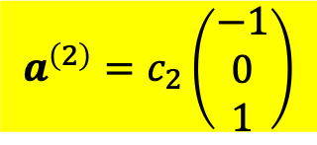

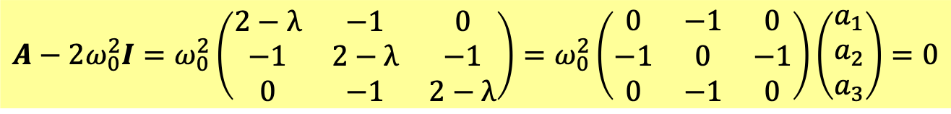

Let’s take $ω_{2}$ as an example for a more detailed study.
First solve $a_{1,2,3}$ for $ω_{2}$.
$$λ=2, ω=ω_{2}\sim \sqrt{2}ω_{0}$$
$$A−2ω_{0}^{2}I=ω_{0}^{2}\left(\begin{matrix}2−λ & −1 & 0 \\ −1 & 2−λ & −1 \\ 0 & −1 & 2−λ\end{matrix}\right)=ω_{0}^{2}\left(\begin{matrix}0 & −1 & 0 \\ −1 & 0 & −1 \\ 0 & −1 & 0\end{matrix}\right)\left(\begin{matrix}a_{1} \\ a_{2} \\ a_{3}\end{matrix}\right)=0$$
$$−a_{2}=0$$
$$−a_{1}−a_{3}=0$$
$$−a_{2}=0$$
$$a^{\left(2\right)}=c_{2}\left(\begin{matrix}−1 \\ 0 \\ 1\end{matrix}\right)$$
This solution is denoted as $a^{\left(2\right)}$, determined up to a constant.
$a^{\left(2\right)}$ is called an eigenvector of $A$.

Slide 19
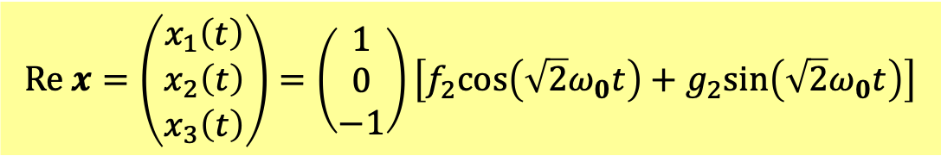
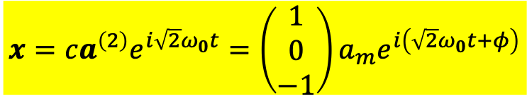

An eigenvector gives a solution!
$$x=ca^{\left(2\right)}e^{i\sqrt{2}ω_{0}t}=\left(\begin{matrix}1 \\ 0 \\ −1\end{matrix}\right)a_{m}e^{i\left(\sqrt{2}ω_{0}t+φ\right)}$$
Take the real part of this complex form.
$$Re x=\left(\begin{matrix}x_{1}\left(t\right) \\ x_{2}\left(t\right) \\ x_{3}\left(t\right)\end{matrix}\right)=\left(\begin{matrix}1 \\ 0 \\ −1\end{matrix}\right)\left[f_{2}cos\left(\sqrt{2}ω_{0}t\right)+g_{2}sin\left(\sqrt{2}ω_{0}t\right)\right]$$
$x_{1,2,3}$ oscillate as SHM by the same frequency, with amplitudes $∝a_{1,2,3}$.
$$x\left(t\right)∝a^{\left(2\right)}$$
$$x_{1}\left(t\right):x_{2}\left(t\right):x_{3}\left(t\right)=a_{1}:a_{2}:a_{3}=−1:0:1$$
In fact, proportion among $x_{1,2,3}$ is fixed as $a_{1}:a_{2}:a_{3}$ at all $t$.

Slide 20
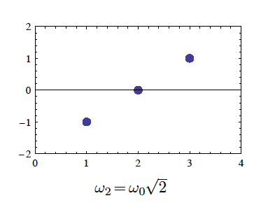







$$x\left(t\right)∝a^{\left(2\right)}$$
$$x_{1}\left(t\right):x_{2}\left(t\right):x_{3}\left(t\right)=a_{1}:a_{2}:a_{3}=−1:0:1$$
at all $t$.
Therefore $a_{1}:a_{2}:a_{3}$ is a good illustrations of $x_{1,2,3}$.
We can draw $a_{1}:a_{2}:a_{3}$ at the original locations of blocks to represent the mode.
Red arrows indicate the SHM of individual blocks.
$$a_{3}$$
$$∆x$$
$$a_{2}$$
$$a_{1}$$
$$x$$

Slide 21

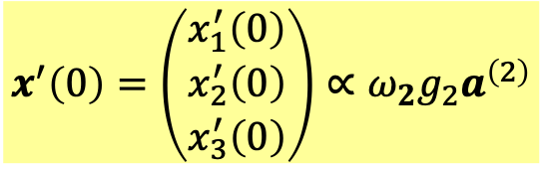

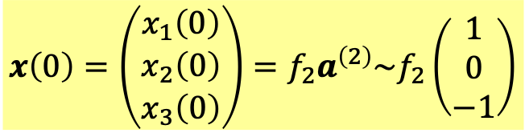
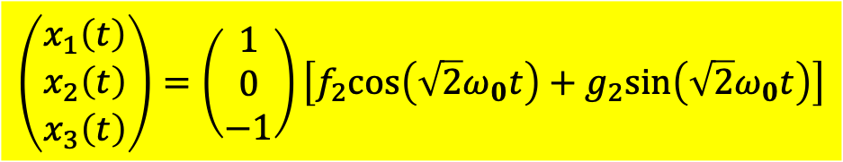



$$a_{3}$$
$$a_{2}$$
$$a_{1}$$
At all $t$:
$$x\left(t\right)∝a^{\left(2\right)}$$
$$x′\left(t\right)∝a^{\left(2\right)}$$
If the initial condition starts with this proportion, the oscillation mode will continue.
$$x\left(0\right)=\left(\begin{matrix}x_{1}\left(0\right) \\ x_{2}\left(0\right) \\ x_{3}\left(0\right)\end{matrix}\right)=f_{2}a^{\left(2\right)}\sim f_{2}\left(\begin{matrix}1 \\ 0 \\ −1\end{matrix}\right)$$
$$x^{′}\left(0\right)=\left(\begin{matrix}x_{1}^{′}\left(0\right) \\ x_{2}^{′}\left(0\right) \\ x_{3}^{′}\left(0\right)\end{matrix}\right)∝ω_{2}g_{2}a^{\left(2\right)}$$
The constant $f_{2},g_{2}$ is determined by initial conditions $x_{1,2,3}\left(0\right),x_{1,2,3}^{′}\left(0\right)$.
This is one oscillation mode that would oscillate independently.
$$\left(\begin{matrix}x_{1}\left(t\right) \\ x_{2}\left(t\right) \\ x_{3}\left(t\right)\end{matrix}\right)=\left(\begin{matrix}1 \\ 0 \\ −1\end{matrix}\right)\left[f_{2}cos\left(\sqrt{2}ω_{0}t\right)+g_{2}sin\left(\sqrt{2}ω_{0}t\right)\right]$$

Slide 22
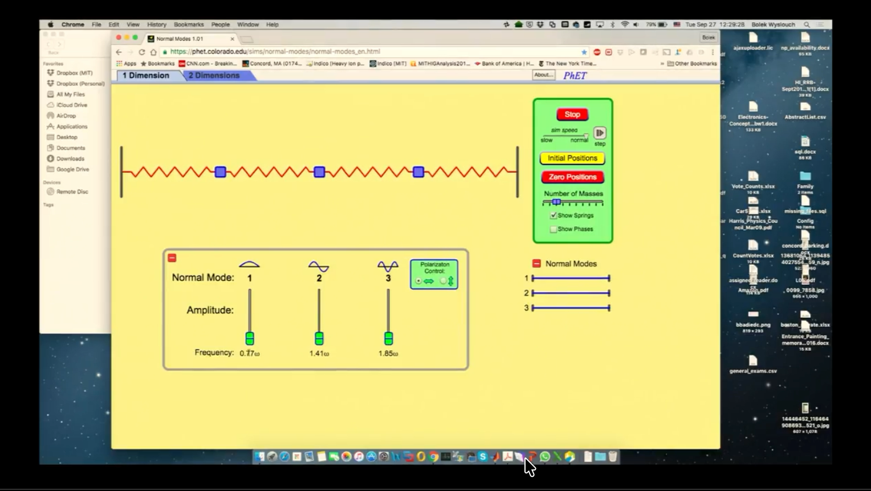


$$x\left(t\right)∝a^{\left(2\right)}∝\left(\begin{matrix}−1 \\ 0 \\ 1\end{matrix}\right)$$
$$λ=2, ω=ω_{2}\sim \sqrt{2}ω_{0}$$
$x_{1,2,3}$ oscillate by the same $ω$, with amplitudes $∝a_{1,2,3}$.
Looked individually every particle is doing a simple harmonic motion.

Slide 23













$$λ=2−\sqrt{2}, ω=ω_{1}\sim \sqrt{2−\sqrt{2}}ω_{0}\text{:}$$
$$\left(\begin{matrix}\sqrt{2} & −1 & 0 \\ −1 & \sqrt{2} & −1 \\ 0 & −1 & \sqrt{2}\end{matrix}\right)\left(\begin{matrix}a_{1} \\ a_{2} \\ a_{3}\end{matrix}\right)=0$$
$$a_{2}$$
$$a_{3}$$
$$a_{1}$$
$$a^{\left(1\right)}\sim \left(\begin{matrix}1 \\ \sqrt{2} \\ 1\end{matrix}\right)$$
$$∆x$$
$$x=a^{\left(1\right)}{ce}^{i\sqrt{2−\sqrt{2}}ω_{0}t}=\left(\begin{matrix}1 \\ 0 \\ −1\end{matrix}\right)a_{m}e^{i\left(\sqrt{2−\sqrt{2}}ω_{0}t+φ\right)}$$
$$x\left(t\right)∝a^{\left(1\right)}$$
$$x$$
$$x_{1}\left(t\right):x_{2}\left(t\right):x_{3}\left(t\right)=a_{1}:a_{2}:a_{3}=1:\sqrt{2}:1$$
$x_{1,2,3}$ oscillate as SHM by same $ω$, with amplitudes $∝a_{1,2,3}$.
$$Re x\left(t\right)=\left(\begin{matrix}x_{1}\left(t\right) \\ x_{2}\left(t\right) \\ x_{3}\left(t\right)\end{matrix}\right)∝a^{\left(1\right)}\left[f_{1}cos\left(\sqrt{2−\sqrt{2}}ω_{0}t\right)+g_{1}sin\left(\sqrt{2−\sqrt{2}}ω_{0}t\right)\right]$$
This is another oscillation mode.

Slide 24



$$a^{\left(1\right)}=c_{1}\left(\begin{matrix}1 \\ \sqrt{2} \\ 1\end{matrix}\right)$$
$$λ=2−\sqrt{2}, ω=ω_{1}\sim \sqrt{2−\sqrt{2}}ω_{0}\text{:}$$

Slide 25











$$λ=2+\sqrt{2}, ω=ω_{3}\sim \sqrt{2+\sqrt{2}}ω_{0}$$
$$a_{1}$$
$$a_{3}$$
$$a^{\left(3\right)}=c_{3}\left(\begin{matrix}1 \\ −\sqrt{2} \\ 1\end{matrix}\right)$$
$$∆x$$
$$a_{2}$$
$$x=a^{\left(3\right)}e^{i\sqrt{2+\sqrt{2}}ω_{0}t}$$
$$x$$
$$x\left(t\right)∝a^{\left(3\right)}$$
$$x_{1}\left(t\right):x_{2}\left(t\right):x_{3}\left(t\right)=a_{1}:a_{2}:a_{3}=1:−\sqrt{2}:1$$
$$Re x\left(t\right)=\left(\begin{matrix}x_{1}\left(t\right) \\ x_{2}\left(t\right) \\ x_{3}\left(t\right)\end{matrix}\right)∝a^{\left(3\right)}\left[f_{1}cos\left(\sqrt{2+\sqrt{2}}ω_{0}t\right)+g_{3}sin\left(\sqrt{2+\sqrt{2}}ω_{0}t\right)\right]$$
This is the third oscillation mode.

Slide 26



$$λ=2+\sqrt{2}, ω=ω_{3}\sim \sqrt{2+\sqrt{2}}ω_{0}$$
$$a^{\left(3\right)}=c_{3}\left(\begin{matrix}1 \\ −\sqrt{2} \\ 1\end{matrix}\right)$$

Slide 27



One eigenvalue, one eigenvector of the matrix corresponds one oscillation mode.
Any $n×n$ symmetric matrix has $n$ eigenvalues and they all are real.
$$A=ω_{0}^{2}\left(\begin{matrix}2 & −1 & 0 \\ −1 & 2 & −1 \\ 0 & −1 & 2\end{matrix}\right)$$
$A$ is a symmetric matrix.
The number of modes equals the number of particles.
In modes, coupled springs act like one spring!

Slide 28














Normal Modes of oscillation
$$ω=ω_{1}\sim \sqrt{2−\sqrt{2}}ω_{0}\text{:}$$
$$a_{2}$$
$$a_{3}$$
$$a_{1}$$
$$a^{\left(1\right)}=c_{1}\left(\begin{matrix}1 \\ \sqrt{2} \\ 1\end{matrix}\right)$$
$$a_{3}$$
$$ω=ω_{2}\sim \sqrt{2}ω_{0}$$
$$a^{\left(2\right)}=c_{2}\left(\begin{matrix}−1 \\ 0 \\ 1\end{matrix}\right)$$
$$a_{2}$$
$$a_{1}$$
$$ω=ω_{3}\sim \sqrt{2+\sqrt{2}}ω_{0}$$
$$a_{1}$$
$$a_{3}$$
$$a^{\left(3\right)}=c_{3}\left(\begin{matrix}1 \\ −\sqrt{2} \\ 1\end{matrix}\right)$$
$$a_{2}$$

Slide 29











The $n$ eigenvectors $u$ can be chosen to be orthogonal.
$$a^{\left(1\right)}=c_{1}\left(\begin{matrix}1 \\ \sqrt{2} \\ 1\end{matrix}\right)$$
$$a^{\left(1\right)}=c_{1}\left(\begin{matrix}1 \\ \sqrt{2} \\ 1\end{matrix}\right)→\frac{1}{2}\left(\begin{matrix}1 \\ \sqrt{2} \\ 1\end{matrix}\right)$$
$$ω_{1}\sim \sqrt{2−\sqrt{2}}ω_{0}\text{:}$$
$$a^{\left(2\right)}=c_{2}\left(\begin{matrix}−1 \\ 0 \\ 1\end{matrix}\right)→\frac{1}{\sqrt{2}}\left(\begin{matrix}−1 \\ 0 \\ 1\end{matrix}\right)$$
$$ω_{2}\sim \sqrt{2}ω_{0}$$
$$a^{\left(2\right)}=c_{2}\left(\begin{matrix}−1 \\ 0 \\ 1\end{matrix}\right)$$
$$a^{\left(3\right)}=c_{3}\left(\begin{matrix}1 \\ −\sqrt{2} \\ 1\end{matrix}\right)$$
$$ω_{3}\sim \sqrt{2+\sqrt{2}}ω_{0}$$
$$a^{\left(3\right)}=c_{3}\left(\begin{matrix}1 \\ −\sqrt{2} \\ 1\end{matrix}\right)→\frac{1}{2}\left(\begin{matrix}1 \\ −\sqrt{2} \\ 1\end{matrix}\right)$$
Indeed, eigenvectors are orthogonal to each other.
$$a^{\left(2\right)T}a^{\left(1\right)}=a^{\left(2\right)}∙a^{\left(1\right)}=0$$
We could choose the length of all eigenvectors to be equal to one.
$$a^{\left(m\right)T}a^{\left(n\right)}=a^{\left(m\right)}∙a^{\left(n\right)}=δ_{mn}$$
They are called orthonormal.
You will see this orthogonality property is extremely important.

Slide 30




$$ω_{1}\sim \sqrt{2−\sqrt{2}}ω_{0}$$
$$ω_{3}\sim \sqrt{2+\sqrt{2}}ω_{0}$$
$$ω_{2}\sim \sqrt{2}ω_{0}$$
System of 3 coupled spring equals 3 independent springs.
The coordinates of the 3 independent springs are linear combinations of $x_{1,2,3}$.

Slide 31





Method 2
以矩陣的對角化來分析來分析：
$$V=X^{T}SX$$
$$S=UΛU^{T}=U\left(\begin{matrix}λ_{1} & 0 \\ 0 & λ_{2}\end{matrix}\right)U^{T}$$
$$V=X^{T}UΛU^{T}X={\left(U^{T}X\right)}^{T}Λ\left(U^{T}X\right)$$
選擇Generalized Coordinates 廣義座標$y_{1},y_{2}$
$$Y=\left(\begin{matrix}y_{1} \\ y_{2}\end{matrix}\right)=U^{T}X$$
$$V={\left(U^{T}X\right)}^{T}Λ\left(U^{T}X\right)=Y^{T}ΛY=λ_{1}y_{1}^{2}+λ_{2}y_{2}^{2}$$
定理：任意線性力學系統，都可以找到廣義座標，位能為廣義座標的平方。
$$V=λ_{1}y_{1}^{2}+λ_{2}y_{2}^{2}$$
廣義座標做獨立的簡諧運動。

Slide 32




$$ω_{1}$$
$$ω_{2}$$
$$ω_{3}$$
In general, more than one modes can be excited. It is not a pure oscillation.
All three modes of added up, called a linear combination.
The coefficients of linear combination are determined by initial position!

Slide 33






Linear Combinations of the 3 mode solutions are solutions, too.
$$\left(\begin{matrix}x_{1} \\ x_{2} \\ x_{3}\end{matrix}\right)=\sum_{i=1}^{3}{a^{\left(i\right)}∙\left[f_{i}cos\left(ω_{i}t\right)+g_{i}sin\left(ω_{i}t\right)\right]}$$
3 coefficients $f_{1,2,3}$ will be determined by 3 initial conditions $x_{1,2,3}\left(0\right)$.
$$\left(\begin{matrix}x_{1}\left(0\right) \\ x_{2}\left(0\right) \\ x_{3}\left(0\right)\end{matrix}\right)=\sum_{i=1}^{3}{a^{\left(i\right)}f_{i}}$$
I have chosen $a^{\left(i\right)}$ to be orthonormal.
$$a^{\left(m\right)T}a^{\left(n\right)}=δ_{mn}$$
$$a^{\left(i\right)T}\left(\begin{matrix}x_{1}\left(0\right) \\ x_{2}\left(0\right) \\ x_{3}\left(0\right)\end{matrix}\right)=\sum_{j=1}^{3}{a^{\left(i\right)T}a^{\left(j\right)}f_{j}}=\sum_{j=1}^{3}{δ_{ij}f_{j}}=f_{i}$$
$$a^{\left(i\right)T}\left(\begin{matrix}x_{1}\left(0\right) \\ x_{2}\left(0\right) \\ x_{3}\left(0\right)\end{matrix}\right)=f_{i}$$
Inner product of $a^{\left(i\right)}$ and initial column vector equals $f_{i}$:
We can use the numbers $f_{1,2,3}$ to construct a solution:
$$\left(\begin{matrix}x_{1} \\ x_{2} \\ x_{3}\end{matrix}\right)=\left(\begin{matrix}\frac{1}{2} \\ \frac{1}{\sqrt{2}} \\ \frac{1}{2}\end{matrix}\right)f_{1}cos\left(ω_{1}t\right)+\left(\begin{matrix}\frac{1}{\sqrt{2}} \\ 0 \\ −\frac{1}{\sqrt{2}}\end{matrix}\right)f_{2}cos\left(ω_{2}t\right)+\left(\begin{matrix}\frac{1}{2} \\ −\frac{1}{\sqrt{2}} \\ \frac{1}{2}\end{matrix}\right)f_{3}cos\left(ω_{2}t\right)$$

Slide 34

$$\left(\begin{matrix}x_{1} \\ x_{2} \\ x_{3}\end{matrix}\right)=\left(\begin{matrix}\frac{1}{2} \\ \frac{1}{\sqrt{2}} \\ \frac{1}{2}\end{matrix}\right)f_{1}cos\left(ω_{1}t\right)+\left(\begin{matrix}\frac{1}{\sqrt{2}} \\ 0 \\ −\frac{1}{\sqrt{2}}\end{matrix}\right)f_{2}cos\left(ω_{2}t\right)+\left(\begin{matrix}\frac{1}{2} \\ −\frac{1}{\sqrt{2}} \\ \frac{1}{2}\end{matrix}\right)f_{3}cos\left(ω_{2}t\right)$$

Slide 35



The other coefficients $g_{1,2,3}$ are determined similarly by more initial conditions $x_{1,2,3}^{′}\left(0\right)$.
$$\left(\begin{matrix}x_{1}^{′}\left(0\right) \\ x_{2}^{′}\left(0\right) \\ x_{3}^{′}\left(0\right)\end{matrix}\right)=\sum_{i=1}^{3}{ω_{i}a^{\left(i\right)}g_{i}=}\left(\begin{matrix}\frac{1}{2} \\ \frac{1}{\sqrt{2}} \\ \frac{1}{2}\end{matrix}\right)ω_{1}g_{1}+\left(\begin{matrix}\frac{1}{\sqrt{2}} \\ 0 \\ −\frac{1}{\sqrt{2}}\end{matrix}\right)ω_{2}g_{2}+\left(−\begin{matrix}\frac{1}{2} \\ \frac{1}{\sqrt{2}} \\ \frac{1}{2}\end{matrix}\right)ω_{3}g_{3}$$
$$a^{\left(i\right)T}\left(\begin{matrix}x_{1}^{′}\left(0\right) \\ x_{2}^{′}\left(0\right) \\ x_{3}^{′}\left(0\right)\end{matrix}\right)=ω_{i}g_{i}$$
We can use the numbers $f_{1,2,3},g_{1,2,3}$to construct a solution:
$$\left(\begin{matrix}x_{1} \\ x_{2} \\ x_{3}\end{matrix}\right)=\sum_{i=1}^{3}{a^{\left(i\right)}∙\left[f_{i}cos\left(ω_{i}t\right)+g_{i}sin\left(ω_{i}t\right)\right]}$$
It satisfies both the system of equation of motion and the initial conditions.
Modes are special solutions. But the above sum of modes is a general solution!

Slide 36








求解策略：
$$\frac{d^{2}}{dt^{2}}x=−A∙x$$
Solving Equation of motion:
首先時間變化為簡諧振盪的模式解：
$$x=e^{iωt}a$$
$$\left(\begin{matrix}x_{1} \\ x_{2} \\ x_{3}\end{matrix}\right)=e^{iωt}\left(\begin{matrix}a_{1} \\ a_{2} \\ a_{3}\end{matrix}\right)$$
時間變化與足標$i=1,2,3$無關！
模式解滿足矩陣的本徵向量方程式：
$$\left(A−ω^{2}I\right)∙a=0$$
本徵向量數量與粒子數目相等：$a^{\left(i\right)}, i=1,⋯3$！
方程式組是線性方程式，模式解的線性組合，還是方程式組的解。
$$x=\sum_{i=1}^{3}{\left[a^{\left(i\right)}f_{i}∙cos\left(ω_{i}t\right)+a^{\left(i\right)}g_{i}∙sin\left(ω_{i}t\right)\right]}$$
將$t=0$的起始條件分解為本徵向量$a^{\left(i\right)}$的線性組合，這永遠能作到。
$$\left(\begin{matrix}x_{1}\left(0\right) \\ x_{2}\left(0\right) \\ x_{3}\left(0\right)\end{matrix}\right)=\sum_{i=1}^{3}{a^{\left(i\right)}f_{i}}$$
$$\left(\begin{matrix}x_{1}^{′}\left(0\right) \\ x_{2}^{′}\left(0\right) \\ x_{3}^{′}\left(0\right)\end{matrix}\right)=\sum_{i=1}^{3}{a^{\left(i\right)}g_{i}}$$
讓組合中的$a^{\left(i\right)}$各自作時間演化 (簡諧振盪)後，到時間$t$再組合！
解矩陣的本徵向量方程式是關鍵，其餘都是自動完成。

Slide 37













起始各個配料依配方$f_{1,2,3}$收集
各個配料分離烹煮$cos\left(ω_{i}t\right)$
$$+$$
個自簡諧振盪後，最後合體！
$$+$$
$$＝$$
$$+$$
$$\left(\begin{matrix}x_{1}\left(0\right) \\ x_{2}\left(0\right) \\ x_{3}\left(0\right)\end{matrix}\right)=\sum_{i=1}^{3}{a^{\left(i\right)}f_{i}}$$
$$+$$
$$⋮$$
$$\left(\begin{matrix}x_{1}^{′}\left(0\right) \\ x_{2}^{′}\left(0\right) \\ x_{3}^{′}\left(0\right)\end{matrix}\right)=\sum_{i=1}^{3}{a^{\left(i\right)}g_{i}}$$
$$\left(\begin{matrix}x_{1} \\ x_{2} \\ x_{3}\end{matrix}\right)=\sum_{i=1}^{3}{\left[a^{\left(i\right)}f_{i}∙cos\left(ω_{i}t\right)+a^{\left(i\right)}g_{i}∙sin\left(ω_{i}t\right)\right]}$$

Slide 38

三個本徵向量的元素似乎滿足簡單的規則：都是正弦函數，角度以等差$\frac{π}{4},\frac{2π}{4},\frac{3π}{4}$增加。
$$a^{\left(1\right)}\sim \left(\begin{matrix}\sin{\frac{π}{4}} \\ \sin{\frac{π}{2}} \\ \sin{\frac{3π}{4}}\end{matrix}\right)=\left(\begin{matrix}\frac{1}{\sqrt{2}} \\ 1 \\ \frac{1}{\sqrt{2}}\end{matrix}\right)$$
$$a^{\left(2\right)}\sim \left(\begin{matrix}\sin{\frac{π}{2}} \\ \sin{π} \\ \sin{\frac{3π}{2}}\end{matrix}\right)=\left(\begin{matrix}1 \\ 0 \\ −1\end{matrix}\right)$$
$$a^{\left(3\right)}\sim \left(\begin{matrix}\sin{\frac{3π}{4}} \\ \sin{\frac{3π}{2}} \\ \sin{\frac{9π}{4}}\end{matrix}\right)=\left(\begin{matrix}\frac{1}{\sqrt{2}} \\ −1 \\ \frac{1}{\sqrt{2}}\end{matrix}\right)$$

Slide 39

















Now extend the formalism to a large number $N$ of particles.
$$x_{j−1}$$
$$x_{j}$$
$$\left(N+1\right)d$$
$$\left(N−1\right)d$$
$$Nd$$
$$N−1$$
$$N$$
$$m\frac{d^{2}x_{j}}{dt^{2}}=−k\left(x_{j}−x_{j−1}\right)+k\left(x_{j+1}−x_{j}\right)$$
$$j=1,2⋯N$$
$$\frac{d^{2}x_{j}}{dt^{2}}=\frac{k}{m}x_{j−1}−{\frac{2k}{m}x}_{j}+\frac{k}{m}x_{j+1}$$
$x_{1},x_{N}$二次微分的方程式中包含$x_{0},x_{N+1}$。
邊界是固定的，就稱為Boundary Condition.
$$x_{0}=x_{N+1}=0$$
$$\frac{d^{2}}{dt^{2}}\left(\begin{matrix}\begin{matrix}x_{1} \\ ⋮\end{matrix} \\ \begin{matrix}x_{j} \\ \begin{matrix}⋮ \\ x_{N}\end{matrix}\end{matrix}\end{matrix}\right)=−ω_{0}^{2}\left(\begin{matrix}\begin{matrix}2 & −1 \\ −1 & 2\end{matrix} & \begin{matrix}0 & ⋯ \\ −1 & 0\end{matrix} & \begin{matrix}0 \\ 0\end{matrix} \\ \begin{matrix}0 & −1 \\ ⋮ & ⋮\end{matrix} & \begin{matrix}2 & −1 \\ ⋮ & ⋱\end{matrix} & \begin{matrix}0 \\ ⋮\end{matrix} \\ \begin{matrix}0 & 0\end{matrix} & \begin{matrix}0 & ⋯\end{matrix} & 2\end{matrix}\right)∙\left(\begin{matrix}\begin{matrix}x_{1} \\ ⋮\end{matrix} \\ \begin{matrix}x_{j} \\ \begin{matrix}⋮ \\ x_{N}\end{matrix}\end{matrix}\end{matrix}\right)$$
$$X≡\left(\begin{matrix}\begin{matrix}x_{1} \\ ⋮\end{matrix} \\ \begin{matrix}x_{j} \\ \begin{matrix}⋮ \\ x_{N}\end{matrix}\end{matrix}\end{matrix}\right)$$
$$ω_{0}^{2}=\frac{k}{m}$$
$$\frac{d^{2}X}{dt^{2}}=−A∙X$$
$$A=ω_{0}^{2}\left(\begin{matrix}2 & −1 & 0 \\ −1 & 2 & −1 \\ 0 & −1 & 2\end{matrix}\right)$$

Slide 40





Elevate $x_{i}$ to complex number and put in the following guess solution:
$$\frac{d^{2}X}{dt^{2}}=−A∙X$$
$$a=\left(\begin{matrix}\begin{matrix}a_{1} \\ ⋮\end{matrix} \\ \begin{matrix}a_{j} \\ \begin{matrix}⋮ \\ a_{N}\end{matrix}\end{matrix}\end{matrix}\right)$$
$$X=ae^{iωt}$$
$$−A∙a=−ω^{2}a$$
The system of differential equations is transformed into a matrix eigenvector problem.
$$−ω_{0}^{2}\left(\begin{matrix}\begin{matrix}2 & −1 \\ −1 & 2\end{matrix} & \begin{matrix}0 & ⋯ \\ −1 & 0\end{matrix} & \begin{matrix}0 \\ 0\end{matrix} \\ \begin{matrix}0 & −1 \\ ⋮ & ⋮\end{matrix} & \begin{matrix}2 & −1 \\ ⋮ & ⋱\end{matrix} & \begin{matrix}0 \\ ⋮\end{matrix} \\ \begin{matrix}0 & 0\end{matrix} & \begin{matrix}0 & ⋯\end{matrix} & 2\end{matrix}\right)∙\left(\begin{matrix}\begin{matrix}a_{1} \\ ⋮\end{matrix} \\ \begin{matrix}a_{j} \\ \begin{matrix}⋮ \\ a_{N}\end{matrix}\end{matrix}\end{matrix}\right)=−ω^{2}\left(\begin{matrix}\begin{matrix}a_{1} \\ ⋮\end{matrix} \\ \begin{matrix}a_{j} \\ \begin{matrix}⋮ \\ a_{N}\end{matrix}\end{matrix}\end{matrix}\right)$$
It is a bit impractical to solve it by the condition of vanishing determinant.
But we are sure symmetric positive definite $N×N$ matrix will have $N$ positive eigenvalues corresponding to $N$ eigenvectors.
And hence there are $N$ oscillation modes.

Slide 41










本徵方程式其實就是$N$個方程式，其中第$j$個方程式可寫成：
$$ω_{0}^{2}\left[{−a}_{j−1}+{2a}_{j}−a_{j+1}\right]=ω^{2}a_{j}$$
這次用個別式子想比用矩陣更容易。
如果本徵向量的元素如上述是等比數列，左手邊與右手邊的比例是定值，與$j$無關。
$$a_{j}^{\left(p\right)}\sim e^{−ip∙j}$$
$$\frac{a_{j+1}}{a_{j}}\sim e^{−ip}$$
$$\frac{a_{j−1}}{a_{j}}\sim e^{ip}$$
這裏嘗試比例為$e^{−ip}$，$p$是一未定的常數。
整式除以$a_{j}$，得：
$$ω_{0}^{2}\left[−e^{ip}+2−e^{−ip}\right]=ω^{2}$$
只要$ω^{2}$的值使此式正確， 第$j$個方程式就滿足。
但注意，此式中沒有$j$，因此只要$ω^{2}$的值使此式正確，所有$N$個方程式都滿足。
$$a^{\left(p\right)}=\left(\begin{matrix}\begin{matrix}\begin{matrix}a_{1} \\ a_{2}\end{matrix} \\ ⋮\end{matrix} \\ \begin{matrix}a_{j} \\ \begin{matrix}⋮ \\ a_{N}\end{matrix}\end{matrix}\end{matrix}\right)\sim \left(\begin{matrix}\begin{matrix}\begin{matrix}e^{−ip} \\ e^{−i2p}\end{matrix} \\ ⋮\end{matrix} \\ \begin{matrix}e^{−ip∙j} \\ \begin{matrix}⋮ \\ e^{−ip∙N}\end{matrix}\end{matrix}\end{matrix}\right)$$
的確就是$N×N$矩陣$A$的本徵向量！
滿足此式的$ω^{2}$值就是對應的本徵值。
$$ω_{0}^{2}\left[−e^{ip}+2−e^{−ip}\right]=ω^{2}$$

Slide 42









$$ω_{0}^{2}\left[2−\left(e^{−ip}−e^{ip}\right)\right]=ω^{2}$$
化簡此式就可以得到本徵值$ω^{2}$。
$$ω^{2}=ω_{0}^{2}\left(2−2\cos{p}\right)$$
注意本徵值$ω^{2}$都是正的。
一個$p$對應一特定的本徵值，$p$還待決定。
如果把等比數列的配方延伸到$x_{0},x_{N+1}$，不是所有$p$都可滿足邊界條件。
$$ω^{2}−2ω_{0}^{2}$$
$$x_{0}=x_{N+1}=0$$
$$2ω_{0}^{2}$$
$$p=−π$$
$$p=π$$

Slide 43














$$X=a^{\left(p\right)}e^{iωt}=\left(\begin{matrix}\begin{matrix}\begin{matrix}e^{−i0p}=1 \\ e^{−ip}\end{matrix} \\ ⋮\end{matrix} \\ \begin{matrix}e^{−ijp} \\ \begin{matrix}⋮ \\ \begin{matrix}e^{−iNp} \\ e^{−i\left(N+1\right)p}\end{matrix}\end{matrix}\end{matrix}\end{matrix}\right)e^{iωt}$$
$$a_{j}^{\left(p\right)}\sim e^{−ip∙j}=\cos{pj}+i\sin{pj}$$
因矩陣$A$是實數矩陣，本徵向量$a$可取其實數部或虛數部都滿足本徵向量方程式：
取其虛數部則可以直接滿足左側的邊界條件：
$$x_{0}=0$$
$$a_{0}=0$$
$$a_{j}^{\left(p\right)}\sim e^{−ip∙j}$$
$$a_{j}^{\left(p\right)}=\sin{pj}$$
$$a_{0}=0$$
$$a^{\left(p\right)}=\sim \left(\begin{matrix}\begin{matrix}\begin{matrix}0 \\ \sin{p}\end{matrix} \\ ⋮\end{matrix} \\ \begin{matrix}\sin{jp} \\ \begin{matrix}⋮ \\ \begin{matrix}\sin{Np} \\ \sin\left(N+1\right)p\end{matrix}\end{matrix}\end{matrix}\end{matrix}\right)$$
模式本徵向量的元素都是正弦函數值，角度以等差$p$增加。
若要滿足右側的邊界條件：
$$a_{N+1}=\sin\left(N+1\right)p＝0$$
$$p∙\left(N+1\right)=mπ$$
$m$是任一自然數。
$$p=\frac{mπ}{N+1}$$
此角度的等差$p$是離散的，以$m$標定：
$$a_{j}^{\left(m\right)}=\sin{\frac{mπ}{N+1}∙j}$$

Slide 44








但還是有無限多個本徵值，這是不可能的。
$$p=\frac{mπ}{N+1}$$
$$a_{j}^{\left(m\right)}=\sin{pj}$$
$m=N+1$對應$a_{j}=0$。非合理本徵向量。
$m=N+$2與$m=N$對應的$p$之和為$2π$，
對應相似的$a_{j}^{\left(N+2\right)}=−a_{j}^{\left(N\right)}$。
其餘$m>N+$2都對應$2N+2−m<N$，
其$p$和為$2π$: $a_{j}^{\left(m\right)}=−a_{j}^{\left(2N+2−m\right)}$
因此$m$只能取以下這些值，共$N$個。
$$m=1,2,3⋯N$$
本徵向量才是獨立的！
如預期洽有$N$個本徵值。
一個$p$對應一特定的本徵值及本徵向量$→$一個$m$對應一本徵值及本徵向量。

Slide 45













Summary
$$ω^{2}−2ω_{0}^{2}$$
$$2ω_{0}^{2}$$
$$m=1$$
$$p=π$$
一個自然數$m$對應一本徵值及一本徵向量。
$$p=\frac{mπ}{N+1}$$
$$m=1,2,3⋯N$$
$$m=2$$
$$a^{\left(p\right)}{ or a}^{\left(m\right)}=\left(\begin{matrix}\begin{matrix}\sin{p} \\ \begin{matrix}⋮ \\ \sin\left(j−1\right)p\end{matrix}\end{matrix} \\ \begin{matrix}\sin{jp} \\ \begin{matrix}\begin{matrix}\sin\left(j+1\right)p \\ ⋮\end{matrix} \\ \sin{Np}\end{matrix}\end{matrix}\end{matrix}\right)$$
$$n=3$$
$$m=3$$
$$ω_{m}^{2}=ω_{0}^{2}\left(2−2\cos{p}\right)$$
$$X=a^{\left(m\right)}Ce^{iω_{m}t}→a^{\left(m\right)}∙\left[A_{m} cos{ ω}_{m}t\right]$$
一個自然數$m$對應一個獨立振盪模式(駐波)。

Slide 46






$$a_{j}^{\left(p\right)}=φ\left(dj,t=0\right)\sim \sin{jp}$$
$$→\sin{\frac{p}{d}∙jd}=\sin{kx} for x=jd, j=1⋯N$$
$$k=\frac{mπ}{\left(N+1\right)d}=\frac{mπ}{L}$$
$$φ\left(x,t=0\right)\sim \sin{kx} for x=jd, j=1⋯N$$
看起來就像一個正弦波的波形！

Slide 47



$$N=2$$
$$N=3$$

Slide 48


$$N=4$$
$$k=\frac{mπ}{\left(N+1\right)d}=\frac{mπ}{L}$$
$$φ\left(x,t=0\right)\sim \sin{kx} for x=jd, j=1⋯N$$

Slide 49





$$N=20$$
$$m=15$$
$$N=6$$

Slide 50




$$N=20$$
$$m=15$$
$$N=6$$
本徵向量的元素恰為正弦函數值，而角度以等距隨粒子編號$j$增加。
有了所有模式的解，一般解將是所有模式的線性組合：
$$X=\sum_{m=1}^{N}{a^{\left(m\right)}∙\left[f_{m}cos\left(ω_{m}t\right)+g_{m}sin\left(ω_{m}t\right)\right]}＝\sum_{m=1}^{N}{a^{\left(m\right)}∙\left[A_{m}\cos\left(ω_{m}t+φ_{m}\right)\right]}$$

Slide 51






這個推導的關鍵是下列對本徵向量的猜想：
$$a^{\left(p\right)}=\left(\begin{matrix}\begin{matrix}\begin{matrix}a_{1} \\ a_{2}\end{matrix} \\ ⋮\end{matrix} \\ \begin{matrix}a_{j} \\ \begin{matrix}⋮ \\ a_{N}\end{matrix}\end{matrix}\end{matrix}\right)\sim \left(\begin{matrix}\begin{matrix}\begin{matrix}e^{−ip} \\ e^{−i2p}\end{matrix} \\ ⋮\end{matrix} \\ \begin{matrix}e^{−ip∙j} \\ \begin{matrix}⋮ \\ e^{−ip∙N}\end{matrix}\end{matrix}\end{matrix}\right)$$
這不是偶然。來自彈簧組的重覆性。
將彈簧組平移一組，彈簧組除了邊界完全不變。
這是為何同樣的運動方程式適用於所有的$x_{j}$。
$$\frac{d^{2}x_{j}}{dt^{2}}=\frac{k}{m}x_{j−1}−{\frac{2k}{m}x}_{j}+\frac{k}{m}x_{j+1}$$
$$a_{j}^{\left(p\right)}\sim e^{−ip∙j}$$
這樣的平移對稱決定了本徵向量必須是虛數指數函數的樣式：
$$V\left(x\right)$$
$$V\left(x+a\right)$$

Slide 52








$$ω^{2}−2ω_{0}^{2}$$
$$2ω_{0}^{2}$$
$$p=π$$
一個自然數$m$對應一本徵值及一本徵向量。
$$p=\frac{mπ}{N+1}$$
$$m=1,2,3⋯N$$
$$ω_{m}^{2}=ω_{0}^{2}\left(2−2\cos{p}\right)$$
$$ω_{m}^{2}−2ω_{0}^{2}={2ω}_{0}^{2}\cos{p}≈{2ω}_{0}^{2}\left(1+\frac{1}{2}p^{2}\right) p≪1$$

Slide 53







求解策略：
$$\frac{d^{2}}{dt^{2}}X=−A∙X$$
$$X≡\left(\begin{matrix}\begin{matrix}x_{1} \\ ⋮\end{matrix} \\ \begin{matrix}x_{j} \\ \begin{matrix}⋮ \\ x_{N}\end{matrix}\end{matrix}\end{matrix}\right)=e^{iωt}\left(\begin{matrix}a_{1} \\ a_{2} \\ a_{3}\end{matrix}\right)$$
Solving Equation of motion:
首先時間變化為簡諧振盪的模式解：
$$X=e^{iωt}a$$
時間變化與足標$i=1,⋯n$無關！
模式解滿足矩陣的本徵向量方程式：
$$\left(A−ω^{2}I\right)∙a=0$$
本徵向量數量與粒子數目相等：$a^{\left(i\right)}, i=1,⋯n$！
關鍵：方程式組是線性方程式，模式解的線性組合，還是方程式組的解。
$$x=\sum_{i=1}^{n}{\left[a^{\left(i\right)}f_{i}∙cos\left(ω_{i}t\right)+a^{\left(i\right)}g_{i}∙sin\left(ω_{i}t\right)\right]}$$
將$t=0$的起始條件分解為本徵向量$a^{\left(i\right)}$的線性組合，這永遠能作到。
$$\left(\begin{matrix}\begin{matrix}x_{1}(0) \\ ⋮\end{matrix} \\ \begin{matrix}x_{j}(0) \\ \begin{matrix}⋮ \\ x_{N}(0)\end{matrix}\end{matrix}\end{matrix}\right)=\sum_{i=1}^{n}{a^{\left(i\right)}f_{i}}$$
$$\left(\begin{matrix}\begin{aligned}x_{1}^{′}\left(0\right) \\ ⋮\end{aligned} \\ \begin{aligned}x_{j}^{′}\left(0\right) \\ ⋮\end{aligned} \\ x_{N}^{′}\left(0\right)\end{matrix}\right)=\sum_{i=1}^{n}{a^{\left(i\right)}ω_{i}g_{i}}$$
讓組合中的$a^{\left(i\right)}$各自作時間演化 (簡諧振盪)後，到時間$t$再組合！
解矩陣的本徵向量方程式是關鍵，其餘都是自動完成。

Slide 54



起始各個配料依配方$f_{1,2,3}$收集
各個配料分離烹煮$cos\left(ω_{i}t\right)$
$$+$$
個自簡諧振盪後，最後合體！
$$+$$
$$＝$$
$$\left(\begin{matrix}\begin{matrix}x_{1}(0) \\ ⋮\end{matrix} \\ \begin{matrix}x_{j}(0) \\ \begin{matrix}⋮ \\ x_{N}(0)\end{matrix}\end{matrix}\end{matrix}\right)=\sum_{i=1}^{n}{a^{\left(i\right)}f_{i}}$$
$$+$$
$$+$$
$$⋮$$
$$\left(\begin{matrix}\begin{aligned}x_{1}^{′}\left(0\right) \\ ⋮\end{aligned} \\ \begin{aligned}x_{j}^{′}\left(0\right) \\ ⋮\end{aligned} \\ x_{N}^{′}\left(0\right)\end{matrix}\right)=\sum_{i=1}^{n}{a^{\left(i\right)}g_{i}}$$
$$X=\sum_{i=1}^{3}{\left[a^{\left(i\right)}f_{i}∙cos\left(ω_{i}t\right)+a^{\left(i\right)}g_{i}∙sin\left(ω_{i}t\right)\right]}$$

Slide 55


Continuous medium with boundary is the continuous limit of coupled springs.
There is a close correspondence between them.
求解策略Strategy：
$$\frac{d^{2}}{dt^{2}}x=−A∙x$$
Solving Equation of motion for coupled springs:
Assume there are mode solutions whose time dependence is a factor of SHM $e^{iωt}$:
$$x=e^{iωt}∙a$$

Slide 56











對照表
$$\frac{d^{2}X}{dt^{2}}=A∙X$$
$$\frac{∂^{2}φ}{∂t^{2}}=v^{2}\frac{∂^{2}φ}{∂x^{2}}$$
$$N→∞$$
$$x_{j}$$
$$φ\left(jd\right)=φ\left(x\right)$$
A series of mode solutions exist.
A series of similar solutions $φ$ exist.
$$X=a e^{iωt}$$
$$φ\left(x,t\right)=X\left(x\right)∙T\left(t\right)$$
Time factor $e^{iωt}$ is separate from $a$.
Time factor $T\left(t\right)$ is separate from space $X\left(x\right)$.
It is independent of block indices.
It is independent of coordinate $x$.

Slide 57



$$\frac{∂^{2}φ}{∂t^{2}}=v^{2}\frac{∂^{2}φ}{∂x^{2}}$$
First step of solving wave equation:
Find solutions that can be separated into a time factor $T\left(t\right)$ and a space factor $X\left(x\right)$.
$$φ\left(x,t\right)=X\left(x\right)∙T\left(t\right)$$
Method of separation of variables
Time factor $T\left(t\right)$ is separate from space $X\left(x\right)$ and independent of coordinate $x$.
The two factors $T\left(t\right)$ and $X\left(x\right)$ can be solved more easily.
Expectation: linear combinations of these separable solutions constitutes all solutions.

Slide 58









Find solutions that can be separated into a time factor $T\left(t\right)$ and a space factor $X\left(x\right)$.
$$φ\left(x,t\right)=X\left(x\right)∙T\left(t\right)$$
$$\frac{∂^{2}φ}{∂t^{2}}=v^{2}\frac{∂^{2}φ}{∂x^{2}}$$
Plug into the wave euqation：
$$X\frac{∂^{2}T}{∂t^{2}} =Tv^{2}\frac{∂^{2}X}{∂x^{2}}$$
$$X\frac{d^{2}T}{dt^{2}} =Tv^{2}\frac{d^{2}X}{dx^{2}}$$
Note that partial differentiation becomes ordinary differentiation.
Divide both sides by $v^{2}X\left(x\right)T\left(t\right)$.
$$\frac{1}{v^{2}}\frac{1}{T}\frac{d^{2}T}{dt^{2}}=\frac{1}{X}\frac{d^{2}X}{dx^{2}}$$
Now left-hand side is only $t$ related while right-hand side only $x$ related.
But $x,t$ are independent variables. General equality is impossible.
The only exception: the two formulae are both constants. Call it $λ$.
$$\frac{1}{v^{2}}\frac{1}{T}\frac{d^{2}T}{dt^{2}}=\frac{1}{X}\frac{d^{2}X}{dx^{2}}≡λ$$
$$\frac{d^{2}X}{dx^{2}}=λ∙X$$
$$\frac{d^{2}T}{dt^{2}}=v^{2}λ∙T$$
We find separate equations for time factor $T\left(t\right)$ and space factor $X\left(x\right)$。
Even better, they are ordinary differential equation instead of partial DE.

Slide 59



$$\frac{d^{2}X}{dx^{2}}=λ∙X$$
$$\frac{d^{2}T}{dt^{2}}=v^{2}λ∙T$$
The time factor $T\left(t\right)$ can be determined right away
$$\frac{d^{2}T}{dt^{2}}=v^{2}λT≡−ω^{2}T$$
If $λ<0$, $T\left(t\right)$ is a SHM with angular frequency $ω=v\sqrt{−λ}$.
$$T\left(t\right)=a_{m}\cos\left(ωt+φ\right)=fcos\left(ωt\right)+gsin\left(ωt\right)$$
Hence a separable solutions of wave equation is also an oscillation mode solution.

Slide 60










$X\left(x\right)$ satisfies a standard 2nd order ODE and the solutions are periodic:
$$\frac{d^{2}X}{dx^{2}}=λX$$
If $λ<0$
$$X\left(x\right)=A^{′}\cos{kx}+B^{′}\sin{kx}$$
$$k≡\sqrt{−λ}$$
Choosing $A^{′}$ equal to zero, $X$ automatically satisfy one of boundary conditions:
$$X\left(0\right)=0$$
$$X\left(x\right)=\sin{kx}$$
The other boundary condition will restrict $k$ we can choose:
$$X\left(L,0\right)\sim sin\left(kL\right)=0$$
$$k_{n}=\frac{nπ}{L}=\sqrt{−λ_{n}}$$
$$X_{n}\left(x\right)= sin\left(\frac{nπ}{L}x\right) n=1,2,⋯∞$$

Slide 61












起始條件與邊界條件是分開的，
$X\left(x\right)$滿足標準的二次常微分方程式：
$$\frac{d^{2}X}{dx^{2}}=λX$$
我們稱這是算子 $\frac{∂^{2}}{∂x^{2}}$的本徵值方程式！
它的解與$λ$是正或負有關：
$$X\left(x\right)=\left\{\begin{aligned}&Ae^{\sqrt{λ}x}+Be^{−\sqrt{λ}x} λ>0 \\ &A^{′}\cos{\sqrt{−λ}x+}B^{′}\sin{\sqrt{−λ}x} λ<0 \\ &A^{′′}x+B^{′′} λ=0\end{aligned}\right.$$
$λ$若是正值，$X\left(x\right)$是指數函數，$λ$若是負值，$X\left(x\right)$則是三角函數。
如果考慮邊界條件，只能選$λ<0,A^{′}=0$。一般會定義角波數：
$$k≡\sqrt{−λ}$$
$$X\left(x\right)=\sin{kx}$$
自動滿足原點邊界條件
$$φ\left(0,t\right)=0$$
另一端邊界條件就對$k$、也就是$λ$有限制：
$$X\left(L,0\right)\sim sin\left(kL\right)=0$$
$$k_{n}=\frac{nπ}{L}=\sqrt{−λ_{n}}$$
$$X_{n}\left(x\right)= sin\left(\frac{nπ}{L}x\right) n=1,2,⋯∞$$
$$\frac{d^{2}X_{n}}{dx^{2}}=λ_{n}X_{n}$$
我們稱這些解是算子 $\frac{∂^{2}}{∂x^{2}}$的本徵函數 Eigenfunction！
物理上對應一系列模式(駐波)，離散、可以$n$標定，但有無限多個。

Slide 62






$$\frac{d^{2}X_{n}}{dx^{2}}=λ_{n}X_{n}$$
With $λ_{n},k_{n}$, the angular frequency of $T$ corresponds to $ω_{n}$:
$$\frac{d^{2}T}{dt^{2}}=v^{2}λ_{n}T≡−ω_{n}^{2}T$$
$T\left(t\right)$ is a SHM with angular frequency $ω_{n}=v\sqrt{−λ_{n}}=vk_{n}$.
$$T\left(t\right)=fcos\left(ω_{n}t\right)+gsin\left(ω_{n}t\right)$$
This seperable solution is called $u^{(n)}$:
$$u^{(n)}\left(x,t\right)=X_{n}\left(x\right)∙T\left(t\right)= sin\left(k_{n}x\right)∙\left(A_{n}\cos{ω_{n}t}+B_{n}\sin{ω_{n}t}\right)$$
$$k_{n}=\frac{nπ}{L}$$
$$ω_{n}=vk_{n}=\frac{nπ}{L}v$$
The time factor $T\left(t\right)$ is an oscillating function of angular frequency $ω_{n}$,
and the space factor $X\left(x\right)$ is a periodic function of angular wave number $k_{n}$.
This is a typical standing wave.

Slide 63


這個解稱為Bernoulli Solution.
Bernoulli Solution其實與d'Alembert solution等價。
Daniel Bernoulli 1700-1782
之前駐波被視為向左正弦波與向右正弦波即是 d'Alembert solution 的疊加。
這樣的兩個波疊加洽使邊界一直維持固定，於是駐波同時是邊界固定弦的振盪模式。
Normal Modes

Slide 64


All particles oscillate as SHM by identical $ω_{n}$ and phase, amplitudes $∝sin\left(\frac{nπ}{L}x\right)$.
$$u^{(n)}\left(x,t\right)=sin\left(\frac{nπ}{L}x\right)\left(A_{n}\cos{ω_{n}t}+B_{n}\sin{ω_{n}t}\right)$$
Wavefunction at different locations are proportional to $sin\left(\frac{nπ}{L}x\right)$ all the time!
$$\frac{u^{(n)}\left(x_{1},t\right)}{u^{(n)}\left(x_{2},t\right)}=\frac{sin\left(\frac{nπ}{L}x_{1}\right)}{sin\left(\frac{nπ}{L}x_{2}\right)}$$

Slide 65








若是在三度空間，波函數可以分離為$\vec{r},t$個別的函數的模式解：
$$φ\left(\vec{r},t\right)=ψ\left(\vec{r}\right)∙T\left(t\right)$$
Method of Separation of Variables
代入波方程式：
$$\frac{1}{v^{2}}\frac{∂^{2}φ}{∂t^{2}}=∇^{2}φ$$
得到：
$$\frac{1}{v^{2}}ψ\frac{∂^{2}T}{∂t^{2}} =T∇^{2}ψ$$
Hermann von Helmholtz 1821-1894
一般會把$v^{2}$移到左邊，同時左右邊都除以$ψ\left(\vec{r}\right)∙T\left(t\right)$：
$$\frac{1}{v^{2}}\frac{1}{T}\frac{d^{2}T}{dt^{2}}=\frac{1}{ψ}∇^{2}ψ$$
現在左邊只與$\vec{r}$有關，右邊只與$t$有關，但兩者是獨立變數！相等並不可能。
唯一的例外：左右兩式都與各自的變數無關，是一常數。設此常數為$λ$。
$$\frac{1}{v^{2}}\frac{1}{T}\frac{d^{2}T}{dt^{2}}=\frac{1}{ψ}∇^{2}ψ≡λ$$
$$\frac{d^{2}T}{dt^{2}}=v^{2}λ∙T$$
$$∇^{2}ψ=λ∙ψ$$
Helmholtz Equation

Slide 66

$$a_{j}^{\left(p\right)}=φ\left(dj,t=0\right)\sim \sin{jp}→\sin{\frac{p}{d}∙jd}=\sin{kx} for x=jd, j=1⋯N$$
$$k=\frac{mπ}{\left(N+1\right)d}=\frac{mπ}{L}$$
$$φ\left(x,t=0\right)\sim \sin{kx} for x=jd, j=1⋯N$$
看起來就像一個正弦波的波形！

Slide 67
$$N=2$$
$$N=3$$

Slide 68
$$N=4$$
$$k=\frac{mπ}{\left(N+1\right)d}=\frac{mπ}{L}$$
$$φ\left(x,t=0\right)\sim \sin{kx} for x=jd, j=1⋯N$$

Slide 69
$$N=20$$
$$m=15$$
$$N=6$$

Slide 70



















對照表
$$\frac{d^{2}X}{dt^{2}}=A∙X$$
$$\frac{∂^{2}φ}{∂t^{2}}=v^{2}\frac{∂^{2}φ}{∂x^{2}}$$
$$x_{j}$$
$$φ\left(jd\right)=φ\left(x\right)$$
A series of mode solutions exist.
A series of similar solutions $φ$ exist.
$$X=a e^{iωt}$$
$$φ\left(x,t\right)=X\left(x\right)∙T\left(t\right)$$
Time factor $e^{iωt}$ is separate from $a$.
Time factor $T\left(t\right)$ is separate from space $X\left(x\right)$.
$$X=Re ae^{iωt}=a a_{m}\cos\left(ωt+φ\right)$$
$$Re φ\left(x,t\right)=X\left(x\right)∙a_{m}\cos\left(ωt+φ\right)$$
本徵向量
$$a$$
$$X\left(x\right)$$
$$\frac{d^{2}X}{dx^{2}}=λX$$
$$A∙a=λa$$
矩陣$A$的本徵值方程式！
算子 $\frac{d^{2}}{dx^{2}}$的本徵值方程式！
$$A$$
$$\frac{d^{2}}{dx^{2}}$$
微分運算稱為算子operator
$X\left(x\right)$就稱為微分算子Differential Operator $\frac{d^{2}}{dx^{2}}$的本徵函數！

Slide 71








$$\frac{∂^{2}X}{∂x^{2}}=λX$$
微分算子 $\frac{∂^{2}}{∂x^{2}}$的本徵值方程式！
$$∇^{2}ψ=λ∙ψ$$
加了邊界條件後，方程式的解就是離散分布，以$n=1⋯∞$標定 。
$$X_{n}\left(x\right)= sin\left(\frac{nπ}{L}x\right)$$
算子 $\frac{∂^{2}}{∂x^{2}}\text{解出來}$的本徵函數。
$$λ_{n}=−\frac{n^{2}π^{2}}{L^{2}}$$
算子 $\frac{∂^{2}}{∂x^{2}}$解出來的本徵值。
$$\frac{d^{2}X_{n}}{dx^{2}}=λ_{n}X_{n}$$
我們從矩陣的本徵向量的例子，就已經可以猜測出$X_{n}\left(x\right)$的重要性質：
不同本徵值的本徵函數彼此正交(何謂正交?)。
所有滿足邊界條件的函數都可分解為$X_{n}\left(x\right)$的線性組合！完備性。
物理上對應一系列模式(駐波)，離散、可以$n$標定，但有無限多個。

Slide 72






求解策略：
$$\frac{d^{2}}{dt^{2}}X=−A∙X$$
$$X≡\left(\begin{matrix}\begin{matrix}x_{1} \\ ⋮\end{matrix} \\ \begin{matrix}x_{j} \\ \begin{matrix}⋮ \\ x_{N}\end{matrix}\end{matrix}\end{matrix}\right)=e^{iωt}\left(\begin{matrix}a_{1} \\ a_{2} \\ a_{3}\end{matrix}\right)$$
Solving Equation of motion:
首先時間變化為簡諧振盪的模式解：
$$X=e^{iωt}a$$
時間變化與足標$i=1,⋯n$無關！ 也就是Separation of Variables 的精神！
模式解滿足矩陣的本徵向量方程式：
$$\left(A−ω^{2}I\right)∙a=0$$
本徵向量數量與粒子數目相等：$a^{\left(i\right)}, i=1,⋯n$！
關鍵：方程式組是線性方程式，模式解的線性組合，還是方程式組的解。
$$x=\sum_{i=1}^{n}{\left[a^{\left(i\right)}f_{i}∙cos\left(ω_{i}t\right)+a^{\left(i\right)}g_{i}∙sin\left(ω_{i}t\right)\right]}$$
將$t=0$的起始條件分解為本徵向量$a^{\left(i\right)}$的線性組合，這永遠能作到。
$$\left(\begin{matrix}\begin{matrix}x_{1}(0) \\ ⋮\end{matrix} \\ \begin{matrix}x_{j}(0) \\ \begin{matrix}⋮ \\ x_{N}(0)\end{matrix}\end{matrix}\end{matrix}\right)=\sum_{i=1}^{n}{a^{\left(i\right)}f_{i}}$$
$$\left(\begin{matrix}\begin{aligned}x_{1}^{′}\left(0\right) \\ ⋮\end{aligned} \\ \begin{aligned}x_{j}^{′}\left(0\right) \\ ⋮\end{aligned} \\ x_{N}^{′}\left(0\right)\end{matrix}\right)=\sum_{i=1}^{n}{a^{\left(i\right)}ω_{i}g_{i}}$$
讓組合中的$a^{\left(i\right)}$各自作時間演化 (簡諧振盪)後，到時間$t$再組合！

Slide 73

起始各個配料依配方$f_{1,2,3}$收集
各個配料按分離烹煮$cos\left(ω_{i}t\right)$
$$+$$
個自簡諧振盪後，最後合體！
$$+$$
$$＝$$
$$\left(\begin{matrix}\begin{matrix}x_{1}(0) \\ ⋮\end{matrix} \\ \begin{matrix}x_{j}(0) \\ \begin{matrix}⋮ \\ x_{N}(0)\end{matrix}\end{matrix}\end{matrix}\right)=\sum_{i=1}^{n}{a^{\left(i\right)}f_{i}}$$
$$+$$
$$+$$
$$⋮$$
$$\left(\begin{matrix}\begin{aligned}x_{1}^{′}\left(0\right) \\ ⋮\end{aligned} \\ \begin{aligned}x_{j}^{′}\left(0\right) \\ ⋮\end{aligned} \\ x_{N}^{′}\left(0\right)\end{matrix}\right)=\sum_{i=1}^{n}{a^{\left(i\right)}g_{i}}$$
$$X=\sum_{i=1}^{3}{\left[a^{\left(i\right)}f_{i}∙cos\left(ω_{i}t\right)+a^{\left(i\right)}g_{i}∙sin\left(ω_{i}t\right)\right]}$$

Slide 74




求解策略：
$$\frac{d^{2}}{dt^{2}}x=−A∙x$$
Solving Equation of motion:
$$\left(\begin{matrix}x_{1} \\ x_{2} \\ x_{3}\end{matrix}\right)=e^{iωt}\left(\begin{matrix}a_{1} \\ a_{2} \\ a_{3}\end{matrix}\right)$$
首先時間變化為簡諧振盪的模式解：
$$x=e^{iωt}a$$
時間變化與足標$i=1,2,3$無關，也就是Separation of Variables 的精神！
模式解滿足矩陣的本徵向量方程式：
$$\left(A−ω^{2}I\right)∙a=0$$
本徵向量數量與粒子數目相等：$a^{\left(i\right)}, i=1,⋯3$！
方程式組是線性方程式，模式解的線性組合，還是方程式組的解。
$$x=\sum_{i=1}^{3}{a^{\left(i\right)}\left[f_{i}∙cos\left(ω_{i}t\right)+g_{i}∙sin\left(ω_{i}t\right)\right]}$$
將$t=0$的起始條件分解為本徵向量$a^{\left(i\right)}$的線性組合，這永遠能作到。
$$\left(\begin{matrix}x_{1}\left(0\right) \\ x_{2}\left(0\right) \\ x_{3}\left(0\right)\end{matrix}\right)=\sum_{i=1}^{3}{a^{\left(i\right)}f_{i}}$$
$$\left(\begin{matrix}x_{1}^{′}\left(0\right) \\ x_{2}^{′}\left(0\right) \\ x_{3}^{′}\left(0\right)\end{matrix}\right)=\sum_{i=1}^{3}{a^{\left(i\right)}ω_{i}g_{i}}$$
讓組合中的$a^{\left(i\right)}$各自作時間演化 (簡諧振盪)後，到時間$t$再組合！
解矩陣的本徵向量方程式是關鍵，其餘都是自動完成。

Slide 75
起始各個配料依配方$f_{1,2,3}$收集
各個配料按分離烹煮$cos\left(ω_{i}t\right)$
$$+$$
個自簡諧振盪後，最後合體！
$$+$$
$$＝$$
$$+$$
$$\left(\begin{matrix}x_{1}\left(0\right) \\ x_{2}\left(0\right) \\ x_{3}\left(0\right)\end{matrix}\right)=\sum_{i=1}^{3}{a^{\left(i\right)}f_{i}}$$
$$+$$
$$⋮$$
$$\left(\begin{matrix}x_{1}^{′}\left(0\right) \\ x_{2}^{′}\left(0\right) \\ x_{3}^{′}\left(0\right)\end{matrix}\right)=\sum_{i=1}^{3}{a^{\left(i\right)}g_{i}}$$
$$\left(\begin{matrix}x_{1} \\ x_{2} \\ x_{3}\end{matrix}\right)=\sum_{i=1}^{3}{\left[a^{\left(i\right)}f_{i}∙cos\left(ω_{i}t\right)+a^{\left(i\right)}g_{i}∙sin\left(ω_{i}t\right)\right]}$$

Slide 76







Equation of motion:
對照表
Wave Equation:
$$\frac{d^{2}X}{dt^{2}}=−A∙X$$
$$\frac{∂^{2}φ}{∂t^{2}}=v^{2}\frac{∂^{2}φ}{∂x^{2}}$$
$$x_{j}$$
$$φ\left(jd\right)=φ\left(x\right)$$
Initial Condition
Initial Condition
$$\left(\begin{matrix}\begin{matrix}x_{1}(0) \\ ⋮\end{matrix} \\ \begin{matrix}x_{j}(0) \\ \begin{matrix}⋮ \\ x_{N}(0)\end{matrix}\end{matrix}\end{matrix}\right)$$
$φ\left(x,0\right),\frac{∂φ}{∂t}\left(x,0\right)$.
$$\left(\begin{matrix}\begin{aligned}x_{1}^{′}\left(0\right) \\ ⋮\end{aligned} \\ \begin{aligned}x_{j}^{′}\left(0\right) \\ ⋮\end{aligned} \\ x_{N}^{′}\left(0\right)\end{matrix}\right)$$

Slide 77


$$\frac{∂^{2}φ}{∂t^{2}}=v^{2}\frac{∂^{2}φ}{∂x^{2}}$$
Solving Wave Equation:
求解策略：
首先尋找時間部分與空間部分，可以分離為$x,t$兩變數個別的函數的模式解：
$$φ\left(x,t\right)=X\left(x\right)∙T\left(t\right)$$
要求滿足邊界條件，如此$X_{n}\left(x\right), n=1,⋯∞$ 會是一系列可數的函數。
$$u_{n}\left(x,t\right)=X_{n}\left(x\right)∙T_{n}\left(t\right)=sin\left(\frac{nπ}{L}x\right)\left(A_{n}\cos{ω_{n}t}+B_{n}\sin{ω_{n}t}\right)$$
關鍵：波方程式是線性方程式，$X_{n}\left(x\right)T_{n}\left(t\right)$作線性組合，還是波方程式的解。
$X_{n}\left(x\right)$可以分解任意起始條件這個性質非常關鍵，$X_{n}\left(x\right)$稱為具有完備性！
讓組合中的$X_{n}\left(x\right)$各自依照對應$T_{n}\left(t\right)$作時間演化 (簡諧振盪)後，到時間$t$再組合！
解可分離解的空間部分$X_{n}\left(x\right)$是關鍵，其餘都是自動完成。

Slide 78







起始各個配料$X_{i}\left(x\right)$依配方$c_{i}$收集
各個配料按分離烹煮$T_{i}\left(t\right)\sim cos\left(ω_{i}t\right)$
各自演化後，最後合體！
$$+$$
$$＝$$
$$+$$
$$+$$
$$+$$
$$⋮$$
$$φ\left(x,t\right)=\sum_{i=1}^{∞}{c_{i}X_{i}\left(x\right)∙T_{i}\left(t\right)}=\sum_{i=1}^{∞}{c_{i}X_{i}\left(x\right)\left(A_{i}\cos{ω_{i}t}+B_{i}\sin{ω_{i}t}\right)}$$
這樣的波函數顯然滿足波方程式，又滿足起始條件，就是唯一解。

Slide 79

















對照表
$$\frac{d^{2}X}{dt^{2}}=−A∙X$$
$$\frac{∂^{2}φ}{∂t^{2}}=v^{2}\frac{∂^{2}φ}{∂x^{2}}$$
$$x_{j}$$
$$φ\left(jd\right)=φ\left(x\right)$$
$$\frac{∂^{2}}{∂x^{2}}φ$$
$$−A∙X$$
$$A$$
$$\frac{d^{2}}{dx^{2}}$$
微分運算稱為算子operator
$$X=Re ae^{iωt}=a a_{m}\cos\left(ωt+φ\right)$$
$$φ\left(x,t\right)=X\left(x\right)∙a_{m}\cos\left(ωt+φ\right)$$
$$a$$
$$X\left(x\right)$$
矩陣的本徵值方程式！
$$−A∙a=λa$$
$$\frac{d^{2}X}{dx^{2}}=λX$$
算子 $\frac{d^{2}}{dx^{2}}$的本徵值方程式！
$$a_{j}\sim e^{−ipj}\text{or 虛數部} \sin{pj}$$
$X\left(x\right)\sim \sin{kx}$
$X\left(x\right)$就稱為微分算子Differential Operator $\frac{d^{2}}{dx^{2}}$的本徵函數！
可分解波函數就對應模式的位移行向量， $sin\left(k_{n}x\right)$就對應本徵向量！

Slide 80

Coupled springs
Classical Wave
Quantum Particle
It is striking all the 3 systems share the same mathematical technique.
Separation of Variables and Eigenvalue problem.

Slide 83


Slide 84


Slide 85


Slide 86


Slide 87


Slide 88


Slide 89

我們再舉兩個例子：
same as in wave equation

Slide 90




Slide 91


傅立葉分析熱傳導棒的溫度分佈

Slide 92













沿電位相等的兩點間沒有梯度電場。
溫度相等的兩點間則沒有傳導熱量流動。
兩相近點之間的溫度差驅動熱量的流動。
當溫度$T\left(x\right)$不同兩點非常靠近時：
$$H=h\frac{ΔT}{Δx}$$
$$E=\frac{ΔV}{Δx}$$
$$H=\frac{dQ}{dt}=h\frac{ΔT}{Δx}→h\frac{dT}{dx}$$
將一傳導棒視為一系列非常靠近的溫度$T\left(x\right)$不同的點：
$$T\left(x−∆x\right)$$
$$T\left(x\right)$$
$$T\left(x+∆x\right)$$
$$∆x$$
$$∆x$$
中間這一點的熱量變化，正比於溫度變化，就等於兩邊熱量流動的差！
$$C∆x\frac{dT}{dt}=h\frac{dT}{dx}\left(x+∆x\right)−h\frac{dT}{dx}\left(x\right)=h∆x\frac{d^{2}T}{dx^{2}}$$
$$\frac{∂T}{∂t}∝\frac{∂^{2}T}{∂x^{2}}$$

Slide 93





$$\frac{∂T}{∂t}=\frac{∂^{2}T}{∂x^{2}}$$
這個問題很難實施固定端邊界條件。自由端較方便。
週期性邊界條件：
$$T\left(t,0\right)=T\left(t,2π\right)$$
$$\frac{∂T}{∂x}\left(t,0\right)=\frac{∂T}{∂x}\left(t,2π\right)$$

Slide 94


Solving heat Equation:
and Schrodiner Wave Equation
首先尋找時間部分與空間部分，可以分離為$x,t$兩變數個別的函數的模式解：
$$φ\left(x,t\right)=X\left(x\right)∙T\left(t\right)$$
波方程式是線性方程式，一系列這樣的模式解，作線性組合，就得到一般解。
要得到線性組合的配方係數， 將起始條件分解為$X\left(x\right)$的線性組合(永遠可以)。
讓組合中的$X\left(x\right)$各自作時間演化$T\left(t\right)$(簡諧振盪)後，到要求的時間$t$再組合！
$$φ\left(x,t\right)=\sum_{i}{c_{i}X_{i}\left(x\right)∙T_{i}\left(t\right)}$$
這樣的波函數既滿足波方程式，又滿足起始條件，就是唯一解。

Slide 95



$$\frac{∂u}{∂t}=\frac{∂^{2}u}{∂x^{2}}$$
Solving Wave Equation:
幾乎就是 Schrodiner Wave Equation
首先尋找時間部分與空間部分，可以分離為$x,t$兩變數個別的函數的模式解：
$$u\left(x,t\right)=X\left(x\right)∙T\left(t\right)$$
波方程式是線性方程式，一系列這樣的模式解，作線性組合，就得到一般解。
要得到線性組合的配方係數， 將起始條件分解為$X\left(x\right)$的線性組合(永遠可以)。
讓組合中的$X\left(x\right)$各自作時間演化$T\left(t\right)$(指數遞減)後，到要求的時間$t$再組合！
$$φ\left(x,t\right)=\sum_{i}{c_{i}X_{i}\left(x\right)∙T_{i}\left(t\right)}$$
這樣的波函數既滿足波方程式，又滿足起始條件，就是唯一解。

Slide 96


3D Heat Conduction

Slide 97





$$H=h\frac{ΔT}{Δx}$$
$$E=−\frac{ΔV}{Δx}$$
$$\vec{H}=−\vec{∇}T$$
$$\vec{E}=−\vec{∇}V$$
兩相近點之間的溫度差驅動熱量的流動。
溫度函數的梯度就正比於熱量流動向量。

Slide 98





首先尋找時間部分與空間部分，可以分離為$x,t$兩變數個別的函數的模式解：
$$u\left(x,t\right)=X\left(x\right)∙T\left(t\right)$$
Method of Separation of Variables
代入波方程式：
$$\frac{∂u}{∂t}=\frac{∂^{2}u}{∂x^{2}}$$
得到：
$$X\frac{∂T}{∂t} =T\frac{∂^{2}X}{∂x^{2}}$$
一般會把$v^{2}$移到左邊，同時左右邊都除以$X\left(x\right)∙T\left(t\right)$。偏微分可以寫成常微分：
$$\frac{1}{v^{2}}\frac{1}{T}\frac{dT}{dt}=\frac{1}{X}\frac{d^{2}X}{dx^{2}}$$
現在左邊只與$x$有關，右邊只與$t$有關，但兩者是獨立變數！相等並不可能。
唯一的例外：左右兩式都與各自的變數無關，是一常數。設此常數為$λ$。
$$\frac{1}{v^{2}}\frac{1}{T}\frac{dT}{dt}=\frac{1}{X}\frac{d^{2}X}{dx^{2}}≡λ$$
我們就得到空間部分$X$與時間部分$T$各自需要滿足的常微分方程式。
將偏微分方程式分解Reduce為常微分方程式，這是常見的作法。

