Slide 1


Slide 2


Slide 3
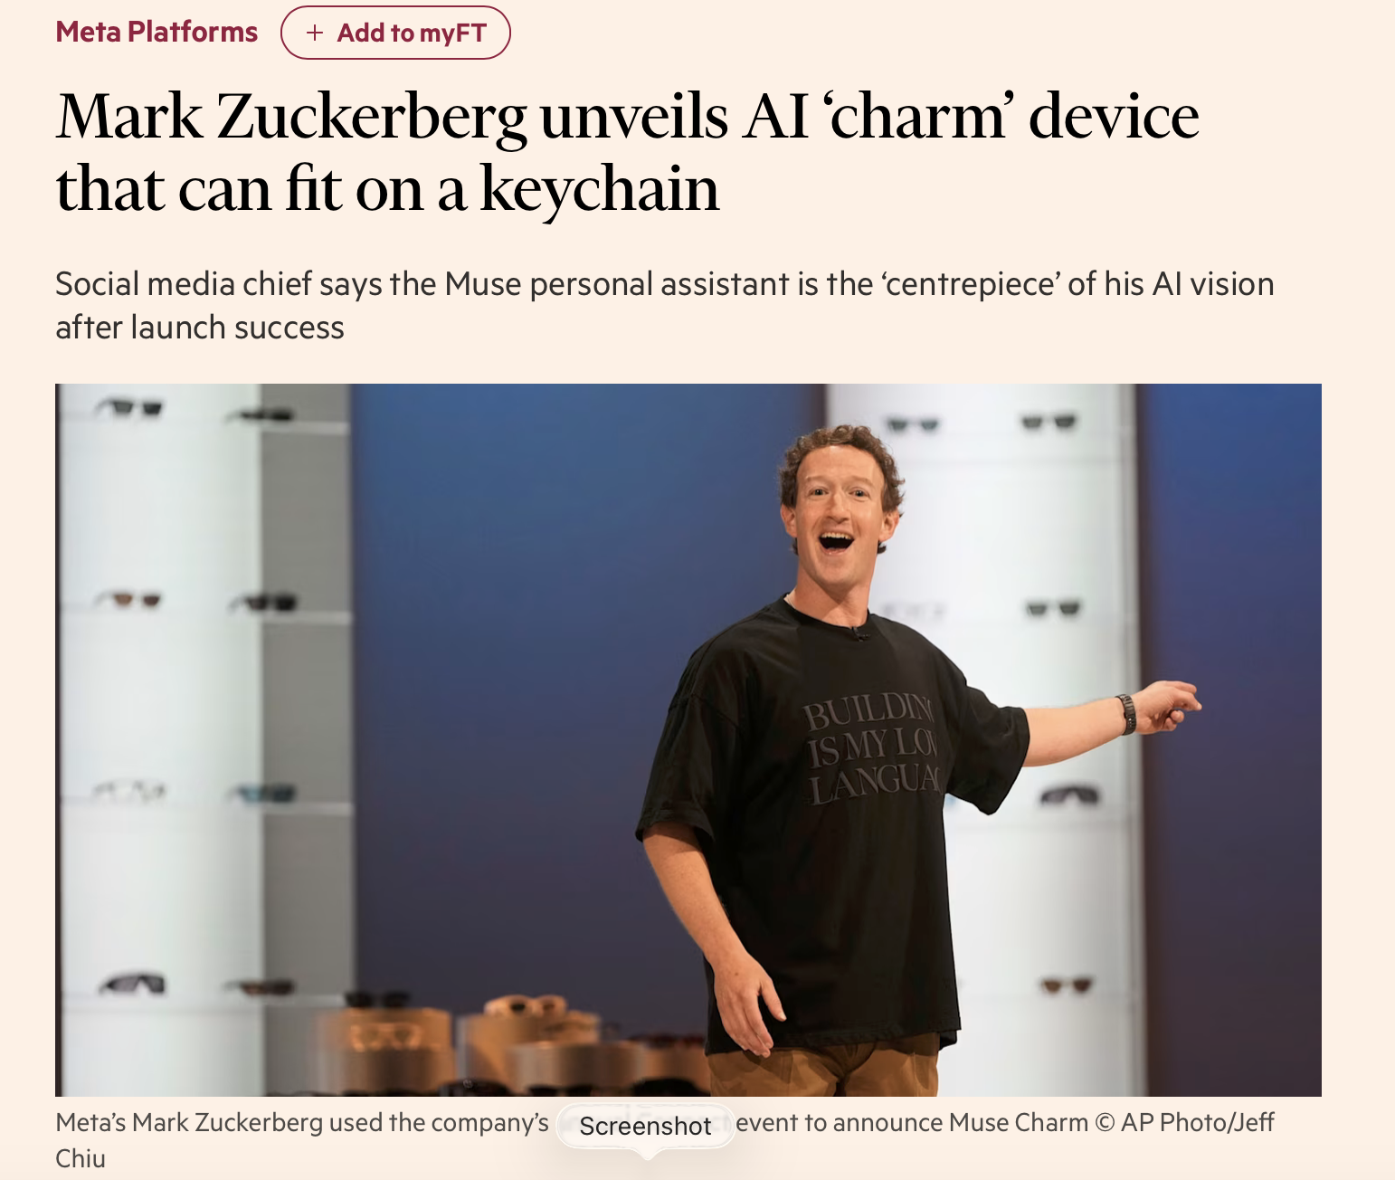

Slide 4
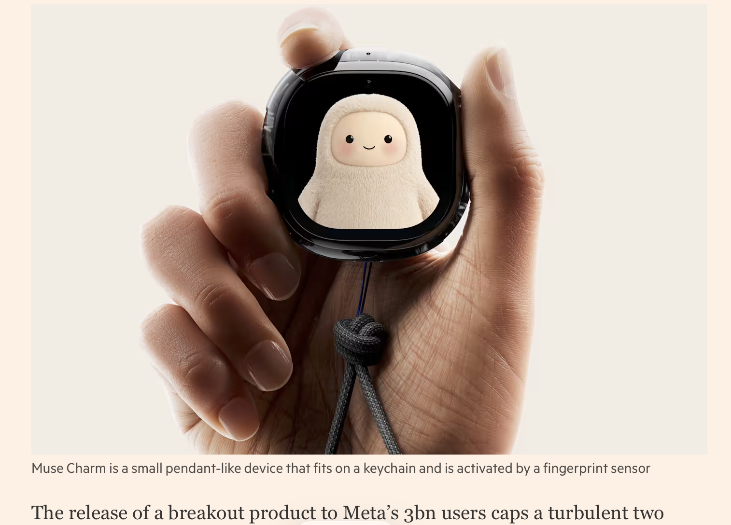

Slide 5


Slide 6
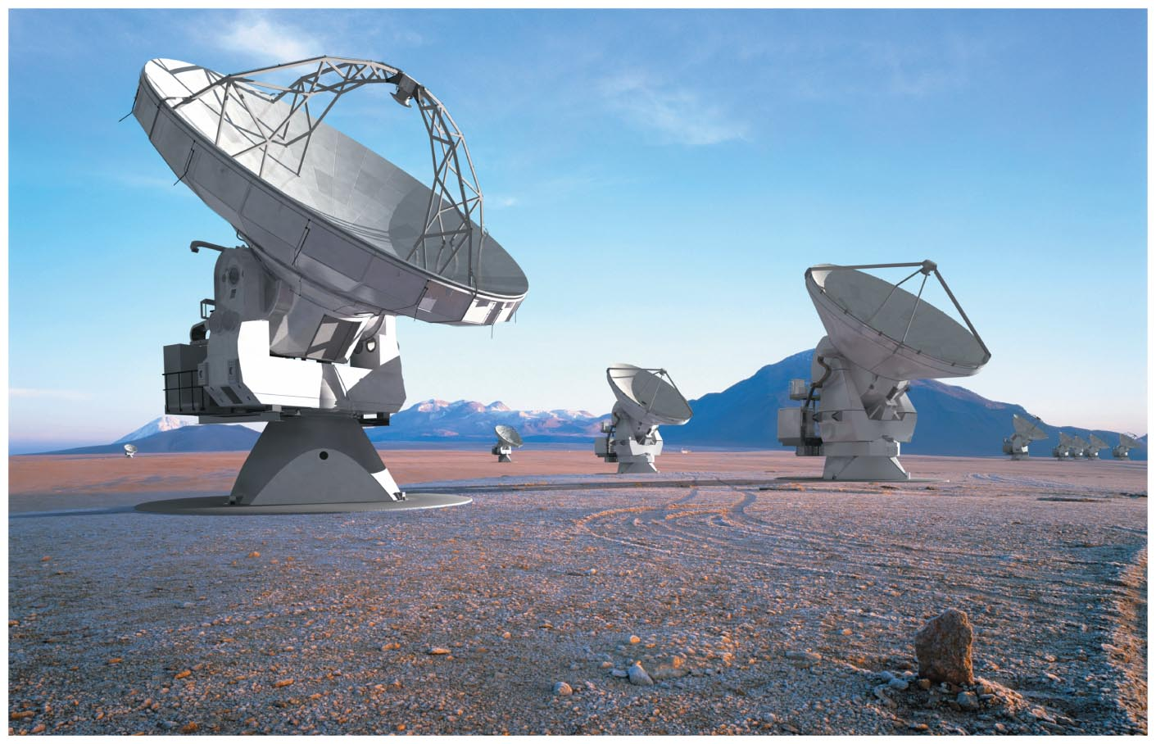
ALMA, the Atacama Large Millimeter Array
電磁波偵測天線陣列

Slide 7
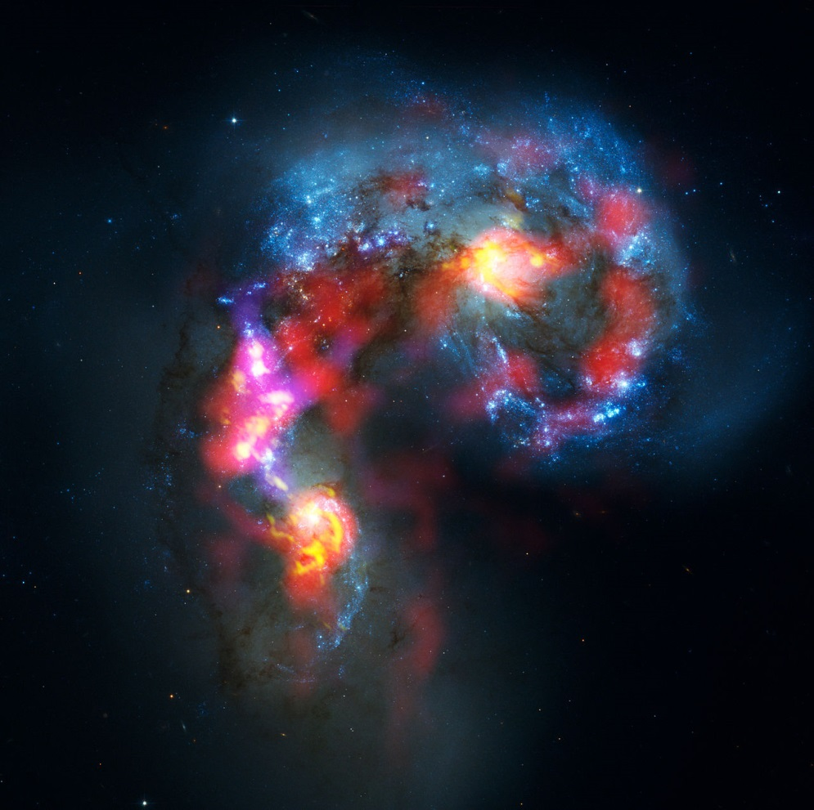
The Antennae Galaxies (also known as NGC 4038 and 4039) are a pair of distorted colliding spiral galaxies about 70 million light-years away, in the constellation of Corvus (The Crow)
電磁波孤獨旅行了七千萬光年的空間，七千萬年後才到達地球，
可以想見，此時，發出這些電磁波的星體，可能已不存在了。
是甚麼樣的機制，維持這些電磁波可以單獨旅行這麼久這麼遠？

Slide 8
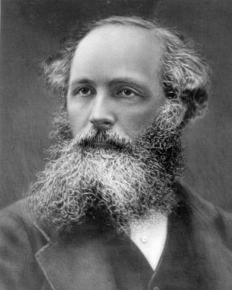
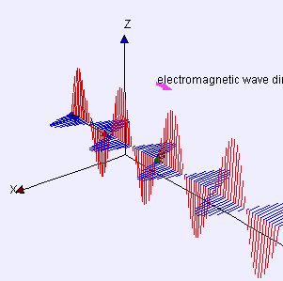
電磁波：電與磁的自動化
馬克思威爾及當時的科學家
many thanks to Fu-Kwun Hwang
James Clerk Maxwell (1831–1879)

Slide 9
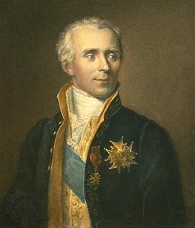
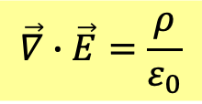
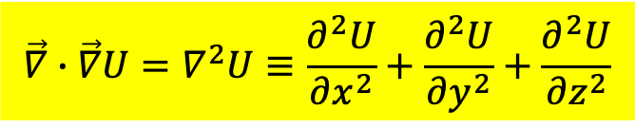

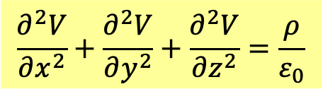
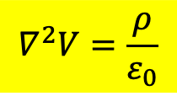
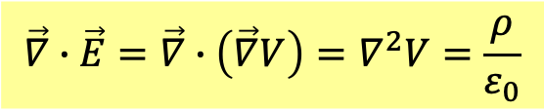
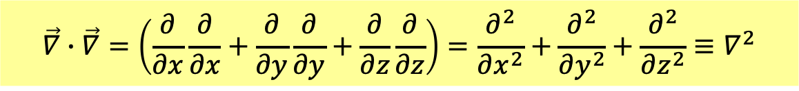
If $\vec{∇}$ acts like a vector, combining two $\vec{∇}$’s as inner product generates a scalar.
$$\vec{∇}∙\vec{∇}=\left(\frac{∂}{∂x}\frac{∂}{∂x}+\frac{∂}{∂y}\frac{∂}{∂y}+\frac{∂}{∂z}\frac{∂}{∂z}\right)=\frac{∂^{2}}{∂x^{2}}+\frac{∂^{2}}{∂y^{2}}+\frac{∂^{2}}{∂z^{2}}≡∇^{2}$$
This is an operation to be acted on functions.
$$\vec{∇}∙\vec{∇}U=∇^{2}U≡\frac{∂^{2}U}{∂x^{2}}+\frac{∂^{2}U}{∂y^{2}}+\frac{∂^{2}U}{∂z^{2}}$$
This operation is called Laplacian。
$$\vec{E}=\vec{∇}V$$
$$\vec{∇}∙\vec{E}=\frac{ρ}{ε_{0}}$$
Plug the first formula into the second：
$$\vec{∇}∙\vec{E}=\vec{∇}∙\left(\vec{∇}V\right)=∇^{2}V=\frac{ρ}{ε_{0}}$$
Pierre-Simon Laplace 1749-1827
Electric Potential satisfies Laplacian Equation!
$$∇^{2}V=\frac{ρ}{ε_{0}}$$
$$\frac{∂^{2}V}{∂x^{2}}+\frac{∂^{2}V}{∂y^{2}}+\frac{∂^{2}V}{∂z^{2}}=\frac{ρ}{ε_{0}}$$

Slide 10
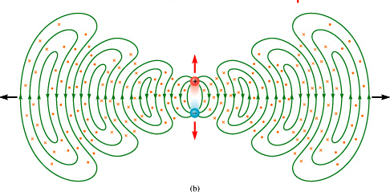
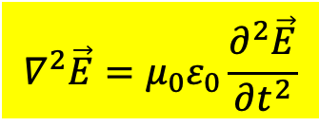
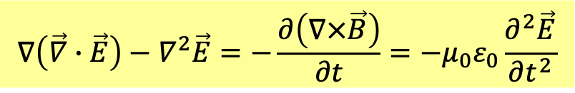
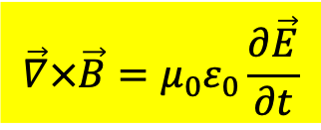

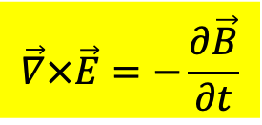
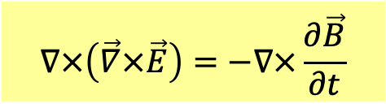


Using differential Maxwell Eq, EM wave equation is easy to derive.
Maxwell Equations in vacuum
$$\vec{∇}×\vec{E}=−\frac{∂\vec{B}}{∂t}$$
$$\vec{∇}×\vec{B}=μ_{0}ε_{0}\frac{∂\vec{E}}{∂t}$$
$$\vec{∇}∙\vec{E}=0$$
$$\vec{∇}∙\vec{B}=0$$
Spatial change of electric field is interrelated to temporal change of magnetic field.
$$∇×\left(\vec{∇}×\vec{E}\right)=−∇×\frac{∂\vec{B}}{∂t}$$
$$\vec{∇}×\left(\vec{∇}×\vec{F}\right)=\vec{∇}\left(\vec{∇}∙\vec{F}\right)−∇^{2}\vec{F}$$
Spatial change of magnetic field is interrelated to temporal change of electric field.
$$∇\left(\vec{∇}∙\vec{E}\right)−∇^{2}\vec{E}=−\frac{∂\left(∇×\vec{B}\right)}{∂t}=−μ_{0}ε_{0}\frac{∂^{2}\vec{E}}{∂t^{2}}$$
$$∇^{2}\vec{E}=μ_{0}ε_{0}\frac{∂^{2}\vec{E}}{∂t^{2}}$$
Wave Equation for Electric Field

Slide 11
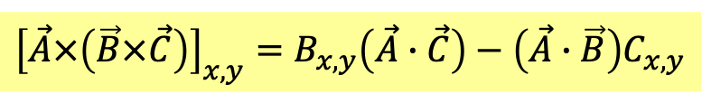
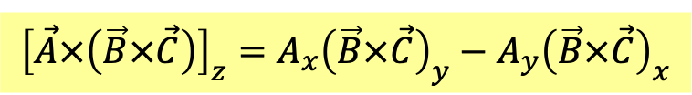



$$\vec{A}×\left(\vec{B}×\vec{C}\right)$$
Triple Prodcut
Calculate the components directly:
$${\left[\vec{A}×\left(\vec{B}×\vec{C}\right)\right]}_{z}=A_{x}{\left(\vec{B}×\vec{C}\right)}_{y}−A_{y}{\left(\vec{B}×\vec{C}\right)}_{x}$$
$$=A_{x}\left(B_{z}C_{x}−B_{x}C_{z}\right)−A_{y}\left(B_{y}C_{z}−B_{z}C_{y}\right)$$
$$=B_{z}\left(A_{x}C_{x}+A_{y}C_{y}\right)−\left(A_{x}B_{x}+A_{y}B_{y}\right)C_{z}$$
$$=B_{z}\left(A_{x}C_{x}+A_{y}C_{y}+A_{z}C_{z}\right)−\left(A_{x}B_{x}+A_{y}B_{y}+A_{z}B_{z}\right)C_{z}$$
$$=B_{z}\left(\vec{A}∙\vec{C}\right)−\left(\vec{A}∙\vec{B}\right)C_{z}$$
Similar Formula is true for the other two components of $\vec{A}×\left(\vec{B}×\vec{C}\right)$.
$${\left[\vec{A}×\left(\vec{B}×\vec{C}\right)\right]}_{x,y}=B_{x,y}\left(\vec{A}∙\vec{C}\right)−\left(\vec{A}∙\vec{B}\right)C_{x,y}$$
Write the expression in the notations of vectors.
$$\vec{A}×\left(\vec{B}×\vec{C}\right)=\vec{B}\left(\vec{A}∙\vec{C}\right)−\left(\vec{A}∙\vec{B}\right)\vec{C}$$
$$\vec{∇}×\left(\vec{∇}×\vec{F}\right)=\vec{∇}\left(\vec{∇}∙\vec{F}\right)−\left(\vec{∇}∙\vec{∇}\right)\vec{F}=\vec{∇}\left(\vec{∇}∙\vec{F}\right)−∇^{2}\vec{F}$$

Slide 12
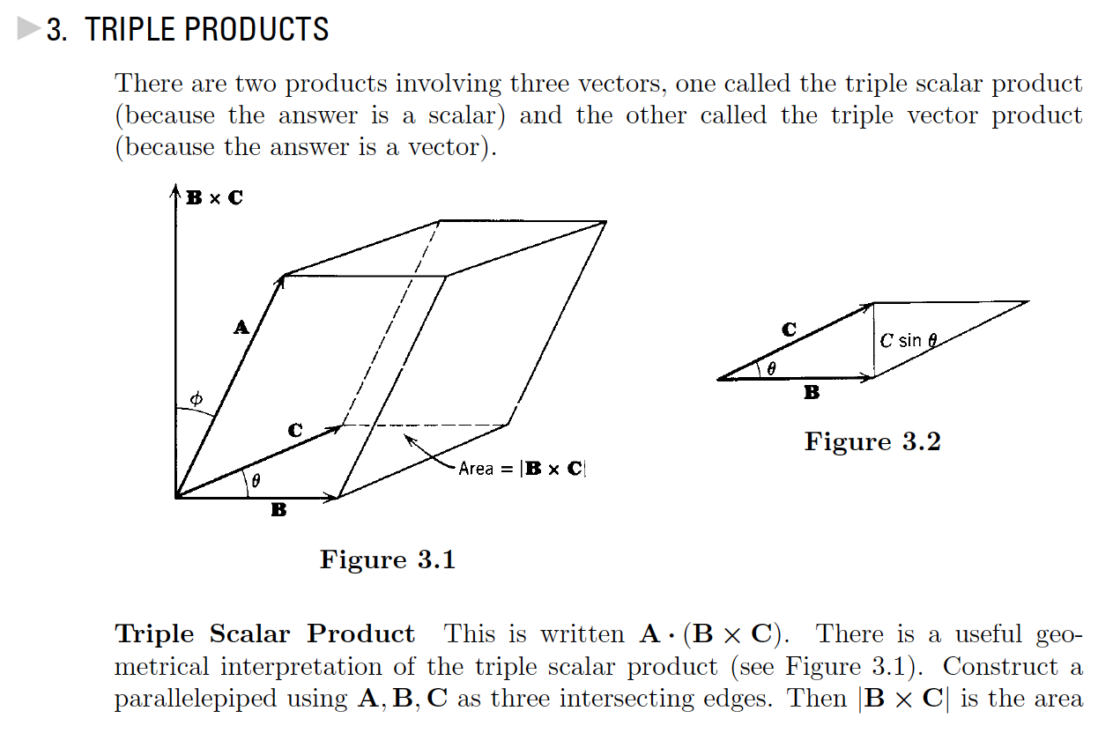
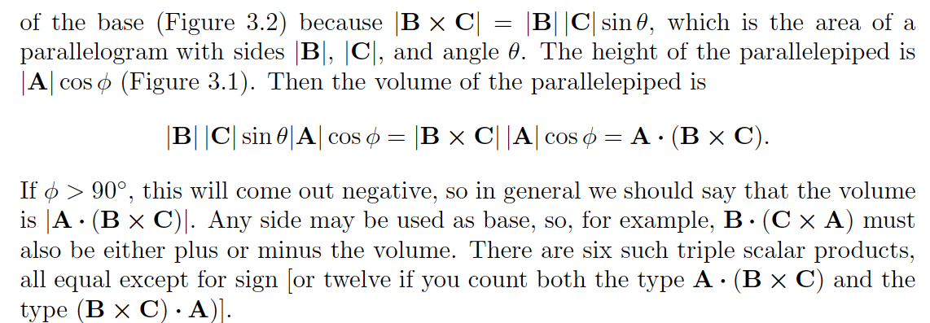

Slide 13
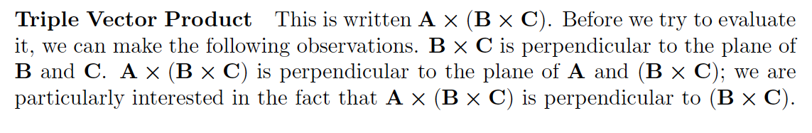
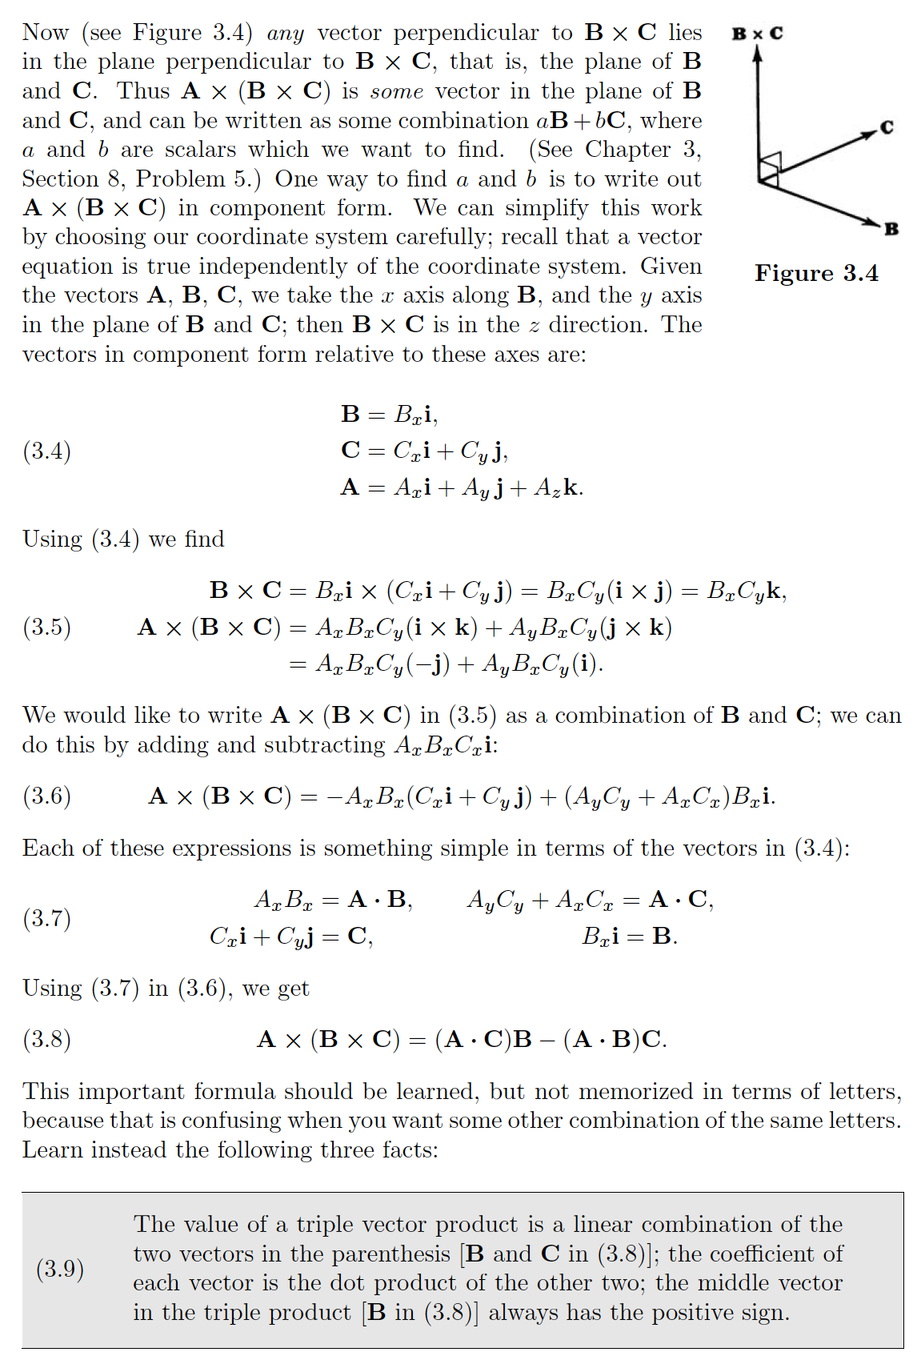

Slide 15
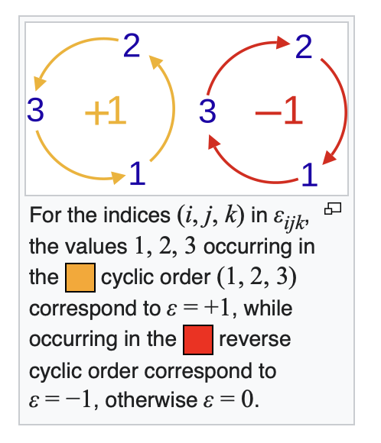
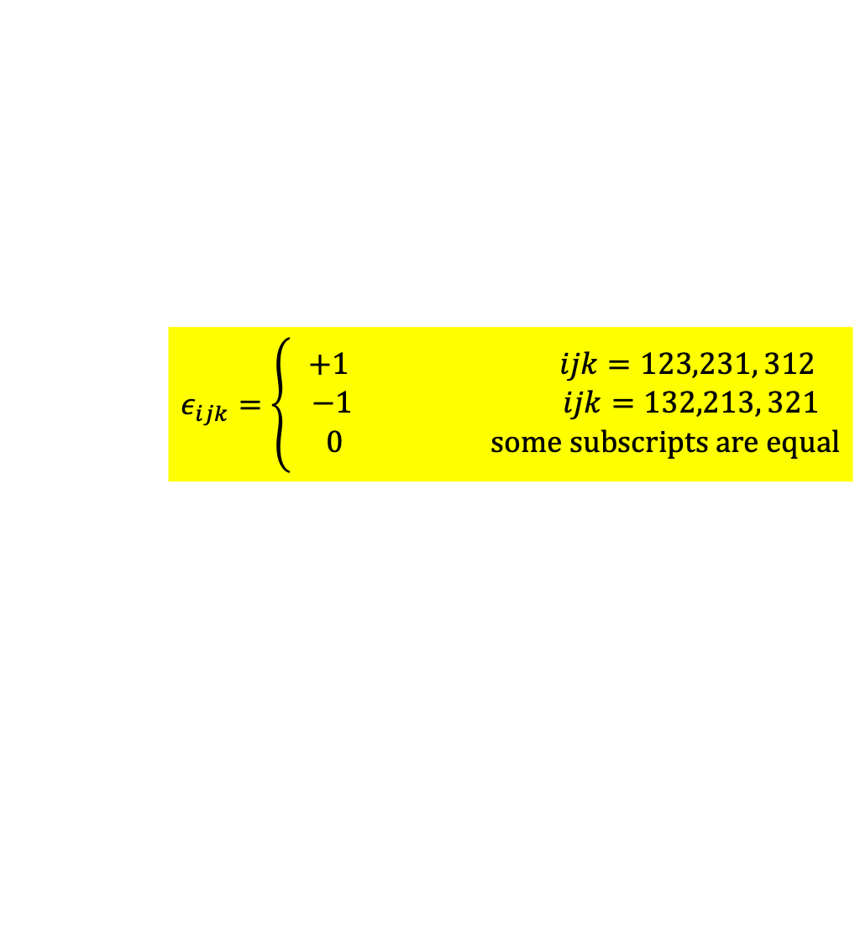
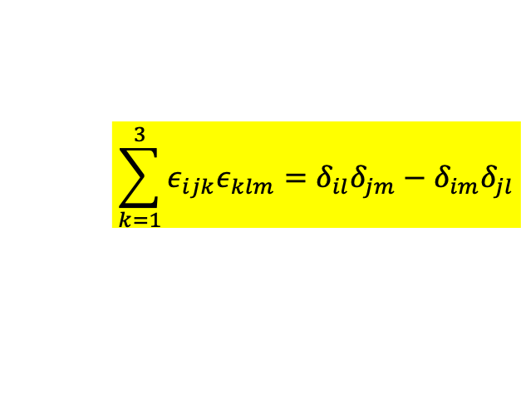
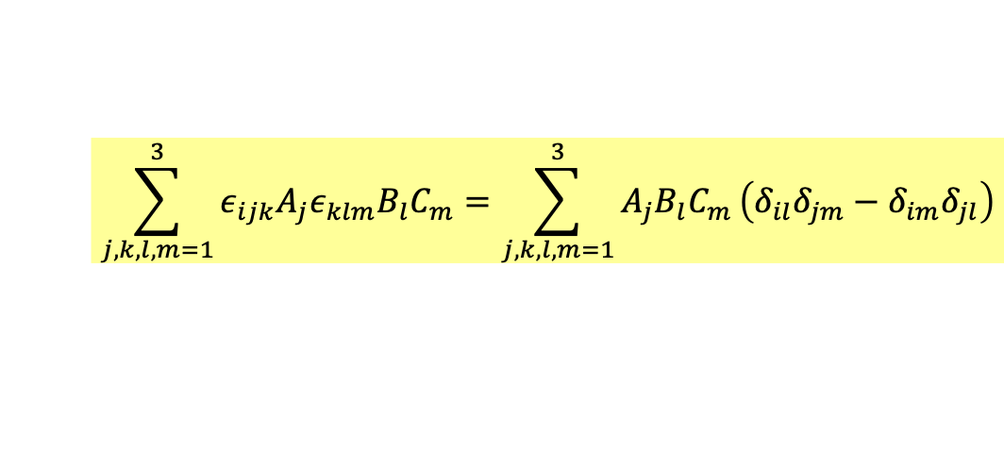

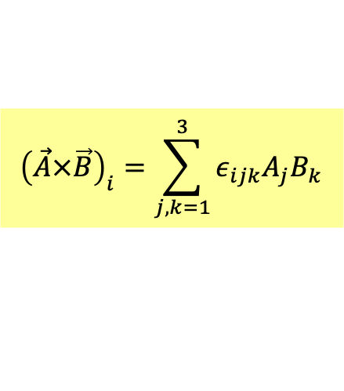
Another Proof: Levi-Civita Tensor
$$ε_{ijk}=\left\{\begin{matrix}+1 ijk=123,231, 312 \\ −1 ijk=132,213, 321 \\ 0 some subscripts are equal\end{matrix}\right.$$
$${\left(\vec{A}×\vec{B}\right)}_{i}=\sum_{j,k=1}^{3}{ε_{ijk}A_{j}B_{k}}$$
Levi-Civita Tensor滿足
$$\sum_{k=1}^{3}{ε_{ijk}ε_{klm}}=δ_{il}δ_{jm}−δ_{im}δ_{jl}$$
左式不為零，只能發生於$ij$與$lm$是$k$以外的兩個不同足標，
只能$i$與$l$同，$j$與$m$同$δ_{il}δ_{jm}$，或者$i$與$m$同，$j$與$l$同$−δ_{im}δ_{jl}$，
$k$求和時，只有一個足標，不同於$ij$者，會有貢獻，因此乘1。得證。
$$\sum_{j,k,l,m=1}^{3}{ε_{ijk}A_{j}ε_{klm}B_{l}C_{m}}=\sum_{j,k,l,m=1}^{3}{A_{j}B_{l}C_{m}}\left(δ_{il}δ_{jm}−δ_{im}δ_{jl}\right)$$
$$\vec{A}×\left(\vec{B}×\vec{C}\right)=\vec{B}\left(\vec{A}∙\vec{C}\right)−\left(\vec{A}∙\vec{B}\right)\vec{C}$$

Slide 16
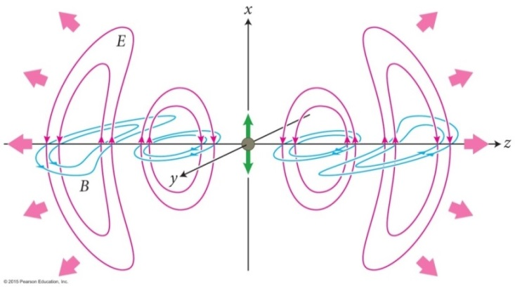
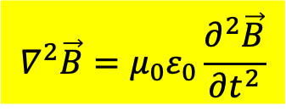
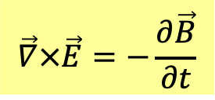
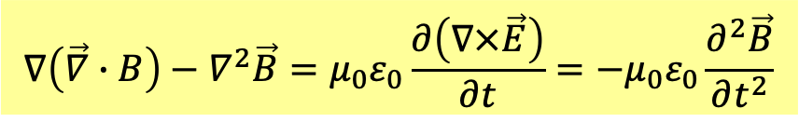

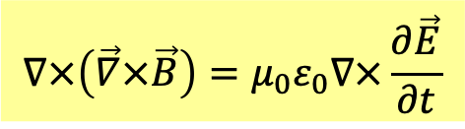
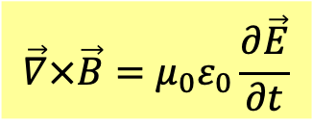

$$\vec{∇}×\vec{E}=−\frac{∂\vec{B}}{∂t}$$
$$\vec{∇}×\vec{B}=μ_{0}ε_{0}\frac{∂\vec{E}}{∂t}$$
$$\vec{∇}∙\vec{E}=0$$
$$\vec{∇}∙\vec{B}=0$$
$$∇×\left(\vec{∇}×\vec{B}\right)=μ_{0}ε_{0}∇×\frac{∂\vec{E}}{∂t}$$
$$∇\left(\vec{∇}∙B\right)−∇^{2}\vec{B}=μ_{0}ε_{0}\frac{∂\left(∇×\vec{E}\right)}{∂t}=−μ_{0}ε_{0}\frac{∂^{2}\vec{B}}{∂t^{2}}$$
$$∇^{2}\vec{B}=μ_{0}ε_{0}\frac{∂^{2}\vec{B}}{∂t^{2}}$$
Wave Equation for Magnetic Field

Slide 17
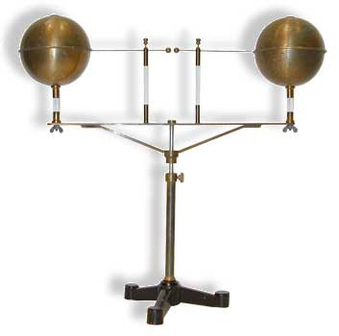
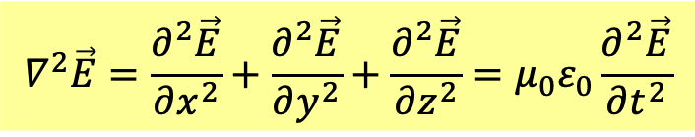
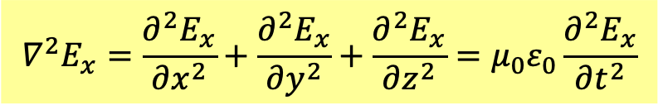
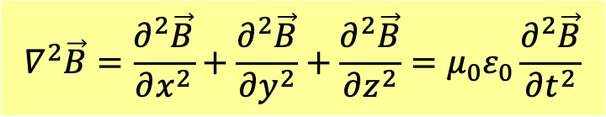
In vacuum, electromagnetic field only come from induction.
$\vec{E},\vec{B}$ both satisfy Wave Equation (no trace of charge and current)!
$$∇^{2}\vec{E}=\frac{∂^{2}\vec{E}}{∂x^{2}}+\frac{∂^{2}\vec{E}}{∂y^{2}}+\frac{∂^{2}\vec{E}}{∂z^{2}}=μ_{0}ε_{0}\frac{∂^{2}\vec{E}}{∂t^{2}}$$
$$∇^{2}\vec{B}=\frac{∂^{2}\vec{B}}{∂x^{2}}+\frac{∂^{2}\vec{B}}{∂y^{2}}+\frac{∂^{2}\vec{B}}{∂z^{2}}=μ_{0}ε_{0}\frac{∂^{2}\vec{B}}{∂t^{2}}$$
3D version of wave equation
The equations mean all the components of $\vec{E}$ and $\vec{B}$ satisfy wave equation, such as:
$$∇^{2}E_{x}=\frac{∂^{2}E_{x}}{∂x^{2}}+\frac{∂^{2}E_{x}}{∂y^{2}}+\frac{∂^{2}E_{x}}{∂z^{2}}=μ_{0}ε_{0}\frac{∂^{2}E_{x}}{∂t^{2}}$$
It could describe, for example, EM wave radiated from a dipole antenna.

Slide 18
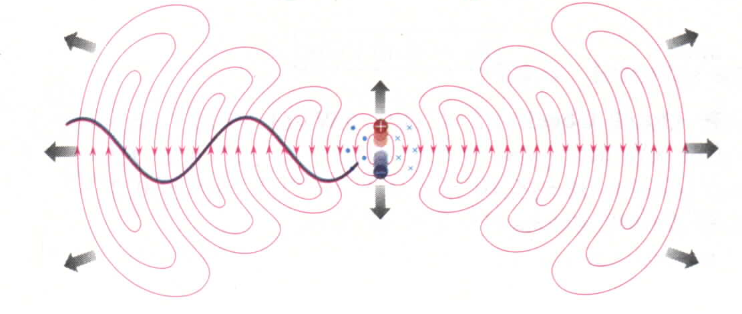
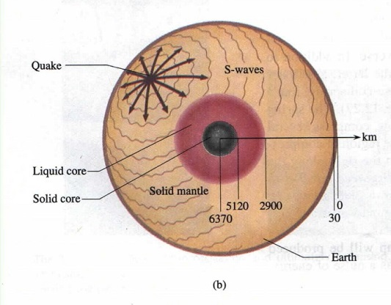
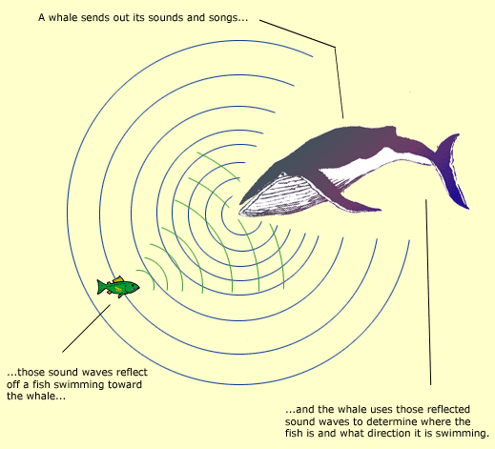
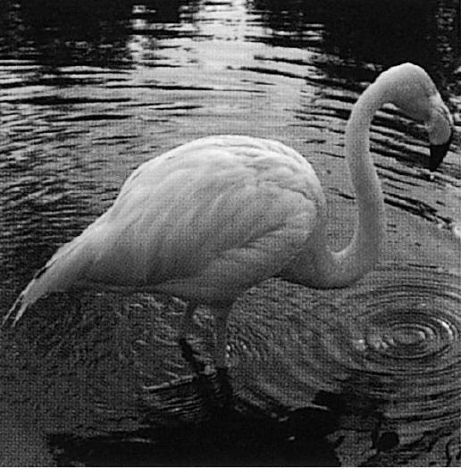
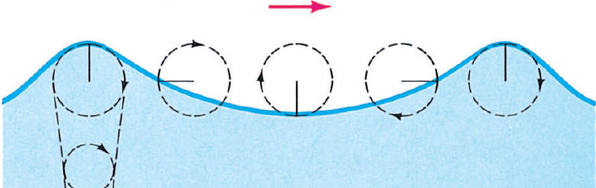
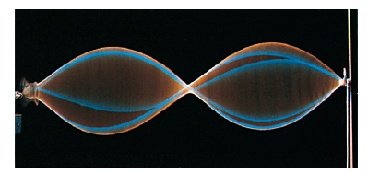
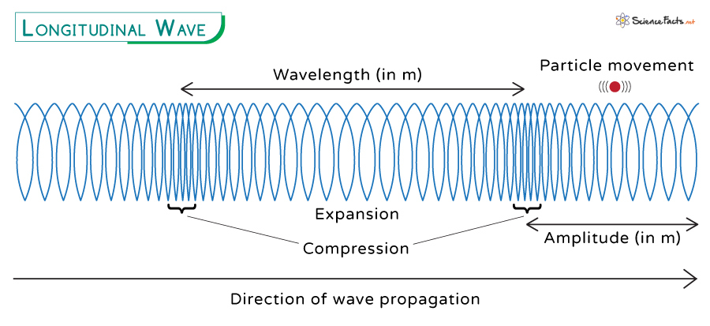
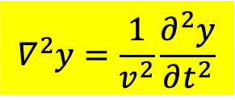
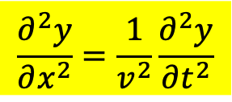
波方程式 Wave Equation
Equation of motion satisfied by all wave phenomena.
$$∇^{2}y=\frac{1}{v^{2}}\frac{∂^{2}y}{∂t^{2}}$$
$$\frac{∂^{2}y}{∂x^{2}}=\frac{1}{v^{2}}\frac{∂^{2}y}{∂t^{2}}$$
3D version
1D version
The above derivation is one of the greatest scientific achievements of all times. The electric and magnetic field can exist in vacuum without charge or current and they satisfy the same wave equation as string wave, sound wave and earth wave. The insights we learn from those waves will apply to electromagnetic wave as well.

Slide 19
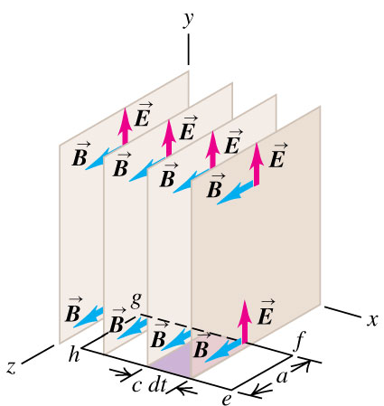





We will concentrate on the 1D version (not really in 1D).
Consider a special version of EM wave with $\vec{E}$ in $y$ and $\vec{B}$ in $z$ directions.
This wave will move in $x$ direction, and we allow $\vec{E},\vec{B}$ to be only $x$ dependent.
$$E_{y}\left(x,t\right),B_{z}\left(x,t\right)$$
They are constant on the $y−z$ plane, and this wave is called Plane Wave.
$$∇^{2}\vec{E}=\frac{∂^{2}\vec{E}}{∂x^{2}}+\frac{∂^{2}\vec{E}}{∂y^{2}}+\frac{∂^{2}\vec{E}}{∂z^{2}}=μ_{0}ε_{0}\frac{∂^{2}\vec{E}}{∂t^{2}}$$
$$\frac{∂^{2}E_{y}}{∂x^{2}}=μ_{0}ε_{0}\frac{∂^{2}E_{y}}{∂t^{2}}$$
$$∇^{2}\vec{B}=\frac{∂^{2}\vec{B}}{∂x^{2}}+\frac{∂^{2}\vec{B}}{∂y^{2}}+\frac{∂^{2}\vec{B}}{∂z^{2}}=μ_{0}ε_{0}\frac{∂^{2}\vec{B}}{∂t^{2}}$$
$$\frac{∂^{2}B_{z}}{∂x^{2}}=μ_{0}ε_{0}\frac{∂^{2}B_{z}}{∂t^{2}}$$

Slide 20






$$E_{y}\left(x,t\right),B_{z}\left(x,t\right)$$
$$\frac{∂^{2}E_{y}}{∂x^{2}}=μ_{0}ε_{0}\frac{∂^{2}E_{y}}{∂t^{2}}$$
$$\frac{∂^{2}B_{z}}{∂x^{2}}=μ_{0}ε_{0}\frac{∂^{2}B_{z}}{∂t^{2}}$$
$$\frac{∂^{2}φ}{∂x^{2}}=\frac{1}{v^{2}}\frac{∂^{2}φ}{∂t^{2}}$$
$$v=\frac{1}{\sqrt{μ_{0}ε_{0}}}$$
$v$ is the wave speed.
Electric field and Magnetic field satisfy wave equation and will wave like all waves!

Slide 21





EM Wave speed is determined by two constants in Maxwell equations.
$$v=\frac{1}{\sqrt{μ_{0}ε_{0}}}$$
$$=\frac{1}{\sqrt{1.26×{10}^{−6}∙8.85×{10}^{−12}}}\sim 2.99×{10}^{8}\text{m/s}$$
$$v=c$$
光速！！
Light is an electromagnetic wave.
馬克斯威爾統一了電磁學與光學！

Slide 22
Plane wave would be a good approximation of 3D EM wave on horizontal plane.

Slide 23


Slide 24


Slide 25


Slide 26


Slide 27




電磁波是依賴電磁感應，因此其電場與磁場必須互相垂直
波的傳播方向又與電場及磁場皆垂直。
會在空間中傳播的電磁場，方向及大小必須滿足特定關係！
$$\vec{S}=\frac{1}{μ_{0}}\vec{E}×\vec{B}$$
Poynting vector $\vec{S}$ 功率傳播向量，就是波傳播的方向。
右手定則

Slide 28



有分離的模式是因邊界條件：Boundary Condition 邊界條件，例如
$$φ\left(0,t\right)=φ\left(L,t\right)=0$$
導體的邊界對電場就會強制電場為零的邊界條件。

Slide 29



Consider a large number $N→∞$ of particles coupled by springs.
We will show equation of motion for coupled springs becomes wave equation.
$$N→∞,d→0$$
Continuous limit
Elastic continuous medium

Slide 30



For large number $N$ coupled springs: Equation of motion:
$$m\frac{d^{2}x_{j}}{dt^{2}}=−k\left(x_{j}−x_{j−1}\right)+k\left(x_{j+1}−x_{j}\right)$$
$$\frac{d^{2}X}{dt^{2}}=−A∙X=−ω_{0}^{2}\left(\begin{matrix}\begin{matrix}2 & −1 \\ −1 & 2\end{matrix} & \begin{matrix}0 & ⋯ \\ −1 & 0\end{matrix} & \begin{matrix}0 \\ 0\end{matrix} \\ \begin{matrix}0 & −1 \\ ⋮ & ⋮\end{matrix} & \begin{matrix}2 & −1 \\ ⋮ & ⋱\end{matrix} & \begin{matrix}0 \\ ⋮\end{matrix} \\ \begin{matrix}0 & 0\end{matrix} & \begin{matrix}0 & ⋯\end{matrix} & 2\end{matrix}\right)∙\left(\begin{matrix}\begin{matrix}x_{1} \\ ⋮\end{matrix} \\ \begin{matrix}x_{j} \\ \begin{matrix}⋮ \\ x_{N}\end{matrix}\end{matrix}\end{matrix}\right)$$
$x_{j}$ is the displacement of $j$th particle away from its original positions $jd.$
$$x_{j}$$

Slide 31






$$x$$
$$X≡\left(\begin{matrix}\begin{matrix}x_{1} \\ ⋮\end{matrix} \\ \begin{matrix}x_{j} \\ \begin{matrix}⋮ \\ x_{N}\end{matrix}\end{matrix}\end{matrix}\right)$$
When the number $N$ of particles is huge, column vector is no longer convenient.
We assign displacement $x_{j}$ of $j$th particle as a function of its original positions $jd$:
$$φ\left(jd\right)≡x_{j}, j=1⋯N$$
When $N→∞,d→0$, discreet locations becomes continuous variable $x$:
$$jd→x$$
$$φ\left(jd\right)=x_{j}→φ\left(x\right)$$
Now $φ\left(x\right)$ is displacement of the particle whose equilibrium position is $x$.
It is also time dependent: $φ\left(x,t\right)$.
We get a two-variable function, called wavefunction.

Slide 32












$$m\frac{d^{2}x_{j}}{dt^{2}}=+k\left(x_{j+1}−x_{j}\right)−k\left(x_{j}−x_{j−1}\right)$$
From the equation of motion of coupled springs,
we plug in the new notation:
$$φ\left(dj\right)≡x_{j}$$
$$m\frac{d^{2}φ\left(dj\right)}{dt^{2}}=+k\left(φ\left(dj+d\right)−φ\left(dj\right)\right)−k\left(φ\left(dj\right)−φ\left(dj−d\right)\right)$$
Divide the difference of displacements 𝜙 by the separation $d$.
$$=+kd\frac{∆φ\left(dj\right)}{d}−kd\frac{∆φ\left(dj−d\right)}{d}$$
Become derivatives as $d=∆x→0$.
$$→kd\left[\frac{dφ}{dx}\left(dj\right)−\frac{dφ}{dx}\left(dj−d\right)\right]$$
Difference of derivatives at neighboring sites.
$$=kd^{2}\frac{∆\frac{dφ}{dx}}{∆x}$$
It equals the derivative of derivative.
$$v≡\sqrt{\frac{kd}{m/d}}≡\sqrt{\frac{τ}{μ}}$$
$$=kd^{2}\frac{d^{2}φ}{dx^{2}}\left(dj\right)$$
Finally
$$\frac{d^{2}φ}{dt^{2}}\left(x\right)=\frac{kd^{2}}{m}\frac{d^{2}φ}{dx^{2}}\left(x\right)$$
$\frac{d^{2}φ}{dt^{2}}$ is differentiated as $x=dj$ is fixed, being partial differentiation $\frac{∂^{2}φ}{∂t^{2}}$.
Same for $\frac{d^{2}φ}{dx^{2}}$, differentiated with fixed $t$.
$$\frac{∂^{2}φ}{∂t^{2}}\left(x,t\right)=v^{2}\frac{∂^{2}φ}{∂x^{2}}\left(x,t\right)$$

Slide 33





彈性介質縱波的波方程式
$$\frac{∂^{2}φ}{∂x^{2}}＝\frac{1}{v^{2}}\frac{∂^{2}φ}{∂t^{2}}$$
彈性介質橫波的波方程式
$$\frac{∂^{2}y}{∂x^{2}}=\frac{μ}{τ}\frac{∂^{2}y}{∂t^{2}}$$
$$\frac{∂^{2}y}{∂x^{2}}=\frac{1}{v^{2}}\frac{∂^{2}y}{∂t^{2}}$$

Slide 34






Coupled Springs
Continuous limit
$$N→∞,d→0$$
Continuous medium wave
Electromagnetic Wave
and all other waves
Schrodinger Electron Wave

Slide 35



Solve Wave equation to find its solutions.
If nature follows wave equation, its solution describe natural phenomenon.
The first (easiest) of the two ways to solve wave equation:
$$\frac{∂^{2}y}{∂x^{2}}=\frac{1}{v^{2}}\frac{∂^{2}y}{∂t^{2}}$$
以下證明：這個方程式有以下的解：
$$f\left(x−vt\right)$$

Slide 36














$$\frac{∂^{2}y}{∂x^{2}}=\frac{1}{v^{2}}\frac{∂^{2}y}{∂t^{2}}$$
波方程式
Plug in the expression, which means it is only function of $x^{′}≡x−vt$.
$$y\left(x,t\right)=f\left(x−vt\right)=f\left(x′\right)$$
$$x^{′}≡x−vt$$
$$\frac{∂y}{∂x}=\frac{df}{dx′}∙\frac{dx^{′}}{dx}=\frac{df}{dx′}$$
fix $t$ and use chain rule.
$$\frac{dx^{′}}{dx}=1$$
with $t$ fixed
$$\frac{∂^{2}y}{∂x^{2}}=\frac{d}{dx}\frac{df}{dx′}=\frac{dx^{′}}{dx}∙\frac{d}{dx′}\frac{df}{dx′}=\frac{d^{2}f}{d{x′}^{2}}$$
$$\frac{∂y}{∂t}=\frac{df}{dx′}∙\frac{dx^{′}}{dt}=\frac{df}{dx′}∙\left(−v\right)$$
$$\frac{dx^{′}}{dt}=−v$$
fix $x$ and use chain rule.
with $x$ fixed
$$\frac{∂^{2}y}{∂t^{2}}=\frac{d}{dt}\frac{df}{dx′}∙\left(−v\right)=\frac{dx^{′}}{dt}∙\frac{d}{dx′}\frac{df}{dx′}∙\left(−v\right)=\frac{d^{2}f}{d{x′}^{2}}∙{\left(−v\right)}^{2}$$
$$\frac{∂^{2}y}{∂x^{2}}=\frac{1}{v^{2}}\frac{∂^{2}y}{∂t^{2}}$$
Indeed, what we guessed is a solution of wave equation！
$x^{′}$將時間與空間連鎖在一起，於是時間微分與空間微分也是連鎖的。

Slide 37








Function $f\left(x\right)$ is $t=0$ wave form at $t=0$。
$$y\left(x,t=0\right)=f\left(x−v∙0\right)=f\left(x\right)$$
$$t=0$$
$$vt$$
$$t$$
$$y\left(x,t\right)=y\left(x−vt,0\right)=f\left(x−vt\right)$$
Later time $t$, wave at $x$ equals wave at $t=0$ at location $x−vt$.
Hence $f\left(x−vt\right)$ means wave form $f\left(x\right)$ is moving at speed $v$ as we expected.
$$v$$

Slide 38


Slide 39



Slide 40







對照表
$$dj$$
$$N→∞,d→0$$
$$x$$
$$x_{j}\left(t\right)$$
Continuous limit
$$φ\left(dj,t\right)=φ\left(x,t\right)$$
Wave function
$$\frac{d^{2}X}{dt^{2}}=A∙X$$
$$\frac{∂^{2}φ}{∂t^{2}}\left(x,t\right)=v^{2}\frac{∂^{2}φ}{∂x^{2}}\left(x,t\right)$$
Wave Equation
This is a partial differential equation PDE.
Solutions: Oscillation Modes
?

Slide 41





方塊波：若電流突然產生，一段時間 T 後突然停止：
$$J$$
$$T$$
$$t$$
$$B,E$$
$$f\left(x\right)$$
$$cT$$
$$x$$
瞬間電流產生一個方塊狀波形的脈衝電磁場。

Slide 42






$$B,E$$
$$f\left(x\right)$$
$$cT$$
$$x$$
瞬間電流產生一個方塊狀波形的脈衝電磁場。
$$f\left(x−vt\right)$$
cT
此脈衝方塊波形的電磁場（前後都為零）將以定速 c 向前孤獨地傳播。
此脈衝在電流消失後還會在遠方繼續傳播！
此脈衝的電場與磁場是獨立於產生它們的電流而存在的！

Slide 43





正弦電磁波
$$E\left(x,t\right)=E_{m}\sin\left[k\left(x−vt\right)\right]＝E_{m}\sin\left(kx−ωt\right)$$
$$\frac{ω}{k}=fλ=c$$
$$f\left(x\right)=E_{m}\sin{kx}$$
$$E\left(x,t\right)=cB\left(x,t\right)$$
正弦電磁波中電場與磁場方向垂直，大小隨時隨地都成正比！

Slide 44



向 $−x$ 移動的波，$將 v 以 –v$取代即可
$$y\left(x,t\right)=g\left(x+vt\right)$$

Slide 45




疊加定理
波方程式是線性方程式：兩個波方程式的解的和依舊是波方程式的解：
$$\frac{∂^{2}y_{1}}{∂x^{2}}=\frac{1}{v^{2}}\frac{∂^{2}y_{1}}{∂t^{2}}$$
$$\frac{∂^{2}y_{2}}{∂x^{2}}=\frac{1}{v^{2}}\frac{∂^{2}y_{2}}{∂t^{2}}$$
$$\frac{∂^{2}\left(y_{1}+y_{2}\right)}{∂x^{2}}=\frac{1}{v^{2}}\frac{∂^{2}\left(y_{1}+y_{2}\right)}{∂t^{2}}$$
y₁+y₂依舊是波方程式的解：
兩個分立的波重疊時，只要將兩個波函數相加即可。
之後若又分立，原來重疊前的波型不變。

Slide 46


弦波波函數的最普遍解d'Alembert solution：
$$y\left(x,t\right)=f\left(x−vt\right)+g\left(x+vt\right)$$
$而 f (x)（g (x)）$即為向右（左）傳播的波的瞬間波型
The wave form propagates at constant wave speed.
The wave form does not change during propagation.
疊加定律
以上結果適用於任何滿足波方程式的波動現象！
Jean le Rond d'Alembert 1717-83

Slide 47



Propagating wave

Slide 48




波方程式其實是一群粒子的運動方程式。
它的唯一解是由所有粒子的初位置及初速度兩個起始條件完全決定。
在此這就對應：起始的弦位移$y\left(x,0\right)$，起始的弦垂直方向速度 $\frac{∂y}{∂t}\left(x,0\right)$。
由$y\left(x,0\right)$及$\frac{∂y}{∂t}\left(x,0\right)$正好可以解出這兩個函數：
$$y\left(x,0\right)=f\left(x\right)+g\left(x\right)$$
$$y\left(x,0\right),\frac{∂y}{∂t}\left(x,0\right)↔f\left(x\right),g\left(x\right)$$
$$\frac{∂y}{∂t}\left(x,0\right)=v\left[f^{′}\left(x\right)−g′\left(x\right)\right]$$
因此由$f\left(x\right),g\left(x\right)$得到滿足方程式及起始條件的唯一解：
$$y\left(x,t\right)=f\left(x−vt\right)+g\left(x+vt\right)$$

