Slide 1

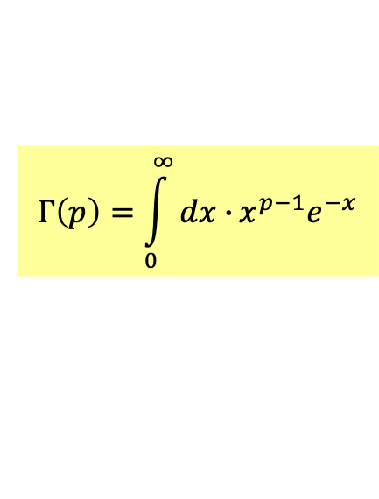
Gamma Function $Γ\left(x\right)$
This is one of the Special Functions.
Bessel function, Legendre function etc. would be a focus this semester.
Most of them are solutions of specific ordinary differential equations.
$$Γ\left(p\right)=\int_{0}^{∞}{dx∙}x^{p−1}e^{−x}$$
Gamma Function is defined as
It appears very often in physics
In Statistical Mechanics, we use it to compute averages in Boltzmann Distribution.

Slide 2

Baos Ch. 11

Slide 3
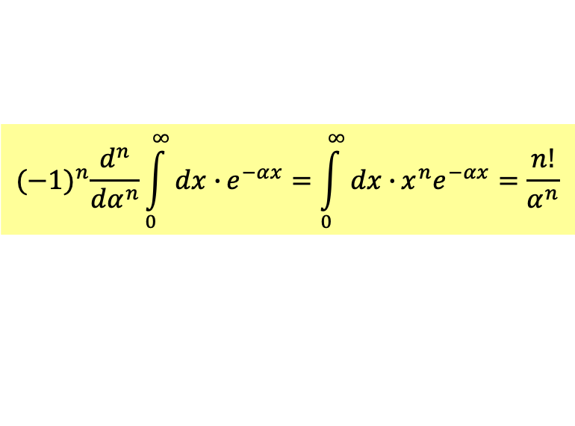

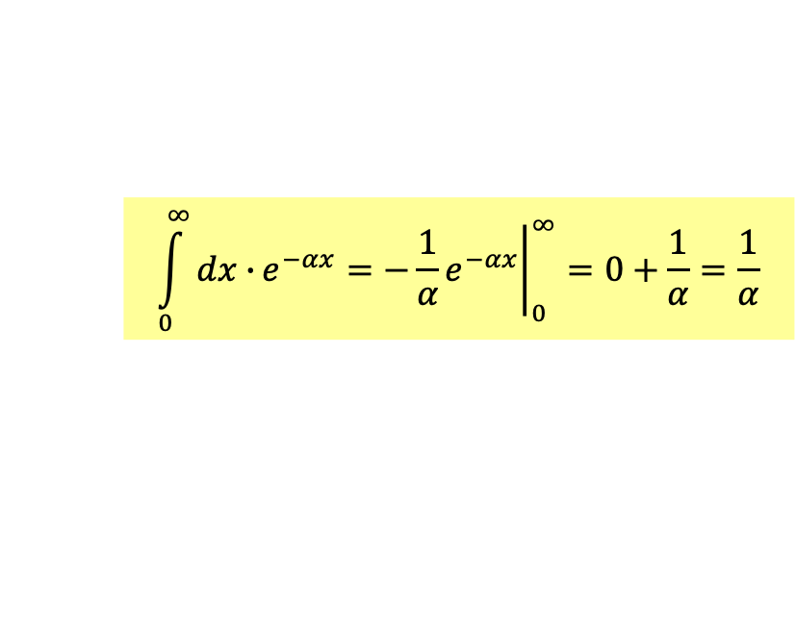
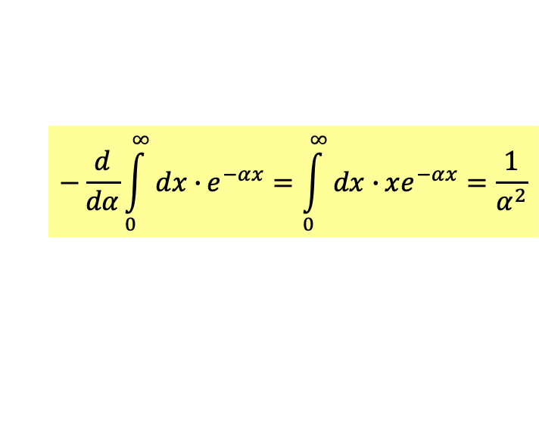
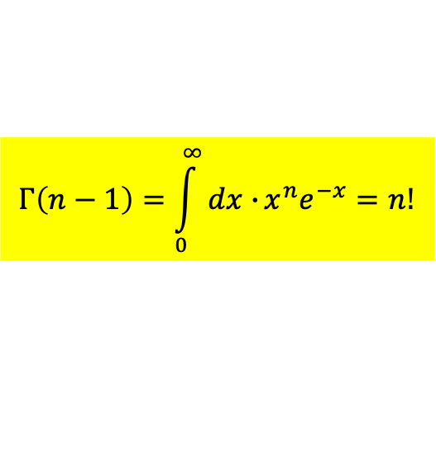

$$Γ\left(p\right)=\int_{0}^{∞}{dx∙}x^{p−1}e^{−x}$$
Let’s start with this simple calculation of $Γ\left(p\right)$ for integer $p$:
$$\int_{0}^{∞}{dx∙}e^{−αx}={\left.−\frac{1}{α}e^{−αx}\right|}_{0}^{∞}=0+\frac{1}{α}=\frac{1}{α}$$
Now differentiate the integral with respect to $−α$ once:
$$−\frac{d}{dα}\int_{0}^{∞}{dx∙}e^{−αx}=\int_{0}^{∞}{dx∙}xe^{−αx}=\frac{1}{α^{2}}$$
Differentiate the original integral with respect to $−α$ $n$ times:
$${(−1)}^{n}\frac{d^{n}}{dα^{n}}\int_{0}^{∞}{dx∙}e^{−αx}=\int_{0}^{∞}{dx∙}x^{n}e^{−αx}=\frac{n!}{α^{n}}$$
$$α=1$$
$$Γ\left(n−1\right)=\int_{0}^{∞}{dx∙}x^{n}e^{−x}=n!$$
Gamma Function of positive integral $n$ is $n$ factorial! What a surprise!

Slide 4




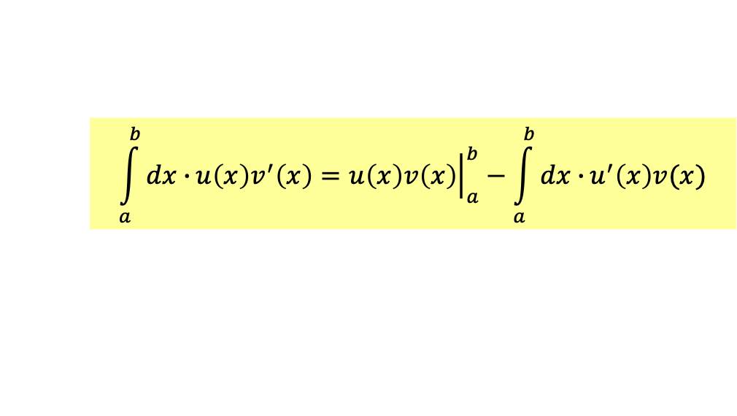


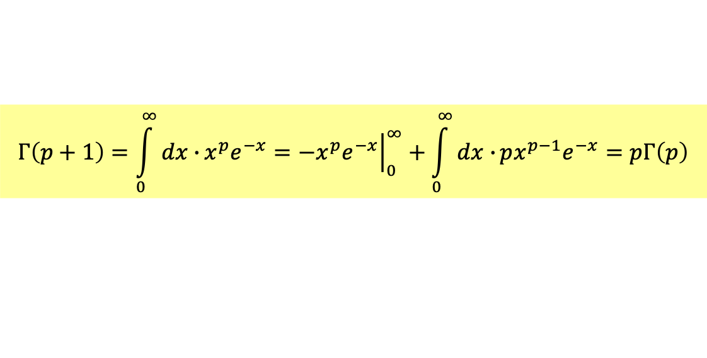
Indeed, we can prove from definition for any $p$ (not just integer $n$):
$$Γ\left(p+1\right)=pΓ\left(p\right)$$
The key equation of Gamma function.
Using integration by parts to compute the left-hand side:
$$\int_{a}^{b}{dx∙}u\left(x\right)v^{′}\left(x\right)={\left.u\left(x\right)v\left(x\right)\right|}_{a}^{b}−\int_{a}^{b}{dx∙}u^{′}\left(x\right)v(x)$$
$$Γ\left(p+1\right)=\int_{0}^{∞}{dx∙}x^{p}e^{−x}={\left.−x^{p}e^{−x}\right|}_{0}^{∞}+\int_{0}^{∞}{dx∙}px^{p−1}e^{−x}=pΓ\left(p\right)$$
Note that if we choose $p$ as a positive integer:
$$Γ\left(1\right)=\int_{0}^{∞}{dx∙}e^{−x}=1$$
Now apply the above formula, we can easily show:
$$Γ\left(2\right)=1Γ\left(1\right)=1$$
$$Γ\left(3\right)=2Γ\left(2\right)=2!$$
$$Γ\left(n−1\right)=n!$$
Gamma Function is $n$ factorial in disguise.

Slide 5
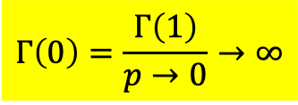
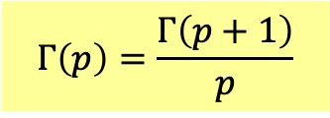
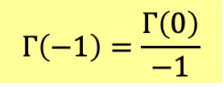
Gamma function is not always well-defined.
$$Γ\left(p\right)=\frac{Γ\left(p+1\right)}{p}$$
$$Γ\left(0\right)=\frac{Γ\left(1\right)}{p→0}→∞$$
Gamma Function is infinite and divergent at $p→0$.
$$Γ\left(−1\right)=\frac{Γ\left(0\right)}{−1}$$
Gamma Function is divergent at negative or zero integer $p≤0$.

Slide 6
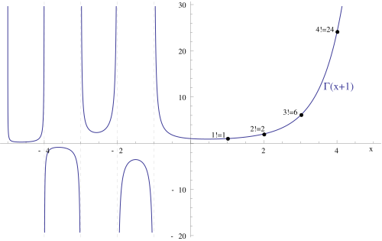
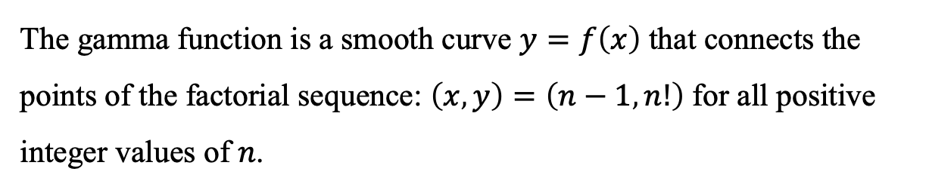


Could we can define Gamma Function for rational number (non-integer) $p$:
$$Γ\left(p\right)=\int_{0}^{∞}{dx∙}x^{p−1}e^{−x}$$
The answer is yes. This integral is finite for positive and real $p$.
Its value is smoothly extended to $n!$ at $p=n−1$
$$Γ\left(n−1\right)=n!$$
The gamma function is a smooth curve $y=f\left(x\right)$ that connects the points of the factorial sequence: $\left(x , y\right)=\left(n−1 , n!\right)$ for all positive integer values of ⁠$n$⁠.

Slide 7
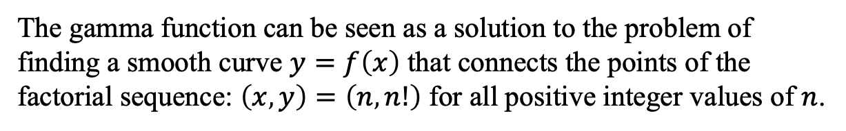
can be defined for any $p∈R$ except for non-positive integers.
The gamma function can be seen as a solution to the problem of finding a smooth curve $y=f\left(x\right)$ that connects the points of the factorial sequence: $\left(x , y\right)=\left(n , n!\right)$ for all positive integer values of ⁠$n$⁠.

Slide 8
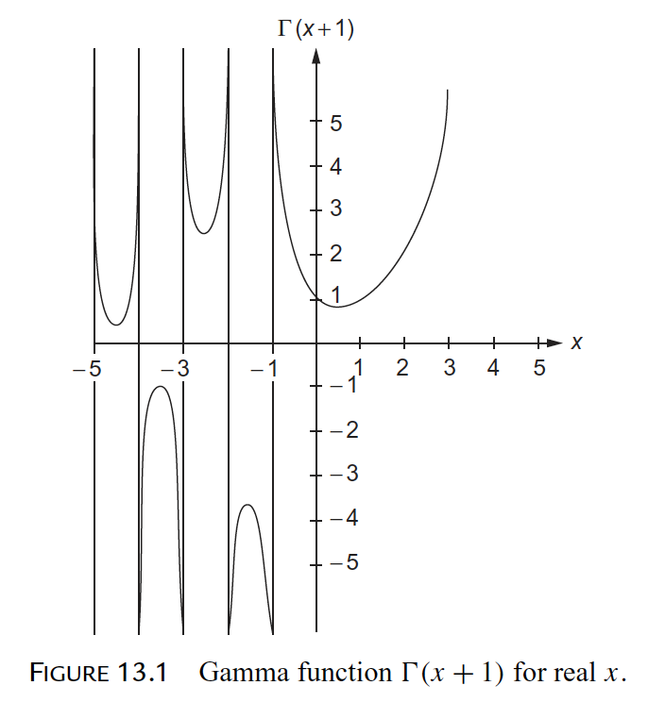
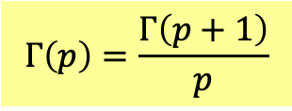

Remember $Γ\left(p\right)$ is divergent at negative integer $p<0$.
But $Γ\left(p\right)$ is defined at $−1<p<0$ using the values at $0<p<1$ and
$$Γ\left(p\right)=\frac{Γ\left(p+1\right)}{p}$$
and other intervals $−1−m<p<−m$ .

Slide 9





$$Γ\left(p+1\right)$$
$$p$$
$$Γ\left(p\right)=\int_{0}^{∞}{dx∙}x^{p−1}e^{−x}$$
$$Γ\left(n−1\right)=n!$$
$$Γ\left(p+1\right)=pΓ\left(p\right)$$

Slide 10
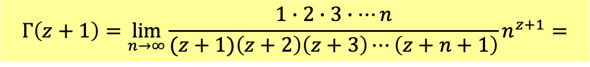
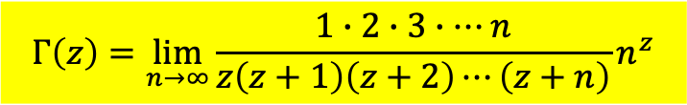

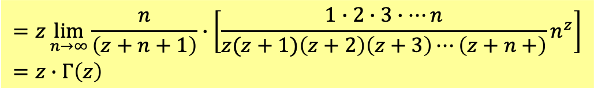
There are two calculable expression of Gamma function:
Euler:
$$Γ\left(z\right)=\lim_{n→∞}{\frac{1∙2∙3∙⋯n}{z\left(z+1\right)\left(z+2\right)⋯\left(z+n\right)}n^{z}}$$
We can check:
$$Γ\left(z+1\right)=\lim_{n→∞}{\frac{1∙2∙3∙⋯n}{(z+1)\left(z+2\right)\left(z+3\right)⋯\left(z+n+1\right)}n^{z+1}}=$$
$$=z\lim_{n→∞}{\frac{n}{\left(z+n+1\right)}∙\left[\frac{1∙2∙3∙⋯n}{z(z+1)\left(z+2\right)\left(z+3\right)⋯\left(z+n+\right)}n^{z}\right]}=z∙Γ\left(z\right)$$
We are sure this formula gives:
$$Γ\left(n−1\right)=n!$$
You can find a rigorous proof on P601 of Arfken.

Slide 11
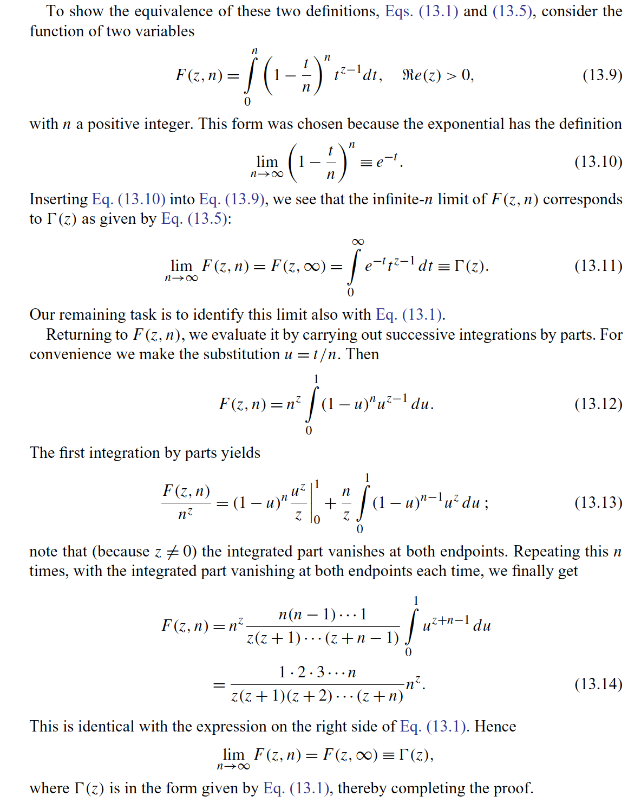

Slide 12
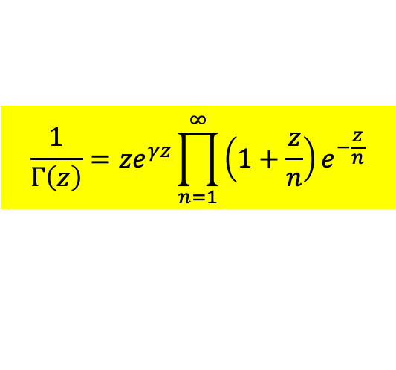
But Euler’s formula is still not easy to evaluate.
Infinite Product of Weierstrass:
$$\frac{1}{Γ\left(z\right)}=ze^{γz}\prod_{n=1}^{∞}{\left(1+\frac{z}{n}\right)}e^{−\frac{z}{n}}$$
Note that the expression in the infinite product is getting closer to $1$ as $n→∞$.
To a certain accuracy, we only need to include finite number of terms.
This expression is readily computable.

Slide 13
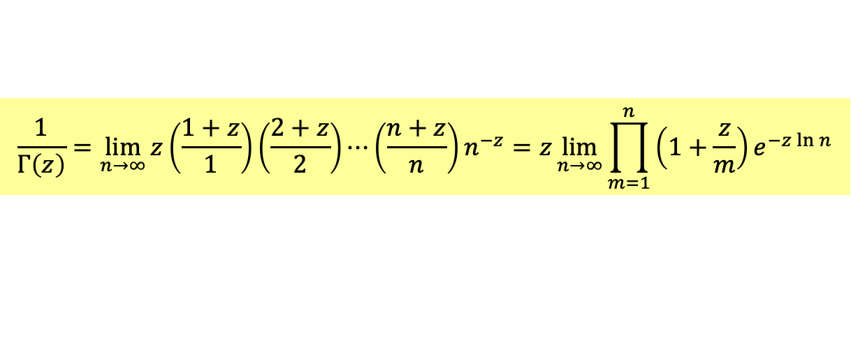
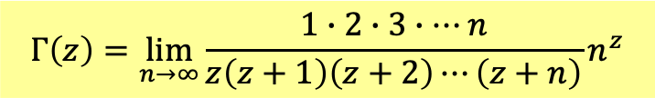
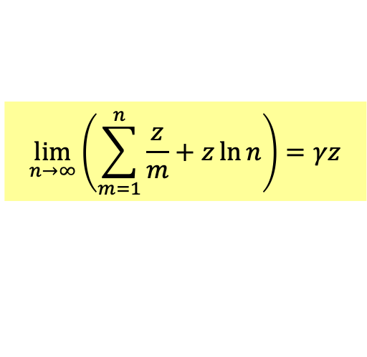
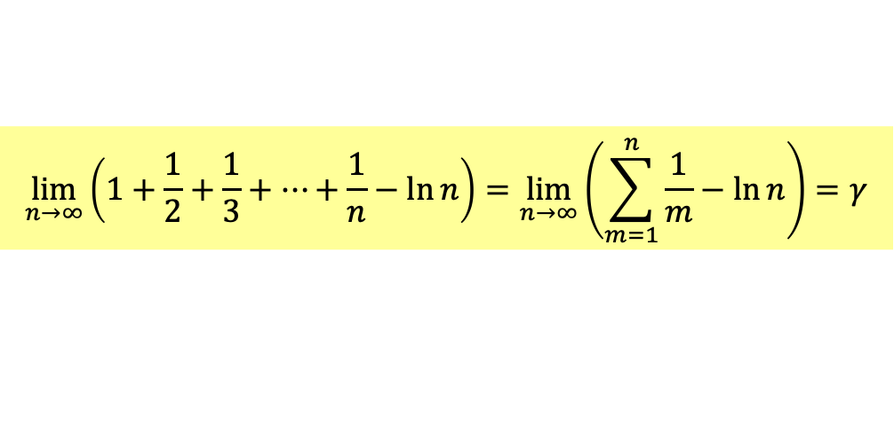
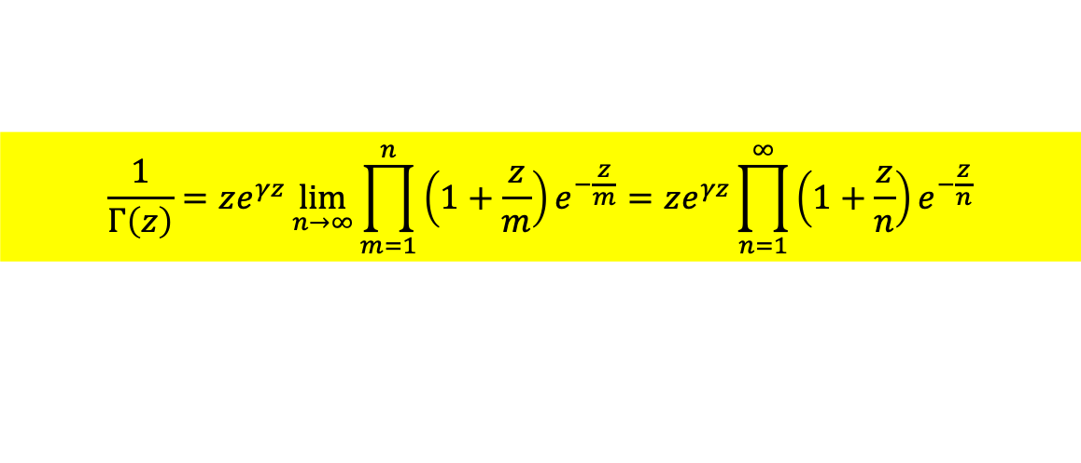
Take Euler’s Formula:
$$Γ\left(z\right)=\lim_{n→∞}{\frac{1∙2∙3∙⋯n}{z\left(z+1\right)\left(z+2\right)⋯\left(z+n\right)}n^{z}}$$
inverse it:
$$\frac{1}{Γ\left(z\right)}=\lim_{n→∞}{z\left(\frac{1+z}{1}\right)\left(\frac{2+z}{2}\right)⋯\left(\frac{n+z}{n}\right)n^{−z}}=z\lim_{n→∞}{\prod_{m=1}^{n}{\left(1+\frac{z}{m}\right)}e^{−z\ln{n}}}$$
$\ln{n}$ can be approximated by a series of $1/m$:
$$\lim_{n→∞}\left(1+\frac{1}{2}+\frac{1}{3}+⋯+\frac{1}{n}−\ln{n}\right)=\lim_{n→∞}\left(\sum_{m=1}^{n}{\frac{1}{m}}−\ln{n}\right)=γ$$
$$\lim_{n→∞}\left(\sum_{m=1}^{n}{\frac{z}{m}}+z\ln{n}\right)=γz$$
Plug this formula back, we proved Weierstrass’s formula is correct:
$$\frac{1}{Γ\left(z\right)}=ze^{γz}\lim_{n→∞}{\prod_{m=1}^{n}{\left(1+\frac{z}{m}\right)}e^{−\frac{z}{m}}}=ze^{γz}\prod_{n=1}^{∞}{\left(1+\frac{z}{n}\right)}e^{−\frac{z}{n}}$$

Slide 14
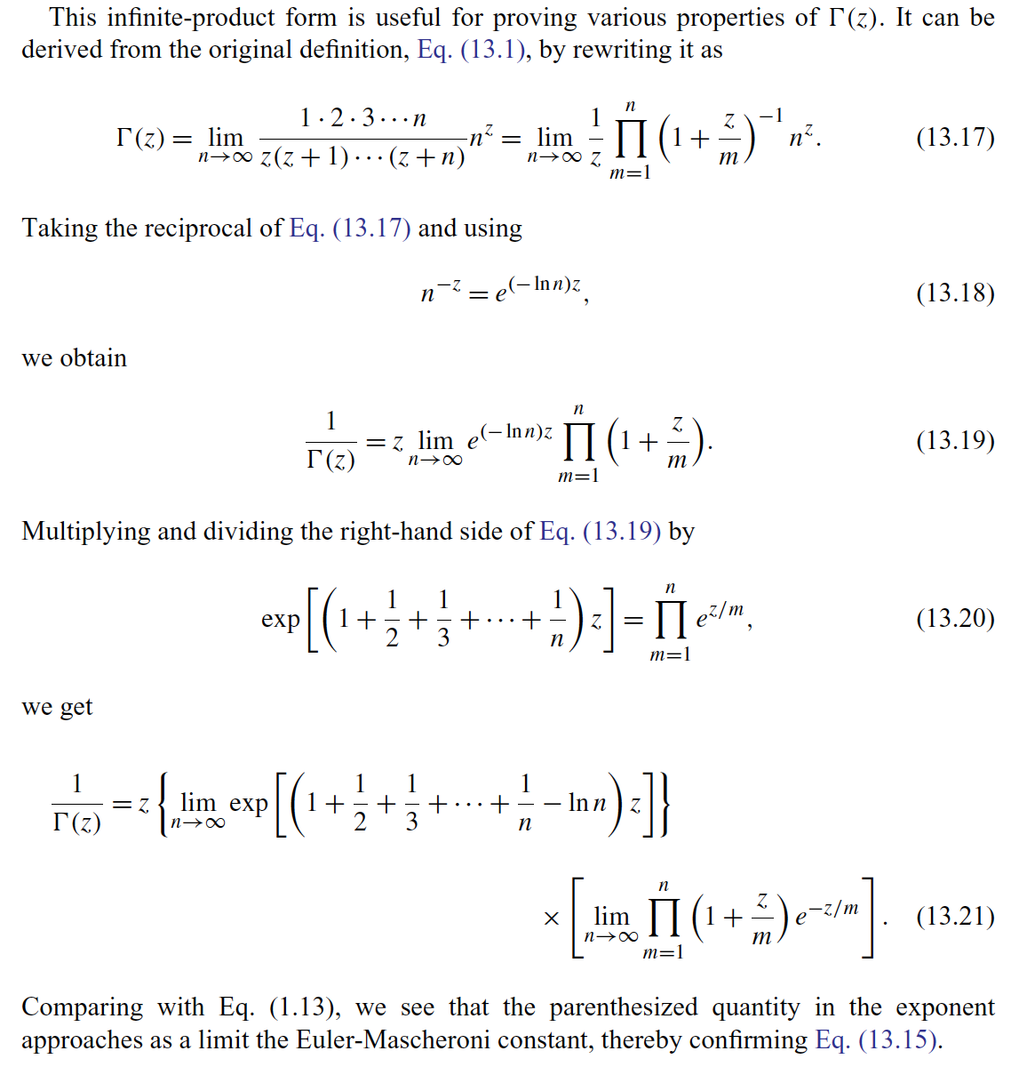
You can find a rigorous proof on P603 of Arfken.

Slide 15
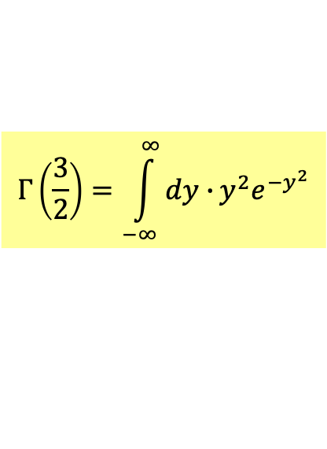
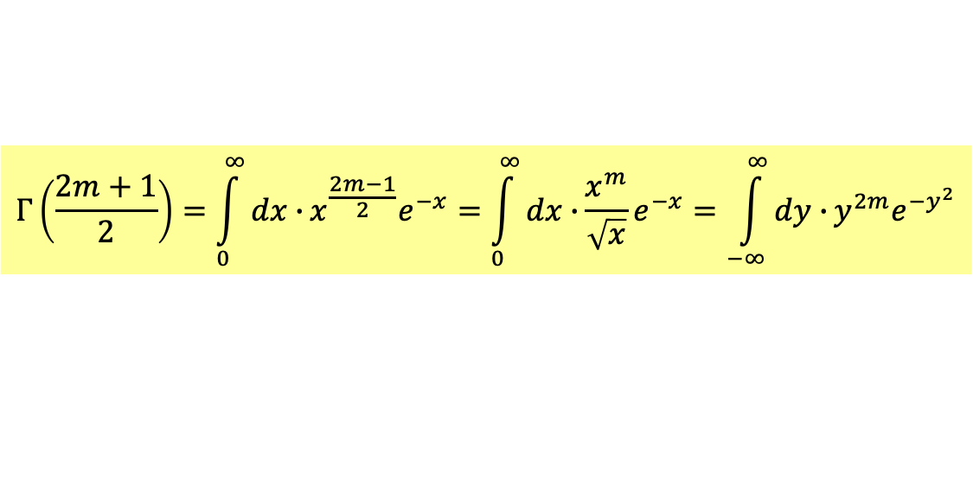
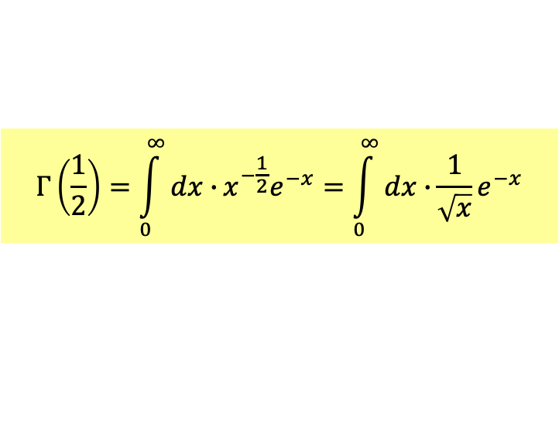
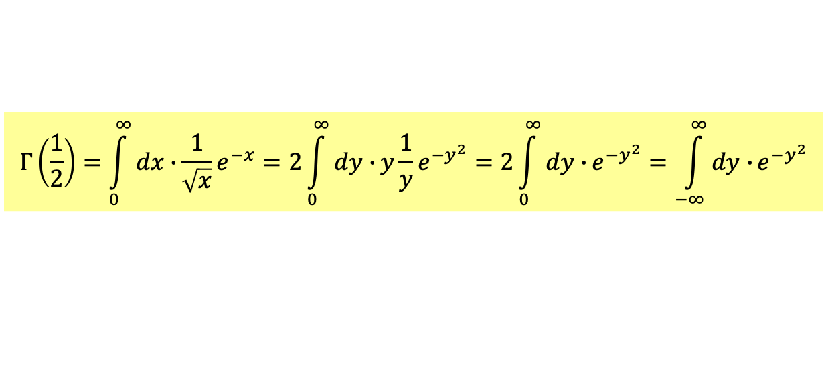

Gamma Functions at half integers $p=\frac{2m+1}{2}$ are especially useful:
$$Γ\left(\frac{1}{2}\right)=\int_{0}^{∞}{dx∙}x^{−\frac{1}{2}}e^{−x}=\int_{0}^{∞}{dx∙}\frac{1}{\sqrt{x}}e^{−x}$$
Change the variable to $x=y^{2}$.
$$Γ\left(\frac{1}{2}\right)=\int_{0}^{∞}{dx∙}\frac{1}{\sqrt{x}}e^{−x}=2\int_{0}^{∞}{dy∙}y\frac{1}{y}e^{−y^{2}}=2\int_{0}^{∞}{dy∙}e^{−y^{2}}=\int_{−∞}^{∞}{dy∙}e^{−y^{2}}$$
$Γ\left(\frac{1}{2}\right)$ is the integral of the Gaussian distribution.
For the general case:
$$Γ\left(\frac{2m+1}{2}\right)=\int_{0}^{∞}{dx∙}x^{\frac{2m−1}{2}}e^{−x}=\int_{0}^{∞}{dx∙}\frac{x^{m}}{\sqrt{x}}e^{−x}=\int_{−∞}^{∞}{dy∙}y^{2m}e^{−y^{2}}$$
We’ll use $Γ\left(\frac{3}{2}\right)$ very soon.
$$Γ\left(\frac{3}{2}\right)=\int_{−∞}^{∞}{dy∙}y^{2}e^{−y^{2}}$$

Slide 16
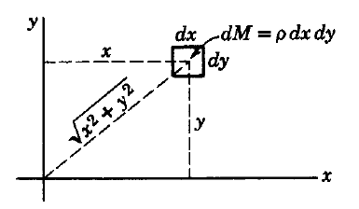
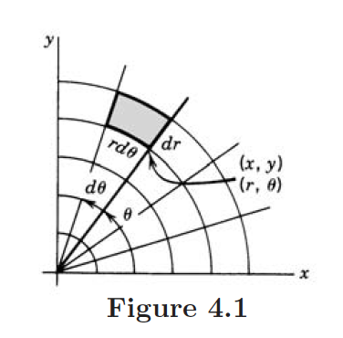



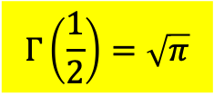
To compute integral of Gaussian distribution, multiply two $Γ\left(\frac{1}{2}\right)$ together.
$$\int_{−∞}^{∞}{dx∙}e^{−x^{2}}\int_{−∞}^{∞}{dy∙}e^{−y^{2}}=Γ\left(\frac{1}{2}\right)Γ\left(\frac{1}{2}\right)=\int_{−∞}^{∞}{dxdy∙}e^{−\left(x^{2}+y^{2}\right)}$$
It equals surface integral on $x−y$ plane, Baos P242-245,
and we can change to polar coordinates.
$$=\int_{0}^{∞}{dr∙}\int_{0}^{2π}{rdθ}e^{−r^{2}}=2π\int_{0}^{∞}{rdr∙e^{−r^{2}}}$$
Baos p258
$$=π\int_{0}^{∞}{d(r^{2})∙e^{−r^{2}}}=π\int_{0}^{∞}{dt∙e^{−t}}=π$$
$$Γ\left(\frac{1}{2}\right)=\sqrt{π}$$

Slide 17
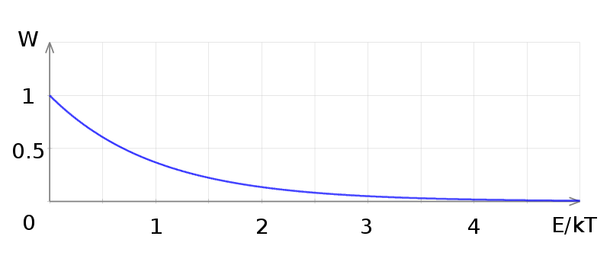



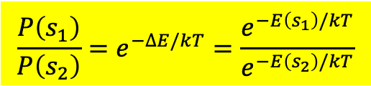
Boltzmann Distribution分布或Canonical Distribution正則分布
$$\frac{P\left(s_{1}\right)}{P\left(s_{2}\right)}=e^{−∆E/kT}=\frac{e^{−E\left(s_{1}\right)/kT}}{e^{−E\left(s_{2}\right)/kT}}$$
或
$$P∝e^{−E/kT}$$
Boltzmann Factor
一個系統在定溫下，出現在一特定狀態的機率正比於Boltzmann Factor。
完全由溫度與能量就可以決定！和其他細節完全無關。
$$P$$
熱平衡真是有強迫性！此圖適用於任何系統！
$$E≫KT, P≪1$$

Slide 18
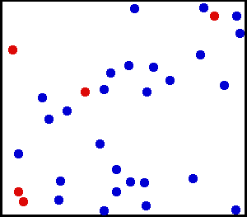
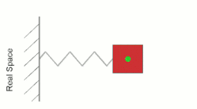

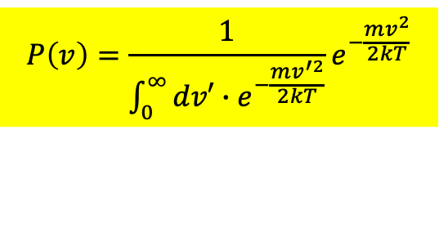
Consider a SHO in an environment of temperature $T$.
It means SHO interacts constantly and randomly with particles in environment.
The probability $P\left(v\right)$ of finding SHO to have velocity $v$ is $∝$ Boltzmann Factor：
$$P\left(v\right)∝e^{−E/kT}∝e^{−\frac{mv^{2}}{2kT}}$$
The total probability $P\left(v\right)$ equals one.
Hence, we divide $e^{−\frac{mv^{2}}{2kT}}$ by its integration over all possible velocity to get $P\left(v\right)$.
$$P\left(v\right)=\frac{1}{\int_{0}^{∞}{dv′∙e^{−\frac{mv^{′2}}{2kT}}}}e^{−\frac{mv^{2}}{2kT}}$$

Slide 19
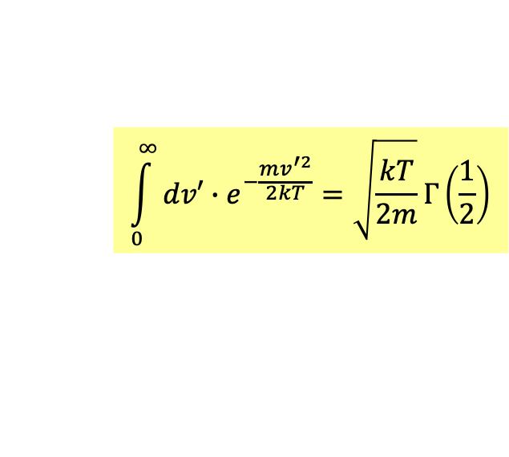
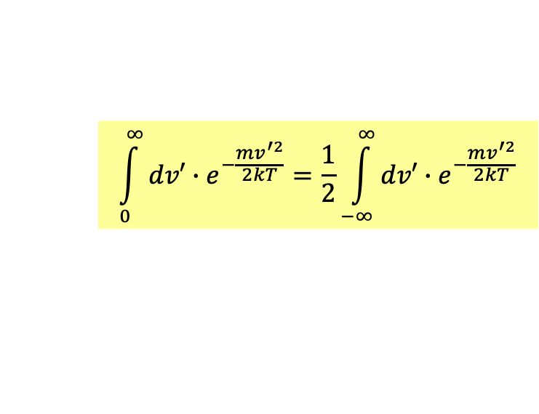
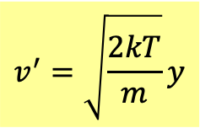
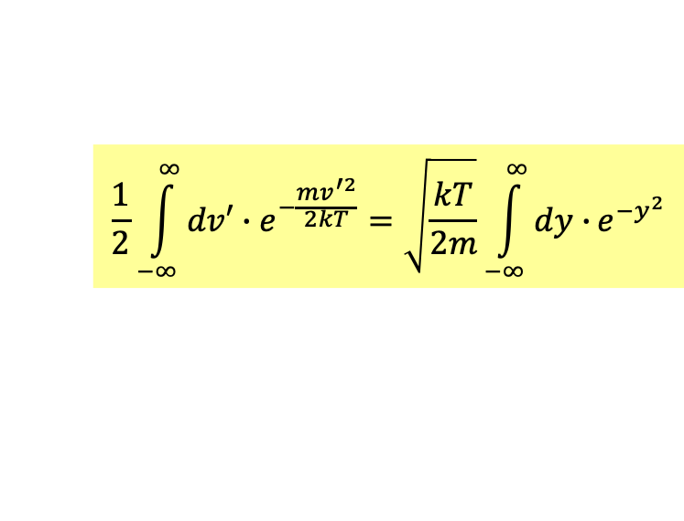
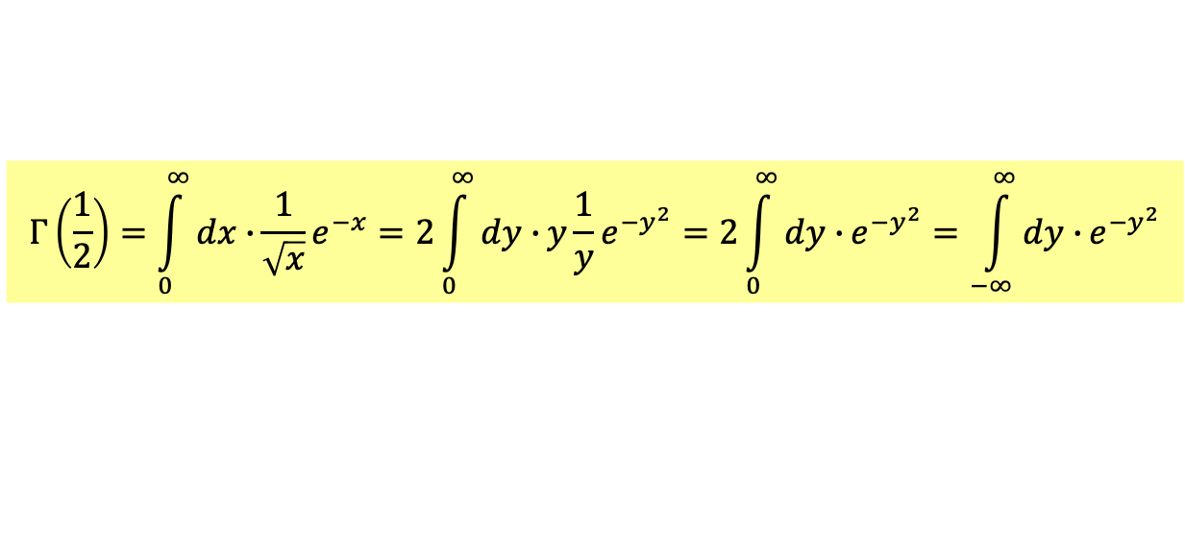
$$\int_{0}^{∞}{dv′∙e^{−\frac{mv^{′2}}{2kT}}}=\frac{1}{2}\int_{−∞}^{∞}{dv′∙e^{−\frac{mv^{′2}}{2kT}}}$$
This integration is integration of Gaussian function and hence is just $Γ\left(\frac{1}{2}\right)$.
$$Γ\left(\frac{1}{2}\right)=\int_{0}^{∞}{dx∙}\frac{1}{\sqrt{x}}e^{−x}=2\int_{0}^{∞}{dy∙}y\frac{1}{y}e^{−y^{2}}=2\int_{0}^{∞}{dy∙}e^{−y^{2}}=\int_{−∞}^{∞}{dy∙}e^{−y^{2}}$$
We just need to change variable:
$$\frac{1}{2}\int_{−∞}^{∞}{dv′∙e^{−\frac{mv^{′2}}{2kT}}}=\sqrt{\frac{kT}{2m}}\int_{−∞}^{∞}{dy∙}e^{−y^{2}}$$
$$v^{′}=\sqrt{\frac{2kT}{m}}y$$
$$\int_{0}^{∞}{dv′∙e^{−\frac{mv^{′2}}{2kT}}}=\sqrt{\frac{kT}{2m}}Γ\left(\frac{1}{2}\right)$$

Slide 20
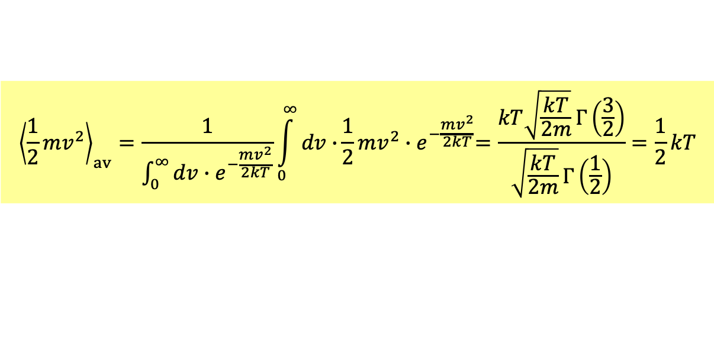
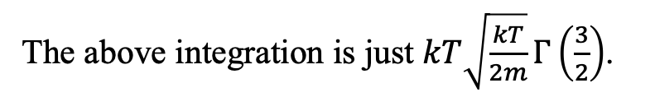
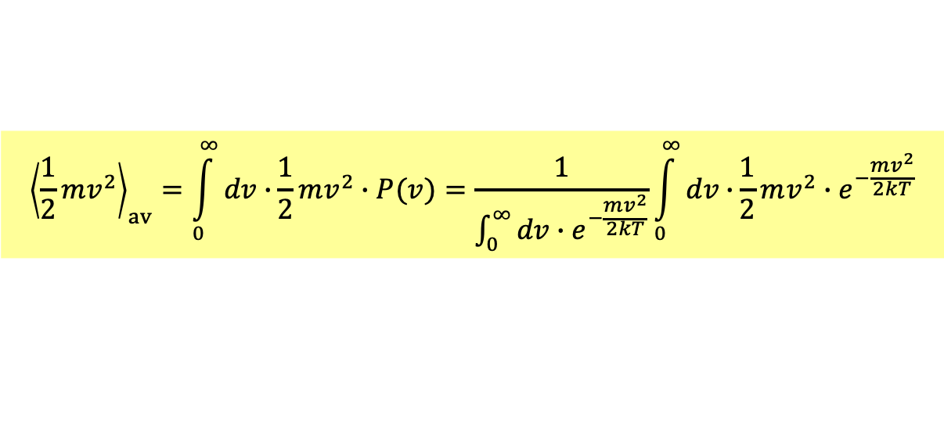
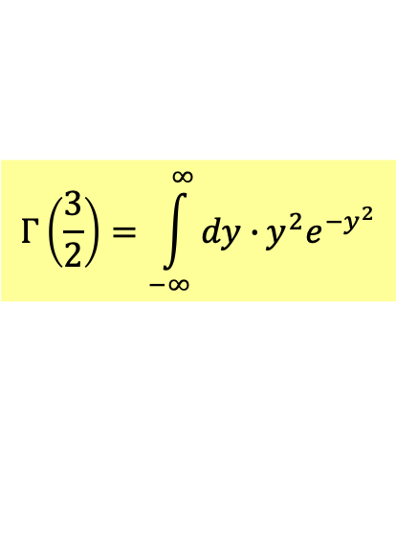
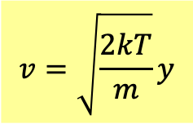
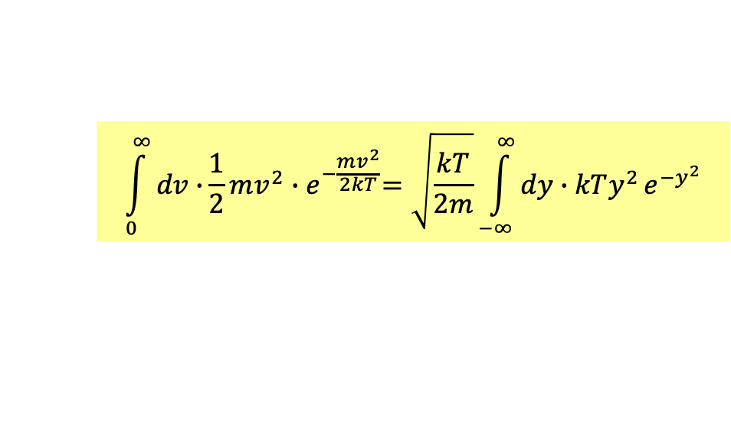
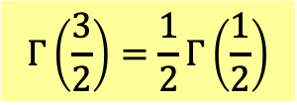
We can now calculate the average of kinetic energy of SHO in $T$:
$${\left\langle \frac{1}{2}mv^{2}\right\rangle }_{av}=\int_{0}^{∞}{dv∙}\frac{1}{2}mv^{2}∙P(v)=\frac{1}{\int_{0}^{∞}{dv∙e^{−\frac{mv^{2}}{2kT}}}}\int_{0}^{∞}{dv∙}\frac{1}{2}mv^{2}{∙e}^{−\frac{mv^{2}}{2kT}}$$
$$\int_{0}^{∞}{dv∙}\frac{1}{2}mv^{2}{∙e}^{−\frac{mv^{2}}{2kT}}=\sqrt{\frac{kT}{2m}}\int_{−∞}^{∞}{dy∙kTy^{2}}e^{−y^{2}}$$
$$v=\sqrt{\frac{2kT}{m}}y$$
Compared with the formula:
$$Γ\left(\frac{3}{2}\right)=\int_{−∞}^{∞}{dy∙}y^{2}e^{−y^{2}}$$
The above integration is just $kT\sqrt{\frac{kT}{2m}}Γ\left(\frac{3}{2}\right)$.
$${\left\langle \frac{1}{2}mv^{2}\right\rangle }_{av}=\frac{1}{\int_{0}^{∞}{dv∙e^{−\frac{mv^{2}}{2kT}}}}\int_{0}^{∞}{dv∙}\frac{1}{2}mv^{2}{∙e}^{−\frac{mv^{2}}{2kT}}=\frac{kT\sqrt{\frac{kT}{2m}}Γ\left(\frac{3}{2}\right)}{\sqrt{\frac{kT}{2m}}Γ\left(\frac{1}{2}\right)}=\frac{1}{2}kT$$
I don’t need the value of Gamma Functions. I use just the following formula.
$$Γ\left(\frac{3}{2}\right)=\frac{1}{2}Γ\left(\frac{1}{2}\right)$$

Slide 21



$${\left\langle \frac{1}{2}mv^{2}\right\rangle }_{av}=\frac{1}{\int_{0}^{∞}{dv∙e^{−\frac{mv^{2}}{2kT}}}}\int_{0}^{∞}{dv∙}\frac{1}{2}mv^{2}{∙e}^{−\frac{mv^{2}}{2kT}}=\frac{1}{2}kT$$
注意此結果完全與質量$m$無關！
因此彈力位能的計算也得到完全相同結果：
$${\left\langle \frac{1}{2}Kx^{2}\right\rangle }_{av}=\frac{1}{\int_{0}^{∞}{dx∙e^{−\frac{Kx^{2}}{2kT}}}}\int_{0}^{∞}{dx∙}\frac{1}{2}Kx^{2}{∙e}^{−\frac{Kx^{2}}{2kT}}=\frac{1}{2}kT$$
任何能量只要是動力座標的平方都會得到相同結果！

Slide 22

能量均分原則 Equipartition of Energy
一個系統中，任一個可以儲存能量的型式（稱為自由度），
只要是動力座標的平方，在頻繁的熱作用（混亂的能量交換）
達到熱平衡後，都會得到同樣的平均能量。
這個平均能量就是溫度：$\frac{1}{2}kT$。
$$\frac{1}{2}kT$$
溫度的微觀意義原來是每一個自由度所分配的能量！
$${\left\langle E\right\rangle }_{av}=\frac{1}{2}kT$$
理想氣體溫度為動能平均是這個更廣泛的原則的一個特例。
混亂製造了平衡態，混亂也使我們可以預測平衡態的性質！
關鍵是需要頻繁混亂的能量交換！這是熱現象的本質。

Slide 23
$$β≡\frac{1}{kT}$$
定義一個新的符號：
$$\frac{1}{\int_{0}^{∞}{dv′∙e^{−\frac{mv^{′2}}{2}β}}}\int_{0}^{∞}{dv∙}\frac{1}{2}mv^{2}{∙e}^{−\frac{mv^{2}}{2}β}$$
$$\frac{1}{\int_{0}^{∞}{dv∙e^{−\frac{mv^{2}}{2}β}}}\int_{0}^{∞}{dv∙}\frac{1}{2}mv^{2}{∙e}^{−\frac{mv^{2}}{2}β}=−\frac{1}{\int_{0}^{∞}{dv′∙e^{−\frac{mv^{′2}}{2}β}}}\frac{∂}{∂β}\int_{0}^{∞}{dv∙}e^{−\frac{mv^{2}}{2}β}$$
分子積分中的$mv^{2}$可以由對$β$的微分得到！
注意分子與分母中的積分是一樣的，因此可寫成對數的微分：
$$=−\frac{∂}{∂β}\ln{\int_{0}^{∞}{dv∙}e^{−\frac{mv^{2}}{2}β}}$$
$$\frac{∂}{∂x}\ln{f}=\frac{1}{f}∙\frac{df}{dx}$$
接著變換變數：
$$x≡\sqrt{\frac{mβ}{2}}v$$
$$dv≡\sqrt{\frac{2}{mβ}}dx$$
如此，注意式中的$β$可以與積分分離。
積分可以不用算。
$$=−\frac{∂}{∂β}\ln{\sqrt{\frac{2}{mβ}}\int_{0}^{∞}{dx∙}e^{−x^{2}}}$$
$$=−\frac{∂}{∂β}\ln{\sqrt{\frac{2}{mβ}}\int_{0}^{∞}{dx∙}e^{−x^{2}}}=−\frac{∂}{∂β}\left[\ln{\sqrt{\frac{1}{β}}}+\ln{\sqrt{\frac{2}{m}}\int_{0}^{∞}{dx∙}e^{−x^{2}}}\right]=−\frac{∂}{∂β}\ln{\sqrt{\frac{1}{β}}}=\frac{1}{2}\frac{∂}{∂β}\ln{β}=\frac{1}{2}\frac{1}{β}=\frac{1}{2}kT$$

Slide 24





In Statistical Mechanics it is essential to have an approximation of $n!$ for large $n$.
Stirling Formula
$$n!\sim n^{n}e^{−n}\sqrt{2πn} n→∞$$
Write it in terms of gamma function, which has an integration definition.
$$Γ\left(p+1\right)\sim p^{p}e^{−p}\sqrt{2πp} p→∞$$
$$Γ\left(p+1\right)=\int_{0}^{∞}{dx∙}x^{p}e^{−x}=\int_{0}^{∞}{dx∙}{\left(e^{\ln{x}}\right)}^{p}e^{−x}=\int_{0}^{∞}{dx∙}e^{p\ln{x}−x}$$
We know how to integrate Gaussian function.
Maybe, $p\ln{x}−x$ can be approximated by a quadratic function of $x$ as $p→∞.$
It does have a minimum at $x=p$.
${\left.\frac{d}{dx}\left(p\ln{x}−x\right)\right|}_{x=p}=0$
$p\ln{x}−x$ can be approximated by a quadratic function of $(x−p)$ as $p→∞$

Slide 25








$p\ln{x}−x$ can be approximated by a quadratic function of $x−p$ as $p→∞$
Change the variable:
$$x−p=y\sqrt{p}$$
$$dx=dy\sqrt{p}$$
$$\int_{0}^{∞}{dx∙}e^{p\ln{x}−x}=\sqrt{p}\int_{−∞}^{∞}{dy∙}e^{p\ln\left(p+y\sqrt{p}\right)−p−y\sqrt{p}}$$
Note that as $x→0, y→$ $−\sqrt{p}→−∞$. See Baos p553.
$$\ln\left(1+x\right)=x−\frac{x^{2}}{2}+\frac{x^{3}}{3}⋯$$
Expand the log in the exponential by:
$$\ln\left(p+y\sqrt{p}\right)=\ln\left[p\left(1+\frac{y}{\sqrt{p}}\right)\right]=\ln{p}+\ln\left(1+\frac{y}{\sqrt{p}}\right)\sim \ln{p}+\frac{y}{\sqrt{p}}−\frac{y^{2}}{2p}+⋯$$
$$p\ln\left(p+y\sqrt{p}\right)−p−y\sqrt{p}=p\ln{p}−p−\frac{y^{2}}{2}$$
Note that there is no linear term in $y$. It is indeed an integration of Gaussian function.
$$Γ\left(p+1\right)\sim \sqrt{p}e^{p\ln{p}−p}\int_{−∞}^{∞}{dy∙}e^{−\frac{y^{2}}{2}}=\sqrt{p}e^{p\ln{p}}e^{−p}\sqrt{2}Γ\left(\frac{1}{2}\right)=p^{p}e^{−p}\sqrt{2πp}$$
This is true for all $p$. When $p=n$,
$$n!\sim n^{n}e^{−n}\sqrt{2πn} n→∞$$

Slide 26

This method of approximate an exponential integration by Gaussian function integration is called Laplace Method:
It could be rigorously proven that this approximation is correct.

Slide 27


