Slide 1
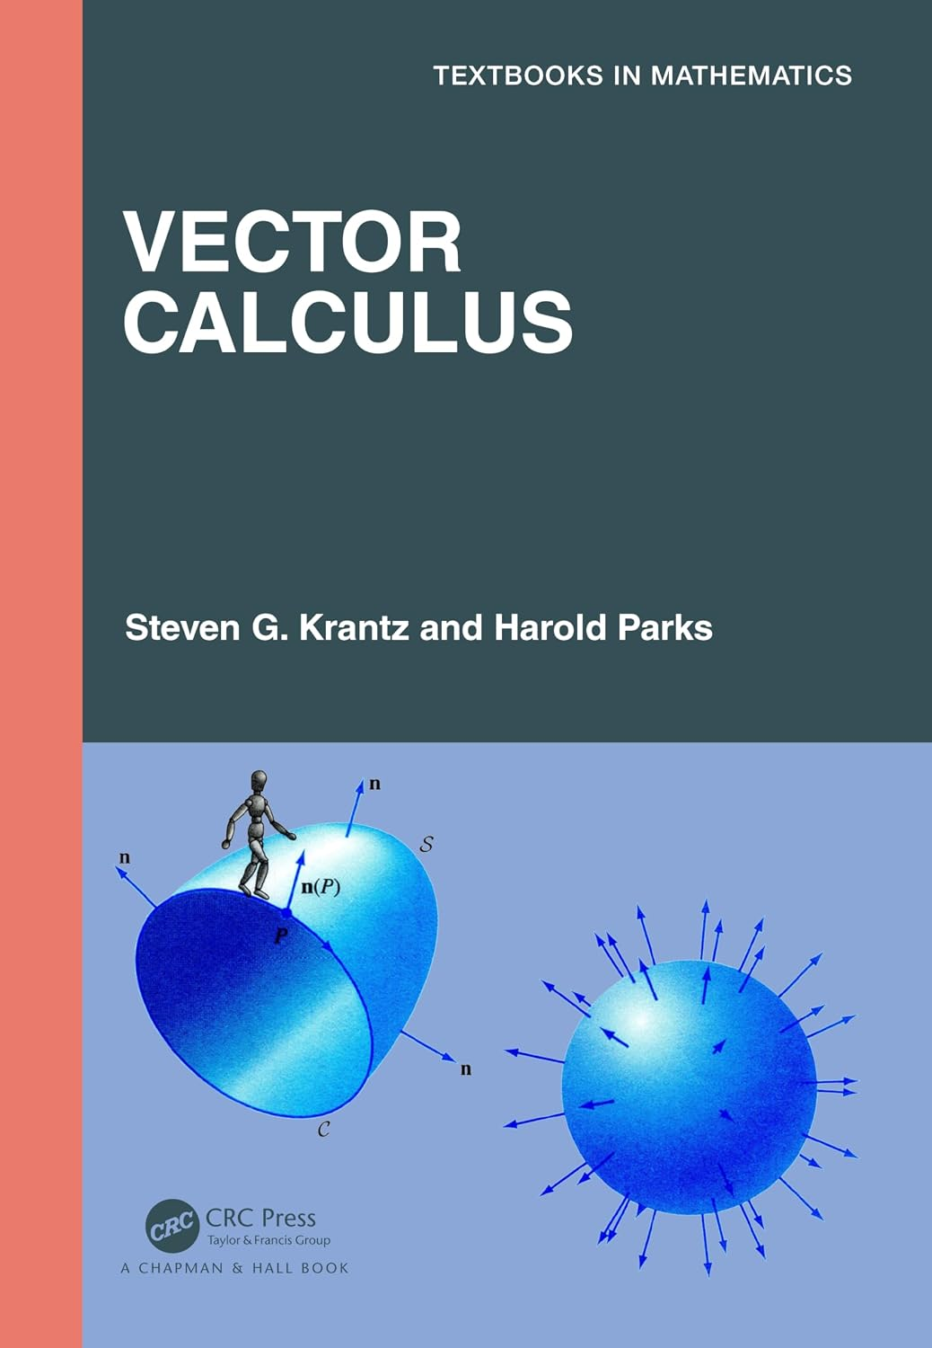
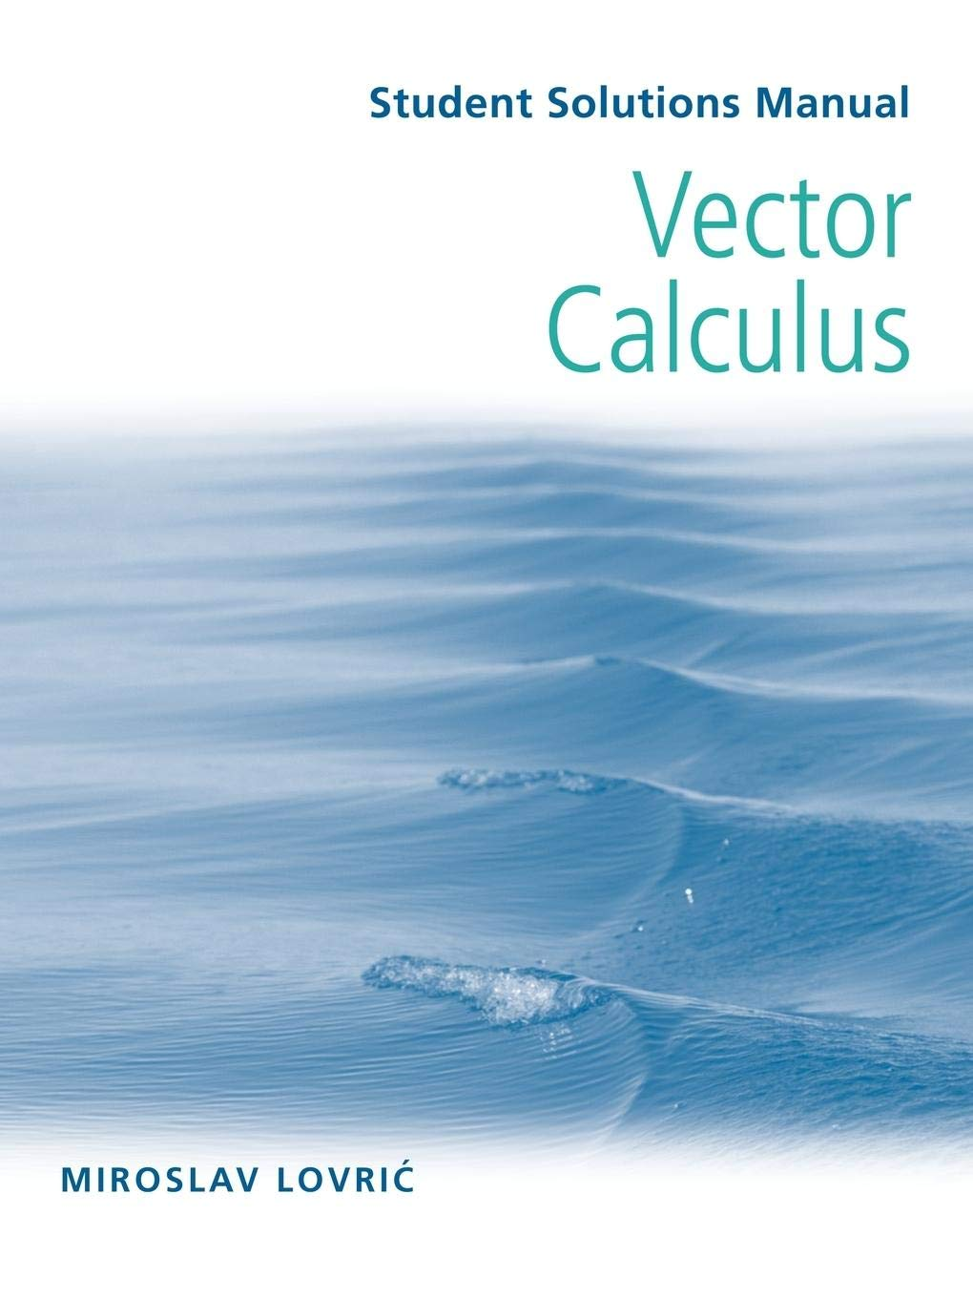
Calculus in 2D and 3D space

Slide 2
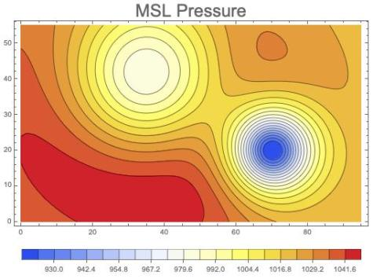
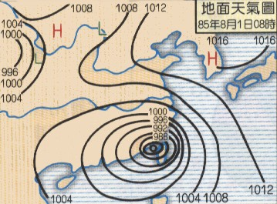
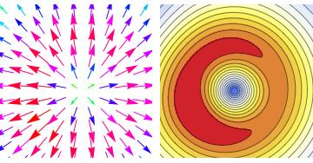
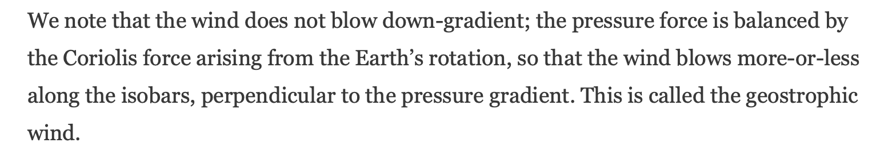
Air pressure on earth surface is a function of position
Pressure difference exert on air everywhere directional: gradient of pressure.

Slide 3
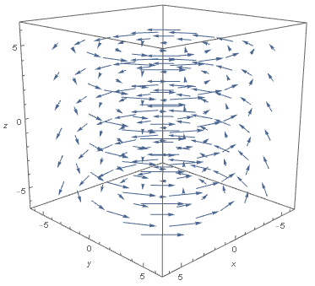
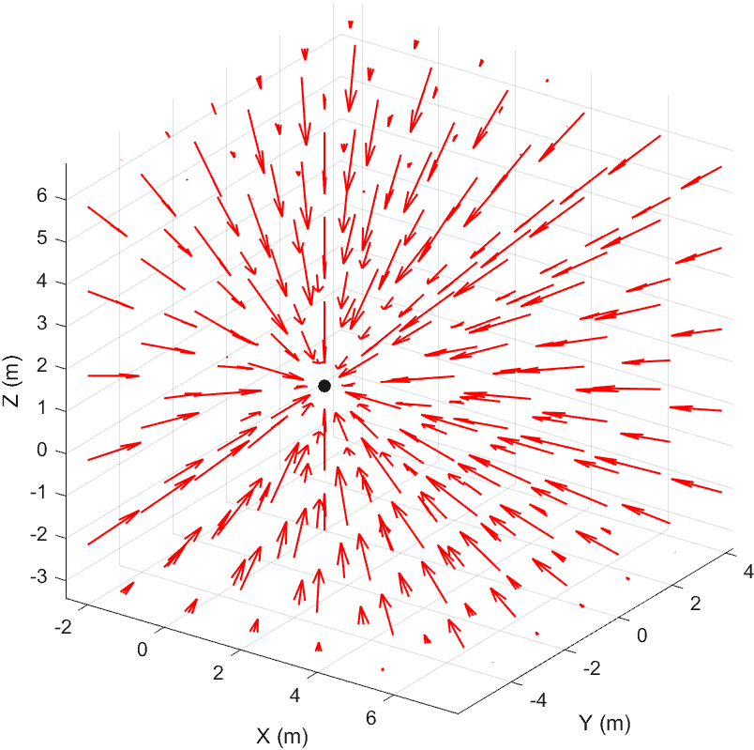
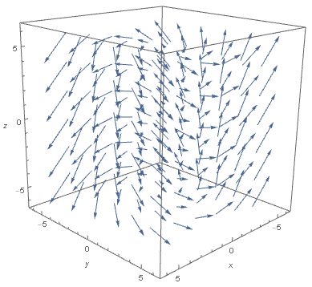
Pressure differences are a vector atevery location : this is a Field.

Slide 4
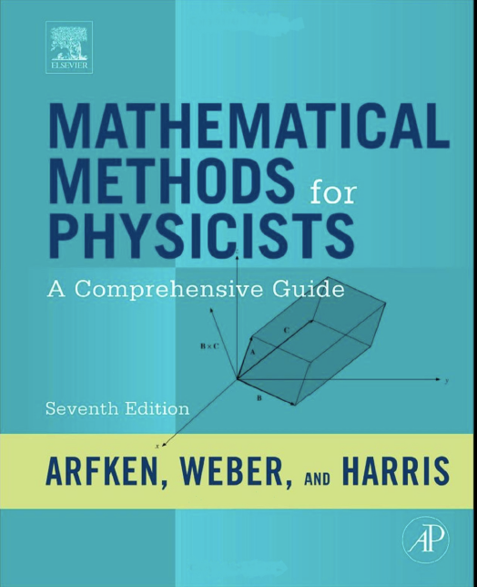
Vectorial Calculus
Section 3.5-3.9

Slide 5
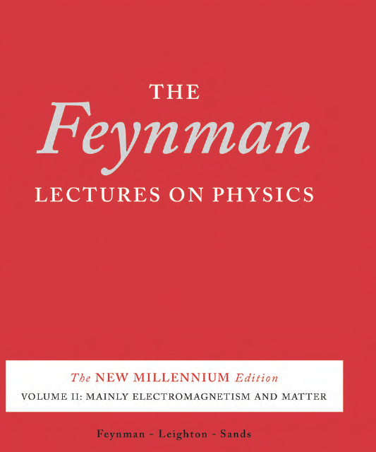

Slide 6
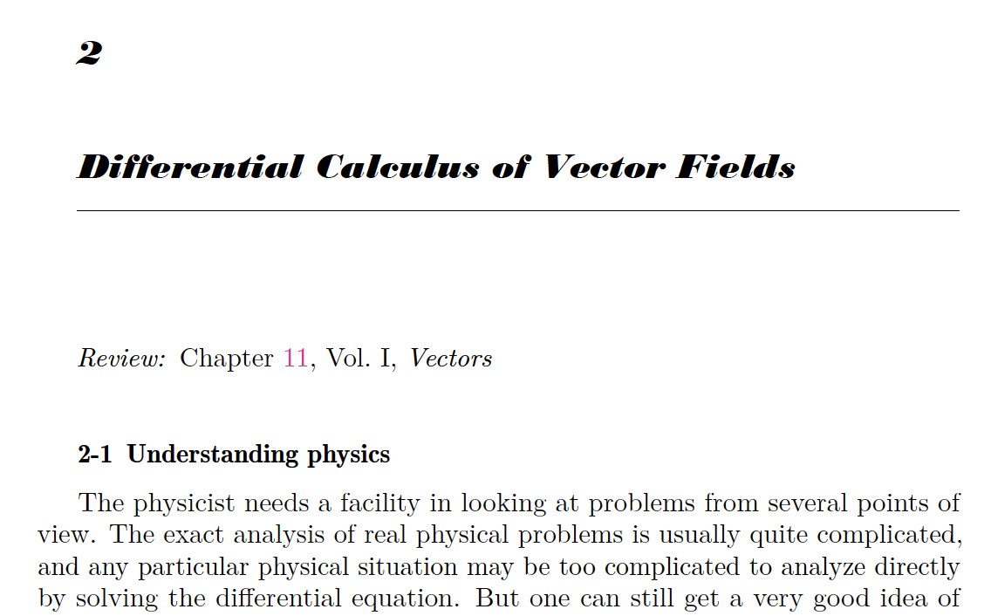
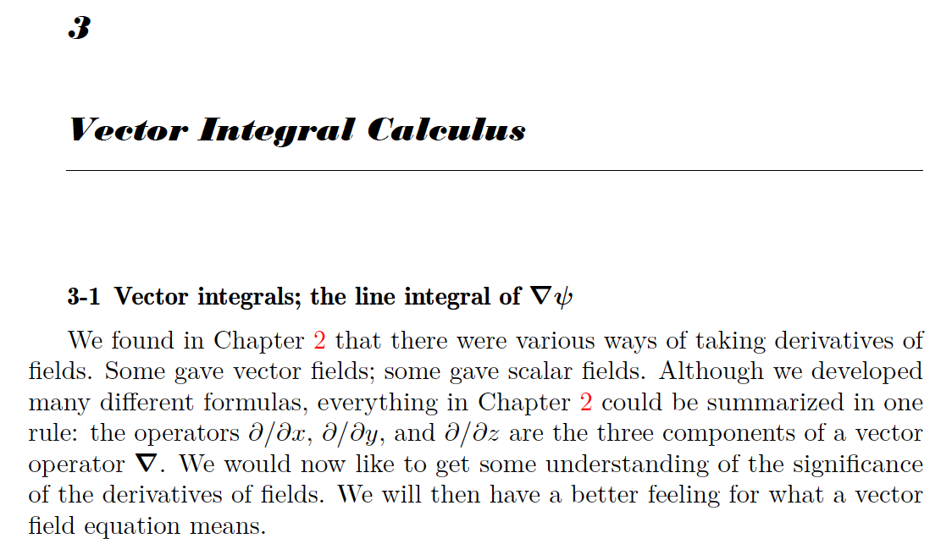

Slide 7
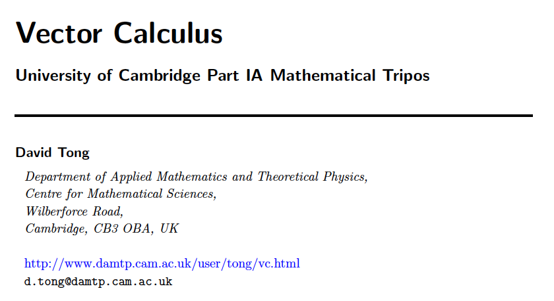
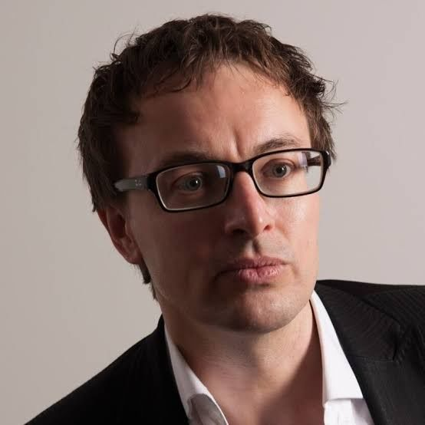
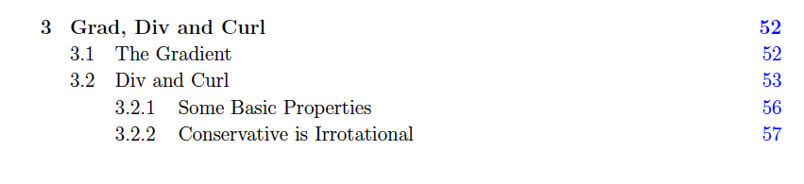

Slide 8

Vectors in Flat Space $R^{2,3}$ 平坦二維或三維空間中的向量
Vectorial Calculus 向量微積分
這是處理$R^{2,3}$空間中的位置與時間的函數！這樣的函數一般稱為場。
This is to deal with functions of space and time, called fields.
在空間中可以定義函數值為純量的函數！純量場 Scalar Field。
Scalar functions (just real number) of space and time are called scalar field.
$$V: R^{3}→R$$

Slide 9
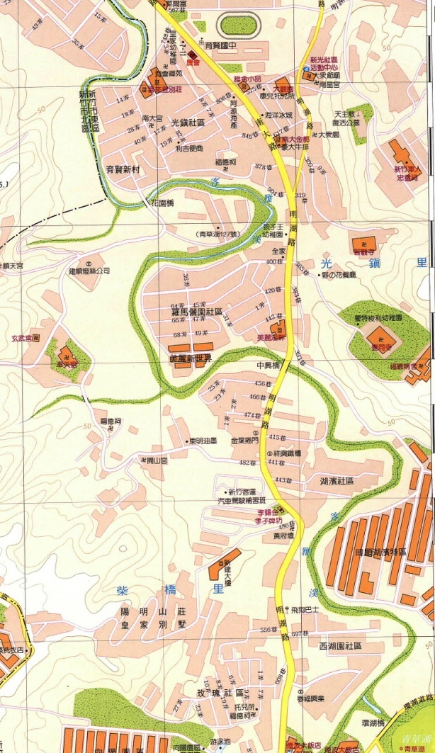
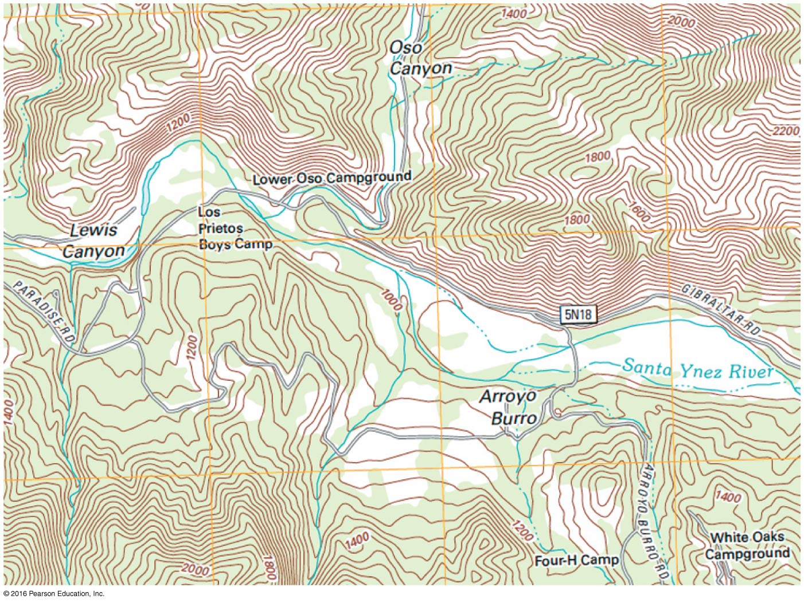

$$U\left(\vec{r}\right)$$
Potential energy is determined by positions and it is a scalar.
位能由位置決定，每一個座標對應一個位能值。
Almost like the heights on a map.
如同地圖上的高度標示一樣！

Slide 10
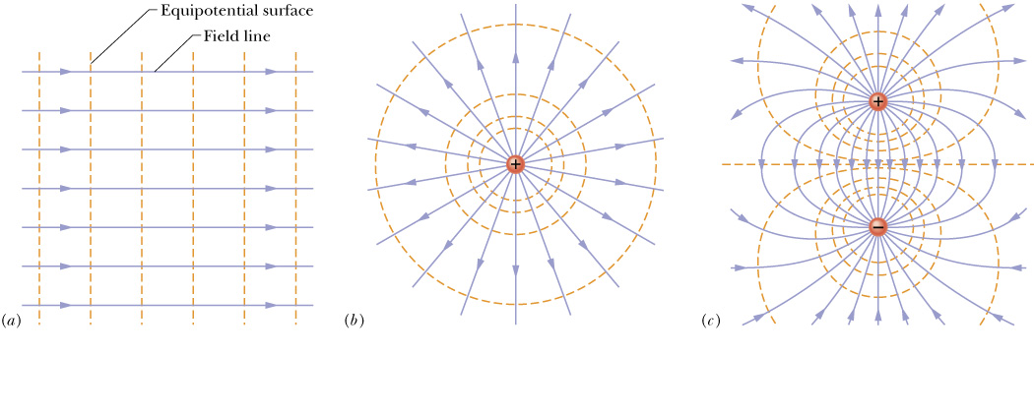
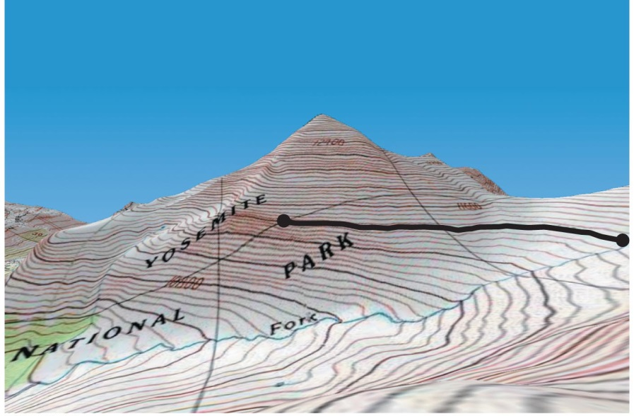
電位$V\left(\vec{r}\right)$是空間的純量函數。Electric Potential $V\left(\vec{r}\right)$ is a scalar function in space.
相對的$，電場\vec{E}\left(\vec{r}\right)$是一個向量函數。On the contrary, electric field is a vector field.

Slide 11
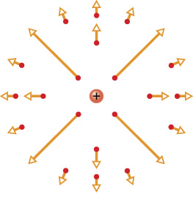

在空間中可以定義函數值為向量的函數！向量場 Vector Field。
When the function values are vectors, the fields are called vector fields.
$$\vec{E}: R^{3}→R^{3}$$

Slide 12
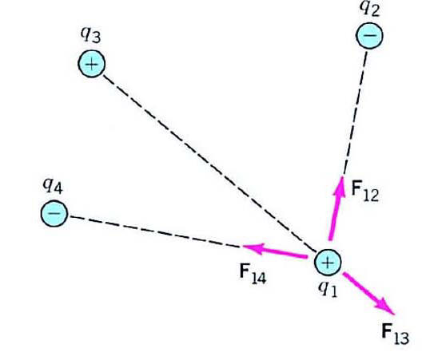
電場的抽象定義：
Q₂
$$\vec{F}=\sum_{i}{\frac{1}{4πε_{0}}\frac{Q_{i}q}{r_{i}^{2}}{\hat{r}}_{i}}$$
Q₁
電荷量$q$可以從複雜的式子中提出來：
$$\vec{E}$$
Q₃
F₂
$$=\left(\sum_{i}{\frac{1}{4πε_{0}}\frac{Q_{i}}{r_{i}^{2}}{\hat{r}}_{i}}\right)∙q=\vec{E}∙q$$
F₃
q
電場 Electric Field
F₁
電場$\vec{E}$只與$q$的位置相關，與$q$的電荷量無關
想像$q$漸漸趨近於零$q→0$….電場$\vec{E}$應該依舊存在吧！

Slide 13
Q₂
$$\vec{E}=\sum_{i}{\frac{1}{4πε_{0}}\frac{Q_{i}}{r_{i}^{2}}{\hat{r}}_{i}}$$
Q₁
電場與q的電荷量無關。
$$\vec{E}$$
Q₃
由固定電荷$Q_{i}$及q的位置決定。
F₂
電場$\vec{E}\left(\vec{r}\right)$是空間的性質。
每一點都有$\vec{E}\left(\vec{r}\right)$，電場遍佈整個空間。
F₃
q
電場可以為零，但永遠存在。
F₁
電場就是會讓位於當地的電荷$q$得到靜電力$q∙\vec{E}$的空間的物理性質。
電場是由固定電荷$Q_{i}$在空間各處產生。

Slide 14
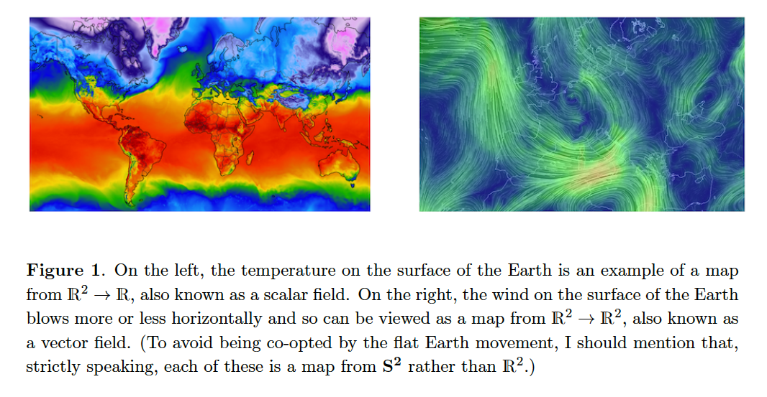


溫度分佈就是純量場$T(\vec{r})$
風速分佈就是向量場$\vec{v}(\vec{r})$
Temperature distribution is a scalar field.
Wind speed distribution is a vector field.

Slide 15

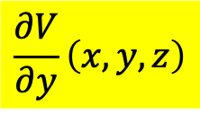

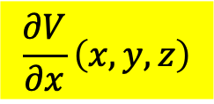

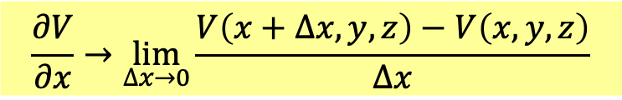
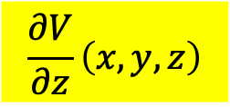

梯度，散度，漩度
Grad, Div, Curl
Major tools in 3D vector calculus: Partial Derivatives
$$\frac{∂V}{∂x}\left(x,y,z\right)$$
$$\frac{∂V}{∂y}\left(x,y,z\right)$$
$$\frac{∂V}{∂z}\left(x,y,z\right)$$
$$\frac{∂V}{∂x}→\lim_{∆x→0}{\frac{V\left(x+∆x,y,z\right)−V\left(x,y,z\right)}{∆x}}$$
$$\left(x,y+∆y\right)$$
$$\left(x+∆x,y+∆y\right)$$
$$\left(x,y\right)$$
$$\left(x+∆x,y\right)$$
Partial derivative is the rate of change along displacement in one axis.
First, an extremely useful theorem!

Slide 16
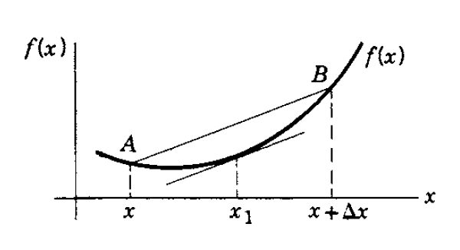

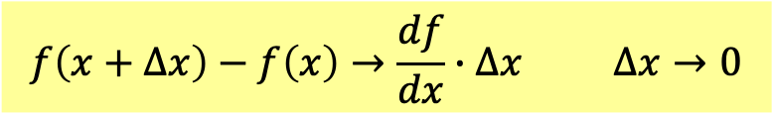

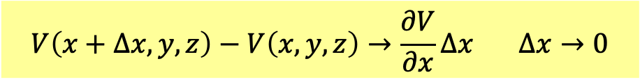


Single-variable function difference equals derivative times variable difference.
$$f\left(x+∆x\right)−f\left(x\right)→\frac{df}{dx}∙∆x ∆x→0$$
If we fix $y,z$, multivariable function $V\left(x,y,z\right)$ becomes single-variable function:
Derivative as $∆x→0$ is partial derivative $\frac{∂V}{∂x}$.
$$V\left(x+∆x,y,z\right)−V\left(x,y,z\right)→\frac{∂V}{∂x}∆x ∆x→0$$
$$\left(x,y+∆y\right)$$
$$\left(x+∆x,y+∆y\right)$$
$$\left(x,y\right)$$
$$\left(x+∆x,y\right)$$

Slide 17




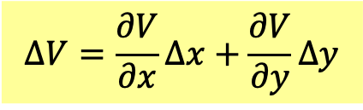
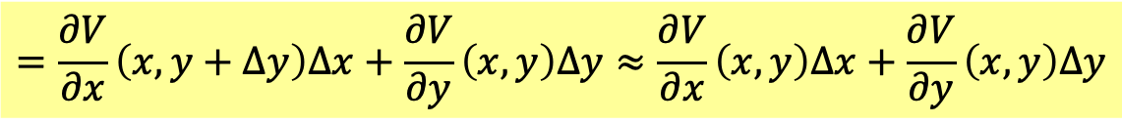
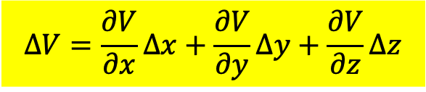
General displacement can be decomposed into displacements along 3 directions.
$$\left(x,y+∆y\right)$$
$$\left(x+∆x,y+∆y\right)$$
$$\left(x,y\right)$$
$$∆V≡V\left(x+∆x,y+∆y\right)−V\left(x,y\right)$$
Change of $V$ can be decomposed into changes along 3 directions.
$$=\left[V\left(x+∆x,y+∆y\right)−V\left(x,y+∆y\right)\right]+\left[V\left(x,y+∆y\right)−V\left(x,y\right)\right]$$
$$=\frac{∂V}{∂x}\left(x,y+∆y\right)∆x+\frac{∂V}{∂y}\left(x,y\right)∆y≈\frac{∂V}{∂x}\left(x,y\right)∆x+\frac{∂V}{∂y}\left(x,y\right)∆y$$
$$∆V=\frac{∂V}{∂x}∆x+\frac{∂V}{∂y}∆y$$
$$∆V=\frac{∂V}{∂x}∆x+\frac{∂V}{∂y}∆y+\frac{∂V}{∂z}∆z$$

Slide 18
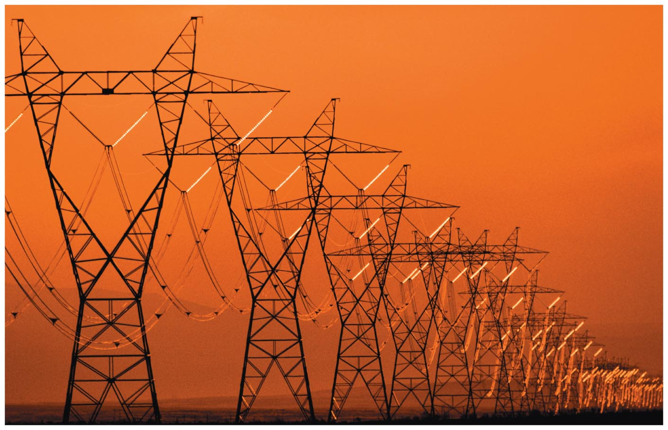
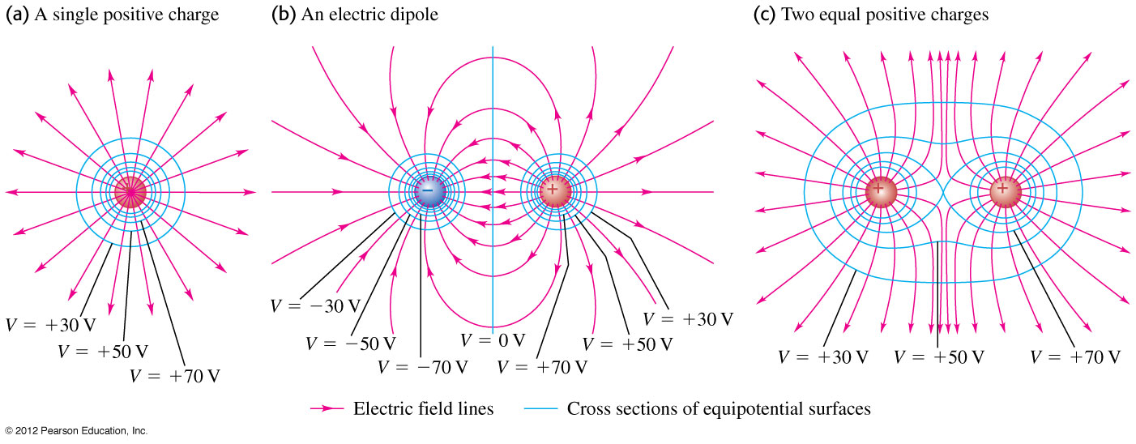
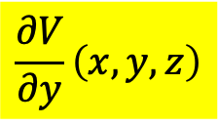
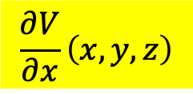
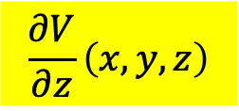
Differentiation in 3D space
We can define three partial derivatives of a scalar field $V\left(x,y,z\right)$.
$$\frac{∂V}{∂x}\left(x,y,z\right)$$
$$\frac{∂V}{∂y}\left(x,y,z\right)$$
$$\frac{∂V}{∂z}\left(x,y,z\right)$$
The three partial derivatives look like components of a vector. Are they?
The answer is yes.
Take electric potential, a function of 3D coordinates, as an example:

Slide 19
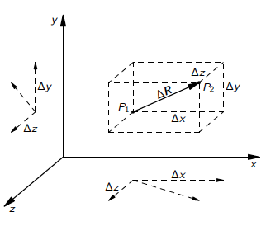
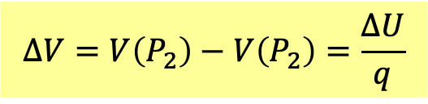
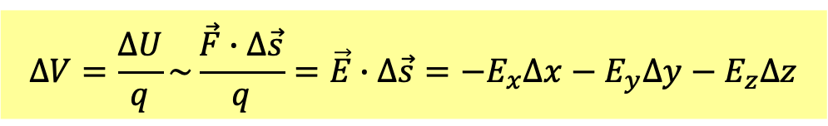


Electric potential difference equals potential energy difference divided by charge.
$$∆V=V\left(P_{2}\right)−V\left(P_{2}\right)=\frac{∆U}{q}$$
$$∆\vec{s}$$
If $P_{1}$ and $P_{2}$are very close with infinitesimal displacement :
$$∆\vec{s}=\left(∆x,∆y,∆z\right)$$
potential energy difference equals electric force times $∆\vec{R}.$
$$∆V=\frac{∆U}{q}\sim \frac{\vec{F}∙∆\vec{s}}{q}=\vec{E}∙∆\vec{s}=−E_{x}∆x−E_{y}∆y−E_{z}∆z$$
Electric potential difference equals inner product of electric field and displacement.
Since $\vec{E}$ does not change much, its value can be approximately taken at $P_{1}$.
There is another way to compute function difference in space.

Slide 20
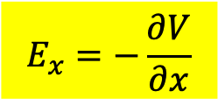

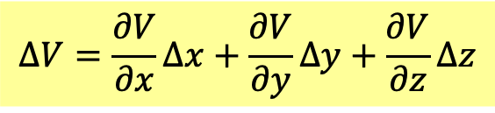
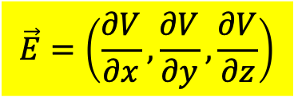
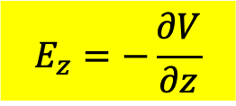
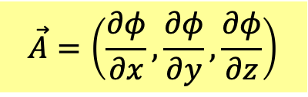
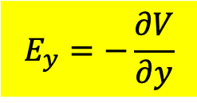
Function difference equals partial derivatives times variable differences.
$$∆V=\frac{∂V}{∂x}∆x+\frac{∂V}{∂y}∆y+\frac{∂V}{∂z}∆z$$
The two computations must equal.
$$∆V\sim −\vec{E}∙∆\vec{s}=−E_{x}∆x−E_{y}∆y−E_{z}∆z$$
Comparing the tow formulae, we find:
$$E_{x}=−\frac{∂V}{∂x}$$
$$E_{y}=−\frac{∂V}{∂y}$$
$$E_{z}=−\frac{∂V}{∂z}$$
The three partial derivatives are indeed components of a vector.
$$\vec{E}=\left(\frac{∂V}{∂x},\frac{∂V}{∂y},\frac{∂V}{∂z}\right)$$
This derivation does not rely on $\vec{E}$ being the electric field.
It is true for any vector field $\vec{A}$ and scalar field $∆φ=\vec{A}∙∆\vec{s}$.
$$\vec{A}=\left(\frac{∂φ}{∂x},\frac{∂φ}{∂y},\frac{∂φ}{∂z}\right)$$

Slide 21
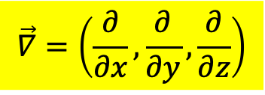
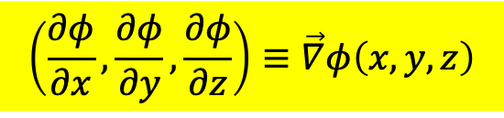
梯度 Gradient
$$\left(\frac{∂φ}{∂x},\frac{∂φ}{∂y},\frac{∂φ}{∂z}\right)≡\vec{∇}φ\left(x,y,z\right)$$
For any scalar field $φ$，$\vec{∇}φ\left(x,y,z\right)$ is a vector field!
We simply treat the operation $\vec{∇}$ as a vector as the notation indicate.
$$\vec{∇}=\left(\frac{∂}{∂x},\frac{∂}{∂y},\frac{∂}{∂z}\right)$$
But $\vec{∇}$ is an operation after all and it must act on a field.

Slide 22
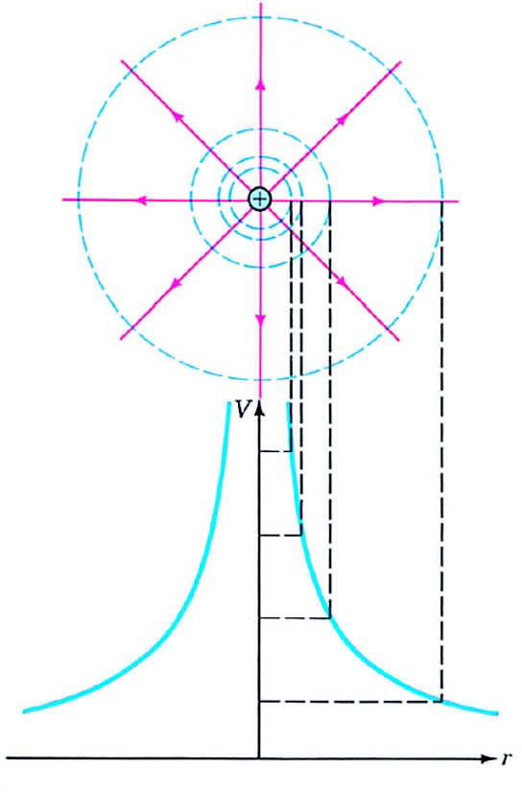









Electric Potential of a point charge:
$$V\left(\vec{r}\right)=\frac{1}{4πε_{0}}\frac{Q}{r}$$
$$\vec{E}=−\left(\frac{∂V}{∂x},\frac{∂V}{∂y},\frac{∂V}{∂z}\right)$$
$$\frac{∂V}{∂x}=\frac{dV}{dr}\frac{∂r}{∂x}$$
$$\frac{dV}{dr}=−\frac{1}{4πε_{0}}\frac{Q}{r^{2}}$$
$$\frac{∂r}{∂x}=\frac{∂}{∂x}\sqrt{x^{2}+y^{2}+z^{2}}=\frac{x}{r}={\hat{r}}_{x}$$
$$\frac{∂r}{∂y}=\frac{y}{r}={\hat{r}}_{y}$$
$$\frac{∂r}{∂z}=\frac{y}{r}={\hat{r}}_{z}$$
$$\left(\frac{∂V}{∂x},\frac{∂V}{∂y},\frac{∂V}{∂z}\right)=−\frac{1}{4πε_{0}}\frac{Qq}{r^{2}}\left({\hat{r}}_{x},{\hat{r}}_{y},{\hat{r}}_{z}\right)$$
$$\vec{E}=−\vec{∇}V=\frac{1}{4πε_{0}}\frac{Q}{r^{2}}\hat{r}$$

Slide 23




We can add up potential difference $\vec{E}∙∆\vec{s}$ of infinitesimal intervals.
General electric potential difference equals the line integral of the electric field.
$$∆V=−\int_{P_{1}}^{P_{2}}{\vec{E}∙d\vec{s}}$$
Theorem: If the line integral of a vector field $\vec{A}$ equals difference of a scalar field $φ$,
$$∆φ=−\int_{\vec{a}}^{\vec{b}}{\vec{A}∙d\vec{s}}$$
$\vec{A}$ equals the gradient of $φ$:
$$\vec{A}=−\vec{∇}φ$$

Slide 24



要使電位$V\left(\vec{r}\right)$具象化最有用的就是等位面
等電位面非常像地圖上的等高線：

Slide 25



沿等位面方向的電場為零，故電位梯度電場垂直於等位面。
等位面越密，電場越強：
$$∆V=−Ed$$
兩點之間的電位差帶動電場向量。

Slide 27


Slide 28

So far, gradient acts on scalar fields to give vector fields.
Partial derivatives in a gradient can act on vector fields too.
We can arrange the indices as an inner product while taking derivatives.
$$\vec{∇}∙\vec{E}\left(x,y,z\right)≡\frac{∂E_{x}}{∂x}+\frac{∂E_{y}}{∂y}+\frac{∂E_{z}}{∂z}$$
The results are a scalar fields.
This is called 散度，Divergence.

Slide 29


Slide 30


Slide 31





Or we can arrange the indices as a cross product. The result will be a vector field.
Levi-Civita Tensor
$$ε_{ijk}=\left\{\begin{matrix}+1 ijk=123,231, 312 \\ −1 ijk=132,213, 321 \\ 0 some subscripts are equal\end{matrix}\right.$$
$${\left(\vec{A}×\vec{B}\right)}_{i}=\sum_{j,k=1}^{3}{ε_{ijk}A_{j}B_{k}}$$
$${\left(\vec{A}×\vec{B}\right)}_{x}=A_{y}B_{z}−A_{z}B_{y}$$
$$\vec{∇}×\vec{E}\left(x,y,z\right)≡\left(\frac{∂E_{z}}{∂y}−\frac{∂E_{y}}{∂z},\frac{∂E_{x}}{∂z}−\frac{∂E_{z}}{∂x},\frac{∂E_{y}}{∂x}−\frac{∂E_{x}}{∂y}\right)$$
This is called 旋度，Curl.

Slide 32


Slide 33


Slide 34


Integration Theorems
Differential operations are related to integration of vector field in space.
Integration of vector field in space is over curved surface or a path (line).
面積分 Surface integral
is related to 散度，Divergence.
線積分 Line integral
is related to 旋度，Curl.

Slide 35








積分形式
微分形式
$$\oint{\vec{E}∙d\vec{a}}=\frac{q}{ε_{0}}$$
$$\vec{∇}∙\vec{E}=\frac{ρ}{ε_{0}}$$
$$\oint{\vec{B}∙d\vec{a}}=0$$
$$\vec{∇}∙\vec{B}=0$$
$$\oint{\vec{E}∙d\vec{s}}=−\frac{dΦ_{B}}{dt}$$
$$\vec{∇}×\vec{E}=−\frac{∂\vec{B}}{∂t}$$
$$\oint{\vec{B}∙d\vec{s}}=μ_{0}i+μ_{0}ε_{0}\frac{dΦ_{E}}{dt}$$
$$\vec{∇}×\vec{B}=μ_{0}\vec{j}+μ_{0}ε_{0}\frac{∂\vec{E}}{∂t}$$
Convert Maxwell Equations from integral formulation to differential formulation

Slide 36




$$Φ_{E}=\oint{\vec{E}∙d\vec{a}}=\frac{q}{ε_{0}}$$
高斯定律 Gauss’s Law
一個封閉曲面的電場面積分：通量，正比於曲面所包圍的總淨電荷量。
But Gauss’s Law in this integration formulation is hard to use.
We will now calculate flux on surface using divergence inside surface.
The law will then be converted it into a differential formulation.
$$\vec{∇}∙\vec{E}=\frac{ρ}{ε_{0}}$$

Slide 37


法拉第透過無數實驗觀察，歸納出場線的兩個性質：
1. 電場的方向即為通過當地之電力線的切線方向。

Slide 38

因此，電力線不會交叉。否則交叉點的電場會有兩個方向。

Slide 39

而且電力線不會中斷，否則中斷處電場方向將不明。
只有兩個例外，電力線由正電荷發出，由負電荷吸收！
那麼：電力線在空間中數目不變而守恆！

Slide 40
第二個特性是：電力線愈密，電場愈大！
對於點電荷，同樣不變的數目的電力線，到越遠處就分配到越大的球面，
球面積正比於距離平方，所以電力線密度正好是距離平方反比，
這與電場大小一樣，因此大膽猜想電力線密度正好是電場大小！

Slide 41

電力線密度定義為通過當地一垂直於電場的單位面積平面的電力線數目。
2. 電場大小與當地的電力線密度成正比！

Slide 42





$$θ$$
$$θ$$
定義面積向量$\vec{A}$：大小就是此平面的面積，方向是垂直於平面的方向。
如此定義後，角度$θ$就是向量$\vec{A}$與電場$\vec{E}$之間的夾角。
$$N=E∙A\cos{θ}=\vec{E}∙\vec{A}≡Φ_{E}$$
$Φ_{E}$電通量 Electric Flux，順著$\vec{A}$的方向通過平面的電力線數目。

Slide 43




如果曲面是封閉曲面（這是高斯定律的主角，就稱高斯面）：
$$\oint{\vec{E}∙d\vec{A}}=\lim_{\begin{aligned}δA→0 \\ N→∞\end{aligned}}{\sum_{i}{{\vec{E}}_{i}∙δ{\vec{A}}_{i}}}$$
如果是封閉曲面，空間會被分成內外兩部分，
可以定義$d\vec{A}$的方向一律是由內指向外：
$${\vec{E}}_{i}∙δ{\vec{A}}_{i}$$
為正時，電力線為離開曲面
為負時，電力線為進入曲面

Slide 44


通過一封閉曲面的總電場通量就有一個很簡單的物理意義；
$$Φ_{E}=\oint{\vec{E}∙d\vec{a}}=離開曲面的電力線數目−進入曲面的電力線數目$$
進入此封閉曲面的電場線數目必等於離開的電場線數目！
$$\oint{\vec{E}∙d\vec{A}}=0$$
電力線數目守恆

Slide 45


若曲面內有一點電荷，電力線由正電荷發出（由負電荷吸收）：
$$Φ_{E}=\oint{\vec{E}∙d\vec{a}}=離開曲面的電力線數目−進入曲面的電力線數目≠0$$
包圍一個電荷的高斯面的電通量，等於正(負)電荷所產生(消滅)的電力線數目。
因電力線產生後不中途消失，
我們立刻可以得到：包圍點電荷$q$的高斯面$S_{1,2,3}$，電通量相等！
通過包圍點電荷的高斯面的電力線數與其形狀、位置、大小都無關！

Slide 46



Electric Flux is defined as the inner product of $\vec{E}$ and $\vec{A}$：
$$Φ_{E}=\sum_{i}{{\vec{E}}_{i}∙δ{\vec{A}}_{i}}$$
The sum becomes integration as$δA→0$, defined as a surface integral.
$$Φ_{E}=\sum_{i}{{\vec{E}}_{i}∙δ{\vec{A}}_{i}}\overset{→}{\begin{aligned}δA→0 \\ N→∞\end{aligned}}\int_{surface}{\vec{E}∙d\vec{A}}$$

Slide 47

The total flux through a closed surface has a simple meaning:
$$Φ_{E}=\oint{\vec{E}∙d\vec{a}}=number of electirc lines leaving−number of entering$$

Slide 48





About flux, first a beautiful mathematical theorem. The key observation:
When a volume is divided into two parts:
$$a+b$$
the electric flux through $a+b$ equals the sum of flux through the two parts $a,b$.
$$Φ_{a+b}=Φ_{a}+Φ_{b}$$
This is because when adding up, the contributions from interior faces $S_{ab}$ cancel out.
The outward normal direction of $S_{ab}$ from part $b$ is opposite the direction from $a$.
$$a$$
$$b$$

Slide 49




$$∆v_{i}$$
If we divide the inner space $V$ of a Gaussian Surface into small cubes $dV$,
The sum of all the flux through the cubes equals the flux through $V$,
since the contributions from interior faces cancel out.
$$Φ_{E}=\sum_{i}{∆Φ_{iE}}$$
Let’s calculate the flux of a vector field through a small cube:

Slide 50













$$\vec{E}\left(x\right)$$
$$\vec{E}\left(x+∆x\right)$$
$$d\vec{a}$$
$$d\vec{a}$$
Flux through a small cube
with sides along $x,y,z$ axes
x$x$x
$$xx+Δx$$
The flux on the two surfaces (right, left) perpendicular to $x$ axis:
$$\vec{E}∙d\vec{a}\sim E_{x}∙da$$
$$E_{x}\left(x+∆x,y,z\right)∙∆y∆z−E_{x}\left(x,y,z\right)∙∆y∆z$$
The change in $E_{x}$, as only $x$ change by $∆x$, equals partial derivative times $∆x$: $\frac{∂E_{x}}{∂x}∆x$.
$$=\left(\frac{∂E_{x}}{∂x}\right)∆x∙∆y∆z$$
$$\left(\frac{∂E_{y}}{∂y}\right)∆y∙∆x∆z$$
Flux on two surfaces (top, bottom) perpendicular to the $y$ axis:
$$\left(\frac{∂E_{z}}{∂z}\right)∆z∙∆x∆y$$
Flux on two surfaces (front, back) perpendicular to the $z$ axis:
$$Φ_{E}=\left(\frac{∂E_{x}}{∂x}+\frac{∂E_{y}}{∂y}+\frac{∂E_{z}}{∂z}\right)∙∆x∆y∆z=\left(\vec{∇}∙\vec{E}\right)∙∆v$$
Total flux:

Slide 51
General displacement can be decomposed into displacements along 3 directions.
$$\left(x,y+∆y\right)$$
$$\left(x+∆x,y+∆y\right)$$
$$\left(x,y\right)$$
$$∆V≡V\left(x+∆x,y+∆y\right)−V\left(x,y\right)$$
Change of $V$ can be decomposed into changes along 3 directions.
$$=\left[V\left(x+∆x,y+∆y\right)−V\left(x,y+∆y\right)\right]+\left[V\left(x,y+∆y\right)−V\left(x,y\right)\right]$$
$$=\frac{∂V}{∂x}\left(x,y+∆y\right)∆x+\frac{∂V}{∂y}\left(x,y\right)∆y≈\frac{∂V}{∂x}\left(x,y\right)∆x+\frac{∂V}{∂y}\left(x,y\right)∆y$$
$$∆V=\frac{∂V}{∂x}∆x+\frac{∂V}{∂y}∆y$$
$$∆V=\frac{∂V}{∂x}∆x+\frac{∂V}{∂y}∆y+\frac{∂V}{∂z}∆z$$

Slide 52





Shape does not matter!
$$∆v_{i}$$
Consider a small volume $V$ and cut it into small cubes as $∆v_{i}→0$:
The flux through $V$ equals the sum of the flux through all the cubes,
since the contributions from interior faces cancel out.
$$Φ_{E}=\sum_{i}{∆Φ_{iE}}=\sum_{i}{\left(\vec{∇}∙{\vec{E}}_{i}\right)∙∆v_{i} }$$
In case $V$ is very small, $\vec{∇}∙\vec{E}$ does not change much,
$$\sim \left(\vec{∇}∙\vec{E}\right)\sum_{i}{∆v_{i} }=V\left(\vec{∇}∙\vec{E}\right)$$
$$\vec{∇}∙\vec{E}=\frac{Φ_{E}}{V}$$
The meaning of divergence is flux of vector field per unit volume for small volume!

Slide 53



$$∆v_{i}$$
In case $V$ is not small and $\vec{∇}∙\vec{E}$ does change,
The sum of flux through cubes approaches volume integral as $∆v_{i}→0$.
$$Φ_{E}=\sum_{i}{∆Φ_{iE}}=\sum_{i}{\left(\vec{∇}∙{\vec{E}}_{i}\right)∙∆v_{i} }→\int{\left(\vec{∇}∙\vec{E}\right)dv}$$
Flux through a surface equals volume integral of divergence inside the surface.
$$\oint_{S}{\vec{E}∙d\vec{a}}=\int_{V}{\left(\vec{∇}∙\vec{E}\right)dv}$$

Slide 54



$$\oint_{S}{\vec{A}∙d\vec{a}}=\int_{V}{\left(\vec{∇}∙\vec{A}\right)dv}$$
It is true for any vector field.
Divergence Theorem
Integration in a volume is related to quantities on the surface.
This is intrinsically generalization of fundamental theorem of calculus.
$$\int_{a}^{b}{ dx}\frac{df}{dx}=f\left(b\right)−f\left(a\right)$$

Slide 55


The fundamental theorem of calculus is a remarkably surprising theorem.
$$\int_{a}^{b}{ dx}\frac{df}{dx}=f\left(b\right)−f\left(a\right)$$
Right-hand side with function values on the boundary is fixed by left hand side computed from functions inside the boundaries.
Why can we simply raise $f\left(x\right)$ a bit just at the boundaries $x=a,b$?
The right-hand side will change but the left-hand side will not.
The key to fundamental theorem and Gauss law is continuity of functions.
If we raise continuous $f\left(x\right)$ at boundaries, it need be raised too nearby.
The left-hand side will be changed too.

Slide 56



Now Physics:
Convert Gauss’s Law from integral formulation to differential formulation
Apply the integral formulation of Gauss’s Law to this small cube:
Electric flux equals the enclosed charge.
$$Φ_{E}=\left(\vec{∇}∙\vec{E}\right)∙∆v=\frac{q}{ε_{0}}=\frac{ρ∙∆v}{ε_{0}}$$
$ρ$ is the charge density inside the cube, approximately a constant for small cube.
$$\vec{∇}∙\vec{E}=\frac{ρ}{ε_{0}}$$
This the differential formulation of Gauss’s Law.
Note that it is an equation true for a point $\vec{r}$ (and for any point) in space.
$$\vec{∇}∙\vec{E}\left(\vec{r}\right)=\frac{ρ\left(\vec{r}\right)}{ε_{0}}$$
Electric line accumulation of unit volume is proportional to charge density.

Slide 57



In reverse, take the differential formulation of Gauss’s law.
$$\vec{∇}∙\vec{E}=\frac{ρ}{ε_{0}}$$
Plug it into the divergence Theorem:
$$\oint{\vec{E}∙d\vec{a}}=\int{\left(\vec{∇}∙\vec{E}\right)dv}$$
We get the integral formulation of Gauss’s law.
$$\oint{\vec{E}∙d\vec{a}}=\int{\left(\frac{ρ}{ε_{0}}\right)dv}=\frac{q}{ε_{0}}$$
Integral formulation of Gauss’s law is equivalent to differential formulation.

Slide 58



Magnetic Gauss’s law can also be converted into differential formulation.
$$\oint{\vec{B}∙d\vec{a}}=0$$
Divergence Theorem
$$\oint{\vec{B}∙d\vec{a}}=\int{\left(\vec{∇}∙\vec{B}\right) dv}$$
Differential formulation: Divergence of the magnetic field is always zero.
$$\vec{∇}∙\vec{B}=0$$

Slide 59








Maxwell Equations
$$\oint{\vec{E}∙d\vec{a}}=\frac{q}{ε_{0}}$$
$$\vec{∇}∙\vec{E}=\frac{ρ}{ε_{0}}$$
$$\oint{\vec{B}∙d\vec{a}}=0$$
$$\vec{∇}∙\vec{B}=0$$
$$\oint{\vec{E}∙d\vec{s}}=−\frac{dΦ_{B}}{dt}$$
$$\vec{∇}×\vec{E}=−\frac{d\vec{B}}{dt}$$
$$\oint{\vec{B}∙d\vec{s}}=μ_{0}i+μ_{0}ε_{0}\frac{dΦ_{E}}{dt}$$
$$\vec{∇}×\vec{B}=μ_{0}\vec{j}+μ_{0}ε_{0}\frac{∂\vec{E}}{∂t}$$

Slide 60







Within a uniform charge distribution：$r<R$
Charge density: $ρ$。
$$E∙4πr^{2}=\frac{ρ\frac{4}{3}πr^{3}}{ε_{0}}$$
$$E=\frac{ρ}{3ε_{0}}r$$
Electric flux inside the ball:
$$\vec{∇}∙\vec{E}=\frac{ρ}{3ε_{0}}\vec{∇}∙\vec{r}=\frac{ρ}{3ε_{0}}\left(\frac{∂x}{∂x}+\frac{∂y}{∂y}+\frac{∂z}{∂z}\right)=\frac{ρ}{ε_{0}}$$

Slide 61




Electric Field of a point charge
$$\vec{∇}∙\vec{E}=\frac{Q}{4πε_{0}}\vec{∇}∙\left(\frac{1}{r^{2}}\hat{r}\right)=0$$
except for $r=0$.

Slide 62
更嚴格的證明：

Slide 63


Slide 64



Slide 65


Slide 66


Slide 67










電荷守恆 Conservation of Charge
Current is the total charge per unit time passing an area $A$:
$$i=\frac{q}{∆t}$$
Usually, $i$ is proportional to $A$.
Define current density: current per unit area.
$$j=\frac{i}{A}$$
Identify the direction of $\vec{j}$ with charge motion.
$$j→\vec{j}$$
In a conductor $\vec{j}$ can be different at various location.
$$\vec{j}→\vec{j}\left(\vec{r}\right)$$
$\vec{j}\left(\vec{r}\right)$ is also a vector field as $E\left(\vec{r}\right)$。

Slide 68















We can calculate current $i$ through a surface by multiplying $j$ and $A$.
If the surface is perpendicular to$j$:
$$j=\frac{i}{A}$$
$$i=jA$$
$$\vec{j}$$
If the surface is not perpendicular to$j$:
We can always project it to $A_{⊥}$ that is $⊥\vec{j}$.
The current through $A$ will pass $A_{⊥}$, too.，
$$\vec{j}$$
$$i=jA_{⊥}=j∙A\cos{θ}=\vec{j}∙\vec{A}$$
Current equals inner product of $\vec{j}$ and $\vec{A}$!
$$i=\vec{j}∙\vec{A}$$
$$Φ_{E}=\vec{E}∙\vec{A}$$
Current is the flux of $\vec{j}$ !

Slide 69


We can easily extend the discussion to a curved surface.
Current is the total flux of $\vec{j}$, ie. sureface integral of $\vec{j}$ !
$$i=\int{\vec{j}∙d\vec{a}}$$

Slide 70





Consider a very small volume $∆V$
Current through its surface is the total flux of $\vec{j}$, which equals $\vec{∇}∙\vec{j}$ times volume:
$$\left(\vec{∇}∙\vec{j}\right)∙∆V$$
By charge conservation, current equals the time derivative of charge inside $∆V$:
$$−\frac{dQ}{dt}=−\frac{∂ρ}{∂t}∙∆V$$
Cancel the factor of $∆V$ on both sides:
$$\vec{∇}∙\vec{j}\left(\vec{r},t\right)＝−\frac{∂ρ\left(\vec{r},t\right)}{∂t}$$
Charge conservation law in differentiation form

Slide 71


If the volume is finite
$$i=\oint_{S}{\vec{j}∙d\vec{a}}$$
Current is the total flux of $\vec{j}$, surface integral of $\vec{j}$.
By charge conservation, current equals the time derivative of charge inside:
$$\oint_{S}{\vec{j}∙d\vec{a}}＝−\frac{dQ}{dt}$$
Charge conservation law in integral form

Slide 72








Maxwell Equations
$$\oint{\vec{E}∙d\vec{a}}=\frac{q}{ε_{0}}$$
$$\vec{∇}∙\vec{E}=\frac{ρ}{ε_{0}}$$
$$\oint{\vec{B}∙d\vec{a}}=0$$
$$\vec{∇}∙\vec{B}=0$$
$$\oint{\vec{E}∙d\vec{s}}=0$$
$$\vec{∇}×\vec{E}=0$$
$$\oint{\vec{B}∙d\vec{s}}=μ_{0}i$$
$$\vec{∇}×\vec{B}=μ_{0}\vec{j}$$
Could we write the line integral in a differential formulation?

Slide 73


$$∆V=−\int_{A}^{B}{\vec{E}∙d\vec{s}}$$
記得電位差等於電場的線積分：
若繞一個封閉曲線計算電場的線積分，因為起點與終點相同，電位差永遠等於零！
$$\oint{\vec{E}∙d\vec{s}}=0$$
沿一個封閉曲線，電場的線積分必為零！
$$\vec{E}$$

Slide 74











磁場$\vec{B}$的線積分！
$$\vec{B}$$
$$\vec{B}$$
$${\vec{r}}_{j}$$
$${\vec{r}}_{j+1}$$
$$∆{\vec{r}}_{j}≡∆{\vec{s}}_{j}$$
$${\vec{r}}_{1}$$
$${\vec{E}}_{j}$$
$$d\vec{s}$$
將一條路徑$A→B$分解為無限多段無限小的路徑$∆\vec{s}$組合起來：
將每一無限小路徑$∆\vec{s}$的$\vec{B}∙d\vec{s}$加總，稱為$\vec{B}$的線積分。
$$\int_{P_{1}}^{P_{2}}{\vec{B}∙d\vec{s}}=\lim_{\begin{aligned}N→∞ \\ ∆s→0\end{aligned}}\sum_{j=0}^{N}{\left({\vec{B}}_{j}∙∆{\vec{s}}_{j}\right)}$$

Slide 75



$$d\vec{s}$$
對任一封閉曲線，磁場的線積分正比於該曲線所包圍的總電流（電流疊加）
$$\oint{\vec{B}∙d\vec{s}}=μ_{0}i$$
安培定律 Ampere’s Law
Curl of a vector field allows us calculate its line integral.

Slide 76








If a curved surface in space is divided into two regions $a+b$,
the boundary path $Γ$ is decomposed into two sub-paths:
$$Γ=Γ_{a}+Γ_{b}$$
Add the line integrals along $Γ_{a}$ and $Γ_{b}$ and contributions on interface $Γ_{ab}$ cancel.
That is because on $Γ_{ab}$, path $Γ_{a}$ and path $Γ_{b}$ move in opposite directions.
Line integral along $Γ$ equals the sum of line integrals along $Γ_{a}$ and $Γ_{b}$.
$$\oint_{Γ}{\vec{B}∙d\vec{s}}=\oint_{Γ_{a}}{\vec{B}∙d\vec{s}}+\oint_{Γ_{b}}{\vec{B}∙d\vec{s}}$$
$${ Γ}_{a}$$
$$a$$
$$b$$
$$Γ_{ab}$$
$$Γ_{b}$$

Slide 77




Square $i$
Any path can be decomposed into the combination of a series of small squares.
Line integral along $Γ$ equals the sum of line integrals along all the small squares.
$$\oint{\vec{B}∙d\vec{s}}=\sum_{i}{\oint{{\vec{B}}_{i}∙d{\vec{s}}_{i}}}$$

Slide 78










Calculate line integral $\oint{\vec{B}∙d\vec{s}}$ along a small square on the $x−y$ plane.
$$−B_{x}∙∆x$$
$$−B_{y}\left(x,y\right)∙∆y$$
$$B_{y}\left(x+∆x,y\right)∙∆y$$
$$B_{x}∙∆x$$
$$\oint{\vec{B}∙d\vec{s}}=\left[B_{y}\left(x+∆x,y\right)∆y−B_{y}\left(x,y\right)∆y\right]−\left[B_{x}\left(x,y+∆y\right)∆x+B_{x}\left(x,y\right)∆x\right]$$
注意：
$$B_{y}\left(x+∆x,y\right)−B_{y}\left(x,y\right)\sim \frac{∂B_{y}}{∂x}∆x$$
$$=\frac{∂B_{y}}{∂x}∆x∆y−\frac{∂B_{x}}{∂y}∆y∆x=\left(\frac{∂B_{y}}{∂x}−\frac{∂B_{x}}{∂y}\right)∙∆x∆y={\left(\vec{∇}×\vec{B}\right)}_{z}∙∆a=\left(\vec{∇}×\vec{B}\right)∙∆\vec{a}$$
$$\oint{\vec{B}∙d\vec{s}}=\left(\vec{∇}×\vec{B}\right)∙∆\vec{a}$$
$${\left(\vec{∇}×\vec{B}\right)}_{z}=\frac{∂B_{y}}{∂x}−\frac{∂B_{x}}{∂y}$$
The line integral of $\vec{E}$ along a small square equals its curl times square area.

Slide 79





Consider an arbitrary loop $Γ$ and decompose it into a series of small squares.
Line integral along $Γ$ equals the sum of line integrals along squares composing $Γ$.
since contributions from intersections of neighboring squares will cancel.
$$\oint{\vec{B}∙d\vec{s}}=\sum_{i}{\oint{{\vec{B}}_{i}∙d{\vec{s}}_{i}}}=\sum_{i}{\left(\vec{∇}×{\vec{B}}_{i}\right)∙∆{\vec{a}}_{i}}$$
In case $Γ$ is very small so that $\vec{∇}×{\vec{B}}_{i}$ does not change much,
$$\sim \left(\vec{∇}×\vec{B}\right)\sum_{i}{∆{\vec{a}}_{i}}=A\left(\vec{∇}×\vec{B}\right)$$
$$\vec{∇}×\vec{B}=\frac{\oint{\vec{B}∙d\vec{s}}}{A}$$
The meaning of curl is line integral of a vector field per unit area for small loop!

Slide 80




In case $Γ$ is not small and $\vec{∇}×{\vec{B}}_{i}$ does change,
sum of line integral along small squares approaches surface integral as $∆a_{i}→0$.
$$\oint{\vec{B}∙d\vec{s}}=\sum_{i}{\left(\vec{∇}×{\vec{B}}_{i}\right)∙∆{\vec{a}}_{i}}→\int{\left(\vec{∇}×\vec{B}\right)∙d\vec{a}}$$
$$\oint_{Γ}{\vec{B}∙d\vec{s}}=\int_{S}{\left(\vec{∇}×\vec{B}\right)∙d\vec{a}}$$
$$S$$
$$Γ=∂S$$
Curve $Γ=∂S$ is defined as the boundary of $S$.
Line integral of a vector field along $Γ=∂S,$ equals surface integral of curl on $S$.
Green’s Theorem

Slide 81


Slide 82



Slide 83






Green’s therorem applies when loop $Γ=∂S$ and surface $S$ lie on the same plane.
Similar Stokes’ Theorem applies actually for arbitrary $C=∂S$ and curved surface $S$.
$$\int_{S}{\left(\vec{∇}×\vec{F}\right)∙d\vec{a}}=\oint_{C}{\vec{F}∙d\vec{s}}$$
$$S$$
$$C=∂S$$
沿任一曲線$C=∂S$的向量場線積分，等於曲線內曲面$S$，該向量場旋度的面積分
Curl of a vector field allows us calculate its line integral.

Slide 85


Slide 86


Slide 87



George Stokes 1819-1903

Slide 88




Apply Ampere’s law to a small square and let the size approaches zero:
Current is the flux of $\vec{j}$!
$$i=\vec{j}∙d\vec{a}$$
$$\oint{\vec{B}∙d\vec{s}}=\left(\vec{∇}×\vec{B}\right)∙d\vec{a}=μ_{0}i=μ_{0}\vec{j}∙d\vec{a}$$
$$\vec{∇}×\vec{B}=μ_{0}\vec{j}$$
differential formulation of Ampere’s Law

Slide 89


Plug Differential Formulation into the Mathematical Stoke’s Law:
$$\oint{\vec{B}∙d\vec{s}}=\int{\left(\vec{∇}×\vec{B}\right)∙d\vec{a}}$$
$$\oint{\vec{B}∙d\vec{s}}=\int{\left(\vec{∇}×\vec{B}\right)∙d\vec{a}}=\int{\left(μ_{0}\vec{j}\right)∙d\vec{a}}=μ_{0}i$$
Integral Formulation

Slide 90




長直導線外的磁場
$$\vec{∇}×\vec{B}=0$$
except for $r=0$.

Slide 91



$$\oint{\vec{E}∙d\vec{s}}=0$$
Integral Formulation
Apply it to a small square and let the size approaches zero:
$$\oint{\vec{E}∙d\vec{s}}=\left(\vec{∇}×\vec{E}\right)∙∆\vec{a}$$
$$\vec{∇}×\vec{E}=0$$
Differential Formulation

Slide 92








Maxwell Equations For Static Fields
$$\oint{\vec{E}∙d\vec{a}}=\frac{q}{ε_{0}}$$
$$\vec{∇}∙\vec{E}=\frac{ρ}{ε_{0}}$$
$$\oint{\vec{B}∙d\vec{a}}=0$$
$$\vec{∇}∙\vec{B}=0$$
$$\oint{\vec{E}∙d\vec{s}}=0$$
$$\vec{∇}×\vec{E}=0$$
$$\oint{\vec{B}∙d\vec{s}}=μ_{0}i$$
$$\vec{∇}×\vec{B}=μ_{0}\vec{j}$$
散度透過高斯定律對應到面積分！旋度透過史塔克定律對應到線積分！

Slide 93







Summary
$$S$$
$$V$$
$$C=∂S$$
$$S$$
$$\oint_{C}{\vec{A}∙d\vec{s}}=\int_{S}{\left(\vec{∇}×\vec{A}\right)∙d\vec{a}}$$
$$\oint_{S}{\vec{F}∙d\vec{a}}=\int_{V}{\left(\vec{∇}∙\vec{F}\right)dv}$$
散度就是一個小體積的單位體積電場總通量！
旋度等於沿無限小的正方形的場線積分乘上正方形面積！

Slide 94









靜電磁場的Maxwell Equations
$$\oint{\vec{E}∙d\vec{a}}=\frac{q}{ε_{0}}$$
$$\vec{∇}∙\vec{E}=\frac{ρ}{ε_{0}}$$
$$\oint{\vec{B}∙d\vec{a}}=0$$
$$\vec{∇}∙\vec{B}=0$$
$$\oint{\vec{E}∙d\vec{s}}=0$$
$$\vec{∇}×\vec{E}=0$$
$$\oint{\vec{B}∙d\vec{s}}=μ_{0}i$$
$$\vec{∇}×\vec{B}=μ_{0}\vec{j}$$
此式有錯誤！

Slide 95





$$\vec{∇}×\vec{B}=μ_{0}\vec{j}$$
安培定律
取此式的散度，猶如一向量與自己的外積取內積，必須等於零！
$$\vec{∇}∙\vec{∇}×\vec{B}=0=μ_{0}\vec{∇}∙\vec{j}$$
右邊是電流密度的散度，就是電流總量，不會是零。此式必須修正！
電荷守恆，所以我們知道右邊等於與電荷密度的時變率！
$$\vec{∇}∙\vec{j}\left(\vec{r},t\right)＝−\frac{∂ρ\left(\vec{r},t\right)}{∂t}$$
馬克斯威爾建議如果在安培定律加上電場的時變率就能把 $\frac{∂ρ}{∂t}$消掉：
$$\vec{∇}×\vec{B}=μ_{0}\vec{j}++μ_{0}ε_{0}\frac{∂\vec{E}}{∂t}$$
安培馬克思威爾定律 displacement current
再取一次此式的散度，
$$\vec{∇}∙\vec{∇}×\vec{B}=0=μ_{0}\vec{∇}∙\vec{j}+μ_{0}ε_{0}\frac{∂\vec{∇}∙\vec{E}}{∂t}=μ_{0}\vec{∇}∙\vec{j}+μ_{0}\frac{∂ρ\left(\vec{r},t\right)}{∂t}=0$$
現在右邊也是零，新的安培馬克思威爾定律就一致了！
所加的項只有在變化的電場才有貢獻，變化的電場也可以產生磁場。

Slide 96



Time changing magnetic field will generate electric field by induction.
$$\oint{\vec{E}∙d\vec{s}}=−\frac{dΦ_{B}}{dt}=−\int{\frac{∂\vec{B}}{∂t}∙d\vec{a}}$$
Faraday’s Law
Apply Farraday’s Law to a small square:
For a small square, fields do not change much.
$$\oint{\vec{E}∙d\vec{s}}=\left(\vec{∇}×\vec{E}\right)∙d\vec{a}=−\frac{∂\vec{B}}{∂t}∙d\vec{a}$$
$$\vec{∇}×\vec{E}=−\frac{∂\vec{B}}{∂t}$$
Faraday’s Law in differential formulation

Slide 97








Complete Maxwell Equations
積分形式
微分形式
$$\oint{\vec{E}∙d\vec{a}}=\frac{q}{ε_{0}}$$
$$\vec{∇}∙\vec{E}=\frac{ρ}{ε_{0}}$$
$$\oint{\vec{B}∙d\vec{a}}=0$$
$$\vec{∇}∙\vec{B}=0$$
$$\oint{\vec{E}∙d\vec{s}}=−\frac{dΦ_{B}}{dt}$$
$$\vec{∇}×\vec{E}=−\frac{∂\vec{B}}{∂t}$$
$$\oint{\vec{B}∙d\vec{s}}=μ_{0}i+μ_{0}ε_{0}\frac{dΦ_{E}}{dt}$$
$$\vec{∇}×\vec{B}=μ_{0}\vec{j}+μ_{0}ε_{0}\frac{∂\vec{E}}{∂t}$$

Slide 98




電場的發明者 Faraday 1791-1861
在對岸英國的法拉第憑直覺，反對靜電力是超距力，因而引進電場的概念。

Slide 99

超距力並不是正確的概念！
電場的引進使得電力有機會可以不再是超距力
Locality在地主義：一個地方發生的事物，在當時只會影響它附近的事物。

Slide 100


積分形式
微分形式
$$\oint{\vec{E}∙d\vec{l}}=−\frac{dΦ_{B}}{dt}$$
$$\vec{∇}×\vec{E}=−\frac{∂\vec{B}}{∂t}$$
左式的路徑內磁場的變化似乎與整條路徑上的電場有關。
Locality在地主義並不確定。但這只是表象。
微分形式的法拉第定律只關乎一個點上的場，
一個點上磁場的變化等於此點上電場旋度。完全在地！
馬克思威爾方程式原來完全遵守法拉第期待的Locality在地主義。

Slide 101






Shapes of the field lines
$$\vec{E}$$
面積分
線積分
$$\oint{{\vec{E}}_{放射}∙d\vec{A}}$$
$$\oint{{\vec{E}}_{放射}∙d\vec{s}}=0$$
放射狀的場線
面積分會補抓放射狀的場線！
$$\oint{{\vec{E}}_{漩渦}∙d\vec{A}}=0$$
$$\oint{E_{漩渦}∙ds}$$
線積分會補抓漩渦狀的場線！
漩渦狀的場線

Slide 102




Electrostatic field and Magnetostatics field are quite different.
$$\vec{∇}∙\vec{E}=\frac{ρ}{ε_{0}}$$
$$\vec{∇}∙\vec{B}=0$$
$$\vec{∇}×\vec{E}=0$$
$$\vec{∇}×\vec{B}=μ_{0}\vec{j}$$
Curl of electrostatic field is zero and divergence of magnetostatics field is zero.

Slide 103





In vacuum (no change and current),
electric field and magnetic can only come from induction.
$$\vec{∇}∙\vec{E}=0$$
$$\vec{∇}∙\vec{B}=0$$
$$\vec{∇}×\vec{E}=−\frac{∂\vec{B}}{∂t}$$
$$\vec{∇}×\vec{B}=μ_{0}ε_{0}\frac{∂\vec{E}}{∂t}$$
Divergence of electric field and magnetic fields are both zero.

Slide 104



以靜磁場與靜電場的場線來理解是最方便的！
靜磁場是零散度，靜磁場線是一條一條的封閉曲線（不一定是圓）。
沒有起點與終點，也就沒有磁荷了！
我們可以把它們稱為漩渦狀的場線。
漩渦狀場線沒有起點或末點，因此對任一高斯面，進入的場線一定離開。
散度永遠為零！也稱為無散度場Divergence Free Field.
$$\oint{{\vec{B}}_{漩渦}∙d\vec{A}}=0$$
$$\vec{∇}∙\vec{B}=0$$

Slide 105


庫倫電場是由點狀源頭發出的場線，可以稱為放射狀，
它是保守力場，放射狀場線對線積分貢獻永遠為零！
$$\oint{{\vec{E}}_{放射}∙d\vec{s}}=0$$
$$\vec{∇}×\vec{E}=0$$
對任一封閉曲線
因此
又稱為無旋度場 Irrotaional Field.

Slide 106
$$\vec{E}$$
面積分
線積分
$$\oint{{\vec{E}}_{放射}∙d\vec{A}}$$
$$\oint{{\vec{E}}_{放射}∙d\vec{s}}=0$$
放射狀的場線
面積分會補抓放射狀的場線！
$$\oint{{\vec{E}}_{漩渦}∙d\vec{A}}=0$$
$$\oint{E_{漩渦}∙ds}$$
線積分會補抓漩渦狀的場線！
漩渦狀的場線

Slide 107


精確的定義：
圖像：
$$\vec{∇}×\vec{E}=0$$
放射狀的場線，
稱為無旋度場 Irrotaional Field
$$\vec{∇}∙\vec{B}=0$$
漩渦狀的場線，
稱為無散度場Divergence Free Field.

Slide 108








$$\oint{\vec{E}∙d\vec{A}}=\frac{q}{ε_{0}}$$
$$\vec{∇}∙\vec{E}=\frac{ρ}{ε_{0}}$$
$$\oint{\vec{B}∙d\vec{A}}=0$$
$$\vec{∇}∙\vec{B}=0$$
$$\oint{\vec{E}∙d\vec{l}}=0$$
$$\vec{∇}×\vec{E}=0$$
$$\oint{\vec{B}∙d\vec{l}}=μ_{0}i$$
$$\vec{∇}×\vec{B}=μ_{0}\vec{j}$$
電荷是靜電場的來源，產生的靜電場是放射狀，無旋度場 Irrotaional Field 。
電流是靜磁場的來源，產生的靜磁場是漩渦狀，稱為無散度場Divergence Free Field。
這兩種場分別各有一個定理！這兩種場都可以寫成另一個場的特定微分！

Slide 109













Potentials
$$\vec{∇}×\vec{E}=0$$
$$\vec{E}=\vec{∇}V$$
電場線積分為零，所以有電位存在，是電位的梯度：
定理：任一無散度向量場$\vec{F}$，
$$\vec{∇}×\vec{F}=0$$
等價於：此一向量場$\vec{F}$可以寫成一個純量場$φ$的梯度：
$$\vec{F}=\vec{∇}φ$$
倒過來的陳述的證明：
純量場$φ$的梯度，必無散度：
$$\vec{∇}×\left(\vec{∇}φ\right)=0$$
向量外積的規則顯示梯度的旋度必為零！ $\vec{∇}×\vec{∇}\sim 0$，電場滿足：
$$\vec{∇}×\vec{F}=0$$
正向的證明：根據 Stokes Theorem
$$\vec{∇}×\vec{F}=0$$
$$\oint{\vec{F}∙d\vec{s}}=0$$
$$∆φ=\int{\vec{F}∙d\vec{s}}$$
是一個保守力場，因此可以寫下位能$φ$：
如同電場為電位的梯度，$\vec{F}$也是𝜙的梯度：
$$\vec{F}=\vec{∇}φ$$
得證！

Slide 110




精確的定義：
圖像：
另一個場的微分：
$$\vec{∇}×\vec{E}=0$$
放射狀的場線
$$\vec{E}=\vec{∇}φ$$
稱為無旋度場 Irrotaional Field
$$\vec{∇}∙\vec{B}=0$$
漩渦狀的場線
$$?$$
稱為無散度場Divergence Free Field.

Slide 111






定理：任一無散度向量場$\vec{B}$，
$$\vec{∇}∙\vec{B}=0$$
等價於此一向量場$\vec{B}$可以寫成一個向量場$\vec{A}$的漩度：
$$\vec{B}=\vec{∇}×\vec{A}$$
倒過來的陳述的證明：
向量外積的規則顯示旋度的散度必為零！向量場$\vec{A}$的旋度的散度為零。
$$\vec{∇}∙\left(\vec{∇}×\right)$$
$$\vec{∇}∙\vec{B}=\vec{∇}∙\left(\vec{∇}×\vec{A}\right)=0$$
正向的證明：我們可以直接定義向量場$\vec{A}$，見下一頁。

Slide 112


Slide 113




精確的定義：
圖像：
另一個場的微分：
$$\vec{∇}×\vec{E}=0$$
放射狀的場線
$$\vec{E}=\vec{∇}φ$$
稱為無旋度場 Irrotaional Field
$$\vec{∇}∙\vec{B}=0$$
漩渦狀的場線
$$\vec{B}=\vec{∇}×\vec{A}$$
稱為無散度場Divergence Free Field.
所以$φ,\vec{A}$可以代替$\vec{E},\vec{B}$，作為討論電磁現象的物理場。
在量子力學中$φ,\vec{A}$甚至比$\vec{E},\vec{B}$更真實。
以上分類不只適用於電磁場。

