Slide 1

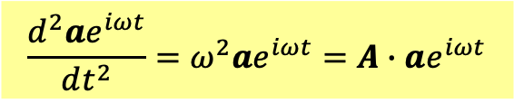
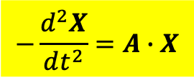
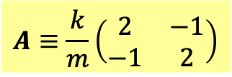

System of 2nd order Linear ODE with constant coefficients
$$−\frac{d^{2}X}{dt^{2}}=A∙X$$
Matrix $A$ is what determines the evolution of the system.
$$A≡\frac{k}{m}\left(\begin{matrix}2 & −1 \\ −1 & 2\end{matrix}\right)$$
Assume that
$$X=ae^{iωt}$$
$$\frac{d^{2}ae^{iωt}}{dt^{2}}=ω^{2}ae^{iωt}=A∙ae^{iωt}$$
$$A∙a=ω^{2}a$$
這是矩陣的本徵問題：線性代數Linear Algebra的中心問題。
This is the eigenvalue problem of a matrix, central to the subject Linear Algebra.

Slide 2
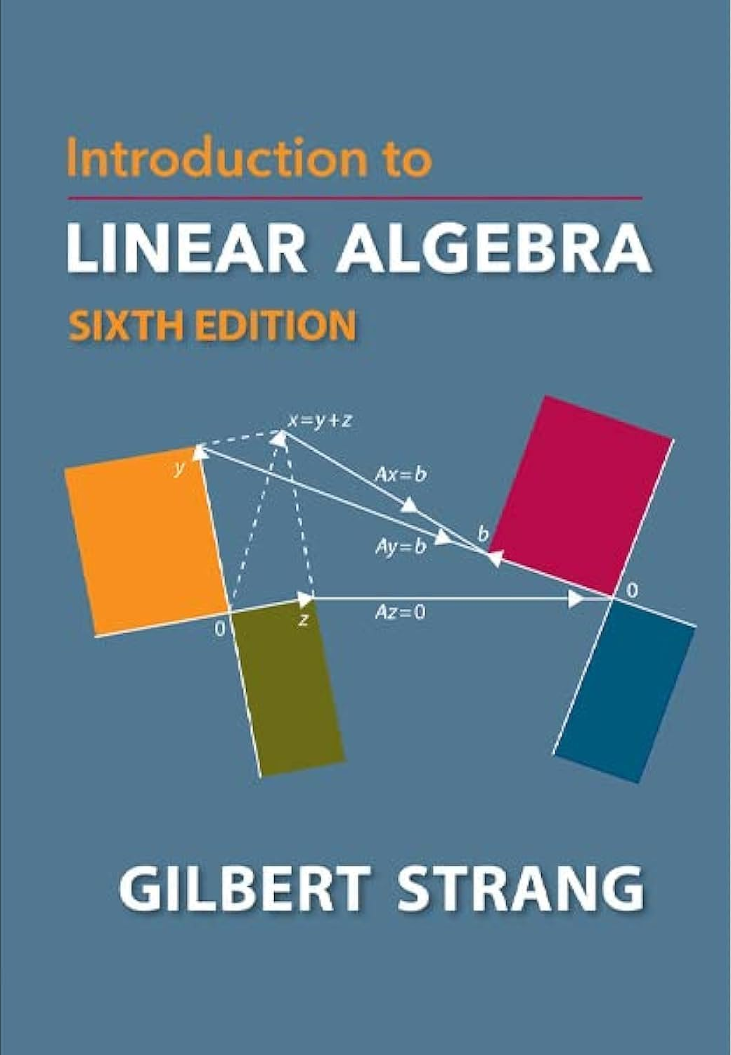

Slide 3
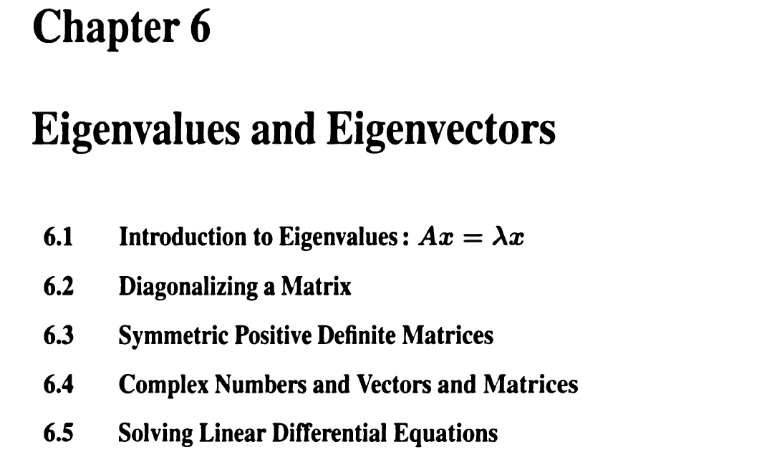
行向量與矩陣的本徵值問題
以下將以數學的角度來討論，都是規則與定理。
以下或許抽象，但因此任何物理，只要能表示為行向量與矩陣，以下定理都適用。

Slide 4




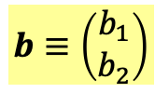


向量或行向量 vector or column vector
$$a≡\left(\begin{matrix}a_{1} \\ a_{2}\end{matrix}\right)$$
兩個數($→N$個數，實數或複數)：$a_{i}, i=1,2$，組成的一組數學量。
Two numbers $a_{i}, i=1,2$($→N$) forms a mathematical quantity, called column vector。
空間向量就是例子，但行向量不一定是空間向量，可以是彈簧組的位移。
Space vectors are example, but columns need not be space vectors, $x≡\left(\begin{matrix}x_{1} \\ x_{2}\end{matrix}\right)$ is not.
Like 3D vectors, Vectors can be multiplied by numbers, and two vectors can add up.
Linear combinations of vectors are still vectors. Vector space is also called linear space.
$$v=c_{1}a+c_{2}b$$
線性組合 Linear combinations
$$\left[\begin{matrix}0.6 \\ 0.4\end{matrix}\right]+2.0∙\left[\begin{matrix}0.1 \\ −0.1\end{matrix}\right]=\left[\begin{matrix}0.8 \\ 0.2\end{matrix}\right]$$
$$a≡\left(\begin{matrix}a_{1} \\ a_{2}\end{matrix}\right)$$
$$b≡\left(\begin{matrix}b_{1} \\ b_{2}\end{matrix}\right)$$
If the components of two vectors are proportional, we say they are in the same direction.
$$a=cb$$
$\left[\begin{matrix}0.8 \\ 0.2\end{matrix}\right]$ and $\left[\begin{matrix}0.4 \\ 0.1\end{matrix}\right]$ are in the same direction.

Slide 5




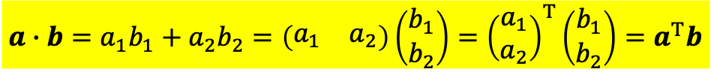



$$a≡\left(\begin{matrix}a_{1} \\ a_{2}\end{matrix}\right)$$
$$b≡\left(\begin{matrix}b_{1} \\ b_{2}\end{matrix}\right)$$
向量vector可以定義長度：
$$\left|a\right|=\sqrt{a_{1}^{2}+a_{1}^{2}}$$
從此延伸，可以定義兩個向量的內積inner product：
$$a∙b=a_{1}b_{1}+a_{2}b_{2}$$
$$\left|a\right|=\sqrt{a∙a}$$
行向量的transpose(轉置)稱為列row向量：
$$a^{T}≡{\left(\begin{matrix}a_{1} \\ a_{2}\end{matrix}\right)}^{T}=\left(\begin{matrix}a_{1} & a_{2}\end{matrix}\right)$$
The transpose of columns are called row vectors.
內積可以用行向量與列向量的矩陣乘積來寫：
$$a∙b=a_{1}b_{1}+a_{2}b_{2}=\left(\begin{matrix}a_{1} & a_{2}\end{matrix}\right)\left(\begin{matrix}b_{1} \\ b_{2}\end{matrix}\right)={\left(\begin{matrix}a_{1} \\ a_{2}\end{matrix}\right)}^{T}\left(\begin{matrix}b_{1} \\ b_{2}\end{matrix}\right)=a^{T}b$$
A row times a column equals a number, the inner product.
兩個向量的內積為零，這兩個向量就彼此正交perpendicular：
$$a^{T}b=0$$

Slide 6
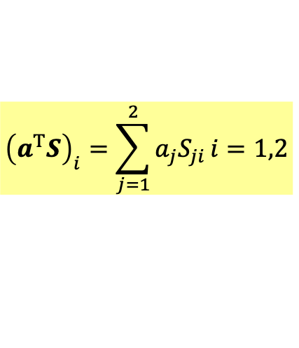
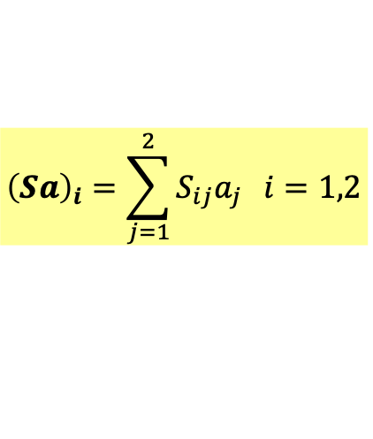


$2×2$ Matrix矩陣是兩組行向量(4個實數或複數)：$a_{ij}, i,j=1,2$，組成的數學量。
$$S=\left(\begin{matrix}S_{11} & S_{12} \\ S_{21} & S_{22}\end{matrix}\right)$$
也可以看成是兩組列向量。兩種看法都有用。
矩陣乘行向量得一行向量：A matrix times a column equals a column.
$$Sa=\left(\begin{matrix}S_{11} & S_{12} \\ S_{21} & S_{22}\end{matrix}\right)\left(\begin{matrix}a_{1} \\ a_{2}\end{matrix}\right)=\left(\begin{matrix}S_{11}a_{1}+S_{12}a_{2} \\ S_{21}a_{1}+S_{22}a_{2}\end{matrix}\right)$$
$${\left(Sa\right)}_{i}=\sum_{j=1}^{2}{S_{ij}a_{j}} i=1,2$$
此規則保證此乘積是線性的
$$S\left(c_{1}a_{1}+c_{2}a_{2}\right)=c_{1}Sa_{1}+c_{2}Sa_{2}$$
列向量乘矩陣得一列向量： A row times a matrix equals a row.
$$a^{T}S=\left(\begin{matrix}a_{1} & a_{2}\end{matrix}\right)\left(\begin{matrix}S_{11} & S_{12} \\ S_{21} & S_{22}\end{matrix}\right)=\left(a_{1}\begin{matrix}S_{11}+{a_{2}S}_{21} & {a_{1}S}_{12}+a_{2}S_{22}\end{matrix}\right)$$
$${\left(a^{T}S\right)}_{i}=\sum_{j=1}^{2}{a_{j}S_{ji}}i=1,2$$

Slide 7
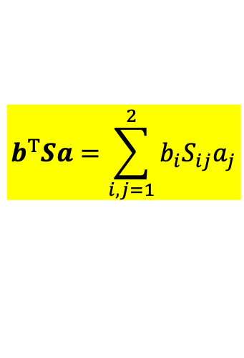
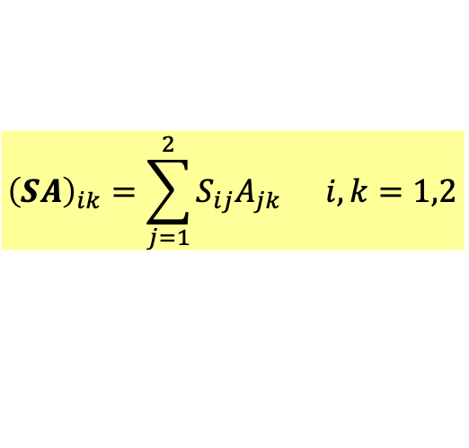
矩陣乘矩陣還是矩陣： A matrix times a matrix equals a matrix.
$$SA=\left(\begin{matrix}S_{11} & S_{12} \\ S_{21} & S_{22}\end{matrix}\right)\left(\begin{matrix}A_{11} & A_{12} \\ A_{21} & A_{22}\end{matrix}\right)=\left(\begin{matrix}S_{11}A_{11}+S_{12}A_{21} & S_{11}A_{12}+S_{12}A_{22} \\ S_{21}A_{11}+S_{22}A_{21} & S_{21}A_{12}+S_{22}A_{22}\end{matrix}\right)$$
21 element of $SA$ equals the inner product of the 2nd row of $S$ and the 1st column of $A$.
$${\left(SA\right)}_{ik}=\sum_{j=1}^{2}{S_{ij}A_{jk}} i,k=1,2$$
$ik$ element of $SA$ equals the inner product of the $i$th row of $S$ and the $k$th column of $A$.
列向量乘矩陣乘行向量，等於列向量乘行向量，得到一個數：
$$b^{T}Sa=\sum_{i,j=1}^{2}{b_{i}S_{ij}a_{j}}$$
A row times a matrix times a column equals a number.
This is called quadratic form.
Arfken p96-99

Slide 8
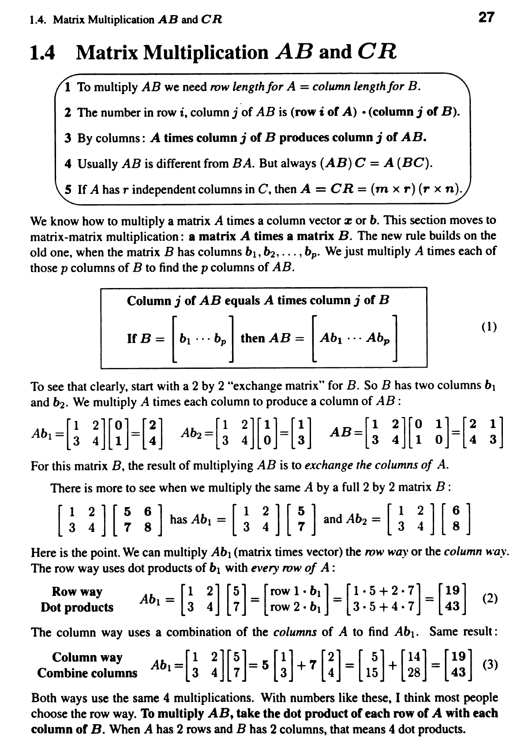

Slide 9
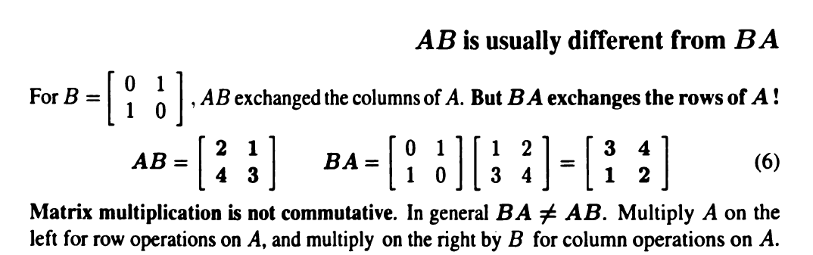
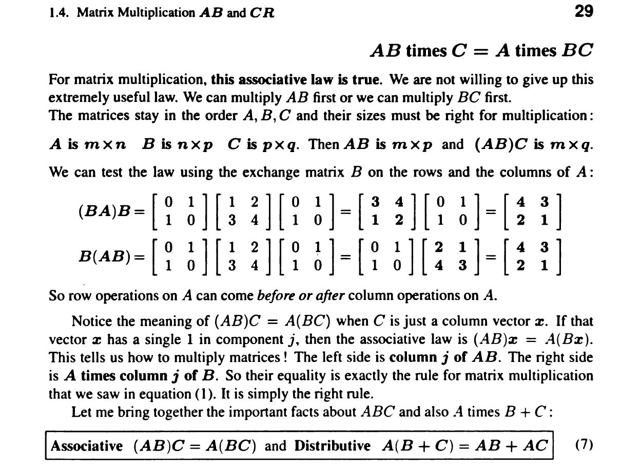

Slide 10



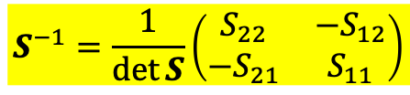







Inverse matrix
$$S^{−1}=\frac{1}{\det{S}}\left(\begin{matrix}S_{22} & −S_{12} \\ −S_{21} & S_{11}\end{matrix}\right)$$
Transpose of matrix $A$
$$A=\left(\begin{matrix}2 & 8 \\ 4 & 9\end{matrix}\right)$$
$$A^{T}=\left(\begin{matrix}2 & 4 \\ 8 & 9\end{matrix}\right)$$
$$A_{ij}^{T}=A_{ji}$$
例如
$$A_{12}^{T}=A_{21}$$
Symmetric Matrix
$$A=\left(\begin{matrix}2 & 8 \\ 4 & 9\end{matrix}\right)$$
$$A^{T}=\left(\begin{matrix}2 & 4 \\ 8 & 9\end{matrix}\right)$$
Not symmetric
$$S=\left(\begin{matrix}2 & 4 \\ 4 & 9\end{matrix}\right)=S^{T}=\left(\begin{matrix}2 & 4 \\ 4 & 9\end{matrix}\right)$$
Symmetric
$$S_{ij}=S_{ij}^{T}=S_{ji}$$
例如
$$S_{12}=S_{12}^{T}=S_{21}$$
Arfken p99, 104-107

Slide 11

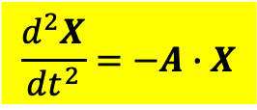

System of 2nd order Linear ODE with constant coefficients
$$\frac{d^{2}X}{dt^{2}}=−A∙X$$
Matrix $A$ is what determines the evolution of the system.
複變函數法
$$X=ae^{iωt}$$
Eigenvalue problem of matrix
$$A∙a=ω^{2}a$$
這是線性代數Linear Algebra的中心問題。

Slide 12

Eigenvalue problem of matrix
$$A∙a=λa$$
這代表矩陣$A$乘在行向量$a$，與一常數乘法沒有差異，並未改變$a$的方向。
This means multiplying a column by a matrix does not change its direction.
任一矩陣$A$有特定的行向量$a$，及對應的常數$λ$滿足上式。
For any specific matrix, there are specific columns $a$ with specific constant $λ$ that satisfy the condition.
行向量$a$稱為矩陣$A$的本徵向量eigenvector，常數$λ$稱為本徵值eigenvalue。
$a$’s are called eigenvectors while $λ^{′}s$ called eigenvalues of the matrix $A$.
To find $a$’s and $λ^{′}s$ is called eigenvalue problem of the matrix $A$.

Slide 13

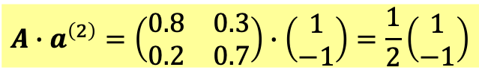








For example, take $A$ as a $2×2$ matrix.
$$A=\left(\begin{matrix}0.8 & 0.3 \\ 0.2 & 0.7\end{matrix}\right)$$
In general, $A$ times a vector will produce another vector not in the same direction.
$$A\left(\begin{matrix}0.8 \\ 0.2\end{matrix}\right)=\left(\begin{matrix}0.8 & 0.3 \\ 0.2 & 0.7\end{matrix}\right)∙\left(\begin{matrix}0.8 \\ 0.2\end{matrix}\right)=\left(\begin{matrix}0.7 \\ 0.3\end{matrix}\right)≠c∙\left(\begin{matrix}0.8 \\ 0.2\end{matrix}\right)$$
$$\left(0.8,0.2\right)$$
$$A$$
$$\left(0.7,0.3\right)$$
But there are two special vectors that matrix multiplication is just a number product.
$$A$$
$$\left(0.5,−0.5\right)$$
$$\left(1,−1\right)$$
$$A∙a^{\left(2\right)}=\left(\begin{matrix}0.8 & 0.3 \\ 0.2 & 0.7\end{matrix}\right)∙\left(\begin{matrix}1 \\ −1\end{matrix}\right)=\frac{1}{2}\left(\begin{matrix}1 \\ −1\end{matrix}\right)$$
For them, $A$ times the vector will produce a vector in the same direction.

Slide 14







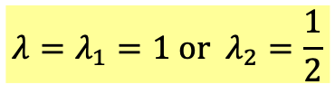
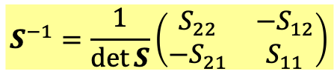
$A$ times its eigenvector will produce a vector in the same direction.
Solving eigenvalue problem of matrix
$$A∙a=λa$$
The procedure is general.
$$\left(A−λI\right)∙a=0$$
$$S^{−1}=\frac{1}{\det{S}}\left(\begin{matrix}S_{22} & −S_{12} \\ −S_{21} & S_{11}\end{matrix}\right)$$
$A−λI$ is also a matrix. If it has an inverse, the vector $a$ can only be zero:
$$a={\left(A−λI\right)}^{−1}∙0=0$$
For $λ$ to be an eigenvalue, the condition is $A−λI$ has no inverse
and hence the determinant of $A−λI$ is zero.
$$\left|A−λI\right|=0$$
$$A=\left(\begin{matrix}0.8 & 0.3 \\ 0.2 & 0.7\end{matrix}\right)$$
$$\left|A−λI\right|= \left|\begin{matrix}0.8−λ & 0.3 \\ 0.2 & 0.7−λ\end{matrix}\right|=λ^{2}−\frac{3}{2}λ+\frac{1}{2}=\left(λ−1\right)\left(λ−\frac{1}{2}\right)=0$$
$$λ=λ_{1}=1 or λ_{2}=\frac{1}{2}$$
are eigenvalues of $\left[\begin{matrix}0.8 & 0.3 \\ 0.2 & 0.7\end{matrix}\right]$.

Slide 15



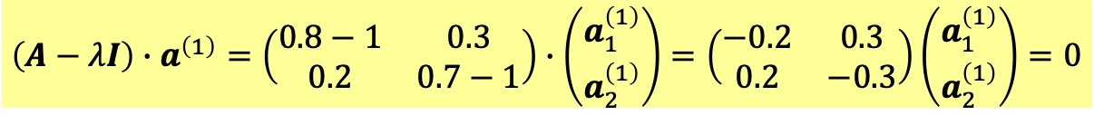

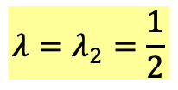
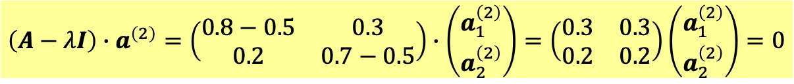


對特定的$λ$，我們可以解出對應的$a$:
For a specific $λ$, we can solve the corresponding columns $a$.
$$λ=λ_{1}=1$$
$$\left(A−λI\right)∙a^{\left(1\right)}=\left(\begin{matrix}0.8−1 & 0.3 \\ 0.2 & 0.7−1\end{matrix}\right)∙\left(\begin{matrix}a_{1}^{\left(1\right)} \\ a_{2}^{\left(1\right)}\end{matrix}\right)=\left(\begin{matrix}−0.2 & 0.3 \\ 0.2 & −0.3\end{matrix}\right)\left(\begin{matrix}a_{1}^{\left(1\right)} \\ a_{2}^{\left(1\right)}\end{matrix}\right)=0$$
$$0.2a_{1}^{\left(1\right)}=0.3a_{2}^{\left(1\right)}$$
Eigenvector has one undetermined constant.
$$a^{\left(1\right)}=c_{1}\left(\begin{matrix}0.6 \\ 0.4\end{matrix}\right)$$
同理：
$$λ=λ_{2}=\frac{1}{2}$$
$$\left(A−λI\right)∙a^{\left(2\right)}=\left(\begin{matrix}0.8−0.5 & 0.3 \\ 0.2 & 0.7−0.5\end{matrix}\right)∙\left(\begin{matrix}a_{1}^{\left(2\right)} \\ a_{2}^{\left(2\right)}\end{matrix}\right)=\left(\begin{matrix}0.3 & 0.3 \\ 0.2 & 0.2\end{matrix}\right)\left(\begin{matrix}a_{1}^{\left(2\right)} \\ a_{2}^{\left(2\right)}\end{matrix}\right)=0$$
$$0.3a_{1}^{\left(2\right)}=−0.3a_{2}^{\left(2\right)}$$
$$a^{\left(2\right)}=c_{2}\left(\begin{matrix}1 \\ −1\end{matrix}\right)$$

Slide 16
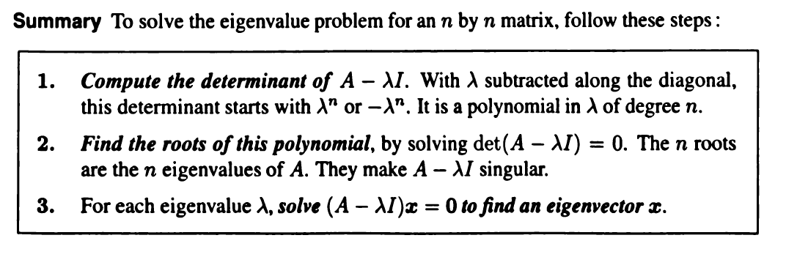

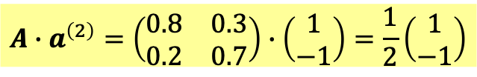
$A$ times the eigenvector will produce a vector in the same direction.
$$A∙a^{\left(1\right)}=\left(\begin{matrix}0.8 & 0.3 \\ 0.2 & 0.7\end{matrix}\right)∙\left(\begin{matrix}0.6 \\ 0.4\end{matrix}\right)=1\left(\begin{matrix}0.6 \\ 0.4\end{matrix}\right)$$
$$A∙a^{\left(2\right)}=\left(\begin{matrix}0.8 & 0.3 \\ 0.2 & 0.7\end{matrix}\right)∙\left(\begin{matrix}1 \\ −1\end{matrix}\right)=\frac{1}{2}\left(\begin{matrix}1 \\ −1\end{matrix}\right)$$
For the two special eigenvectors, matrix multiplication is just a number product.

Slide 17







Solving eigenvalue problem of matrix
我們再試一個矩陣，這次是一對稱矩陣！
$$S=\left(\begin{matrix}9 & 3 \\ 3 & 1\end{matrix}\right)$$
$$S∙u=λu$$
$$\left(S−λI\right)∙u=0$$
If it has an inverse, the vector $u$ can only be zero:
$$u={\left(S−λI\right)}^{−1}∙0=0$$
For $λ$ to be an eigenvalue, the condition is $S−λI$ has no inverse
and hence the determinant of $S−λI$ is zero.
det $\left(S−λI\right)=0$
det $\left(S−λI\right)=\text{det}\left[\begin{matrix}9−λ & 3 \\ 3 & 1−λ\end{matrix}\right]=λ^{2}−10λ=λ\left(λ−10\right)=0$
$$λ=λ_{1}=0 or λ_{2}=10$$
are eigenvalues.

Slide 18


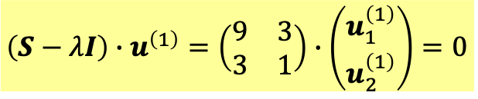

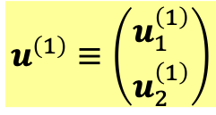


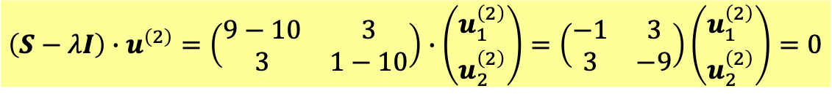


對特定的$λ$，我們可以解出對應的$u^{\left(1\right)},u^{\left(2\right)}$
$$u^{\left(1\right)}≡\left(\begin{matrix}u_{1}^{\left(1\right)} \\ u_{2}^{\left(1\right)}\end{matrix}\right)$$
$$λ=λ_{1}=0$$
$$\left(S−λI\right)∙u^{\left(1\right)}=\left(\begin{matrix}9 & 3 \\ 3 & 1\end{matrix}\right)∙\left(\begin{matrix}u_{1}^{\left(1\right)} \\ u_{2}^{\left(1\right)}\end{matrix}\right)=0$$
$$3u_{1}^{\left(1\right)}=−u_{2}^{\left(1\right)}$$
Eigenvector has one undetermined constant.
$$u^{\left(1\right)}=c_{1}\left(\begin{matrix}1 \\ −3\end{matrix}\right)$$
同理：
$$λ=λ_{2}=10$$
$$\left(S−λI\right)∙u^{\left(2\right)}=\left(\begin{matrix}9−10 & 3 \\ 3 & 1−10\end{matrix}\right)∙\left(\begin{matrix}u_{1}^{\left(2\right)} \\ u_{2}^{\left(2\right)}\end{matrix}\right)=\left(\begin{matrix}−1 & 3 \\ 3 & −9\end{matrix}\right)\left(\begin{matrix}u_{1}^{\left(2\right)} \\ u_{2}^{\left(2\right)}\end{matrix}\right)=0$$
$$u_{1}^{\left(2\right)}=3u_{2}^{\left(2\right)}$$
$$u^{\left(2\right)}=c_{2}\left(\begin{matrix}3 \\ 1\end{matrix}\right)$$

Slide 19
There are two beautiful theorems that illustrate the utility of eigenvectors
The eigenvectors and eigenvalues are representations of a matrix!

Slide 20
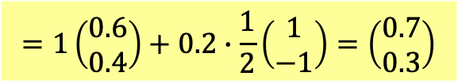





Theorem: All vectors can be written as the linear combination of eigenvectors $a^{\left(1\right)}$and $a^{\left(2\right)}$.
$$X=c_{1}a^{\left(1\right)}+c_{2}a^{\left(2\right)}$$
These are two equations for two unknowns $c_{1,2}$.
As long as $a^{\left(1\right)}$and $a^{\left(2\right)}$ are not in the same directions, $c_{1,2}$ can be solved.
$$X=\left(\begin{matrix}0.8 \\ 0.2\end{matrix}\right)=c_{1}\left(\begin{matrix}0.6 \\ 0.4\end{matrix}\right)+c_{2}\left(\begin{matrix}1 \\ −1\end{matrix}\right)$$
$$c_{1}=1, c_{2}=0.2$$
$$X=a^{\left(1\right)}+2a^{\left(2\right)}$$
Then the action of $A$ on any vector $X$ can be easily written down:
$$AX=A\left(c_{1}a^{\left(1\right)}+c_{2}a^{\left(2\right)}\right)=c_{1}Aa^{\left(1\right)}+c_{2}Aa^{\left(2\right)}=c_{1}λ_{1}a^{\left(1\right)}+c_{2}λ_{2}a^{\left(2\right)}$$
For example:
$$AX=\left(\begin{matrix}0.8 & 0.3 \\ 0.2 & 0.7\end{matrix}\right)∙\left(\begin{matrix}0.8 \\ 0.2\end{matrix}\right)=A∙a^{\left(1\right)}+2A∙a^{\left(2\right)}$$
$$=1\left(\begin{matrix}0.6 \\ 0.4\end{matrix}\right)+0.2∙\frac{1}{2}\left(\begin{matrix}1 \\ −1\end{matrix}\right)=\left(\begin{matrix}0.7 \\ 0.3\end{matrix}\right)$$
The information in the eigenvectors and eigenvalues alone can represent the matrix!
一個矩陣的本徵值與本徵向量就足夠能代表該矩陣。

Slide 21
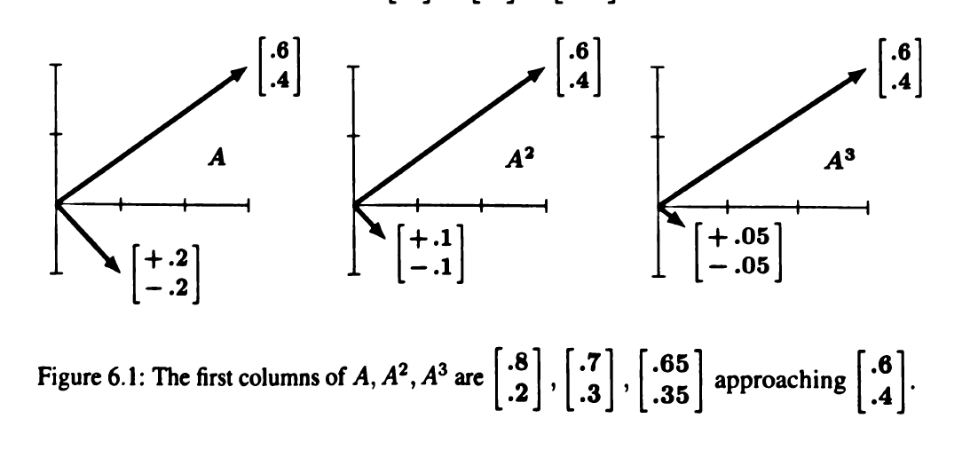

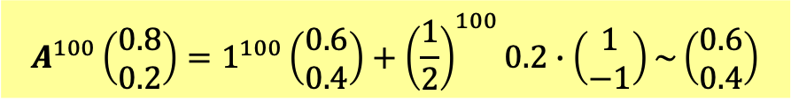

Theorem: The eigenvectors $a$ of $A$ are also eigenvectors of $A^{n}$ with the eigenvalue $λ^{n}$.
$$A∙a=λa$$
$$A^{n}∙a=λ^{n}a$$
$$A^{n}a=A^{n−1}Aa=A^{n−1}∙λa=λA^{n−2}∙Aa=λA^{n−2}∙λa⋯=λ^{n}a$$
The action of $A^{n}$ on any vector $X$ can also be written down similarly:
$$A^{n}X=c_{1}A^{n}a^{\left(1\right)}+c_{2}A^{n}a^{\left(2\right)}=c_{1}λ_{1}^{n}a^{\left(1\right)}+c_{2}λ_{2}^{n}a^{\left(2\right)}$$
$$A^{100}\left(\begin{matrix}0.8 \\ 0.2\end{matrix}\right)=1^{100}\left(\begin{matrix}0.6 \\ 0.4\end{matrix}\right)+{\left(\frac{1}{2}\right)}^{100}0.2∙\left(\begin{matrix}1 \\ −1\end{matrix}\right)\sim \left(\begin{matrix}0.6 \\ 0.4\end{matrix}\right)$$
This matrix is called a Markov matrix, with an eigenvalue $=1$, the other $<1$.
The repeated action of a Markov matrix will push any vector into the eigenvector with $λ=1$.

Slide 22

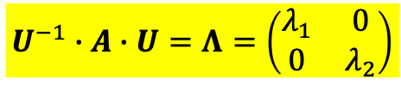



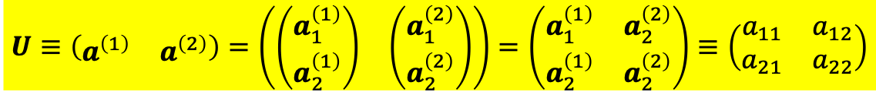
Diagonalizing a matrix 對角化
$$A∙a^{\left(1\right)}=λ_{1}a^{\left(1\right)}$$
$$A∙a^{\left(2\right)}=λ_{2}a^{\left(2\right)}$$
$a_{1},a_{2}$ are column vectors and we can use them to form a matrix.
$$U≡\left(\begin{matrix}a^{\left(1\right)} & a^{\left(2\right)}\end{matrix}\right)=\left(\begin{matrix}\left(\begin{matrix}a_{1}^{\left(1\right)} \\ a_{2}^{\left(1\right)}\end{matrix}\right) & \left(\begin{matrix}a_{1}^{\left(2\right)} \\ a_{2}^{\left(2\right)}\end{matrix}\right)\end{matrix}\right)=\left(\begin{matrix}a_{1}^{\left(1\right)} & a_{2}^{\left(2\right)} \\ a_{2}^{\left(1\right)} & a_{2}^{\left(2\right)}\end{matrix}\right)≡\left(\begin{matrix}a_{11} & a_{12} \\ a_{21} & a_{22}\end{matrix}\right)$$
$$AU=\left(\begin{matrix}A_{11} & A_{12} \\ A_{21} & A_{22}\end{matrix}\right)\left(\begin{matrix}\left(\begin{matrix}a_{11} \\ a_{21}\end{matrix}\right) & \left(\begin{matrix}a_{12} \\ a_{22}\end{matrix}\right)\end{matrix}\right)=\left(\begin{matrix}{Aa}^{\left(1\right)} & Aa^{\left(2\right)}\end{matrix}\right)=\left(λ_{1}\begin{matrix}a^{\left(1\right)} & λ_{2}a^{\left(2\right)}\end{matrix}\right)$$
$$=\left(\begin{matrix}{λ_{1}a}_{11} & λ_{2}a_{12} \\ λ_{1}a_{21} & λ_{2}a_{22}\end{matrix}\right)=\left(\begin{matrix}a_{11} & a_{12} \\ a_{21} & a_{22}\end{matrix}\right)\left(\begin{matrix}λ_{1} & 0 \\ 0 & λ_{2}\end{matrix}\right)=U∙Λ$$
$$AU=UΛ$$
兩邊左乘$U$的反矩陣$U^{−1}$ Multiply both sides on the left by $U^{−1}$：
$$U^{−1}∙A∙U=Λ=\left(\begin{matrix}λ_{1} & 0 \\ 0 & λ_{2}\end{matrix}\right)$$
is diagonal with eigenvalues as diagonal elements.
$U^{−1}AU$是一個對角矩陣，矩陣元素就是本徵值！

Slide 23



$$AU=UΛ$$
兩邊右乘$U^{−1}$ Multiply both sides on the right by $U^{−1}$：
$$A=UΛU^{−1}=U\left(\begin{matrix}λ_{1} & 0 \\ 0 & λ_{2}\end{matrix}\right)U^{−1}$$
Any Matrix can be decomposed into 3 factors,
involving just eigenvalues and eigenvectors.
Info. of eigenvalues
Info. of eigenvectors
$$\left[\begin{matrix}0.8 & 0.3 \\ 0.2 & 0.7\end{matrix}\right]=\left[\begin{matrix}0.6 & 1 \\ 0.4 & −1\end{matrix}\right]\left[\begin{matrix}1 & 0 \\ 0 & 0.5\end{matrix}\right]\left[\begin{matrix}1 & 1 \\ 0.4 & −0.6\end{matrix}\right]$$
一個矩陣的本徵值與本徵向量就足夠能代表該矩陣。

Slide 24
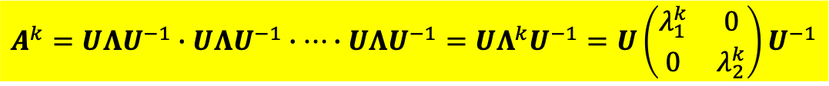
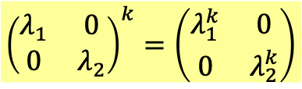

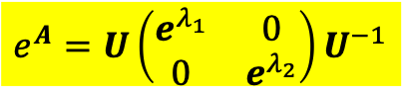
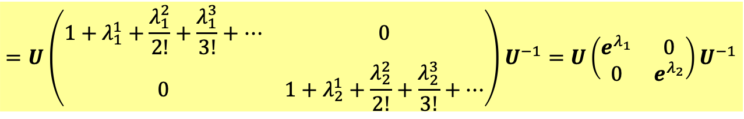
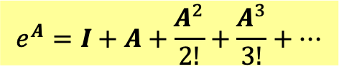
對角矩陣的冪次很容易計算 It is easy to compute the powers of a diagonal matrix:
$${\left(\begin{matrix}λ_{1} & 0 \\ 0 & λ_{2}\end{matrix}\right)}^{k}=\left(\begin{matrix}λ_{1}^{k} & 0 \\ 0 & λ_{2}^{k}\end{matrix}\right)$$
$$A=UΛU^{−1}$$
This formula is useful for the following calculation!
$$A^{k}=UΛU^{−1}∙UΛU^{−1}∙⋯∙UΛU^{−1}=UΛ^{k}U^{−1}=U\left(\begin{matrix}λ_{1}^{k} & 0 \\ 0 & λ_{2}^{k}\end{matrix}\right)U^{−1}$$
矩陣的指數函數很容易定義。We can define the exponential function of a matrix.
$$e^{A}=I+A+\frac{A^{2}}{2!}+\frac{A^{3}}{3!}+⋯$$
$$=U\left(\begin{matrix}1+λ_{1}^{1}+\frac{λ_{1}^{2}}{2!}+\frac{λ_{1}^{3}}{3!}+⋯ & 0 \\ 0 & 1+λ_{2}^{1}+\frac{λ_{2}^{2}}{2!}+\frac{λ_{2}^{3}}{3!}+⋯\end{matrix}\right)U^{−1}=U\left(\begin{matrix}e^{λ_{1}} & 0 \\ 0 & e^{λ_{2}}\end{matrix}\right)U^{−1}$$
$$e^{A}=U\left(\begin{matrix}e^{λ_{1}} & 0 \\ 0 & e^{λ_{2}}\end{matrix}\right)U^{−1}$$

Slide 25

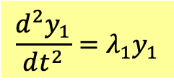

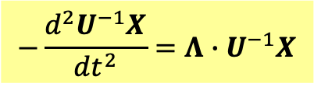
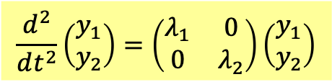
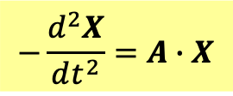

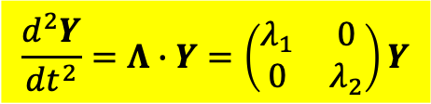
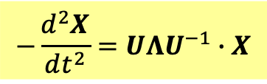




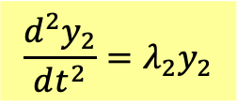
利用對角化後的矩陣，線性微分方程組很容易求解：
$$−\frac{d^{2}X}{dt^{2}}=A∙X$$
$$A=UΛU^{−1}$$
$$−\frac{d^{2}X}{dt^{2}}=UΛU^{−1}∙X$$
$$−\frac{d^{2}U^{−1}X}{dt^{2}}=Λ∙U^{−1}X$$
$$Λ=\left(\begin{matrix}λ_{1} & 0 \\ 0 & λ_{2}\end{matrix}\right)$$
兩邊乘$U^{−1}$
選擇Generalized Coordinates 廣義座標$y_{1},y_{2}$：
$$Y=\left(\begin{matrix}y_{1} \\ y_{2}\end{matrix}\right)=U^{−1}X=U^{−1}\left(\begin{matrix}x_{1} \\ x_{2}\end{matrix}\right)$$
這兩個線性組合滿足的微分方程非常簡單：
$$\frac{d^{2}Y}{dt^{2}}=Λ∙Y=\left(\begin{matrix}λ_{1} & 0 \\ 0 & λ_{2}\end{matrix}\right)Y$$
$$\frac{d^{2}}{dt^{2}}\left(\begin{matrix}y_{1} \\ y_{2}\end{matrix}\right)=\left(\begin{matrix}λ_{1} & 0 \\ 0 & λ_{2}\end{matrix}\right)\left(\begin{matrix}y_{1} \\ y_{2}\end{matrix}\right)$$
$$\frac{d^{2}y_{1}}{dt^{2}}=λ_{1}y_{1}$$
$$\frac{d^{2}y_{2}}{dt^{2}}=λ_{2}y_{2}$$
負責廣義座標的時間演化的矩陣是對角的，因此無耦合，此廣義座標彼此獨立。
這樣的廣義座標$y_{1},y_{2}$稱為Normal Coordinates，獨立作簡諧運動！
$$y_{1}=c_{1}cos\left(\sqrt{λ_{1}}t+φ_{1}\right)$$
$$y_{2}=c_{2}cos\left(\sqrt{λ_{2}}t+φ_{2}\right)$$

Slide 26
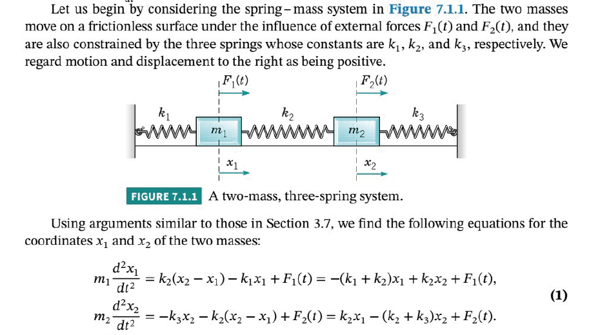

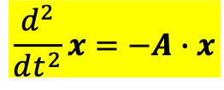

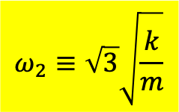

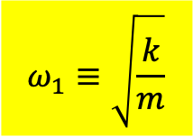

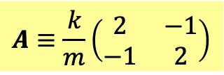

以耦合振盪為例：
$$\frac{d^{2}}{dt^{2}}x=−A∙x$$
$$A≡\frac{k}{m}\left(\begin{matrix}2 & −1 \\ −1 & 2\end{matrix}\right)$$
$$x≡\left(\begin{matrix}x_{1} \\ x_{2}\end{matrix}\right)=\left(\begin{matrix}a_{1} \\ a_{2}\end{matrix}\right)e^{iωt}$$
$$A∙a=ω^{2}a$$
本徵值有兩個，各自對應一本徵向量。
$$ω_{1}≡\sqrt{\frac{k}{m}}$$
$$a^{\left(1\right)}=C_{1}\left(\begin{matrix}1 \\ 1\end{matrix}\right)$$
$$ω_{2}≡\sqrt{3}\sqrt{\frac{k}{m}}$$
$$a^{\left(2\right)}=C_{2}\left(\begin{matrix}1 \\ −1\end{matrix}\right)$$
代入前面的解：
$$\left(\begin{matrix}x_{1} \\ x_{2}\end{matrix}\right)=c_{1}\left(\begin{matrix}1 \\ 1\end{matrix}\right)cos{ ω}_{1}t{+}c_{2}\left(\begin{matrix}1 \\ −1\end{matrix}\right)cos ω_{2}t$$

Slide 27
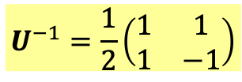




如果用對角化矩陣來思考：
$$U≡\left(\begin{matrix}a^{\left(1\right)} & a^{\left(1\right)}\end{matrix}\right)=\left(\begin{matrix}a_{11} & a_{12} \\ a_{21} & a_{22}\end{matrix}\right)=\left(\begin{matrix}1 & 1 \\ 1 & −1\end{matrix}\right)$$
$$U^{−1}=\frac{1}{2}\left(\begin{matrix}1 & 1 \\ 1 & −1\end{matrix}\right)$$
$$Y=\left(\begin{matrix}y_{1} \\ y_{2}\end{matrix}\right)=U^{−1}X=\frac{1}{2}\left(\begin{matrix}1 & 1 \\ 1 & −1\end{matrix}\right)\left(\begin{matrix}x_{1} \\ x_{2}\end{matrix}\right)$$
這樣的廣義座標$y_{1},y_{2}$稱為Normal Coordinates，獨立作簡諧運動！
$$y_{1}=\frac{1}{2}\left(x_{1}+x_{2}\right)=x_{+}$$
$$y_{2}=\frac{1}{2}\left(x_{1}−x_{2}\right)=x_{−}$$
如果一開始的起始條件，就使模式座標只有一個不為零，
彈簧組就會以該模式作單純的簡諧運動。

Slide 28








對稱運動模式
反對稱運動模式
物體的變形會有無限多個模式，可以一個一個編號。
每一個模式，如同簡諧運動，對應一個內在的特定的振動頻率！
不同模式頻率不同。一般來說，頻率越高的模式，越難激發。

Slide 29





$$A≡\left(\begin{matrix}\frac{k_{1}+k_{2}}{m} & −\frac{k_{2}}{m} \\ −\frac{k_{2}}{m} & \frac{k_{2}+k_{3}}{m}\end{matrix}\right)$$
考慮一般的耦合振盪為例：
$$\frac{d^{2}}{dt^{2}}x=−A∙x$$
$$x≡\left(\begin{matrix}x_{1} \\ x_{2}\end{matrix}\right)=\left(\begin{matrix}a_{1} \\ a_{2}\end{matrix}\right)e^{iωt}$$
$$A∙a=ω^{2}a=λa$$
Every eigenvalue corresponds to a single oscillation mode.
But are you sure that the eigenvalues $ω_{1}^{2},ω_{2}^{2}$ are both positive?
$ω_{1}^{2},ω_{2}^{2}>?0$
If $ω^{2}<0$, $e^{iωt}$ is an exponential function instead of oscillating function.
Will prove if matrix $S$ is symmetric and positive definite, eigenvalues $ω^{2}$ are both positive.
And for coupled system the matrix $S$ is symmetric and positive definite.

Slide 30




對稱矩陣
定理：一個對稱矩陣的本徵值都是實數，且不同本徵值的本徵向量彼此正交。
All $n$ eigenvalues $λ$ of a symmetric matrix $S$ are real.
The $n$ eigenvectors $u$ can be chosen to be orthogonal.
反例：$\left[\begin{matrix}0.8 & 0.3 \\ 0.2 & 0.7\end{matrix}\right]$.
$$a^{\left(1\right)}=c_{1}\left[\begin{matrix}0.6 \\ 0.4\end{matrix}\right]$$
$$a^{\left(2\right)}=c_{2}\left[\begin{matrix}1 \\ −1\end{matrix}\right]$$
$$a^{\left(1\right)}∙a^{\left(2\right)}≠0$$

Slide 31












$$S=\left(\begin{matrix}9 & 3 \\ 3 & 1\end{matrix}\right)$$
這就是對稱矩陣。
$$λ=λ_{1}=0$$
$$\left(S−λI\right)∙u^{\left(1\right)}=\left(\begin{matrix}9 & 3 \\ 3 & 1\end{matrix}\right)∙\left(\begin{matrix}a_{11} \\ a_{21}\end{matrix}\right)$$
$$3u_{11}=u_{21}$$
$$u^{\left(1\right)}=c_{1}\left(\begin{matrix}1 \\ 3\end{matrix}\right)$$
可以選常數$c_{1}$使向量長度為1:
$$u^{\left(1\right)}=\frac{1}{\sqrt{10}}\left(\begin{matrix}1 \\ 3\end{matrix}\right)$$
Choose $c_{1}$ so that the length equals 1:
$$λ=λ_{2}=10$$
$$u^{\left(2\right)}=c_{2}\left(\begin{matrix}3 \\ −1\end{matrix}\right)→\frac{1}{\sqrt{10}}\left(\begin{matrix}3 \\ −1\end{matrix}\right)$$
很容易確認這兩個本徵向量是彼此正交。 $u^{\left(1\right)}$ and $u^{\left(2\right)}$ are orthogonal.
$$u^{\left(2\right)T}u^{\left(1\right)}=u^{\left(2\right)}∙u^{\left(1\right)}=0$$
$$u^{\left(m\right)T}u^{\left(n\right)}=u^{\left(m\right)}∙u^{\left(n\right)}=δ_{mn}$$
這兩個向量稱為orthonormal.

Slide 32





All $n$ eigenvalues $λ^{′}s$ of a symmetric matrix $S$ are real.
Proof:
$$Su=λu$$
Take inner product of the both sides with the complex conjugate of eigenvector $u^{∗}$.
$$u^{∗T}Su=λu^{∗T}u$$
$u^{∗T}u=u_{1}^{∗}u_{1}+u_{2}^{∗}u_{2}$ is real by definition. 這是複數行向量的內積，定義必定為實數。
要確認$u^{∗T}Su$是否是實數，取他的Complex conjugate
$${\left(u^{∗T}Su\right)}^{∗}={\left(\sum_{i,j=1}^{2}{u_{i}^{∗}S_{ij}u_{j}}\right)}^{∗}=\sum_{i,j=1}^{2}{u_{i}S_{ij}^{∗}u_{j}^{∗}}=\sum_{i,j=1}^{2}{u_{j}^{∗}}S_{ij}u_{i}=\sum_{i,j=1}^{2}{u_{j}^{∗}}S_{ji}u_{i}=u^{∗T}Su$$
$S$ is real實數
$S$ is 對稱 symmetric
$u^{∗T}Su$ is real. Hence $λ^{′}s$ are real. And $u$’s are real too.
$λ$是實數，$S$是實數，解$u$的方程式都是實數，$u$自然就是實數。

Slide 33











The $n$ eigenvectors $u$ can be chosen to be orthogonal.
Proof:
Consider two eigenvectors with different eigenvalues:
$$Su^{\left(1\right)}=λ_{1}u^{\left(1\right)}$$
將第一式與$u^{\left(2\right)}$作內積，可得：
Take inner product of the both sides with $u^{\left(2\right)}.$
$$u^{\left(2\right)T}Su^{\left(1\right)}=λ_{1}u^{\left(2\right)T}u^{\left(1\right)}$$
左邊可以寫成:
$$S_{ij}=S_{ji}$$
$$u^{\left(2\right)T}Su^{\left(1\right)}=\sum_{i,j=1}^{2}{u_{2i}S_{ij}u_{1j}}=\sum_{i,j=1}^{2}{u_{1j}S_{ji}u_{2i}}=u^{\left(1\right)T}∙Su^{\left(2\right)}=u^{\left(1\right)T}λ_{2}u^{\left(2\right)}=λ_{2}u^{\left(2\right)T}u^{\left(1\right)}$$
$$Su^{\left(2\right)}=λ_{2}u^{\left(2\right)}$$
$$λ_{1}u^{\left(2\right)T}u^{\left(1\right)}=λ_{2}u^{\left(2\right)T}u^{\left(1\right)}$$
$$0=\left(λ_{1}−λ_{2}\right)u^{\left(2\right)T}u^{\left(1\right)}$$
右式兩本徵向量的內積必須為零，彼此正交！
$$u^{\left(2\right)T}u^{\left(1\right)}=u^{\left(2\right)}∙u^{\left(1\right)}=0$$
本徵向量的正交性
可以選本徵向量的長度都為1，
$$u^{\left(m\right)T}u^{\left(n\right)}=u^{\left(m\right)}∙u^{\left(n\right)}=δ_{mn}$$
這兩個向量稱為orthonormal.

Slide 34







展開定理
定理：若有兩個orthonormal的向量，任何向量都可展開成他們的線性組合，
With two orthonormal vectors , any vector can be written as their linear combination.
且係數很容易寫下！with the coefficients easily computed.
給定任一向量：$v$，若展開可以如下：
$$v=c_{1}u^{\left(1\right)}+c_{2}u^{\left(2\right)}$$
取向量$v$與本徵向量$u_{1}$的內積：
$$u^{\left(1\right)T}v=u^{\left(1\right)T}\left(c_{1}u^{\left(1\right)}+c_{2}u^{\left(2\right)}\right)=c_{1}u^{\left(1\right)T}u^{\left(1\right)}+c_{2}u^{\left(1\right)T}u^{\left(2\right)}$$
代入正交關係：
$$u^{\left(1\right)T}u^{\left(2\right)}=0$$
$$u^{\left(1\right)T}u^{\left(1\right)}=1$$
$$u^{\left(1\right)T}v=u^{\left(1\right)}∙v=c_{1}$$
同理：
$$u^{\left(2\right)T}v=u^{\left(2\right)}∙v=c_{2}$$

Slide 35




展開定理
給定任一向量：$v$，可以展開如下：
$$v=c_{1}u^{\left(1\right)}+c_{2}u^{\left(2\right)}$$
$$u^{\left(1\right)T}v=u^{\left(1\right)}∙v=c_{1}$$
$$u^{\left(2\right)T}v=u^{\left(2\right)}∙v=c_{2}$$

Slide 36



向量可以用它的分量表示！
把一向量投影在選取的座標軸上即是它的分量！
$$\vec{a}=a_{x}\hat{i}+a_{y}\hat{j}=\left(a_{x},a_{y}\right)$$
分量法
$$a_{x}=\hat{i}∙\vec{a}, a_{y}=\hat{j}∙\vec{a}$$
這兩個orthonormal的本徵向量$u_{1},u_{2}$，類似組成一組座標軸的單位向量$\hat{i},\hat{j}$！

Slide 37







使對稱矩陣$S$對角化的矩陣$U$，有很好的性質：
$$U≡\left(\begin{matrix}u^{\left(1\right)} & u^{\left(2\right)}\end{matrix}\right)=\left(\begin{matrix}\left(\begin{matrix}a_{11} \\ a_{21}\end{matrix}\right) & \left(\begin{matrix}a_{12} \\ a_{22}\end{matrix}\right)\end{matrix}\right)$$
$$U^{T}≡\left(\begin{matrix}\left(\begin{matrix}a_{11} & a_{21}\end{matrix}\right) \\ \left(\begin{matrix}a_{12} & a_{22}\end{matrix}\right)\end{matrix}\right)=\left(\begin{matrix}u^{\left(1\right)} \\ u^{\left(2\right)}\end{matrix}\right)$$
$$u^{\left(1\right)T}u^{\left(2\right)}=0$$
$$u^{\left(1\right)T}u^{\left(1\right)}=1$$
$$U^{T}U≡\left(\begin{matrix}\left(\begin{matrix}a_{11} & a_{21}\end{matrix}\right) \\ \left(\begin{matrix}a_{12} & a_{22}\end{matrix}\right)\end{matrix}\right)\left(\begin{matrix}\left(\begin{matrix}a_{11} \\ a_{21}\end{matrix}\right) & \left(\begin{matrix}a_{12} \\ a_{22}\end{matrix}\right)\end{matrix}\right)=\left(\begin{matrix}u^{\left(1\right)} \\ u^{\left(2\right)}\end{matrix}\right)\left(\begin{matrix}u^{\left(1\right)} & u^{\left(2\right)}\end{matrix}\right)=\left(\begin{matrix}1 & 0 \\ 0 & 1\end{matrix}\right)$$
$$U^{−1}=U^{T}$$
定理：因此任一對稱矩陣$S$可以表示為對角化的矩陣，夾在$U,U^{T}$之間。
$$S=UΛU^{T}=U\left(\begin{matrix}λ_{1} & 0 \\ 0 & λ_{2}\end{matrix}\right)U^{T}$$
$U^{T}$比$U^{−1}$更容易寫！

Slide 38










The $n$ eigenvectors $u$ can be chosen to be orthogonal.
Proof:
Consider two eigenvectors with different eigenvalues:
$$Su_{1}=λ_{1}u_{1}$$
$$Su_{2}=λ_{2}u_{2}$$
將第一式與$u_{2}$作內積，可得：
$$u_{2}^{T}Su_{1}=λ_{1}u_{2}^{T}u_{1}$$
將第二式與$u_{1}$作內積，注意內積前後順序可對調，得：
$$u_{1}^{T}Su_{2}=λ_{2}u_{1}^{T}u_{2}=λ_{2}u_{2}^{T}u_{1}$$
兩式相減：
$$u_{2}^{T}Su_{1}−u_{1}^{T}Su_{2}=\left(λ_{1}−λ_{2}\right)u_{2}^{T}u_{1}$$
因$S$是對稱矩陣，左手邊的兩項相等，相減為零！
$$u_{2}^{T}Su_{1}={\left(u_{2}^{T}Su_{1}\right)}^{T}=u_{1}^{T}S^{T}u_{2}=u_{1}^{T}Su_{2}$$
也可以用分量來看：
$$u_{2}^{T}Su_{1}=\sum_{i,j=1}^{2}{u_{2i}S_{ij}u_{1j}}=\sum_{i,j=1}^{2}{u_{2i}}S_{ji}u_{1j}=\sum_{i,j=1}^{2}{u_{1j}S_{ji}u_{2i}}=u_{1}^{T}Su_{2}$$
右式兩本徵向量的內積必須為零，彼此正交！
$$u_{2}^{T}u_{1}=0$$
$$u_{m}^{T}u_{n}=δ_{mn}$$
本徵向量的正交性

Slide 39





Positive Definite 正定矩陣與二次型
$$\left(\begin{matrix}\frac{d^{2}x_{1}}{dt^{2}} \\ \frac{d^{2}x_{2}}{dt^{2}}\end{matrix}\right)=−\left(\begin{matrix}\frac{k_{1}+k_{2}}{m} & −\frac{k_{2}}{m} \\ −\frac{k_{2}}{m} & \frac{k_{2}+k_{3}}{m}\end{matrix}\right)\left(\begin{matrix}x_{1} \\ x_{2}\end{matrix}\right)≡S∙x$$
彈簧組物理還可以以能量討論：
$$V=\frac{1}{2}k_{2}{\left(x_{2}−x_{1}\right)}^{2}+\frac{1}{2}k_{1}x_{1}^{2}+\frac{1}{2}k_{3}x_{2}^{2}$$
$$=\frac{1}{2}\left(k_{1}+k_{2}\right)x_{1}^{2}+k_{2}x_{1}x_{2}+\frac{1}{2}\left(k_{2}+k_{3}\right)x_{2}^{2}$$
$$=m\left(x_{1},x_{2}\right)\left(\begin{matrix}\frac{k_{1}+k_{2}}{m} & −\frac{k_{2}}{m} \\ −\frac{k_{2}}{m} & \frac{k_{2}+k_{3}}{m}\end{matrix}\right)\left(\begin{matrix}x_{1} \\ x_{2}\end{matrix}\right)≡m x^{T}Sx$$
Quadratic form 二次型 of the matrix $A$.

Slide 40


要確定$ω$有兩個實數解，本徵值$λ$必須是正實數才行！
To be sure that $ω$ has two real solutions, eigenvalue $λ$ must be positive.
若Quadratic form 二次型 $x^{T}Sx$ 恆為正值，此矩陣$S$為正定矩陣。
If Quadratic form $x^{T}Sx$ is always positive, the matrix $S$ is Positive Definite 正定.
Theorem: if $S$ is positive definite, all the eigenvalues are positive.
Pick $x=u_{1}$. $u_{1}^{T}Su_{1}$ is known to be positive。
$$u^{\left(1\right)T}Su^{\left(1\right)}=λ_{1}u^{\left(1\right)T}u^{\left(1\right)}=λ_{1}$$
$λ_{1}$ is positive and so is $λ_{2}$.
彈簧組位能恆為正，因此$S$為正定矩陣：本徵值$λ$都是正數。
For coupled oscillation, potential is alwayspositive and hence $S$ is positive definite.
$$V=\frac{1}{2}k_{2}{\left(x_{2}−x_{1}\right)}^{2}+\frac{1}{2}k_{1}x_{1}^{2}+\frac{1}{2}k_{3}x_{2}^{2}=m x^{T}Sx$$
Both eigenvalues are positive. $ω=\sqrt{λ}$ are both real.
模式頻率：$ω=\sqrt{λ}$ 都是實數。

Slide 41




Theorem: If all the eigenvalues of $S$ are positive, $S$ is positive definite. $x^{T}Sx>0$.
$$u^{\left(1\right)T}Su^{\left(1\right)}=λ_{1}u^{\left(1\right)T}u^{\left(1\right)}=λ_{1}$$
$$u^{\left(2\right)T}Su^{\left(2\right)}=λ_{2}$$
Any vector $x$ can be expanded as
$$x=c_{1}u^{\left(1\right)}+c_{2}u^{\left(2\right)}$$
$$x^{T}Sx={\left(c_{1}u^{\left(1\right)}+c_{2}u^{\left(2\right)}\right)}^{T}S\left(c_{1}u^{\left(1\right)}+c_{2}u^{\left(2\right)}\right)$$
$=c_{1}^{2}u^{\left(1\right)T}Su^{\left(1\right)}+c_{2}^{2}u^{\left(2\right)T}Su^{\left(2\right)}+c_{1}c_{2}\left(u^{\left(2\right)T}Su^{\left(1\right)}+u^{\left(1\right)T}Su^{\left(2\right)}\right)$
$=c_{1}^{2}u^{\left(1\right)T}Su^{\left(1\right)}+c_{2}^{2}u^{\left(2\right)T}Su^{\left(2\right)}+c_{1}c_{2}\left(λ_{1}u^{\left(2\right)T}u^{\left(1\right)}+λ_{2}u^{\left(1\right)T}u^{\left(2\right)}\right)$
已知這兩個本徵向量是彼此正交。
$=c_{1}^{2}u^{\left(1\right)T}Su^{\left(1\right)}+c_{2}^{2}u^{\left(2\right)T}Su^{\left(2\right)}=c_{1}^{2}λ_{1}+c_{2}^{2}λ_{2}>0$
$S$ is positive definite. $x^{T}Sx>0$.
That $S$ is positive definite is equivalent to that all the eigenvalues of $S$ are positive.

Slide 42




若$S$為正定對稱矩陣：If $S$ is a positive definite symmetric matrix:
$$S=UΛU^{T}=U\left(\begin{matrix}λ_{1} & 0 \\ 0 & λ_{2}\end{matrix}\right)U^{T}$$
$$=U\left(\begin{matrix}λ_{1} & 0 \\ 0 & λ_{2}\end{matrix}\right)U^{T}=U\left(\begin{matrix}\sqrt{λ_{1}} & 0 \\ 0 & \sqrt{λ_{2}}\end{matrix}\right)\left(\begin{matrix}\sqrt{λ_{1}} & 0 \\ 0 & \sqrt{λ_{2}}\end{matrix}\right)U^{T}$$
$$=\left[U\left(\begin{matrix}\sqrt{λ_{1}} & 0 \\ 0 & \sqrt{λ_{2}}\end{matrix}\right)\right]{\left[U\left(\begin{matrix}\sqrt{λ_{1}} & 0 \\ 0 & \sqrt{λ_{2}}\end{matrix}\right)\right]}^{T}=AA^{T}$$
定理：正定對稱矩陣永遠可以寫成：
$$S=AA^{T}$$

