Slide 1
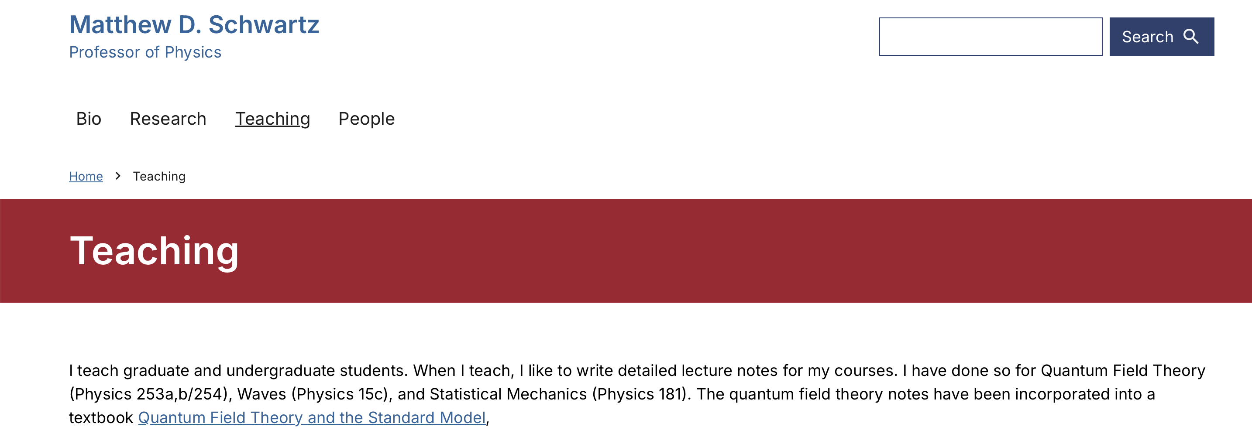
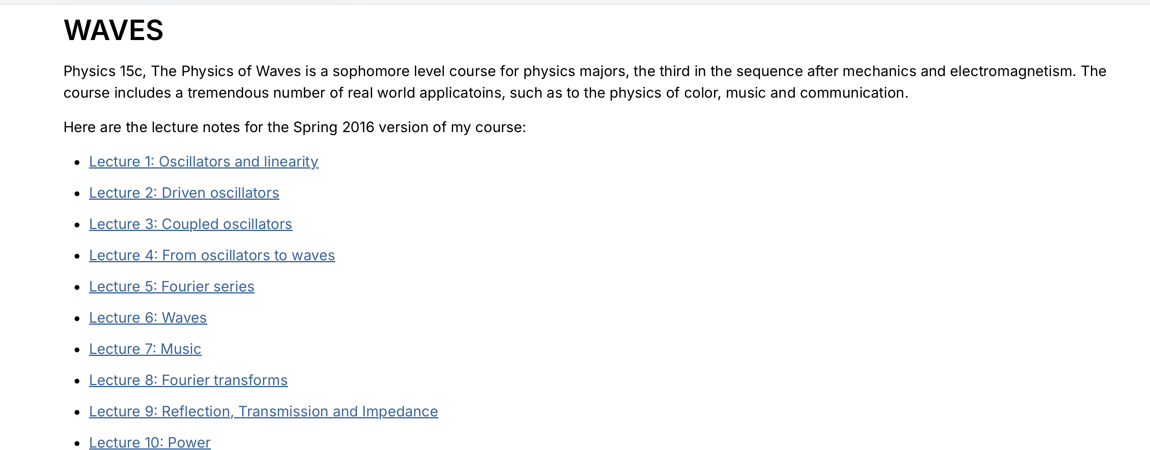

Slide 2
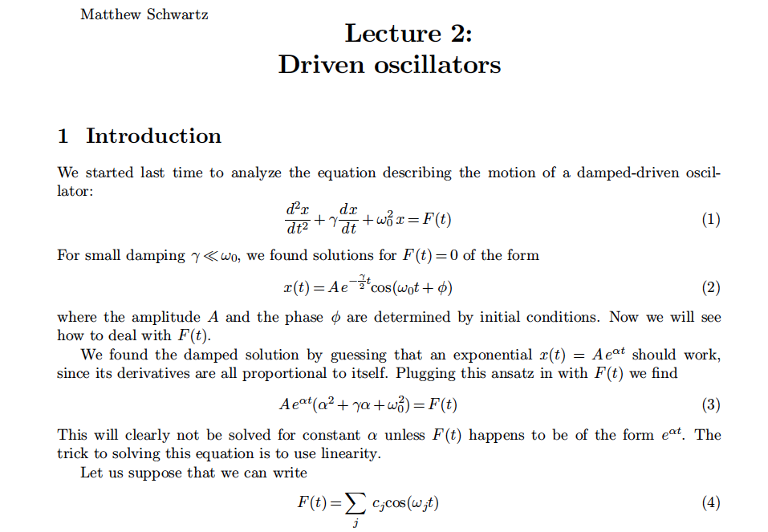

Slide 3

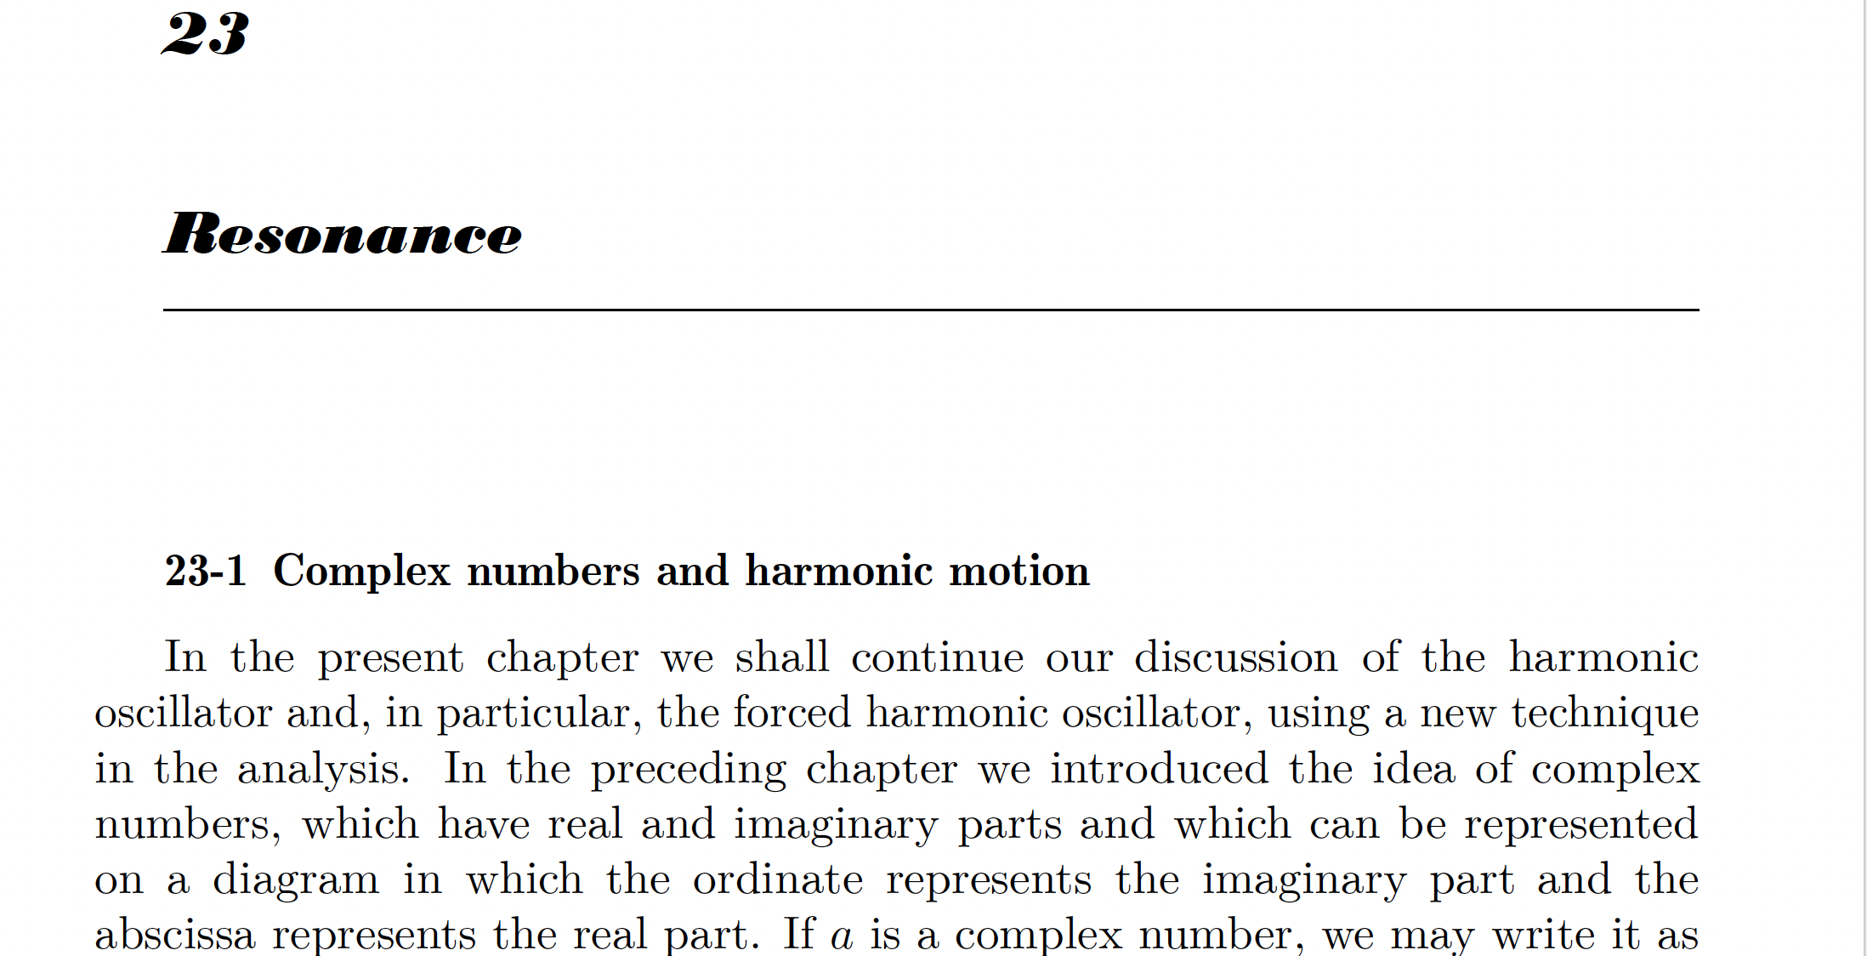

Slide 4
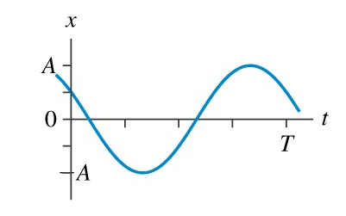
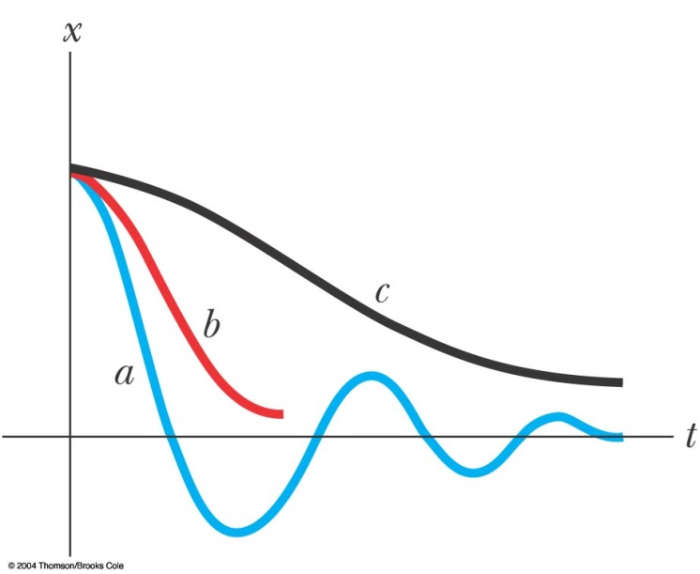












$$z=z_{0}e^{αt}$$
If $α$ is imaginary,
$$z=z_{0}e^{iωt}$$
$$=Ae^{i\left(ωt+φ\right)}=A\cos\left(ωt+φ\right)+iA\sin\left(ωt+φ\right)$$
$$Re\left[z\right]=A\cos\left(ωt+φ\right)$$
The solution is oscillating SHM.
If $α$ is real,
$$z=z_{0}e^{±bt}$$
$$Re\left[z\right]=Ae^{±bt}$$
The solution is exponentially decreasing or increasing.
If $α$ is complex,
$$z=z_{0}e^{±bt+iωt}=Ae^{±bt}∙e^{i\left(ωt+φ\right)}$$
$$Re\left[z\right]=Ae^{±bt}∙\cos\left(ωt+φ\right)$$
The solution is a oscillation with exponentially decreasing amplitude.
General solutions are linear combinations
$$z=c_{1}e^{α_{1}t}+c_{2}e^{α_{2}t}+⋯c_{N}e^{α_{N}t}$$
最後取實數部即可得實數解 Pick the real part
$$x=Re z$$

Slide 5
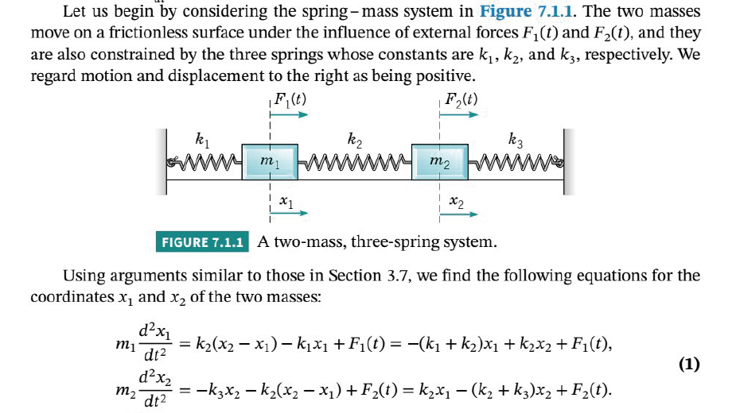
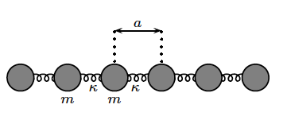

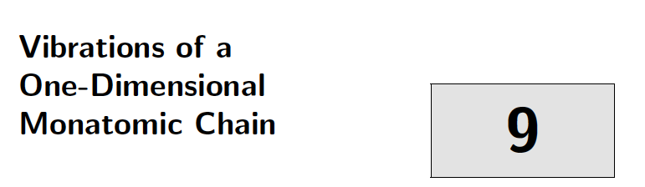
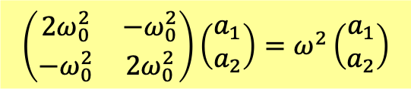
單體的運動方程式
Ordinary Differential Equation
Coupled oscillation
多體且彼此耦合的運動方程式
System of ODE
Matrix and Linear Algebra
$$\left(\begin{matrix}2ω_{0}^{2} & −ω_{0}^{2} \\ −ω_{0}^{2} & 2ω_{0}^{2}\end{matrix}\right)\left(\begin{matrix}a_{1} \\ a_{2}\end{matrix}\right)=ω^{2}\left(\begin{matrix}a_{1} \\ a_{2}\end{matrix}\right)$$
Eigenvalue problem of Matrix
Solid state Physics model
連續及大量極限
連續介質的波方程式
Partial Differential Equation

Slide 7
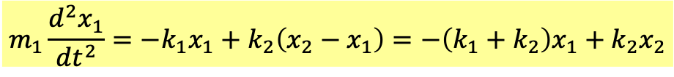
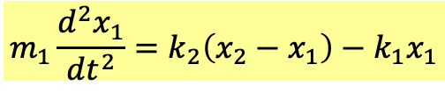
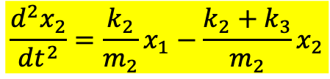
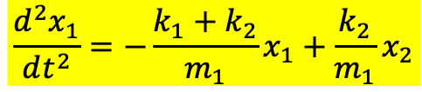
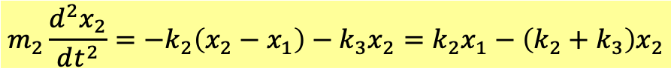
耦合振盪 coupled oscillation, Spring-Mass system
$$m_{1}\frac{d^{2}x_{1}}{dt^{2}}=k_{2}\left(x_{2}−x_{1}\right)−k_{1}x_{1}$$
$$m_{1}\frac{d^{2}x_{1}}{dt^{2}}=−k_{1}x_{1}+k_{2}\left(x_{2}−x_{1}\right)=−\left(k_{1}+k_{2}\right)x_{1}+k_{2}x_{2}$$
The forces exerted on $m_{1}$ come from two springs.
Note that the change of length of the right hand-hand side spring: $x_{2}−x_{1}$
$$m_{2}\frac{d^{2}x_{2}}{dt^{2}}=−k_{2}\left(x_{2}−x_{1}\right)−k_{3}x_{2}=k_{2}x_{1}−{\left(k_{2}+k_{3}\right)x}_{2}$$
The forces on the two particles are linear combinations of $x_{1,2}$. It is a linear system.
It is customary to move all the constants to the right hand side.
$$\frac{d^{2}x_{1}}{dt^{2}}=−\frac{k_{1}+k_{2}}{m_{1}}x_{1}+\frac{k_{2}}{m_{1}}x_{2}$$
$$\frac{d^{2}x_{2}}{dt^{2}}=\frac{k_{2}}{m_{2}}x_{1}−{\frac{k_{2}+k_{3}}{m_{2}}x}_{2}$$

Slide 8
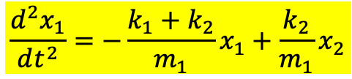
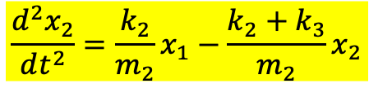
耦合振盪 coupled oscillation
$$\frac{d^{2}x_{1}}{dt^{2}}=−\frac{k_{1}+k_{2}}{m_{1}}x_{1}+\frac{k_{2}}{m_{1}}x_{2}$$
$$\frac{d^{2}x_{2}}{dt^{2}}=\frac{k_{2}}{m_{2}}x_{1}−{\frac{k_{2}+k_{3}}{m_{2}}x}_{2}$$
兩個粒子的受力，是兩個粒子座標的兩個線性組合，稱為線性系統。
線性系統的運動方程式可以以矩陣與行向量的語言來描述。
運動方程式的解可以寫成矩陣的本徵值問題。
線性系統可簡化為模式廣義座標的簡諧運動。

Slide 9

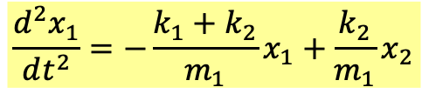

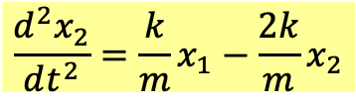
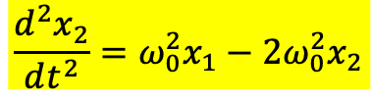
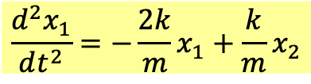
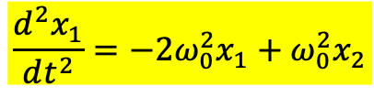
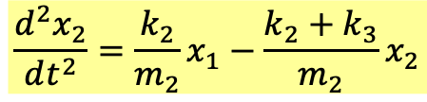
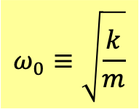
$$\frac{d^{2}x_{1}}{dt^{2}}=−\frac{k_{1}+k_{2}}{m_{1}}x_{1}+\frac{k_{2}}{m_{1}}x_{2}$$
$$\frac{d^{2}x_{2}}{dt^{2}}=\frac{k_{2}}{m_{2}}x_{1}−{\frac{k_{2}+k_{3}}{m_{2}}x}_{2}$$
For simplicity of discussion, assume that：
$${k_{1}=k}_{2}=k$$
$${m_{1}=m}_{2}=m$$
$$\frac{d^{2}x_{1}}{dt^{2}}=−\frac{2k}{m}x_{1}+\frac{k}{m}x_{2}$$
$$\frac{d^{2}x_{1}}{dt^{2}}=−2ω_{0}^{2}x_{1}+ω_{0}^{2}x_{2}$$
$$ω_{0}≡\sqrt{\frac{k}{m}}$$
$$\frac{d^{2}x_{2}}{dt^{2}}=\frac{k}{m}x_{1}−{\frac{2k}{m}x}_{2}$$
$$\frac{d^{2}x_{2}}{dt^{2}}=ω_{0}^{2}x_{1}−{2ω_{0}^{2}x}_{2}$$
This is a System of 2nd order linear ODE.

Slide 10
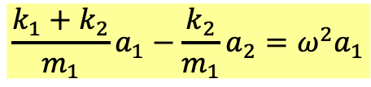
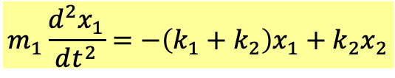
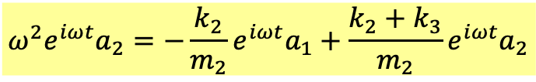

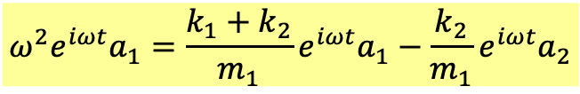

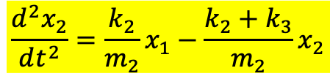
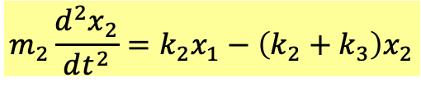
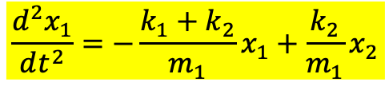
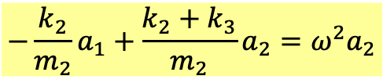
$$m_{1}\frac{d^{2}x_{1}}{dt^{2}}=−\left(k_{1}+k_{2}\right)x_{1}+k_{2}x_{2}$$
$$\frac{d^{2}x_{1}}{dt^{2}}=−\frac{k_{1}+k_{2}}{m_{1}}x_{1}+\frac{k_{2}}{m_{1}}x_{2}$$
$$m_{2}\frac{d^{2}x_{2}}{dt^{2}}=k_{2}x_{1}−{\left(k_{2}+k_{3}\right)x}_{2}$$
$$\frac{d^{2}x_{2}}{dt^{2}}=\frac{k_{2}}{m_{2}}x_{1}−{\frac{k_{2}+k_{3}}{m_{2}}x}_{2}$$
All terms are linear in $x$’s. Systems of 2nd order linear ODE.
先設$x_{1,2}$推廣為複數：
猜解並代入
$$x_{1}=a_{1}∙e^{iωt}$$
$$x_{2}=a_{2}∙e^{iωt}$$
$$ω^{2}e^{iωt}a_{1}=\frac{k_{1}+k_{2}}{m_{1}}e^{iωt}a_{1}−\frac{k_{2}}{m_{1}}e^{iωt}a_{2}$$
$$\frac{k_{1}+k_{2}}{m_{1}}a_{1}−\frac{k_{2}}{m_{1}}a_{2}=ω^{2}a_{1}$$
$$ω^{2}e^{iωt}a_{2}=−\frac{k_{2}}{m_{2}}e^{iωt}a_{1}+\frac{k_{2}+k_{3}}{m_{2}}e^{iωt}a_{2}$$
$$−\frac{k_{2}}{m_{2}}a_{1}+\frac{k_{2}+k_{3}}{m_{2}}a_{2}=ω^{2}a_{2}$$

Slide 11
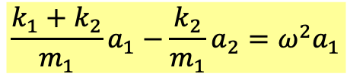

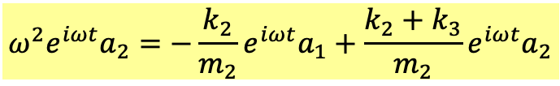


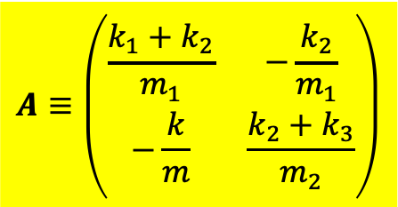
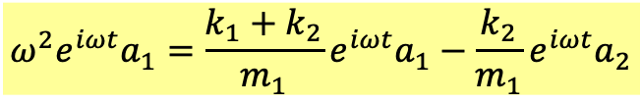
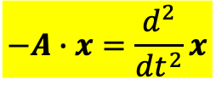
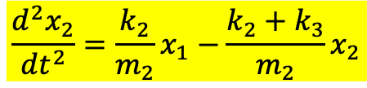
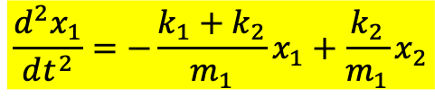
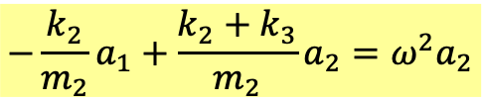
$$\frac{d^{2}x_{1}}{dt^{2}}=−\frac{k_{1}+k_{2}}{m_{1}}x_{1}+\frac{k_{2}}{m_{1}}x_{2}$$
$$−A∙x=\frac{d^{2}}{dt^{2}}x$$
$$\frac{d^{2}x_{2}}{dt^{2}}=\frac{k_{2}}{m_{2}}x_{1}−{\frac{k_{2}+k_{3}}{m_{2}}x}_{2}$$
$$A≡\left(\begin{matrix}\frac{k_{1}+k_{2}}{m_{1}} & −\frac{k_{2}}{m_{1}} \\ −\frac{k}{m} & \frac{k_{2}+k_{3}}{m_{2}}\end{matrix}\right)$$
All terms are linear in $x$’s. Systems of 2nd order linear ODE.
先設$x_{1,2}$推廣為複數：
猜解並代入
$$x≡\left(\begin{matrix}x_{1} \\ x_{2}\end{matrix}\right)$$
$$x_{1}=a_{1}∙e^{iωt}$$
$$x_{2}=a_{2}∙e^{iωt}$$
$$ω^{2}e^{iωt}a_{1}=\frac{k_{1}+k_{2}}{m_{1}}e^{iωt}a_{1}−\frac{k_{2}}{m_{1}}e^{iωt}a_{2}$$
$$\frac{k_{1}+k_{2}}{m_{1}}a_{1}−\frac{k_{2}}{m_{1}}a_{2}=ω^{2}a_{1}$$
$$ω^{2}e^{iωt}a_{2}=−\frac{k_{2}}{m_{2}}e^{iωt}a_{1}+\frac{k_{2}+k_{3}}{m_{2}}e^{iωt}a_{2}$$
$$−\frac{k_{2}}{m_{2}}a_{1}+\frac{k_{2}+k_{3}}{m_{2}}a_{2}=ω^{2}a_{2}$$

Slide 12
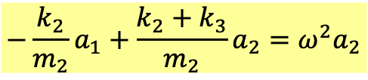
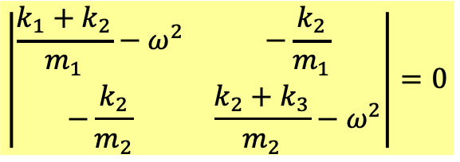

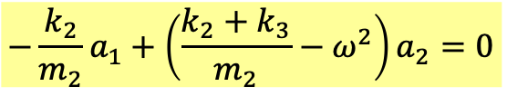
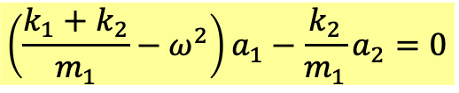
$$\frac{k_{1}+k_{2}}{m_{1}}a_{1}−\frac{k_{2}}{m_{1}}a_{2}=ω^{2}a_{1}$$
$$−\frac{k_{2}}{m_{2}}a_{1}+\frac{k_{2}+k_{3}}{m_{2}}a_{2}=ω^{2}a_{2}$$
微分方程組被轉化為$a_{1},a_{2}$的一次代數方程組以及一個未知數$ω$。
$$\left(\frac{k_{1}+k_{2}}{m_{1}}−ω^{2}\right)a_{1}−\frac{k_{2}}{m_{1}}a_{2}=0$$
$$−\frac{k_{2}}{m_{2}}a_{1}+\left(\frac{k_{2}+k_{3}}{m_{2}}−ω^{2}\right)a_{2}=0$$
因為右式為零，此方程組只有在行列式為零時才有解：
$$\left|\begin{matrix}\frac{k_{1}+k_{2}}{m_{1}}−ω^{2} & −\frac{k_{2}}{m_{1}} \\ −\frac{k_{2}}{m_{2}} & \frac{k_{2}+k_{3}}{m_{2}}−ω^{2}\end{matrix}\right|=0$$
未知數$ω^{2}應該只有$兩個解！這其實就是本徵值！

Slide 13



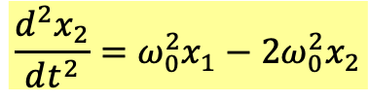


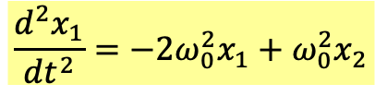
$$\frac{d^{2}x_{1}}{dt^{2}}=−2ω_{0}^{2}x_{1}+ω_{0}^{2}x_{2}$$
$$\frac{d^{2}x_{2}}{dt^{2}}=ω_{0}^{2}x_{1}−{2ω_{0}^{2}x}_{2}$$
Method 0
先設$x_{1,2}$為複數，猜想其解如簡諧運動也可以寫成虛數的指數函數：
First elevate the real $x^{′}s$ into complex function.
And guess the solution is a complex number exponential function.
We will prove in the future that exponential functions of imaginary number work:
$$x_{1}=a_{1}∙e^{iωt}$$
$$x_{2}=a_{2}∙e^{iωt}$$
$ω$ is a real unknown to be solved.
注意此猜想中，$x_{1,2}$是以同樣的方式一起隨時間振盪：$e^{iωt}$。
Note that in this guess, $x_{1,2}$ oscillate with time in identical manner:$e^{iωt}$.
將解代入方程式 Plug the above formula into the equation:
$$ω^{2}e^{iωt}a_{1}=2ω_{0}^{2}e^{iωt}a_{1}−ω_{0}^{2}e^{iωt}a_{2}$$
$$2ω_{0}^{2}a_{1}−ω_{0}^{2}a_{2}=ω^{2}a_{1}$$
$$ω^{2}e^{iωt}a_{2}=−ω_{0}^{2}e^{iωt}a_{1}+2ω_{0}^{2}e^{iωt}a_{2}$$
$$−ω_{0}^{2}a_{1}+2ω_{0}^{2}a_{2}=ω^{2}a_{2}$$
微分方程組被轉化為$a_{1},a_{2}$的一次代數方程組。
The original system of ODE is transformed into a system of algebraic Eq of $a_{1},a_{2}$.

Slide 14



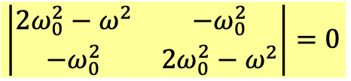





$$2ω_{0}^{2}a_{1}−ω_{0}^{2}a_{2}=ω^{2}a_{1}$$
$$−ω_{0}^{2}a_{1}+2ω_{0}^{2}a_{2}=ω^{2}a_{2}$$
Move all the terms to the left-hand side.
$$\left(2ω_{0}^{2}−ω^{2}\right)a_{1}−ω_{0}^{2}a_{2}=0$$
$$−ω_{0}^{2}a_{1}+\left(2ω_{0}^{2}−ω^{2}\right)a_{2}=0$$
This is a homogeneous system of algebraic equation of $a_{1},a_{2}$.
$a_{1}=a_{2}=0$ is a solution, but we want non-zero $a_{1},a_{2}$ solution
According to Crammer’s Rule, it has non-zero solution only if the determinant is zero!
$$\left|\begin{matrix}2ω_{0}^{2}−ω^{2} & −ω_{0}^{2} \\ −ω_{0}^{2} & 2ω_{0}^{2}−ω^{2}\end{matrix}\right|=0$$
Arfken p83-85, 88
$${\left(ω^{2}−2ω_{0}^{2}\right)}^{2}−{\left(ω_{0}^{2}\right)}^{2}=0$$
$$ω^{2}=ω_{0}^{2},3ω_{0}^{2}$$
未知數$ω^{2}應該只有$兩個可能！The unknown $ω^{2}$ has only two options!
$$ω=ω_{1}≡ω_{0}$$
$$ω=ω_{2}≡\sqrt{3}ω_{0}$$
Only in these two cases is there non-zero $a_{1},a_{2}$ solution.
Arfken p88-91
When the determinant is zero, the two equations are linearly dependent.
They are essentially the same since one can be written as a multiple of the other.

Slide 15
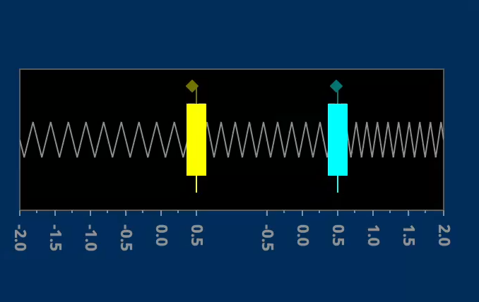
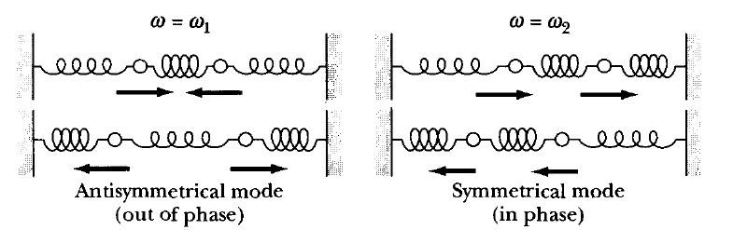












對特定的$ω$，我們可以解出對應的$a_{1},a_{2}$ Let’s find $a_{1},a_{2}$ for specific $ω$.
$$ω=ω_{1}=ω_{0}$$
Plug in
$$\left(2ω_{0}^{2}−ω^{2}\right)a_{1}−ω_{0}^{2}a_{2}=0$$
$$\left(2ω_{0}^{2}−ω_{0}^{2}\right)a_{1}−ω_{0}^{2}a_{2}=0$$
$$ω_{0}^{2}a_{1}−ω_{0}^{2}a_{2}=0$$
$$a_{1}−a_{2}=0$$
$$−ω_{0}^{2}a_{1}+\left(2ω_{0}^{2}−ω^{2}\right)a_{2}=0$$
$$−ω_{0}^{2}a_{1}+\left(2ω_{0}^{2}−ω_{0}^{2}\right)a_{2}=0$$
$$−ω_{0}^{2}a_{1}+ω_{0}^{2}a_{2}=0$$
$$−a_{1}+a_{2}=0$$
The second equation is minus the first one.
$$a_{1}=a_{2}≡C_{1}=A_{1}e^{iφ_{1}}$$
This satisfies both equation.
Therefore, we find that the solution is:
$$x_{1}=a_{1}∙e^{iω_{1}t}=C_{1}∙e^{iω_{0}t}=A_{1}e^{i\left(ω_{0}t+φ_{1}\right)}$$
$$x_{2}=C_{1}∙e^{iω_{0}t}=A_{1}e^{i\left(ω_{0}t+φ_{1}\right)}$$
取實數部，就得到原方程組的解：Take the real part:
$$x_{1}=x_{2}=Re A_{1}e^{i\left(ω_{0}t+φ_{1}\right)}=A_{1}\cos\left(ω_{0}t+φ_{1}\right)$$
$$x_{1}^{′}=x_{2}^{′}=−ω_{0}A_{1}\sin\left(ω_{0}t+φ_{1}\right)$$
The two move and oscillatetogether! $x_{1}=x_{2}$。
這樣的運動就稱為一個模式，對稱模式。
This is called a mode: in this case Symmetric mode.
If initial condition is symmetric：$x_{1}\left(0\right)=x_{2}\left(0\right)$, $x_{1}^{′}\left(0\right)=x_{2}^{′}\left(0\right)$，
symmetric mode will ensue and continue.

Slide 16
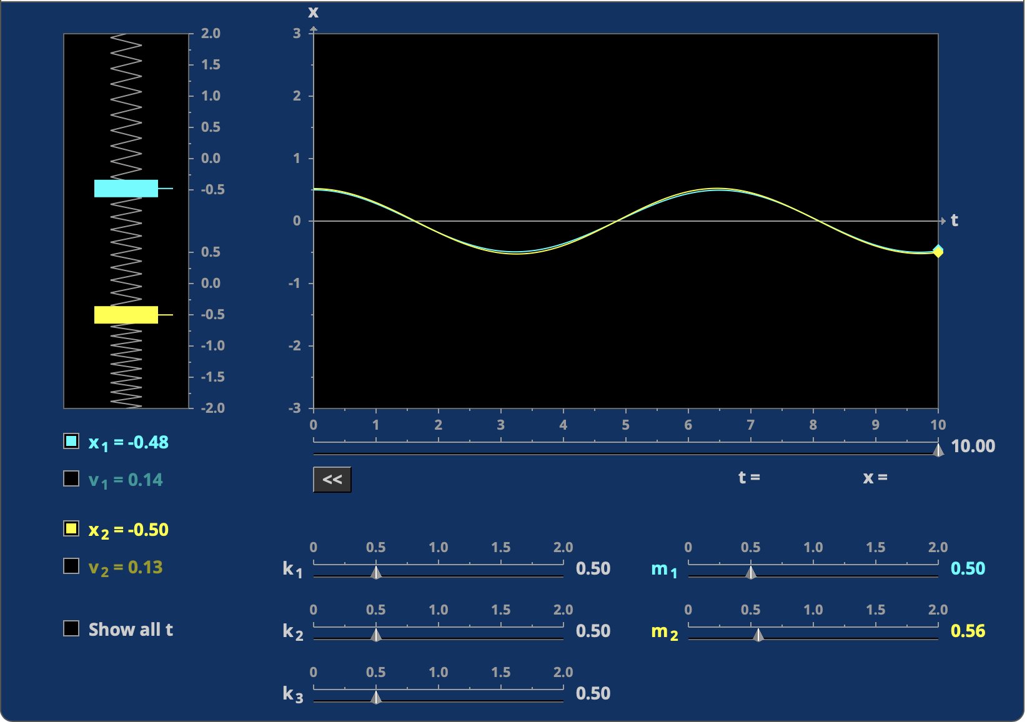




此模式是由$a_{1},a_{2}$標定，畫出 $a_{1},a_{2}$可以代表此模式。
This mode is designated by $a_{1},a_{2}$. You can draw $a_{1},a_{2}$ to represent the mode.
兩個粒子$x_{1},x_{2}$是以$a_{1},a_{2}$為振幅一起作同步(同$ω$)的簡諧運動。
In the mode, the two particles take $a_{1},a_{2}$ as amplitudes, oscillate together (same $ω$).
$$a_{1}=a_{2}$$
$$x_{1}=a_{1}∙A_{1}\cos\left(ω_{0}t+φ_{1}\right)$$
$$x_{2}=a_{2}∙A_{1}\cos\left(ω_{0}t+φ_{1}\right)$$

Slide 17


$x_{1}\left(0\right)=x_{2}\left(0\right)=A$, $x_{1}^{′}\left(0\right)=x_{2}^{′}\left(0\right)=0$

Slide 18


$x_{1}\left(0\right)=x_{2}\left(0\right)=0$, $x_{1}^{′}\left(0\right)=x_{2}^{′}\left(0\right)=B$

Slide 19














$$ω=ω_{2}=\sqrt{3}ω_{0}$$
$$\left(2ω_{0}^{2}−3ω_{0}^{2}\right)a_{1}−ω_{0}^{2}a_{2}=0$$
$$−ω_{0}^{2}a_{1}−ω_{0}^{2}a_{2}=0$$
$$a_{1}+a_{2}=0$$
$$−ω_{0}^{2}a_{1}+\left(2ω_{0}^{2}−3ω_{0}^{2}\right)a_{2}=0$$
$$−ω_{0}^{2}a_{1}−ω_{0}^{2}a_{2}=0$$
$$a_{1}+a_{2}=0$$
The second equation is the same as the first one.
$$a_{1}=−a_{2}≡C_{2}=A_{2}e^{iφ_{2}}$$
The solution is:
$$x_{1}=a_{1}e^{iω_{2}t}=C_{2}e^{i\sqrt{3}ω_{0}t}=A_{2}e^{i\left(\sqrt{3}ω_{0}t+φ_{2}\right)}$$
$$x_{2}=−x_{1}=A_{2}e^{i\left(\sqrt{3}ω_{0}t+φ_{2}\right)}$$
Now taking the real part would give us the solution.
$$x_{1}=Re A_{2}e^{i\left(\sqrt{3}ω_{0}t+φ_{2}\right)}=A_{2}\cos\left(\sqrt{3}ω_{0}t+φ_{2}\right)$$
$$x_{2}=−x_{1}=−A_{2}\cos\left(\sqrt{3}ω_{0}t+φ_{2}\right)$$
$$x_{1}^{′}=−x_{2}^{′}=\sqrt{3}ω_{0}A_{2}\sin\left(\sqrt{3}ω_{0}t+φ_{1}\right)$$
The two move opposite! $x_{2}=−x_{1}$。
這樣的運動就稱為反對稱模式。This is called Antisymetric Mode.
If initial condition is symmetric $x_{1}\left(0\right)=−x_{2}\left(0\right)$, $x_{1}^{′}\left(0\right)=−x_{2}^{′}\left(0\right)$
antisymmetric mode will ensue and continue.

Slide 20






兩個粒子$x_{1},x_{2}$是以$a_{1},a_{2}$為振幅一起作同步(同$ω$)的簡諧運動。
$a_{1},a_{2}$一正一負，因此$x_{1},x_{2}$的振盪有相角差$π$。
$$a_{1}={−a}_{2}$$
$$x_{1}=a_{1}∙A_{2}\cos\left(\sqrt{3}ω_{0}t+φ_{2}\right)$$
$$x_{2}=a_{2}∙A_{2}\cos\left(\sqrt{3}ω_{0}t+φ_{2}\right)$$
$$=−a_{1}∙A_{2}\cos\left(\sqrt{3}ω_{0}t+φ_{2}\right)$$

Slide 21


$x_{1}\left(0\right)=−x_{2}\left(0\right)=A$, $x_{1}^{′}\left(0\right)=−x_{2}^{′}\left(0\right)=0$

Slide 22


$x_{1}\left(0\right)=−x_{2}\left(0\right)=0$, $x_{1}^{′}\left(0\right)=−x_{2}^{′}\left(0\right)=B$

Slide 23






We have found two oscillating solutions for Coupled system.
$$x_{1}=−x_{2}=A_{1}\cos\left(ω_{0}t+φ_{1}\right)$$
$$x_{1}=x_{2}=A_{1}\cos\left(ω_{0}t+φ_{1}\right)$$
$$ω_{2}=\sqrt{3}ω_{0}$$
$$ω_{1}=ω_{0}$$
If initial conditions follow the condition of the mode,
$x_{1}\left(0\right)=−x_{2}\left(0\right)$, $x_{1}^{′}\left(0\right)=−x_{2}^{′}\left(0\right)$
$x_{1}\left(0\right)=x_{2}\left(0\right)$, $x_{1}^{′}\left(0\right)=x_{2}^{′}\left(0\right)$
the system will continue oscillating as SHM according to the mode!

Slide 24








$$x_{1}=−x_{2}=A_{1}\cos\left(ω_{0}t+φ_{1}\right)$$
$$x_{1}=x_{2}=A_{1}\cos\left(ω_{0}t+φ_{1}\right)$$
$$ω_{2}=\sqrt{3}ω_{0}$$
$$ω_{1}=ω_{0}$$
$x_{1}\left(0\right)=−x_{2}\left(0\right)$, $x_{1}^{′}\left(0\right)=−x_{2}^{′}\left(0\right)$
$x_{1}\left(0\right)=x_{2}\left(0\right)$, $x_{1}^{′}\left(0\right)=x_{2}^{′}\left(0\right)$
中間的彈簧的中點沒有移動，等同固定。
中間的彈簧並沒有長度的變化。
粒子都只受一條加上半條彈簧的力，
所以兩個粒子都只受一條彈簧的力，
$$ω_{2}=\sqrt{\frac{k+2k}{m}}=\sqrt{3}ω_{0}$$
$$ω_{1}=\sqrt{\frac{k}{m}}=ω_{0}$$

Slide 25







原則上物體的變形模式有無限多個，但並不是連續分布。
因此可以分離地一個一個編號。
每一個模式，如同簡諧運動，對應一個內在的特定的振動頻率！
不同模式頻率不同。一般來說，頻率越高的模式，越難激發。

Slide 26
A general solution is a sum of the two modes.
一般起始條件下，彈簧組運動就是兩種模式的疊加！
There are four undetermined constants $A_{1,2},φ_{1,2}$.
$$x_{1}=A_{1}\cos\left(ω_{0}t+φ_{1}\right)+A_{2}\cos\left(\sqrt{3}ω_{0}t+φ_{2}\right)$$
$$x_{2}=A_{1}\cos\left(ω_{0}t+φ_{1}\right)−A_{2}\cos\left(\sqrt{3}ω_{0}t+φ_{2}\right)$$
There are also four i$nitial conditions{ x}_{1,2}\left(0\right),x_{1,2}^{′}\left(0\right)$.
It would be the one unique solution.

Slide 27


Slide 28


Slide 29


Slide 30



Method I
線性方程式組的右手邊可以以矩陣及行向量的乘積來簡化符號！
The right-hand side can be simplified as a multiplication of matrix and column.
$$\frac{d^{2}x_{1}}{dt^{2}}=−\frac{2k}{m}x_{1}+\frac{k}{m}x_{2}$$
$$\left(\begin{matrix}\frac{d^{2}x_{1}}{dt^{2}} \\ \frac{d^{2}x_{2}}{dt^{2}}\end{matrix}\right)=−\left(\begin{matrix}\frac{2k}{m} & −\frac{k}{m} \\ −\frac{k}{m} & \frac{2k}{m}\end{matrix}\right)\left(\begin{matrix}x_{1} \\ x_{2}\end{matrix}\right)$$
$$\frac{d^{2}x_{2}}{dt^{2}}=\frac{k}{m}x_{1}−{\frac{2k}{m}x}_{2}$$

Slide 31


矩陣乘行向量得一行向量： multiplication of a matrix and a column is a column.
$${\left(Sa\right)}_{i}=\sum_{j=1}^{2}{S_{ij}a_{j}}=\left(\begin{matrix}S_{11} & S_{12} \\ S_{21} & S_{22}\end{matrix}\right)\left(\begin{matrix}a_{1} \\ a_{2}\end{matrix}\right)=\left(\begin{matrix}S_{11}a_{1}+S_{12}a_{2} \\ S_{21}a_{1}+S_{22}a_{2}\end{matrix}\right)$$
此規則保證此乘積是線性的
$$S\left(c_{1}a_{1}+c_{2}a_{2}\right)=c_{1}Sa_{1}+c_{2}Sa_{2}$$
矩陣乘矩陣還是矩陣： multiplication of two matrices and is a matrix.
$${\left(SA\right)}_{mn}=\sum_{j=1}^{2}{S_{mj}A_{jn}}=\left(\begin{matrix}S_{11} & S_{12} \\ S_{21} & S_{22}\end{matrix}\right)\left(\begin{matrix}A_{11} & A_{12} \\ A_{21} & A_{22}\end{matrix}\right)=\left(\begin{matrix}S_{11}A_{11}+S_{12}A_{21} & S_{11}A_{12}+S_{12}A_{22} \\ S_{21}A_{11}+S_{22}A_{21} & S_{21}A_{12}+S_{22}A_{22}\end{matrix}\right)$$
Arfken p96-99

Slide 32








$$\left(\begin{matrix}\frac{d^{2}x_{1}}{dt^{2}} \\ \frac{d^{2}x_{2}}{dt^{2}}\end{matrix}\right)=−\left(\begin{matrix}\frac{2k}{m} & −\frac{k}{m} \\ −\frac{k}{m} & \frac{2k}{m}\end{matrix}\right)\left(\begin{matrix}x_{1} \\ x_{2}\end{matrix}\right)$$
We can use simplified notations to write the equation.
行向量 Column vector
矩陣 Matrix
$$x≡\left(\begin{matrix}x_{1} \\ x_{2}\end{matrix}\right)$$
$$A≡\left(\begin{matrix}\frac{2k}{m} & −\frac{k}{m} \\ −\frac{k}{m} & \frac{2k}{m}\end{matrix}\right)≡\left(\begin{matrix}2ω_{0}^{2} & −ω_{0}^{2} \\ −ω_{0}^{2} & 2ω_{0}^{2}\end{matrix}\right)$$
$$ω_{0}≡\sqrt{\frac{k}{m}}$$
兩粒子位置自然組成一行向量。
$$\frac{d^{2}}{dt^{2}}x=\left(\begin{matrix}\frac{d^{2}x_{1}}{dt^{2}} \\ \frac{d^{2}x_{2}}{dt^{2}}\end{matrix}\right)$$
$$−\left(\begin{matrix}\frac{2k}{m} & −\frac{k}{m} \\ −\frac{k}{m} & \frac{2k}{m}\end{matrix}\right)\left(\begin{matrix}x_{1} \\ x_{2}\end{matrix}\right)=A∙x$$
$$\frac{d^{2}}{dt^{2}}x=−A∙x$$

Slide 33









$$−A∙x=\frac{d^{2}}{dt^{2}}x$$
Elevate the real $x^{′}s$ into complex function. Guess the solutions are the same exponential:
The solution can be written as a constant column vector $a$ times the usual $e^{iωt}.$
$ω$ and $a$ are to be determined.
$$x≡\left(\begin{matrix}x_{1} \\ x_{2}\end{matrix}\right)=ae^{iωt}$$
$$a≡\left(\begin{matrix}a_{1} \\ a_{2}\end{matrix}\right)$$
$$x_{1}=a_{1}e^{iωt}$$
$$x_{2}=a_{2}e^{iωt}$$
Key idea is the two particle oscillate with one frequency.
Plug the guess into Eq.
$$−A∙ae^{iωt}=−ω^{2}ae^{iωt}$$
$$\left(\begin{matrix}2ω_{0}^{2} & −ω_{0}^{2} \\ −ω_{0}^{2} & 2ω_{0}^{2}\end{matrix}\right)\left(\begin{matrix}a_{1} \\ a_{2}\end{matrix}\right)=ω^{2}\left(\begin{matrix}a_{1} \\ a_{2}\end{matrix}\right)$$
$$A∙a=ω^{2}a$$
The differential Equation of $x(t)$ is transformed into algebraic equation of $a$.
This is the eigenvalue problem of Matrix $A$.${ ω}^{2}$ is the eigenvalue while $a$ the eigenvector.
微分方程組被轉化為矩陣$A$的本徵值$ω$問題，$a$稱為本徵向量 。

Slide 34










To solve eigenvalue problem:
$$\left(\begin{matrix}2ω_{0}^{2} & −ω_{0}^{2} \\ −ω_{0}^{2} & 2ω_{0}^{2}\end{matrix}\right)\left(\begin{matrix}a_{1} \\ a_{2}\end{matrix}\right)=ω^{2}\left(\begin{matrix}a_{1} \\ a_{2}\end{matrix}\right)$$
$$A∙a=ω^{2}a$$
$$\left(\begin{matrix}2ω_{0}^{2}−ω^{2} & −ω_{0}^{2} \\ −ω_{0}^{2} & 2ω_{0}^{2}−ω^{2}\end{matrix}\right)\left(\begin{matrix}a_{1} \\ a_{2}\end{matrix}\right)=0$$
$$\left(A−ω^{2}I\right)∙a=0$$
If the matrix $\left(A−ω^{2}\right)$ has an inverse matrix ${\left(A−ω^{2}\right)}^{−1}$, $a$ equals 0.
$$a={\left(A−ω^{2}\right)}^{−1}\left(\begin{matrix}0 \\ 0\end{matrix}\right)=\left(\begin{matrix}0 \\ 0\end{matrix}\right)$$
This is not what we want.
Unless, determinant $\left|A−ω^{2}\right|=0.$ Then inverse matrix ${\left(A−ω^{2}\right)}^{−1}$ does not exist.
Only in this case would $a$ have nontrivial solutions.
$$\left|\begin{matrix}2ω_{0}^{2}−ω^{2} & −ω_{0}^{2} \\ −ω_{0}^{2} & 2ω_{0}^{2}−ω^{2}\end{matrix}\right|=0$$
$$\left|A−ω^{2}I\right|=0$$
$${\left(ω^{2}−2ω_{0}^{2}\right)}^{2}−{\left(ω_{0}^{2}\right)}^{2}=0$$
$$ω^{2}−2ω_{0}^{2}=±ω_{0}^{2}$$
$$ω^{2}=ω_{0}^{2},3ω_{0}^{2}$$

Slide 35

Inverse matrix
$$S^{−1}=\frac{1}{\det{S}}\left(\begin{matrix}S_{22} & −S_{12} \\ −S_{21} & S_{11}\end{matrix}\right)$$

Slide 36













$$ω^{2}=ω_{0}^{2},3ω_{0}^{2}$$
本徵值$ω^{2}$有兩個，各自對應一本徵向量$a$。
Two eigenvalues $ω^{2}$, each corresponding to one eigenvetor $a$, determined by this formula:
For
$$ω^{2}=ω_{0}^{2}$$
$$ω=ω_{1}≡ω_{0}$$
$$\left(\begin{matrix}2ω_{0}^{2}−ω_{1}^{2} & −ω_{0}^{2} \\ −ω_{0}^{2} & 2ω_{0}^{2}−ω_{1}^{2}\end{matrix}\right)\left(\begin{matrix}a_{1} \\ a_{2}\end{matrix}\right)=0$$
$$\left(\begin{matrix}ω_{0}^{2} & −ω_{0}^{2} \\ −ω_{0}^{2} & ω_{0}^{2}\end{matrix}\right)\left(\begin{matrix}a_{1} \\ a_{2}\end{matrix}\right)=ω_{0}^{2}\left(\begin{matrix}1 & −1 \\ −1 & 1\end{matrix}\right)\left(\begin{matrix}a_{1} \\ a_{2}\end{matrix}\right)=0$$
$$a_{1}−a_{2}=0$$
$$a^{\left(1\right)}=a_{1}\left(\begin{matrix}1 \\ 1\end{matrix}\right)$$
Index to denote the first mode
$$x=a^{\left(1\right)}e^{iω_{1}t}=\left(\begin{matrix}1 \\ 1\end{matrix}\right){a_{1}e}^{iω_{0}t}=\left(\begin{matrix}1 \\ 1\end{matrix}\right)A_{1}e^{i\left(ω_{0}t+φ_{1}\right)}$$
$$a_{1}≡A_{1}e^{iφ_{1}}$$
Take the real part:
$$x=\left(\begin{matrix}x_{1} \\ x_{2}\end{matrix}\right)=\left(\begin{matrix}1 \\ 1\end{matrix}\right)A_{1}\cos\left(ω_{0}t+φ_{1}\right)=\left(\begin{matrix}1 \\ 1\end{matrix}\right)\left[f_{1}cos\left(ω_{0}t\right)+g_{1}sin\left(ω_{0}t\right)\right]$$
$$x_{1}=A_{1}\cos\left(ω_{0}t+φ_{1}\right)$$
$$x_{2}=x_{1}{=A}_{1}\cos\left(ω_{0}t+φ_{1}\right)$$
$$\frac{x_{1}}{x_{2}}=\frac{a_{1}^{\left(1\right)}}{a_{2}^{\left(1\right)}}=1$$
This mode is designated by$a_{1}^{\left(1\right)},a_{2}^{\left(1\right)}$.
Note that in this mode, the ratio of $\frac{x_{1}}{x_{2}}$ at any time equals the ratio of $\frac{a_{1}^{\left(1\right)}}{a_{2}^{\left(1\right)}}$.

Slide 37











$$ω^{2}=3ω_{0}^{2}$$
$$ω=ω_{2}≡\sqrt{3}ω_{0}$$
$$\left(\begin{matrix}2ω_{0}^{2}−ω_{2}^{2} & −ω_{0}^{2} \\ −ω_{0}^{2} & 2ω_{0}^{2}−ω_{2}^{2}\end{matrix}\right)\left(\begin{matrix}a_{1} \\ a_{2}\end{matrix}\right)=0$$
$$\left(\begin{matrix}−ω_{0}^{2} & −ω_{0}^{2} \\ −ω_{0}^{2} & −ω_{0}^{2}\end{matrix}\right)\left(\begin{matrix}a_{1} \\ a_{2}\end{matrix}\right)=ω_{0}^{2}\left(\begin{matrix}−1 & −1 \\ −1 & −1\end{matrix}\right)\left(\begin{matrix}a_{1} \\ a_{2}\end{matrix}\right)=0$$
$$a_{1}+a_{2}=0$$
$$a^{\left(2\right)}=a_{2}\left(\begin{matrix}1 \\ −1\end{matrix}\right)$$
Index to denote the second mode
$$\text{x}\text{=}a^{\left(2\right)}e^{iω_{2}t}=\left(\begin{matrix}1 \\ −1\end{matrix}\right){a_{1}e}^{i\sqrt{3}ω_{0}t}=\left(\begin{matrix}1 \\ −1\end{matrix}\right){A_{2}e}^{i\left(\sqrt{3}ω_{0}t+φ_{2}\right)}$$
$$a_{1}≡A_{2}e^{iφ_{2}}$$
Take the real part:
$$x=\left(\begin{matrix}x_{1} \\ x_{2}\end{matrix}\right)=\left(\begin{matrix}1 \\ −1\end{matrix}\right)A_{2}\cos\left(\sqrt{3}ω_{0}t+φ_{2}\right)=\left(\begin{matrix}1 \\ −1\end{matrix}\right)\left[f_{2}cos\left(\sqrt{3}ω_{0}t\right)+g_{2}sin\left(\sqrt{3}ω_{0}t\right)\right]$$
$$x_{1}=A_{2}\cos\left(\sqrt{3}ω_{0}t+φ_{2}\right)$$
$$x_{2}=−x_{1}=−A_{2}\cos\left(\sqrt{3}ω_{0}t+φ_{2}\right)$$
$$\frac{x_{1}}{x_{2}}=\frac{a_{1}^{\left(1\right)}}{a_{2}^{\left(1\right)}}=−1$$
In this mode, the ratio of $\frac{x_{1}}{x_{2}}$ at any time equals the ratio of $\frac{a_{1}^{\left(1\right)}}{a_{2}^{\left(1\right)}}=−1$.

Slide 38








一個本徵向量就對應一個可獨立振盪的模式。
One eigenvalue $ω^{2}$ with one eigenvector $a$ corresponds to one oscillating mode.
We have found two oscillating solutions for Coupled system.
In these modes, the ratio of $\frac{x_{1}}{x_{2}}$ at any time equals the ratio of $\frac{a_{1}^{\left(1,2\right)}}{a_{2}^{\left(1,2\right)}}$.
We can plot $a$ as follows to represent a mode:
$$a_{1}^{\left(2\right)}$$
$$a_{1}^{\left(1\right)}$$
$$a_{2}^{\left(1\right)}$$
$$a_{2}^{\left(2\right)}$$
$$ω_{2}=\sqrt{3}ω_{0}$$
$$ω_{1}=ω_{0}$$
$$\frac{x_{1}}{x_{2}}=\frac{a_{1}^{\left(1\right)}}{a_{2}^{\left(1\right)}}=−1$$
$$\frac{x_{1}}{x_{2}}=\frac{a_{1}^{\left(1\right)}}{a_{2}^{\left(1\right)}}=1$$

Slide 39






We have found two oscillating solutions for Coupled system.
$$\frac{x_{1}}{x_{2}}=\frac{a_{1}^{\left(1\right)}}{a_{2}^{\left(1\right)}}=−1$$
$$ω_{2}=\sqrt{3}ω_{0}$$
$$ω_{1}=ω_{0}$$
$$\frac{x_{1}}{x_{2}}=\frac{a_{1}^{\left(1\right)}}{a_{2}^{\left(1\right)}}=1$$
If initial conditions follow the condition of the mode,
$$\frac{x_{1}\left(0\right)}{x_{2}\left(0\right)}=\frac{a_{1}^{\left(2\right)}}{a_{2}^{\left(2\right)}}=−1$$
$$\frac{x_{1}\left(0\right)}{x_{2}\left(0\right)}=\frac{a_{1}^{\left(1\right)}}{a_{2}^{\left(1\right)}}=1$$
the system will continue oscillating as SHM according to the mode!
We usually say: one mode is excited while the other is not.
Is it possible both modes are excited in the beginning? Of course.

Slide 40


$x_{1}\left(0\right)=2x_{2}\left(0\right)$, $x_{1}^{′}\left(0\right)=x_{2}^{′}\left(0\right)=0$

Slide 41

$x_{1}\left(0\right)=A,x_{2}\left(0\right)=0$, $x_{1}^{′}\left(0\right)=x_{2}^{′}\left(0\right)=0$

Slide 42






有了以上兩個模式的解，一般解將是兩者的線性組合：
With two mode solutions, any linear combinations of the two modes are also solutions of the system of linear ODE. There are four unspecified constants $f_{1,2},g_{1,2}.$
$$\left(\begin{matrix}x_{1} \\ x_{2}\end{matrix}\right)=\left(\begin{matrix}1 \\ 1\end{matrix}\right)\left[f_{1}cos\left(ω_{0}t\right)+g_{1}sin\left(ω_{0}t\right)\right]+\left(\begin{matrix}1 \\ −1\end{matrix}\right)\left[f_{2}cos\left(\sqrt{3}ω_{0}t\right)+g_{2}sin\left(\sqrt{3}ω_{0}t\right)\right]$$
四個未定常數將由四個起使條件決定。例如：
The four unspecified constants will be determined by four initial conditions.
$$\left(\begin{matrix}x_{1}\left(0\right) \\ x_{2}\left(0\right)\end{matrix}\right)=\left(\begin{matrix}1 \\ 1\end{matrix}\right)f_{1}+\left(\begin{matrix}1 \\ −1\end{matrix}\right)f_{2}$$
$$x_{1}\left(0\right)=f_{1}+f_{2}$$
$$x_{2}\left(0\right)=f_{1}−f_{2}$$
因此$f_{1,2}$可以唯一決定。 $f_{1,2}$ will now be uniquely specified.
$$\left(\begin{matrix}x_{1}^{′}\left(0\right) \\ x_{2}^{′}\left(0\right)\end{matrix}\right)=\left(\begin{matrix}1 \\ 1\end{matrix}\right)g_{1}ω_{0}+\left(\begin{matrix}1 \\ −1\end{matrix}\right)g_{2}\sqrt{3}ω_{0}$$
$$x_{1}^{′}\left(0\right)=g_{1}ω_{0}+g_{2}\sqrt{3}ω_{0}$$
$$x_{2}^{′}\left(0\right)=g_{1}ω_{0}−g_{2}\sqrt{3}ω_{0}$$
$g_{1,2}$也可以唯一決定。 $g_{1,2}$ will also be uniquely specified.
Note that $g_{1,2}$ will vanish if initial velocities $x_{1,2}^{′}\left(0\right)$ are both zero.
於是微分方程組加起始條件，求解完成。
Our result satisfy both system of ODE and initial condition. It is the unique solution.

Slide 43









For example: if
$x_{1}\left(0\right)=2A,x_{2}\left(0\right)=0$, $x_{1}^{′}\left(0\right)=x_{2}^{′}\left(0\right)=0$
$$g_{1}=g_{2}=0$$
$$\left(\begin{matrix}x_{1}\left(0\right) \\ x_{2}\left(0\right)\end{matrix}\right)=\left(\begin{matrix}2A \\ 0\end{matrix}\right)=\left(\begin{matrix}1 \\ 1\end{matrix}\right)f_{1}+\left(\begin{matrix}1 \\ −1\end{matrix}\right)f_{2}$$
$$f_{1}+f_{2}=2A$$
$$f_{1}=f_{2}=A$$
$$f_{1}−f_{2}=0$$
$$\left(\begin{matrix}x_{1} \\ x_{2}\end{matrix}\right)=\left(\begin{matrix}1 \\ 1\end{matrix}\right)\left[Acos\left(ω_{0}t\right)\right]+\left(\begin{matrix}1 \\ −1\end{matrix}\right)\left[Acos\left(\sqrt{3}ω_{0}t\right)\right]$$
$$x_{1}=A\left[cos\left(ω_{0}t\right)+cos\left(\sqrt{3}ω_{0}t\right)\right]$$
$$x_{2}=A\left[cos\left(ω_{0}t\right)−cos\left(\sqrt{3}ω_{0}t\right)\right]$$

Slide 44
There is another way to look at this solution.
Method II
$$x_{1}=A_{1}\cos\left(ω_{0}t+φ_{1}\right)+A_{2}\cos\left(\sqrt{3}ω_{0}t+φ_{2}\right)$$
$$x_{2}=A_{1}\cos\left(ω_{0}t+φ_{1}\right)−A_{2}\cos\left(\sqrt{3}ω_{0}t+φ_{2}\right)$$
$$x_{+}≡x_{1}+x_{2}=2A_{1}\cos\left(ω_{0}t+φ_{1}\right)$$
Generalized Coordinates 廣義座標
$$x_{−}≡x_{1}−x_{2}=2A_{2}\cos\left(\sqrt{3}ω_{0}t+φ_{2}\right)$$
廣義座標可以完全決定真實座標！
$x_{+},x_{−}$ are pure simple harmonic oscillators with respective angular frequencies.
從廣義座標$x_{+},x_{−}$滿足的運動方程式的角度來看：
$$\frac{d^{2}x_{1}}{dt^{2}}=−2ω_{0}^{2}x_{1}+ω_{0}^{2}x_{2}$$
$$\frac{d^{2}x_{2}}{dt^{2}}=ω_{0}^{2}x_{1}−{2ω_{0}^{2}x}_{2}$$
$$\frac{d^{2}\left(x_{1}+x_{2}\right)}{dt^{2}}=−ω_{0}^{2}x_{1}−{ω_{0}^{2}x}_{2}$$
$$+$$
$$\frac{d^{2}x_{+}}{dt^{2}}=−ω_{0}^{2}x_{+}$$
$$\frac{d^{2}x_{1}}{dt^{2}}=−2ω_{0}^{2}x_{1}+ω_{0}^{2}x_{2}$$
$$\frac{d^{2}x_{2}}{dt^{2}}=ω_{0}^{2}x_{1}−{2ω_{0}^{2}x}_{2}$$
$$\frac{d^{2}x_{−}}{dt^{2}}=−3ω_{0}^{2}x_{−}$$
$$−$$
$x_{+},x_{−}$ are called Normal Coordinates. 模式座標
$$x≡\left(\begin{matrix}x_{+} \\ x_{−}\end{matrix}\right)$$
$$−A∙x=\frac{d^{2}}{dt^{2}}x$$
$$A≡\left(\begin{matrix}ω_{0}^{2} & 0 \\ 0 & 3ω_{0}^{2}\end{matrix}\right)$$
For normal coordinates, $A$ is now diagonal. Off-diagonal elements means coupling.
$x_{+},x_{−}$ are uncoupled, independent SHM.

Slide 45




在這兩個模式，廣義座標非常簡單。
$$x_{1}=−x_{2}=A_{2}\cos\left(\sqrt{3}ω_{0}t+φ_{1}\right)$$
$$x_{1}=x_{2}=A_{1}\cos\left(ω_{0}t+φ_{1}\right)$$
$$x_{+}=0,x_{−}=2A_{2}\cos\left(\sqrt{3}ω_{0}t+φ_{2}\right)$$
$$x_{+}=A_{1}\cos\left(ω_{0}t+φ_{1}\right),x_{−}=0$$
可以說這兩個模式座標就是來標定這兩個模式的。

Slide 46







This formalism could be easily extended to the more general cases.
The force constants $k_{1},k_{2},k_{3}$ could be different.
$$\frac{d^{2}x_{1}}{dt^{2}}=−\frac{k_{1}+k_{2}}{m_{1}}x_{1}+\frac{k_{2}}{m_{1}}x_{2}$$
$$x≡\left(\begin{matrix}x_{1} \\ x_{2}\end{matrix}\right)$$
行向量 Column vector
矩陣 Matrix
$$\frac{d^{2}x_{2}}{dt^{2}}=\frac{k_{2}}{m_{2}}x_{1}−{\frac{k_{2}+k_{3}}{m_{2}}x}_{2}$$
$$S≡\left(\begin{matrix}\frac{k_{1}+k_{2}}{m} & −\frac{k_{2}}{m} \\ −\frac{k_{2}}{m} & \frac{k_{2}+k_{3}}{m}\end{matrix}\right)≡\left(\begin{matrix}S_{11} & S_{12} \\ S_{21} & S_{22}\end{matrix}\right)$$
$$\frac{d^{2}}{dt^{2}}x=\left(\begin{matrix}\frac{d^{2}x_{1}}{dt^{2}} \\ \frac{d^{2}x_{2}}{dt^{2}}\end{matrix}\right)=−\left(\begin{matrix}\frac{k_{1}+k_{2}}{m} & −\frac{k_{2}}{m} \\ −\frac{k_{2}}{m} & \frac{k_{2}+k_{3}}{m}\end{matrix}\right)\left(\begin{matrix}x_{1} \\ x_{2}\end{matrix}\right)≡S∙x$$
$$\frac{d^{2}}{dt^{2}}x=−S∙x$$
$S$ is a symmetric Matrix.

Slide 47











To define symmetric matrix, first define the Transpose of matrix $A$
$$A=\left(\begin{matrix}2 & 8 \\ 4 & 9\end{matrix}\right)$$
$$A^{T}=\left(\begin{matrix}2 & 4 \\ 8 & 9\end{matrix}\right)$$
$$A_{ij}^{T}=A_{ji}$$
例如
$$A_{12}^{T}=A_{21}$$
Symmetric Matrix $S$
$$S^{T}=S$$
$$A=\left(\begin{matrix}2 & 8 \\ 4 & 9\end{matrix}\right)$$
$$A^{T}=\left(\begin{matrix}2 & 4 \\ 8 & 9\end{matrix}\right)$$
Not symmetric
$$S=\left(\begin{matrix}2 & 4 \\ 4 & 9\end{matrix}\right)=S^{T}=\left(\begin{matrix}2 & 4 \\ 4 & 9\end{matrix}\right)$$
Symmetric
$$S_{ij}=S_{ij}^{T}=S_{ji}$$
例如
$$S_{12}=S_{12}^{T}=S_{21}$$
Arfken p99, 104-107

Slide 48









$$−S∙x=\frac{d^{2}}{dt^{2}}x$$
Method I
Elevate the real $x^{′}s$ into complex function. Guess the solutions are the same exponential:
The solution can be written as a constant column vector $a$ times the usual $e^{iωt}.$
$ω$ and $a$ are to be determined.
$$x≡\left(\begin{matrix}x_{1} \\ x_{2}\end{matrix}\right)=ae^{iωt}$$
$$a≡\left(\begin{matrix}a_{1} \\ a_{2}\end{matrix}\right)$$
$$\left(\begin{matrix}\frac{k_{1}+k_{2}}{m} & −\frac{k_{2}}{m} \\ −\frac{k_{2}}{m} & \frac{k_{2}+k_{3}}{m}\end{matrix}\right)\left(\begin{matrix}a_{1} \\ a_{2}\end{matrix}\right)=ω^{2}\left(\begin{matrix}a_{1} \\ a_{2}\end{matrix}\right)$$
Plug the guess into Eq.
$$−S∙ae^{iωt}=−ω^{2}ae^{iωt}$$
$$\left(\begin{matrix}\frac{k_{1}+k_{2}}{m}−ω^{2} & −\frac{k_{2}}{m} \\ −\frac{k_{2}}{m} & \frac{k_{2}+k_{3}}{m}−ω^{2}\end{matrix}\right)\left(\begin{matrix}a_{1} \\ a_{2}\end{matrix}\right)=0$$
$$S∙a=ω^{2}a$$
$$\left(S−ω^{2}I\right)∙a=0$$
This is the eigenvalue problem of Matrix $S$.${ ω}^{2}$ is the eigenvalue while $a$ the eigenvector.

Slide 49









$$\left(\begin{matrix}\frac{k_{1}+k_{2}}{m}−ω^{2} & −\frac{k_{2}}{m} \\ −\frac{k_{2}}{m} & \frac{k_{2}+k_{3}}{m}−ω^{2}\end{matrix}\right)\left(\begin{matrix}a_{1} \\ a_{2}\end{matrix}\right)=0$$
$$\left(S−ω^{2}I\right)∙a=0$$
Unless, determinant $\left|S−ω^{2}\right|=0.$ Then inverse matrix ${\left(S−ω^{2}\right)}^{−1}$ does not exist.
Only in this case would $a$ have nontrivial solutions.
$$\left|\begin{matrix}\frac{k_{1}+k_{2}}{m}−ω^{2} & −\frac{k_{2}}{m} \\ −\frac{k_{2}}{m} & \frac{k_{2}+k_{3}}{m}−ω^{2}\end{matrix}\right|=0$$
$$\left|S−ω^{2}I\right|=0$$
This is a second order equation for $ω^{2}$ usually with two solutions $ω_{1}^{2},ω_{2}^{2}$.
Plug$ω^{2}=ω_{1}^{2},ω_{2}^{2}$ into
$$\left(S−ω^{2}I\right)∙a=0$$
to solve the two columns vector $a$:
$$a^{\left(1\right)}=\left(\begin{matrix}a_{1}^{\left(1\right)} \\ a_{2}^{\left(1\right)}\end{matrix}\right)$$
$$a^{\left(2\right)}=\left(\begin{matrix}a_{1}^{\left(2\right)} \\ a_{2}^{\left(2\right)}\end{matrix}\right)$$

Slide 50






We have found two oscillating mode solutions for the coupled system.
$$a^{\left(1\right)}e^{iω_{1}t}=\left(\begin{matrix}a_{1}^{\left(1\right)} \\ a_{2}^{\left(1\right)}\end{matrix}\right)e^{iω_{1}t}$$
$$a^{\left(2\right)}e^{iω_{2}t}=\left(\begin{matrix}a_{1}^{\left(2\right)} \\ a_{2}^{\left(2\right)}\end{matrix}\right)e^{iω_{2}t}$$
Since the ODE’s are linear, any linear combinations of the two modes are solutions.
$$x=\left(\begin{matrix}a_{1}^{\left(1\right)} \\ a_{2}^{\left(1\right)}\end{matrix}\right)∙e^{iω_{1}t}∙\left(c_{1}e^{iφ_{1}}\right)+\left(\begin{matrix}a_{1}^{\left(2\right)} \\ a_{2}^{\left(2\right)}\end{matrix}\right)∙e^{iω_{2}t}∙\left(c_{2}e^{iφ_{2}}\right)$$
Take the real part.
Two complex coefficients
$$x=\left(\begin{matrix}x_{1} \\ x_{2}\end{matrix}\right)=\left(\begin{matrix}a_{1}^{\left(1\right)} \\ a_{2}^{\left(1\right)}\end{matrix}\right)c_{1}cos\left(ω_{1}t+φ_{1}\right){+}\left(\begin{matrix}a_{1}^{\left(2\right)} \\ a_{2}^{\left(2\right)}\end{matrix}\right)c_{2}cos\left(ω_{2}t+φ_{2}\right)$$
It is clear that, for example:
$$\left[f_{2}cos\left(ω_{2}t\right)+g_{2}sin\left(ω_{2}t\right)\right]$$
$$x_{1}=a_{1}^{\left(1\right)}c_{1}cos\left(ω_{1}t+φ_{1}\right){+}a_{1}^{\left(2\right)}c_{2}cos\left(ω_{2}t+φ_{2}\right)$$
$$x_{2}=a_{2}^{\left(1\right)}c_{1}cos\left(ω_{1}t+φ_{1}\right){+}a_{2}^{\left(2\right)}c_{2}cos\left(ω_{2}t+φ_{2}\right)$$
Again, four unspecified constants $c_{1,2},φ_{1,2}$ will be determined by four initial conditions:
$x_{1}\left(0\right)$,$x_{2}\left(0\right),$ $x_{1}^{′}\left(0\right),x_{2}^{′}\left(0\right)$
We have solved the coupled oscillation problem for two particles.

Slide 51






It is easier to fit initial conditions by another form of cosine and sine solution.
$$x=\left(\begin{matrix}x_{1} \\ x_{2}\end{matrix}\right)=\left(\begin{matrix}a_{1}^{\left(1\right)} \\ a_{2}^{\left(1\right)}\end{matrix}\right)\left[f_{1}cos\left(ω_{0}t\right)+g_{1}sin\left(ω_{0}t\right)\right]{+}\left(\begin{matrix}a_{1}^{\left(2\right)} \\ a_{2}^{\left(2\right)}\end{matrix}\right)\left[f_{2}cos\left(\sqrt{3}ω_{0}t\right)+g_{2}sin\left(\sqrt{3}ω_{0}t\right)\right]$$
四個未定常數將由四個起使條件決定。例如：
The four unspecified constants will be determined by four initial conditions.
$$\left(\begin{matrix}x_{1}\left(0\right) \\ x_{2}\left(0\right)\end{matrix}\right)=\left(\begin{matrix}a_{1}^{\left(1\right)} \\ a_{2}^{\left(1\right)}\end{matrix}\right)f_{1}+\left(\begin{matrix}a_{1}^{\left(2\right)} \\ a_{2}^{\left(2\right)}\end{matrix}\right)f_{2}$$
$$x_{1}\left(0\right)=a_{1}^{\left(1\right)}f_{1}+a_{1}^{\left(2\right)}f_{2}$$
$$x_{2}\left(0\right)=a_{2}^{\left(1\right)}f_{1}−a_{2}^{\left(2\right)}f_{2}$$
因此$f_{1,2}$可以唯一決定。 $f_{1,2}$ will now be uniquely specified.
$$\left(\begin{matrix}x_{1}^{′}\left(0\right) \\ x_{2}^{′}\left(0\right)\end{matrix}\right)=\left(\begin{matrix}a_{1}^{\left(1\right)} \\ a_{2}^{\left(1\right)}\end{matrix}\right)g_{1}ω_{0}+\left(\begin{matrix}a_{1}^{\left(2\right)} \\ a_{2}^{\left(2\right)}\end{matrix}\right)g_{2}\sqrt{3}ω_{0}$$
$$x_{1}^{′}\left(0\right)=a_{1}^{\left(1\right)}g_{1}ω_{0}+a_{1}^{\left(2\right)}g_{2}\sqrt{3}ω_{0}$$
$$x_{2}^{′}\left(0\right)=a_{2}^{\left(1\right)}g_{1}ω_{0}−a_{2}^{\left(2\right)}g_{2}\sqrt{3}ω_{0}$$
$g_{1,2}$也可以唯一決定。 $g_{1,2}$ will also be uniquely specified.
Note that $g_{1,2}$ will vanish if initial velocities $x_{1,2}^{′}\left(0\right)$ are both zero.
於是微分方程組加起始條件，求解完成。
Our result satisfy both system of ODE and initial condition. It is the unique solution.

Slide 52




Slide 53

But are you sure that the eigenvalues $ω_{1}^{2},ω_{2}^{2}$ are both positive?
$ω_{1}^{2},ω_{2}^{2}>?0$
If $ω^{2}<0$, $e^{iωt}$ is an exponential function instead of oscillating function.
Will prove if matrix $S$ is symmetric and positive definite, eigenvalues $ω^{2}$ are both positive.
And for coupled system the matrix $S$ is symmetric and positive definite.
對稱矩陣
定理：一個對稱矩陣的本徵值都是實數，且不同本徵值的本徵向量彼此正交。
All $n$ eigenvalues $λ$ of a symmetric matrix $S$ are real.
The $n$ eigenvectors $u$ can be chosen to be orthogonal.

Slide 54



要確定$ω$有兩個實數解，本徵值$λ$必須是正實數才行！
Positive Definite 正定 Matrix
若一對稱矩陣$S$的本徵值都是正數，此矩陣稱為正定矩陣。
證明：若Quadratic form 二次型 $x^{T}Sx$ 恆為正值，此矩陣$S$為正定矩陣。
取 $x=u_{1}$。已知$u_{1}^{T}Su_{1}$為正。
$$u^{\left(1\right)T}Su^{\left(1\right)}=λ_{1}u^{\left(1\right)T}u^{\left(1\right)}=λ_{1}$$
因此$λ_{1}$為正。同理$λ_{2}$亦為正。矩陣$S$本徵值皆為正，為正定矩陣。
彈簧組位能恆為正，因此$S$為正定矩陣：本徵值$λ$都是正數。
$$V=\frac{1}{2}k_{2}{\left(x_{2}−x_{1}\right)}^{2}+\frac{1}{2}k_{1}x_{1}^{2}+\frac{1}{2}k_{3}x_{2}^{2}=m x^{T}Sx$$
模式頻率：$ω=\sqrt{λ}$ 都是實數。

Slide 55





$$A≡\left(\begin{matrix}\frac{k_{11}}{m_{1}} & \frac{k_{12}}{m_{1}} & \frac{k_{13}}{m_{1}} \\ \frac{k_{21}}{m_{2}} & \frac{k_{22}}{m_{2}} & \frac{k_{23}}{m_{2}} \\ \frac{k_{31}}{m_{3}} & \frac{k_{32}}{m_{3}} & \frac{k_{33}}{m_{3}}\end{matrix}\right)$$
$$−A∙x=\frac{d^{2}}{dt^{2}}x$$
$$A∙a=ω^{2}a$$

Slide 56



This formalism could be also easily extended to more than two masses.

Slide 57




將本徵值及對應的角頻率由小到大編號：
$$ω_{1}\sim \sqrt{2−\sqrt{2}}ω_{0}$$
$$ω_{2}\sim \sqrt{2}ω_{0}$$
$$ω_{3}\sim \sqrt{2+\sqrt{2}}ω_{0}$$

Slide 58











$$a_{1}^{\left(2\right)}$$
$$a_{3}^{\left(2\right)}$$
$$a_{2}^{\left(2\right)}$$
$$ω_{2}\sim \sqrt{2}ω_{0}$$
$$a^{\left(2\right)}\sim \left(\begin{matrix}−1 \\ 0 \\ 1\end{matrix}\right)$$
$$x=a^{\left(2\right)}e^{iω_{2}t}$$
兩個粒子$x_{1},x_{2}$以$a_{1},a_{2}$為振幅一起作同步(同$ω$)的簡諧運動。
$a_{1},a_{3}$一正一負，因此$x_{1},x_{3}$的振盪有相角差$π$。$a_{2}$為零，在此模式$x_{2}$是靜止的。
若起始條件滿足，位移行向量正比於本徵向量：
$$x\left(0\right)=\left(\begin{matrix}x_{1}\left(0\right) \\ x_{2}\left(0\right) \\ x_{3}\left(0\right)\end{matrix}\right)∝a^{\left(2\right)}\sim \left(\begin{matrix}1 \\ 0 \\ −1\end{matrix}\right)$$
$$x^{′}\left(0\right)=\left(\begin{matrix}x_{1}^{′}\left(0\right) \\ x_{2}^{′}\left(0\right) \\ x_{3}^{′}\left(0\right)\end{matrix}\right)=\left(\begin{matrix}0 \\ 0 \\ 0\end{matrix}\right)$$
以下式就是運動方程式與起始條件的解，接下來位移就會維持此比例關係。
$$x\left(t\right)=\left(\begin{matrix}x_{1}\left(t\right) \\ x_{2}\left(t\right) \\ x_{3}\left(t\right)\end{matrix}\right)∝a^{\left(2\right)}\cos{ω_{2}t}\sim \left(\begin{matrix}1 \\ 0 \\ −1\end{matrix}\right)\cos{ω_{2}t}$$
這是一個可獨立振盪的模式。

Slide 59










$$ω_{1}\sim \sqrt{2−\sqrt{2}}ω_{0}$$
$$a_{2}^{\left(1\right)}$$
$$a_{1}^{\left(1\right)}$$
$$a_{3}^{\left(1\right)}$$
$$a^{\left(1\right)}\sim \left(\begin{matrix}1 \\ \sqrt{2} \\ 1\end{matrix}\right)\sim \left(\begin{matrix}\sin{\frac{π}{4}} \\ \sin{\frac{π}{2}} \\ \sin{\frac{3π}{4}}\end{matrix}\right)$$
$$x\left(0\right)=\left(\begin{matrix}x_{1}\left(0\right) \\ x_{2}\left(0\right) \\ x_{3}\left(0\right)\end{matrix}\right)∝a^{\left(1\right)}\sim \left(\begin{matrix}1 \\ 0 \\ −1\end{matrix}\right)$$
$$x^{′}\left(0\right)=\left(\begin{matrix}x_{1}^{′}\left(0\right) \\ x_{2}^{′}\left(0\right) \\ x_{3}^{′}\left(0\right)\end{matrix}\right)=\left(\begin{matrix}0 \\ 0 \\ 0\end{matrix}\right)$$
以下式就是運動方程式與起始條件的解：
$$x\left(t\right)=\left(\begin{matrix}x_{1}\left(t\right) \\ x_{2}\left(t\right) \\ x_{3}\left(t\right)\end{matrix}\right)∝a^{\left(1\right)}\cos{ω_{1}t}$$
這是另一個可獨立振盪的模式。

Slide 60







$$a_{1}^{\left(3\right)}$$
$$a_{3}^{\left(3\right)}$$
$$ω_{3}\sim \sqrt{2+\sqrt{2}}ω_{0}$$
$$a^{\left(3\right)}\sim \left(\begin{matrix}1 \\ −\sqrt{2} \\ 1\end{matrix}\right)$$
$$a_{2}^{\left(3\right)}$$
$$x\left(t\right)=\left(\begin{matrix}x_{1}\left(t\right) \\ x_{2}\left(t\right) \\ x_{3}\left(t\right)\end{matrix}\right)∝a^{\left(3\right)}\cos{ω_{3}t}$$
位移行向量若一開始就與一本徵向量成正比，接下來位移就會維持此比例關係。
一個本徵向量對應一個可獨立振盪的模式。
每一個運動模式(本徵向量$a$)，有一個特定的簡諧振動頻率(本徵值)！
模式的數目，就是本徵向量數目，洽等於粒子數目。

Slide 61










有了以上三個模式的解，一般解將是三者的線性組合：
$$ω_{1}\sim \sqrt{2−\sqrt{2}}ω_{0}$$
$$\left(\begin{matrix}x_{1} \\ x_{2} \\ x_{3}\end{matrix}\right)=\sum_{i=1}^{3}{a^{\left(i\right)}∙\left[f_{i}cos\left(ω_{i}t\right)+g_{i}sin\left(ω_{i}t\right)\right]}$$
$$ω_{2}\sim \sqrt{2}ω_{0}$$
$$ω_{3}\sim \sqrt{2+\sqrt{2}}ω_{0}$$
三個未定常數$f_{1,2,3},$將由三個起使條件$x_{1,2,3}\left(0\right)$決定：
$$\left(\begin{matrix}x_{1}\left(0\right) \\ x_{2}\left(0\right) \\ x_{3}\left(0\right)\end{matrix}\right)=\sum_{i=1}^{3}{a^{\left(i\right)}f_{i}=}\frac{1}{\sqrt{2}}\left(\begin{matrix}\frac{1}{\sqrt{2}} \\ 1 \\ \frac{1}{\sqrt{2}}\end{matrix}\right)f_{1}+\frac{1}{\sqrt{2}}\left(\begin{matrix}1 \\ 0 \\ −1\end{matrix}\right)f_{2}+\frac{1}{\sqrt{2}}\left(\begin{matrix}\frac{1}{\sqrt{2}} \\ −1 \\ \frac{1}{\sqrt{2}}\end{matrix}\right)f_{3}$$
根據對稱矩陣本徵向量的展開定理，三個本徵向量彼此正交：
$$a^{\left(m\right)T}a^{\left(n\right)}=δ_{mn}$$
可以如上選$a^{\left(n\right)}$使其向量長度為1。
任一起始條件的行向量$\left(\begin{matrix}x_{1}\left(0\right) \\ x_{2}\left(0\right) \\ x_{3}\left(0\right)\end{matrix}\right)$，都可以展開成三個本徵向量的線性組合。
$$a^{\left(i\right)T}\left(\begin{matrix}x_{1}\left(0\right) \\ x_{2}\left(0\right) \\ x_{3}\left(0\right)\end{matrix}\right)=f_{i}$$
$f_{1,2,3}$可以解出：
另外三個未定常數 $g_{1,2,3}$則由另外三個起使條件$x_{1,2,3}^{′}\left(0\right)$以類似方式決定。

Slide 62





起始各個配料依配方$f_{1,2,3}$收集
各個配料按分離烹煮$cos\left(ω_{i}t\right)$
個自簡諧振蕩後，最後合體！
$$+$$
$$＝$$
$$+$$
$$+$$
$$+$$
$$⋮$$

Slide 63

三個本徵向量的元素似乎滿足簡單的規則：都是正弦函數，角度以等差$\frac{π}{4},\frac{2π}{4},\frac{3π}{4}$增加。
$$a^{\left(1\right)}\sim \left(\begin{matrix}\sin{\frac{π}{4}} \\ \sin{\frac{π}{2}} \\ \sin{\frac{3π}{4}}\end{matrix}\right)=\left(\begin{matrix}\frac{1}{\sqrt{2}} \\ 1 \\ \frac{1}{\sqrt{2}}\end{matrix}\right)$$
$$a^{\left(2\right)}\sim \left(\begin{matrix}\sin{\frac{π}{2}} \\ \sin{π} \\ \sin{\frac{3π}{2}}\end{matrix}\right)=\left(\begin{matrix}1 \\ 0 \\ −1\end{matrix}\right)$$
$$a^{\left(3\right)}\sim \left(\begin{matrix}\sin{\frac{3π}{4}} \\ \sin{\frac{3π}{2}} \\ \sin{\frac{9π}{4}}\end{matrix}\right)=\left(\begin{matrix}\frac{1}{\sqrt{2}} \\ −1 \\ \frac{1}{\sqrt{2}}\end{matrix}\right)$$

