Slide 1
傅立葉級數 Fourier Series

Slide 2
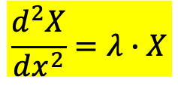


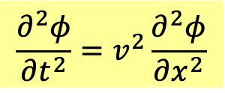
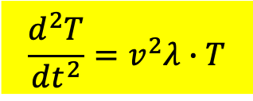
Solving Wave Equation:
$$\frac{∂^{2}φ}{∂t^{2}}=v^{2}\frac{∂^{2}φ}{∂x^{2}}$$
求解策略 I：
Search for separable solutions, products of a function of $x$ and a function of $t$.
They correspond to oscillation modes in coupled spring system.
$$φ\left(x,t\right)=X\left(x\right)∙T\left(t\right)$$
$$\frac{d^{2}X}{dx^{2}}=λ∙X$$
$$\frac{d^{2}T}{dt^{2}}=v^{2}λ∙T$$
$T\left(t\right)$ is solved right away as SHM.
With boundary condition, allowed $X_{n}\left(x\right), n=1,⋯∞$ would be countable.。
We found a series of separable solutions:
$$u_{n}\left(x,t\right)=X_{n}\left(x\right)∙T_{n}\left(t\right)=sin\left(\frac{nπ}{L}x\right)\left(A_{n}\cos{ω_{n}t}+B_{n}\sin{ω_{n}t}\right)$$

Slide 3
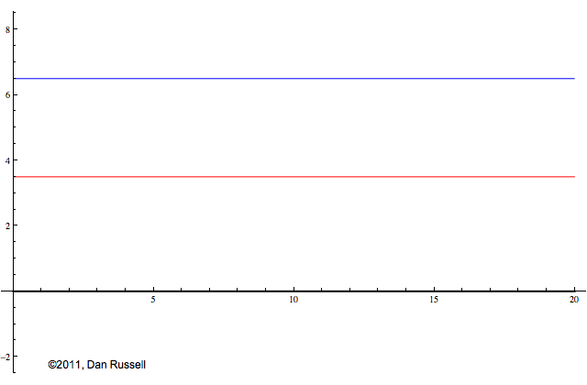
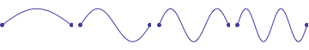
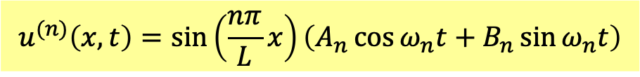
Separable solutions are really special!
$$u^{(n)}\left(x,t\right)=sin\left(\frac{nπ}{L}x\right)\left(A_{n}\cos{ω_{n}t}+B_{n}\sin{ω_{n}t}\right)$$
All particles oscillate as SHM by identical $ω_{n}$ and phase, amplitudes $∝sin\left(\frac{nπ}{L}x\right)$.
It could also be seen as a Sine function of $x$ with time varying amplitude.
Not all solution acts like that.

Slide 4
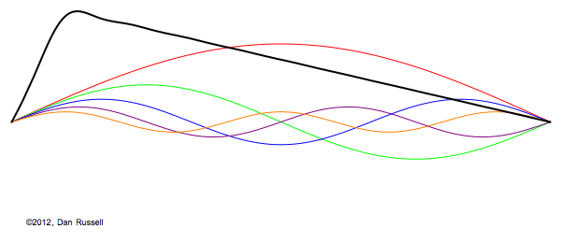
Blackline is a solution when we pull string, with fixed ends, at one point and release.

Slide 5
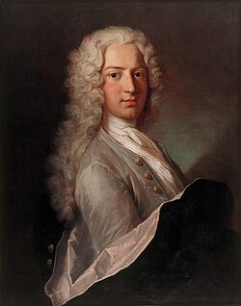
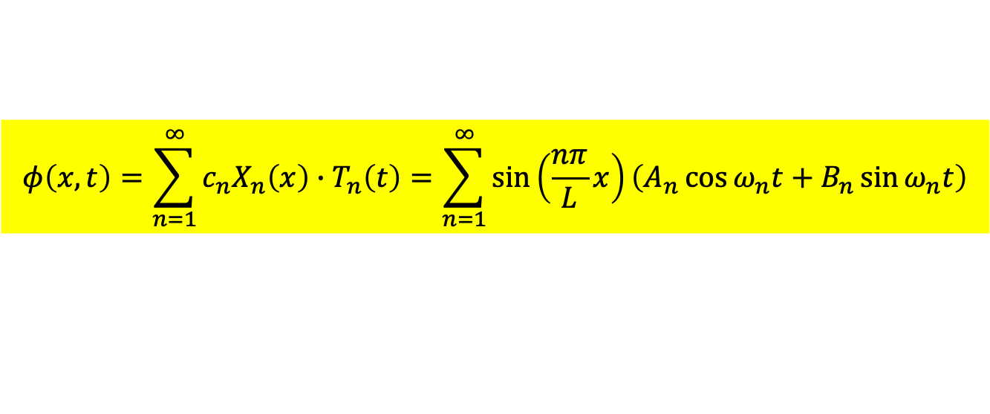
D. Bernoulli, 1700-1782
求解策略II：
Since wave equation is linear, linear combinations of $X_{n}\left(x\right)T_{n}\left(t\right)$ are solutions, too.
$$φ\left(x,t\right)=\sum_{n=1}^{∞}{c_{n}X_{n}\left(x\right)∙T_{n}\left(t\right)}=\sum_{n=1}^{∞}{sin\left(\frac{nπ}{L}x\right)\left(A_{n}\cos{ω_{n}t}+B_{n}\sin{ω_{n}t}\right)}$$
This is an infinite series of functions, summing up lots of separables with coefficients!
These are all solutions of wave equation.
That solutions of Wave E. can be written in this form was proposed by Bernoulli.
They are called Bernoulli Solutions. With $A_{n},B_{n}$we can form lots of Bernoulli Solutions.

Slide 6
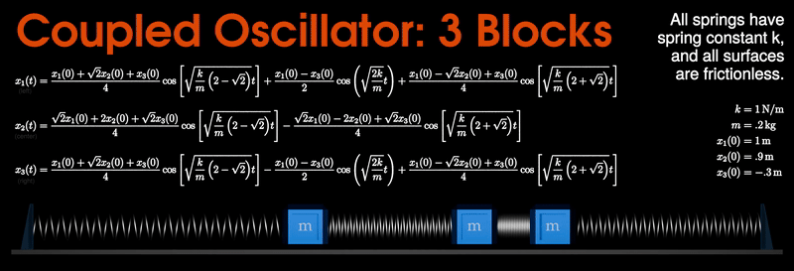
This also happens in coupled spring system.
The equation of motions are linear ODE.
Linear Combinations of mode solutions are solutions, too.

Slide 7
For fixed end string: The following is one example of Bernoulli Solution.
The blackline solution is the sum of colored lines of separable oscillating solutions.

Slide 8
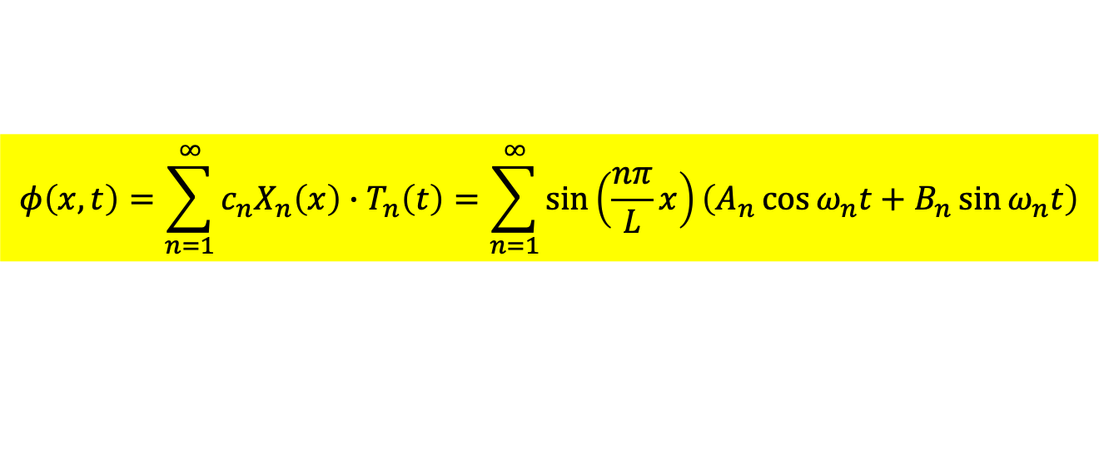
求解策略II：
Since wave equation is linear, linear combinations of $X_{n}\left(x\right)T_{n}\left(t\right)$ are solutions, too.
$$φ\left(x,t\right)=\sum_{n=1}^{∞}{c_{n}X_{n}\left(x\right)∙T_{n}\left(t\right)}=\sum_{n=1}^{∞}{sin\left(\frac{nπ}{L}x\right)\left(A_{n}\cos{ω_{n}t}+B_{n}\sin{ω_{n}t}\right)}$$
How to compute coefficients $A_{n},B_{n}$ for a specific problem.
Are all solutions of the form of Bernoulli Solutions?
Do Bernoulli Solutions exhaust all possible solutions of wave equation?

Slide 9

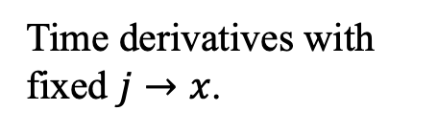



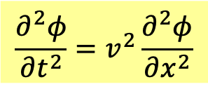
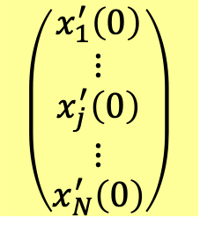

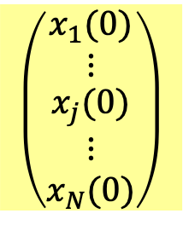
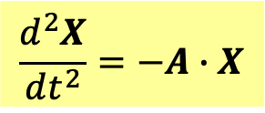
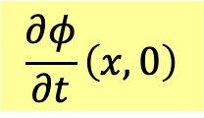
Equation of motion:
對照表
Wave Equation:
$$\frac{d^{2}X}{dt^{2}}=−A∙X$$
$$\frac{∂^{2}φ}{∂t^{2}}=v^{2}\frac{∂^{2}φ}{∂x^{2}}$$
$$x_{j}$$
$$φ\left(jd\right)=φ\left(x\right)$$
We usually choose linear combination coefficients to fit initial condition.
Initial Condition
Initial Condition
$$\left(\begin{matrix}\begin{matrix}x_{1}(0) \\ ⋮\end{matrix} \\ \begin{matrix}x_{j}(0) \\ \begin{matrix}⋮ \\ x_{N}(0)\end{matrix}\end{matrix}\end{matrix}\right)$$
$$φ\left(x,0\right)$$
Wavefunction at $t=0$
$$\frac{∂φ}{∂t}\left(x,0\right)$$
$$\left(\begin{matrix}\begin{aligned}x_{1}^{′}\left(0\right) \\ ⋮\end{aligned} \\ \begin{aligned}x_{j}^{′}\left(0\right) \\ ⋮\end{aligned} \\ x_{N}^{′}\left(0\right)\end{matrix}\right)$$
Time derivatives with fixed $j→x$.
Time partial of wavefunction at $t=0$
Could we always find coefficients $A_{n},B_{n}$ to satisfy specific initial condition?
If yes, we are done, because we have found Bernoulli Solutions to all problems.
Every problem can have only one solution! So yes, all solutions are like Bernoulli’s.

Slide 10
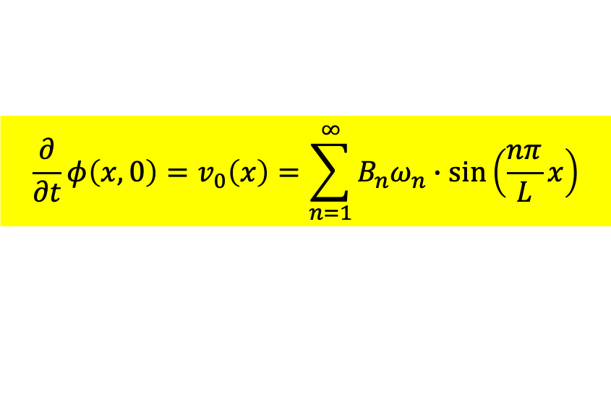
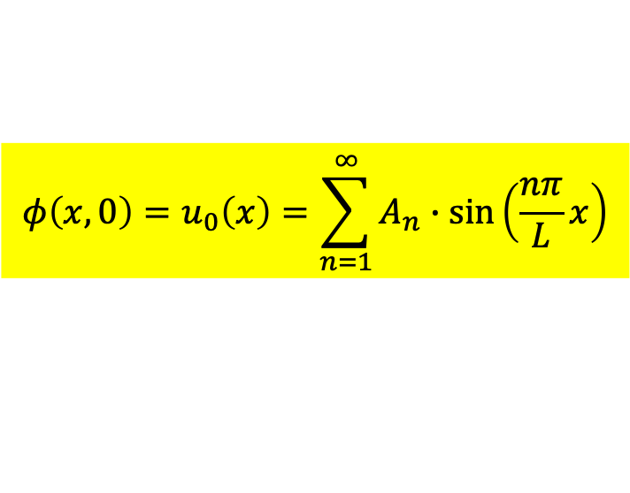

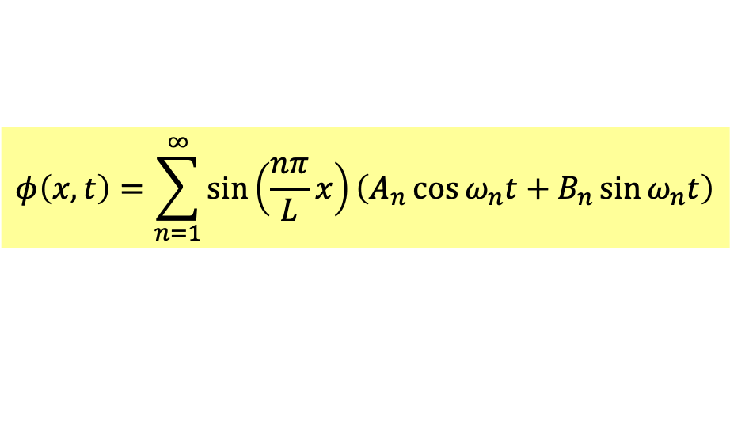
$$φ\left(x,t\right)=\sum_{n=1}^{∞}{sin\left(\frac{nπ}{L}x\right)\left(A_{n}\cos{ω_{n}t}+B_{n}\sin{ω_{n}t}\right)}$$
Bernoulli’s solution
The coefficients $A_{n},B_{n}$ are found, (or fixed) to satisfy initial conditions.
Plug in $t=0$ to the expression above, we find the key equation:
$$φ\left(x,0\right)=u_{0}\left(x\right)=\sum_{n=1}^{∞}{A_{n}∙sin\left(\frac{nπ}{L}x\right)}$$
Technically we’d say: function $u_{0}\left(x\right)$ is expanded as a series of Sine functions.
$$\frac{∂}{∂t}φ\left(x,0\right)=v_{0}\left(x\right)=\sum_{n=1}^{∞}{B_{n}ω_{n}∙sin\left(\frac{nπ}{L}x\right)}$$
How to compute $A_{n},B_{n}$?
1768-1830
Jean-Baptiste Joseph Fourier
The following method is proposed by Fourier 50 years after Bernoulli.
Expansion of a function as a series of Sine functions is called Fourier Series.

Slide 11
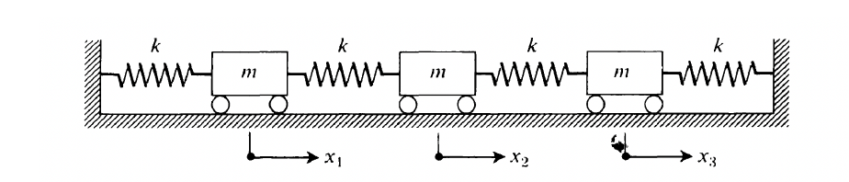
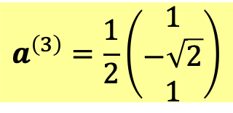





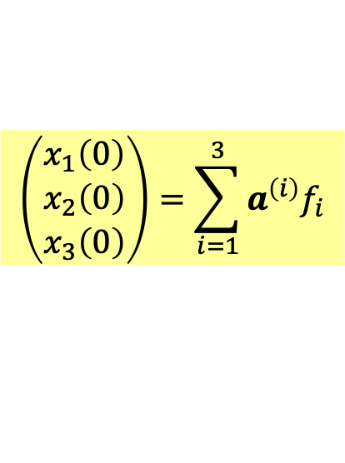
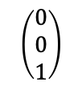


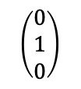
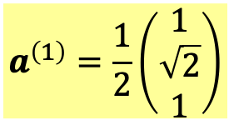
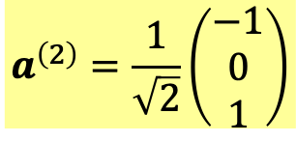
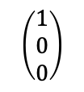
Let’s take a hint from the case of 3 body coupled springs:
Plug in $t=0$ to sums of mode solutions.
$$\left(\begin{matrix}x_{1}\left(0\right) \\ x_{2}\left(0\right) \\ x_{3}\left(0\right)\end{matrix}\right)=\sum_{i=1}^{3}{a^{\left(i\right)}f_{i}}$$
Initial conditions determine coefficients $f_{i}$.
We choose $a^{\left(i\right)}$ to be orthonormal.
$$a^{\left(m\right)T}a^{\left(n\right)}=δ_{mn}$$
In analogy, orthonormal eigenvectors look exactly like orthogonal coordinate axes!
$$a^{\left(1\right)}=\frac{1}{2}\left(\begin{matrix}1 \\ \sqrt{2} \\ 1\end{matrix}\right)$$
$$a^{\left(2\right)}=\frac{1}{\sqrt{2}}\left(\begin{matrix}−1 \\ 0 \\ 1\end{matrix}\right)$$
$$a^{\left(3\right)}=\frac{1}{2}\left(\begin{matrix}1 \\ −\sqrt{2} \\ 1\end{matrix}\right)$$
$$a^{\left(1\right)}⊥a^{\left(2\right)}⊥a^{\left(3\right)}$$
$$\left(\begin{matrix}0 \\ 0 \\ 1\end{matrix}\right)$$
$a^{\left(2\right)}$
$a^{\left(3\right)}$
$a^{\left(1\right)}$
$$\left(\begin{matrix}0 \\ 1 \\ 0\end{matrix}\right)$$
$$\left(\begin{matrix}1 \\ 0 \\ 0\end{matrix}\right)$$
This is not 3D space, but its abstract computational rules are identical to 3D.
We call this kind of look-alike 3D space a (generalized) Vector Space.
All linear combinations of $n$ orthonormal axes form a vector space of dimension $n$.
Computation rules of this vector space are identical to $n$D space

Slide 12
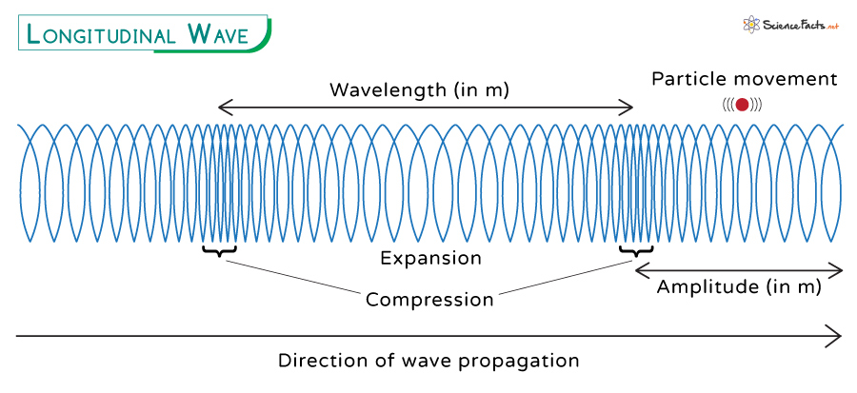

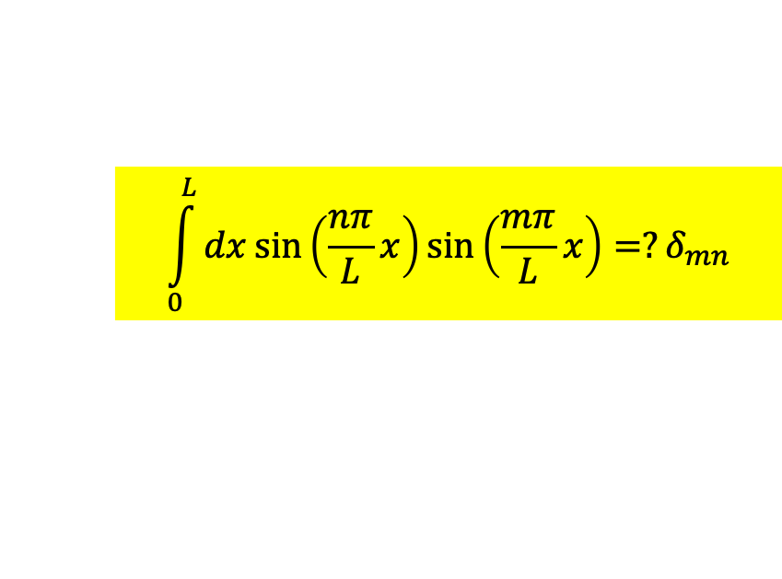







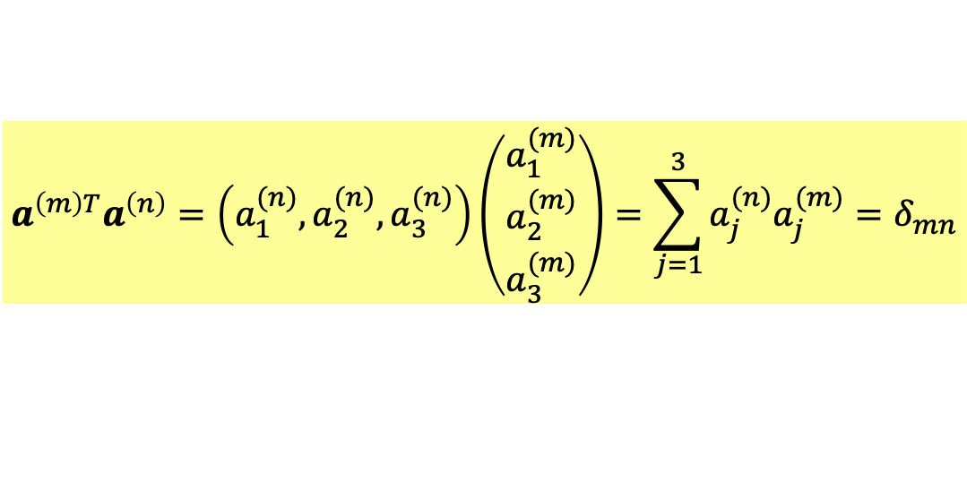

In the case of $N=3$ coupled springs:
$a^{\left(i\right)}$ are orthonormal.
$$a^{\left(m\right)T}a^{\left(n\right)}=\left(a_{1}^{(n)},a_{2}^{(n)},a_{3}^{(n)}\right)\left(\begin{matrix}a_{1}^{(m)} \\ a_{2}^{(m)} \\ a_{3}^{(m)}\end{matrix}\right)=\sum_{j=1}^{3}{a_{j}^{(n)}a_{j}^{(m)}}=δ_{mn}$$
$$dj, j=1,2,3$$
$$x_{j}\left(t\right)$$
$$a_{j}\left(t\right)$$
Continuous limit
$x$, $0<x<L$
$$φ\left(x,t\right)$$
$$X\left(x,t\right)$$
Note that subscript $j$ corresponds to $x.$ Inner product in continuous limit
will be multiplying $X_{m,n}\left(x\right)$ at the same $x$ then sum up over all $x$: ie. integraion.
$$\int_{0}^{L}{dx}sin\left(\frac{nπ}{L}x\right)sin\left(\frac{mπ}{L}x\right)=?δ_{mn}$$
Are $sin\left(\frac{nπ}{L}x\right)$ orthonormal?

Slide 13
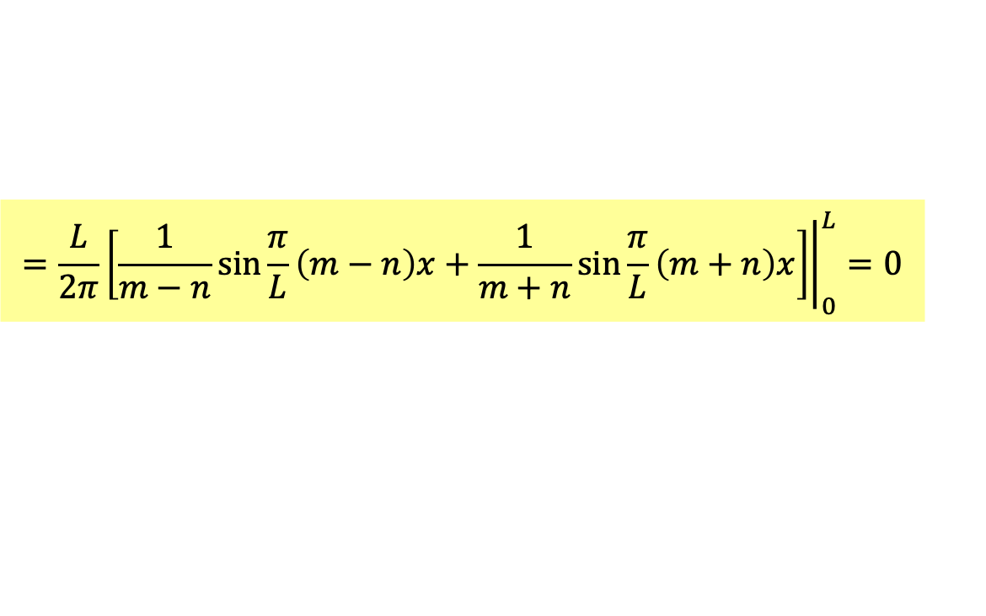
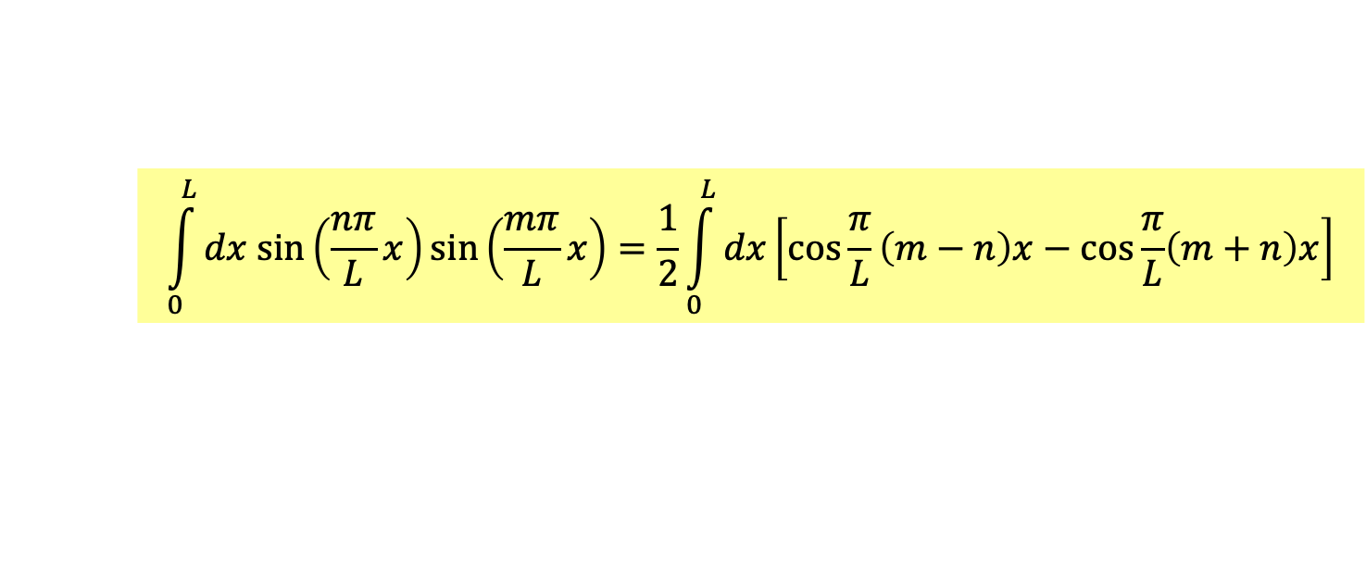


Method 0
Are $sin\left(\frac{nπ}{L}x\right)$ orthonormal?
If $m≠n$
$$\int_{0}^{L}{dx sin\left(\frac{nπ}{L}x\right)sin\left(\frac{mπ}{L}x\right)}=\frac{1}{2}\int_{0}^{L}{dx\left[\cos{\frac{π}{L}\left(m−n\right)x}−cos\frac{π}{L}\left(m+n\right)x\right]}$$
$$=\frac{L}{2π}{\left.\left[\frac{1}{m−n}sin{\frac{π}{L}\left(m−n\right)x}+\frac{1}{m+n}\sin{\frac{π}{L}\left(m+n\right)x}\right]\right|}_{0}^{L}=0$$
Sine functions are periodic.

Slide 14

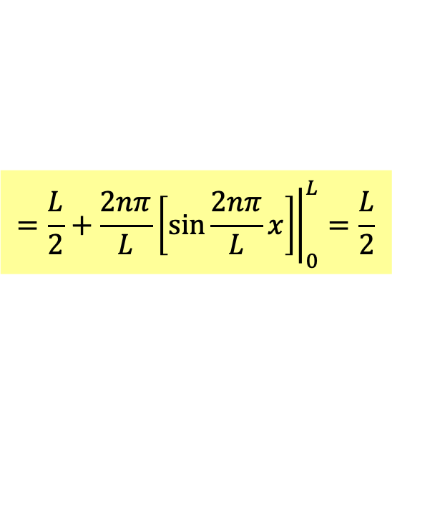


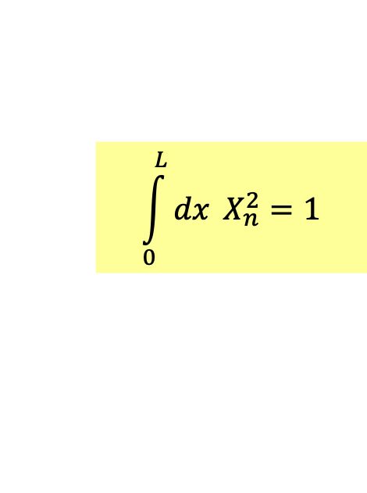
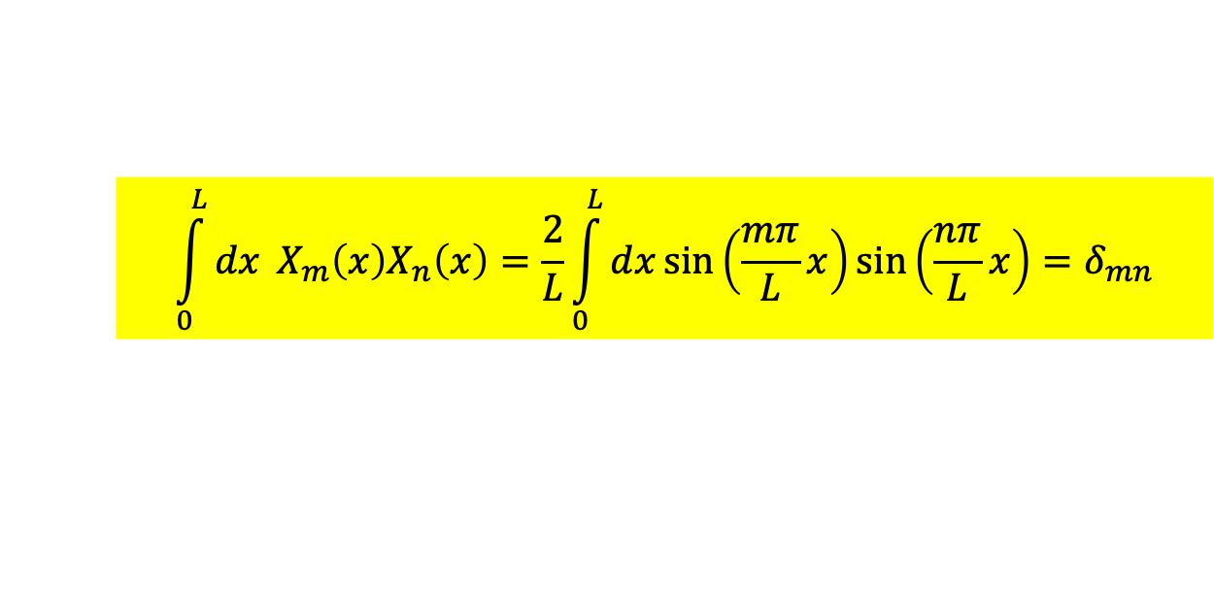

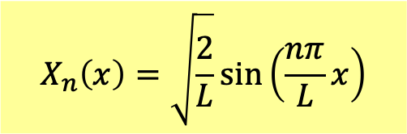
若$m=n$，
$$\int_{0}^{L}{dx sin\left(\frac{nπ}{L}x\right)sin\left(\frac{nπ}{L}x\right)}=\frac{1}{2}\int_{0}^{L}{dx\left[1−cos\frac{2nπ}{L}{x}\right]}$$
$$=\frac{L}{2}+\frac{2nπ}{L}{\left.\left[\sin{\frac{2nπ}{L}x}\right]\right|}_{0}^{L}=\frac{L}{2}$$
We could redefine eigenfunctions $X_{n}\left(x\right)$ such that vector length equal to $1$:
$$X_{n}\left(x\right)=\sqrt{\frac{2}{L}}sin\left(\frac{nπ}{L}x\right)$$
$$\int_{0}^{L}{dx} X_{n}^{2}=1$$
Yes, $sin\left(\frac{nπ}{L}x\right)$ is orthonormal if inner product is understood as integration over $x$.
$$\int_{0}^{L}{dx} X_{m}\left(x\right)X_{n}\left(x\right)=\frac{2}{L}\int_{0}^{L}{dx}sin\left(\frac{mπ}{L}x\right)sin\left(\frac{nπ}{L}x\right)=δ_{mn}$$
Kronecker $δ$ Function
$$δ_{mn}=\left\{\begin{matrix}0 m≠n \\ 1 m=n \end{matrix}\right.$$

Slide 15
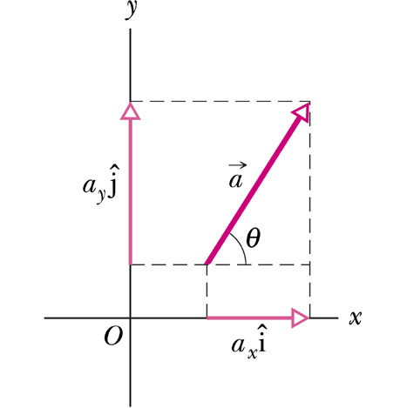
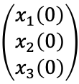


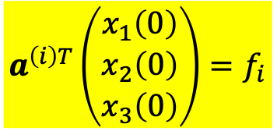




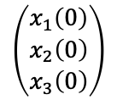
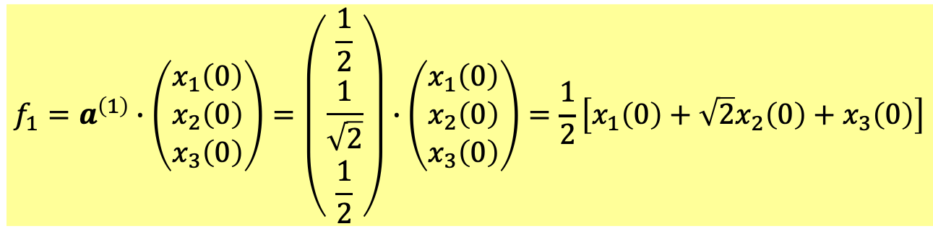

Back to the case of 3 body coupled springs:
$a^{\left(2\right)}$
$a^{\left(2\right)}$
$$\left(\begin{matrix}x_{1}\left(0\right) \\ x_{2}\left(0\right) \\ x_{3}\left(0\right)\end{matrix}\right)$$
$a^{\left(3\right)}$
$a^{\left(1\right)}$
$$a^{\left(2\right)}f_{2}$$
$$\left(\begin{matrix}x_{1}\left(0\right) \\ x_{2}\left(0\right) \\ x_{3}\left(0\right)\end{matrix}\right)$$
$a^{\left(1\right)}$
$$a^{\left(1\right)}f_{1}$$
Initial conditions looks like a vector,
and is expanded in terms of axes $a^{\left(i\right)}$ with $f_{i}$ as components.
Components $f_{i}$ equals the inner product of $a^{\left(i\right)}$ and initial condition vector.
$$a^{\left(i\right)T}\left(\begin{matrix}x_{1}\left(0\right) \\ x_{2}\left(0\right) \\ x_{3}\left(0\right)\end{matrix}\right)=f_{i}$$
For example,
$$f_{1}=a^{\left(1\right)}∙\left(\begin{matrix}x_{1}\left(0\right) \\ x_{2}\left(0\right) \\ x_{3}\left(0\right)\end{matrix}\right)=\left(\begin{matrix}\frac{1}{2} \\ \frac{1}{\sqrt{2}} \\ \frac{1}{2}\end{matrix}\right)∙\left(\begin{matrix}x_{1}\left(0\right) \\ x_{2}\left(0\right) \\ x_{3}\left(0\right)\end{matrix}\right)=\frac{1}{2}\left[x_{1}\left(0\right)+\sqrt{2}x_{2}\left(0\right)+x_{3}\left(0\right)\right]$$

Slide 16


$$\vec{a}=a_{x}\hat{i}+a_{y}\hat{j}=\left(a_{x},a_{y}\right)$$
$$a_{x}=\hat{i}∙\vec{a}, a_{y}=\hat{j}∙\vec{a}$$
For orthonormal axes $\hat{i},\hat{j}$, components of a vector can be computed by inner products!

Slide 17

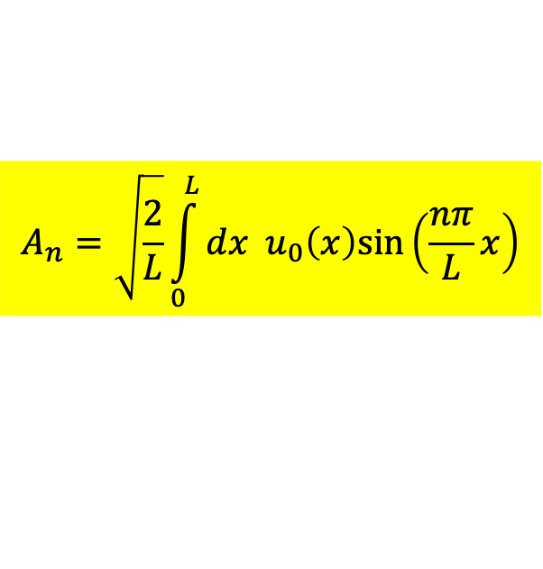
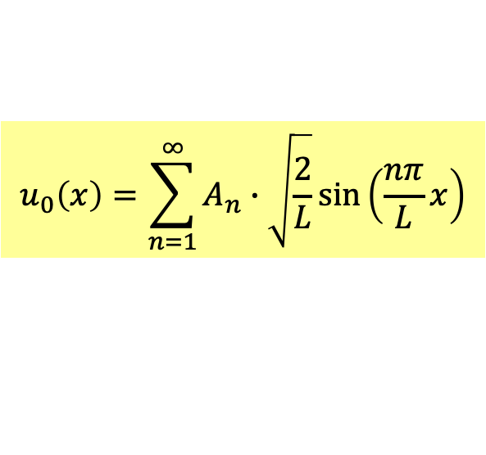
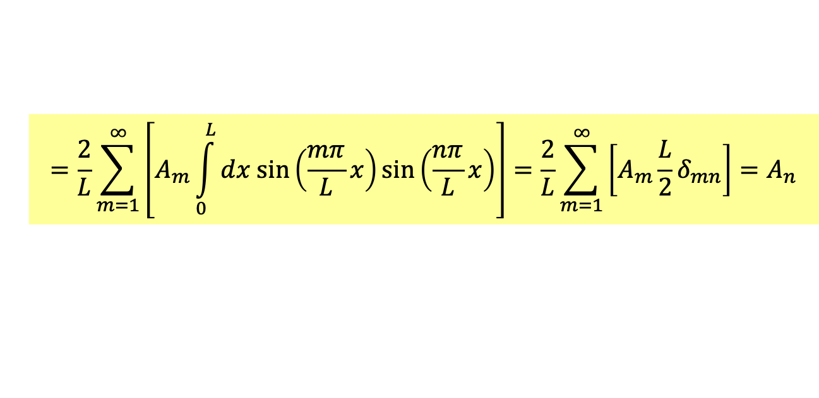

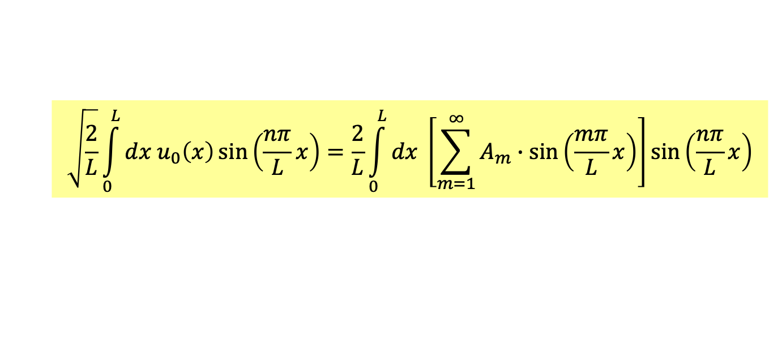

Decomposing $u_{0}\left(x\right)$ into linear combination of $X_{n}\left(x\right)$ could proceed similarly.
$$u_{0}\left(x\right)=\sum_{n=1}^{∞}{A_{n}∙\sqrt{\frac{2}{L}}sin\left(\frac{nπ}{L}x\right)}$$
$$\vec{a}=a_{x}\hat{i}+a_{y}\hat{j}$$
Take inner product of $u_{0}$ and $X_{n}$ in the sense of an integration:
$$a_{x}=\hat{i}∙\vec{a}$$
$$\sqrt{\frac{2}{L}}\int_{0}^{L}{dx u_{0}\left(x\right)}sin\left(\frac{nπ}{L}x\right)=\frac{2}{L}\int_{0}^{L}{dx \left[\sum_{m=1}^{∞}{A_{m}∙sin\left(\frac{mπ}{L}x\right)}\right]}sin\left(\frac{nπ}{L}x\right)$$
$$=\frac{2}{L}\sum_{m=1}^{∞}{\left[A_{m}\int_{0}^{L}{dx sin\left(\frac{mπ}{L}x\right)}sin\left(\frac{nπ}{L}x\right)\right]}=\frac{2}{L}\sum_{m=1}^{∞}{\left[A_{m}\frac{L}{2}δ_{mn}\right]}=A_{n}$$
Jean-Baptiste Joseph Fourier
$$A_{n}=\sqrt{\frac{2}{L}}\int_{0}^{L}{dx u_{0}\left(x\right)sin\left(\frac{nπ}{L}x\right)}$$
$$a_{x}=\hat{i}∙\vec{a}$$
Plug in these coefficients to Bernoulli’s solution and we solve the problem.

Slide 18
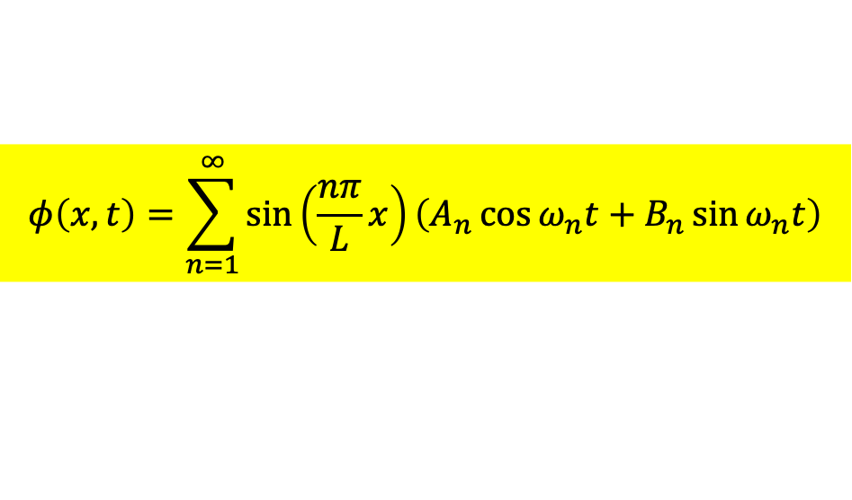
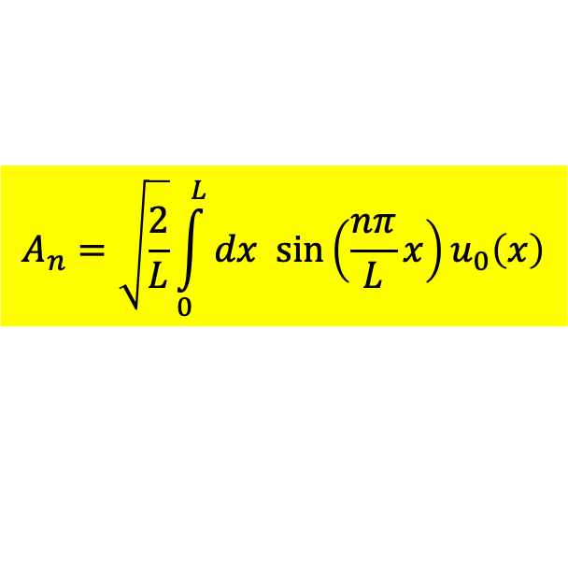
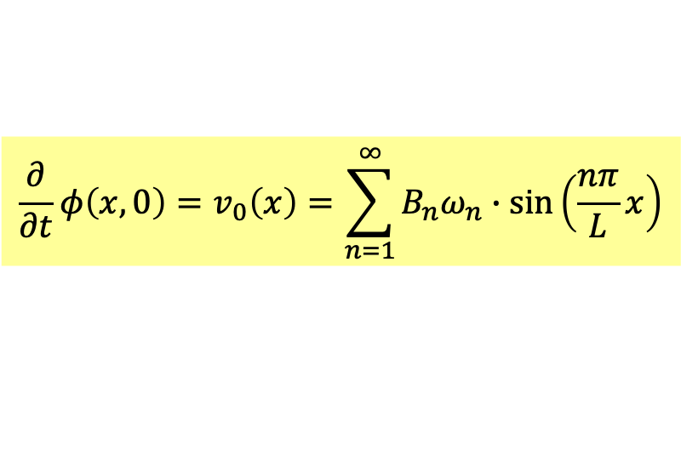
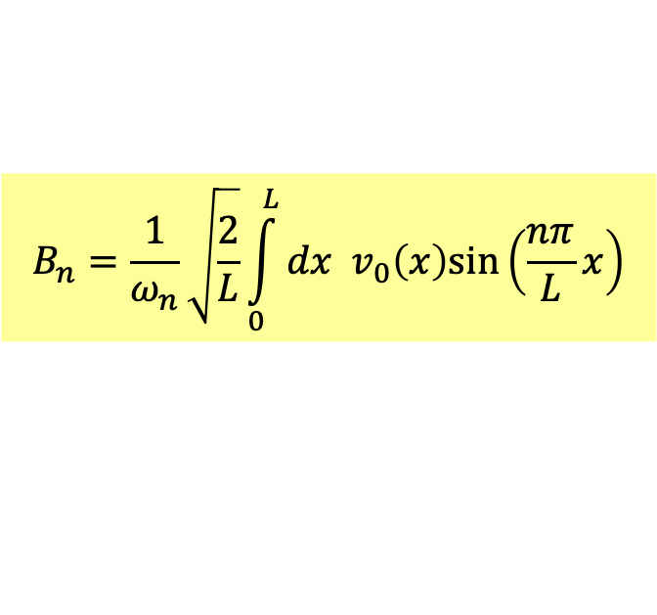

Bernoulli’s solution
$$φ\left(x,t\right)=\sum_{n=1}^{∞}{sin\left(\frac{nπ}{L}x\right)\left(A_{n}\cos{ω_{n}t}+B_{n}\sin{ω_{n}t}\right)}$$
Fourier Series of initial condition.
$$φ\left(x,0\right)=u_{0}\left(x\right)=\sum_{n=1}^{∞}{A_{n}∙sin\left(\frac{nπ}{L}x\right)}$$
$$\frac{∂}{∂t}φ\left(x,0\right)=v_{0}\left(x\right)=\sum_{n=1}^{∞}{B_{n}ω_{n}∙sin\left(\frac{nπ}{L}x\right)}$$
Fourier Series coefficient formula.
$$A_{n}=\sqrt{\frac{2}{L}}\int_{0}^{L}{dx sin\left(\frac{nπ}{L}x\right)}u_{0}\left(x\right)$$
$$B_{n}=\frac{1}{ω_{n}}\sqrt{\frac{2}{L}}\int_{0}^{L}{dx v_{0}\left(x\right)sin\left(\frac{nπ}{L}x\right)}$$
It satisfies both the system of equations of motion and initial conditions.
There is one and only one function that satisfies both EOM and initial conditions.
This is the only one solution.
We prove: any solution of Wave E. is a linear combination of separable solutions.

Slide 19










$$x=\sum_{i=1}^{3}{a^{\left(i\right)}\left[f_{i}∙cos\left(ω_{i}t\right)+g_{i}∙sin\left(ω_{i}t\right)\right]}$$
$$f_{i}=a^{\left(n\right)T}\left(\begin{matrix}x_{1}\left(0\right) \\ x_{2}\left(0\right) \\ x_{3}\left(0\right)\end{matrix}\right)=\sum_{j=1}^{3}{a_{j}^{(n)}x_{j}\left(0\right)}$$
$$dj, j=1,2,3$$
$$x_{j}\left(t\right)$$
$$a_{j}\left(t\right)$$
Continuous limit
$$x$$
$$φ\left(x,t\right)$$
$$X\left(x,t\right)$$
$$φ\left(x,t\right)=\sum_{n=1}^{∞}{sin\left(\frac{nπ}{L}x\right)\left(A_{n}\cos{ω_{n}t}+B_{n}\sin{ω_{n}t}\right)}$$
$$A_{n}=\sqrt{\frac{2}{L}}\int_{0}^{L}{dx sin\left(\frac{nπ}{L}x\right)}φ\left(x,0\right)$$
Inner product of coupled spring system in continuous limit
will be multiplying two functions at the same $x$ then sum up over all $x$: ie. integraion.

Slide 20









例如：考慮起始條件為一個Sawtooth鋸齒波形
$$u_{0}\left(x\right)$$
$$u_{0}\left(x\right)=\frac{1}{L}x$$
$$0<x<L$$
$$x/L$$
$$A_{n}=\sqrt{\frac{2}{L}}\int_{0}^{L}{dx u_{0}\left(x\right)sin\left(\frac{nπ}{L}x\right)}=\sqrt{\frac{2}{L}}\int_{0}^{L}{dx\frac{1}{L}x∙sin\left(\frac{nπ}{L}x\right)}$$
$$=\sqrt{\frac{2}{L}}\left\{{\frac{1}{nπ} \left.\left[xcos\left(\frac{nπ}{L}x\right)\right]\right|}_{0}^{L}+\frac{1}{nπ}\int_{0}^{L}{dx }cos\left(\frac{nπ}{L}x\right)\right\}$$
Integration by part
$$=\sqrt{2L}\frac{1}{nπ}cos\left(nπ\right)+\sqrt{2L}{{\left(\frac{1}{nπ}\right)}^{2}\left.\left[sin\left(\frac{nπ}{L}x\right)\right]\right|}_{0}^{L}=\sqrt{2L}\frac{{\left(−1\right)}^{n}}{nπ}$$
$$u_{0}\left(x\right)=\sum_{n=1}^{∞}{2\frac{{\left(−1\right)}^{n}}{nπ}sin\left(\frac{nπ}{L}x\right)}$$

Slide 21


Slide 22






If we start with string at rest: $v_{0}=0,B_{i}=0$.
$$\left|A_{n}\right|$$
$$u_{0}\left(x\right)$$
$$x/L$$
With coefficients $A_{n}$, we can write down the solution:
$$φ\left(x,t\right)=\sum_{n=1}^{∞}{A_{n}sin\left(\frac{nπ}{L}x\right)∙\cos{ω_{n}t}}=\sum_{n=1}^{∞}{2\frac{{\left(−1\right)}^{n}}{nπ}sin\left(\frac{nπ}{L}x\right)∙\cos{ω_{n}t}}$$
It satisfies both the system of equations of motion and initial conditions.
This is the only one solution.

Slide 23

The end of solving wave equation with boundary conditions.

Slide 24

Here is an example with animation!

Slide 25







Initial condition of the string:
$$u_{0}\left(x\right)$$
Initial condition can be decomposed into an infinite Fourier Series:
$$u_{0}\left(x\right)=\sum_{n=1}^{∞}{A_{n}∙sin\left(\frac{nπ}{L}x\right)}$$
$$A_{n}$$
$$n$$
Note that coefficients $A_{n}$ decrease rapidly with $n$.
Usually around 10 leading terms are enough to build a satisfactory approximation.

Slide 26

$$φ\left(x,t\right)=\sum_{n=1}^{∞}{sin\left(\frac{nπ}{L}x\right)\left(A_{n}\cos{ω_{n}t}+B_{n}\sin{ω_{n}t}\right)}$$
Terms $A_{n}∙sin\left(\frac{nπ}{L}x\right)$in Fourier series evolve with time separately like separable solutions.
Sum them up and we get the final solution.

Slide 27


Slide 28


Slide 29


Slide 30



Slide 31




$$\frac{∂^{2}φ}{∂t^{2}}=v^{2}\frac{∂^{2}φ}{∂x^{2}}$$
求解策略 Bernoulli Solutions
Solving Wave Equation:
Separation of variables plus Fourier Series
Search for separable solutions, products of a function of $x$ and a function of $t$.
$$φ\left(x,t\right)=X\left(x\right)∙T\left(t\right)$$
Satisfying an ODE, $T\left(t\right)$ is solved right away as oscillating SHM.
With boundary condition, $X\left(x\right)$ satisfies an ODE, called eigenvalue equation.
Allowed $X_{n}\left(x\right), n=1,⋯∞$ would be countable, called eigenfunctions
We found a series of separable solutions:
$$u_{n}\left(x,t\right)=X_{n}\left(x\right)∙T_{n}\left(t\right)=sin\left(\frac{nπ}{L}x\right)\left(A_{n}\cos{ω_{n}t}+B_{n}\sin{ω_{n}t}\right)$$
Since wave equation is linear, linear combinations of $X_{n}\left(x\right)T_{n}\left(t\right)$ are solutions, too.
$$φ\left(x,t\right)=\sum_{n=1}^{∞}{c_{n}X_{n}\left(x\right)∙T_{n}\left(t\right)}=\sum_{n=1}^{∞}{sin\left(\frac{nπ}{L}x\right)\left(A_{n}\cos{ω_{n}t}+B_{n}\sin{ω_{n}t}\right)}$$
Any initial condition $u_{0}\left(x\right)$ can be expanded as a linear combination of $X_{n}\left(x\right).$
$$φ\left(x,0\right)=u_{0}\left(x\right)=\sum_{n=1}^{∞}{A_{n}∙\sqrt{\frac{2}{L}}sin\left(\frac{nπ}{L}x\right)}$$
call it a mixture if you want.
This property of Fourier Seris is crucial. We say, it is complete 具有完備性.

Slide 32










各個配料分離烹煮$T_{i}\left(t\right)\sim cos\left(ω_{i}t\right)$
各個配料$X_{i}\left(x\right)$依配方$A_{i}$收集
最後合體！
Find recipe of ingredients.
$$+$$
Cook and then mix cooked ingredients.
$$＝$$
$$+$$
$$+$$
$$+$$
$$⋮$$
$$φ\left(x,t\right)=\sum_{n=1}^{∞}{c_{n}X_{n}\left(x\right)∙T_{n}\left(t\right)}=\sum_{n=1}^{∞}{sin\left(\frac{nπ}{L}x\right)\left(A_{n}\cos{ω_{n}t}+B_{n}\sin{ω_{n}t}\right)}$$
這樣的波函數顯然滿足波方程式，又滿足起始條件，就是唯一解。

Slide 33


Coupled springs
Classical Wave
Quantum Particle
It is striking all the 3 systems share the same mathematical technique.

Slide 34


$$φ\left(x,0\right)=u_{0}\left(x\right)=\sum_{n=1}^{∞}{A_{n}∙\sqrt{\frac{2}{L}}sin\left(\frac{nπ}{L}x\right)}$$
Any initial condition $u_{0}\left(x\right)$ can be expanded as a Fourier Series $.$
This property of Fourier Series is crucial. We say, it is complete 具有完備性.
Is this infinite Fourier Series convergent? The answer is yes.
How is this infinite Fourier series approaching $u_{0}\left(x\right)$? The answer is:
$$\lim_{N→∞}{\int_{0}^{L}{dx {\left[u_{0}\left(x\right)−\sum_{n=1}^{∞}{A_{n}∙\sqrt{\frac{2}{L}}sin\left(\frac{nπ}{L}x\right)}\right]}^{2}}}=0$$

Slide 35

若確認任一合邊界條件的函數可以本徵函數分解，我們能計算其分解係數。
但這樣的分解真的是正確的嗎？分解所得的無限級數真的與被分解的函數相等嗎？
物理直覺：合理的起始條件下，波方程式應該都有解，因此這樣的分解一定可行 。
數學上相等與否的判準：這些係數組成的$X_{n}\left(x\right)$的線性組合，會趨近被分解的函數。
$$\lim_{N→∞}{\int_{0}^{L}{dx {\left[u_{0}\left(x\right)−\sum_{n=1}^{N}{A_{n}∙X_{n}\left(x\right)}\right]}^{2}}}=0$$
兩者差距的平方和(積分)$N→∞$時，趨近於零。
這稱為Completeness.完備性，必須嚴格證明的。下學期將說明。
但在波方程式的例子中，起始條件的展開其實就是傅立葉級數的一部分。
猜測且相信 ：三角函數是Complete完備的。傅立葉無限級數可以趨近任一週期函數！
我們可以先說明$X_{n}$的展開等價於傅立葉級數展開，因此一系列$X_{n}$也是完備的。
下學期再說明滿足某些條件的算子的本徵函數也都是完備的。

Slide 36

傅立葉級數

Slide 37








任一滿足邊界條件$f\left(0\right)=f\left(L\right)=0$的函數$f\left(x\right)$都可分解為一正弦函數級數：
$$f\left(x\right)=\sum_{n=1}^{∞}{A_{n}∙sin\left(\frac{nπ}{L}x\right)}$$
$$f\left(x\right)$$
$$k=\frac{π}{L}$$
This is a special case of Fourier Series.
$$x$$
$$k=\frac{2π}{L}$$
$$k=\frac{3π}{L}$$
$$k=\frac{4π}{L}$$
Jean-Baptiste Joseph Fourier
1768-1830

Slide 38

傅立葉級數Fourier Series for periodic function
The series is usually extended to include similar Cosine functions and a constant:
$$f\left(x\right)=a_{0}+\sum_{n=1}^{∞}{\left[{a_{n}∙\sin{\frac{nπ}{L}x}+b}_{n}∙\cos{\frac{nπ}{L}x}\right]}$$
There is no doubt this expression is a periodic function of period $2L$.
It is proved any such periodic function can be written as such a Fourier Series.
Usually, the range is defined as $−L<x<L$.
Fourier Series for periodic function and for function with fixed ends are equivalent.

Slide 39




Fourier Series for periodic function and for function with fixed ends:
傅立葉分析是分解週期函數為一系列正弦函數與餘弦函數的級數和。
波方程式的起始條件則是定義在一個線段中：
$$φ\left(x,0\right)=u_{0}\left(x\right), 0<x<L$$
我們若將$u_{0}\left(x\right)$延展到整個空間，成為一週期函數，傅立葉分析就能用！
定義延展後的函數為一奇函數：
$$u_{0}\left(−x\right)=−u_{0}\left(x\right), −∞<x<∞$$
同時是一週期為$2L$的週期函數：
$$u_{0}\left(x+2L\right)=u_{0}\left(x\right), −∞<x<∞$$

Slide 40







$$u_{0}\left(−x\right)=−u_{0}\left(x\right),$$
$$u_{0}\left(0\right)=−u_{0}\left(0\right)=0$$
$$u_{0}\left(x+2L\right)=u_{0}\left(x\right),$$
$$u_{0}\left(L\right)=u_{0}\left(−L\right)=−u_{0}\left(L\right)=0$$
這個$u_{0}\left(x\right)$的延展，滿足邊界條件，同時在$0<x<L$等同於原來的起始條件。
此延展為一週期函數，傅立葉分析就能用！
$$u_{0}\left(x\right)=\sum_{n=1}^{∞}{\left[A_{n}∙\sin{\frac{nπ}{L}x}+B_{n}∙\cos{\frac{nπ}{L}x}\right]}$$
$$=\sum_{n=1}^{∞}{A_{n}∙\sin{\frac{nπ}{L}x}}$$
$u_{0}\left(x\right)$是奇函數，只有正弦函數留下。這個傅立葉數列是完備的！
這一系列算子的本徵函數$X_{n}\left(x\right)=\sqrt{\frac{2}{L}}sin\left(\frac{nπ}{L}x\right)$是完備的！

Slide 41





完整的傅立葉級數公式：
$$f\left(x\right)=\frac{a_{0}}{2}+\sum_{n=1}^{∞}{\left[a_{n}∙\cos{\frac{nπ}{L}x}+b_{n}∙\sin{\frac{nπ}{L}x}\right]}$$
$$a_{0}=\frac{1}{2L}\int_{−L}^{L}{dx f\left(x\right)}$$
$$a_{n}=\frac{1}{L}\int_{−L}^{L}{dx f\left(x\right)}\cos{\frac{nπ}{L}x}$$
Inner product of $f\left(x\right)$ and $\cos{\frac{nπ}{L}x}$.
$$b_{n}=\frac{1}{L}\int_{−L}^{L}{dx f\left(x\right)}\sin{\frac{nπ}{L}x}$$

Slide 42


Slide 43


Slide 44


Slide 45


Slide 46



$$L=2$$

Slide 47


Slide 48


Slide 49





The variable can be chosen to be time: $x→t$
Any periodic signal of period $T$ can be written as a Fourier Series of Harmonics.
$$x\left(t\right)=\sum_{n=1}^{∞}{\left[a_{n}\cos\left(n\frac{2π}{T}t\right)+b_{n}\sin\left(n\frac{2π}{T}t\right)\right]}=\sum_{n=1}^{∞}{\left[a_{n}\cos{ω_{n}t}+b_{n}\sin{ω_{n}t}\right]}$$
各成分的週期$T_{n}=\frac{T}{n}$是函數週期的整數分之一！
$$T_{n}=\frac{T}{n}$$
各成分的頻率$f_{n}$是訊號函數頻率$f$的整數倍！
研究三角函數就等於研究所有週期函數。

Slide 51



Slide 52


一般來說，n 越大，強度越小，所以通常只要有限個成分就能近似一個周期運動！

Slide 53


$$f\left(x\right)=a_{0}+\sum_{n=1}^{∞}{\left[{a_{n}∙\sin{\frac{nπ}{L}x}+b}_{n}∙\cos{\frac{nπ}{L}x}\right]}$$
It is sometimes useful to redefine $\frac{π}{L}x$ as new variable $x$.
$$f\left(x\right)=a_{0}+\sum_{n=1}^{∞}{\left[{a_{n}∙\sin{nx}+b}_{n}∙\cos{nx}\right]}$$
The period of $f\left(x\right)$ is now $2π$, defined in the region:$−π<x<π.$
This is officially how Fourier Series is defined.

Slide 54









首先三角函數形成正交歸一的一系列函數：
$$\int_{−π}^{π}{dx\cos{mx}\cos{nx}}=\frac{1}{2}\int_{−π}^{π}{dx\left[\cos\left(m+n\right)x+\cos\left(m−n\right)x\right]}$$
若$m≠n$
$$=\frac{1}{2}{\left.\left[\frac{1}{m+n}sin\left(m+n\right)x+\frac{1}{m+n}\sin\left(m−n\right)x\right]\right|}_{−π}^{π}$$
正弦函數是週期函數，上式為零。
若$m=n$，
$$\int_{−π}^{π}{dx\cos{mx}\cos{nx}}=\frac{1}{2}\int_{−π}^{π}{dx\left[\cos\left(m+n\right)x+1\right]}$$
$$=\frac{1}{2}\int_{−π}^{π}{dx}=π$$
綜合兩式可以表示為：
Kronecker $δ$ Function
$$\int_{−π}^{π}{dx\cos{mx}\cos{nx}}=πδ_{mn}$$
$$δ_{mn}=\left\{\begin{matrix}0 m≠n \\ 1 m=n \end{matrix}\right.$$

Slide 55







同理：
$$\int_{−π}^{π}{dx\sin{mx}\sin{nx}}=πδ_{mn}$$
$$\int_{−π}^{π}{dx\cos{mx}\sin{nx}}=\frac{1}{2}\int_{−π}^{π}{dx\left[\sin\left(m+n\right)x+\sin\left(m−n\right)x\right]}$$
若$m≠n$
$$=\frac{1}{2}{\left.\left[\frac{1}{m+n}cos\left(m+n\right)x+\frac{1}{m+n}\cos\left(m−n\right)x\right]\right|}_{−π}^{π}=0$$
若$m=n$，
$$=\frac{1}{2}{\left.\left[\frac{1}{m+n}cos\left(2m\right)x\right]\right|}_{−π}^{π}=0$$
$$\int_{−π}^{π}{dx\cos{mx}\sin{nx}}=0$$

Slide 56






三角函數形成正交歸一的一系列函數：
$$\int_{−π}^{π}{dx\cos{mx}\cos{nx}}=πδ_{mn}$$
$$\int_{−π}^{π}{dx\sin{mx}\sin{nx}}=πδ_{mn}$$
$$\int_{−π}^{π}{dx\cos{mx}\sin{nx}}=0$$
The coefficients can be easily computed:
我們只要對$f\left(x\right)$成三角函數後積分即可。
$$\frac{1}{π}\int_{−π}^{π}{dx f\left(x\right)}\cos{nx}=\frac{1}{π}\int_{−π}^{π}{dx \left[a_{0}+\sum_{m=1}^{∞}{\left[a_{m}∙\cos{mx}+b_{m}∙\sin{mx}\right]}\right]}\cos{nx}$$
$$=\frac{1}{π}\int_{−π}^{π}{dx \left[a_{0}+\sum_{m=1}^{∞}{\left[a_{m}∙\cos{mx}+b_{n}∙\sin{mx}\right]}\right]}\cos{nx}=\sum_{m=1}^{∞}{\left[a_{m}δ_{mn}\right]}=a_{n}$$

Slide 57




完整的傅立葉級數公式：
$$f\left(x\right)=a_{0}+\sum_{n=1}^{∞}{\left[a_{n}∙\cos{nx}+b_{n}∙\sin{nx}\right]}, −π<x<π$$
$$a_{0}=\frac{1}{2π}\int_{−π}^{π}{dx f\left(x\right)}$$
$$a_{n}=\frac{1}{π}\int_{−π}^{π}{dx f\left(x\right)}\cos{nx}$$
$$b_{n}=\frac{1}{π}\int_{−π}^{π}{dx f\left(x\right)}\sin{nx}$$

Slide 58









You observed Fourier series sometimes comes with only Sine series or Cosine series
If $f\left(x\right)$ is an Odd function, only Sine series contribute！
$$f\left(−x\right)=−f\left(x\right)$$
$$f\left(x\right)$$
$$f\left(x\right)=\sum_{n=1}^{∞}{a_{n}∙\sin{nx}}$$
If $f\left(x\right)$ is an even function, only Cosine series contribute！
$$f\left(−x\right)=f\left(x\right)$$
$$f\left(x\right)$$
$$f\left(x\right)=a_{0}+\sum_{n=1}^{∞}{b_{n}∙\cos{nx}}$$
$$−π$$
$$π$$

Slide 59





例如：Sawtooth 鋸齒函數
$$u_{0}\left(x\right)=\frac{1}{π}x, −π<x<π$$
$$a_{n}=\frac{1}{π}\int_{−π}^{π}{dx \frac{1}{π}x}sin\left(nx\right)=$$
$$=\frac{1}{π^{2}}{\frac{1}{n}\left.\left[xcos\left(nx\right)\right]\right|}_{−π}^{π}+\frac{1}{π^{2}}\frac{1}{n}\int_{−π}^{π}{dx }cos\left(nx\right)$$
$$=2\frac{1}{nπ}cos\left(nπ\right)+{{\left(\frac{1}{nπ}\right)}^{2}\left.\left[xsin\left(\frac{nπ}{L}x\right)\right]\right|}_{−π}^{π}$$
$$=2\frac{{\left(−1\right)}^{n}}{nπ}$$

Slide 60






$$u_{0}\left(x\right)=\frac{1}{π}x, −π<x<π$$
$$b_{n}=\frac{1}{π}\int_{−π}^{π}{dx \frac{1}{π}x}cos\left(nx\right)=\frac{1}{π}\int_{−π}^{0}{dx \frac{1}{π}x}cos\left(nx\right)+\frac{1}{π}\int_{0}^{π}{dx \frac{1}{π}x}cos\left(nx\right)$$
$$=\frac{1}{π}\int_{0}^{π}{dx \frac{1}{π}\left(−x\right)}cos\left(−nx\right)+\frac{1}{π}\int_{0}^{π}{dx \frac{1}{π}x}cos\left(nx\right)=0$$
餘弦函數是偶函數Even function
$$cos\left(−nx\right)=cos\left(nx\right)$$
起始條件是奇函數Odd function
$$u_{0}\left(−x\right)=−u_{0}\left(x\right)$$
相乘後為奇函數，在原點兩邊積分將互相抵消！
$$\frac{1}{π}x=\sum_{n=1}^{∞}{\left(2\frac{{\left(−1\right)}^{n}}{nπ}∙\sin{nx}\right)}$$
鋸齒函數的傅立葉級數展開如下：

Slide 61

$$\left|A_{n}\right|$$

Slide 63


數學家早已證明三角函數是完備的。
$$\lim_{N→∞}{\int_{−π}^{π}{dx {\left[f\left(x\right)−a_{0}+\sum_{n=1}^{N}{\left[a_{n}∙\cos{nx}+b_{n}∙\sin{nx}\right]}\right]}^{2}}}=0$$

Slide 64




考慮起始條件為一個Sawtooth鋸齒波形
$$u_{0}\left(x\right)$$
$$0<x<L$$
$$x/L$$
延展，滿足邊界條件，同時在$0<x<L$等同於原來的起始條件。
$$0<x′<π$$

Slide 65







傅立葉數列的結果，只要換一下變數即可直接用於固定端點的弦：
$$\frac{1}{π}x′=\sum_{n=1}^{∞}{2\frac{{\left(−1\right)}^{n}}{nπ}∙\sin{nx′}}$$
$$x^{′}=\frac{π}{L}x$$
$$\frac{1}{L}x=\sum_{n=1}^{∞}{2\frac{{\left(−1\right)}^{n}}{nπ}\sin{\frac{nπ}{L}x}}=\sum_{n=1}^{∞}{\sqrt{2L}\frac{{\left(−1\right)}^{n}}{nπ}∙X_{n}\left(x\right)}$$
$$A_{n}=\sqrt{2L}\frac{{\left(−1\right)}^{n}}{nπ}$$
所得到的係數與直接用本徵函數的正交歸一定理所得結果相同！
$$A_{n}=\int_{0}^{L}{dx u_{0}\left(x\right)}X_{n}\left(x\right)=$$
$$=\sqrt{2L}\frac{1}{nπ}cos\left(nπ\right)+\sqrt{2L}{{\left(\frac{1}{nπ}\right)}^{2}\left.\left[xsin\left(\frac{nπ}{L}x\right)\right]\right|}_{0}^{L}=\sqrt{2L}\frac{{\left(−1\right)}^{n}}{nπ}$$
這一系列算子的本徵函數$X_{n}\left(x\right)=\sqrt{\frac{2}{L}}sin\left(\frac{nπ}{L}x\right)$是完備的！

Slide 66


Slide 67




There is another easier way to solve wave equation:
$$\frac{∂^{2}y}{∂x^{2}}=\frac{1}{v^{2}}\frac{∂^{2}y}{∂t^{2}}$$
This is called d'Alembert solution.
Prove wave equation has the following solution:
$$f\left(x−vt\right)$$
Jean le Rond d'Alembert 1717-83

Slide 68















$$\frac{∂^{2}y}{∂x^{2}}=\frac{1}{v^{2}}\frac{∂^{2}y}{∂t^{2}}$$
波方程式
Plug in the expression. Note that it is a function of only $x^{′}≡x−vt$.
$$y\left(x,t\right)=f\left(x−vt\right)=f\left(x′\right)$$
$$x^{′}≡x−vt$$
$$\frac{∂y}{∂x}=\frac{∂x^{′}}{∂x}\frac{df}{dx′}=\frac{df}{dx′}$$
fix $t$ and use chain rule.
$$\frac{∂x^{′}}{∂x}=1$$
with $t$ fixed
$$\frac{∂^{2}y}{∂x^{2}}=\frac{∂}{∂x}\left(\frac{df}{dx′}\right)=\frac{∂x^{′}}{∂x}\frac{d}{dx′}\left(\frac{df}{dx′}\right)=\frac{d^{2}f}{d{x′}^{2}}$$
Second partial is second derivative of $f$.
$$\frac{∂y}{∂t}=\frac{∂x^{′}}{∂t}\frac{df}{dx′}=−v\frac{df}{dx′}$$
$$\frac{∂x^{′}}{∂t}=−v$$
fix $x$ and use chain rule.
with $x$ fixed
$$\frac{∂^{2}y}{∂t^{2}}=−v\frac{∂}{∂t}\left(\frac{df}{dx′}\right)=−v\frac{∂x^{′}}{∂t}\frac{d}{dx′}\left(\frac{df}{dx′}\right)=v^{2}\frac{d^{2}f}{d{x′}^{2}}$$
$$\frac{∂^{2}y}{∂x^{2}}=\frac{1}{v^{2}}\frac{∂^{2}y}{∂t^{2}}$$
Indeed, what we guessed is a solution of wave equation！
$x^{′}$將時間與空間連鎖在一起，於是時間微分與空間微分也是連鎖的。

Slide 69







Function $f\left(x\right)$ is wave form at $t=0$。
$$y\left(x,t=0\right)=f\left(x−v∙0\right)=f\left(x\right)$$
$$t=0$$
$$vt$$
$$t$$
$$y\left(x,t\right)=y\left(x−vt,0\right)=f\left(x−vt\right)$$
At later time $t$, wave at $x$ $y\left(x,t\right)$ equals wave at $t=0$ at location $x−vt$.

Slide 70

$f\left(x−vt\right)$ means that a wave form $f\left(x\right)$ is moving at speed $v$, as we expected.
$$v$$

Slide 71





Slide 72


Slide 73



Slide 74












Sinusoidal wave
$$f\left(x\right)=y_{m}\sin\left(kx+φ\right)$$
Wave form is a periodic Sine function of period $λ$.
$$\sin\left(kx+φ\right)=\sin\left(kx+kλ+φ\right)$$
$$kλ=2π$$
$$k≡\frac{2π}{λ}$$
Sinusoidal wave function:
$$y\left(x,t\right)=f\left(x−vt\right)=y_{m}\sin\left(kx−kvt+φ\right)$$
$$y\left(x,t\right)=y_{m}\sin\left(kx−ωt+φ\right)$$
$$ω=2πf=\frac{2π}{T}$$
$$f=\frac{1}{T}$$
$$v∆t$$
$$v$$

Slide 75


This is periodic wave with specified wavelength and frequency in uniform medium!
$$y\left(x,t\right)=y_{m}\sin\left(kx−ωt+φ\right)$$

Slide 76


$f\left(x−vt\right)$ means that a wave form $f\left(x\right)$ is moving at speed $v$ to the right.
Replacing $v with –v$, we find a wave function $g\left(x+vt\right)$ moving to the left.
$$y\left(x,t\right)=g\left(x+vt\right)$$

Slide 77





疊加定理 Superposition Principle
Since wave Equation is linear, linear combinations of solutions are also solutions.
$$\frac{∂^{2}y_{1}}{∂x^{2}}=\frac{1}{v^{2}}\frac{∂^{2}y_{1}}{∂t^{2}}$$
$$\frac{∂^{2}y_{2}}{∂x^{2}}=\frac{1}{v^{2}}\frac{∂^{2}y_{2}}{∂t^{2}}$$
$$\frac{∂^{2}\left(y_{1}+y_{2}\right)}{∂x^{2}}=\frac{1}{v^{2}}\frac{∂^{2}\left(y_{1}+y_{2}\right)}{∂t^{2}}$$

Slide 78

A general solution: d'Alembert solution
$$y\left(x,t\right)=f\left(x−vt\right)+g\left(x+vt\right)$$
$f\left(x\right),g\left(x\right)$ are waveforms propagating to the right and the left respectively.
The wave forms propagates at constant wave speed.
The wave forms do not change during propagation.
Jean le Rond d'Alembert 1717-83

Slide 79



These are properties we expect from a Propagating Wave

Slide 80






$$t=0$$
$$y\left(x,t\right)=f\left(x−vt\right)+g\left(x+vt\right)$$
Functions $f\left(x\right),g(x)$ can be solved from initial conditions: $y\left(x,0\right),\frac{∂y}{∂t}\left(x,0\right)$.
$$y\left(x,0\right),\frac{∂y}{∂t}\left(x,0\right)↔f\left(x\right),g\left(x\right)$$
$$y\left(x,0\right)=u_{0}\left(x\right)=f\left(x\right)+g\left(x\right)$$
$$\frac{∂y}{∂t}\left(x,0\right)=v_{0}\left(x\right)=v\left[f^{′}\left(x\right)−g′\left(x\right)\right]$$
$$y\left(x,t\right)=\frac{1}{2}\left[u_{0}\left(x−vt\right)+u_{0}\left(x+vt\right)\right]+\frac{1}{2v}\int_{x−vt}^{x+vt}{dx^{′}v_{0}\left(x′\right)}$$

Slide 81




Take the case $v_{0}=0$ as examples. $u_{0}\left(x\right)$ is the initial wave form.
$$y\left(x,t\right)=\frac{1}{2}\left[u_{0}\left(x−vt\right)+u_{0}\left(x+vt\right)\right]$$
Right moving wave form and left are exactly one half the initial wave form at rest.
The wave form will slip into two, one propagating to the right, one to the left.
$$t=0$$
$$t=2 s$$

Slide 82



Slide 83


Bernoulli’s solution
d'Alembert solution:
$$\sum_{n=1}^{∞}{sin\left(\frac{nπ}{L}x\right)\left(A_{n}\cos{ω_{n}t}+B_{n}\sin{ω_{n}t}\right)}$$
$$f\left(x−vt\right)+g\left(x+vt\right)$$
Two types of solutions are equivalent.

Slide 84
Standing waves (separable solutions) are d'Alembert solutions.

Slide 85

Standing waves (separable solutions) are d'Alembert solutions.

Slide 86

Sawtooth waves (as a Bernoulli solution-coloured lines)
$$φ\left(x,t\right)=\sum_{n=1}^{∞}{sin\left(\frac{nπ}{L}x\right)\left(A_{n}\cos{ω_{n}t}+B_{n}\sin{ω_{n}t}\right)}$$

Slide 87
Sawtooth waves (as a Bernoulli solution-coloured lines) are d'Alembert solutions.

Slide 88



$$\frac{∂^{2}φ}{∂t^{2}}=v^{2}\frac{∂^{2}φ}{∂x^{2}}$$
Wave Equation
If the size of the medium is infinite or its boundaries are far away,
we have d'Alembert solution of a travelling or propagating wave from：
$$φ\left(x,t\right)=f\left(x−vt\right)+g\left(x+vt\right)$$
行進傳播

Slide 89
If the size of the medium is finite, its boundaries are nearby.
振盪
Reflection from boundaries would make wave behave more like vibrations!
It resembles a system of coupled springs! Bernoulli’s solution works better.

