Slide 1
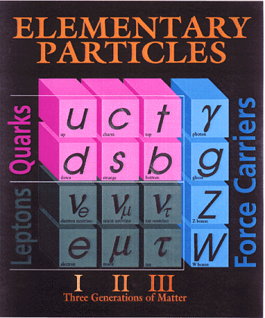
Now we have a good understanding of gauge bosons including their masses.
But fermions are still massless. That is actually pretty good. Why?

Slide 2
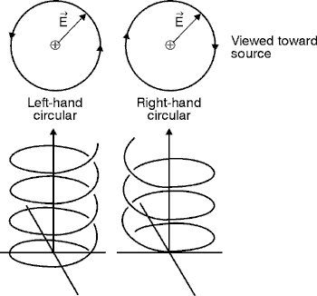
Circular Polarized Light

Slide 3
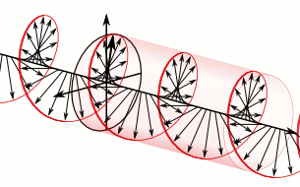
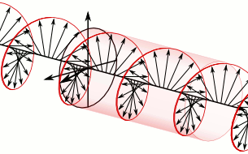
右手旋 Right-Handed
左手旋 Left-Handed
關鍵是場的旋轉軸與場傳播方向的關係。

Slide 4
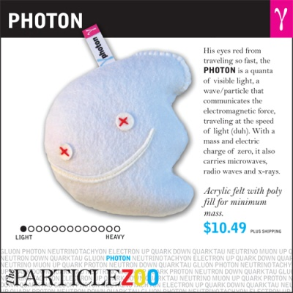

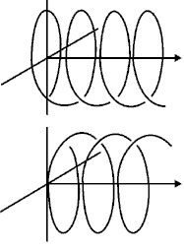
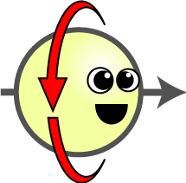
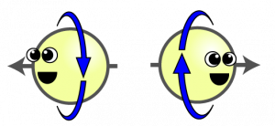
傳播中的電子也有自旋

Slide 5



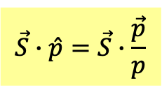

Spin states
Helicity螺旋性 States
自旋角動量只能選一個方向，要求電子為其本徵態。
$$\vec{S}∙\hat{p}=\vec{S}∙\frac{\vec{p}}{p}$$
$\vec{S}∙\hat{p}$稱為螺旋度 Helicity。

Slide 6
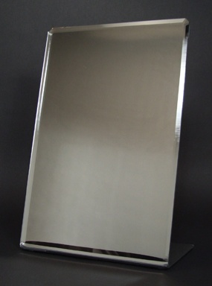
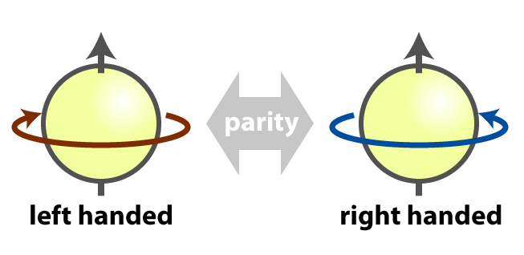
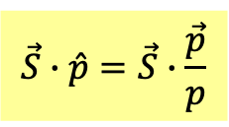
在鏡射變換下左手旋與右手旋的態會互換。
$$\vec{S}∙\hat{p}=\vec{S}∙\frac{\vec{p}}{p}$$

Slide 7
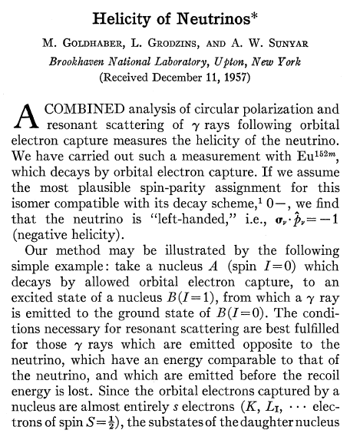
In 1957 we found neutrino has only one helicity.

Slide 8
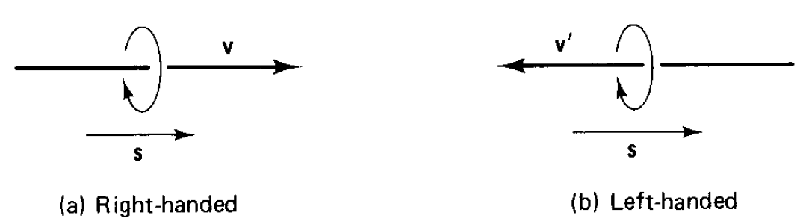
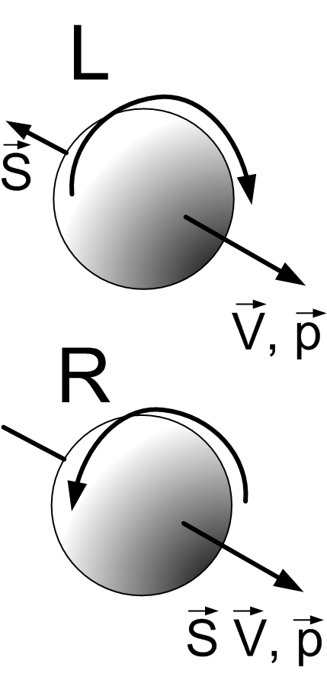

Slide 9
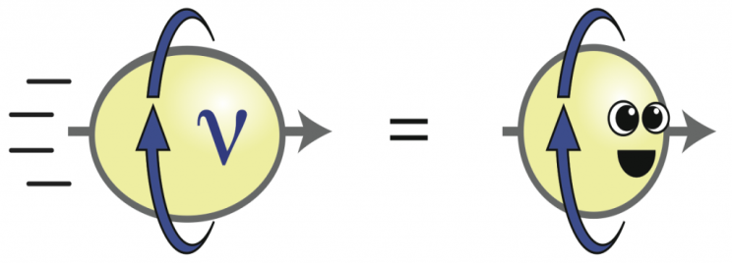
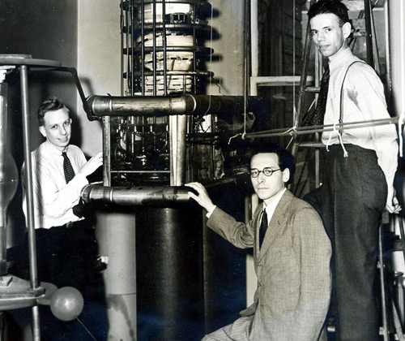
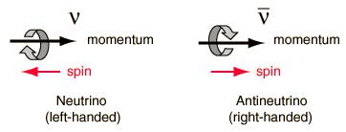
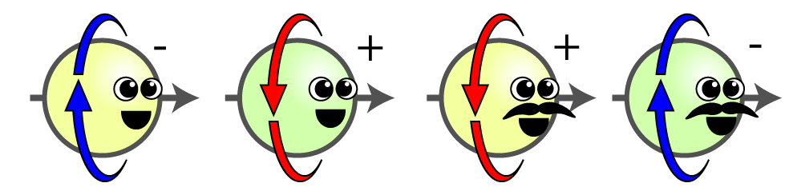


A 1958 ex. by Goldhaber et al measured the helicity of neutrino!
所有微中子都是左手旋！
沒有右手旋的微中子！
反微中子只有右手旋。
$$ν$$
$$\overline{ν }$$
左旋微中子

Slide 10
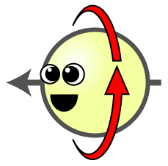
在鏡射變換下左右旋態會互換
$$\vec{S}∙\hat{p}→−\vec{S}∙\hat{p}$$
鏡射變換並不對稱。

Slide 11
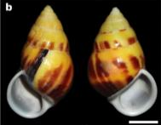

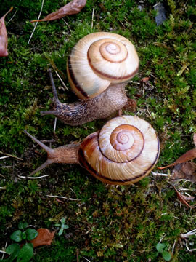
Left and right coiling Euhadra snails

Slide 12
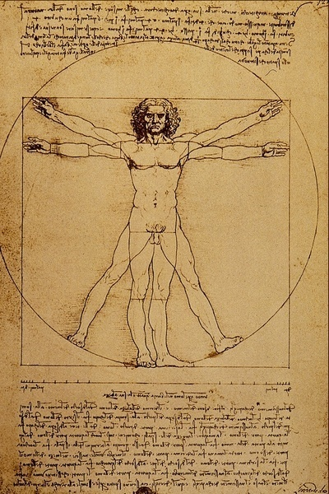
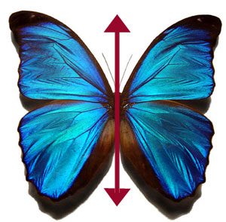
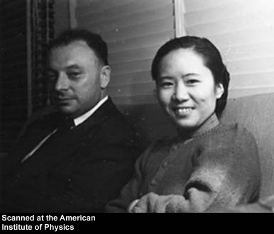
At the fundamental level, it is hard to believe God favor left over right or right or left.
I don’t believe that the Lord is a weak left-hander, and I am ready to bet a very large sum that the experiments will give symmetric results.
Pauli’s letter to Weisskopf 3 days before he was told the news

Slide 13
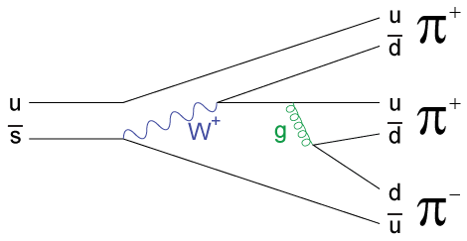


$τ−θ$ puzzle
由衰變產物的共振曲線發現粒子。
$τ$ and$θ$ 具有幾乎一樣的質量與半衰期。
如此沒有個性的兩顆粒子！
But Theta decays into 2 pions.
Tau decays into 3 pions.

Slide 14
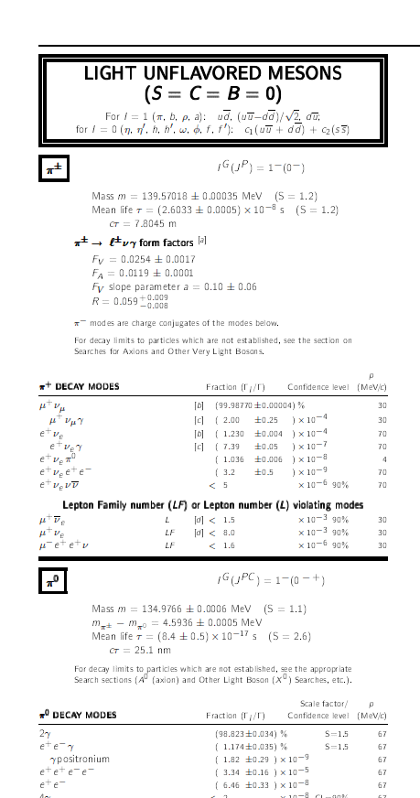

所有基本粒子都有一個內在的Parity，即是$\hat{P}$的本徵值。
$π$的parity是$−1$: Pseudo-scalar particles

Slide 15



$τ$ and$θ$ 具有幾乎一樣的質量與半衰期。
But Theta decays into a parity even state.
Tau decays into a parity odd state.
根據鏡射對稱，parity值不變，$τ$ $應該P=−1，而 θ應該P=−1。$。
$τ$ and$θ$是兩顆不同的粒子。
How could two different particles look so similar?
$τ−θ$ puzzle

Slide 16
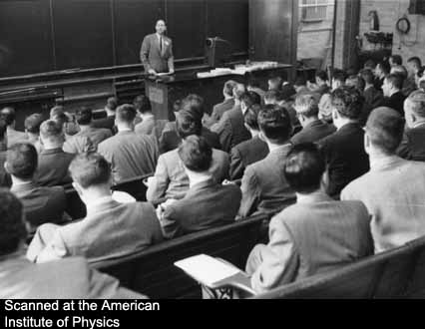
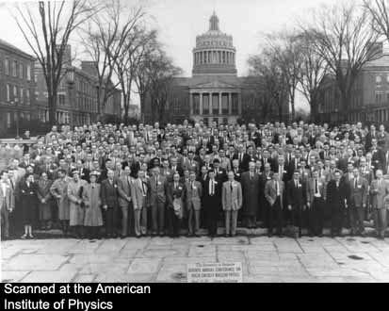
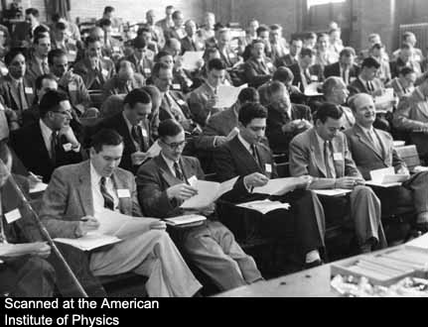
Rochester Conference

Slide 17
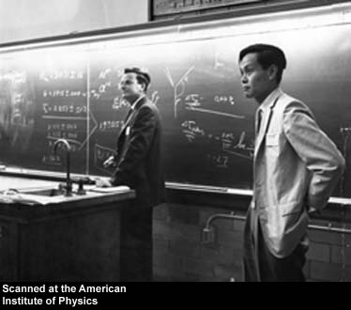
Feynman的室友實驗學家Block提醒了他，說不定鏡射並不對稱！
Could it be that the theta and tau are different parity states of the same particle which has no definite parity, that parity is not conserved. Feynman at Rochester 1956

Slide 18
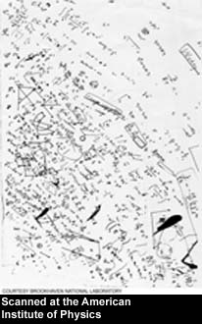
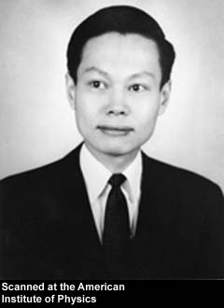
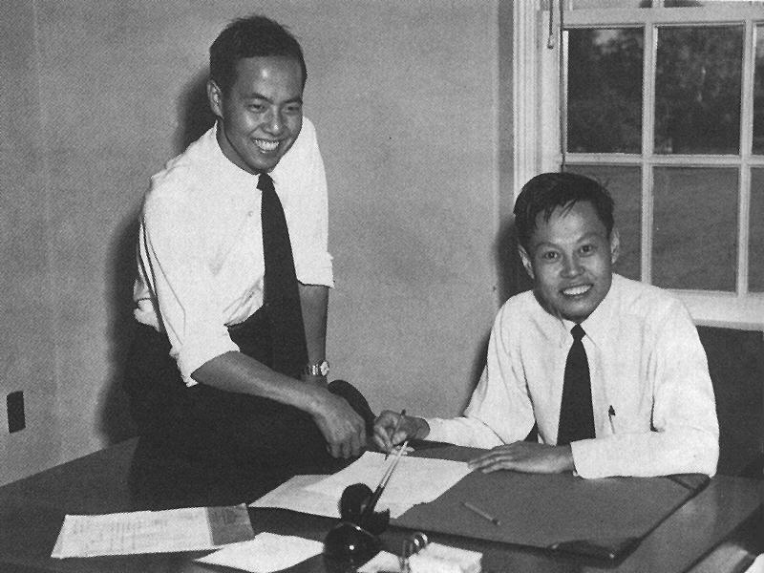
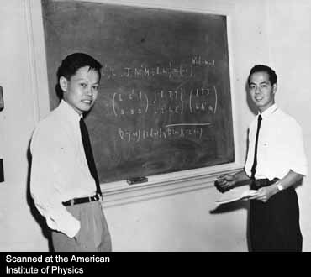
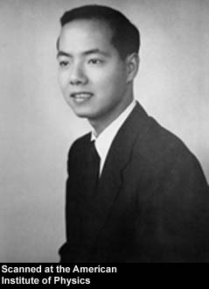
楊振寧帶著這個點子去找他長期合作的李政道。

Slide 19
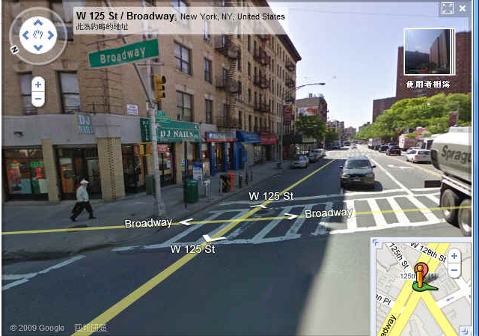
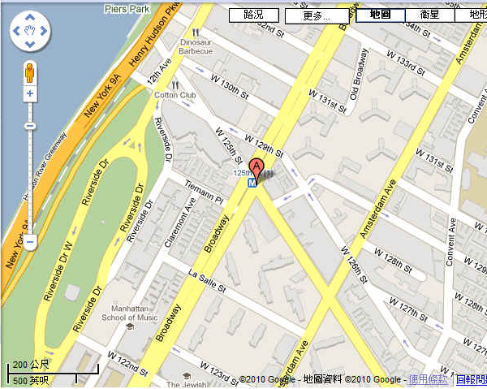
..many fine Chinese restaurants. Finding they are not open yet, they retired to the nearby White Rose Café. They discussed the possibility that parity is conserved in strong interaction that produced tau and theta, yet violated in the weak interaction by which they decay.
Approximate Symmetry, Partial Symmetry

Slide 20
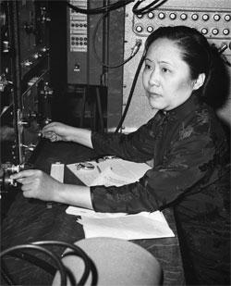


李政道帶著這點子與吳健雄討論：
到底有沒有實驗驗證過$β$衰變是否是鏡射對稱。
吳健雄塞給了李政道一本一千頁的$β$衰變光譜大全。

Slide 21
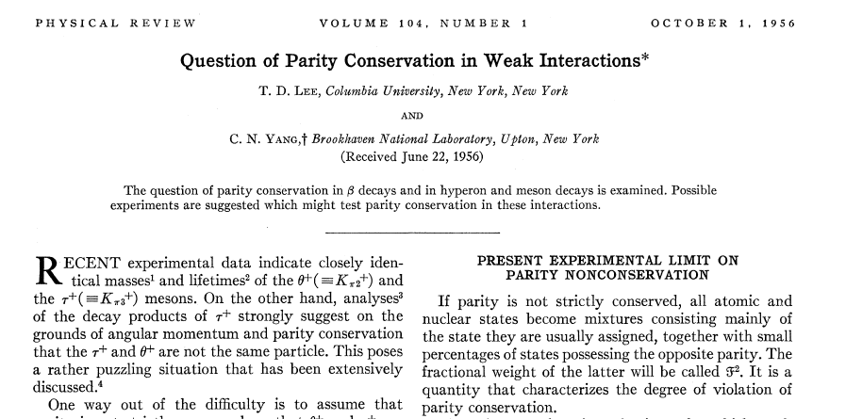
原來的標題：Is parity conserved in weak interaction?

Slide 22
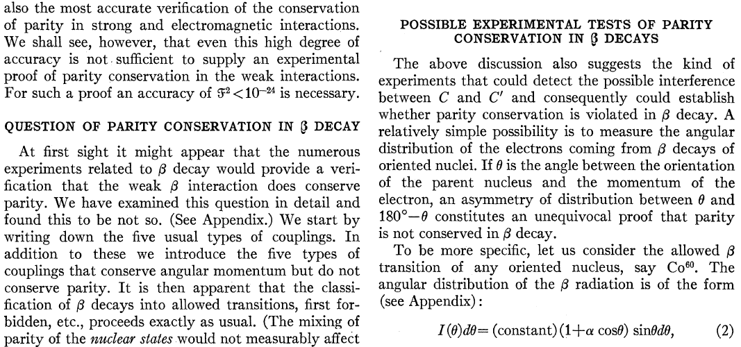

Slide 23
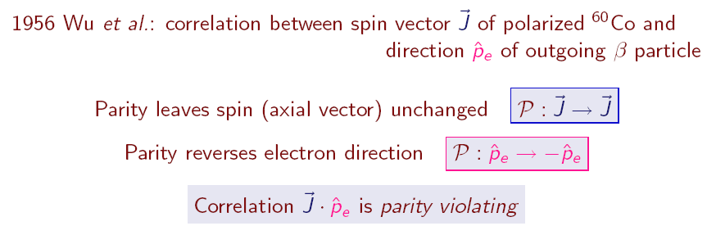
以原子核的固定自旋方向為軸，衰變產物電子動量的角分布。

Slide 24
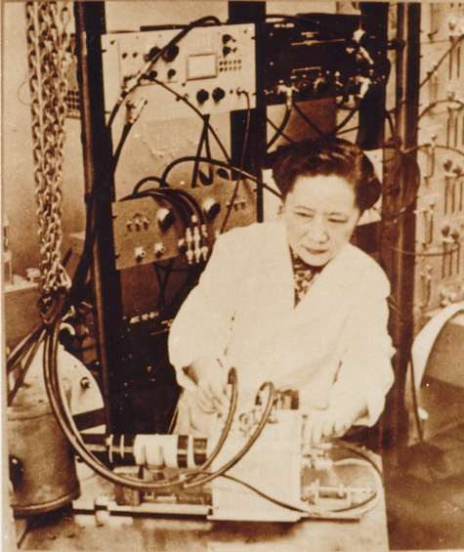
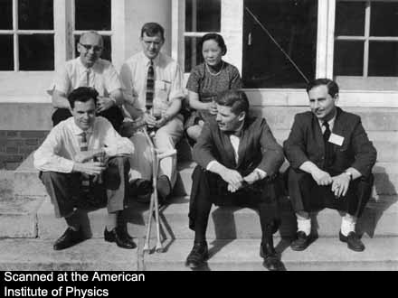
C.S. Wu

Slide 25
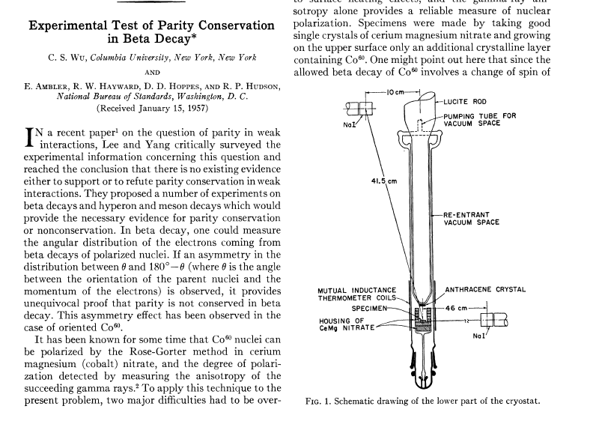

Slide 26
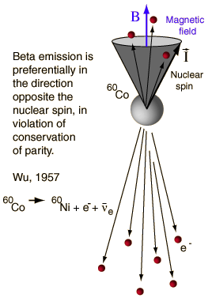
How to check Parity violation?
Polarize the nucleus, and observe if there is any anisotropy in beta decays.
In beta decay of Cobalt 60, most electrons are emitted in direction opposite to nuclear spin. In mirror world, most are parallel.

Slide 27
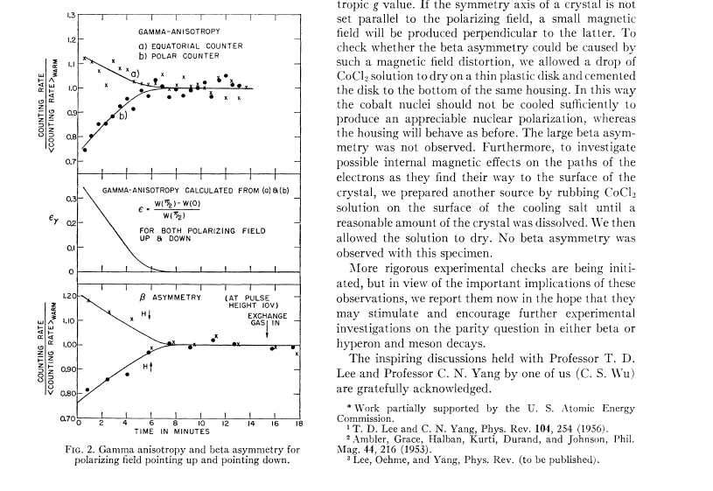

Slide 28
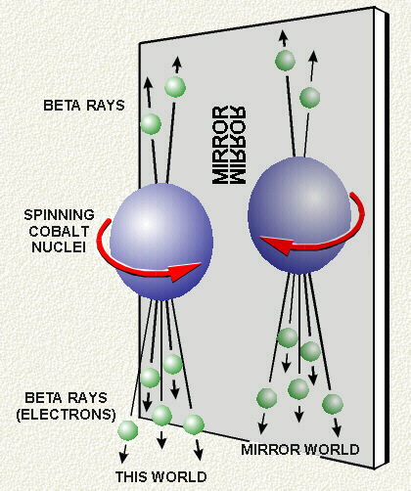
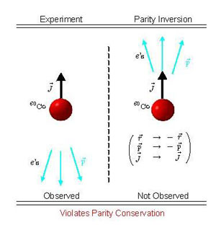

Slide 29
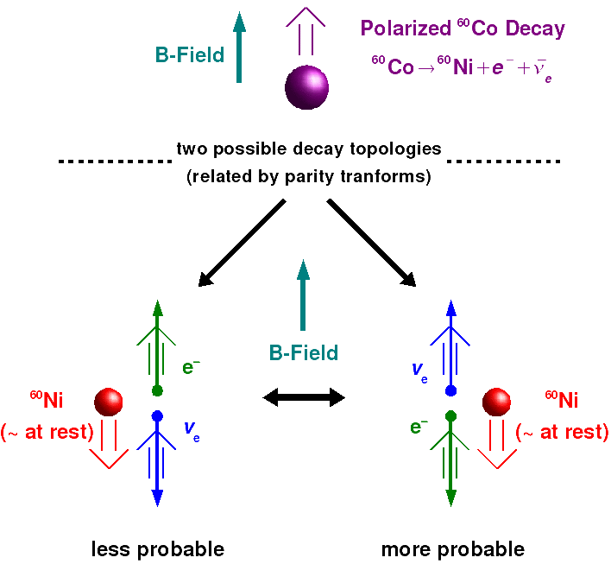

$$J=5$$
$$J=4$$

Slide 30



Slide 31

Lederman聽說了Wu的結果，一月四日招集了Lee與其他同事討論測量邈子衰變的電子方向的測量來驗證鏡射破壞，一月八日就得到結果。

Slide 32

假如衰變的反微中子右旋比左旋多，那麼反向離開的邈子較多右旋，
收集同一方向離開的邈子，其自旋，如Wu實驗的原子核，是被極化的！
觀察這些邈子衰變時，電子動量相對於邈子自旋的角度分布。
Lederman很快發現非同向性！$\left\langle {\vec{J}}_{μ}∙{\vec{p}}_{e}\right\rangle ≠0$

Slide 34


Nobel in just one year.

Slide 35



Theta and tau 是同一個粒子 $K^{+}$.

Slide 36


Slide 37


Slide 38
I don’t believe that the Lord is a weak left-hander, and I am ready to bet a very large sum that the experiments will give symmetric results.
Pauli’s letter to Weisskopf 3 days before he was told the news
Now after the first shock is over, I begin to collect myself. I was to give a lecture at 8:15PM on the “past and recent history of the neutrino”. At 5:00PM the mail brought me the three experimental papers. Now where shall I start? It is good that I did not make a bet
Pauli’s letter to Weisskopf 10 days later

Slide 39

The Lord is indeed a weak left-hander.

Slide 40



What shocks me is not the fact that “god is just left-handed” but the fact that in spite of this he exhibits Himself as left/right symmetric when he expresses Himself strongly. How can the strength of an interaction produce or create symmetry?
The strong interaction is parity symmetric while the weak interaction is not.

Slide 41



In a certain sense, a rather complete theoretical structure has been shattered at its base and we are not sure how the pieces will be put together! Rabi
The symmetry is broken. The problem now is how bad.

Slide 42






如果微中子是左旋，在這個交點中的電子只能是左旋。
$$ν_{e}$$
$$W^{−}$$
W⁻
$$e$$

Slide 43


左右旋的費米子，弱交互規範作用是不同的。
這樣的交互作用稱為 Chiral. （弱作用是能分辨左右的）
Left-handed fermions act differently from Right handed Fermions.

Slide 44







Dirac find it’s possible for 4 by 4 matrices
$$\left\{γ^{μ},γ^{ν}\right\}=2g^{μν}$$
$$p^{μ}p_{μ}−m^{2}c^{2}=\left(γ^{κ}p_{κ}+mc\right)\left(γ^{λ}p_{λ}−mc\right)=0$$
Pick the first order factor:
$$γ^{μ}p_{μ}−mc=0$$
Make the replacement and put in the wave function:
$$p^{μ}→i∂_{μ}$$
$$iγ^{μ}∂_{μ}ψ−mψ=0$$
Dirac Equation
If γ’s are 4 by 4 matrices, Ψ must be a 4 component column:
$$i\left(γ^{0}\frac{∂ψ}{∂t}+γ^{i}\frac{∂ψ}{∂x^{i}}\right)−mψ=0$$
$$ψ=\left(\begin{matrix}\begin{matrix}\begin{matrix}ψ_{1} \\ ψ_{2}\end{matrix} \\ ψ_{3}\end{matrix} \\ ψ_{4}\end{matrix}\right)$$
Note that it consists of 4 Equations.

Slide 45








Again, suppose the momentum relation can be factored into linear combinations of p’s:
$$p^{μ}p_{μ}−m^{2}c^{2}=\left(β^{κ}p_{κ}+mc\right)\left(γ^{λ}p_{λ}−mc\right)$$
Expand the right-hand side:
$$p^{μ}p_{μ}−m^{2}c^{2}=β^{κ}{γ^{λ}p}_{κ}p_{λ}−mc\left(β^{κ}−γ^{κ}\right)p_{κ}−m^{2}c^{2}$$
Now for massless fermion: $m=0$
$$p^{μ}p_{μ}=β^{κ}{γ^{λ}p}_{κ}p_{λ}$$
It is now possible that:
$$β^{κ}≠γ^{κ}$$
$$p^{μ}p_{μ}=β^{κ}{γ^{λ}p}_{κ}p_{λ}$$
We can now choose 2 by 2 matrices :
$β^{κ}=\left(1,σ^{i}\right) ≠γ^{κ}$ $=\left(1,−σ^{i}\right)$
$$p^{μ}p_{μ}=β^{κ}{γ^{λ}p}_{κ}p_{λ}$$
is satisfied.
We get 2 equations for massless fermion, which are 2 component columns.
$$β^{μ}∂_{μ}ψ=0$$
$$γ^{μ}∂_{μ}ψ=0$$
Massless fermions contain only half the degrees of freedom.

Slide 46




This is result can been seen another way using $γ^{5}$:
$$γ^{5}≡iγ^{0}γ^{1}γ^{2}γ^{3}$$
$$γ^{5}γ^{0}≡iγ^{0}γ^{1}γ^{2}γ^{3}γ^{0}={\left(−1\right)}^{3}γ^{0}\left(iγ^{0}γ^{1}γ^{2}γ^{3}\right)=−{γ^{0}γ}^{5}$$
$γ^{5}$ anticomutes with all the other $γ^{μ}$.
$$\left\{γ^{5},γ^{0}\right\}=0$$
$${\left(γ^{5}\right)}^{2}=I$$
$γ^{5}$ is a projector can have eigenvalues of just $±1$.

Slide 47











Consider a massless fermion:
$$iγ^{μ}∂_{μ}ψ=0$$
Note that we have a matrix $γ^{5}$ that anticommute with all the Dirac Matrices:
$$\left\{γ^{μ},γ^{5}\right\}=0$$
$$γ^{μ}γ^{5}=−γ^{5}γ^{μ}$$
We can multiply the Dirac Eq. by $γ^{5}$ and it will pass all the $γ^{μ}$ to reach $ψ$.
$$iγ^{5}γ^{μ}∂_{μ}ψ=0$$
$$iγ^{μ}∂_{μ}\left(γ^{5}ψ\right)=0$$
$γ^{5}ψ$ satisfy the same Dirac Eq. as $ψ$.
$$ψ_{L}=P_{L}ψ≡\frac{1−γ^{5}}{2}ψ$$
$$ψ_{R}=P_{R}ψ≡\frac{1+γ^{5}}{2}ψ$$
We can project $ψ$into two part:
Both parts satisfy Dirac Eq. independently. We usually say they are decoupled.
$$iγ^{μ}∂_{μ}\left[\left(\frac{1±γ^{5}}{2}\right)ψ\right]=0$$
$$iγ^{μ}∂_{μ}ψ_{L}=0$$
$$iγ^{μ}∂_{μ}ψ_{R}=0$$
Without mass $ψ_{L},ψ_{R}$ can be seen as two different particles.

Slide 48













To describe $ψ_{L}$ and $ψ_{R}$, two components are quite enough.
In the basis called Weyl representation, $γ^{5}$ is diagonal.
$$γ^{5}=\left(\begin{matrix}−I & 0 \\ 0 & I\end{matrix}\right)$$
$$γ^{0}=\left(\begin{matrix}0 & 1 \\ 1 & 0\end{matrix}\right)$$
$$γ^{i}=\left(\begin{matrix}0 & σ^{i} \\ −σ^{i} & 0\end{matrix}\right)$$
and:
In this rep, $P_{L,R}$ are projections into the top and lower two components respectively.
$$ψ_{L}=P_{L}ψ≡\left(\begin{matrix}I & 0 \\ 0 & 0\end{matrix}\right)ψ=\left(\begin{matrix}ψ_{L} \\ 0\end{matrix}\right)$$
$$ψ_{R}=P_{R}ψ≡\left(\begin{matrix}0 & 0 \\ 0 & −I\end{matrix}\right)ψ=\left(\begin{matrix}0 \\ ψ_{R}\end{matrix}\right)$$
$$ψ=\left(\begin{matrix}ψ_{L} \\ ψ_{R}\end{matrix}\right)$$
2 components $ψ_{L,R}$ are called Weyl spinors.
For massless fermion, Dirac Eq. decompose into two separate equations one for $ψ_{L}$, one $ψ_{R}$:
$$iγ^{μ}∂_{μ}\left(P_{L}ψ\right)=i\left(\begin{matrix}0 & 1 \\ 1 & 0\end{matrix}\right)∂_{0}\left(\begin{matrix}ψ_{L} \\ 0\end{matrix}\right)+i\left(\begin{matrix}0 & σ^{i} \\ −σ^{i} & 0\end{matrix}\right)∂_{i}\left(\begin{matrix}ψ_{L} \\ 0\end{matrix}\right)=0$$
$${\overline{σ}}^{μ}∂_{μ}ψ_{L}=0$$
$${\overline{σ}}^{μ}=\left(1,−σ^{i}\right)$$
$$iγ^{μ}∂_{μ}\left(P_{R}ψ\right)=0$$
$$σ^{μ}∂_{μ}ψ_{R}=0$$
$ψ_{L}$ and $ψ_{R}$ are separate or decoupled.
$$σ^{μ}=\left(1,σ^{i}\right)$$

Slide 49


Massless fermion contains only half the degrees of freedom.
A pure left-handed or a pure right-handed must be massless.
$${\overline{σ}}^{μ}∂_{μ}ψ_{L}=0$$
$$σ^{μ}∂_{μ}ψ_{R}=0$$

Slide 50











$${\overline{σ}}^{μ}∂_{μ}ψ_{L}=0$$
For plane wave
$${\overline{σ}}^{μ}p_{μ}ψ_{L}=0$$
$$\frac{1}{2}\vec{σ}∙\hat{p} ψ_{L}=−\frac{1}{2}ψ_{L}$$
$$p_{0}ψ_{L}+\vec{σ}∙\vec{p} ψ_{L}=0$$
$$p_{0}=\left|\vec{p}\right|$$
Helicity $\vec{s}∙\hat{p}=\frac{1}{2}ℏ\vec{σ}∙\hat{p}$ is the spin along the direction of the particle momentum.
In the massless limit, $ψ_{L},ψ_{R}$ correspond to eigenstates of helicity.
$$\frac{1}{2}\vec{σ}∙\hat{p} ψ_{R}=\frac{1}{2}ψ_{R}$$
$$\vec{s}∙\hat{p}=\frac{1}{2}ℏ$$
$$\vec{s}∙\hat{p}=−\frac{1}{2}ℏ$$
$$ψ_{R}$$
$$ψ_{L}$$
The state whose $\vec{s}$ points in the same direction as $\vec{p}$ is called right-handed particles.
The state whose $\vec{s}$ points in opposite direction as $\vec{p}$ is called left-handed particles.
They are separate particles (if massless, we said we will pretend at the moment they are).

Slide 51




We can keep using Dirac field and its Lagrangian density.
Dirac eq. can be derived from the following Lagrangian.
$$ℒ=\overline{ψ}\left(iγ^{μ}∂_{μ}−m\right)ψ$$
$$\overline{ψ}≡ψ^{†}γ^{0}$$
First calculation $δℒ$ with respect to any $δψ$,$δ\overline{ψ}$.
$$δℒ=δ\overline{ψ}∙\frac{∂ℒ}{∂\overline{ψ}}+\frac{∂ℒ}{∂ψ}∙δψ=δ\overline{ψ}∙\left(iγ^{μ}∂_{μ}−m\right)ψ+\overline{ψ}\left(iγ^{μ}∂_{μ}−m\right)∙δψ$$
Observe that if $\left(iγ^{μ}∂_{μ}−m\right)ψ=0$, then $\overline{ψ}\left(iγ^{μ}∂_{μ}−m\right)=0$, and hence $δℒ=0$ for any $δψ$.
Therefore, $\left(iγ^{μ}∂_{μ}−m\right)ψ=0$ is the equation of motion of the Lagrangian.
$$ℒ=\overline{ψ}\left(iγ^{μ}∂_{μ}−m\right)ψ$$

Slide 52







The Dirac Lagrangian can be written in terms of bispinors $ψ_{L,R}$:
$$ψ_{L}=P_{L}ψ≡\frac{1−γ^{5}}{2}ψ=\left(\begin{matrix}ψ_{L} \\ 0\end{matrix}\right)$$
$$ψ_{R}=P_{R}ψ≡\frac{1+γ^{5}}{2}ψ=\left(\begin{matrix}0 \\ ψ_{R}\end{matrix}\right)$$
$$ℒ=\overline{ψ}iγ^{μ}∂_{μ}\left(P_{L}+P_{R}\right)ψ$$
$$=\overline{ψ}iγ^{μ}∂_{μ}P_{L}ψ+\overline{ψ}iγ^{μ}∂_{μ}P_{R}ψ$$
$$\overline{ψ}iγ^{μ}∂_{μ}ψ_{L}=\overline{ψ}iγ^{μ}∂_{μ}P_{L}ψ=\overline{ψ}iγ^{μ}∂_{μ}\left(\frac{1−γ^{5}}{2}\right)ψ_{L}$$
$$=ψ^{∗T}γ^{0}i\left(\frac{1+γ^{5}}{2}\right)γ^{μ}∂_{μ}ψ_{L}=ψ^{∗T}{\left(\frac{1−γ^{5}}{2}\right)γ}^{0}iγ^{μ}∂_{μ}ψ_{L}={(P_{L}ψ)}^{†}γ^{0}iγ^{μ}∂_{μ}ψ_{L}$$
$$i{\overline{ψ}}_{L}γ^{μ}∂_{μ}ψ_{L}$$
$$i{\overline{ψ}}_{L}γ^{μ}∂_{μ}ψ_{L}+i{\overline{ψ}}_{R}γ^{μ}∂_{μ}ψ_{R}$$
At two sides of $γ^{μ}$ fermions are of the same handedness, both $ψ_{L}$ or both $ψ_{R}$.
As expected, kinetic energy $γ^{μ}$ terms decouple $ψ_{L,R}$.

Slide 53


Note that gauge boson interaction is also a $γ^{μ}$ term and thus also decouple $ψ_{L,R}$.
$$\frac{g}{2}\overline{ψ}γ^{μ}τ∙W_{μ}ψ=\frac{g}{2}{\overline{ψ}}_{L}γ^{μ}τ∙W_{μ}ψ_{L}+\frac{g}{2}{\overline{ψ}}_{R}γ^{μ}τ∙W_{μ}ψ_{R}$$
如果微中子是左旋，在這個交點中的電子只能是左旋。
$$ν_{e}$$
$$W^{−}$$
$$W^{−}$$
$$e$$

Slide 54









The Lagrangian can also be written in terms of Two component Weyl spinors:
$$ℒ=\overline{ψ}iγ^{μ}∂_{μ}\left(P_{L}+P_{R}\right)ψ$$
$$=\overline{ψ}iγ^{μ}∂_{μ}P_{L}ψ+\overline{ψ}iγ^{μ}∂_{μ}P_{R}ψ$$
Note that
$$ψ=\left(\begin{matrix}ψ_{L} \\ ψ_{R}\end{matrix}\right)$$
$$\overline{ψ}=\left(\begin{matrix}ψ_{R}^{†} & ψ_{L}^{†}\end{matrix}\right)$$
$$P_{L}ψ=\left(\begin{matrix}ψ_{L} \\ 0\end{matrix}\right)$$
$$P_{R}ψ=\left(\begin{matrix}0 \\ ψ_{R}\end{matrix}\right)$$
and remember in this basis:
$$γ^{0}=\left(\begin{matrix}0 & 1 \\ 1 & 0\end{matrix}\right)$$
$$γ^{i}=\left(\begin{matrix}0 & σ^{i} \\ −σ^{i} & 0\end{matrix}\right)$$
We can directly plug this decomposition of $ψ$into the Lagrangian:
and get the Lagrangian for the left-handed and right-handed Weyl spinors:
$$ℒ=iψ_{L}^{†}σ^{μ}∂_{μ}ψ_{L}+iψ_{R}^{†}σ^{μ}∂_{μ}ψ_{R}$$

Slide 55











所有微中子都是左手旋！
$${\overline{σ}}^{μ}∂_{μ}ψ_{L}=0$$
Solve the equation of motion by Fourier Transformation.
$$ψ_{L}=\int{\frac{d^{3}p}{{\left(2π\right)}^{3}}\left[au\left(\vec{p}\right)e^{−ipx}+b^{†}v\left(\vec{p}\right)e^{ipx}\right]}$$
And quantize it.
Peskin p61
For
$$p=\left(p^{0},0,0,p^{0}\right)$$
$$u=\left(\begin{matrix}0 \\ 1\end{matrix}\right)$$
$a$ annihilate a fermion of $J_{Z}$ eigenvalues $−\frac{1}{2}$.
$$\left(−p^{0}−p^{0}σ^{3}\right)u=0$$
$$\left(p^{0}+p^{0}σ^{3}\right)v=0$$
$$v=\left(\begin{matrix}0 \\ 1\end{matrix}\right)$$
$b^{†}$ create an antifermion of $J_{Z}$ eigenvalues $+\frac{1}{2}$.
左旋微中子
反微中子只有右手旋。
$$ν$$
$$\overline{ν }$$

Slide 56



















只有左旋粒子才與 W 有交互作用
$$u_{L}$$
$$c_{L}$$
$$t_{L}$$
$$W^{−}$$
$$W^{−}$$
$$W^{−}$$
$$d_{L}$$
$$s_{L}$$
$$b_{L}$$
$$ν_{e}$$
$$ν_{μ}$$
$$ν_{τ}$$
$$W^{−}$$
$$W^{−}$$
$$W^{−}$$
$$e_{L}$$
$$μ_{L}$$
$$τ_{L}$$
$$W^{−}$$

Slide 57



















只有左旋粒子才與 W 有交互作用
$$d_{L}$$
$$s_{L}$$
$$b_{L}$$
$$W^{+}$$
$$W^{+}$$
$$W^{+}$$
$$u_{L}$$
$$c_{L}$$
$$t_{L}$$
$$ν_{e}$$
$$ν_{μ}$$
$$ν_{τ}$$
$$W^{+}$$
$$W^{+}$$
$$W^{+}$$
$$e_{L}$$
$$μ_{L}$$
$$τ_{L}$$
$$W^{+}$$

Slide 58



弱交互作用不是 Weak $SU(2)$ gauge interaction
而是 Left-Handed Weak $SU(2)L$ gauge interaction
W 是 Left-Handed Weak $SU(2)L$的規範粒子！
For left-handed weak $SU(2)L$, left-handed particles are doublets.
L
L
$$\left(\begin{matrix}u_{L} \\ d_{L}\end{matrix}\right)→U\left(\begin{matrix}u_{L} \\ d_{L}\end{matrix}\right)$$
$$\left(\begin{matrix}ν_{e} \\ e_{L}\end{matrix}\right)→U\left(\begin{matrix}ν_{e} \\ e_{L}\end{matrix}\right)$$

Slide 59
For Left-Handed Weak $SU(2)L$, right-handed particles are singlets.
R
R
R
Singlet
W與右旋粒子無作用！

Slide 60
左右旋的費米子，弱交互規範作用是不同的。
這樣的交互作用稱為 Chiral. （弱作用是能分辨左右的）
Left-handed fermions act differently from Right handed Fermions.

Slide 61







R
L
右旋的電子，完全沒有弱交互作用。
例如邈子衰變。Muon decay
$$νμ$$
$$νe$$
$$e$$
$$W^{−}$$
$$μ$$
$$μ^{−}→e^{−}+{\overline{ν}}_{e}+ν_{μ}$$
Experiments discover all the particles participating the interaction are left-handed.
我們宇宙是左右不對稱。 Mirror symmetry is broken!

Slide 62


對任一有質量的費米子我一定可以找到一個座標系比它運動得更快。
在此新座標系中觀察，粒子的動量改變方向，而自旋並不改變！
因此在此新座標系中觀察，本來的右旋費米子就變成左旋費米子！

Slide 63
Weak singlet $e_{R}$
Weak Doublet ${\left(\begin{matrix}ν_{e} \\ e\end{matrix}\right)}_{L}$
此費米子的弱交互作用，在新座標系中觀察與在原來座標系中，是不同的。
弱交互作用在羅倫茲變換下，不是不變的！這當然不能允許。
除非你永遠無法跑得比它快！那此費米子是無質量的。
從弱作用規範對稱的角度來看，電子、夸克質量是不被允許的。
Fermion Masses are forbidden by the chiral weak symmetry!

Slide 64

Fermion Masses are forbidden by the chiral weak symmetry!
It helps to think that fermions are born massless, ie. intrinsically chiral.
生下來是無質量，本質上是Chiral，質量是外在機制所賦予。
Fermion masses are added on by external mechanism.
Let’s start with chiral fermions.

Slide 65

這很奇怪！This is odd.
如果我找到一個座標系比電子運動得更快。例如速度是電子的兩倍。
If the observer moves faster than electron, $\vec{p}$change direction but $\vec{s}$doesn’t.
在此新座標系中觀察，粒子的動量改變方向，而自旋並不改變！
$$\hat{p}→−\hat{p}$$
$$\vec{s}→\vec{s}$$
$$\vec{s}∙\hat{p}→−\vec{s}∙\hat{p}$$
因此在此新座標系中觀察，本來的左旋費米子就變成右旋費米子!
For the new observer, the original left-handed particle becomes right-handed,
supposedly no weak interaction and hence no decay.
可是這個邈子衰變產生的電子應該是左旋才對！
物理不應該隨觀察者狀態而改變。
Physics shouldn’t depend on the state of the observer.

Slide 66
R
L
在一個坐標系，費米子有弱交互作用，在另一座標系中就沒有弱交互作用。
這是難以接受的。This is unacceptable.
The only loophole in the augument is:
maybe you just can’t move faster than electron.
Intrinsically electrons moves in the speed of light and is massless.
除非你永遠無法跑得比它快！如同沒有質量的光子。
有質量的粒子，速度一定小於光速，一定可以找一個比它速度快的坐標系。
要讓以上討論失效，唯一的可能就是此費米子是無質量的。
左右旋的費米子，若是交互作用不同，質量是不被允許的。

Slide 67






What does a mass do in QFT?
Still start with Dirac field and its Lagrangian density which contains masses:
$$ℒ⊃m\overline{ψ}ψ=m\overline{ψ}\left(P_{L}+P_{R}\right)ψ$$
$$ψ_{L}≡\left(\begin{matrix}ψ_{L} \\ 0\end{matrix}\right)$$
$$m{\overline{ψ}}_{L}ψ_{R}+m{\overline{ψ}}_{R}ψ_{L}$$
The mass term mixes $ψ_{L,R}$.

Slide 68






$$ℒ⊃m\overline{ψ}ψ=m\overline{ψ}\left(P_{L}+P_{R}\right)ψ$$
$$m{\overline{ψ}}_{L}ψ_{R}+m{\overline{ψ}}_{R}ψ_{L}$$
Plug in Weyl spinors:
$$ψ=\left(\begin{matrix}ψ_{L} \\ ψ_{R}\end{matrix}\right)$$
$$\overline{ψ}=\left(\begin{matrix}ψ_{R}^{†} & ψ_{L}^{†}\end{matrix}\right)$$
The mass of a fermion equals
$$ℒ⊃mψ_{L}^{†}ψ_{R}+mψ_{R}^{†}ψ_{L}$$
Unlike kinetic energy terms that decouples $ψ_{L,R}$, the mass term mixes them.
$$iψ_{L}^{†}σ^{μ}∂_{μ}ψ_{L}+iψ_{R}^{†}σ^{μ}∂_{μ}ψ_{R}$$
Massless Fermions could contain just $ψ_{L}$ or $ψ_{R}$.
Massive Fermions usually contain both $ψ_{L}$ and $ψ_{R}$, called Dirac Mass.

Slide 69
參與能分辨左右的弱作用的費米子，原本都應該沒有質量的！對稱不允許。

Slide 70

Consider mass term $mψ_{L}^{†}ψ_{R}+mψ_{R}^{†}ψ_{L}$ as vertices,
propagation of massive fermion looks like:

Slide 71







R
L
右旋的電子，完全沒有弱交互作用。
$$νμ$$
$$νe$$
$$e$$
$$W^{−}$$
$$μ$$
$$μ^{−}→e^{−}+{\overline{ν}}_{e}+ν_{μ}$$
All the particles participating the interaction are left-handed.
The right-handedness of electron are developed later when propagating after interaction!

Slide 72
R
L
質量是一個左手旋費米子與右手旋費米子必須共同參與的機制！
Mass is a mechanism the right-handed and left-handed particles have to participate together. Without partners of opposite handedness, partciles will be massless.
真實的有質量的電子必須同時是左手旋又是右手旋。它必須有伴！
真實傳播的電子必須同時又是singlet又是doublet。
可見在真實世界，分類的規則被破壞了。這個破壞者就是希格斯場。

Slide 73


$$m_{e}{\overline{e}}_{L}e_{R}+m_{e}{\overline{e}}_{R}e_{L}$$
$e_{L}$ is part of a doublet and $e_{R}$ is a singlet. The electron mass is not invariant
所有參加 Chiral 弱作用的費米子根據Weak ${\text{SU}(2)}_{L}$對稱性都不能有質量。
所有參加 Chiral 弱作用的費米子都有質量
Weak ${\text{SU}(2)}_{L}$對稱必須被破壞！
But we have already break ${\text{SU}(2)}_{L}$ gauge symmetry by Higgs mechanism.

Slide 74


得到一個不為零的質量項：

Slide 75











$$H=\left(\begin{matrix}H_{1} \\ H_{2}\end{matrix}\right)=\left(\begin{matrix}H^{+} \\ H^{0}\end{matrix}\right)$$
$$L=\left(\begin{matrix}ν_{e} \\ e_{L}\end{matrix}\right)$$
$$Q=\left(\begin{matrix}u_{L} \\ d_{L}\end{matrix}\right)$$
$$m_{e}{\overline{e}}_{R}e_{L}+h.c.$$
$$y_{e} {\overline{e}}_{R}\left(H^{†}L\right)+h.c$$
$$y_{d} {\overline{d}}_{R}\left(H^{†}Q\right)+h.c$$
Yukawa Coupling
This is both gauge invariant and Lorentz invariant.
Plug in the non-trivial VEV:
$$\left(\begin{matrix}\left\langle H^{+}\right\rangle \\ \left\langle H^{0}\right\rangle \end{matrix}\right)=\frac{1}{\sqrt{2}}\left(\begin{matrix}0 \\ v\end{matrix}\right)$$
$$(\frac{1}{\sqrt{2}}y_{e}v) {\overline{e}}_{R}e_{L}+h.c$$
$$m_{e}=\frac{1}{\sqrt{2}}y_{e}v$$
$$m_{d}=\frac{1}{\sqrt{2}}y_{d}v$$

Slide 76












How about $u$ quark mass? We need a new doublet Higgs. Not really.
$$H=\left(\begin{matrix}H_{1} \\ H_{2}\end{matrix}\right)=\left(\begin{matrix}H^{+} \\ H^{0}\end{matrix}\right)$$
$$\tilde{H}=iτ_{2}H^{∗}=\left(\begin{matrix}H^{0∗} \\ −H^{−}\end{matrix}\right)$$
$\tilde{H}$ is also a doublet just like $H$.
$$H→e^{−i\left(\frac{τ_{1}}{2}∙θ_{1}+\frac{τ_{2}}{2}∙θ_{2}+\frac{τ_{3}}{2}∙θ_{3}\right)}H$$
$$τ_{1}=\left(\begin{matrix}0 & 1 \\ 1 & 0\end{matrix}\right)$$
$$τ_{2}=\left(\begin{matrix}0 & −i \\ i & 0\end{matrix}\right)$$
$$τ_{3}=\left(\begin{matrix}1 & 0 \\ 0 & −1\end{matrix}\right)$$
$$τ_{1,3}τ_{2}=−τ_{2}τ_{1,3}$$
$$τ_{2}H^{∗}→τ_{2}e^{i\left(\frac{τ_{1}}{2}∙θ_{1}+\frac{{−τ}_{2}}{2}∙θ_{2}+\frac{τ_{3}}{2}∙θ_{3}\right)}H^{∗}=e^{i\left(\frac{−τ_{1}}{2}∙θ_{1}+\frac{{−τ}_{2}}{2}∙θ_{2}+\frac{−τ_{3}}{2}∙θ_{3}\right)}{τ_{2}H}^{∗}=U{τ_{2}H}^{∗}$$
$$y_{u} {\overline{u}}_{R}\left({\tilde{H}}^{†}Q\right)+h.c$$
This is both gauge invariant and Lorentz invariant.
Plug in the non-trivial VEV:
$$\left(\begin{matrix}\left\langle H^{0∗}\right\rangle \\ −\left\langle H^{−}\right\rangle \end{matrix}\right)=\frac{1}{\sqrt{2}}\left(\begin{matrix}v \\ 0\end{matrix}\right)$$
$$(\frac{1}{\sqrt{2}}y_{u}v) {\overline{u}}_{R}u_{L}+h.c$$
$$m_{u}=\frac{1}{\sqrt{2}}y_{u}v$$

Slide 77
希格斯場或粒子與費米子有交互作用，可將左手旋粒子變成右手旋粒子！

Slide 78

電子從衰變剛剛產生時，是左手旋。
飛了一陣子，被觀測到時，左手旋右手旋都出現了！

Slide 80






$$y_{e} {\overline{e}}_{R}\left(H^{†}L\right)$$
$$y_{d} {\overline{e}}_{R}\left(H^{†}Q\right)$$
$$y_{u} {\overline{u}}_{R}\left({\tilde{H}}^{†}Q\right)$$
$$m_{e}=\frac{1}{\sqrt{2}}y_{e}v$$
$$m_{d}=\frac{1}{\sqrt{2}}y_{d}v$$
$$m_{u}=\frac{1}{\sqrt{2}}y_{u}v$$
費米子的質量及此粒子與 Higgs 粒子的交互作用是同一回事！

Slide 81

基本粒子質量$m$的分布就反映它們跟希格斯粒子的作用強度$y$！

Slide 82


Slide 83


Slide 84

It is Higgs field, not Higgs boson that gives everything its mass!

Slide 85

所有的費米子都是藉著與真空中的希格斯場交互作用而得到質量。
不是希格斯粒子。

Slide 86

Vacuum is not trivial!

Slide 87


受歡迎，與希格斯場交互作用強的粒子，走起來就會較慢，慣性大！

Slide 88



不受歡迎，交互作用弱的粒子，慣性小，走起來就會較快！

Slide 89



Slide 90


Slide 91


Slide 92

為什麼，假如希格斯粒子被發現了，我會覺得非常失望？

Slide 93



Slide 94







Pontecorvo發現，風味微中子可能不是可永久保存的定態！
固定風味微中子 (Flavor eigenstates)
Mixing
配方
可以持久保存的微中子（mass eigenstates）
如果微中子有質量：
可以持久保存的微中子必須是 風味微中子 的混合（疊加）！

Slide 95
Mixing
Neutrinos in their mass eigenstates, which are a combination of their flavor (orange, yellow, red) eigenstates

Slide 96







如果是如此，長程旅行，風味微中子一定會變味！
長途旅行，微中子必須以定態的面貌出現，
如果三個定態質量不同，到了遠方，就會有其他風味的微中子顯露出來！

Slide 97





Neutrino Oscillation!
微中子變味的機率是距離的震盪函數。
有質量差自然有質量。
量到微中子震盪就相當於量到微中子質量。

Slide 98




四川的變臉表演

Slide 99



Slide 100

會變臉的微中子一定是有質量的！

Slide 101


Slide 102











Massive Fermions usually contain both $ψ_{L}$ and $ψ_{R}$.
But it is not a must! We can generate a $ψ_{R}$ from $ψ_{L}$.
$$σ_{1}=\left(\begin{matrix}0 & 1 \\ 1 & 0\end{matrix}\right)$$
$$σ_{2}=\left(\begin{matrix}0 & −i \\ i & 0\end{matrix}\right)$$
$$σ=\left(\begin{matrix}1 & 0 \\ 0 & −1\end{matrix}\right)$$
$$σ_{1,3}σ_{2}=−σ_{2}σ_{1,3}$$
$$\frac{1}{2}\vec{σ}∙\hat{p} ψ_{L}=−\frac{1}{2}ψ_{L}$$
$$\frac{1}{2}\vec{σ}∙\hat{p} ψ_{R}=\frac{1}{2}ψ_{R}$$
Try the complex conjugate of $ψ_{L}$.
$$iσ_{2}ψ_{L}^{∗}$$
$$\vec{σ}∙\hat{p}\left(σ_{2}ψ_{L}^{∗}\right)=\left(σ_{1}p_{1}+σ_{2}p_{2}+σ_{3}p_{3}\right)\left(σ_{2}ψ_{L}^{∗}\right)$$
$$=σ_{2}\left(−σ_{1}p_{1}+σ_{2}p_{2}−σ_{3}p_{3}\right)\left(ψ_{L}^{∗}\right)=σ_{2}\left(−σ_{1}^{∗}p_{1}−σ_{2}^{∗}p_{2}−σ_{3}^{∗}p_{3}\right)ψ_{L}^{∗}$$
$$=σ_{2}{\left(−\vec{σ}∙\hat{p} ψ_{L}\right)}^{∗}=\frac{1}{2}σ_{2}ψ_{L}^{∗}$$
$$iσ_{2}ψ_{L}^{∗}\sim ψ_{R}$$
is a right-handed field!

Slide 103








$$\frac{m}{2}\overline{ψ}ψ$$
$$ψ≡\left(\begin{matrix}ψ_{L} \\ iσ_{2}ψ_{L}^{∗} \end{matrix}\right)$$
Majorana mass
The mass term mixes $ψ_{L}$ with $ψ_{L}^{∗}$. It mean fermion and anti-fermion are mixed.
This kind of mass term is only for charge neutral particle, such as neutrino.
Or use Weyl spinors:
The mass of a fermion equals
$$ℒ⊃mψ_{L}^{†}ψ_{R}+mψ_{R}^{†}ψ_{L}$$
$$iσ_{2}ψ_{L}^{∗}\sim ψ_{R}$$
$$imψ_{L}^{†}σ_{2}ψ_{L}^{∗}−imψ_{L}^{T}σ_{2}ψ_{L}$$
$$−imψ_{L}^{T}σ_{2}ψ_{L}+h.c.$$
$$ψ_{L}≡\left(\begin{matrix}ψ_{1} \\ ψ_{2}\end{matrix}\right)$$
$$ψ_{L}^{T}σ_{2}ψ_{L}=\left(ψ_{1},ψ_{2}\right)\left(\begin{matrix}0 & −i \\ i & 0\end{matrix}\right)\left(\begin{matrix}ψ_{1} \\ ψ_{2}\end{matrix}\right)=−i\left(ψ_{1}ψ_{2}−ψ_{2}ψ_{1}\right)$$
Massive Neutral Fermions could contain just $ψ_{L}$ or $ψ_{R}$.

Slide 104

Why is neutrino mass so small?
The smallness of neutrino mass may indicate it arise from a new scale other than EW.

Slide 105




Seesaw mechanism of neutrino mass consists of Majorana mass terms:
$$\sim \left(\begin{matrix}ν_{L}^{T} & ν_{R}^{T}\end{matrix}\right)∙σ_{2}∙\left(\begin{matrix}0 & m_{ν}^{D} \\ m_{ν}^{D} & M_{R}\end{matrix}\right)∙\left(\begin{matrix}ν_{L} \\ ν_{R}\end{matrix}\right)$$
$$\frac{{\left(m_{ν}^{D}\right)}^{2}}{M_{R}}$$
The eigenvalues are respectively:
and
$$M_{R}$$
If $m_{D}$ is weak scale $\sim {10}^{3}\text{GeV}$, a $M_{R}$ $\sim {10}^{14}\text{GeV}$ will give small enough neutrino mass.
But a high energy seesaw means the new mechanism is beyond our reach of detection.

Slide 106
Spinors as representations of Lorentz Group

Slide 107
Generators

Slide 108

$$SO(3,1)\sim {SU(2)}_{L}×{SU(2)}_{R}$$

Slide 111

$${\left(\begin{matrix}\frac{1}{2} & 0\end{matrix}\right)}^{⋇}×\left(\begin{matrix}\frac{1}{2} & 0\end{matrix}\right)=\left(\begin{matrix}0 & \frac{1}{2}\end{matrix}\right)×\left(\begin{matrix}\frac{1}{2} & 0\end{matrix}\right)=\left(\begin{matrix}\frac{1}{2} & \frac{1}{2}\end{matrix}\right)$$

Slide 112










$${\left(J^{±}\right)}^{†}=J^{∓}$$
The complex conjugate of a representation $\left(j^{+},j^{−}\right)$ is still a representation.
It will interchange its $j^{+}$ and $j^{−}$ numbers: ${\left(j^{+},j^{−}\right)}^{⋇}\sim \left(j^{−},j^{+}\right)$.
$${\left(\begin{matrix}\frac{1}{2} & 0\end{matrix}\right)}^{⋇}=\left(\begin{matrix}0 & \frac{1}{2}\end{matrix}\right)$$
$${\left(\begin{matrix}0 & \frac{1}{2}\end{matrix}\right)}^{⋇}=\left(\begin{matrix}\frac{1}{2} & 0\end{matrix}\right)$$
Hence there are only two ways to from an invarant $\left(\begin{matrix}0 & 0\end{matrix}\right)$from two spinors.
$${\left(\begin{matrix}\frac{1}{2} & 0\end{matrix}\right)}^{⋇}×\left(\begin{matrix}0 & \frac{1}{2}\end{matrix}\right)=\left(\begin{matrix}0 & \frac{1}{2}\end{matrix}\right)×\left(\begin{matrix}0 & \frac{1}{2}\end{matrix}\right)=\left(\begin{matrix}0 & 0\end{matrix}\right)+\left(\begin{matrix}0 & 1\end{matrix}\right)$$
This would be the mass term:
$$ψ_{L}^{†}ψ_{R}$$
$$ψ_{R}^{†}ψ_{L}$$
$${\left(\begin{matrix}\frac{1}{2} & 0\end{matrix}\right)}^{⋇}×\left(\begin{matrix}\frac{1}{2} & 0\end{matrix}\right)×\left(\begin{matrix}\frac{1}{2} & \frac{1}{2}\end{matrix}\right)=\left(\begin{matrix}0 & \frac{1}{2}\end{matrix}\right)×\left(\begin{matrix}\frac{1}{2} & 0\end{matrix}\right)×\left(\begin{matrix}\frac{1}{2} & \frac{1}{2}\end{matrix}\right)$$
$$=\left(\begin{matrix}\frac{1}{2} & \frac{1}{2}\end{matrix}\right)×\left(\begin{matrix}\frac{1}{2} & \frac{1}{2}\end{matrix}\right)⊃\left(\begin{matrix}0 & 0\end{matrix}\right)$$
This would be the kinetic energy term:
$$ψ_{L}^{†}σ^{μ}∂_{μ}ψ_{L}$$
$$ψ_{R}^{†}σ^{μ}∂_{μ}ψ_{R}$$
These are the only quadratic Lorentz invarant term from spinors.

Slide 113

$$ℒ=iψ_{L}^{†}σ^{μ}∂_{μ}ψ_{L}+iψ_{R}^{†}σ^{μ}∂_{μ}ψ_{R}−mψ_{L}^{†}ψ_{R}−mψ_{R}^{†}ψ_{L}$$
Two component spinor form
$$=\overline{ψ}\left(iγ^{μ}∂_{μ}\right)P_{L}ψ+\overline{ψ}\left(iγ^{μ}∂_{μ}\right)P_{R}ψ−m\overline{ψ}P_{L}ψ−m\overline{ψ}P_{R}ψ$$
$$=\overline{ψ}iγ^{μ}∂_{μ}ψ−m\overline{ψ}ψ$$
Four component bispinor form
Massless Fermions could contain just $ψ_{L}$ or $ψ_{R}$.

Slide 114




Majorana mass
$${\left(\begin{matrix}\frac{1}{2} & 0\end{matrix}\right)}^{⋇}=\left(\begin{matrix}0 & \frac{1}{2}\end{matrix}\right)$$
$${\left(\begin{matrix}0 & \frac{1}{2}\end{matrix}\right)}^{⋇}=\left(\begin{matrix}\frac{1}{2} & 0\end{matrix}\right)$$
$$ψ_{L}^{⋇}\sim χ_{R}$$
$$ψ_{R}^{⋇}\sim χ_{L}$$
Could we make a right-handed spinor $χ_{R}$ from a $ψ_{L}$, to couple to and make a mass?

Slide 117
So massive Majorana fermions contain just $ψ_{L}$(or $ψ_{R})$.
The right-handed spinor $iσ^{2}ψ_{L}^{∗}$ plays the role of $ψ_{R}$.

