Slide 1
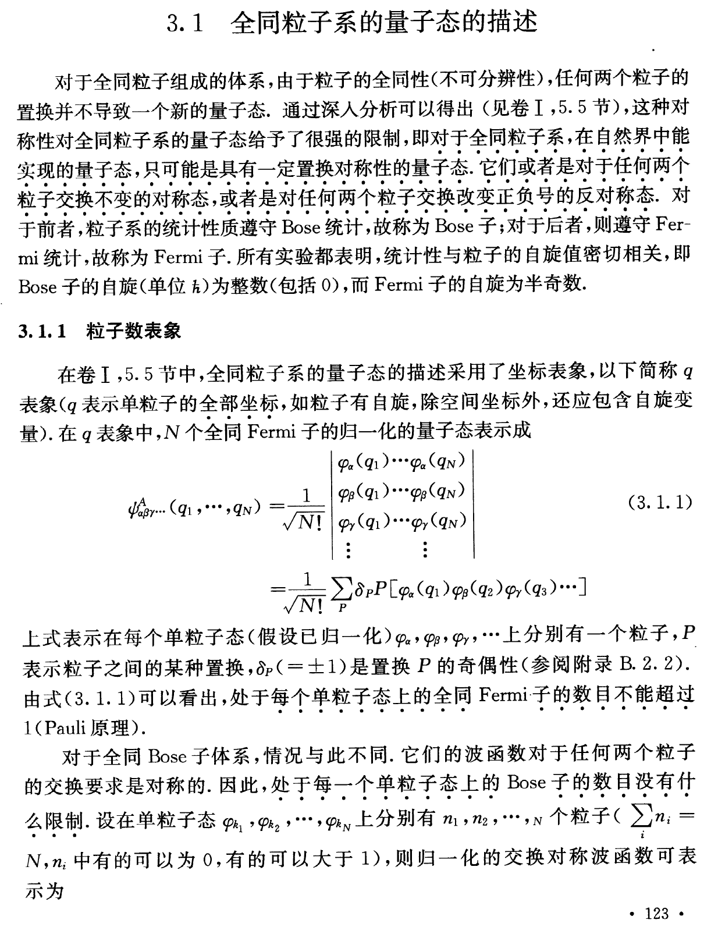

Slide 2
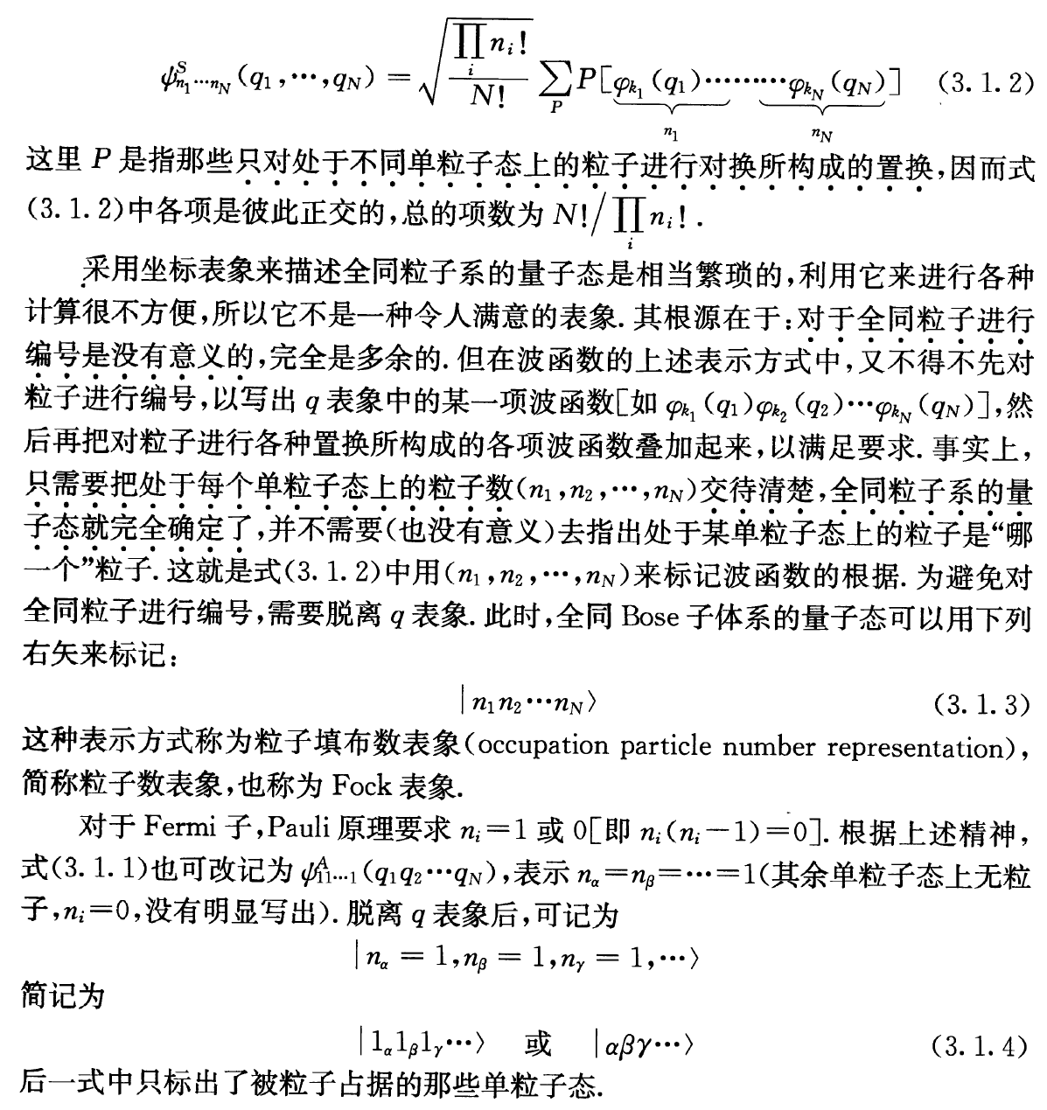

Slide 3
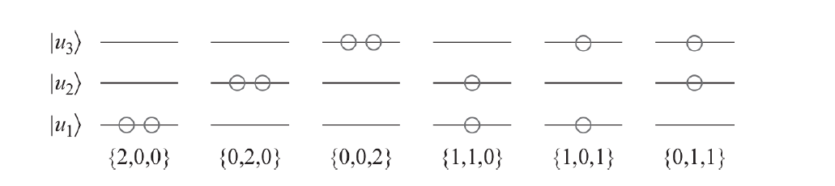
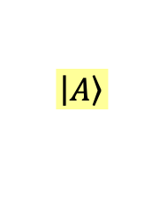
$$\left|\left.C\right\rangle \right.$$
$$\left|\left.B\right\rangle \right.$$
$$\left|\left.A\right\rangle \right.$$
狀態不要編號，符號就會很簡單。
$$\left|\left.C\right\rangle \right.$$
只要標明每一個可能狀態的粒子數即可
$$\left|\left.B\right\rangle \right.$$
Occupation Number Representation 狀態佔據數表象
$$\left|\left.A\right\rangle \right.$$
記住：若是費米子，佔據數不能超過1。
$$\left\{1,1,1\right\}$$
例如$\left\{1,1,1\right\}$這個態，用波函數寫，就會變成：
$$ψ_{A}\left(x_{1}\right)ψ_{B}\left(x_{2}\right)ψ_{C}\left(x_{3}\right)+ψ_{A}\left(x_{2}\right)ψ_{B}\left(x_{1}\right)ψ_{C}\left(x_{3}\right)+ψ_{A}\left(x_{1}\right)ψ_{B}\left(x_{3}\right)ψ_{C}\left(x_{2}\right)+$$
$$ψ_{A}\left(x_{2}\right)ψ_{B}\left(x_{3}\right)ψ_{C}\left(x_{1}\right)+ψ_{A}\left(x_{3}\right)ψ_{B}\left(x_{1}\right)ψ_{C}\left(x_{2}\right)+ψ_{A}\left(x_{3}\right)ψ_{B}\left(x_{2}\right)ψ_{C}\left(x_{1}\right)$$
這樣的表象，粒子數目還可以自然的有變化！

Slide 4
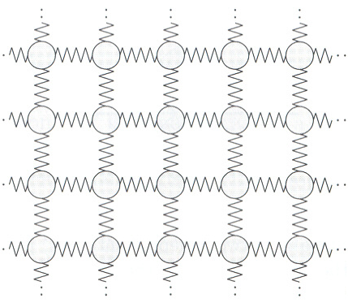
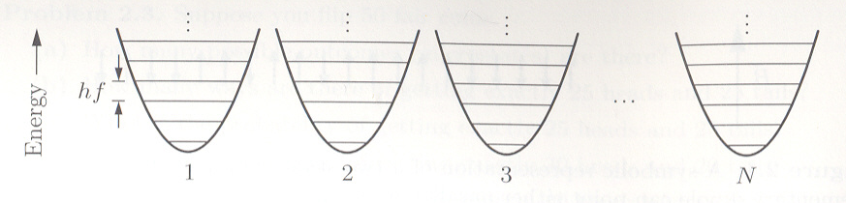
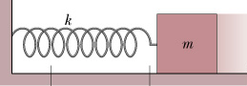
Many-Body Problem
以一系列相同的量子彈簧來模擬一個固體，加以編號，彈簧總數設為$N$。
每一個的能量只能是$n∙hf$。
所以我們可以以一個個裝有球的盒子來對應一個個的量子彈簧。
盒子中球的數目就對應能量的量子數$n$。

Slide 5
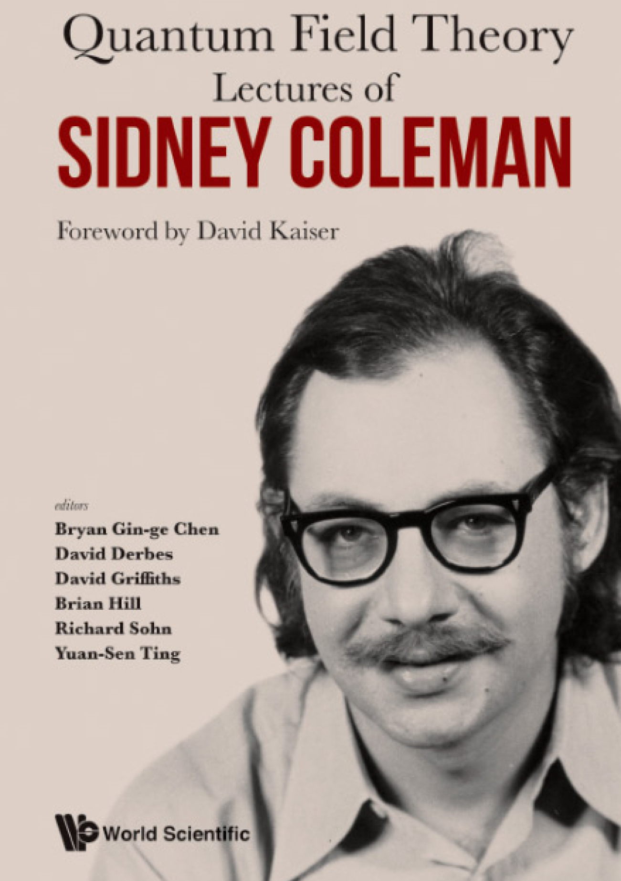
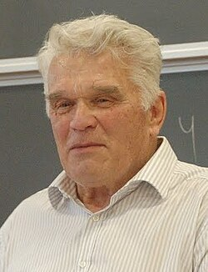
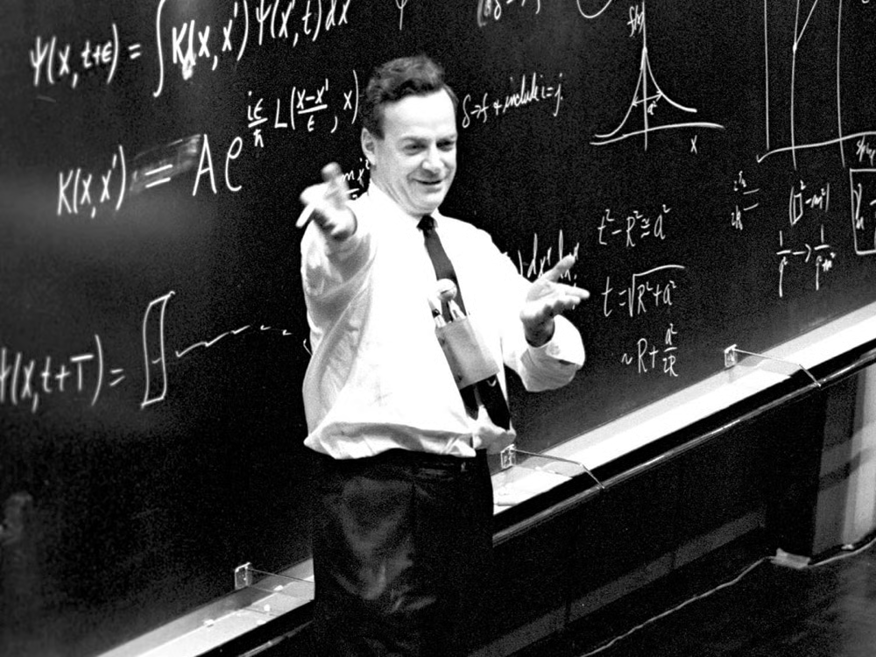
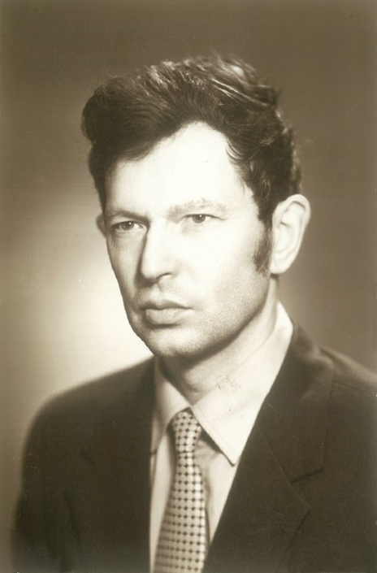
Functional Integration
Ludvig Faddeev 1934-2017
Victor Popov 1937-1994

Slide 6

I am going to tell you what nature behaves like. If you will simply
admit that maybe she does behave like this, you will find her
a delightful, entrancing thing. Do not keep saying to yourself,
if you can possible avoid it, "But how can it be like that?"
because you will get 'down the drain', into a blind alley from
which nobody has escaped. Nobody knows how it can be like that.
我將描述給你聽自然是如何運作的。你如果乾脆承認自然就是如此運作的，
你會覺得它是蠻可愛的，但如果你一直問這怎麼可能呢？
我可以告訴這將是一條死胡同，因為，沒有人知道這為什麼會是可能的。

Slide 7
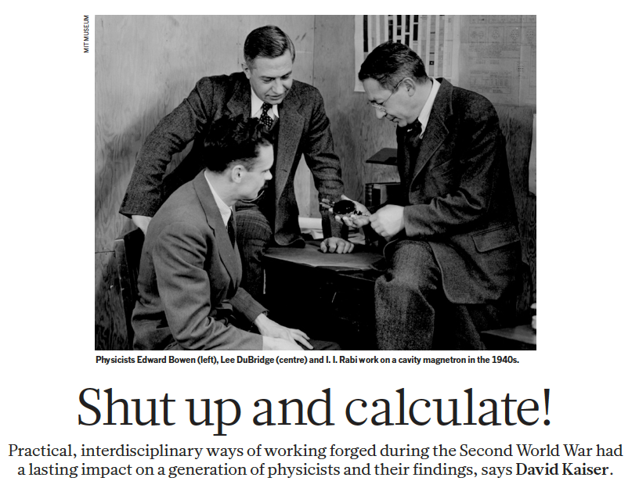
這樣的務實態度竟然有一句話可以形容：
閉嘴！算就是了！

Slide 8
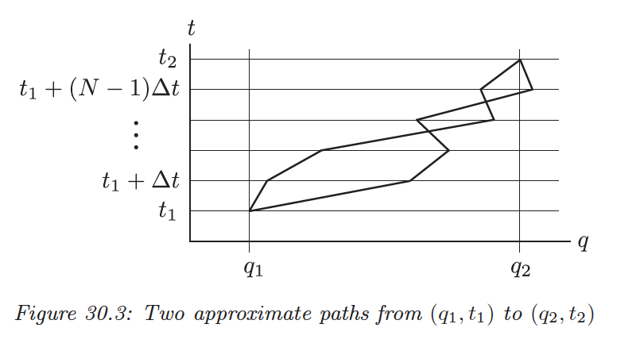



Path integral is an integral about a system’s history.
But the concept of path is classical and contradictory to QM.
If we insist, at least we need to say we don’t know which path it chooses.
$$x$$
$$x_{1}$$
$$x_{2}$$
This is similar to the double-slit experiment.
The amplitudes of each path, or each history, need be added up.

Slide 9



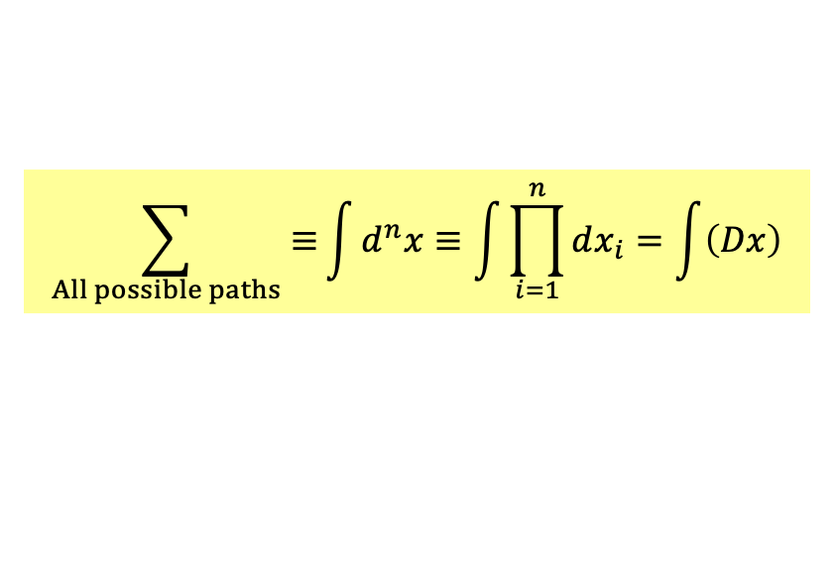

How to add?
$$x$$
$$x_{1}$$
$$x_{2}$$
Consider approximate path from $q_{1}$ to $q_{2}$ between $t_{1}$ to $t_{2}$.
Record the position at $t_{1}+i∆t$ as $x_{i}$.
$x≡\left(q_{1},x_{1},x_{2},⋯x_{n},q_{2}\right)$ is a history of motion or path of a particle in 1D.
Allowing for all possible path means allowing $x_{i}$ to vary between $−∞$ to $∞$.
$$\sum_{All possible paths}{≡}\int{d^{n}x}≡\int{\prod_{i=1}^{n}{dx_{i}}}=\int{\left(Dx\right)}$$
This path integral is the sum (of amplitudes) over all possible paths.

Slide 10
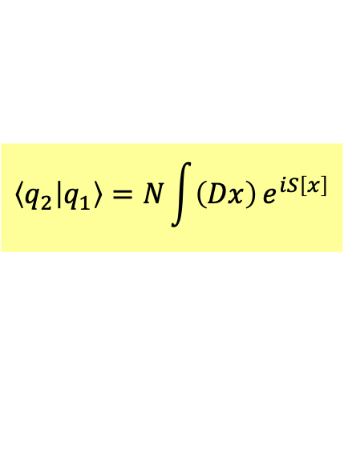
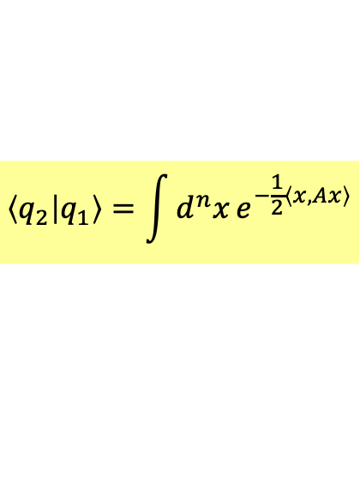

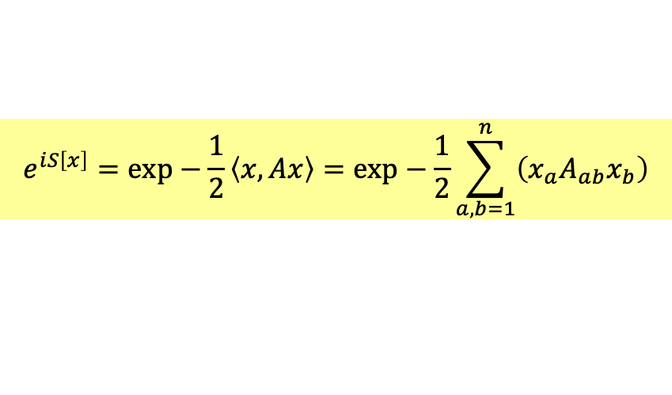
Feynman told us how to calculate the amplitudes of each path: $e^{iS\left[x\right]}$.
The amplitude equals the sum over all possible paths.
$$\left\langle q_{2} | q_{1}\right\rangle =N\int{\left(Dx\right)}e^{iS\left[x\right]}$$
$S\left[x\right]$ is usually a quadratic form:
$$e^{iS\left[x\right]}=exp−\frac{1}{2}\left\langle x,Ax\right\rangle =exp−\frac{1}{2}\sum_{a,b=1}^{n}{\left(x_{a}A_{ab}x_{b}\right)}$$
the sum of amplitude from $q_{1}$ to $q_{2}$ will be
$$\left\langle q_{2} | q_{1}\right\rangle =\int{d^{n}x}e^{−\frac{1}{2}\left\langle x,Ax\right\rangle }$$

Slide 11



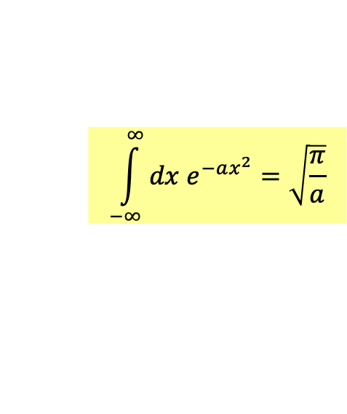

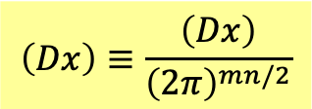
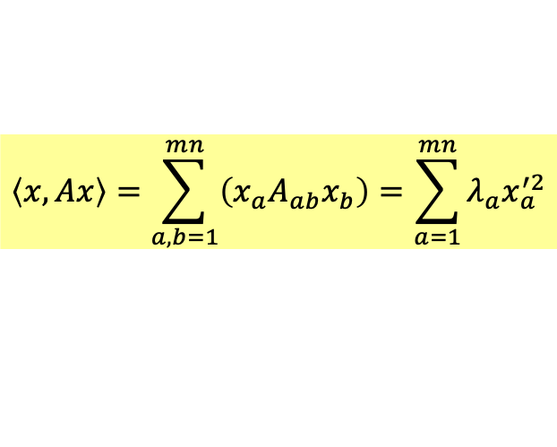

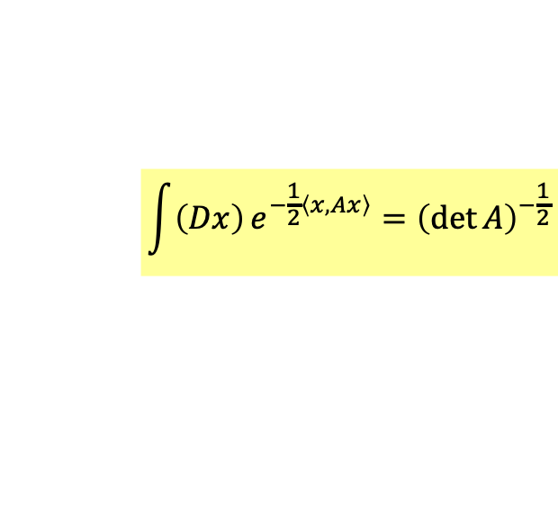

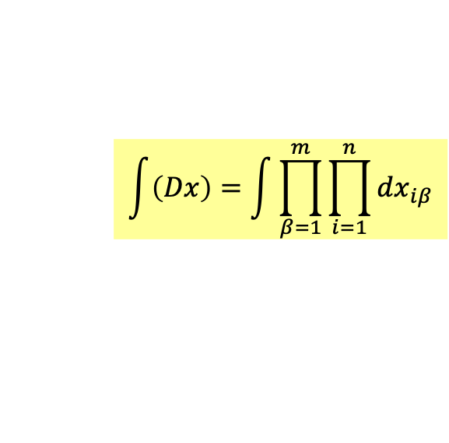
$x_{a}$ can be extended to include more degrees of freedom $β$.
$$x_{a}=\left(x_{1β},x_{2β},⋯x_{nβ}\right), a=1⋯mn$$
Just pile up!
For each $x_{β}$, we have a chart as:
$$\int{\left(Dx\right)}=\int{\prod_{β=1}^{m}{\prod_{i=1}^{n}{dx_{iβ}}}}$$
$$\left\langle x,Ax\right\rangle =\sum_{a,b=1}^{mn}{\left(x_{a}A_{ab}x_{b}\right)}=\sum_{a=1}^{mn}{λ_{a}x_{a}^{′2}}$$
$$x_{β}$$
$$x_{1β}$$
$$x_{2β}$$
$${\int{\prod_{β=1}^{m}{\prod_{i=1}^{n}{dx_{iβ}^{′}}}}e}^{−\frac{1}{2}\left\langle x^{′},Ax^{′}\right\rangle }={\left(2π\right)}^{mn/2}\prod_{a=1}^{mn}{{\left(λ_{a}\right)}^{−\frac{1}{2}}}={\left(2π\right)}^{mn/2}{\left(\det{A}\right)}^{−\frac{1}{2}}$$
$$\left(Dx\right)≡\frac{\left(Dx\right)}{{\left(2π\right)}^{mn/2}}$$
$$\int_{−∞}^{∞}{dx e^{−ax^{2}}}=\sqrt{\frac{π}{a}}$$
$\left(Dx\right)$ is a sum over all possible path with multiple degrees of freedom.
$$\int{\left(Dx\right)}e^{−\frac{1}{2}\left\langle x,Ax\right\rangle }={\left(\det{A}\right)}^{−\frac{1}{2}}$$

Slide 12

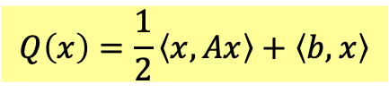

The quadratic form could have a linear term:
$$Q\left(x\right)=\frac{1}{2}\left\langle x,Ax\right\rangle +\left\langle b,x\right\rangle$$
$Q$ is maximized at $\overline{x}=−A^{−1}b$.
$$Q\left(x\right)=Q\left(\overline{x}\right)+\frac{1}{2}\left\langle x−\overline{x},A\left(x−\overline{x}\right)\right\rangle =−\frac{1}{2}\left\langle b,A^{−1}b\right\rangle +\frac{1}{2}\left\langle x−\overline{x},A\left(x−\overline{x}\right)\right\rangle$$
Infinity integration for $\left(dx\right)$ is invariant after a shift $x→x−\overline{x}$.
$$\int{\left(dx\right)}e^{−Q\left(x\right)}=e^{−\frac{1}{2}\left\langle b,A^{−1}b\right\rangle }\int{\left(dx\right)}e^{−\frac{1}{2}\left\langle x−\overline{x},A\left(x−\overline{x}\right)\right\rangle }=e^{−\frac{1}{2}\left\langle b,A^{−1}b\right\rangle }{\left(\det{A}\right)}^{−\frac{1}{2}}$$

Slide 13

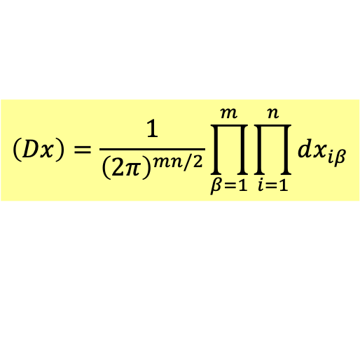


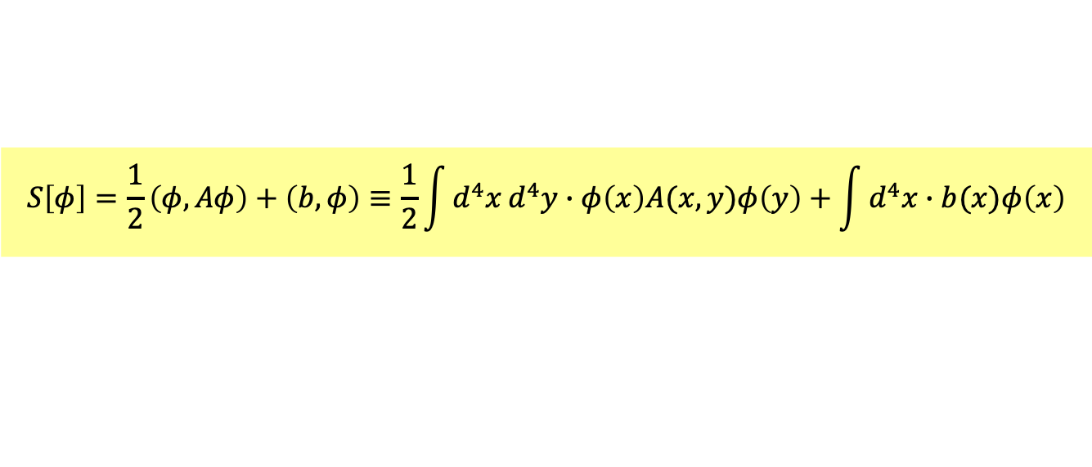

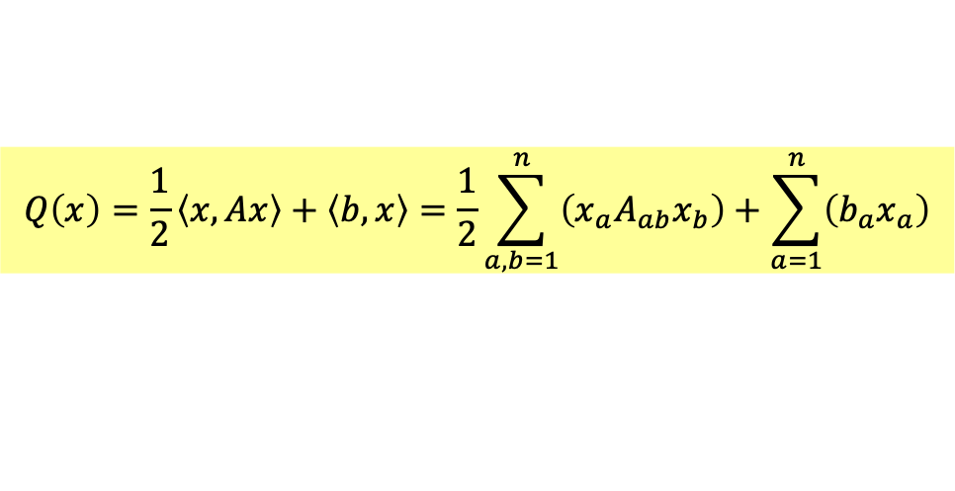
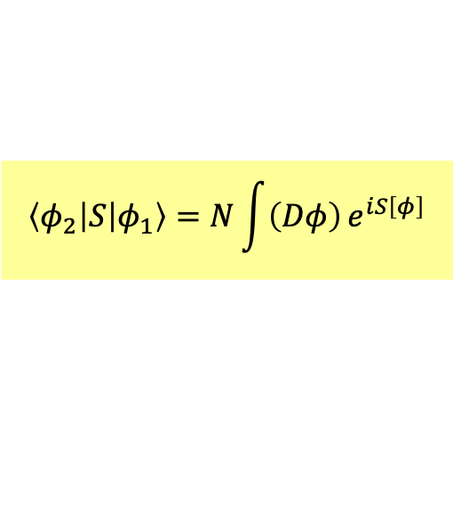
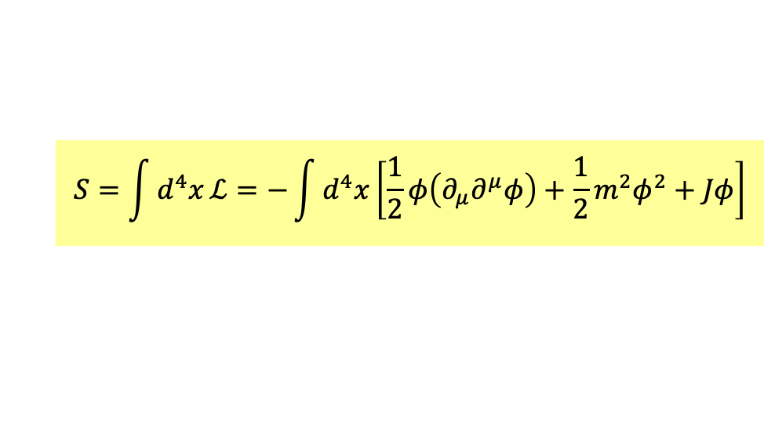


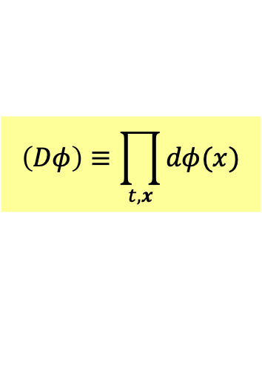
We can extend the above to scalar field theory by:
$$x_{a}→φ\left(x\right)$$
$$a→t,x$$
$$β→x$$
Now space $x$ is the index $β$, spacetime $x$ is $a$.
$$\left(Dx\right)=\frac{1}{{\left(2π\right)}^{mn/2}}\prod_{β=1}^{m}{\prod_{i=1}^{n}{dx_{iβ}}}$$
$$\left(Dφ\right)≡\prod_{t,x}{dφ(x)}$$
$$φ\left(x\right)$$
is a sum over all possible field configuration and evolution.
$$\left\langle φ_{2} | S | φ_{1}\right\rangle =N\int{\left(Dφ\right)}e^{iS\left[φ\right]}$$
The amplitude or $S$ matrix is given by path integral.
$$Q\left(x\right)=\frac{1}{2}\left\langle x,Ax\right\rangle +\left\langle b,x\right\rangle =\frac{1}{2}\sum_{a,b=1}^{n}{\left(x_{a}A_{ab}x_{b}\right)}+\sum_{a=1}^{n}{\left(b_{a}x_{a}\right)}$$
$$S\left[φ\right]=\frac{1}{2}\left(φ,Aφ\right)+\left(b,φ\right)≡\frac{1}{2}\int{d^{4}x}d^{4}y∙φ\left(x\right)A(x,y)φ\left(y\right)+\int{d^{4}x}∙b(x)φ\left(x\right)$$
Consider a scalar field with source $J\left(x\right)$. The action can be written as a $Q\left[φ\right]$.
$$S=\int{d^{4}x}ℒ=−\int{d^{4}x}\left[\frac{1}{2}φ\left(∂_{μ}∂^{μ}φ\right)+\frac{1}{2}m^{2}φ^{2}+Jφ\right]$$
$$A=□+m^{2}$$

Slide 14
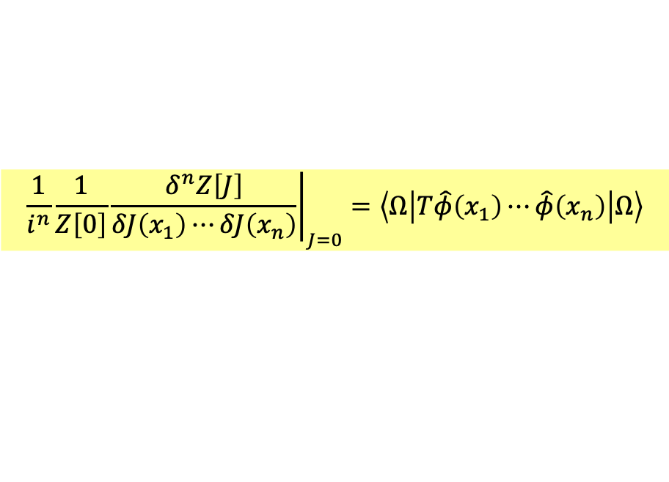
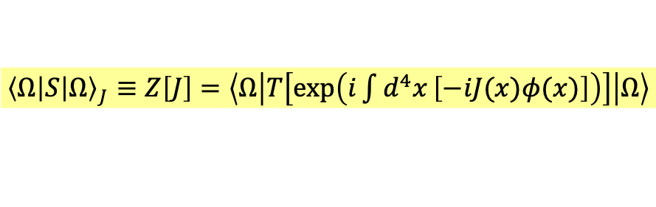

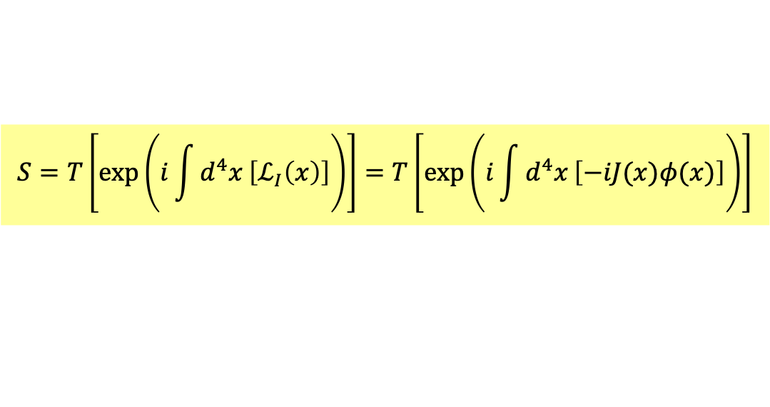


Consider a scalar field with source $J\left(x\right)$. The action can be written as a $Q\left[φ\right]$.
$$S=\int{d^{4}x}ℒ=−\int{d^{4}x}\left[\frac{1}{2}φ\left(∂_{μ}∂^{μ}φ\right)+\frac{1}{2}m^{2}φ^{2}+Jφ\right]$$
All QFT quantities can be calculated by the vacuum-to-vacuum amplitude with source.
$${\left\langle Ω | S | Ω\right\rangle }_{J}≡Z\left[J\right]$$
This amplitude is a functional of the function $J(x)$, ie for every $J(x)$ it gives a number.
By canonical quantization, in the interaction picture,
$$ℒ_{I}=J(x)φ(x)$$
The S matrix can be written as:
$$S=T\left[\text{exp}\left(i\int{d^{4}x}\left[ℒ_{I}\left(x\right)\right]\right)\right]=T\left[\text{exp}\left(i\int{d^{4}x}\left[−iJ(x)φ(x)\right]\right)\right]$$
$${\left\langle Ω | S | Ω\right\rangle }_{J}≡Z\left[J\right]=\left\langle Ω | T\left[\text{exp}\left(i\int{d^{4}x}\left[−iJ(x)φ(x)\right]\right)\right] | Ω\right\rangle$$
Its derivatives about $J(x)$ gives all the Green functions of QFT, so generating functional.
$${\left.\frac{1}{i^{n}}\frac{1}{Z\left[0\right]}\frac{δ^{n}Z\left[J\right]}{δJ\left(x_{1}\right)⋯δJ\left(x_{n}\right)}\right|}_{J=0}=\left\langle Ω | T\hat{φ}\left(x_{1}\right)⋯\hat{φ}\left(x_{n}\right) | Ω\right\rangle$$

Slide 15
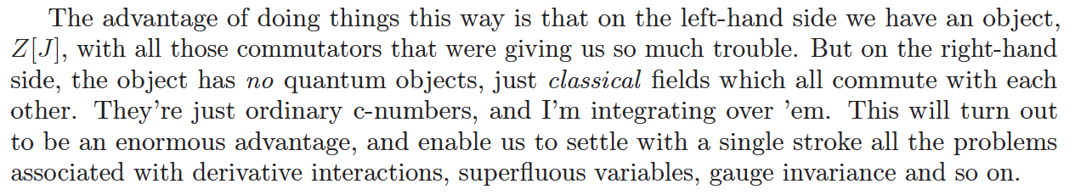
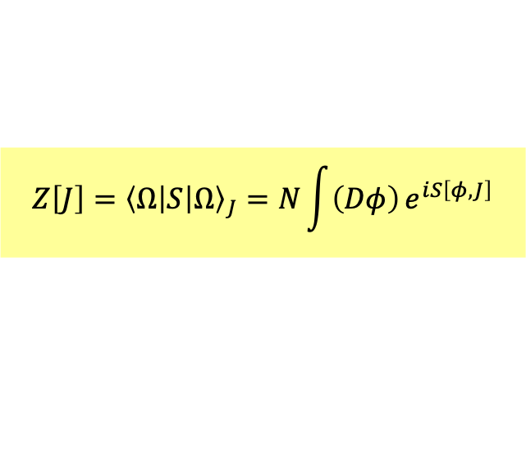
${\left\langle Ω | S | Ω\right\rangle }_{J}$ can also be calculated by path or history integral.
$e^{iS\left[φ,J\right]}$ would be the amplitudes of various histories , ie. as the weight of summation.
$$Z\left[J\right]={\left\langle Ω | S | Ω\right\rangle }_{J}=N\int{\left(Dφ\right)}e^{iS\left[φ,J\right]}$$

Slide 16





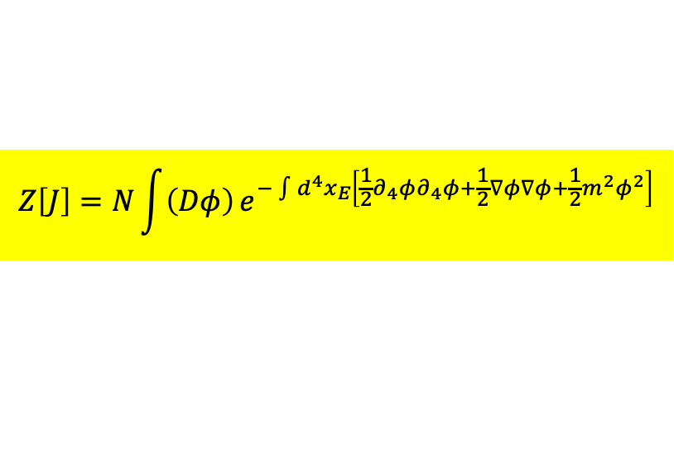

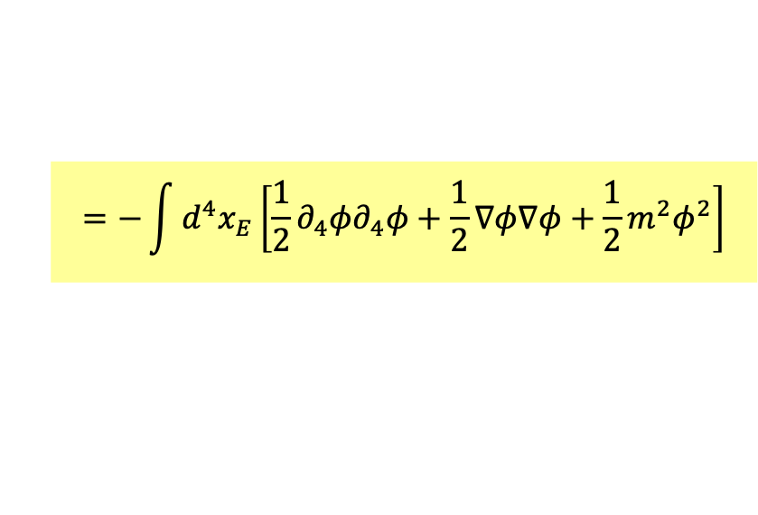
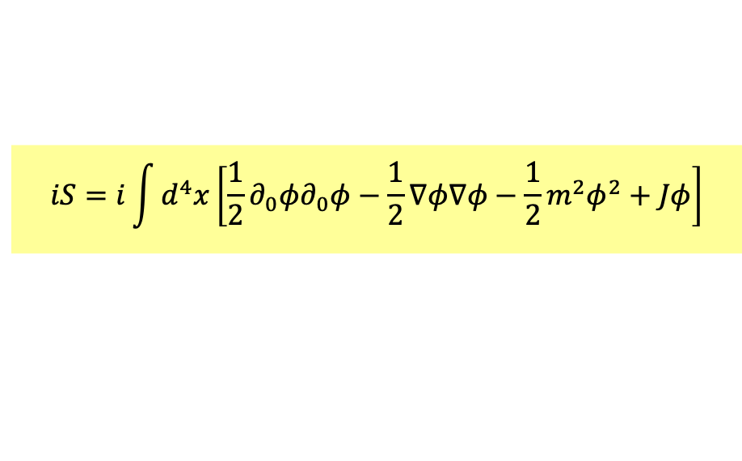
Does it make mathematical sense?
$$N\int{\left(Dφ\right)}e^{iS\left[φ\right]}$$
It is oscillating, not exponentially decreasing as $φ→∞$.
We can continue both sides to Euclidean space by a Wick Rotation.
Let $x^{0}$ becomes imaginary:
$x_{0}=−ix_{4},x_{4}$ real
$$x^{2}=x_{0}^{2}−x^{2}=−x_{4}^{2}−x^{2}=−x_{E}^{2}$$
Momenta will change accordingly so that the contour integral over half circle vanishes.
$p_{0}=ip_{4},p_{4}$ real
$$p^{2}=p_{0}^{2}−p^{2}=−p_{4}^{2}−x^{2}=−p_{E}^{2}$$
$$iS=i\int{d^{4}x}\left[\frac{1}{2}∂_{0}φ∂_{0}φ−\frac{1}{2}∇φ∇φ−\frac{1}{2}m^{2}φ^{2}+Jφ\right]$$
$□_{E}$ is d'Alembertian.
$$=−\int{d^{4}x_{E}}\left[\frac{1}{2}∂_{4}φ∂_{4}φ+\frac{1}{2}∇φ∇φ+\frac{1}{2}m^{2}φ^{2}\right]$$
$$Z\left[J\right]=N\int{\left(Dφ\right)}e^{−\int{d^{4}x_{E}}\left[\frac{1}{2}∂_{4}φ∂_{4}φ+\frac{1}{2}∇φ∇φ+\frac{1}{2}m^{2}φ^{2}\right]}$$
exponentially decreasing

Slide 17
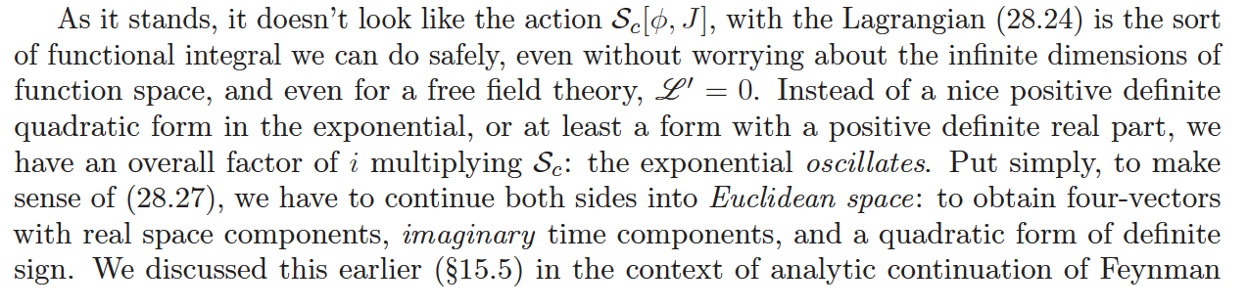
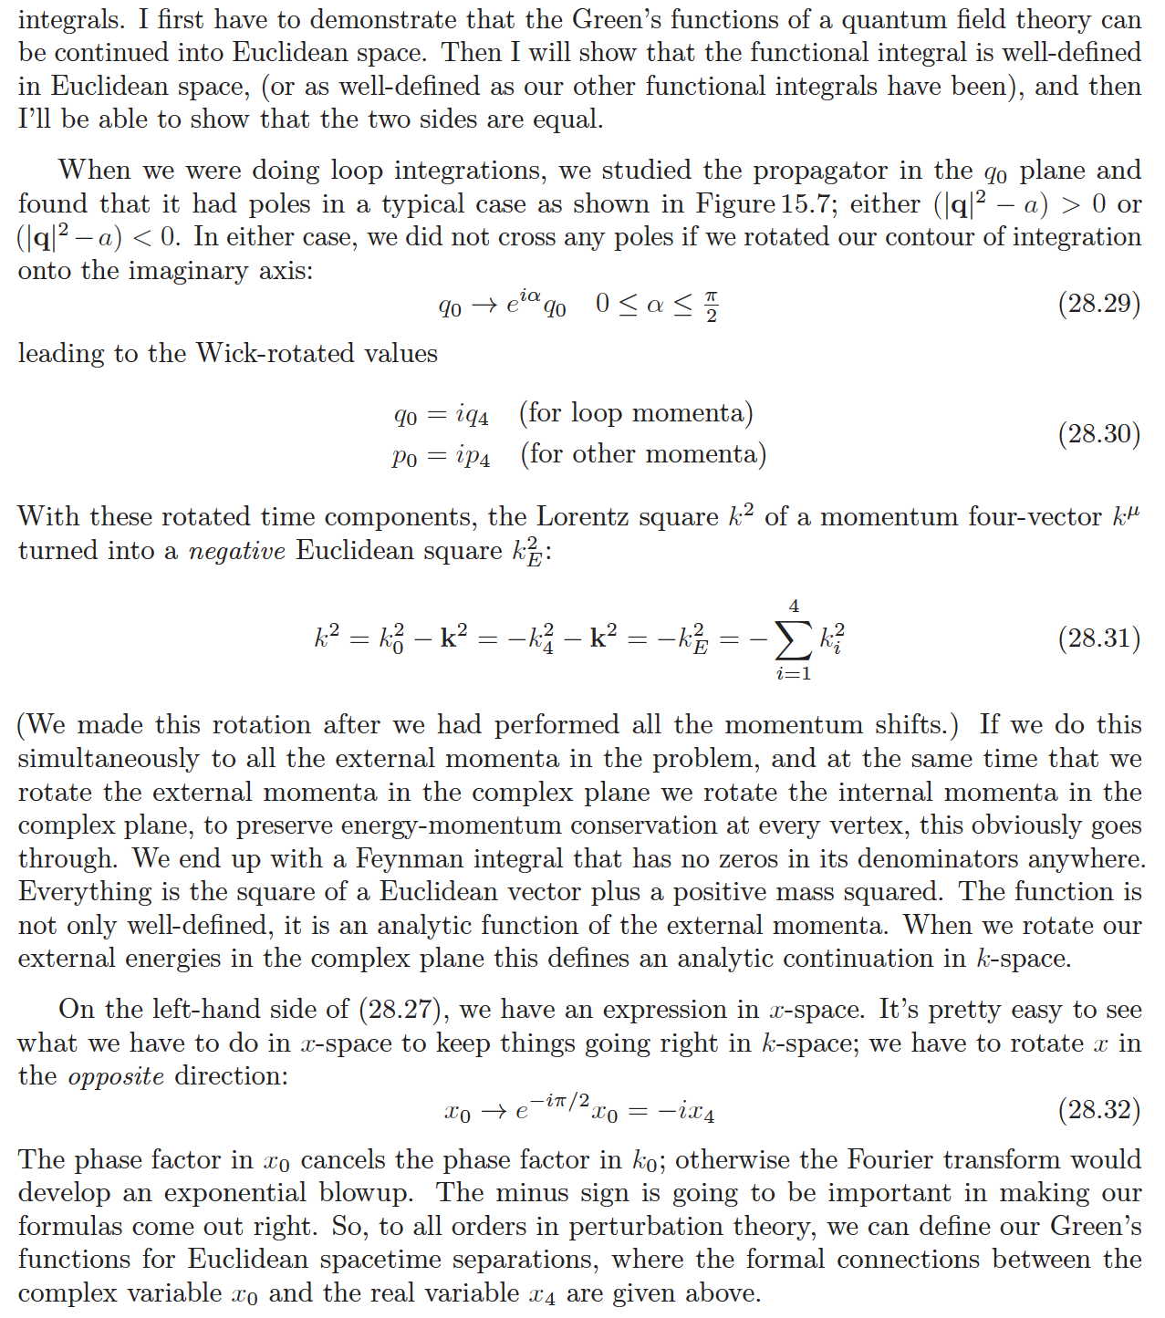

Slide 19
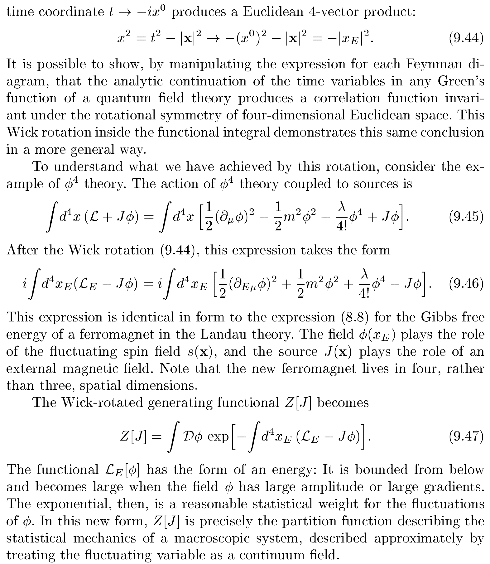

Slide 20
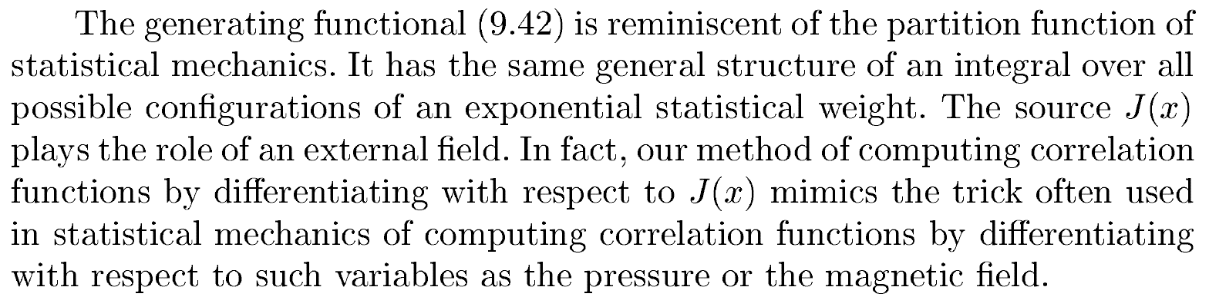
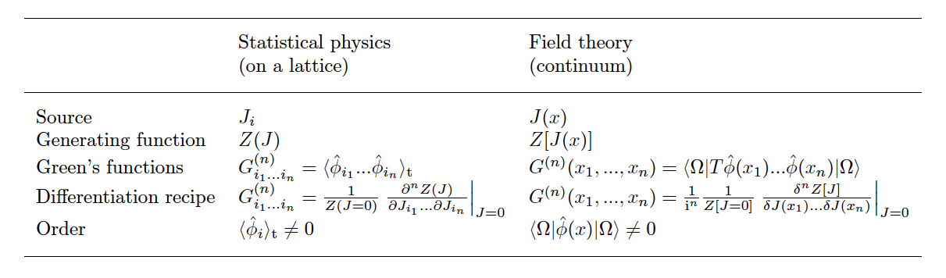
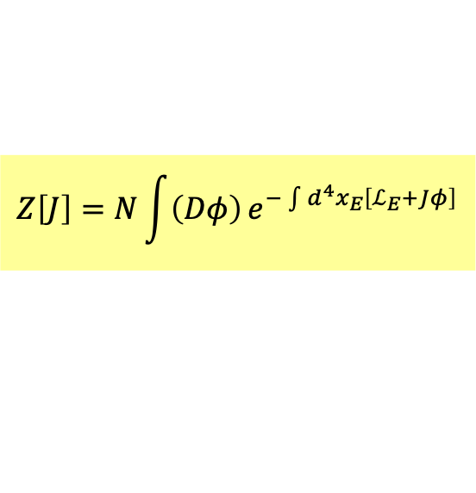
量子場論與多體系統統計力學在數學上是互通的
$$Z\left[J\right]=N\int{\left(Dφ\right)}e^{−\int{d^{4}x_{E}}\left[ℒ_{E}+Jφ\right]}$$
In Euclidean Space,
summation over history becomes summation over all possible configurations.
That is partition function in statistical mechanics with Canonical Ensemble .

Slide 21
Feynman Rule from Feynman’s path integral

Slide 22
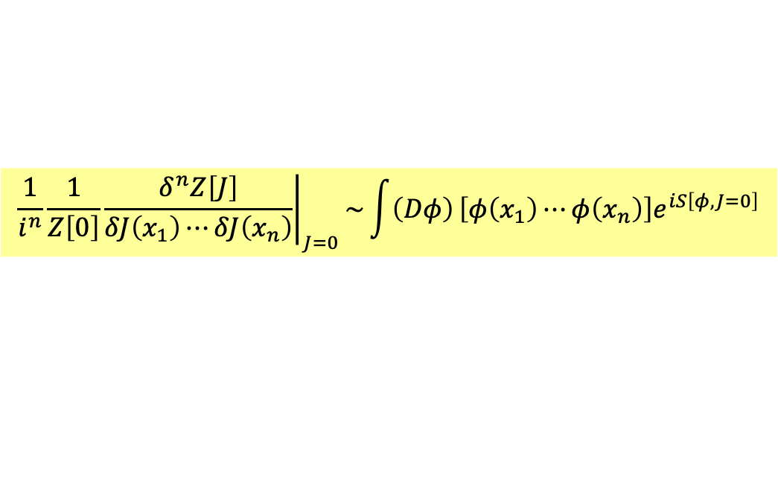

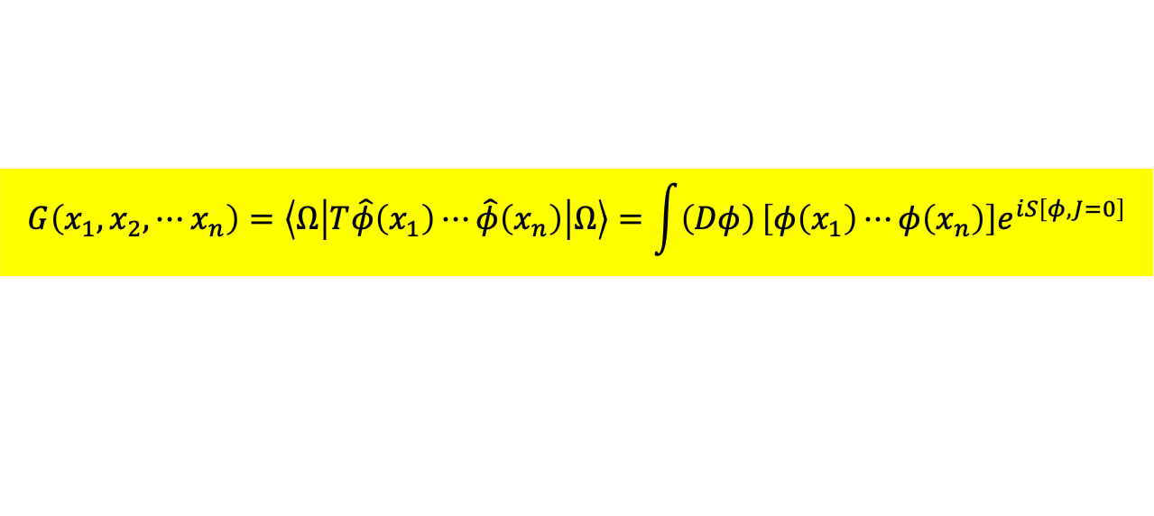
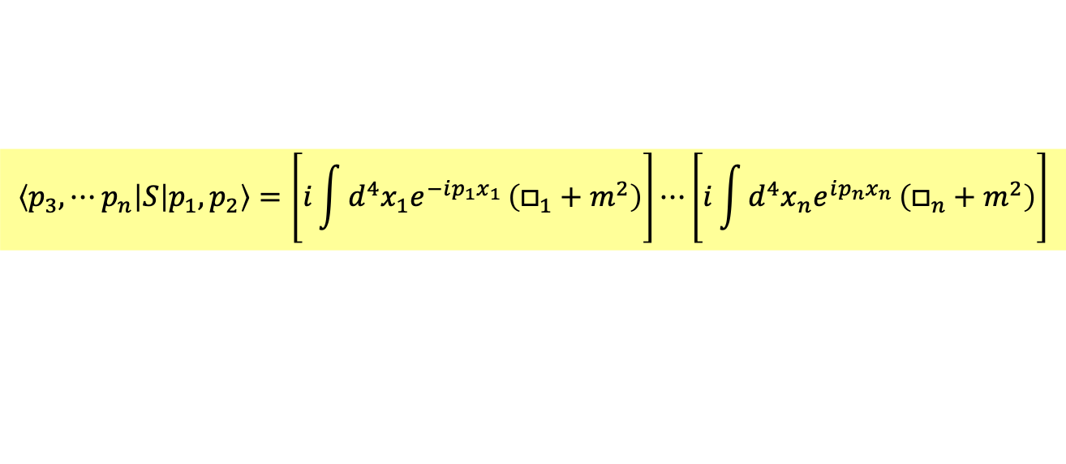
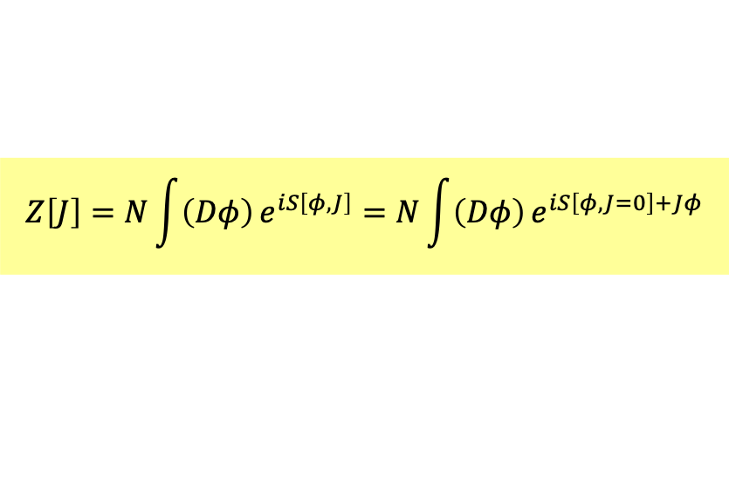
$Z\left[J\right]$ is called generating functional.
We define it as calculated in Euclidean space and continued back to Minkowski Space.
$$Z\left[J\right]=N\int{\left(Dφ\right)}e^{iS\left[φ,J\right]}=N\int{\left(Dφ\right)}e^{iS\left[φ,J=0\right]+Jφ}$$
Its derivatives with $J(x)$ can also be calculated in path integral formalism.
$${\left.\frac{1}{i^{n}}\frac{1}{Z\left[0\right]}\frac{δ^{n}Z\left[J\right]}{δJ\left(x_{1}\right)⋯δJ\left(x_{n}\right)}\right|}_{J=0}\sim \int{\left(Dφ\right)}\left[φ\left(x_{1}\right)⋯φ\left(x_{n}\right)\right]e^{iS\left[φ,J=0\right]}$$
We already know $Z\left[J\right]$’s derivatives with $J(x)$ gives the Green functions of QFT. So
$$G\left(x_{1},x_{2},⋯x_{n}\right)=\left\langle Ω | T\hat{φ}\left(x_{1}\right)⋯\hat{φ}\left(x_{n}\right) | Ω\right\rangle =\int{\left(Dφ\right)}\left[φ\left(x_{1}\right)⋯φ\left(x_{n}\right)\right]e^{iS\left[φ,J=0\right]}$$
Observe that commuting $φ\left(x_{1}\right)⋯φ\left(x_{n}\right)$ at R automatically arranged into time order at L.
With Green’s function, we can calculate the S matrix, by LSZ reduction formula.
$$\left\langle p_{3},⋯p_{n} | S | p_{1},p_{2}\right\rangle =\left[i\int{d^{4}x_{1}e^{−ip_{1}x_{1}}}\left(□_{1}+m^{2}\right)\right]⋯\left[i\int{d^{4}x_{n}e^{ip_{n}x_{n}}}\left(□_{n}+m^{2}\right)\right]$$
$$×\left\langle Ω | T\hat{φ}\left(x_{1}\right)⋯\hat{φ}\left(x_{n}\right) | Ω\right\rangle$$

Slide 23

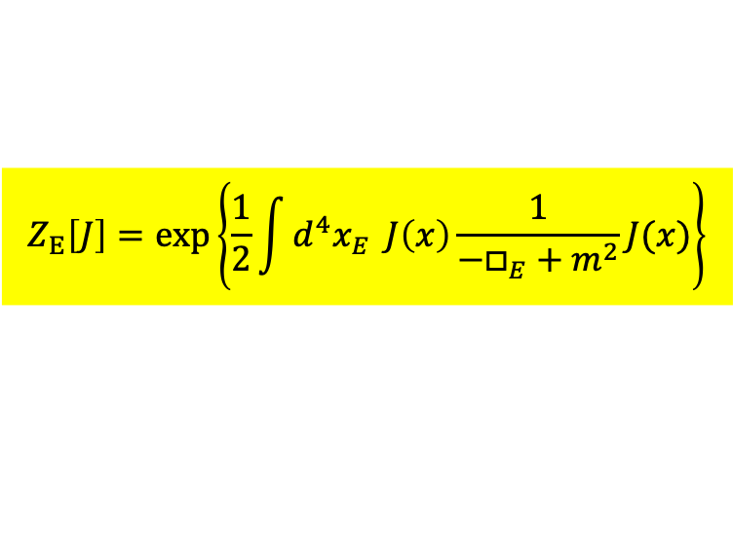


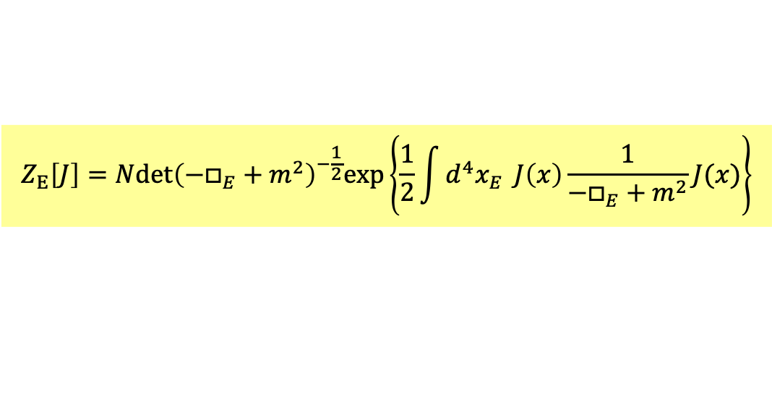



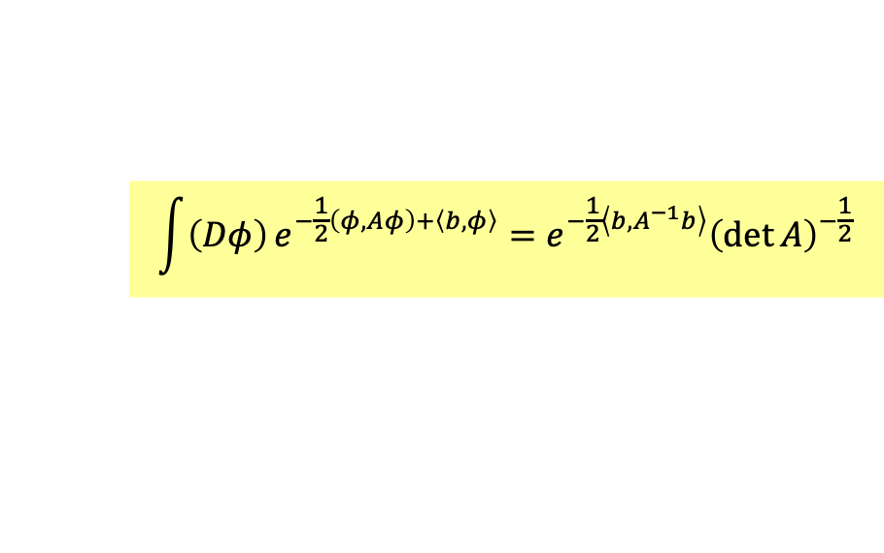

Let’s calculate first in Euclidean Space!
$$Z\left[J\right]\sim \int{\left(Dφ\right)}e^{−\int{d^{4}x_{E}}\left[\frac{1}{2}∂_{4}φ∂_{4}φ+\frac{1}{2}∇φ∇φ+\frac{1}{2}m^{2}φ^{2}+jφ\right]}\sim \int{\left(Dφ\right)}e^{−\int{d^{4}x_{E}}\left[\frac{1}{2}φ\left(−□_{E}+m^{2}\right)φ+Jφ\right]}$$
Using the familiar formula we just derived:
$$\int{\left(Dφ\right)}e^{−\frac{1}{2}\left(φ,Aφ\right)+\left\langle b,φ\right\rangle }=e^{−\frac{1}{2}\left\langle b,A^{−1}b\right\rangle }{\left(\det{A}\right)}^{−\frac{1}{2}}$$
$$A=−□_{E}^{2}+m^{2}, b=J$$
$$Z_{E}\left[J\right]=N{det\left(−□_{E}+m^{2}\right)}^{−\frac{1}{2}}exp\left\{\frac{1}{2}\int{d^{4}x_{E}} J\left(x\right)\frac{1}{−□_{E}+m^{2}}J(x)\right\}$$
Choose $N$ so that:$Z_{E}\left[J=0\right]=1$
$$Z_{E}\left[J\right]=exp\left\{\frac{1}{2}\int{d^{4}x_{E}} J\left(x\right)\frac{1}{−□_{E}+m^{2}}J(x)\right\}$$
$$\frac{1}{−□_{E}+m^{2}}$$
The function connecting two sources is just the propagator!
$Z_{E}\left[J\right]$ is just sum of any numbers of….
$$⋯⋯$$

Slide 24






$$\frac{1}{−□_{E}+m^{2}}$$
can be continued back to Monkowski space.
$$\frac{−i}{□+m^{2}+iε}\sim ∆_{F}(x,y)$$
It would be Feynman Propagator $∆_{F}(x,y)$.
$$\left(□+m^{2}+iε\right)∆_{F}(x,y)={−iδ}^{(4)}\left(x−y\right)$$
$iε$ is to ensure there is no pole in the analytic continuation.
Euclidean
Monkowski
By Fourier Transformation:
$$Z\left[J\right]=exp\left\{\frac{1}{2}\int{d^{4}x} J\left(x\right)\frac{−i}{□+m^{2}+iε}J(x)\right\}=exp\left\{\frac{1}{2}\int{d^{4}k} \tilde{J}\left(k\right)\frac{i}{k^{2}−m^{2}−iε}\tilde{J}\left(k\right)\right\}$$

Slide 25







Now we can add interaction $ℒ_{I}\left(φ\right)$:
$$Z\left[J\right]=N\int{\left(Dφ\right)}e^{−i\int{d^{4}x}\left[\frac{1}{2}φ\left(□+m^{2}+iε\right)φ+ℒ_{I}\left(φ\right)+Jφ\right]}$$
We can separate the interaction Lagrangian:
$$Z\left[J\right]=N \int{\left(Dφ\right)exp\left[i\int{d^{4}x ℒ_{I}\left(φ\right)}\right]}e^{−i\int{d^{4}x}\left[\frac{1}{2}φ\left(□+m^{2}+iε\right)φ−Jφ\right]}$$
$φ$ can be obtained by functional derivatives of $J$ and derivatives is taken out of integral.
$$Z\left[J\right]=N exp\left[i\int{d^{4}x ℒ_{I}\left(−i\frac{δ}{δJ}\right)}\right]\int{\left(Dφ\right)}e^{−i\int{d^{4}x}\left[\frac{1}{2}φ\left(□+m^{2}+iε\right)φ−Jφ\right]}$$
$$=N exp\left[i\int{d^{4}x ℒ_{I}\left(−i\frac{δ}{δJ}\right)}\right]exp\left[\frac{1}{2}\int{d^{4}x} J\left(x\right)\frac{−i}{□+m^{2}+iε}J(x)\right]$$
$$\sum_{n}{}$$
$$⋯⋯$$

Slide 26













$$+$$
$$⋯⋯$$
$$+$$
$$⋯⋯$$
$$ℒ_{I}\left(−i\frac{δ}{δJ}\right)$$
$$ℒ_{I}\left(−i\frac{δ}{δJ}\right)$$
$$ℒ_{I}\left(−i\frac{δ}{δJ}\right)$$
$$ℒ_{I}\left(−i\frac{δ}{δJ}\right)$$
$$ℒ_{I}\left(−i\frac{δ}{δJ}\right)$$
$$+$$
$$⋯⋯$$
$$+$$
$$⋯⋯$$
$$Z\left[J\right]=N exp\left[i\int{d^{4}x ℒ_{I}\left(−i\frac{δ}{δJ}\right)}\right]exp\left[\frac{1}{2}\int{d^{4}x} J\left(x\right)\frac{−i}{□+m^{2}+iε}J(x)\right]$$
Every derivative in $ℒ_{I}$ take out a source.
The field operators in Green’s function could be written as derivatives of $J$, too.
Every derivative take out one source, too.
$$\left\langle Ω | Tφ\left(x_{1}\right)⋯φ\left(x_{1}\right) | Ω\right\rangle ={\left.\frac{1}{i^{n}}\frac{δ^{n}}{δJ\left(x_{1}\right)⋯δJ\left(x_{n}\right)}exp\left[i\int{d^{4}x ℒ_{I}\left(−i\frac{δ}{δJ}\right)}\right]Z_{0}\left[J\right]\right|}_{J=0}$$
All source dots in $Z_{0}$ must either end up as in-out particles or as a leg in interaction vertex.
Otherwise, it will vanish as we take $J=0$.

Slide 27









$${S^{(2)}=U}^{(2)}\left(∞,−∞\right)=−\frac{1}{2}\int_{−∞}^{∞}{d^{4}x_{1}\int_{−∞}^{∞}{d^{4}x_{2} T\left[ℒ_{I}\left(x_{1}\right){∙ℒ}_{I}\left(x_{2}\right)\right]}}$$
Amplitude for scattering
$$\left\langle B\left({\vec{p}}_{3}\right) B\left({\vec{p}}_{4}\right) | S | A\left({\vec{p}}_{1}\right)A\left({\vec{p}}_{1}\right)\right\rangle$$
$${ e}^{ip_{4}∙x_{1}}$$
$${ e}^{ip_{3}∙x_{2}}$$
$$\left\langle B\left({\vec{p}}_{3}\right) B\left({\vec{p}}_{4}\right) | \left[\int_{−∞}^{∞}{d^{4}x_{1}d^{4}x_{1}}T\left[g\hat{A}\left(x_{1}\right)\hat{B}\left(x_{1}\right)\hat{C}\left(x_{1}\right)∙g\hat{A}\left(x_{2}\right)\hat{B}\left(x_{2}\right)\hat{C}\left(x_{2}\right)\right]\right] | A\left({\vec{p}}_{1}\right)A\left({\vec{p}}_{1}\right)\right\rangle$$
$${ e}^{−ip_{1}∙x_{2}}$$
$${ e}^{−ip_{2}∙x_{1}}$$
$$=\int_{−∞}^{∞}{d^{4}x_{1}d^{4}x_{1}}{ e}^{−i\left(p_{1}−p_{3}\right)∙x_{2}}∙{ e}^{−i\left(p_{2}−p_{4}\right)∙x_{1}}\left\langle 0 | T\left[\hat{C}\left(x_{1}\right)\hat{C}\left(x_{2}\right)\right] | 0\right\rangle$$
B
B
$$=\frac{i}{{\left(p_{1}−p_{3}\right)}^{2}−m^{2}+iε}$$
C
A
A

Slide 28
Every field either couple with another field to form a propagator or annihilate (create) external particles!
Otherwise, the amplitude will vanish when a operators hit vacuum!

Slide 29





This is the easiest way to derive the technique of Feynman diagrams.
It works even if interaction contains derivatives, a thorny case for canonical quantization.
$$\left\langle Ω | Tφ\left(x_{1}\right)⋯φ\left(x_{1}\right) | Ω\right\rangle ={\left.\frac{1}{i^{n}}\frac{δ^{n}}{δJ\left(x_{1}\right)⋯δJ\left(x_{n}\right)}exp\left[i\int{d^{4}x ℒ_{I}\left(−i\frac{δ}{δJ}\right)}\right]Z_{0}\left[J\right]\right|}_{J=0}$$
$$ℒ_{I}\left(φ\right)=λφ^{3}$$
Take as an example:
$$⋯⋯$$
Expand the exponential to second order, ie. With two vertices.
$$λ\frac{δ^{3}}{δJ^{3}\left(x\right)}∙λ\frac{δ^{3}}{δJ^{3}\left(y\right)}$$
$$\frac{δ^{4}}{δJ\left(x_{1}\right)⋯δJ\left(x_{4}\right)}$$
Green Function with four external lines:
Contribution will come from five propagators with 10 $J$:
The source dots either end up in an interaction vertex or as in or out particles.

Slide 30




路徑積分運用於規範場論
You make a gauge transformation :
$$V→V+∂_{t}θ$$
$$A→A+∇θ$$
or
$$A^{μ}→A^{μ}+∂^{μ}θ$$
The observable electromagnetic fields $E,B=F^{μν}$ do not change!
You represent the same physical state by two different set of physical quantities $A^{μ}$.
Some information in $A^{μ}$ is redundant.
This is different from symmetry.
Symmetry states two different physical states have identical properties, such as energy.

Slide 31




We usually choose a Gauge condition to fix the gauge.
Lorentz gauge:
$$∂_{μ}A^{μ}=0$$
$$∂_{μ}A^{μ}=f(x)$$
Landau gauge:
$$∇∙A=0$$
Axial gauge:
$$A^{3}=0$$

Slide 32

$$A^{μ}\left(x\right)$$
Different field evolution may represent the same history.
if we do arbitrary gauge transformation along the way.
$\left(DA^{μ}\right)$, as summation over histories, is overcounting.

Slide 33












If the $x’s$ of these vertical lines represent physical states at successive times,
and $y$ represents the arbitrary gauge transformations you can make.
Note that different $y$ do not mean different states. One vertical line is one state.
$$y=f(x)$$
$G\left(x,y\right)=0$
$\int{\left(DA^{μ}\right)}$ is like summing over $x$ and $y$: $\int{dxdy}$, which is redundant.
Choosing one $y$ for every $x$ ie. A line across $x−y$ plane would be enough.
We can impose a constraint or condition when we integrate:
$$y=f(x)$$
$$\int{dxdy} δ\left(y−f(x)\right)=\int{dx} \int{dy}δ\left(y−f(x)\right)=\int{dx}$$
$$=1$$
$y−f\left(x\right)=0$
is better written as a condition for $x,y$:
$G\left(x,y\right)=0$
$$\int{dx}=\int{dx} \int{dy}\frac{∂G}{∂y}δ\left(G\left(x,y\right)\right)=\int{dxdy}\frac{∂G}{∂y}δ\left(G\left(x,y\right)\right)$$
Note the $\frac{∂G}{∂y}$ that compensate the difference of gauge condition $G$ and variable $y$.

Slide 34


Faddeev and Popov
This is the proper way to sum over history with redundant variables!
It can be easily extended to the case where there are more than one $x$ and $y$:
There would be $m$ conditions $G^{k=1⋯m}$ between $x_{i=1⋯n}$ and $y_{j=1⋯m}$:
$$\int{d^{n}x}=\int{d^{n}x} \int{d^{m}y} det\left(\frac{∂G^{k}}{∂y_{j}}\right) δ\left(G^{k}\left(x_{i},y_{j}\right)\right)=\int{d^{n}xd^{m}y}det\left(\frac{∂G}{∂y}\right)δ\left(G\left(x,y\right)\right)$$
$$=1$$
The derivative now needs to be Jacobian $det\left(\frac{∂G}{∂y}\right)$ of multivariable integration.

Slide 35











$$\int{d^{n}xd^{m}y}$$
$$\int{\left(DA^{μ}\right)}$$
$G\left(x,y\right)=0$
$$G\left(A^{μ}(x)\right)=0$$
Gauge conditions
$$\left(x_{i},0\right)+(0,y_{j})$$
$$A^{μ}(x)+∂^{μ}α\left(x\right)$$
$$y_{j=1⋯m}$$
$$α\left(x\right)$$
$$\int{d^{n}xd^{m}y}det\left(\frac{∂G}{∂y}\right)δ\left(G\left(x,y\right)\right)$$
$$\int{\left(DA^{μ}\right) det\left(\frac{δG(x)}{δα(x)}\right) δ\left(G\left(A^{μ}(x)\right)\right)e^{iS\left[A^{μ}\right]}}$$
Functional derivative

Slide 36




$$G\left(A^{μ}(x)\right)=0$$
Gauge conditions
$$A^{μ}(x)+∂^{μ}α\left(x\right)$$
$$\int{\left(DA^{μ}\right) det\left(\frac{δG(x)}{δα(x)}\right) δ\left(G\left(A^{μ}(x)\right)\right)e^{iS\left[A^{μ}\right]}}$$
This is an ansatz ie. an educated guess.
We can prove it is gauge invariance, which is just a displacement in $α$:$α+α′$.
An infinite integration $\int_{−∞}^{∞}{dα}$ is always invariant under $α+α′$.
We can also prove it is identical to canonical quantization in axial gauge.

Slide 37




$$\int{\left(DA^{μ}\right) det\left(\frac{δG(x)}{δα(x)}\right) δ\left(G\left(A^{μ}(x)\right)\right)e^{iS\left[A^{μ}\right]}}$$
Even better, for most gauge conditions in QED, $det\left(\frac{δG}{δα}\right)$ is a constant.
Take Lorentz gauge as an example:
$$G\left[A^{μ}\right]=∂_{μ}A^{μ}=0$$
The condition is transformed into:
$$G\left[A^{μ}(x)+∂^{μ}α\right]=∂_{μ}A^{μ}+∂_{μ}∂^{μ}α$$
Note that the difference is independent of any physical fields.
$$det\left(\frac{δG}{δα}\right)=det\left(\frac{δ□α}{δα}\right)=det\left(□δ^{\left(4\right)}(x−y)\right)$$
This is a constant to be absorbed into normalization of $Z$. We ignore det in QED.
You can no longer do that in non-abelian gauge theory.

Slide 38







You can no longer ignore det in non-abelian gauge theory.
$$δW_{μ}=\frac{1}{g}∂_{μ}α+α×W_{μ}$$
or in components:
$$δW_{μ}^{k}=\frac{1}{g}∂_{μ}α^{k}+ε^{ijk}α^{i}W_{μ}^{j}$$
Take Lorentz gauge:
$$G^{k}=∂^{μ}W_{μ}^{k}=0$$
$$\int{\left(DW_{μ}^{k}\right)det\left(\frac{δG^{k}}{δα^{i}}\right)δ\left(∂^{μ}W_{μ}^{k}\right)e^{iS}}$$
The condition is transformed into:
$$G^{k}\left[W_{μ}^{k}+\frac{1}{g}∂_{μ}α^{k}+ε^{ijk}α^{i}W_{μ}^{j}\right]=∂^{μ}W_{μ}^{k}+\frac{1}{g}∂_{μ}∂^{μ}α^{k}+∂_{μ}\left(ε^{ijk}α^{i}W_{μ}^{j}\right)$$
$$=∂^{μ}W_{μ}^{k}+\frac{1}{g}∂_{μ}\left[∂^{μ}α^{k}−g∂_{μ}\left(ε^{jik}{W_{μ}^{j}α}^{i}\right)\right]$$
Note that the difference depends on gauge field and can’t be ignored.
$$det\left(\frac{δG^{k}}{δα^{i}}\right)=det\left(\frac{δ□α}{δα}\right)\sim det\left[∂_{μ}∂^{μ}δ^{\left(4\right)}\left(x−y\right)δ^{ki}−gδ^{\left(4\right)}\left(x−y\right)ε^{jik}W_{μ}^{j}\right]$$
Det term involves gauge bosons.

Slide 39







Another way to twist Lorentz gauge. Consider conditions with a variable function $f$.
$$G\left[A^{μ}\right]=∂_{μ}A^{μ}−f\left(x\right)=0$$
Gauge transformation will change $f\left(x\right)$. So it is a surrogate of $α\left(x\right)$.
Gauge invariance suggest the following will not depend on $f\left(x\right)$.
$$\int{\left(DA^{μ}\right) δ\left(∂_{μ}A^{μ}−f\right)e^{iS\left[A^{μ}\right]}}$$
We ignore the det.
We can tame infinity of integrating $α$ by giving it an exponentially damping weight.
$$\int{\left(Df\right)}\int{\left(DA^{μ}\right) δ\left(∂_{μ}A^{μ}−f\right)∙\exp{\frac{i}{2ξ}\int{d^{4}x}f^{2}}{∙e}^{iS\left[A^{μ}\right]}}$$
$$∂_{μ}A^{μ}−f\left(x\right)$$
Change the order of integration:
$$\int{\left(DA^{μ}\right)}\int{\left(Df\right) δ\left(∂_{μ}A^{μ}−f\right)∙\exp{\frac{i}{2ξ}\int{d^{4}x}f^{2}}{∙e}^{iS\left[A^{μ}\right]}}$$
Integrate over the delta function:
$$\int{\left(DA^{μ}\right)}\exp{\frac{i}{2ξ}\int{d^{4}x}{\left(∂_{μ}A^{μ}\right)}^{2}}{∙e}^{iS\left[A^{μ}\right]}$$

Slide 40





$$\int{\left(DA^{μ}\right)}∙{e^{\frac{i}{2ξ}\int{d^{4}x}{\left(∂_{μ}A^{μ}\right)}^{2}}∙e}^{i\int{d^{4}x}ℒ\left[A^{μ}\right]}$$
$$∂_{μ}A^{μ}−f\left(x\right)$$
Yes, we are resuming the redundant variables.
Yes, the new gauge fixing term breaks gauge symmetry.
But it yields same Green functions as gauge symmetric theory.
That means redundant variables are carefully handled so that it doesn’t cause troubles.
See also Schwartz P268
The new exponential changes the kinetic energy of $A^{μ}$ and hence the propagator.
$$ℒ⊃−\frac{1}{4}F_{μν}F^{μν}+\frac{1}{2ξ}{\left(∂_{μ}A^{μ}\right)}^{2}=\frac{1}{2}∂_{μ}A_{ν}∂^{μ}A^{ν}−\frac{1}{2}∂_{ν}A_{μ}∂^{μ}A^{ν}+\frac{1}{2ξ}{\left(∂_{μ}A^{μ}\right)}^{2}$$
After integration by part:
$$F^{μν}≡∂^{μ}A^{ν}−∂^{ν}A^{μ}$$
$$ℒ⊃−\frac{1}{2}A_{ν}{∂_{μ}∂}^{μ}A^{ν}−\frac{1}{2}A_{μ}∂^{μ}{∂_{ν}A}^{ν}+\frac{1}{2ξ}A_{μ}∂^{μ}{∂_{ν}A}^{ν}$$
$$=−\frac{1}{2}A_{μ}\left[g^{μν}□−(1−\frac{1}{ξ})∂^{μ}∂^{ν}\right]A_{ν}$$

Slide 41







$$−\frac{1}{2}A_{μ}\left[g^{μν}□−(1−\frac{1}{ξ})∂^{μ}∂^{ν}\right]A_{ν}$$
We can find photon propagator from the above kinetic energy:
It is the inverse of the operator in , ie. Green function of this Differential Eq:
$$\left[g^{μν}□−\left(1−\frac{1}{ξ}\right)∂^{μ}∂^{ν}\right]D_{νρ}\left(x−y\right)=δ_{ρ}^{μ}δ^{\left(4\right)}\left(x−y\right)$$
Its Fourier transformation is easier to solve.
$$\left[−g^{μν}k^{2}−\left(1−\frac{1}{ξ}\right)k^{μ}k^{ν}\right]{\tilde{D}}_{μν}\left(k\right)=iδ_{ρ}^{μ}$$
We can use Transversal and Longitudinal projections. Note that $P^{T.L}P^{T,L}=P^{T,L}$.
$P_{μν}^{L}$ project out 4-vectors $⊥$ to $k_{ν}$, while $P_{μν}^{T}$ picks these transverse components.
$$P_{μν}^{T}=g_{μν}−\frac{k_{μ}k_{ν}}{k^{2}}$$
$$P_{μν}^{L}=\frac{k_{μ}k_{ν}}{k^{2}}$$
$$\left[−g^{μν}k^{2}−\left(1−\frac{1}{ξ}\right)k^{μ}k^{ν}\right]=k^{2}P_{μν}^{T}+\frac{k^{2}}{ξ}P_{μν}^{L}$$
Its inverse is just inverting the Transversal and Longitudinal part.
$${\tilde{D}}_{μν}\left(k\right)=\frac{i}{k^{2}+iε}\left(g_{μν}−\frac{k_{μ}k_{ν}}{k^{2}}\right)+\frac{iξ}{k^{2}+iε}\frac{k_{μ}k_{ν}}{k^{2}}$$

Slide 42





$${\tilde{D}}_{μν}\left(k\right)=\frac{i}{k^{2}+iε}\left(g_{μν}−\frac{k_{μ}k_{ν}}{k^{2}}\right)+\frac{iξ}{k^{2}+iε}\frac{k_{μ}k_{ν}}{k^{2}}$$
The parameter $ξ$ could be anything we choose for our convenience.
Physical results should be independent of $ξ$.
Two popular choices:
$ξ=1$, Feynman Gauge:
$${\tilde{D}}_{μν}\left(k\right)=\frac{ig_{μν}}{k^{2}+iε}$$
$ξ=0$, Landau Gauge:
$${\tilde{D}}_{μν}\left(k\right)=\frac{i}{k^{2}+iε}\left(g_{μν}−\frac{k_{μ}k_{ν}}{k^{2}}\right)$$

Slide 43



路徑積分運用於費米場
How about fermions? Could I use the same master equation of functional integration?
$$ℒ=\overline{ψ}\left(iγ^{μ}∂_{μ}−m\right)ψ$$
$$Z\left[J\right]=N\int{\left(Dψ\right)\left(D\overline{ψ}\right)}e^{i\int{d^{4}x}\left[\overline{ψ}\left(iγ^{μ}∂_{μ}−m\right)ψ++\overline{J}ψ+\overline{ψ}J\right]}$$
Of course we cannot. But the same almost applies with modification.
The key problem is that for fermion $ψ$ could not be ordinary number.
As an operator, $ψ$ anti-commute. But do we have numbers that anti-commute?
The same is yes, called Grassmann numbers.
Hermann Grassmann
1809-1877
But it is shocking we know how to calculate $Z\left[J\right]$ without using Grassmann numbers.

Slide 44





From earlier pages, now do a complex version:
$$Q\left(x\right)=\frac{1}{2}\left\langle x^{∗},Ax\right\rangle +\left\langle b^{∗},x\right\rangle +\left\langle x^{∗},b\right\rangle$$
$Q$ is maximized at $\overline{x}=−A^{−1}b$.
$$Q\left(x\right)=Q\left(\overline{x}\right)+\frac{1}{2}\left\langle {(x−\overline{x})}^{∗},A\left(x−\overline{x}\right)\right\rangle =\frac{1}{2}\left\langle b^{∗},A^{−1}b\right\rangle +\frac{1}{2}\left\langle {(x−\overline{x})}^{∗},A\left(x−\overline{x}\right)\right\rangle$$
The functional integration:
$$\int{\left(dxdx^{∗}\right)}e^{−Q\left(x\right)}=\int{\left(dxdx^{∗}\right)}e^{−\frac{1}{2}\left\langle b^{∗},A^{−1}b\right\rangle −\frac{1}{2}\left\langle {(x−\overline{x})}^{∗},A\left(x−\overline{x}\right)\right\rangle }$$
$$=e^{−\frac{1}{2}\left\langle b^{∗},A^{−1}b\right\rangle }\int{\left(dxdx^{∗}\right)}e^{−\frac{1}{2}\left\langle {(x−\overline{x})}^{∗},A\left(x−\overline{x}\right)\right\rangle }$$
Then we said the infinite integration is invariant as x shift by a number.
$$\int{\left(dxdx^{∗}\right)}e^{−\frac{1}{2}\left\langle x^{∗},Ax\right\rangle }=\int{\left(dxdx^{∗}\right)}e^{−\frac{1}{2}\left\langle {(x−\overline{x})}^{∗},A\left(x−\overline{x}\right)\right\rangle }$$
Note that this Gaussian integration is independent of $\overline{x}$ or $b$.

Slide 45





Note that the integration is now independent of $\overline{x}$ or $b$.
$$\int{\left(dxdx^{∗}\right)}e^{−Q\left(x\right)}=e^{−\frac{1}{2}\left\langle b^{∗},A^{−1}b\right\rangle }\int{\left(dxdx^{∗}\right)}e^{−\frac{1}{2}\left\langle x^{∗},Ax\right\rangle }$$
Apply this formula to our Naïve fermion generating functional:
$$Z\left[J\right]=N\int{\left(Dψ\right)\left(D\overline{ψ}\right)}e^{i\int{d^{4}x}\left[\overline{ψ}\left(iγ^{μ}∂_{μ}−m\right)ψ+\overline{J}ψ+\overline{ψ}J\right]}$$
$$Z\left[J=0\right]=1$$
$$=e^{i\int{d^{4}x}\left[\overline{J}{\left(iγ^{μ}∂_{μ}−m\right)}^{−1}J\right]}∙N\int{\left(Dψ\right)\left(D\overline{ψ}\right)}e^{i\int{d^{4}x}\left[\overline{ψ}\left(iγ^{μ}∂_{μ}−m\right)ψ\right]}=e^{i\int{d^{4}x}\left[\overline{J}{\left(iγ^{μ}∂_{μ}−m\right)}^{−1}J\right]}$$
We are done and it is correct! But the key we need shift symmetry in Grassman number.
All diagrammatic program of QFT of fermions (QED) follows as before from here.

Slide 46













Grassman number and its integration with shift invariance:
$θ,ξ$ anticommute
$$\left\{θ,ξ\right\}=θξ+ξθ=0$$
$θ,ξ$ anticommute with themselves:
$$\left\{θ,θ\right\}=θθ+θθ=0$$
Any larger than one power of $θ,ξ$ vanish
$$θθ=0, θ^{n>1}=0$$
Any function of $θ$ can expanded like:
$$f\left(θ\right)=a+bθ$$
$$e^{aθ}=1+aθ$$
$θ$ integration must satisfy shift invariance:
$$\int{dθ θ}=\int{dθ\left(a+θ\right)}=a\int{dθ }+\int{dθ θ}$$
$$\int{dθ }=0$$
We can then choose to normalize $θ$ so that:
$$\int{dθ θ}=1$$
Integration of a function:
$$\int{dθ}f\left(θ\right)=\int{dθ\left(a+bθ\right)}=a\int{dθ }+b\int{dθ θ}=b$$
Grassman number integration is identical to taking derivative.

Slide 47









$θ$ has a complex conjugate $\overline{θ}$.
$θ,\overline{θ}$ anticommute
$$\left\{θ,\overline{θ}\right\}=0$$
$$\overline{θ}\overline{θ}=0, {\overline{θ}}^{n>1}=0$$
$$\int{dθd\overline{θ}}=0$$
$$\int{dθd\overline{θ}}θ=0$$
$$\int{dθd\overline{θ}}\overline{θ}=0$$
$$\int{dθd\overline{θ}∙\overline{θ}θ}=\int{dθ θ}∙\int{d\overline{θ} \overline{θ}}=1$$
$$\int{dθd\overline{θ}∙e^{−\frac{1}{2}\overline{θ}aθ}}=\int{dθd\overline{θ}∙\left(1−\frac{a}{2}\overline{θ}θ\right)}=\frac{a}{2}$$

Slide 48








Now we can calculate the Gaussian Integration:
$$θ=\left(θ_{1},⋯θ_{i}⋯θ_{n}\right)$$
$$\left(dθ\right)=dθ_{1}dθ_{2}⋯dθ_{n}$$
$$\int{\left(dθ\right)\left(d\overline{θ}\right)}e^{−\frac{1}{2}\left\langle \overline{θ},Aθ\right\rangle }=\int{\left(dθ\right)\left(d\overline{θ}\right)}e^{−\frac{1}{2}\sum_{i,j=1}^{n}{{\overline{θ}}_{i}A_{ij}θ_{j}}}$$
$$=\int{\left(dθ\right)\left(d\overline{θ}\right)}\left[1−{\overline{θ}}_{i}A_{ij}θ_{j}+\frac{1}{2}\left({\overline{θ}}_{i}A_{ij}θ_{j}\right)\left({\overline{θ}}_{i}A_{ij}θ_{j}\right)+⋯\right]$$
The only term that will survive is the one with all $n$ $θ_{j}$ and all $n$ ${\overline{θ}}_{i}$.
$$=\int{\left(dθ\right)\left(d\overline{θ}\right)}\left[\frac{1}{n!}\sum_{permutations \left\{i_{n}\right\} }{±A_{i_{1}i_{2}}⋯A_{i_{n−1}i_{n}}}\right]\left(θ\right)\left(\overline{θ}\right)$$
This is a sum over all elements $\left\{i,j\right\}$ where we choose each row and column once.
Exactly how you compute $A$’s determinant.
$$\int{\left(dθ\right)\left(d\overline{θ}\right)}e^{−\frac{1}{2}\left\langle \overline{θ},Aθ\right\rangle }=\det{A}$$
In contrast:
$$\int{\left(dx\right)}e^{−\frac{1}{2}\left\langle x,Ax\right\rangle }={\left(\det{A}\right)}^{−\frac{1}{2}}$$

Slide 49








大結局：鬼場
Now I got a fancy and efficient way to write determinant of an operator.
$$\int{\left(Dψ\right)\left(D\overline{ψ}\right)}e^{i\int{d^{4}x}\left[\overline{ψ}Aψ\right]}\sim \det{A}$$
You may still remember we need it in non-abelian gauge theory quantization.
$$\int{\left(DW_{μ}^{k}\right)det\left(\frac{δG^{k}}{δα^{i}}\right)δ\left(∂^{μ}W_{μ}^{k}\right)e^{iS}}$$
$$det\left(\frac{δG^{k}}{δα^{i}}\right)\sim det\left[∂_{μ}∂^{μ}δ^{\left(4\right)}\left(x−y\right)δ^{ki}−gδ^{\left(4\right)}\left(x−y\right)ε^{jik}W_{μ}^{j}\right]$$
We simply identify $A$ with
$$A=∂_{μ}∂^{μ}δ^{\left(4\right)}\left(x−y\right)δ^{ki}−gδ^{\left(4\right)}\left(x−y\right)ε^{jik}W_{μ}^{j}$$
Introduce 3 ghost fermion $η^{j}$, one for every $W_{μ}^{j}$.
$$det\left(\frac{δG^{k}}{δα^{i}}\right)\sim \int{\left(Dη\right)\left(D\overline{η}\right)}e^{i\int{d^{4}x}\left[\overline{η}Aη\right]}$$
$$η≡\left(η^{1},η^{2},η^{3}\right)$$
$$\overline{η}Aη=\overline{η^{j}}□η^{j}−g\overline{η^{k}}ε^{jik}∂_{μ}\left(W_{μ}^{j}η^{i}\right)=\overline{η}∂_{μ}D^{μ}η=\overline{η}□η+g∂_{μ}\overline{η}W_{μ}×η$$

Slide 50
You can no longer do that in non-abelian gauge theory.
$$δW_{μ}=\frac{1}{g}∂_{μ}α+α×W_{μ}$$
or in components:
$$δW_{μ}^{k}=\frac{1}{g}∂_{μ}α^{k}+ε^{ijk}α^{i}W_{μ}^{j}$$
Take Lorentz gauge:
$$G^{k}=∂^{μ}W_{μ}^{k}=0$$
$$\int{\left(DW_{μ}^{k}\right)det\left(\frac{δG^{k}}{δα^{i}}\right)δ\left(∂^{μ}W_{μ}^{k}\right)e^{iS}}$$
The condition is transformed into:
$$G^{k}\left[W_{μ}^{k}+\frac{1}{g}∂_{μ}α^{k}+ε^{ijk}α^{i}W_{μ}^{j}\right]=∂^{μ}W_{μ}^{k}+\frac{1}{g}∂_{μ}∂^{μ}α^{k}+∂_{μ}\left(ε^{ijk}α^{i}W_{μ}^{j}\right)$$
$$=∂^{μ}W_{μ}^{k}+\frac{1}{g}∂_{μ}\left[∂^{μ}α^{k}−g∂_{μ}\left(ε^{jik}{W_{μ}^{j}α}^{i}\right)\right]$$
Note that the difference depends on gauge field and can’t be ignored.
$$det\left(\frac{δG^{k}}{δα^{i}}\right)=det\left(\frac{δ□α}{δα}\right)\sim det\left[∂_{μ}∂^{μ}δ^{\left(4\right)}\left(x−y\right)δ^{ki}−gδ^{\left(4\right)}\left(x−y\right)ε^{jik}W_{μ}^{j}\right]$$
Det term involves gauge bosons.

Slide 51




$$\overline{η}Aη=\overline{η^{j}}□η^{j}−g\overline{η^{k}}ε^{jik}∂_{μ}\left(W_{μ}^{j}η^{i}\right)=\overline{η}∂_{μ}D^{μ}η=\overline{η}□η+g∂_{μ}\overline{η}W_{μ}×η$$
Adding ghost fields is the final Fadeev-Popov prescription:
$$\int{\left(DW_{μ}\right)\left(Dη\right)\left(D\overline{η}\right)}δ\left(∂^{μ}W_{μ}\right)e^{i\int{d^{4}x}\left[\overline{η}∂_{μ}D^{μ}η\right]+iS\left[W_{μ}\right]}$$
Note that we one ghost $η^{j}$for every $W_{μ}^{j}$ and $η^{j}$ couple only to $W_{μ}^{j}$.
Ghost propagate like a scalar without spin :
But they are fermions (it certainly breaks CPT theorem, it’s ghost anyway.)
$$ip^{μ}gε^{abc}$$

