Slide 1
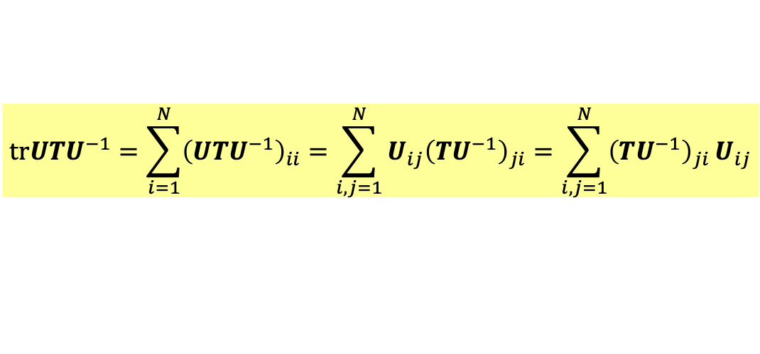


證明：
tr $UTU^{−1}=\text{tr} T$
$$trUTU^{−1}=\sum_{i=1}^{N}{{\left(UTU^{−1}\right)}_{ii}}=\sum_{i,j=1}^{N}{{U_{ij}\left(TU^{−1}\right)}_{ji}}=\sum_{i,j=1}^{N}{{\left(TU^{−1}\right)}_{ji}}U_{ij}$$
$$=trTU^{−1}U=\text{tr} T$$

