Slide 1

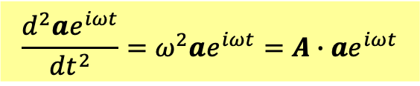
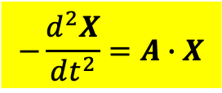
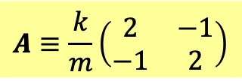

System of 2nd order Linear ODE with constant coefficients
$$−\frac{d^{2}X}{dt^{2}}=A∙X$$
Matrix $A$ is what determines the evolution of the system.
例如耦合振盪
$$A≡\frac{k}{m}\left(\begin{matrix}2 & −1 \\ −1 & 2\end{matrix}\right)$$
複變函數法
$$X=ae^{iωt}$$
$$\frac{d^{2}ae^{iωt}}{dt^{2}}=ω^{2}ae^{iωt}=A∙ae^{iωt}$$
$$A∙a=ω^{2}a$$
這是矩陣的本徵問題：線性代數Linear Algebra的中心問題。

Slide 2

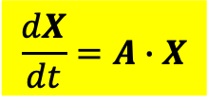

System of 1st order Linear ODE with constant coefficients
$$\frac{dX}{dt}=A∙X$$
Matrix $A$ is what determines the evolution of the system.
複變函數法
$$X=ae^{λt}$$
Identical Eigenvalue problem of matrix
$$A∙a=λa$$

Slide 3
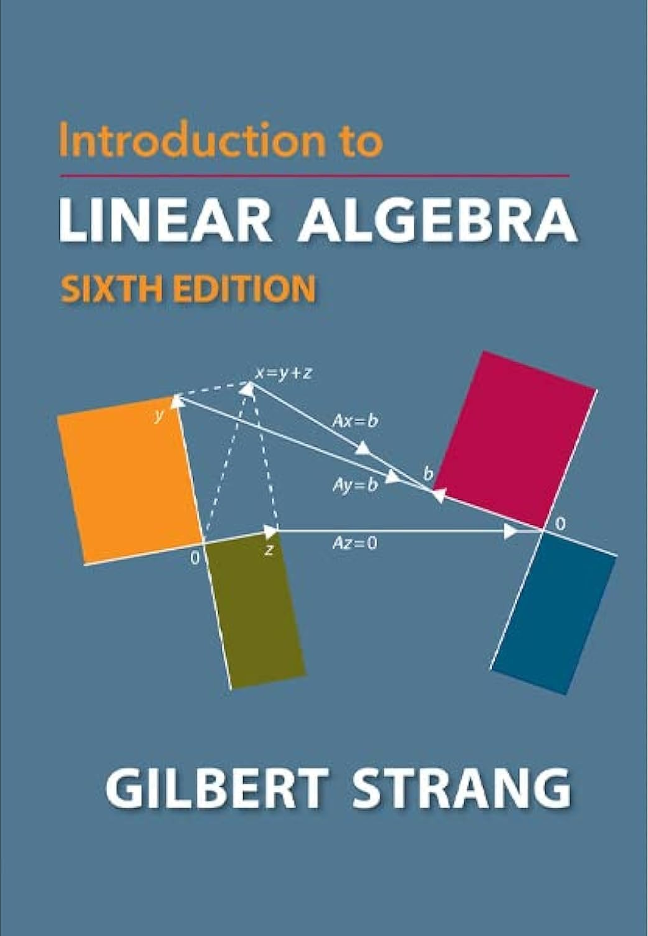

Slide 4
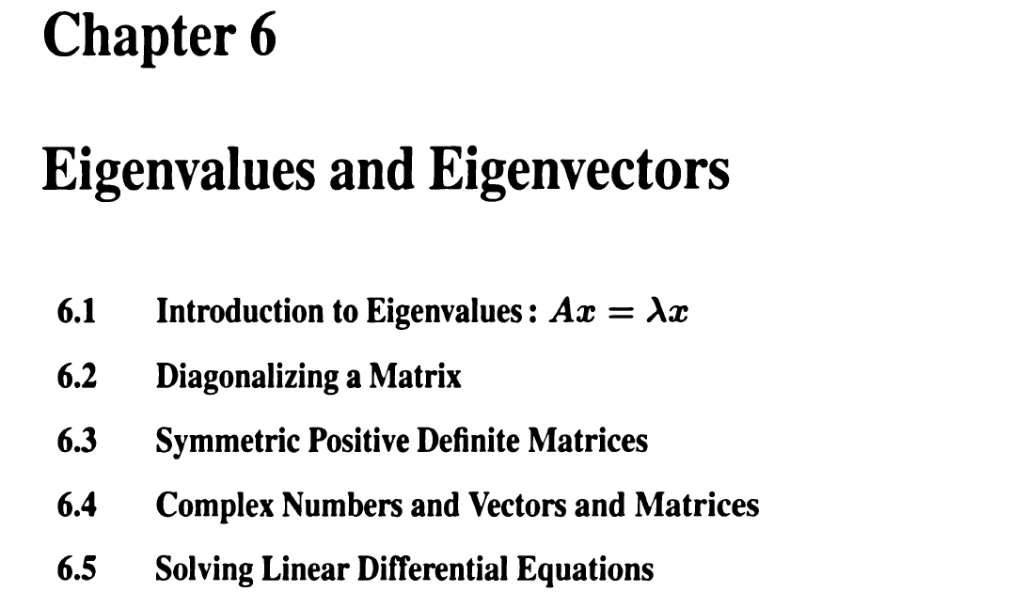
行向量與矩陣的本徵值問題

Slide 5







向量或行向量 vector or column vector
$$a≡\left(\begin{matrix}a_{1} \\ a_{2}\end{matrix}\right)$$
兩個數($→N$個數，實數或複數)：$a_{i}, i=1,2$，組成的一組數學量。
空間向量就是例子，但行向量不一定是空間向量，可以是彈簧組的位移。
可以是電子自旋的狀態！
But like 3D vectors, Vectors can be multiplied by a number, and two vectors can add up.
Linear combinations of vectors are still vectors. Vector space is also called linear space.
$$a≡\left(\begin{matrix}a_{1} \\ a_{2}\end{matrix}\right)$$
$$b≡\left(\begin{matrix}b_{1} \\ b_{2}\end{matrix}\right)$$
$$v=c_{1}a+c_{2}b$$
線性組合或線性疊加
$$\left[\begin{matrix}0.6 \\ 0.4\end{matrix}\right]+2.0∙\left[\begin{matrix}0.1 \\ −0.1\end{matrix}\right]=\left[\begin{matrix}0.8 \\ 0.2\end{matrix}\right]$$
If the components of two vectors are proportional, we say they are in the same direction.
$$a=cb$$
$\left[\begin{matrix}0.8 \\ 0.2\end{matrix}\right]$ and $\left[\begin{matrix}0.4 \\ 0.1\end{matrix}\right]$ are in the same direction.

Slide 6




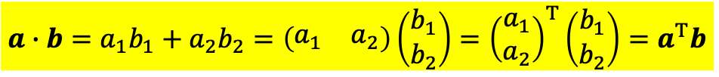
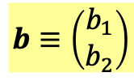


$$a≡\left(\begin{matrix}a_{1} \\ a_{2}\end{matrix}\right)$$
$$b≡\left(\begin{matrix}b_{1} \\ b_{2}\end{matrix}\right)$$
向量vector可以定義長度：
$$\left|a\right|=\sqrt{a_{1}^{2}+a_{1}^{2}}$$
從此延伸，可以定義兩個向量的內積inner product：
$$a∙b=a_{1}b_{1}+a_{2}b_{2}$$
$$\left|a\right|=\sqrt{a∙a}$$
行向量的transpose(轉置)稱為列row向量：
$$a^{T}≡{\left(\begin{matrix}a_{1} \\ a_{2}\end{matrix}\right)}^{T}=\left(\begin{matrix}a_{1} & a_{2}\end{matrix}\right)$$
內積可以用行向量與列向量的矩陣乘積來寫：
$$a∙b=a_{1}b_{1}+a_{2}b_{2}=\left(\begin{matrix}a_{1} & a_{2}\end{matrix}\right)\left(\begin{matrix}b_{1} \\ b_{2}\end{matrix}\right)={\left(\begin{matrix}a_{1} \\ a_{2}\end{matrix}\right)}^{T}\left(\begin{matrix}b_{1} \\ b_{2}\end{matrix}\right)=a^{T}b$$
兩個向量的內積為零，這兩個向量就彼此正交perpendicular：
$$a^{T}b=0$$

Slide 7
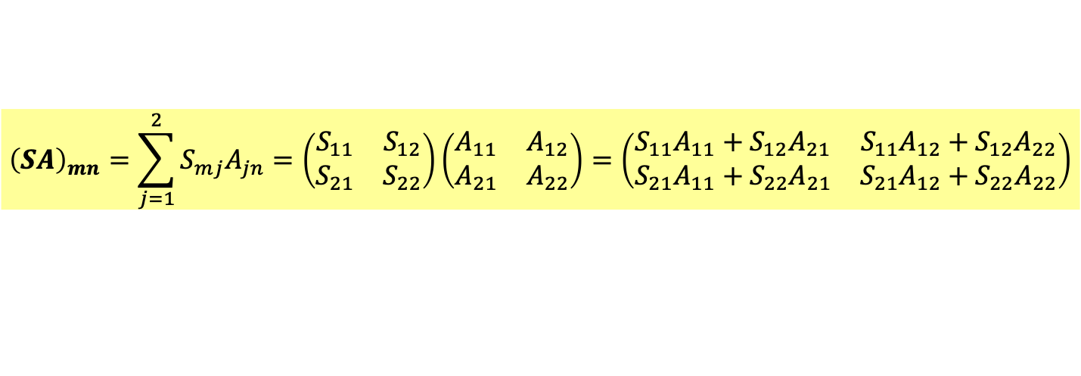
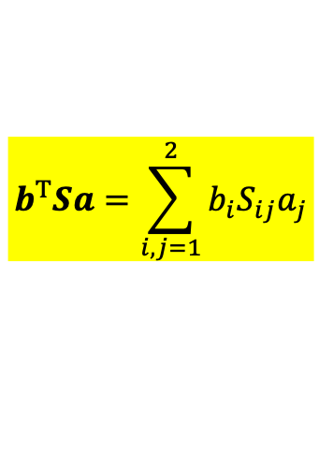
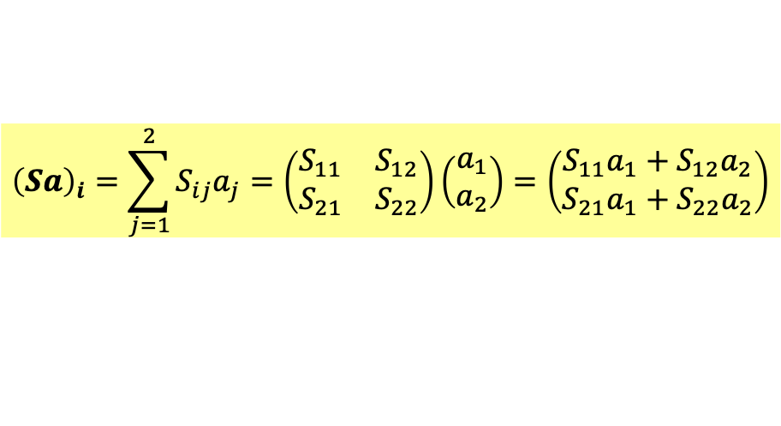
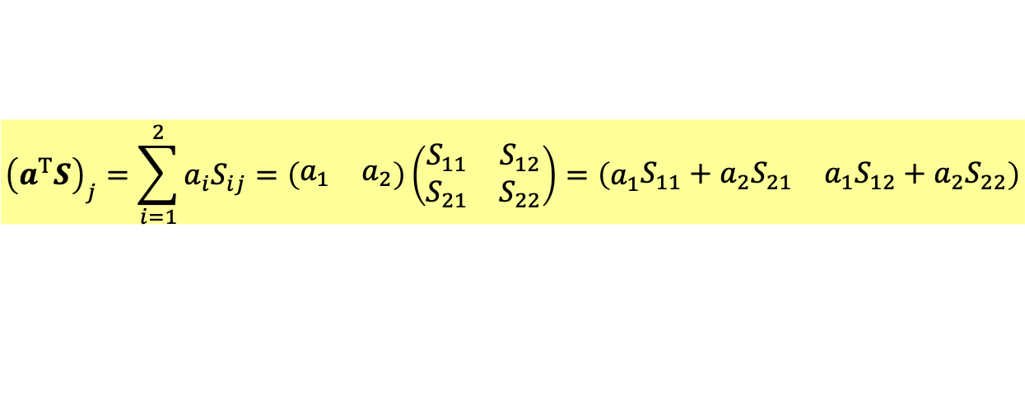

$2×2$ Matrix矩陣是兩組行向量(4個實數或複數)：$a_{ij}, i,j=1,2$，組成的數學量。
$$S=\left(\begin{matrix}S_{11} & S_{12} \\ S_{21} & S_{22}\end{matrix}\right)$$
也可以看成是兩組列向量。兩種看法都有用。
矩陣乘行向量得一行向量：
$${\left(Sa\right)}_{i}=\sum_{j=1}^{2}{S_{ij}a_{j}}=\left(\begin{matrix}S_{11} & S_{12} \\ S_{21} & S_{22}\end{matrix}\right)\left(\begin{matrix}a_{1} \\ a_{2}\end{matrix}\right)=\left(\begin{matrix}S_{11}a_{1}+S_{12}a_{2} \\ S_{21}a_{1}+S_{22}a_{2}\end{matrix}\right)$$
此規則保證此乘積是線性的
$$S\left(c_{1}a_{1}+c_{2}a_{2}\right)=c_{1}Sa_{1}+c_{2}Sa_{2}$$
列向量乘矩陣得一列向量：
$${\left(a^{T}S\right)}_{j}=\sum_{i=1}^{2}{a_{i}S_{ij}}=\left(\begin{matrix}a_{1} & a_{2}\end{matrix}\right)\left(\begin{matrix}S_{11} & S_{12} \\ S_{21} & S_{22}\end{matrix}\right)=\left(a_{1}\begin{matrix}S_{11}+{a_{2}S}_{21} & {a_{1}S}_{12}+a_{2}S_{22}\end{matrix}\right)$$
矩陣乘矩陣還是矩陣：
$${\left(SA\right)}_{mn}=\sum_{j=1}^{2}{S_{mj}A_{jn}}=\left(\begin{matrix}S_{11} & S_{12} \\ S_{21} & S_{22}\end{matrix}\right)\left(\begin{matrix}A_{11} & A_{12} \\ A_{21} & A_{22}\end{matrix}\right)=\left(\begin{matrix}S_{11}A_{11}+S_{12}A_{21} & S_{11}A_{12}+S_{12}A_{22} \\ S_{21}A_{11}+S_{22}A_{21} & S_{21}A_{12}+S_{22}A_{22}\end{matrix}\right)$$
列向量乘矩陣乘行向量，等於列向量乘行向量，得到一個數：
$$b^{T}Sa=\sum_{i,j=1}^{2}{b_{i}S_{ij}a_{j}}$$
Arfken p96-99

Slide 8
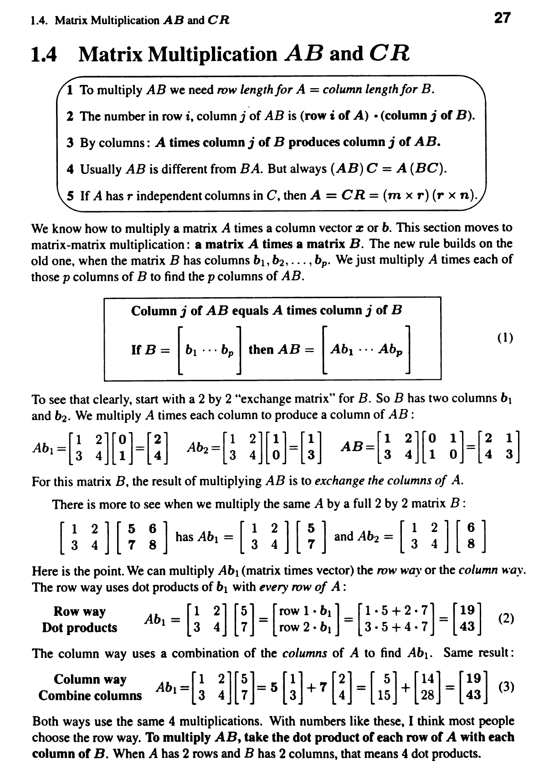

Slide 9
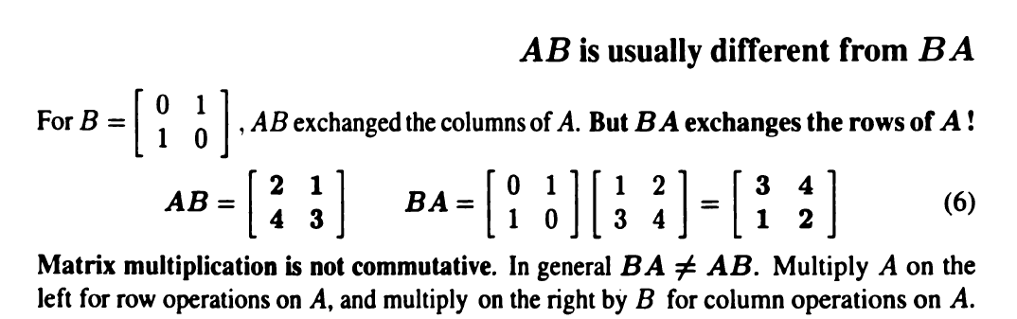
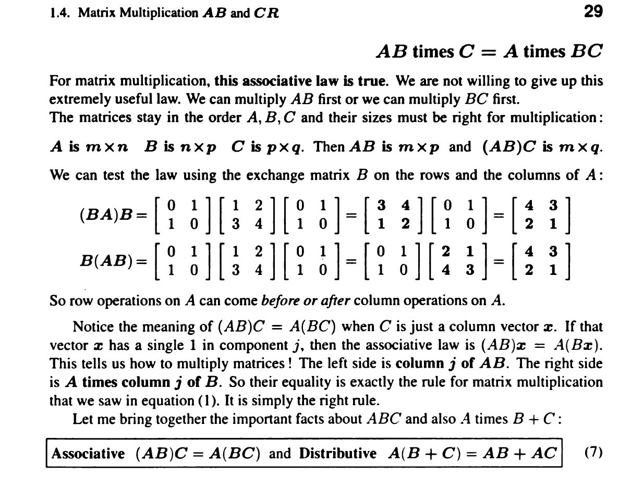

Slide 10



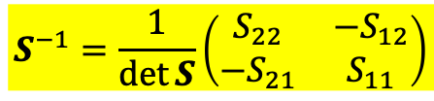







Inverse matrix
$$S^{−1}=\frac{1}{\det{S}}\left(\begin{matrix}S_{22} & −S_{12} \\ −S_{21} & S_{11}\end{matrix}\right)$$
Transpose of matrix $A$
$$A=\left(\begin{matrix}2 & 8 \\ 4 & 9\end{matrix}\right)$$
$$A^{T}=\left(\begin{matrix}2 & 4 \\ 8 & 9\end{matrix}\right)$$
$$A_{ij}^{T}=A_{ji}$$
例如
$$A_{12}^{T}=A_{21}$$
Symmetric Matrix
$$A=\left(\begin{matrix}2 & 8 \\ 4 & 9\end{matrix}\right)$$
$$A^{T}=\left(\begin{matrix}2 & 4 \\ 8 & 9\end{matrix}\right)$$
Not symmetric
$$S=\left(\begin{matrix}2 & 4 \\ 4 & 9\end{matrix}\right)=S^{T}=\left(\begin{matrix}2 & 4 \\ 4 & 9\end{matrix}\right)$$
Symmetric
$$S_{ij}=S_{ij}^{T}=S_{ji}$$
例如
$$S_{12}=S_{12}^{T}=S_{21}$$
Arfken p99, 104-107

Slide 11

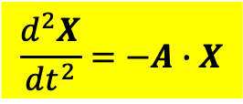

System of 2nd order Linear ODE with constant coefficients
$$\frac{d^{2}X}{dt^{2}}=−A∙X$$
Matrix $A$ is what determines the evolution of the system.
複變函數法
$$X=ae^{iωt}$$
Eigenvalue problem of matrix
$$A∙a=ω^{2}a$$
這是線性代數Linear Algebra的中心問題。

Slide 12




Eigenvalue problem of matrix
$$A∙a=λa$$
這代表矩陣$A$乘在行向量$a$，與一常數乘法沒有差異，並未改變$a$的方向。
任一矩陣$A$有特定的行向量$a$，及對應的常數$λ$滿足上式。
行向量$a$稱為矩陣$A$的本徵向量eigenvector，常數$λ$稱為本徵值eigenvalue。
For example, take $A$ as a $2×2$ matrix.
$$A=\left(\begin{matrix}0.8 & 0.3 \\ 0.2 & 0.7\end{matrix}\right)$$
In general, $A$ times a vector will produce another vector not in the same direction.
$$A\left(\begin{matrix}0.8 \\ 0.2\end{matrix}\right)=\left(\begin{matrix}0.8 & 0.3 \\ 0.2 & 0.7\end{matrix}\right)∙\left(\begin{matrix}0.8 \\ 0.2\end{matrix}\right)=\left(\begin{matrix}0.7 \\ 0.3\end{matrix}\right)≠c∙\left(\begin{matrix}0.8 \\ 0.2\end{matrix}\right)$$
But there are two special vectors that matrix multiplication is just a number product.
For them, $A$ times the vector will produce a vector in the same direction.

Slide 13







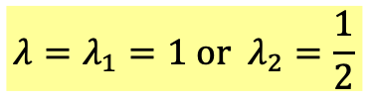
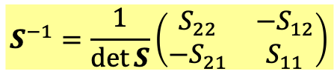
$A$ times the eigenvector will produce a vector in the same direction.
Solving eigenvalue problem of matrix
$$A∙a=λa$$
$$\left(A−λI\right)∙a=0$$
$$S^{−1}=\frac{1}{\det{S}}\left(\begin{matrix}S_{22} & −S_{12} \\ −S_{21} & S_{11}\end{matrix}\right)$$
$A−λI$ is also a matrix. If it has an inverse, the vector $a$ can only be zero:
$$a={\left(A−λI\right)}^{−1}∙0=0$$
For $λ$ to be an eigenvalue, the condition is $A−λI$ has no inverse
and hence the determinant of $A−λI$ is zero.
det $\left(A−λI\right)=0$
$$A=\left(\begin{matrix}0.8 & 0.3 \\ 0.2 & 0.7\end{matrix}\right)$$
det $\left(A−λI\right)=\text{det}\left(\begin{matrix}0.8−λ & 0.3 \\ 0.2 & 0.7−λ\end{matrix}\right)=λ^{2}−\frac{3}{2}λ+\frac{1}{2}=\left(λ−1\right)\left(λ−\frac{1}{2}\right)=0$
$$λ=λ_{1}=1 or λ_{2}=\frac{1}{2}$$
are eigenvalues of $\left[\begin{matrix}0.8 & 0.3 \\ 0.2 & 0.7\end{matrix}\right]$.

Slide 14





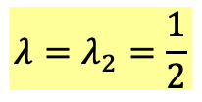


對特定的$λ$，我們可以解出對應的$a_{1},a_{2}$
$$λ=λ_{1}=1$$
$$a_{1}≡\left(\begin{matrix}a_{11} \\ a_{21}\end{matrix}\right)$$
$$\left(A−λI\right)∙a_{1}=\left(\begin{matrix}0.8−1 & 0.3 \\ 0.2 & 0.7−1\end{matrix}\right)∙\left(\begin{matrix}a_{11} \\ a_{21}\end{matrix}\right)=\left(\begin{matrix}−0.2 & 0.3 \\ 0.2 & −0.3\end{matrix}\right)\left(\begin{matrix}a_{11} \\ a_{21}\end{matrix}\right)=0$$
$$0.2a_{11}=0.3a_{21}$$
Eigenvector has one undetermined constant.
$$a_{1}=c_{1}\left(\begin{matrix}0.6 \\ 0.4\end{matrix}\right)$$
同理：
$$λ=λ_{2}=\frac{1}{2}$$
$$\left(A−λI\right)∙a_{2}=\left(\begin{matrix}0.8−0.5 & 0.3 \\ 0.2 & 0.7−0.5\end{matrix}\right)∙\left(\begin{matrix}a_{12} \\ a_{22}\end{matrix}\right)=\left(\begin{matrix}0.3 & 0.3 \\ 0.2 & 0.2\end{matrix}\right)\left(\begin{matrix}a_{11} \\ a_{21}\end{matrix}\right)=0$$
$$0.3a_{12}=−0.3a_{22}$$
$$a_{2}=c_{2}\left(\begin{matrix}1 \\ −1\end{matrix}\right)$$

Slide 15
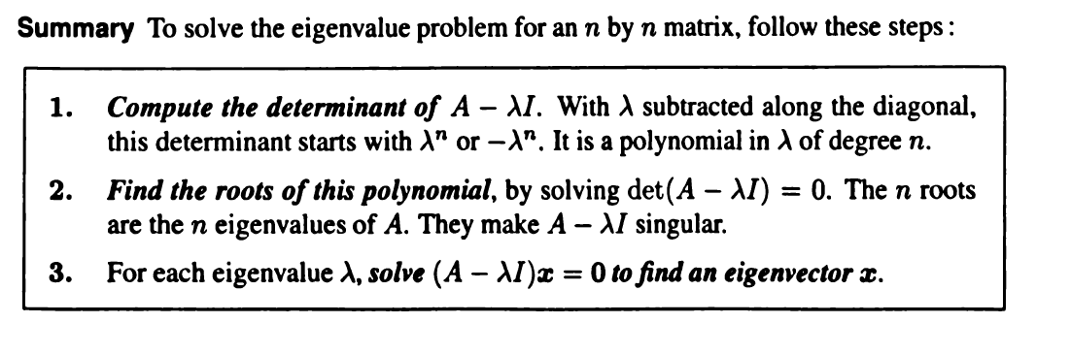

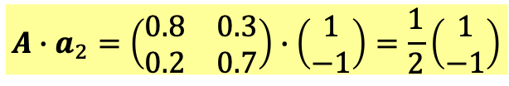
$A$ times the eigenvector will produce a vector in the same direction.
$$A∙a_{1}=\left(\begin{matrix}0.8 & 0.3 \\ 0.2 & 0.7\end{matrix}\right)∙\left(\begin{matrix}0.6 \\ 0.4\end{matrix}\right)=1\left(\begin{matrix}0.6 \\ 0.4\end{matrix}\right)$$
$$A∙a_{2}=\left(\begin{matrix}0.8 & 0.3 \\ 0.2 & 0.7\end{matrix}\right)∙\left(\begin{matrix}1 \\ −1\end{matrix}\right)=\frac{1}{2}\left(\begin{matrix}1 \\ −1\end{matrix}\right)$$
For the two special eigenvectors, matrix multiplication is just a number product.

Slide 16







Solving eigenvalue problem of matrix
我們再試一個矩陣，這次是一對稱矩陣！
$$S=\left(\begin{matrix}9 & 3 \\ 3 & 1\end{matrix}\right)$$
$$S∙u=λu$$
$$\left(S−λI\right)∙u=0$$
If it has an inverse, the vector $u$ can only be zero:
$$u={\left(S−λI\right)}^{−1}∙0=0$$
For $λ$ to be an eigenvalue, the condition is $S−λI$ has no inverse
and hence the determinant of $S−λI$ is zero.
det $\left(S−λI\right)=0$
det $\left(S−λI\right)=\text{det}\left[\begin{matrix}9−λ & 3 \\ 3 & 1−λ\end{matrix}\right]=λ^{2}−10λ=λ\left(λ−10\right)=0$
$$λ=λ_{1}=0 or λ_{2}=10$$
are eigenvalues.

Slide 17









對特定的$λ$，我們可以解出對應的$u_{1},u_{2}$
$$λ=λ_{1}=0$$
$$u_{1}≡\left(\begin{matrix}u_{11} \\ u_{21}\end{matrix}\right)$$
$$\left(S−λI\right)∙u_{1}=\left(\begin{matrix}9 & 3 \\ 3 & 1\end{matrix}\right)∙\left(\begin{matrix}u_{11} \\ u_{21}\end{matrix}\right)=0$$
$$3u_{11}=−u_{21}$$
Eigenvector has one undetermined constant.
$$u_{1}=c_{1}\left(\begin{matrix}1 \\ −3\end{matrix}\right)$$
同理：
$$λ=λ_{2}=10$$
$$\left(S−λI\right)∙u_{2}=\left(\begin{matrix}9−10 & 3 \\ 3 & 1−10\end{matrix}\right)∙\left(\begin{matrix}u_{12} \\ u_{22}\end{matrix}\right)=\left(\begin{matrix}−1 & 3 \\ 3 & −9\end{matrix}\right)\left(\begin{matrix}u_{12} \\ u_{22}\end{matrix}\right)=0$$
$$u_{12}=3u_{22}$$
$$u_{2}=c_{2}\left(\begin{matrix}3 \\ 1\end{matrix}\right)$$

Slide 18
There are two beautiful theorems that illustrate the utility of eigenvectors

Slide 19


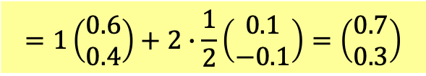



Theorem: The eigenvectors $a$ of $A$ are also eigenvectors of $A^{n}$ with the eigenvalue $λ^{n}$.
$$A∙a=λa$$
$$A^{n}∙a=λ^{n}a$$
Theorem: All vectors can be written as the linear combination of $a_{1}$ and $a_{2}$.
$$X=c_{1}a_{1}+c_{2}a_{2}$$
Then the action of $A$ and $A^{n}$ on any vector can be easily written down:
$$AX=c_{1}Aa_{1}+c_{2}Aa_{2}=c_{1}λ_{1}a_{1}+c_{2}λ_{2}a_{2}$$
The information in the eigenvectors alone of a specific matrix can represent the matrix!
一個矩陣的本徵值與本徵向量就足夠能代表該矩陣。
$$X=\left(\begin{matrix}0.8 \\ 0.2\end{matrix}\right)=\left(\begin{matrix}0.6 \\ 0.4\end{matrix}\right)+2\left(\begin{matrix}0.1 \\ −0.1\end{matrix}\right)$$
一行向量可以寫成本徵向量的線性組合
$$AX=\left(\begin{matrix}0.8 & 0.3 \\ 0.2 & 0.7\end{matrix}\right)∙\left(\begin{matrix}0.8 \\ 0.2\end{matrix}\right)=A∙\left(\begin{matrix}0.6 \\ 0.4\end{matrix}\right)+2A∙\left(\begin{matrix}0.1 \\ −0.1\end{matrix}\right)$$
$$=1\left(\begin{matrix}0.6 \\ 0.4\end{matrix}\right)+2∙\frac{1}{2}\left(\begin{matrix}0.1 \\ −0.1\end{matrix}\right)=\left(\begin{matrix}0.7 \\ 0.3\end{matrix}\right)$$

Slide 20
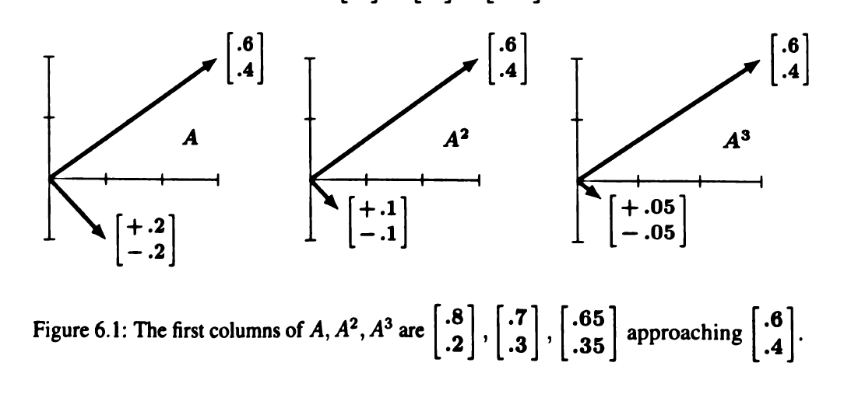
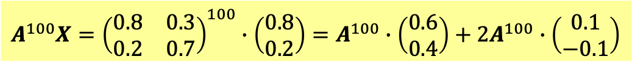
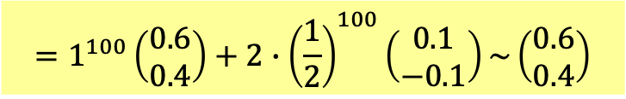

更厲害的是：
$$A^{n}X=c_{1}A^{n}a_{1}+c_{2}A^{n}a_{2}=c_{1}λ_{1}^{n}a_{1}+c_{2}λ_{2}^{n}a_{2}$$
$$X=\left(\begin{matrix}0.8 \\ 0.2\end{matrix}\right)=\left(\begin{matrix}0.6 \\ 0.4\end{matrix}\right)+2\left(\begin{matrix}0.1 \\ −0.1\end{matrix}\right)$$
$$A^{100}X={\left(\begin{matrix}0.8 & 0.3 \\ 0.2 & 0.7\end{matrix}\right)}^{100}∙\left(\begin{matrix}0.8 \\ 0.2\end{matrix}\right)=A^{100}∙\left(\begin{matrix}0.6 \\ 0.4\end{matrix}\right)+2A^{100}∙\left(\begin{matrix}0.1 \\ −0.1\end{matrix}\right)$$
$$=1^{100}\left(\begin{matrix}0.6 \\ 0.4\end{matrix}\right)+2∙{\left(\frac{1}{2}\right)}^{100}\left(\begin{matrix}0.1 \\ −0.1\end{matrix}\right)\sim \left(\begin{matrix}0.6 \\ 0.4\end{matrix}\right)$$
This matrix is called a Markov matrix, with an eigenvalue $=1$, the other $<1$.
The repeated action of a Markov matrix will push any vector into the eigenvector with $λ=1$.

Slide 21
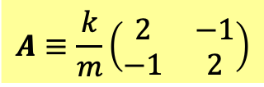
System of 2nd order Linear ODE with constant coefficients
$$−\frac{d^{2}X}{dt^{2}}=A∙X$$
Matrix $A$ is what determines the evolution of the system.
例如耦合振盪
$$A≡\frac{k}{m}\left(\begin{matrix}2 & −1 \\ −1 & 2\end{matrix}\right)$$
複變函數法
$$X=ae^{iωt}$$
$$\frac{d^{2}ae^{iωt}}{dt^{2}}=ω^{2}ae^{iωt}=A∙ae^{iωt}$$
$$A∙a=ω^{2}a$$
這是矩陣的本徵值問題：線性代數Linear Algebra的中心問題。

Slide 22




利用本徵向量，線性微分方程組很容易求解：
With the eigenvectors and eigenvalues, we can solve the ODE system.
$$A∙a=ω^{2}a＝λa$$
$$ω_{i}^{2}=λ_{i}$$
$a_{i}$是對應的本徵向量。
例如：
$$X=Re C_{1}a_{1}e^{i\sqrt{λ_{1}}t}=c_{1}a_{1}cos\left(\sqrt{λ_{1}}t+φ_{1}\right)$$
加上另一解：
$$X=c_{1}a_{1}cos\left(\sqrt{λ_{1}}t+φ_{1}\right){+}c_{2}a_{2}cos\left(\sqrt{λ_{2}}t+φ_{2}\right)$$
The four initial conditions $X\left(0\right),X′\left(0\right)$ will determine four constants $c_{1,2},φ_{1,2}$.

Slide 23





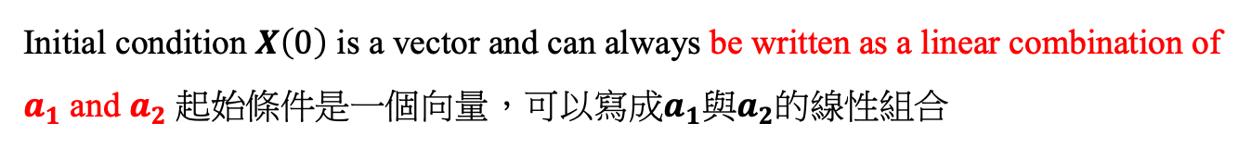
For simplicity, set
$$X^{′\left(0\right)}=0, hence φ_{1}=φ_{2}=0.$$
Initial condition $X\left(0\right)$ is a vector and can always be written as a linear combination of $a_{1}$ and $a_{2}$ 起始條件是一個向量，可以寫成$a_{1}$與$a_{2}$的線性組合
$$X\left(0\right)=c_{1}a_{1}+c_{2}a_{2}$$
如此就決定了constants $c_{1,2}$，接下來時間演化：
$$X\left(t\right)=c_{1}a_{1}cos\sqrt{λ_{1}}t{+}c_{2}a_{2}cos\sqrt{λ_{2}}t$$
這個解，可以理解為 $a_{1}$與$a_{2}$這兩個成分，各自以簡諧運動隨時間演化發展。
如果起始時$X\left(0\right)∝a_{1}$，彈簧組就會以$\sqrt{λ_{1}}$為角頻率作純粹簡諧運動。
$$\sim a_{1}cos\sqrt{λ_{1}}t$$
起始時$X\left(0\right)∝a_{2}$，彈簧組就會以$\sqrt{λ_{2}}$為角頻率作純粹簡諧運動。
$$\sim a_{2}cos\sqrt{λ_{2}}t$$
如果起始時兩種成分都有，兩種模式可以分別作純粹簡諧運動演化後再疊加：
$$X\left(t\right)=c_{1}a_{1}cos\sqrt{λ_{1}}t{+}c_{2}a_{2}cos\sqrt{λ_{2}}t$$
這兩種特定模式的簡諧運動好像是獨立的！

Slide 24


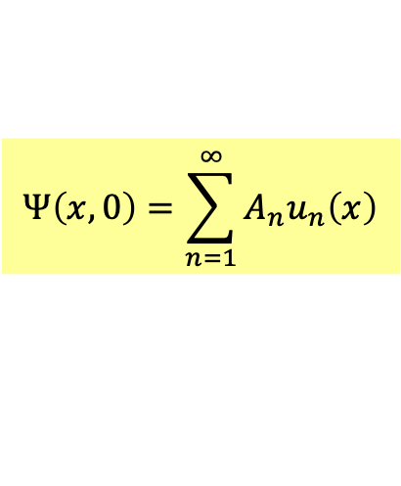
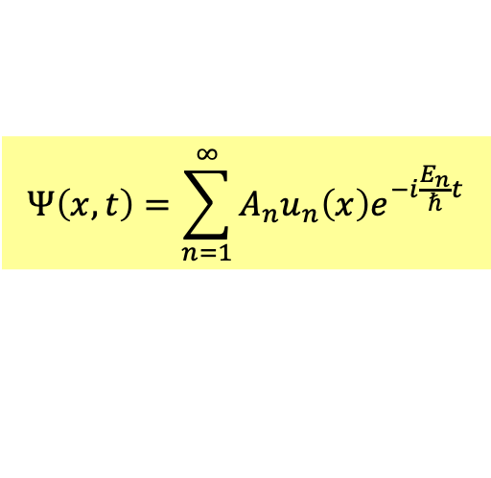

位能下薛丁格方程式的普遍解法：
首先， 位能下薛丁格方程式會有一系列的定態解：
$$Ψ_{n}\left(x,t\right)=u_{n}\left(x\right)∙e^{−i\frac{E_{n}}{ℏ}t}$$
定態解就是時間部分與空間可以分離的解！
將$t=0$時的波函數，即起始條件，對定態解$u_{n}$展開如下：
$$Ψ\left(x,0\right)=\sum_{n=1}^{∞}{A_{n}u_{n}\left(x\right)}$$
$$u_{n}=C\sin\left(\frac{nπ}{a}x\right)$$
這就是傅立葉分析！
$t=0$時此狀態可以視為定態的如上疊加，
而接下來定態隨時間的演化，就是在$u_{n}$上乘$e^{−i\frac{E_{n}}{ℏ}t}$，這滿足位能薛丁格方程式。
乘完之後依同樣方式疊加，整個波函數也就滿足薛丁格方程式。
$$Ψ\left(x,t\right)=\sum_{n=1}^{∞}{A_{n}u_{n}\left(x\right)e^{−i\frac{E_{n}}{ℏ}t}}$$
我們已經在自由薛丁格方程式用了這樣的策略！當時的正弦波就是定態。
這個程序原則上適用於任何位能。

Slide 25




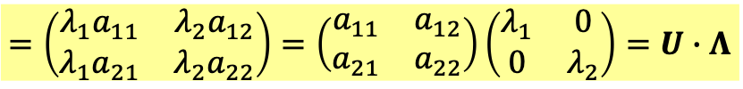





Diagonalizing a matrix 對角化
$$A∙a_{1}=λ_{1}a_{1}$$
$$A∙a_{2}=λ_{2}a_{2}$$
$a_{1},a_{2}$ are column vectors and we can use them to form a matrix.
$$U≡\left(\begin{matrix}a_{1} & a_{2}\end{matrix}\right)=\left(\begin{matrix}\left(\begin{matrix}a_{11} \\ a_{21}\end{matrix}\right) & \left(\begin{matrix}a_{12} \\ a_{22}\end{matrix}\right)\end{matrix}\right)=\left(\begin{matrix}a_{11} & a_{12} \\ a_{21} & a_{22}\end{matrix}\right)$$
$$AU=\left(\begin{matrix}A_{11} & A_{12} \\ A_{21} & A_{22}\end{matrix}\right)\left(\begin{matrix}\left(\begin{matrix}a_{11} \\ a_{21}\end{matrix}\right) & \left(\begin{matrix}a_{12} \\ a_{22}\end{matrix}\right)\end{matrix}\right)=\left(A\begin{matrix}\left(\begin{matrix}a_{11} \\ a_{21}\end{matrix}\right) & A\left(\begin{matrix}a_{12} \\ a_{22}\end{matrix}\right)\end{matrix}\right)$$
$$=\left(\begin{matrix}{λ_{1}a}_{11} & λ_{2}a_{12} \\ λ_{1}a_{21} & λ_{2}a_{22}\end{matrix}\right)=\left(\begin{matrix}a_{11} & a_{12} \\ a_{21} & a_{22}\end{matrix}\right)\left(\begin{matrix}λ_{1} & 0 \\ 0 & λ_{2}\end{matrix}\right)=U∙Λ$$
$$AU=UΛ$$
兩邊乘$U$的反矩陣$U^{−1}$：
$$U^{−1}∙A∙U=Λ=\left(\begin{matrix}λ_{1} & 0 \\ 0 & λ_{2}\end{matrix}\right)$$
is diagonal with eigenvalues as diagonal elements.
$U^{−1}AU$是一個對角矩陣，矩陣元素就是本徵值！
$$A=UΛU^{−1}=U\left(\begin{matrix}λ_{1} & 0 \\ 0 & λ_{2}\end{matrix}\right)U^{−1}$$
Any Matrix can be decomposed into 3 factors,
involving just eigenvalues and eigenvectors.
Info. of eigenvalues
Info. of eigenvectors
$$\left[\begin{matrix}0.8 & 0.3 \\ 0.2 & 0.7\end{matrix}\right]=\left[\begin{matrix}0.6 & 1 \\ 0.4 & −1\end{matrix}\right]\left[\begin{matrix}1 & 0 \\ 0 & 0.5\end{matrix}\right]\left[\begin{matrix}1 & 1 \\ 0.4 & −0.6\end{matrix}\right]$$
一個矩陣的本徵值與本徵向量就足夠能代表該矩陣。

Slide 26
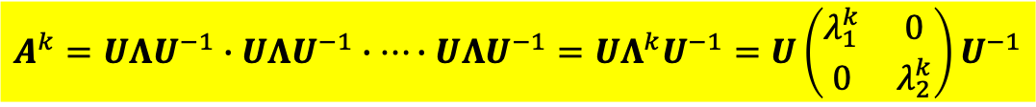

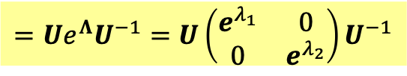
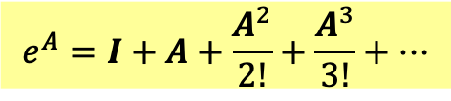
$$A=UΛU^{−1}$$
This formula is useful for the following calculation!
$$A^{k}=UΛU^{−1}∙UΛU^{−1}∙⋯∙UΛU^{−1}=UΛ^{k}U^{−1}=U\left(\begin{matrix}λ_{1}^{k} & 0 \\ 0 & λ_{2}^{k}\end{matrix}\right)U^{−1}$$
矩陣的指數函數很容易定義與計算。
$$e^{A}=I+A+\frac{A^{2}}{2!}+\frac{A^{3}}{3!}+⋯$$
$$e^{A}=I+UΛU^{−1}+\frac{UΛ^{1}U^{−1}}{2!}+\frac{UΛ^{2}U^{−1}}{3!}+⋯=U\left(I+Λ+\frac{Λ^{2}}{2!}+\frac{Λ^{3}}{3!}+⋯\right)U^{−1}$$
$$=Ue^{Λ}U^{−1}=U\left(\begin{matrix}e^{λ_{1}} & 0 \\ 0 & e^{λ_{2}}\end{matrix}\right)U^{−1}$$

Slide 27

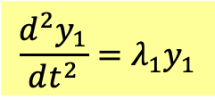

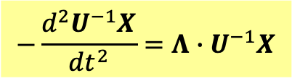
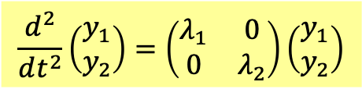
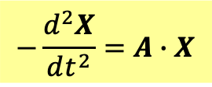

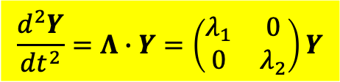
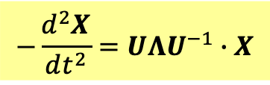




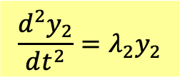
利用對角化後的矩陣，線性微分方程組很容易求解：
$$−\frac{d^{2}X}{dt^{2}}=A∙X$$
$$A=UΛU^{−1}$$
$$−\frac{d^{2}X}{dt^{2}}=UΛU^{−1}∙X$$
$$−\frac{d^{2}U^{−1}X}{dt^{2}}=Λ∙U^{−1}X$$
$$Λ=\left(\begin{matrix}λ_{1} & 0 \\ 0 & λ_{2}\end{matrix}\right)$$
兩邊乘$U^{−1}$
選擇Generalized Coordinates 廣義座標$y_{1},y_{2}$
$$Y=\left(\begin{matrix}y_{1} \\ y_{2}\end{matrix}\right)=U^{−1}X$$
他們滿足的微分方程非常簡單：
$$\frac{d^{2}Y}{dt^{2}}=Λ∙Y=\left(\begin{matrix}λ_{1} & 0 \\ 0 & λ_{2}\end{matrix}\right)Y$$
$$\frac{d^{2}}{dt^{2}}\left(\begin{matrix}y_{1} \\ y_{2}\end{matrix}\right)=\left(\begin{matrix}λ_{1} & 0 \\ 0 & λ_{2}\end{matrix}\right)\left(\begin{matrix}y_{1} \\ y_{2}\end{matrix}\right)$$
$$\frac{d^{2}y_{1}}{dt^{2}}=λ_{1}y_{1}$$
$$\frac{d^{2}y_{2}}{dt^{2}}=λ_{2}y_{2}$$
負責廣義座標的時間演化的矩陣是對角，因此無耦合，此廣義座標彼此獨立。
這樣的廣義座標$y_{1},y_{2}$稱為Normal Coordinates，獨立作簡諧運動！
$$y_{1}=c_{1}cos\left(\sqrt{λ_{1}}t+φ_{1}\right)$$
$$y_{2}=c_{2}cos\left(\sqrt{λ_{2}}t+φ_{2}\right)$$

Slide 28
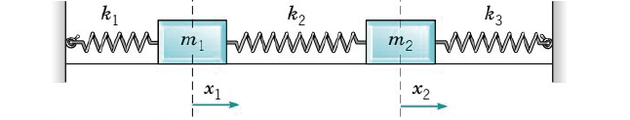

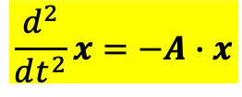

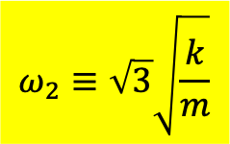

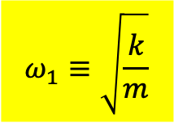

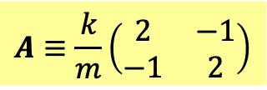

以耦合振盪為例：
$$\frac{d^{2}}{dt^{2}}x=−A∙x$$
$$A≡\frac{k}{m}\left(\begin{matrix}2 & −1 \\ −1 & 2\end{matrix}\right)$$
$$x≡\left(\begin{matrix}x_{1} \\ x_{2}\end{matrix}\right)=\left(\begin{matrix}a_{1} \\ a_{2}\end{matrix}\right)e^{iωt}$$
$$A∙a=ω^{2}a$$
本徵值有兩個，各自對應一本徵向量。
$$ω_{1}≡\sqrt{\frac{k}{m}}$$
$$\left(\begin{matrix}a_{1} \\ a_{2}\end{matrix}\right)=C_{1}\left(\begin{matrix}1 \\ 1\end{matrix}\right)$$
$$ω_{2}≡\sqrt{3}\sqrt{\frac{k}{m}}$$
$$\left(\begin{matrix}a_{1} \\ a_{2}\end{matrix}\right)=C_{2}\left(\begin{matrix}1 \\ −1\end{matrix}\right)$$
代入前面的解：
$$\left(\begin{matrix}x_{1} \\ x_{2}\end{matrix}\right)=c_{1}\left(\begin{matrix}1 \\ 1\end{matrix}\right)cos{ ω}_{1}t{+}c_{2}\left(\begin{matrix}1 \\ −1\end{matrix}\right)cos ω_{2}t$$

Slide 29
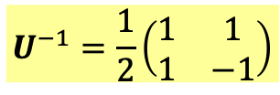
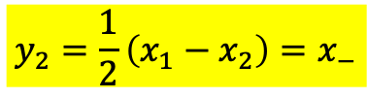

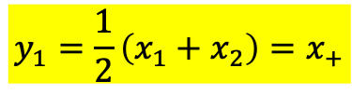
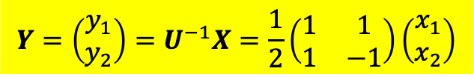
如果用對角化矩陣來思考：
$$U≡\left(\begin{matrix}a_{1} & a_{2}\end{matrix}\right)=\left(\begin{matrix}a_{11} & a_{12} \\ a_{21} & a_{22}\end{matrix}\right)=\left(\begin{matrix}1 & 1 \\ 1 & −1\end{matrix}\right)$$
$$U^{−1}=\frac{1}{2}\left(\begin{matrix}1 & 1 \\ 1 & −1\end{matrix}\right)$$
$$Y=\left(\begin{matrix}y_{1} \\ y_{2}\end{matrix}\right)=U^{−1}X=\frac{1}{2}\left(\begin{matrix}1 & 1 \\ 1 & −1\end{matrix}\right)\left(\begin{matrix}x_{1} \\ x_{2}\end{matrix}\right)$$
這樣的廣義座標$y_{1},y_{2}$稱為Normal Coordinates，獨立作簡諧運動！
$$y_{1}=\frac{1}{2}\left(x_{1}+x_{2}\right)=x_{+}$$
$$y_{2}=\frac{1}{2}\left(x_{1}−x_{2}\right)=x_{−}$$

Slide 30







原則上物體的變形模式有無限多個，但並不是連續分布。
因此可以分離地一個一個編號。
每一個模式，如同簡諧運動，對應一個內在的特定的振動頻率！
不同模式頻率不同。一般來說，頻率越高的模式，越難激發。
物體的所有變形就是以這些模式或它們的疊加來進行！
一個物體有那些振盪模式 Norm以及對應的頻率，就是該物體的一個特徵。

Slide 31




一個矩陣會有實數的本徵值嗎？
定理：一個對稱矩陣的本徵值都是實數，且不同本徵值的本徵向量彼此正交。
All $n$ eigenvalues $λ$ of a symmetric matrix $S$ are real.
The $n$ eigenvectors $u$ can be chosen to be orthogonal.
反例：$\left[\begin{matrix}0.8 & 0.3 \\ 0.2 & 0.7\end{matrix}\right]$.
$$a_{1}=c_{1}\left[\begin{matrix}0.6 \\ 0.4\end{matrix}\right]$$
$$a_{2}=c_{2}\left[\begin{matrix}1 \\ −1\end{matrix}\right]$$
$$a_{1}∙a_{2}≠0$$

Slide 32




All $n$ eigenvalues $λ$ of a symmetric matrix $S$ are real.
Proof:
$$Su=λu$$
Take a inner product of the both sides with the complex conjugate of eigenvector $u^{∗}$.
$$u^{∗T}Su=λu^{∗T}u$$
$u^{∗T}u=u_{1}^{∗}u_{1}+u_{2}^{∗}u_{2}$ is real.
要確認$u^{∗T}Su$是否是實數，取他的Complex conjugate
$${\left(u^{∗T}Su\right)}^{∗}={\left(\sum_{i,j=1}^{2}{u_{i}^{∗}S_{ij}u_{j}}\right)}^{∗}=\sum_{i,j=1}^{2}{u_{i}S_{ij}^{∗}u_{j}^{∗}}=\sum_{i,j=1}^{2}{u_{j}^{∗}}S_{ij}u_{i}=\sum_{i,j=1}^{2}{u_{j}^{∗}}S_{ji}u_{i}=u^{∗T}Su$$
對稱
確認$u^{∗T}Su$是實數，因此$λ$一定是實數。

Slide 33











The $n$ eigenvectors $u$ can be chosen to be orthogonal.
Proof:
Consider two eigenvectors with different eigenvalues:
$$Su_{1}=λ_{1}u_{1}$$
$$Su_{2}=λ_{2}u_{2}$$
將第一式與$u_{2}$作內積，可得：
$$u_{2}^{T}Su_{1}=λ_{1}u_{2}^{T}u_{1}$$
$$u_{2}^{T}Su_{1}={\left(u_{2}^{T}Su_{1}\right)}^{T}=u_{1}^{T}∙S^{T}u_{2}$$
左邊可以寫成:
$$S_{ij}=S_{ji}$$
$$u_{2}^{T}Su_{1}=\sum_{i,j=1}^{2}{u_{2i}S_{ij}u_{1j}}=\sum_{i,j=1}^{2}{u_{1j}S_{ji}u_{2i}}=u_{1}^{T}∙Su_{2}=u_{1}^{T}{λ_{2}u}_{2}=λ_{2}u_{2}^{T}u_{1}$$
得：
$$λ_{1}u_{2}^{T}u_{1}=λ_{2}u_{2}^{T}u_{1}$$
$$0=\left(λ_{1}−λ_{2}\right)u_{2}^{T}u_{1}$$
兩式相減：
右式兩本徵向量的內積必須為零，彼此正交！
$$u_{2}^{T}u_{1}=u_{1}∙u_{2}=0$$
可以選本徵向量的長度都為1，
$$u_{m}^{T}u_{n}=u_{m}∙u_{n}=δ_{mn}$$
本徵向量的正交性

Slide 34











$$S=\left(\begin{matrix}9 & 3 \\ 3 & 1\end{matrix}\right)$$
這就是對稱矩陣。
$$λ=λ_{1}=0$$
$$\left(S−λI\right)∙u_{1}=\left(\begin{matrix}9 & 3 \\ 3 & 1\end{matrix}\right)∙\left(\begin{matrix}a_{11} \\ a_{21}\end{matrix}\right)$$
$$3u_{11}=u_{21}$$
$$u_{1}=c_{1}\left(\begin{matrix}1 \\ 3\end{matrix}\right)$$
可以選常數$c_{1}$使向量長度為1:
$$u_{1}=\frac{1}{\sqrt{10}}\left(\begin{matrix}1 \\ 3\end{matrix}\right)$$
$$λ=λ_{2}=10$$
$$u_{2}=c_{2}\left(\begin{matrix}3 \\ −1\end{matrix}\right)→\frac{1}{\sqrt{10}}\left(\begin{matrix}3 \\ −1\end{matrix}\right)$$
很容易確認這兩個本徵向量是彼此正交。
$$u_{2}^{T}u_{1}=u_{1}∙u_{2}=0$$
$$u_{m}^{T}u_{n}=u_{m}∙u_{n}=δ_{mn}$$
這兩個向量稱為orthonormal.

Slide 35







展開定理
若有兩個orthonormal的向量，任何向量都可展開成他們的線性組合，
且係數很容易寫下！
給定任一向量：$v$，若展開可以如下：
$$v=c_{1}u_{1}+c_{2}u_{2}$$
取向量$v$與本徵向量$u_{1}$的內積：
$$u_{1}^{T}v=u_{1}^{T}\left(c_{1}u_{1}+c_{2}u_{2}\right)=c_{1}u_{1}^{T}u_{1}+c_{2}u_{1}^{T}u_{2}$$
代入正交關係：
$$u_{1}^{T}u_{2}=0$$
$$u_{1}^{T}u_{1}=1$$
$$u_{1}^{T}v=u_{1}∙v=c_{1}$$
同理：
$$u_{2}^{T}v=u_{2}∙v=c_{2}$$

Slide 36




展開定理
給定任一向量：$v$，可以展開如下：
$$v=c_{1}u_{1}+c_{2}u_{2}$$
$$u_{1}^{T}v=u_{1}∙v=c_{1}$$
$$u_{2}^{T}v=u_{2}∙v=c_{2}$$

Slide 37



向量可以用它的分量表示！
把一向量投影在選取的座標軸上即是它的分量！
$$\vec{a}=a_{x}\hat{i}+a_{y}\hat{j}=\left(a_{x},a_{y}\right)$$
分量法
$$a_{x}=\hat{i}∙\vec{a}, a_{y}=\hat{j}∙\vec{a}$$
這兩個orthonormal的本徵向量$u_{1},u_{2}$，類似組成一組座標軸的單位向量$\hat{i},\hat{j}$！

Slide 38










The $n$ eigenvectors $u$ can be chosen to be orthogonal.
Proof:
Consider two eigenvectors with different eigenvalues:
$$Su_{1}=λ_{1}u_{1}$$
$$Su_{2}=λ_{2}u_{2}$$
將第一式與$u_{2}$作內積，可得：
$$u_{2}^{T}Su_{1}=λ_{1}u_{2}^{T}u_{1}$$
將第二式與$u_{1}$作內積，注意內積前後順序可對調，得：
$$u_{1}^{T}Su_{2}=λ_{2}u_{1}^{T}u_{2}=λ_{2}u_{2}^{T}u_{1}$$
兩式相減：
$$u_{2}^{T}Su_{1}−u_{1}^{T}Su_{2}=\left(λ_{1}−λ_{2}\right)u_{2}^{T}u_{1}$$
因$S$是對稱矩陣，左手邊的兩項相等，相減為零！
$$u_{2}^{T}Su_{1}={\left(u_{2}^{T}Su_{1}\right)}^{T}=u_{1}^{T}S^{T}u_{2}=u_{1}^{T}Su_{2}$$
也可以用分量來看：
$$u_{2}^{T}Su_{1}=\sum_{i,j=1}^{2}{u_{2i}S_{ij}u_{1j}}=\sum_{i,j=1}^{2}{u_{2i}}S_{ji}u_{1j}=\sum_{i,j=1}^{2}{u_{1j}S_{ji}u_{2i}}=u_{1}^{T}Su_{2}$$
右式兩本徵向量的內積必須為零，彼此正交！
$$u_{2}^{T}u_{1}=0$$
$$u_{m}^{T}u_{n}=δ_{mn}$$
本徵向量的正交性

