Slide 1
單體的運動方程式
Ordinary Differential Equation
多體且彼此耦合的運動方程式
System of ODE
Matrix and Linear Algebra
Eigenvalue problem of Matrix
連續及大量極限
連續介質的波方程式
Partial Differential Equation

Slide 2
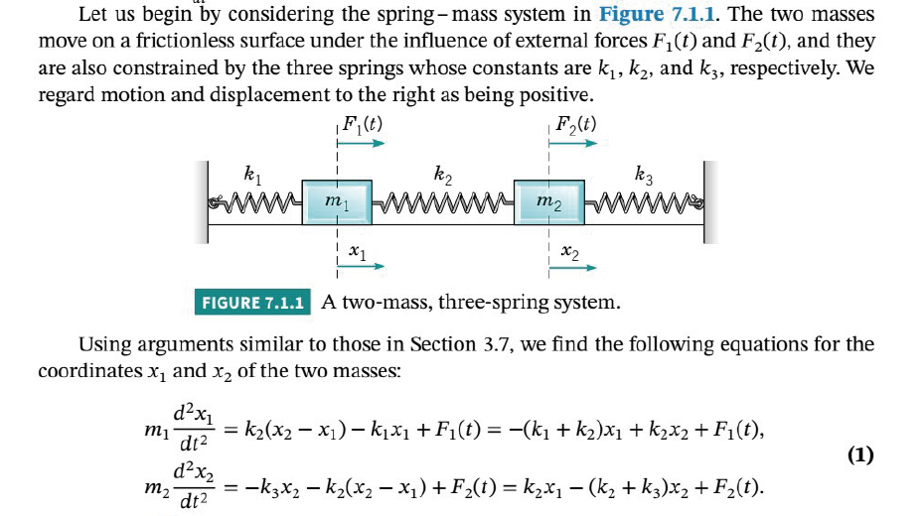
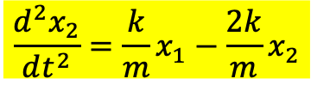
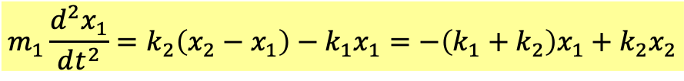
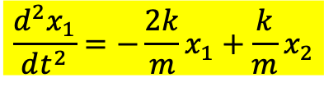
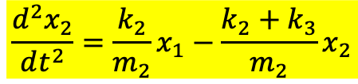
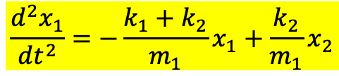

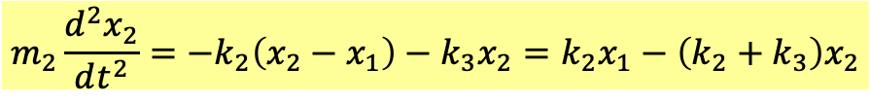

耦合振盪 coupled oscillation
$$m_{1}\frac{d^{2}x_{1}}{dt^{2}}=k_{2}\left(x_{2}−x_{1}\right)−k_{1}x_{1}=−\left(k_{1}+k_{2}\right)x_{1}+k_{2}x_{2}$$
$$m_{2}\frac{d^{2}x_{2}}{dt^{2}}=−k_{2}\left(x_{2}−x_{1}\right)−k_{3}x_{2}=k_{2}x_{1}−{\left(k_{2}+k_{3}\right)x}_{2}$$
$$\frac{d^{2}x_{1}}{dt^{2}}=−\frac{k_{1}+k_{2}}{m_{1}}x_{1}+\frac{k_{2}}{m_{1}}x_{2}$$
$$\frac{d^{2}x_{2}}{dt^{2}}=\frac{k_{2}}{m_{2}}x_{1}−{\frac{k_{2}+k_{3}}{m_{2}}x}_{2}$$
為簡化討論，假設：
$${k_{1}=k}_{2}=k$$
$${m_{1}=m}_{2}=m$$
$$\frac{d^{2}x_{1}}{dt^{2}}=−\frac{2k}{m}x_{1}+\frac{k}{m}x_{2}$$
$$\frac{d^{2}x_{2}}{dt^{2}}=\frac{k}{m}x_{1}−{\frac{2k}{m}x}_{2}$$
All terms are linear in $x$’s. Systems of 2nd order linear ODE.

Slide 3

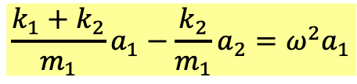
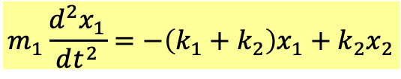
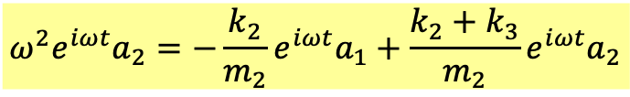

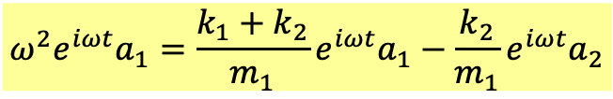

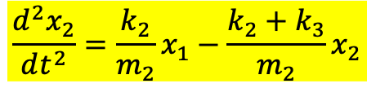
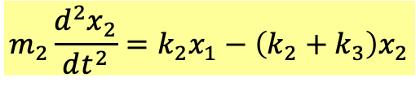

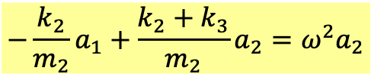
$$m_{1}\frac{d^{2}x_{1}}{dt^{2}}=−\left(k_{1}+k_{2}\right)x_{1}+k_{2}x_{2}$$
$$\frac{d^{2}x_{1}}{dt^{2}}=−\frac{k_{1}+k_{2}}{m_{1}}x_{1}+\frac{k_{2}}{m_{1}}x_{2}$$
$$m_{2}\frac{d^{2}x_{2}}{dt^{2}}=k_{2}x_{1}−{\left(k_{2}+k_{3}\right)x}_{2}$$
$$\frac{d^{2}x_{2}}{dt^{2}}=\frac{k_{2}}{m_{2}}x_{1}−{\frac{k_{2}+k_{3}}{m_{2}}x}_{2}$$
All terms are linear in $x$’s. Systems of 2nd order linear ODE.
先設$x_{1,2}$推廣為複數：
猜解並代入
$$x_{1}=a_{1}∙e^{iωt}$$
$$x_{2}=a_{2}∙e^{iωt}$$
$$ω^{2}e^{iωt}a_{1}=\frac{k_{1}+k_{2}}{m_{1}}e^{iωt}a_{1}−\frac{k_{2}}{m_{1}}e^{iωt}a_{2}$$
$$\frac{k_{1}+k_{2}}{m_{1}}a_{1}−\frac{k_{2}}{m_{1}}a_{2}=ω^{2}a_{1}$$
$$ω^{2}e^{iωt}a_{2}=−\frac{k_{2}}{m_{2}}e^{iωt}a_{1}+\frac{k_{2}+k_{3}}{m_{2}}e^{iωt}a_{2}$$
$$−\frac{k_{2}}{m_{2}}a_{1}+\frac{k_{2}+k_{3}}{m_{2}}a_{2}=ω^{2}a_{2}$$

Slide 4

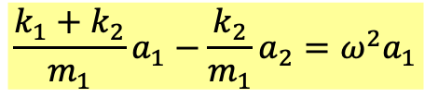
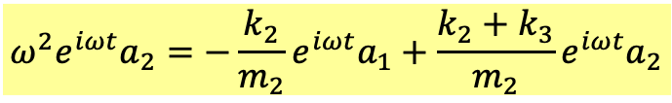

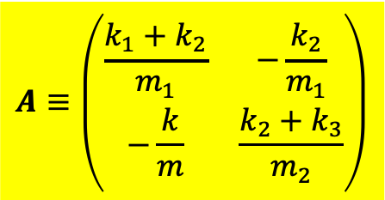

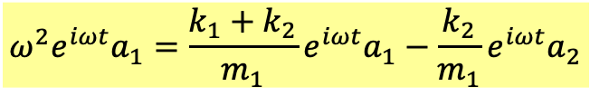

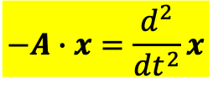

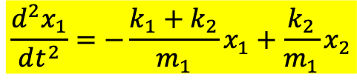
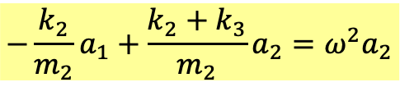
$$\frac{d^{2}x_{1}}{dt^{2}}=−\frac{k_{1}+k_{2}}{m_{1}}x_{1}+\frac{k_{2}}{m_{1}}x_{2}$$
$$−A∙x=\frac{d^{2}}{dt^{2}}x$$
$$\frac{d^{2}x_{2}}{dt^{2}}=\frac{k_{2}}{m_{2}}x_{1}−{\frac{k_{2}+k_{3}}{m_{2}}x}_{2}$$
$$A≡\left(\begin{matrix}\frac{k_{1}+k_{2}}{m_{1}} & −\frac{k_{2}}{m_{1}} \\ −\frac{k}{m} & \frac{k_{2}+k_{3}}{m_{2}}\end{matrix}\right)$$
All terms are linear in $x$’s. Systems of 2nd order linear ODE.
先設$x_{1,2}$推廣為複數：
猜解並代入
$$x≡\left(\begin{matrix}x_{1} \\ x_{2}\end{matrix}\right)$$
$$x_{1}=a_{1}∙e^{iωt}$$
$$x_{2}=a_{2}∙e^{iωt}$$
$$ω^{2}e^{iωt}a_{1}=\frac{k_{1}+k_{2}}{m_{1}}e^{iωt}a_{1}−\frac{k_{2}}{m_{1}}e^{iωt}a_{2}$$
$$\frac{k_{1}+k_{2}}{m_{1}}a_{1}−\frac{k_{2}}{m_{1}}a_{2}=ω^{2}a_{1}$$
$$ω^{2}e^{iωt}a_{2}=−\frac{k_{2}}{m_{2}}e^{iωt}a_{1}+\frac{k_{2}+k_{3}}{m_{2}}e^{iωt}a_{2}$$
$$−\frac{k_{2}}{m_{2}}a_{1}+\frac{k_{2}+k_{3}}{m_{2}}a_{2}=ω^{2}a_{2}$$

Slide 5

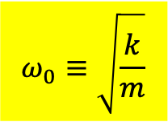
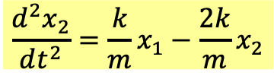
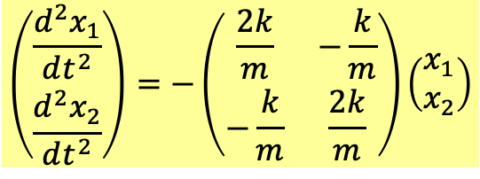
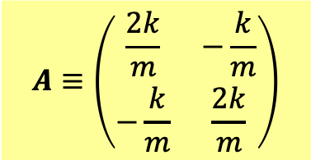
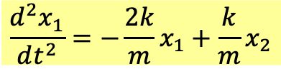

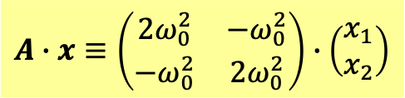
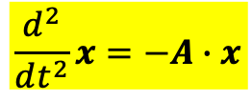
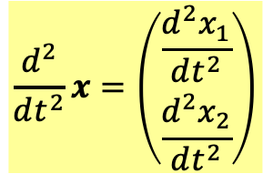
線性方程式組的右手邊可以以矩陣及行向量的乘積來簡化符號！
$$\frac{d^{2}x_{1}}{dt^{2}}=−\frac{2k}{m}x_{1}+\frac{k}{m}x_{2}$$
$$\left(\begin{matrix}\frac{d^{2}x_{1}}{dt^{2}} \\ \frac{d^{2}x_{2}}{dt^{2}}\end{matrix}\right)=−\left(\begin{matrix}\frac{2k}{m} & −\frac{k}{m} \\ −\frac{k}{m} & \frac{2k}{m}\end{matrix}\right)\left(\begin{matrix}x_{1} \\ x_{2}\end{matrix}\right)$$
$$\frac{d^{2}x_{2}}{dt^{2}}=\frac{k}{m}x_{1}−{\frac{2k}{m}x}_{2}$$
行向量
$$A≡\left(\begin{matrix}\frac{2k}{m} & −\frac{k}{m} \\ −\frac{k}{m} & \frac{2k}{m}\end{matrix}\right)$$
矩陣
$$x≡\left(\begin{matrix}x_{1} \\ x_{2}\end{matrix}\right)$$
$$\frac{d^{2}}{dt^{2}}x=\left(\begin{matrix}\frac{d^{2}x_{1}}{dt^{2}} \\ \frac{d^{2}x_{2}}{dt^{2}}\end{matrix}\right)$$
$$ω_{0}≡\sqrt{\frac{k}{m}}$$
$$A∙x≡\left(\begin{matrix}2ω_{0}^{2} & −ω_{0}^{2} \\ −ω_{0}^{2} & 2ω_{0}^{2}\end{matrix}\right)∙\left(\begin{matrix}x_{1} \\ x_{2}\end{matrix}\right)$$
$$\frac{d^{2}}{dt^{2}}x=−A∙x$$

Slide 6
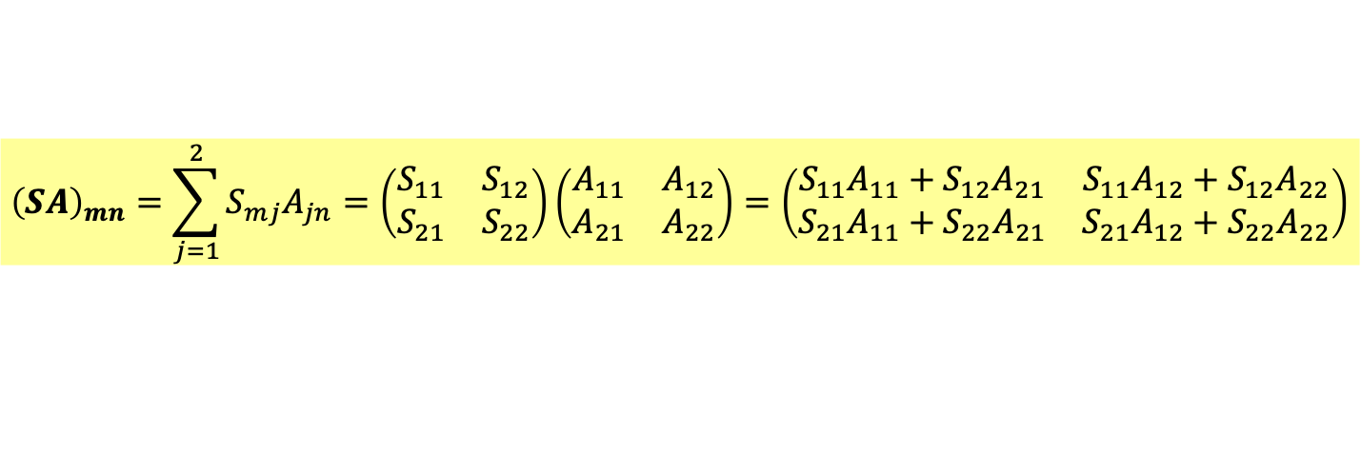
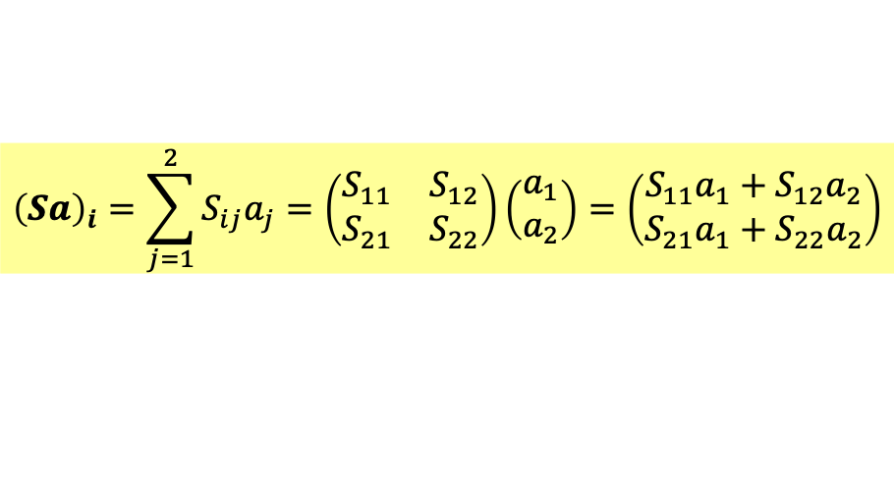
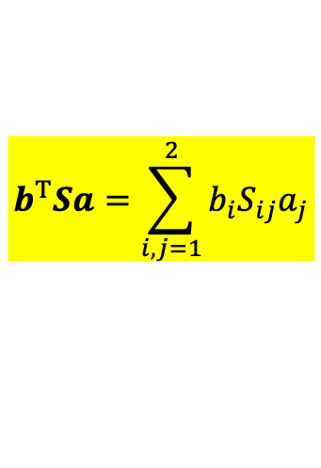
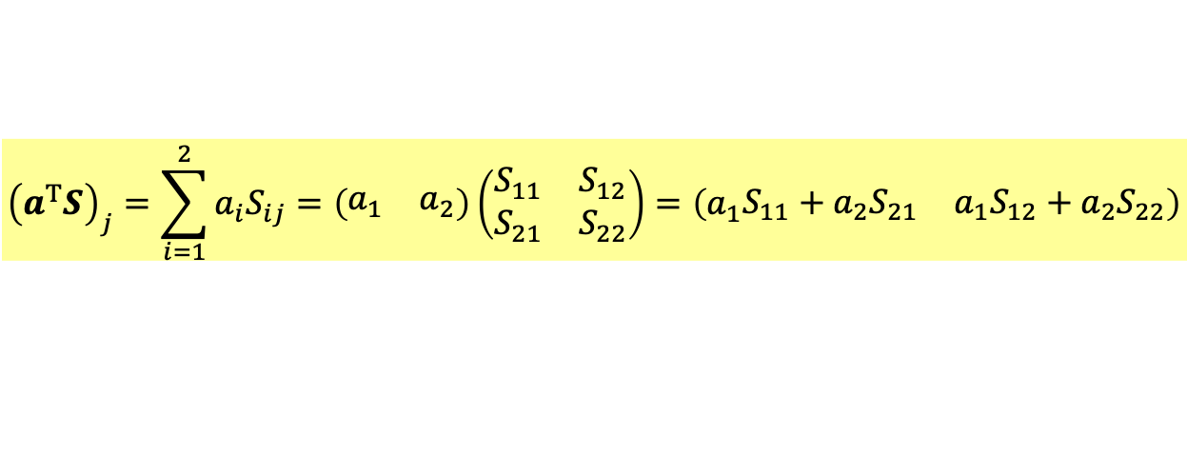
矩陣乘行向量得一行向量：
$${\left(Sa\right)}_{i}=\sum_{j=1}^{2}{S_{ij}a_{j}}=\left(\begin{matrix}S_{11} & S_{12} \\ S_{21} & S_{22}\end{matrix}\right)\left(\begin{matrix}a_{1} \\ a_{2}\end{matrix}\right)=\left(\begin{matrix}S_{11}a_{1}+S_{12}a_{2} \\ S_{21}a_{1}+S_{22}a_{2}\end{matrix}\right)$$
此規則保證此乘積是線性的
$$S\left(c_{1}a_{1}+c_{2}a_{2}\right)=c_{1}Sa_{1}+c_{2}Sa_{2}$$
列向量乘矩陣得一列向量：
$${\left(a^{T}S\right)}_{j}=\sum_{i=1}^{2}{a_{i}S_{ij}}=\left(\begin{matrix}a_{1} & a_{2}\end{matrix}\right)\left(\begin{matrix}S_{11} & S_{12} \\ S_{21} & S_{22}\end{matrix}\right)=\left(a_{1}\begin{matrix}S_{11}+{a_{2}S}_{21} & {a_{1}S}_{12}+a_{2}S_{22}\end{matrix}\right)$$
矩陣乘矩陣還是矩陣：
$${\left(SA\right)}_{mn}=\sum_{j=1}^{2}{S_{mj}A_{jn}}=\left(\begin{matrix}S_{11} & S_{12} \\ S_{21} & S_{22}\end{matrix}\right)\left(\begin{matrix}A_{11} & A_{12} \\ A_{21} & A_{22}\end{matrix}\right)=\left(\begin{matrix}S_{11}A_{11}+S_{12}A_{21} & S_{11}A_{12}+S_{12}A_{22} \\ S_{21}A_{11}+S_{22}A_{21} & S_{21}A_{12}+S_{22}A_{22}\end{matrix}\right)$$
列向量乘矩陣乘行向量，等於列向量乘行向量，得到一個數：
$$b^{T}Sa=\sum_{i,j=1}^{2}{b_{i}S_{ij}a_{j}}$$
Arfken p96-99

Slide 7
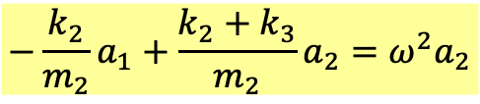
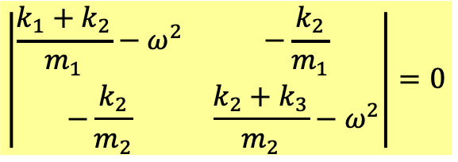

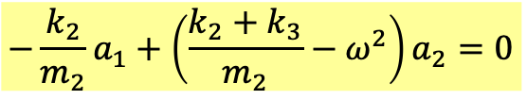
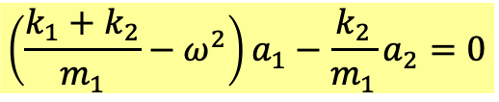
$$\frac{k_{1}+k_{2}}{m_{1}}a_{1}−\frac{k_{2}}{m_{1}}a_{2}=ω^{2}a_{1}$$
$$−\frac{k_{2}}{m_{2}}a_{1}+\frac{k_{2}+k_{3}}{m_{2}}a_{2}=ω^{2}a_{2}$$
微分方程組被轉化為$a_{1},a_{2}$的一次代數方程組以及一個未知數$ω$。
$$\left(\frac{k_{1}+k_{2}}{m_{1}}−ω^{2}\right)a_{1}−\frac{k_{2}}{m_{1}}a_{2}=0$$
$$−\frac{k_{2}}{m_{2}}a_{1}+\left(\frac{k_{2}+k_{3}}{m_{2}}−ω^{2}\right)a_{2}=0$$
因為右式為零，此方程組只有在行列式為零時才有解：
$$\left|\begin{matrix}\frac{k_{1}+k_{2}}{m_{1}}−ω^{2} & −\frac{k_{2}}{m_{1}} \\ −\frac{k_{2}}{m_{2}} & \frac{k_{2}+k_{3}}{m_{2}}−ω^{2}\end{matrix}\right|=0$$
未知數$ω^{2}應該只有$兩個解！這其實就是本徵值！

Slide 8
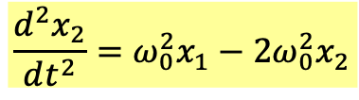



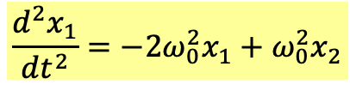




$$\frac{d^{2}x_{1}}{dt^{2}}=−2ω_{0}^{2}x_{1}+ω_{0}^{2}x_{2}$$
$$\frac{d^{2}x_{2}}{dt^{2}}=ω_{0}^{2}x_{1}−{2ω_{0}^{2}x}_{2}$$
先設$x_{1,2}$為複數，猜想其解如簡諧運動也可以寫成虛數的指數函數：
$$x_{1}=a_{1}∙e^{iωt}$$
$$x_{2}=a_{2}∙e^{iωt}$$
$$x≡\left(\begin{matrix}x_{1} \\ x_{2}\end{matrix}\right)=\left(\begin{matrix}a_{1} \\ a_{2}\end{matrix}\right)e^{iωt}$$
注意此猜想中，$x_{1,2}$是以同樣的方式一起隨時間振盪：$e^{iωt}$。
可以想見此解要成立，$ω$須是特定的值，$\left(\begin{matrix}a_{1} \\ a_{2}\end{matrix}\right)$必須是特定的行向量。
要找到它們，就要將解代入方程式：
$$ω^{2}e^{iωt}a_{1}=2ω_{0}^{2}e^{iωt}a_{1}−ω_{0}^{2}e^{iωt}a_{2}$$
$$2ω_{0}^{2}a_{1}−ω_{0}^{2}a_{2}=ω^{2}a_{1}$$
$$ω^{2}e^{iωt}a_{2}=−ω_{0}^{2}e^{iωt}a_{1}+2ω_{0}^{2}e^{iωt}a_{2}$$
$$−ω_{0}^{2}a_{1}+2ω_{0}^{2}a_{2}=ω^{2}a_{2}$$
微分方程組被轉化為$a_{1},a_{2}$的一次代數方程組以及一個未知數$ω$。
這個$a_{1},a_{2}$的一次代數方程組也可以以矩陣及行向量表示：
以矩陣及行向量的語言來寫：
$$A∙a=ω^{2}a$$
$$a≡\left(\begin{matrix}a_{1} \\ a_{2}\end{matrix}\right)$$
這稱為矩陣$A$的本徵值$ω$問題，$a$稱為本徵向量。

Slide 9



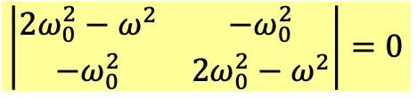





$$2ω_{0}^{2}a_{1}−ω_{0}^{2}a_{2}=ω^{2}a_{1}$$
$$−ω_{0}^{2}a_{1}+2ω_{0}^{2}a_{2}=ω^{2}a_{2}$$
這稱為矩陣$A$的本徵值$ω$問題，$a$稱為本徵向量。
$$\left(2ω_{0}^{2}−ω^{2}\right)a_{1}−ω_{0}^{2}a_{2}=0$$
$$−ω_{0}^{2}a_{1}+\left(2ω_{0}^{2}−ω^{2}\right)a_{2}=0$$
因為右式為零，此方程組只有在行列式為零時才有解：
$$\left|\begin{matrix}2ω_{0}^{2}−ω^{2} & −ω_{0}^{2} \\ −ω_{0}^{2} & 2ω_{0}^{2}−ω^{2}\end{matrix}\right|=0$$
$${\left(ω^{2}−2ω_{0}^{2}\right)}^{2}−{\left(ω_{0}^{2}\right)}^{2}=0$$
未知數$ω^{2}應該只有$兩個解！
$$ω^{2}=ω_{0}^{2},3ω_{0}^{2}$$
$$ω_{1}≡ω_{0}$$
$$ω_{2}≡\sqrt{3}ω_{0}$$

Slide 10
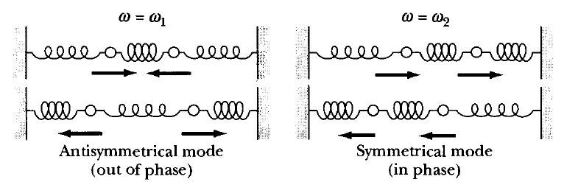










對特定的$ω$，我們可以解出對應的$a_{1},a_{2}$，
$$ω_{1}=ω_{0}$$
$$\left(2ω_{0}^{2}−ω_{0}^{2}\right)a_{1}−ω_{0}^{2}a_{2}=0$$
$$ω_{0}^{2}a_{1}−ω_{0}^{2}a_{2}=0$$
$$−ω_{0}^{2}a_{1}+\left(2ω_{0}^{2}−ω_{0}^{2}\right)a_{2}=0$$
$$−ω_{0}^{2}a_{1}+ω_{0}^{2}a_{2}=0$$
$$a_{1}=a_{2}≡C_{1}=A_{1}e^{iφ_{1}}$$
The solution is:
$$x_{1}=C_{1}∙e^{iω_{0}t}=A_{1}e^{i\left(ω_{0}t+φ_{1}\right)}$$
$$x_{2}=C_{1}∙e^{iω_{0}t}=A_{1}e^{i\left(ω_{0}t+φ_{1}\right)}$$
Now taking the real part would give us the solution.
$$x_{1}=x_{2}=Re A_{1}e^{i\left(ω_{0}t+φ_{1}\right)}=A_{1}\cos\left(ω_{0}t+φ_{1}\right)$$
The two move together!
$$x_{1}^{′}=x_{2}^{′}=−ω_{0}A_{1}\sin\left(ω_{0}t+φ_{1}\right)$$
例如起始條件$x_{1}\left(0\right)=x_{2}\left(0\right)=a_{m}$, $x_{1}^{′}\left(0\right)=x_{2}^{′}\left(0\right)=0$，此對稱運動模式就會進行。

Slide 11
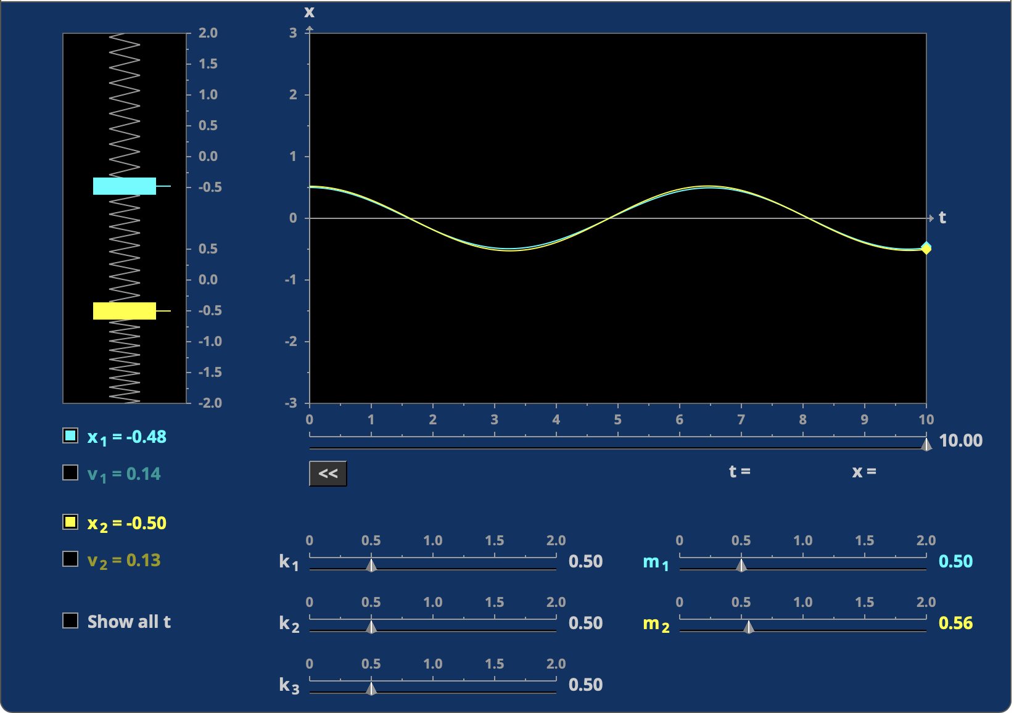

Slide 12











$$ω_{2}=\sqrt{3}ω_{0}$$
$$\left(2ω_{0}^{2}−3ω_{0}^{2}\right)a_{1}−ω_{0}^{2}a_{2}=0$$
$$−ω_{0}^{2}a_{1}−ω_{0}^{2}a_{2}=0$$
$$−ω_{0}^{2}a_{1}+\left(2ω_{0}^{2}−3ω_{0}^{2}\right)a_{2}=0$$
$$−ω_{0}^{2}a_{1}−ω_{0}^{2}a_{2}=0$$
$$a_{1}=−a_{2}≡C_{2}=A_{2}e^{iφ_{2}}$$
The solution is:
$$x_{1}=C_{2}∙e^{i\sqrt{3}ω_{0}t}=A_{2}e^{i\left(\sqrt{3}ω_{0}t+φ_{2}\right)}$$
$$x_{2}=−C_{2}∙e^{i\sqrt{3}ω_{0}t}=A_{2}e^{i\left(\sqrt{3}ω_{0}t+φ_{2}\right)}$$
Now taking the real part would give us the solution.
$$x_{1}=Re A_{2}e^{i\left(\sqrt{3}ω_{0}t+φ_{2}\right)}=A_{2}\cos\left(\sqrt{3}ω_{0}t+φ_{2}\right)$$
$$x_{2}=−x_{1}=−A_{2}\cos\left(\sqrt{3}ω_{0}t+φ_{2}\right)$$
$$x_{1}^{′}=−x_{2}^{′}=\sqrt{3}ω_{0}A_{2}\sin\left(\sqrt{3}ω_{0}t+φ_{1}\right)$$
The two move opposite!
起始條件為$x_{1}\left(0\right)=−x_{2}\left(0\right)=a_{m}$, $x_{1}^{′}\left(0\right)=x_{2}^{′}\left(0\right)=0$，此反對稱運動模式就會進行。

Slide 13
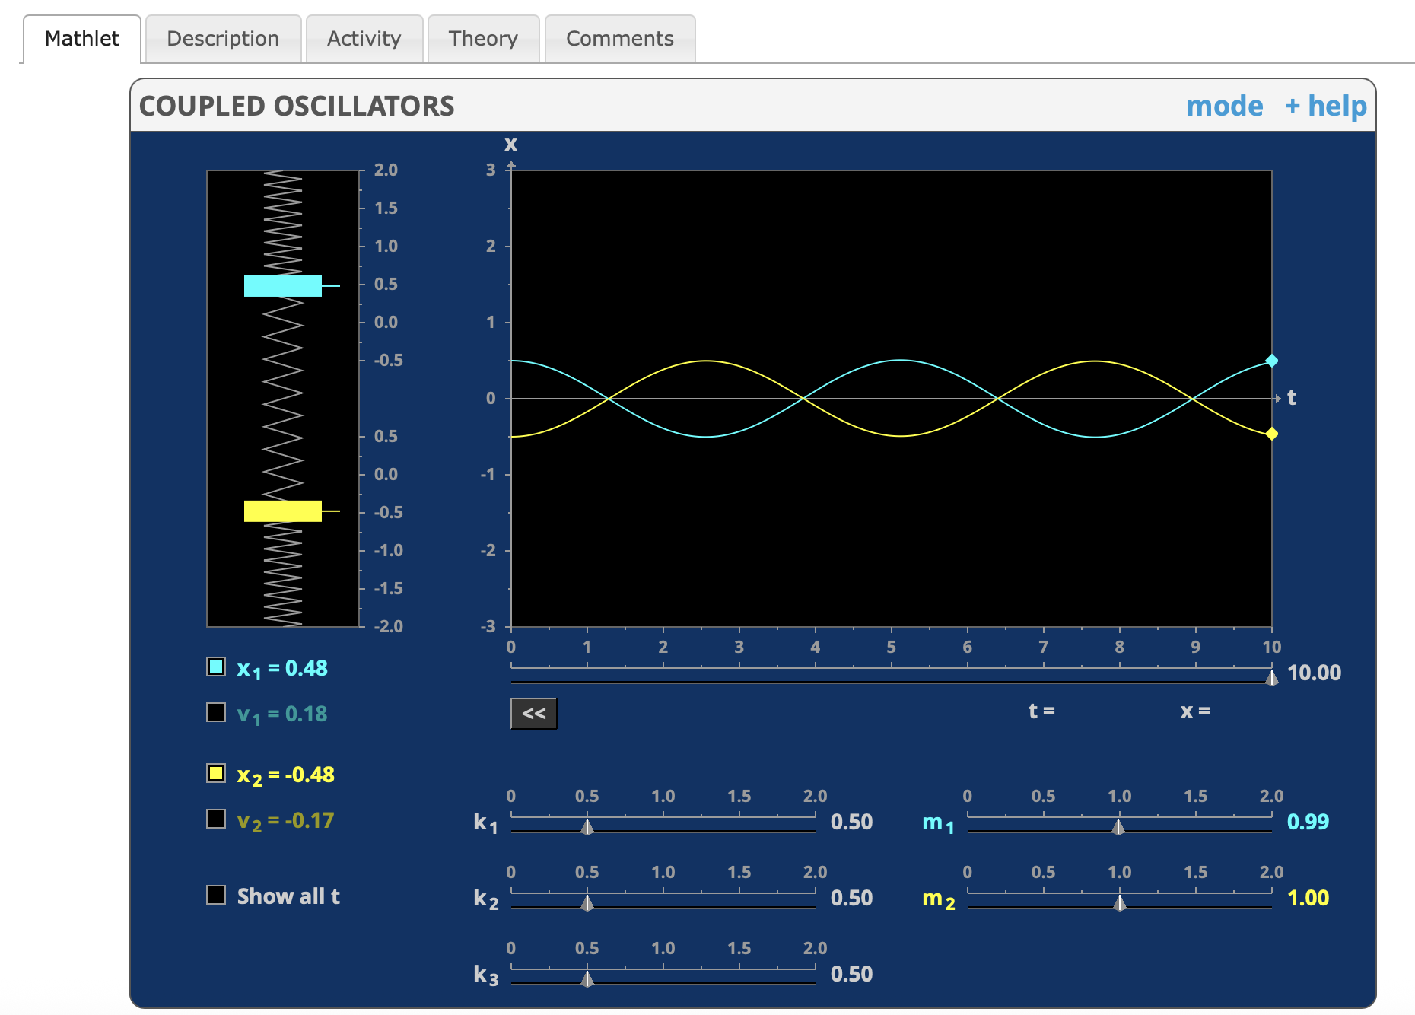

Slide 14
在這兩個振盪模式，彈簧組作簡諧運動。

Slide 15
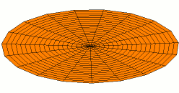
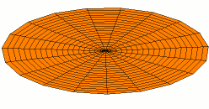
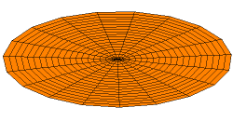
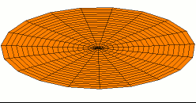
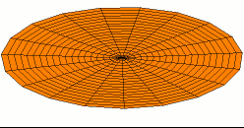
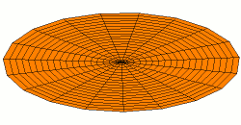
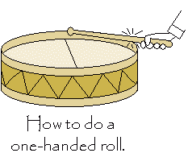
原則上物體的變形模式有無限多個，但並不是連續分布。
因此可以分離地一個一個編號。
每一個模式，如同簡諧運動，對應一個內在的特定的振動頻率！
不同模式頻率不同。一般來說，頻率越高的模式，越難激發。
物體的所有變形就是以這些模式或它們的疊加來進行！
一個物體有那些振盪模式 Norm以及對應的頻率，就是該物體的一個特徵。

Slide 16
A general solution is a sum of the two modes.
一般起始條件就是兩種模式的疊加！
There are four undetermined constants $A_{1,2},φ_{1,2}$.
$$x_{1}=A_{1}\cos\left(ω_{0}t+φ_{1}\right)+A_{2}\cos\left(\sqrt{3}ω_{0}t+φ_{2}\right)$$
$$x_{2}=A_{1}\cos\left(ω_{0}t+φ_{1}\right)−A_{2}\cos\left(\sqrt{3}ω_{0}t+φ_{2}\right)$$
There are also four i$nitial conditions{ x}_{1,2}\left(0\right),x_{1,2}^{′}\left(0\right)$.
It would be the one unique solution.

Slide 17


Slide 18


Slide 19


Slide 20










Method I
$$−A∙x=\frac{d^{2}}{dt^{2}}x$$
$$x≡\left(\begin{matrix}x_{1} \\ x_{2}\end{matrix}\right)=ae^{iωt}$$
$$a≡\left(\begin{matrix}a_{1} \\ a_{2}\end{matrix}\right)$$
This is the eigenvalue problem of Matrix $A$.
微分方程組被轉化為矩陣$A$的本徵值$ω$問題，$a$稱為本徵向量 。
$$A≡\left(\begin{matrix}2ω_{0}^{2} & −ω_{0}^{2} \\ −ω_{0}^{2} & 2ω_{0}^{2}\end{matrix}\right)$$
$$A∙a=ω^{2}a$$
本徵值$ω^{2}$有兩個，各自對應一本徵向量$a$。
$$ω_{1}≡ω_{0}$$
$$\left(\begin{matrix}a_{1} \\ a_{2}\end{matrix}\right)=c_{1}\left(\begin{matrix}1 \\ 1\end{matrix}\right)$$
$$ω_{2}≡\sqrt{3}ω_{0}$$
$$\left(\begin{matrix}a_{1} \\ a_{2}\end{matrix}\right)=c_{2}\left(\begin{matrix}1 \\ −1\end{matrix}\right)$$
$$\left(\begin{matrix}x_{1} \\ x_{2}\end{matrix}\right)=c_{1}\left(\begin{matrix}1 \\ 1\end{matrix}\right)cos ω_{0}t{+}c_{2}\left(\begin{matrix}1 \\ −1\end{matrix}\right)cos\sqrt{3}ω_{0}t$$

Slide 21





This formalism could be easily extended to more than two masses.
$$A≡\left(\begin{matrix}\frac{k_{11}}{m_{1}} & \frac{k_{12}}{m_{1}} & \frac{k_{13}}{m_{1}} \\ \frac{k_{21}}{m_{2}} & \frac{k_{22}}{m_{2}} & \frac{k_{23}}{m_{2}} \\ \frac{k_{31}}{m_{3}} & \frac{k_{32}}{m_{3}} & \frac{k_{33}}{m_{3}}\end{matrix}\right)$$
$$−A∙x=\frac{d^{2}}{dt^{2}}x$$
$$A∙a=ω^{2}a$$

Slide 22


Slide 23


$$x_{n}=a_{n}cos\left(ω_{n}t+φ_{n}\right)$$
$$x_{n}=a_{n}∙e^{i\left(ω_{n}t+φ_{n}\right)}$$

Slide 24


$$X=\left(\begin{matrix}x_{1} \\ x_{2} \\ x_{3}\end{matrix}\right)$$
$$\frac{d^{2}X}{dt^{2}}=\left(\begin{matrix}−\frac{k}{m_{1}} & \frac{k}{m_{1}} & 0 \\ \frac{k}{m_{2}} & −\frac{2k}{m_{2}} & \frac{k}{m_{2}} \\ 0 & \frac{k}{m_{3}} & −\frac{k}{m_{3}}\end{matrix}\right)∙X≡A∙X$$

Slide 25






$$X=\left(\begin{matrix}x_{1} \\ x_{2} \\ x_{3}\end{matrix}\right)=\left(\begin{matrix}a_{1} \\ a_{2} \\ a_{3}\end{matrix}\right)e^{iωt}≡ae^{iωt}$$
$$\frac{d^{2}X}{dt^{2}}=A∙X$$
代入
$$A∙a=−ω^{2}a$$
微分方程式被轉化為本徵值方程式：
$ω^{2}$及$a$分別為矩陣$A$的Eigenvalues本徵值及Eigenvectors本徵向量。
$$\left(\begin{matrix}−\frac{k}{m_{1}}+ω^{2} & \frac{k}{m_{1}} & 0 \\ \frac{k}{m_{2}} & −\frac{2k}{m_{2}}+ω^{2} & \frac{k}{m_{2}} \\ 0 & \frac{k}{m_{3}} & −\frac{k}{m_{3}}+ω^{2}\end{matrix}\right)∙a=0$$
$a$只有當矩陣的行列式為零時有非零解：，
$$\left|\begin{matrix}−\frac{k}{m_{1}}+ω^{2} & \frac{k}{m_{1}} & 0 \\ \frac{k}{m_{2}} & −\frac{2k}{m_{2}}+ω^{2} & \frac{k}{m_{2}} \\ 0 & \frac{k}{m_{3}} & −\frac{k}{m_{3}}+ω^{2}\end{matrix}\right|=0$$
$$ω^{2}有三個解\text{Eigenvalues}。每一個解對應一個向量a：\text{eigenvectors}$$

Slide 26



三個頻率分別對應三個不同的$\left(a_{1},a_{2},a_{3}\right)$模式mode
例如$ω=\frac{ω_{0}}{4}時，a=\left(1,0,−1 \right)$

Slide 27


Slide 28


Slide 29


Slide 30
















There is another way to look at this solution.
Method 2
$$x_{1}=A_{1}\cos\left(ω_{0}t+φ_{1}\right)+A_{2}\cos\left(\sqrt{3}ω_{0}t+φ_{2}\right)$$
$$x_{2}=A_{1}\cos\left(ω_{0}t+φ_{1}\right)−A_{2}\cos\left(\sqrt{3}ω_{0}t+φ_{2}\right)$$
$$x_{+}≡x_{1}+x_{2}=2A_{1}\cos\left(ω_{0}t+φ_{1}\right)$$
Generalized Coordinates 廣義座標
$$x_{−}≡x_{1}−x_{2}=2A_{2}\cos\left(\sqrt{3}ω_{0}t+φ_{2}\right)$$
廣義座標可以完全決定真實座標！
$x_{+},x_{−}$ are pure simple harmonic oscillators with respective angular frequencies.
從廣義座標$x_{+},x_{−}$滿足的運動方程式的角度來看：
$$\frac{d^{2}x_{1}}{dt^{2}}=−2ω_{0}^{2}x_{1}+ω_{0}^{2}x_{2}$$
$$\frac{d^{2}x_{2}}{dt^{2}}=ω_{0}^{2}x_{1}−{2ω_{0}^{2}x}_{2}$$
$$\frac{d^{2}\left(x_{1}+x_{2}\right)}{dt^{2}}=−ω_{0}^{2}x_{1}−{ω_{0}^{2}x}_{2}$$
$$+$$
$$\frac{d^{2}x_{+}}{dt^{2}}=−ω_{0}^{2}x_{+}$$
$$\frac{d^{2}x_{1}}{dt^{2}}=−2ω_{0}^{2}x_{1}+ω_{0}^{2}x_{2}$$
$$\frac{d^{2}x_{2}}{dt^{2}}=ω_{0}^{2}x_{1}−{2ω_{0}^{2}x}_{2}$$
$$\frac{d^{2}x_{−}}{dt^{2}}=−3ω_{0}^{2}x_{−}$$
$$−$$
$x_{+},x_{−}$ are called Normal Coordinates. 模式座標
$$x≡\left(\begin{matrix}x_{+} \\ x_{−}\end{matrix}\right)$$
$$−A∙x=\frac{d^{2}}{dt^{2}}x$$
$$A≡\left(\begin{matrix}ω_{0}^{2} & 0 \\ 0 & 3ω_{0}^{2}\end{matrix}\right)$$
For normal coordinates, $A$ is now diagonal. Off-diagonal elements means coupling.
$x_{+},x_{−}$ are uncoupled, independent SHM.

Slide 31




在這兩個模式，廣義座標非常簡單。
$$x_{1}=−x_{2}=A_{2}\cos\left(ω_{0}t+φ_{1}\right)$$
$$x_{1}=x_{2}=A_{1}\cos\left(ω_{0}t+φ_{1}\right)$$
$$x_{+}=0,x_{−}=2A_{2}\cos\left(\sqrt{3}ω_{0}t+φ_{2}\right)$$
$$x_{+}=A_{1}\cos\left(ω_{0}t+φ_{1}\right),x_{−}=0$$
可以說這兩個模式座標就是來標定這兩個模式的。

Slide 32


Slide 33










$$x_{j−1}$$
$$x_{j}$$
$$m\frac{d^{2}x_{j}}{dt^{2}}=−k\left(x_{j}−x_{j−1}\right)+k\left(x_{j+1}−x_{j}\right)$$
$$\frac{d^{2}x_{j}}{dt^{2}}=\frac{k}{m}x_{j−1}−{\frac{2k}{m}x}_{j}+\frac{k}{m}x_{j+1}$$
$$ω_{0}^{2}=\frac{k}{m}$$
$$\frac{d^{2}}{dt^{2}}\left(\begin{matrix}\begin{matrix}x_{1} \\ ⋮\end{matrix} \\ \begin{matrix}x_{j} \\ \begin{matrix}⋮ \\ x_{N}\end{matrix}\end{matrix}\end{matrix}\right)=ω_{0}^{2}\left(\begin{matrix}\begin{matrix}−2 & 1 \\ 1 & −2\end{matrix} & \begin{matrix}0 & ⋯ \\ 1 & 0\end{matrix} & \begin{matrix}0 \\ 0\end{matrix} \\ \begin{matrix}0 & 1 \\ ⋮ & ⋮\end{matrix} & \begin{matrix}−2 & −1 \\ ⋮ & ⋱\end{matrix} & \begin{matrix}0 \\ ⋮\end{matrix} \\ \begin{matrix}0 & 0\end{matrix} & \begin{matrix}0 & ⋯\end{matrix} & −2\end{matrix}\right)∙\left(\begin{matrix}\begin{matrix}x_{1} \\ ⋮\end{matrix} \\ \begin{matrix}x_{j} \\ \begin{matrix}⋮ \\ x_{N}\end{matrix}\end{matrix}\end{matrix}\right)$$
$$X≡\left(\begin{matrix}\begin{matrix}x_{1} \\ ⋮\end{matrix} \\ \begin{matrix}x_{j} \\ \begin{matrix}⋮ \\ x_{N}\end{matrix}\end{matrix}\end{matrix}\right)$$
$$\frac{d^{2}X}{dt^{2}}=A∙X$$
Consider the ends fixed, called boundary condition.
$$x_{0}=x_{n+1}=0$$

Slide 34








先設$x_{i}$為複數，如下猜解並代入：
$$a=\left(\begin{matrix}\begin{matrix}a_{1} \\ ⋮\end{matrix} \\ \begin{matrix}a_{j} \\ \begin{matrix}⋮ \\ a_{n−1}\end{matrix}\end{matrix}\end{matrix}\right)$$
$$\frac{d^{2}X}{dt^{2}}=A∙X$$
$$X=ae^{iωt}$$
$$−A∙a=ω^{2}a$$
微分方程組被轉化為矩陣的本徵值問題。
$$−ω_{0}^{2}\left(\begin{matrix}\begin{matrix}−2 & 1 \\ 1 & −2\end{matrix} & \begin{matrix}0 & ⋯ \\ 1 & 0\end{matrix} & \begin{matrix}0 \\ 0\end{matrix} \\ \begin{matrix}0 & 1 \\ ⋮ & ⋮\end{matrix} & \begin{matrix}−2 & −1 \\ ⋮ & ⋱\end{matrix} & \begin{matrix}0 \\ ⋮\end{matrix} \\ \begin{matrix}0 & 0\end{matrix} & \begin{matrix}0 & ⋯\end{matrix} & −2\end{matrix}\right)∙\left(\begin{matrix}\begin{matrix}a_{1} \\ ⋮\end{matrix} \\ \begin{matrix}a_{j} \\ \begin{matrix}⋮ \\ a_{N}\end{matrix}\end{matrix}\end{matrix}\right)=ω^{2}\left(\begin{matrix}\begin{matrix}a_{1} \\ ⋮\end{matrix} \\ \begin{matrix}a_{j} \\ \begin{matrix}⋮ \\ a_{N}\end{matrix}\end{matrix}\end{matrix}\right)$$
在此本徵向量可以猜出來，下一頁將驗證：
$$a=\left(\begin{matrix}\begin{matrix}a_{1} \\ ⋮\end{matrix} \\ \begin{matrix}a_{j} \\ \begin{matrix}⋮ \\ a_{n−1}\end{matrix}\end{matrix}\end{matrix}\right)\sim \left(\begin{matrix}\begin{matrix}e^{−ik} \\ ⋮\end{matrix} \\ \begin{matrix}e^{−ik∙j} \\ \begin{matrix}⋮ \\ e^{−ik∙n}\end{matrix}\end{matrix}\end{matrix}\right)$$
$$a_{j}\sim e^{−ik∙j}$$

Slide 35









$$\left(\begin{matrix}\begin{matrix}c_{1} \\ ⋮\end{matrix} \\ \begin{matrix}c_{j} \\ \begin{matrix}⋮ \\ c_{N}\end{matrix}\end{matrix}\end{matrix}\right)\sim \left(\begin{matrix}\begin{matrix}e^{−ik∙a} \\ ⋮\end{matrix} \\ \begin{matrix}e^{−ik∙ja} \\ \begin{matrix}⋮ \\ e^{−ik∙Na}\end{matrix}\end{matrix}\end{matrix}\right)$$
$$c_{j}\sim e^{−ik∙ja}$$
常數$k$稱晶格動量，一個$k$對應一特定的態。
$k+\frac{2nπ}{a}$，與$k$對應完全一樣的平面波函數$e^{−ikja}=e^{−ikja−i2njπ}$，因此等價。
可將$k$限制在一個範圍內：
$$−\frac{π}{a}<k<\frac{π}{a}$$
其他$k$都與此範圍的$k$等價。
週期性條件：
$$k=±\frac{2nπ}{L}$$
$$∆k=\frac{2π}{L}$$
狀態數如預期：
$$\frac{2π}{a∆k}=\frac{L}{a}=N$$

Slide 36









本徵方程式：
$$ω_{0}^{2}∙\left(\begin{matrix}\begin{matrix}−2 & ⋯ & 0 \\ ⋮ & ⋱ & 1 \\ 0 & 1 & −2\end{matrix} & \begin{matrix}0 & 0 & ⋯ \\ 0 & 0 & ⋯ \\ 1 & 0 & ⋯\end{matrix} \\ \begin{matrix}0 & 0 & 1 \\ 0 & 0 & 0 \\ ⋮ & ⋮ & ⋮\end{matrix} & \begin{matrix}−2 & 1 & ⋯ \\ 1 & −2 & ⋯ \\ ⋮ & ⋮ & ⋱\end{matrix}\end{matrix}\right)\left(\begin{matrix}\begin{matrix}e^{−ik} \\ \begin{matrix}⋮ \\ e^{−i\left(j−1\right)k}\end{matrix}\end{matrix} \\ \begin{matrix}e^{−ijk} \\ \begin{matrix}\begin{matrix}e^{−i\left(j+1\right)k} \\ ⋮\end{matrix} \\ e^{−ik∙n}\end{matrix}\end{matrix}\end{matrix}\right)=ω^{2}\left(\begin{matrix}\begin{matrix}e^{−ik} \\ \begin{matrix}⋮ \\ e^{−i\left(j−1\right)k}\end{matrix}\end{matrix} \\ \begin{matrix}e^{−ijk} \\ \begin{matrix}\begin{matrix}e^{−i\left(j+1\right)k} \\ ⋮\end{matrix} \\ e^{−ik∙n}\end{matrix}\end{matrix}\end{matrix}\right)$$
此本徵向量的特徵是等比數列：
$$a_{j}\sim e^{−ijk}$$
$$\frac{a_{j+1}}{a_{j}}\sim e^{−ik}$$
第$j$個元素的等式為：
代入本徵向量方程式：
$$−ω_{0}^{2}\left[e^{−\left(j−1\right)ik}−2e^{−jik}+e^{−\left(j+1\right)ik}\right]=ω^{2}e^{−jik}$$
整式除以$e^{−jik}$，得：
$$−ω_{0}^{2}\left[e^{ik}−2+e^{−ik}\right]=ω^{2}$$
化簡就可以得到：
$$ω^{2}=ω_{0}^{2}\left(2−2\cos{k}\right)$$
一個$k$對應一特定的本徵值。
本徵向量可以取其實數部或虛數部都滿足本徵向量方程式：
取其虛數部都滿足本徵向量方程式：

Slide 37














$$a=\left(\begin{matrix}\begin{matrix}e^{−ik} \\ \begin{matrix}⋮ \\ e^{−i\left(j−1\right)k}\end{matrix}\end{matrix} \\ \begin{matrix}e^{−ijk} \\ \begin{matrix}\begin{matrix}e^{−i\left(j+1\right)k} \\ ⋮\end{matrix} \\ e^{−ik∙n}\end{matrix}\end{matrix}\end{matrix}\right)$$
因矩陣$A$是實數矩陣，本徵向量$a$可取其實數部或虛數部都滿足本徵向量方程式：
取其虛數部則可以直接滿足左側的邊界條件：
$$x_{0}=x_{n+1}=0$$
$$a_{j}\sim e^{−ikj}$$
$$a_{j}=\sin{kj}$$
$$a_{0}=0$$
若要滿足右側的邊界條件：
$$a_{n+1}=0$$
$$k∙\left(n+1\right)=sπ$$
只能取左式這些值， $s=n+1$對應$a_{j}=0$。
$$k=\frac{sπ}{n+1}$$
$s=n+$2與$s=1$對應的$k$差$π$。 對應相似的$a_{j}$。
$$s=1,2,3⋯n$$
共$n$個，代入色散關係：
$$ω_{s}^{2}=ω_{0}^{2}\left(2−2\cos{\frac{sπ}{n+1}a}\right)$$
如預期有$n$個本徵值。
$$a_{j}=\sin{\frac{sπ}{n+1}∙j}$$

Slide 38


Continuum limit
$$m\frac{d^{2}x_{j}}{dt^{2}}=−k\left(x_{j}−x_{j−1}\right)+k\left(x_{j+1}−x_{j}\right)$$
Wave

Slide 39









$$m\frac{d^{2}x_{j}}{dt^{2}}=−k\left(x_{j}−x_{j−1}\right)+k\left(x_{j+1}−x_{j}\right)$$
當粒子數量太龐大，用行向量就不是那麼方便，反而選一個函數$φ\left(x\right)$較好。
函數$φ\left(x\right)$只有在有粒子處 $x=dj$有定義，
$$φ\left(dj\right)≡x_{j}$$
但當$N→∞,d→0$，有粒子處的位置就近乎是連續的變數：
$$dj→x$$
$$φ\left(dj\right)→φ\left(x\right)$$
$$m\frac{d^{2}φ\left(dj\right)}{dt^{2}}=+k\left(φ\left(dj+d\right)−φ\left(dj\right)\right)−k\left(φ\left(dj\right)−φ\left(dj−d\right)\right)$$
$$=+kd\frac{φ\left(dj+d\right)−φ\left(dj\right)}{d}−kd\frac{φ\left(dj\right)−φ\left(dj−d\right)}{d}$$
$$→kd\left[\frac{dφ}{dx}\left(dj\right)−\frac{dφ}{dx}\left(dj−d\right)\right]$$
$$→kd\frac{d^{2}φ}{dx^{2}}\left(dj\right)$$
$$\frac{d^{2}φ}{dt^{2}}\left(x\right)=\frac{kd}{m}\frac{d^{2}φ}{dx^{2}}\left(x\right)$$

Slide 40













$$φ\left(dj\right)≡x_{j}$$
$$φ\left(dj,t\right)≡x_{j}\left(t\right)$$
$$φ\left(dj,t\right)→φ\left(x,t\right)$$
$$\frac{d^{2}φ}{dt^{2}}\left(x\right)=\frac{kd}{m}\frac{d^{2}φ}{dx^{2}}\left(x\right)$$
$$\frac{∂^{2}φ}{∂t^{2}}\left(x,t\right)=\frac{kd}{m}\frac{∂^{2}φ}{∂x^{2}}\left(x,t\right)$$
$$\frac{d^{2}X}{dt^{2}}=A∙X$$
$$\frac{∂^{2}φ}{∂t^{2}}\left(x,t\right)=\frac{kd}{m}\frac{∂^{2}φ}{∂x^{2}}\left(x,t\right)$$
$$\frac{kd}{m}\frac{∂^{2}φ}{∂x^{2}}\left(x,t\right)$$
$$A∙X$$
$$X=ae^{iωt}$$
$$φ\left(x,t\right)=\tilde{φ}\left(x\right)e^{iωt}$$
$$−A∙a=ω^{2}a$$
$$−\frac{kd}{m}\frac{∂^{2}\tilde{φ}}{∂x^{2}}=ω^{2}\tilde{φ}$$

Slide 41



System of 2nd order Linear ODE with constant coefficients
$$\frac{d^{2}X}{dt^{2}}=A∙X$$
複變函數法
$$X=ae^{iωt}$$
Eigenvalue problem of matrix
$$A∙a=ω^{2}a$$

Slide 42



System of 1st order Linear ODE with constant coefficients
$$\frac{dX}{dt}=A∙X$$
複變函數法
$$X=ae^{λt}$$
Identical Eigenvalue problem of matrix
$$A∙a=λa$$

Slide 43

Eigenvalue problem of matrix
$$A∙a=λa$$

