Slide 1
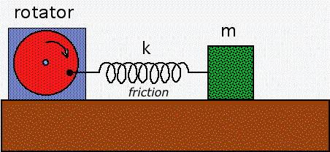
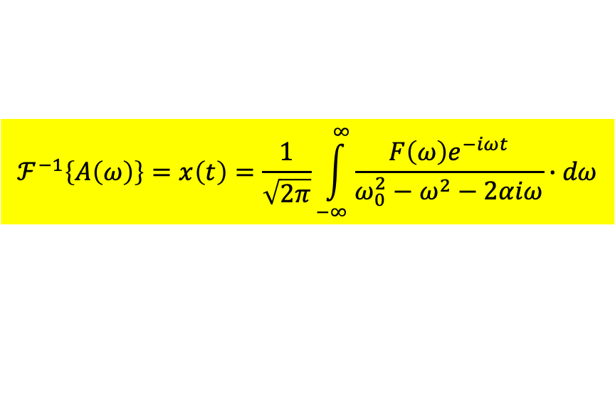

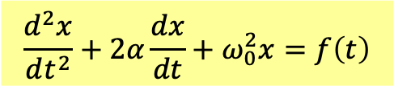
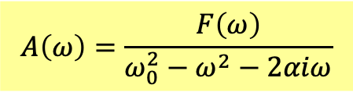

$$\frac{d^{2}x}{dt^{2}}+2α\frac{dx}{dt}+ω_{0}^{2}x=f\left(t\right)$$
General forced oscillation
$$f\left(t\right)→F\left(ω\right)≡ℱ\left\{f\left(t\right)\right\}$$
$$x\left(t\right)→A\left(ω\right)≡ℱ\left\{x\left(t\right)\right\}$$
Taking a Fourier Transformation on the whole differential equation:
$${\left(−iω\right)}^{2}A\left(ω\right)+2α{\left(−iω\right)}^{1}A\left(ω\right)+ω_{0}^{2}A\left(ω\right)=F\left(ω\right)$$
Again, the differential equation is transformed into an algebraic equation for $A\left(ω\right)$.
$$A\left(ω\right)=\frac{F\left(ω\right)}{ω_{0}^{2}−ω^{2}−2αiω}$$
Taking the inverse Fourier Transformation of $A\left(ω\right)$, we solved the ODE.
$$ℱ^{−1}\left\{A\left(ω\right)\right\}=x\left(t\right)=\frac{1}{\sqrt{2π}}\int_{−∞}^{∞}{\frac{F\left(ω\right)e^{−iωt}}{ω_{0}^{2}−ω^{2}−2αiω}∙dω}$$
How to do the integral? Complex analysis.

Slide 2
Complex Analysis
Mathematical miracles do occur.
By making things more complicated, we could make them much more simple.

Slide 3
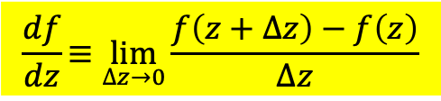

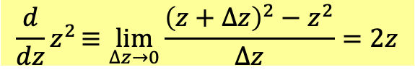



Elevate the real variable $x$ of a continuous function $f(x)$ to a complex variable $z$.
$$f(x)→f(z)≡u\left(x,y\right)+iv\left(x,y\right)$$
$$z=x+iy$$
For example:
$$z^{2}=x^{2}−y^{2}+2xyi$$
$$u\left(x,y\right)=x^{2}−y^{2} v\left(x,y\right)=2xy$$
If $f(x)$ is continuous and good behaved like polynomials, $f(z)$ will be quite restricted.
Such complex functions are called analytic, meaning they have continuous derivatives.
Derivatives of complex functions can define as usual!
$$\frac{df}{dz}≡\lim_{∆z→0}{\frac{f\left(z+∆z\right)−f\left(z\right)}{∆z}}$$
For example:
$$\frac{d}{dz}z^{2}≡\lim_{∆z→0}{\frac{{\left(z+∆z\right)}^{2}−z^{2}}{∆z}}=2z$$
Mononomials $z^{n}$ have continuous derivatives and hence are analytic everywhere.
Finite degree Polynomials are analytic everywhere.

Slide 4
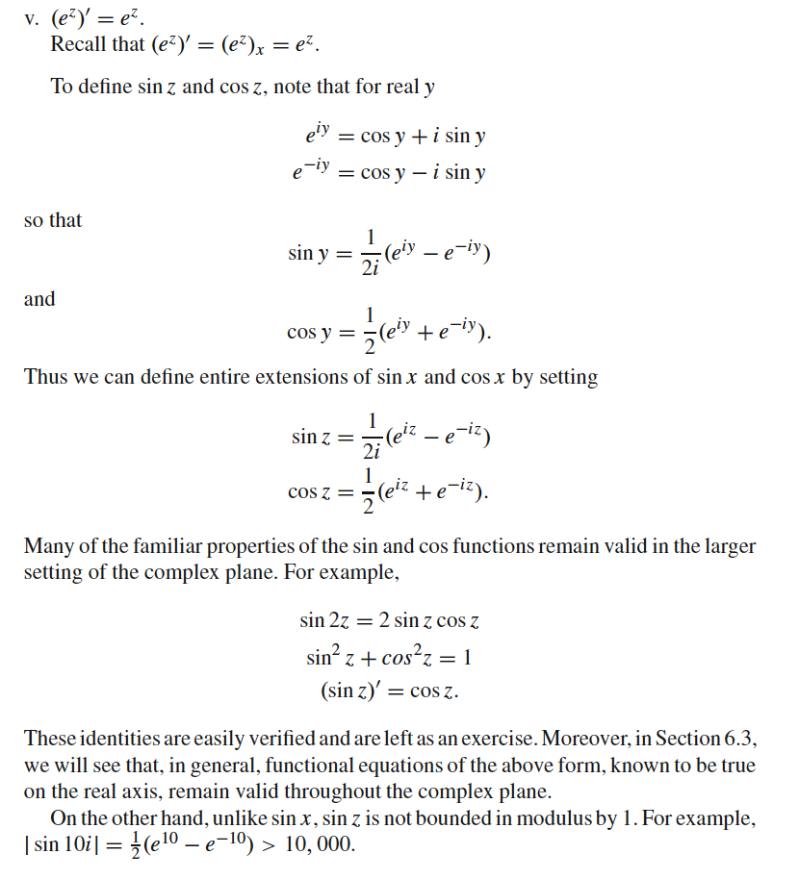
Some infinite degree Polynomials or power series are analytic, too.
For example, exponential function and Sine Cosine functions are analytic.

Slide 5
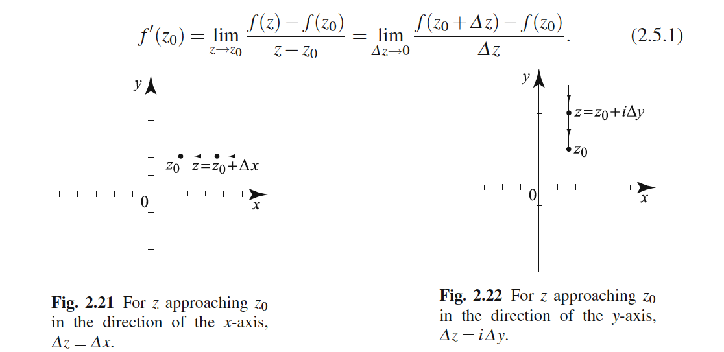

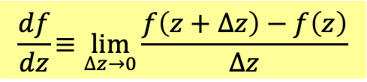



Analyticity poses extremely strong restrictions on the function.
The key is complex variables is essentially a two-dimensional plane.
Its calculus is in essence vectorial calculus on plane.
For derivatives, on a plane we can approach a point $∆z→0$ in multiple ways.
$$\frac{df}{dz}≡\lim_{∆z→0}{\frac{f\left(z+∆z\right)−f\left(z\right)}{∆z}}$$
$$∆z=∆x→0$$
$$∆y=0 always$$
$$∆z=i∆y→0$$
$$∆x=0 always$$

Slide 6
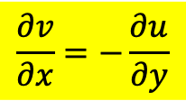
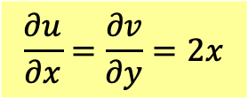
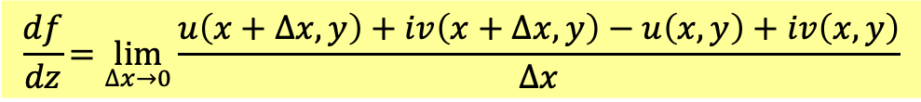
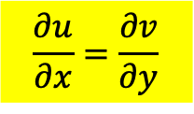

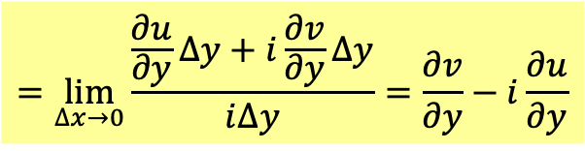

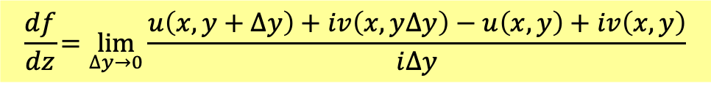

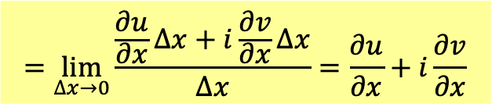

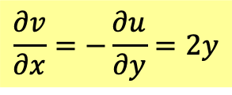
If
$$∆z=∆x→0$$
$$\frac{df}{dz}=\lim_{∆x→0}{\frac{u\left(x+∆x,y\right)+iv\left(x+∆x,y\right)−u\left(x,y\right)+iv\left(x,y\right)}{∆x}}$$
$$=\lim_{∆x→0}{\frac{\frac{∂u}{∂x}∆x+i\frac{∂v}{∂x}∆x}{∆x}}=\frac{∂u}{∂x}+i\frac{∂v}{∂x}$$
If
$$∆z=i∆y→0$$
$$\frac{df}{dz}=\lim_{∆y→0}{\frac{u\left(x,y+∆y\right)+iv\left(x,y∆y\right)−u\left(x,y\right)+iv\left(x,y\right)}{i∆y}}$$
$$=\lim_{∆x→0}{\frac{\frac{∂u}{∂y}∆y+i\frac{∂v}{∂y}∆y}{i∆y}}=\frac{∂v}{∂y}−i\frac{∂u}{∂y}$$
The two expressions must equal to each other.
$$\frac{∂u}{∂x}=\frac{∂v}{∂y}$$
$$\frac{∂v}{∂x}=−\frac{∂u}{∂y}$$
Cauchy-Riemann Condition for the real and imaginary parts of an analytic function.
$$z^{2}=x^{2}−y^{2}+2xyi$$
$$u\left(x,y\right)=x^{2}−y^{2} v\left(x,y\right)=2xy$$
$$\frac{∂u}{∂x}=\frac{∂v}{∂y}=2x$$
$$\frac{∂v}{∂x}=−\frac{∂u}{∂y}=2y$$

Slide 7
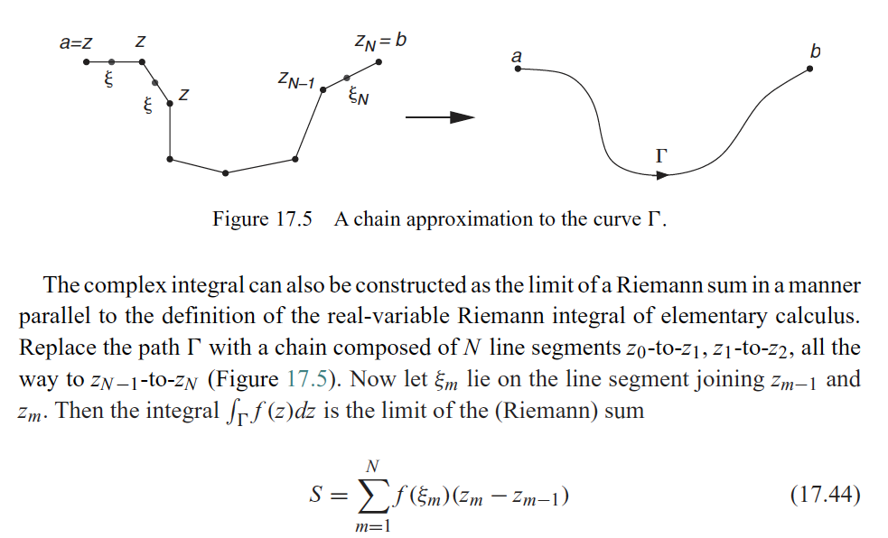
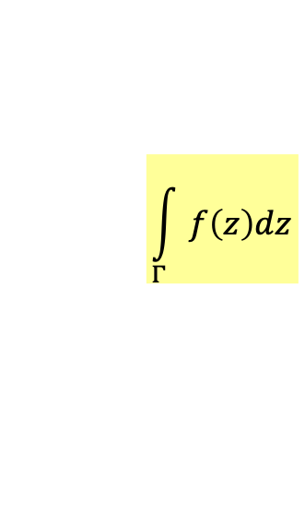
$$\int_{Γ}{f\left(z\right)dz}$$
Complex integration is along a path on the complex plane and path dependent!
It is basically a line integral on 2D plane.

Slide 8
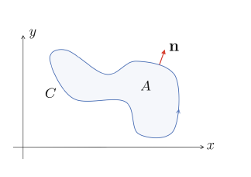
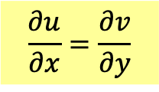
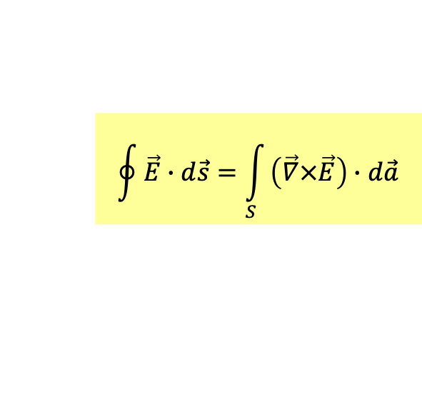
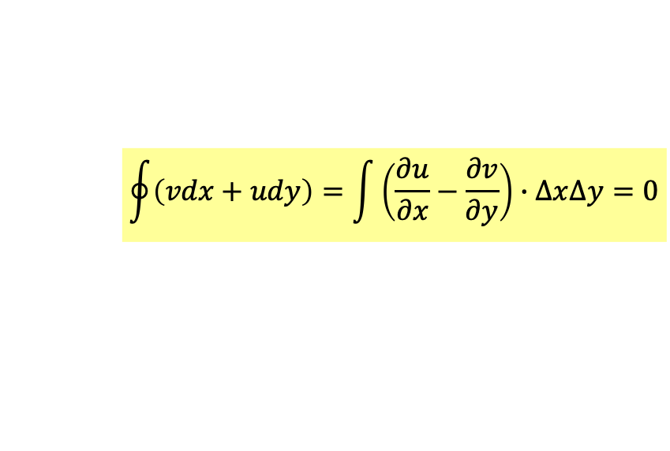
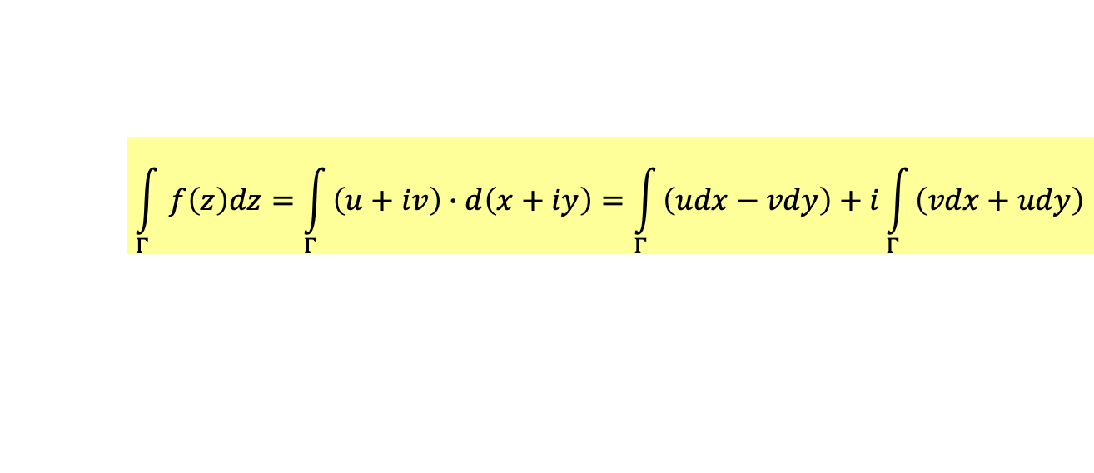
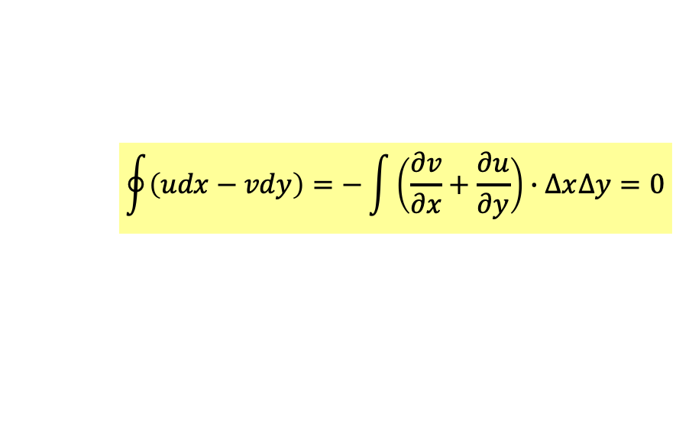
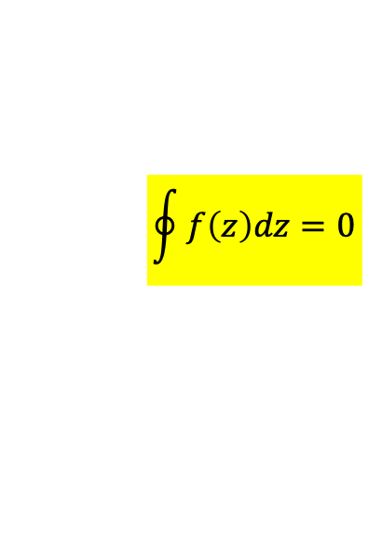
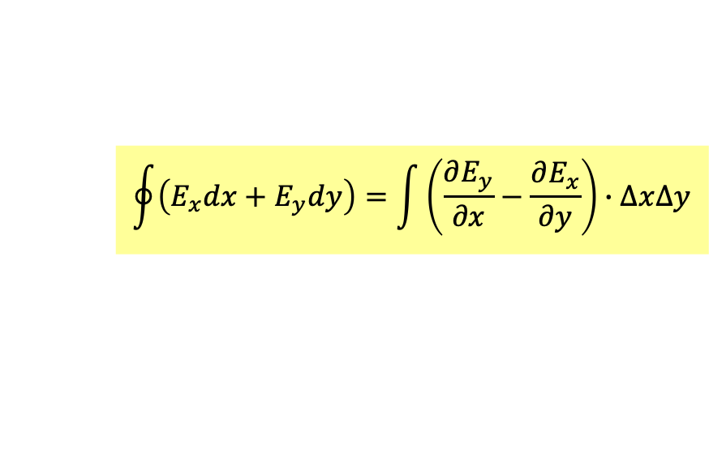

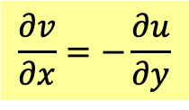

$$\int_{Γ}{f\left(z\right)dz}=\int_{Γ}{\left(u+iv\right)∙d\left(x+iy\right)}=\int_{Γ}{\left(udx−vdy\right)}+i\int_{Γ}{\left(vdx+udy\right)}$$
When $Γ$ is a closed curve, we call it a contour $C$!
$$\oint{f\left(z\right)dz}=\oint{\left(udx−vdy\right)}+i\oint{\left(vdx+udy\right)}$$
Apply Stokes’ Law to the contour on a plane.
$$\oint{\vec{E}∙d\vec{s}}=\int_{S}{\left(\vec{∇}×\vec{E}\right)∙d\vec{a}}$$
$$\oint{\left(E_{x}dx+E_{y}dy\right)}=\int{\left(\frac{∂E_{y}}{∂x}−\frac{∂E_{x}}{∂y}\right)∙∆x∆y}$$
Assign $u$ as $E_{x}$ and $−v$ as $E_{y}$ and apply the Cauchy-Riemann Condition:
$$\oint{\left(udx−vdy\right)}=−\int{\left(\frac{∂v}{∂x}+\frac{∂u}{∂y}\right)∙∆x∆y}=0$$
$$\frac{∂v}{∂x}=−\frac{∂u}{∂y}$$
Assign $v$ as $E_{x}$ and $u$ as $E_{y}$:
$$\oint{\left(vdx+udy\right)}=\int{\left(\frac{∂u}{∂x}−\frac{∂v}{∂y}\right)∙∆x∆y}=0$$
$$\frac{∂u}{∂x}=\frac{∂v}{∂y}$$
$$\oint{f\left(z\right)dz}=0$$
Contour integral is zero for analytic functions.
Cauchy Theorem

Slide 9
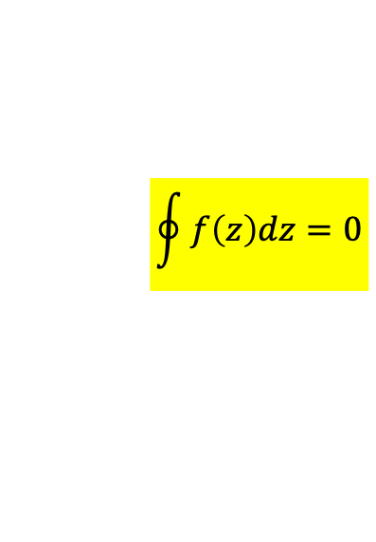
$$\oint{f\left(z\right)dz}=0$$
Contour integral is zero for analytic functions.
Cauchy Theorem

Slide 10
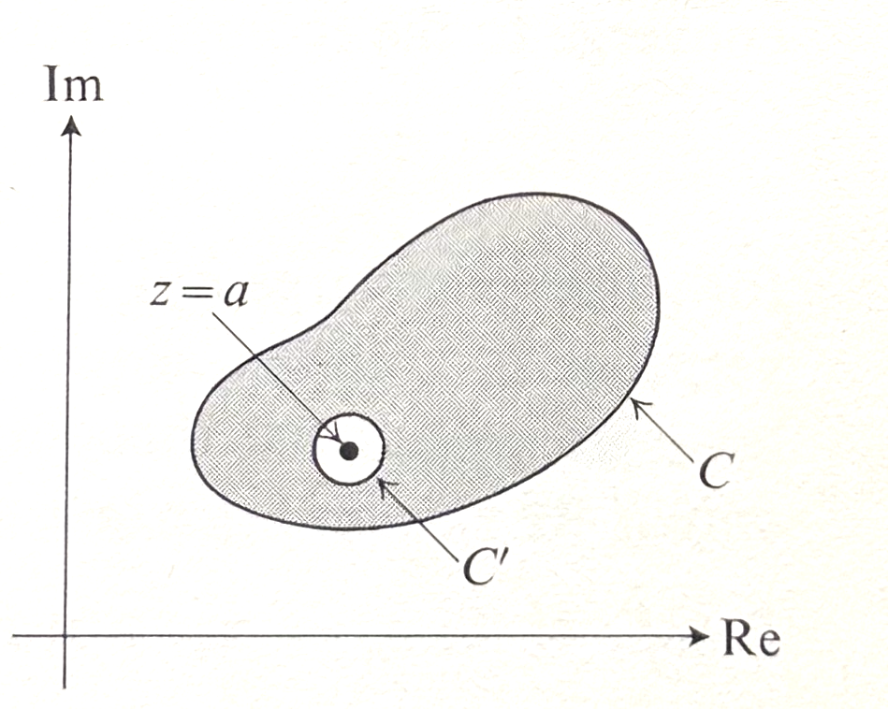
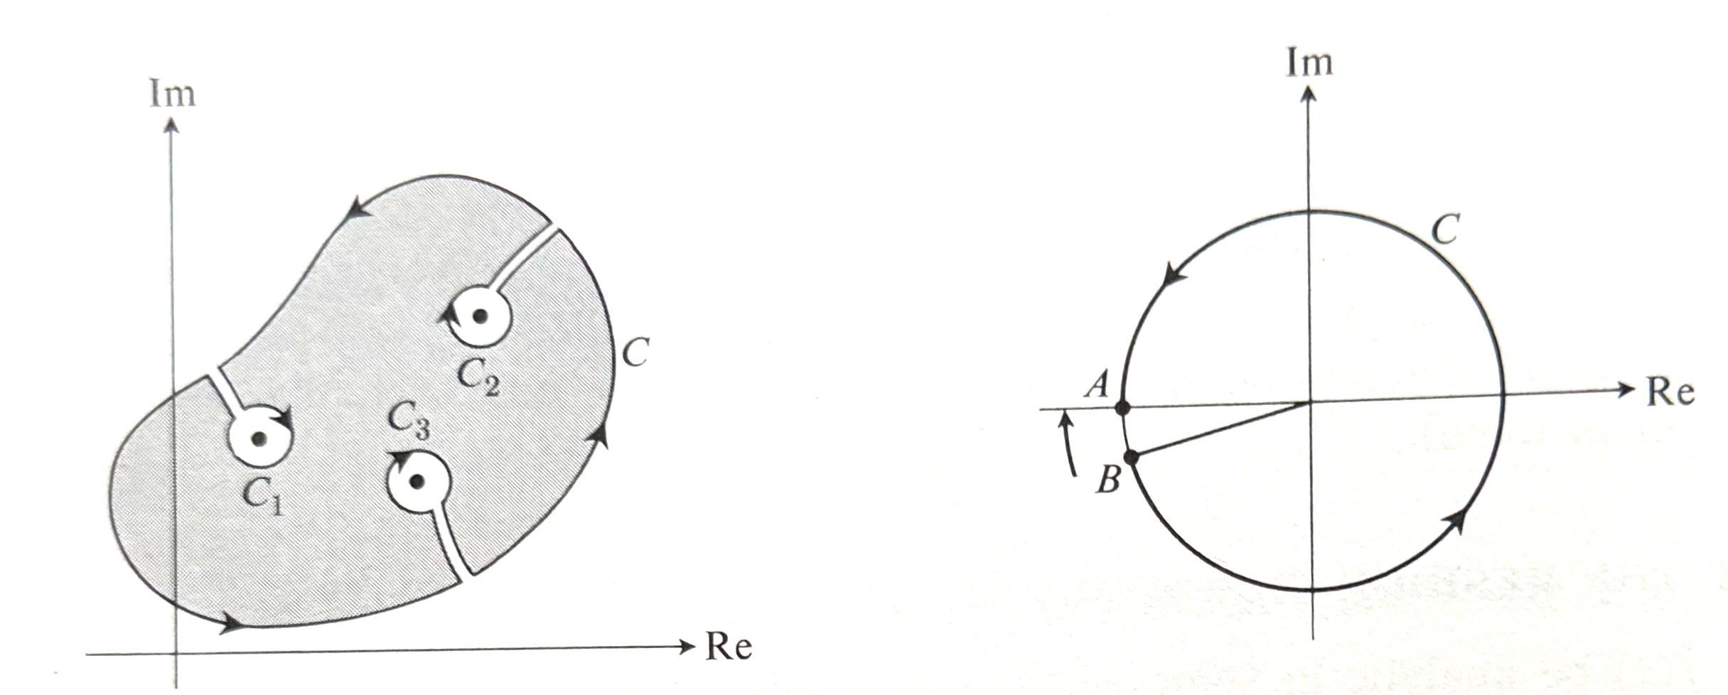
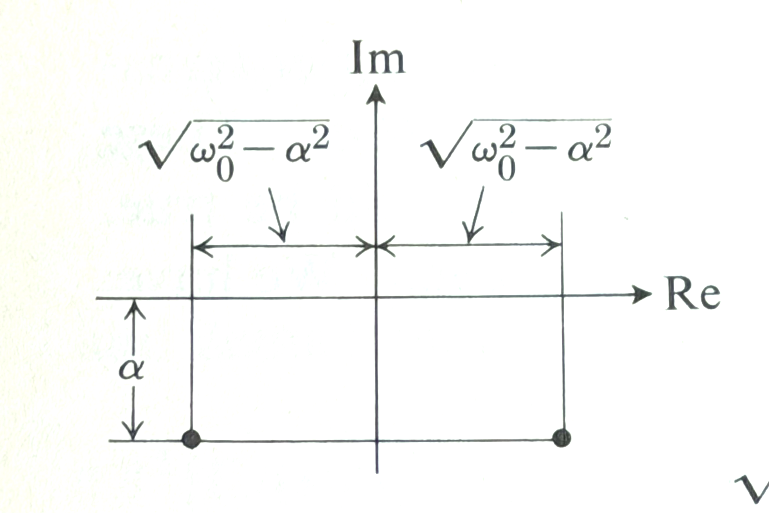
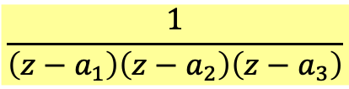
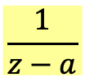
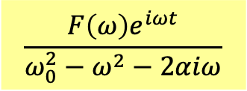

Contour integral is zero only for analytic functions.
Nonanalytic functions could be:
$$\frac{1}{z−a}$$
This function diverges at $z=a$. We call it a pole of order one!
$$\frac{1}{\left(z−a_{1}\right)\left(z−a_{2}\right)\left(z−a_{3}\right)}$$
This function has 3 poles at $z=a_{1},a_{2},a_{3}$!
$$\frac{F\left(ω\right)e^{iωt}}{ω_{0}^{2}−ω^{2}−2αiω}$$
These functions have isolated singularities.

Slide 11
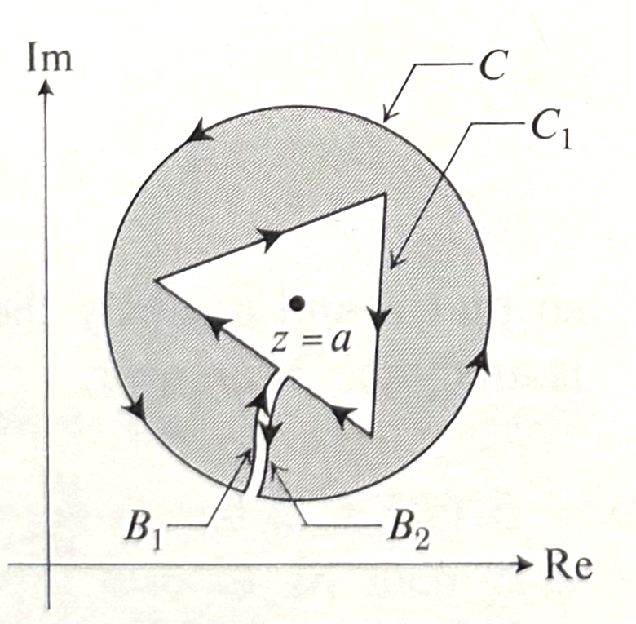
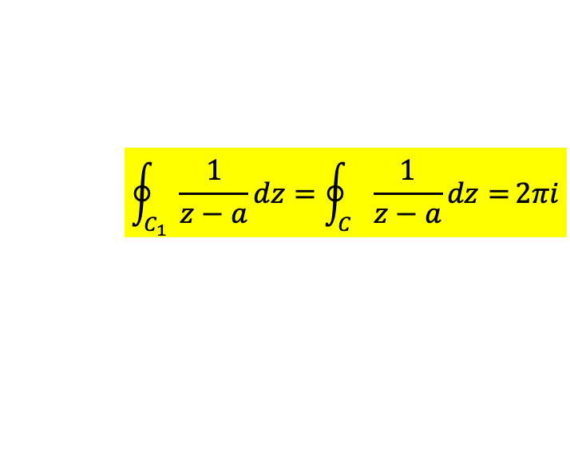
With Cauchy Theorem, we can devise contours that circumvent poles.
Along these contours, integrals equal zero.
This zero integral equals the difference between the integrals along contours $C, C_{1}$.
$$\oint_{C_{1}}{\frac{1}{z−a}dz}=\oint_{C}{\frac{1}{z−a}dz=}2πi$$
Contour integrals of the function with poles are equal, independent of contours.

Slide 12
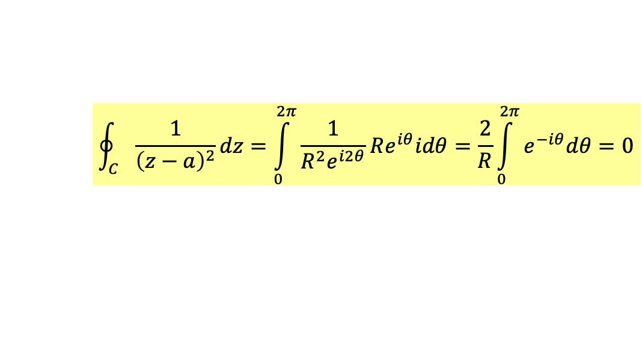

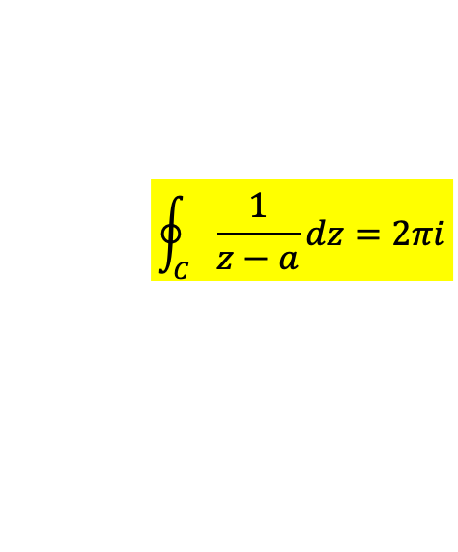



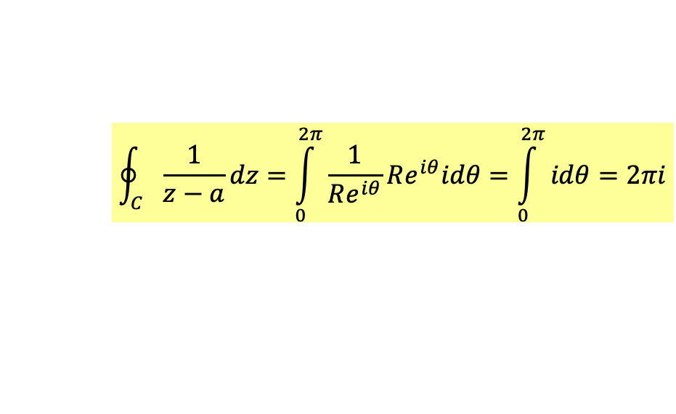
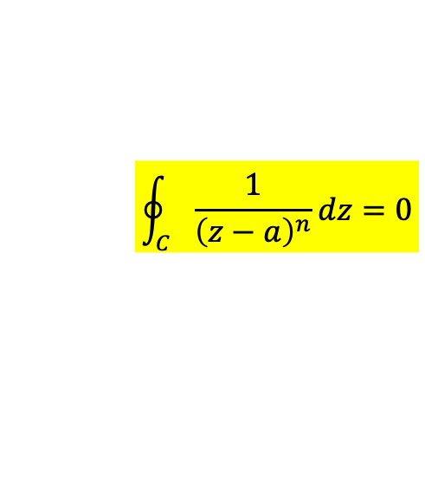
We can compute contour integral of functions with a pole choosing the best contour:
a circle with center at $z=a$.
$$\oint_{C}{\frac{1}{z−a}dz}=\int_{0}^{2π}{\frac{1}{Re^{iθ}}Re^{iθ}idθ}=\int_{0}^{2π}{idθ}=2πi$$
$$θ$$
$$\oint_{C}{\frac{1}{z−a}dz}=2πi$$
The result is independent of $R$.
Contour integral of functions with poles of order two or higher is zero.
$$\oint_{C}{\frac{1}{{\left(z−a\right)}^{2}}dz}=\int_{0}^{2π}{\frac{1}{R^{2}e^{i2θ}}Re^{iθ}idθ}=\frac{2}{R}\int_{0}^{2π}{e^{−iθ}dθ}=0$$
$$\oint_{C}{\frac{1}{{\left(z−a\right)}^{n}}dz}=0$$
Contour integrals of a function around its pole are equal, independent of contours.
$$\oint_{C_{1}}{\frac{1}{z−a}dz}=\oint_{C}{\frac{1}{z−a}dz=}2πi$$

Slide 13
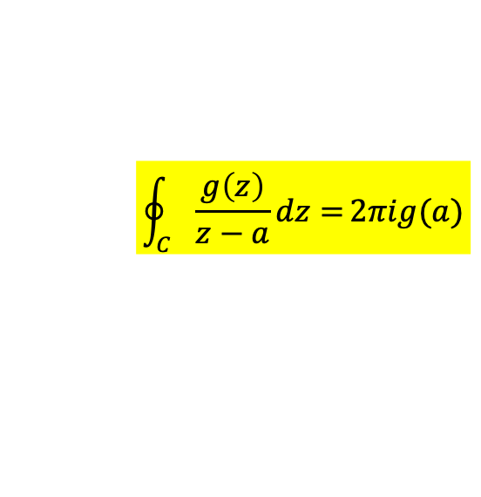
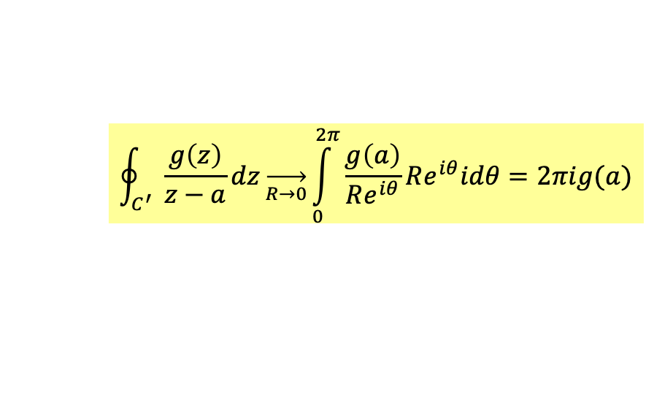
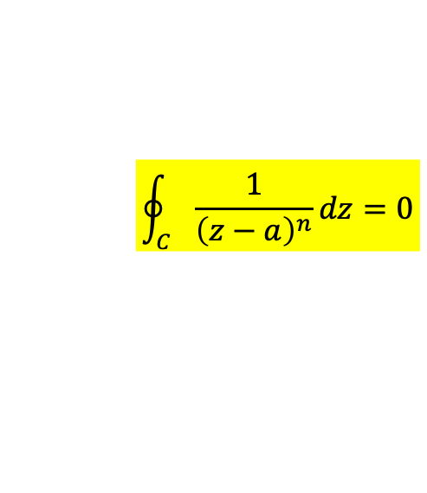
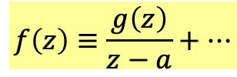

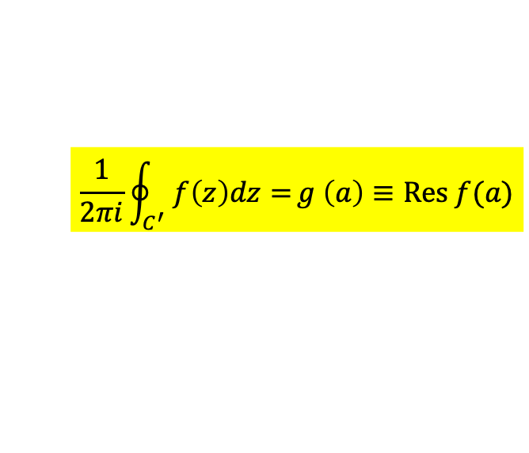
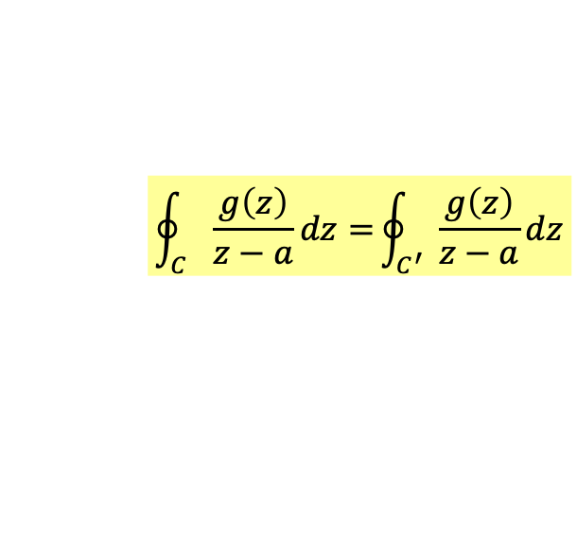
Cauchy Integral Formula
$$\oint_{C}{\frac{g\left(z\right)}{z−a}dz=}\oint_{C^{′}}{\frac{g\left(z\right)}{z−a}dz}$$
$$\oint_{C^{′}}{\frac{g\left(z\right)}{z−a}dz}\overset{→}{R→0}\int_{0}^{2π}{\frac{g\left(a\right)}{Re^{iθ}}Re^{iθ}idθ}=2πig(a)$$
$$\oint_{C}{\frac{g\left(z\right)}{z−a}dz=}2πig(a)$$
We can calculate the function value in the middle from values on the edge.
For a function $f\left(z\right)$ with a pole at $z=a$:
(you could add analytic function $A\left(z\right)$ or higher poles $\frac{1}{{\left(z−a\right)}^{n}}$, only pole order $1$ matters)
$$f\left(z\right)≡\frac{g\left(z\right)}{z−a}+…$$
$$\oint{A\left(z\right)dz}=0$$
$$\frac{1}{2πi}\oint_{C^{′}}{f\left(z\right)dz=}g \left(a\right)≡Res f(a)$$
$$\oint_{C}{\frac{1}{{\left(z−a\right)}^{n}}dz}=0$$
This only non-zero contour integral of $f\left(z\right)$ is called its residue 留數.

Slide 14

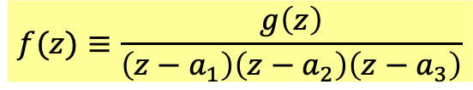
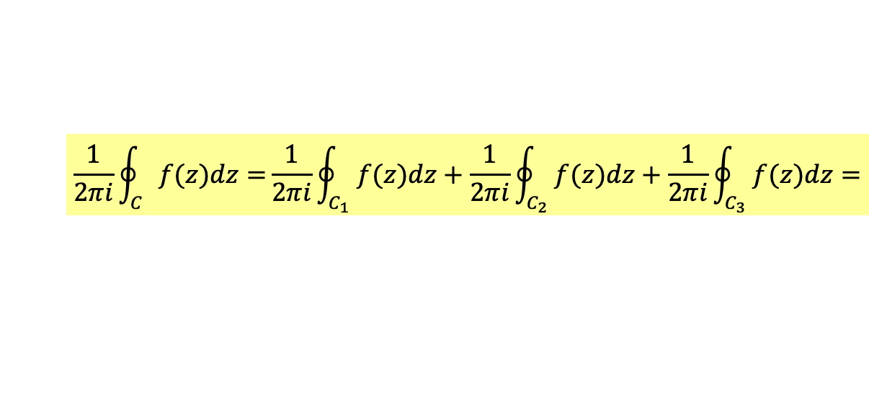
If the function has more than one poles, contour integral would be the sum
of its residue at all the poles, defined as the contour integral along small circles round the poles.
$$f(z)≡\frac{g\left(z\right)}{\left(z−a_{1}\right)\left(z−a_{2}\right)\left(z−a_{3}\right)}$$
$$\frac{1}{2πi}\oint_{C}{f(z)dz=}\frac{1}{2πi}\oint_{C_{1}}{f(z)dz}+\frac{1}{2πi}\oint_{C_{2}}{f(z)dz}+\frac{1}{2πi}\oint_{C_{3}}{f(z)dz=}$$
$$=Res f\left(a_{1}\right)+Res f\left(a_{2}\right)+Res f(a_{3})$$

Slide 15
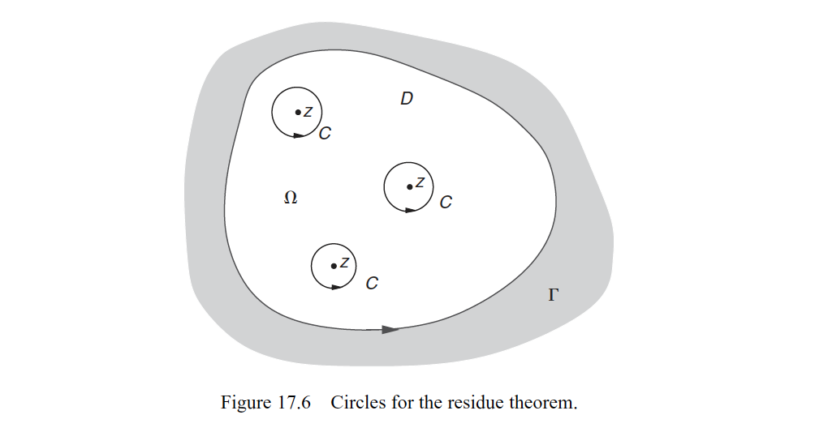



$$\oint_{C}{f(z)dz=2πi}\sum_{k=1}^{n}{Res f\left(a_{k}\right)}$$
Contour integrals of a function equal the sum of residues of poles inside the contour.
$$f(z)≡\frac{g\left(z\right)}{z−a}$$
$$Res f\left(a\right)=\frac{1}{2πi}\oint_{C}{f\left(z\right)dz=}g(a)$$
The residue at a pole is defined as the contour integral along a small circle around the pole.

Slide 16



$$\frac{d^{2}x}{dt^{2}}+2α\frac{dx}{dt}+ω_{0}^{2}x=f\left(t\right)$$
General forced oscillation
$$A\left(ω\right)=\frac{F\left(ω\right)}{ω_{0}^{2}−ω^{2}−2αiω}$$
Taking the inverse Fourier Transformation of $A\left(ω\right)$, we solved the ODE.
$$x\left(t\right)=\frac{1}{\sqrt{2π}}\int_{−∞}^{∞}{\frac{F\left(ω\right)e^{−iωt}}{ω_{0}^{2}−ω^{2}−2αiω}∙dω}$$
How to do the integral? Complex analysis.

Slide 17

















$$ω$$
$$\frac{F\left(ω\right)e^{−iωt}}{ω_{0}^{2}−ω^{2}−2αiω}$$
Elevate $ω$ to complex number.
$$\frac{F\left(ω\right)e^{−iωt}}{\left(ω−ω_{2}\right)\left(ω_{1}−ω\right)}$$
$$ω_{2}$$
$$ω_{1}$$
There are Poles at:
$$ω=−αi±\sqrt{ω_{0}^{2}−α^{2}}≡ω_{1,2}$$
$$\frac{F\left(ω\right)e^{iωt}}{\left(ω−ω_{2}\right)}∙\frac{1}{\left(ω_{1}−ω\right)}$$
$$f(z)≡\frac{g\left(z\right)}{z−a}$$
For the pole at $ω_{1}$:
$$Res f\left(a\right)=g(a)$$
$$=\frac{F\left(ω_{1}\right)e^{iω_{1}t}}{\left(ω_{1}−ω_{2}\right)}$$
$Res$ at $ω_{1}$
For the pole at $ω_{2}$:
$$\frac{F\left(ω\right)e^{iωt}}{\left(ω_{1}−ω\right)}∙\frac{1}{\left(ω−ω_{2}\right)}$$
$$=−\frac{F\left(ω_{2}\right)e^{iω_{2}t}}{\left(ω_{1}−ω_{2}\right)}$$
$Res$ at $ω_{2}$

Slide 18












Consider a contour of lower half circle:
$$\oint{\frac{F\left(ω\right)e^{−iωt}}{ω_{0}^{2}−ω^{2}−2αiω}∙dω}$$
$$ω$$
$$R$$
$$θ$$
The contour integral equals sum of the residues at $ω_{1,2}$.
The contour integral is the same regardless of $R$.
$$C$$
$$\oint{\frac{F\left(ω\right)e^{−iωt}}{ω_{0}^{2}−ω^{2}−2αiω}∙dω}=\int_{−R}^{R}{\frac{F\left(ω\right)e^{−iωt}}{ω_{0}^{2}−ω^{2}−2αiω}∙dω}+\int_{C}{\frac{F\left(ω\right)e^{−iωt}}{ω_{0}^{2}−ω^{2}−2αiω}∙dω}$$
The integral on real axis is part of this contour integral.
On the lower circle $C$, the imaginary part of $ω$ in the exponential is proportional to $R$.
$e^{−iωt}$ becomes small as the circle becomes large if
$$t>0$$
$$Im ω=−R\sin{θ}$$
$$e^{−iωt}∝e^{−R\sin{θ}t}\overset{→}{\begin{aligned}R→∞ \\ t>0\end{aligned}}0$$
Take the limit $R→∞$, the integral along $C$ vanishes.
$$\int_{C}{\frac{F\left(ω\right)e^{−iωt}}{ω_{0}^{2}−ω^{2}−2αiω}∙dω}\overset{→}{R→∞}0$$

Slide 19




Contour integrals of a function equal the sum of residues of poles inside.
The contour integral equals the integral on the real axis:
$$\oint{\frac{F\left(ω\right)e^{−iωt}}{ω_{0}^{2}−ω^{2}−2αiω}∙dω}\overset{→}{R→∞}\int_{−∞}^{∞}{\frac{F\left(ω\right)e^{−iωt}}{ω_{0}^{2}−ω^{2}−2αiω}∙dω}=2πi\left(Res \text{at} ω_{1}\text{+} Res \text{at} ω_{2}\right)$$
$$x\left(t\right)=\frac{1}{\sqrt{2π}}\int_{−∞}^{∞}{\frac{F\left(ω\right)e^{−iωt}}{ω_{0}^{2}−ω^{2}−2αiω}∙dω}=i\sqrt{2π}\left[\frac{F\left(ω_{1}\right)e^{−iω_{1}t}}{\left(ω_{1}−ω_{2}\right)}−\frac{F\left(ω_{2}\right)e^{−iω_{2}t}}{\left(ω_{1}−ω_{2}\right)}\right]$$
$$=i\sqrt{2π}\frac{1}{\left(ω_{1}−ω_{2}\right)}\left[F\left(ω_{1}\right)e^{−iω_{1}t}−F\left(ω_{2}\right)e^{−iω_{2}t}\right]$$
$$ω$$

Slide 20




What if
$$t<0$$
Now we would choose an upper half circle.
On the upper circle $C$, the imaginary part of $ω$ is positive.
$$Im ω=R\sin{θ}$$
$e^{−iωt}$ again becomes small as the circle becomes large.
$$e^{−iωt}∝e^{R\sin{θ}t}\overset{→}{\begin{aligned}R→∞ \\ t<0\end{aligned}}0$$
$$\oint{\frac{F\left(ω\right)e^{−iωt}}{ω_{0}^{2}−ω^{2}−2αiω}∙dω}\overset{→}{R→∞}\int_{−∞}^{∞}{\frac{F\left(ω\right)e^{−iωt}}{ω_{0}^{2}−ω^{2}−2αiω}∙dω}=0$$
But now the contour does not surround the poles, and the integral is zero.

Slide 21







As an example, consider:
$$F\left(ω\right)≡ℱ\left\{f\left(t\right)\right\}=\frac{1}{\sqrt{2π}}\int_{−∞}^{∞}{f\left(t\right)∙e^{iωt}∙dt}=\frac{1}{\sqrt{2π}}\int_{−τ}^{τ}{f_{0}e^{iωt}∙dt}$$
$$F\left(ω\right)=\sqrt{\frac{2}{π}}f_{0}\frac{\sin{ωτ}}{ω}$$
$$x(t)=2if_{0}\left[\frac{\sin{ω_{1}τ}}{ω_{1}\left(ω_{1}−ω_{2}\right)}e^{−iω_{1}t}−\frac{\sin{ω_{2}τ}}{ω_{2}\left(ω_{1}−ω_{2}\right)}e^{−iω_{2}t}\right]$$
$$ω_{1,2}=±\sqrt{ω_{0}^{2}−α^{2}}−αi≡=±p−αi$$
$x(t)$ can be simplified into a real form:
$$x(t)=\frac{f_{0}}{ω_{0}^{2}}\left[\cos{p\left(t−τ\right)}+\frac{α}{p}\sin{p\left(t−τ\right)}\right]e^{−α\left(t−τ\right)}$$
$$−\frac{f_{0}}{ω_{0}^{2}}\left[\cos{p\left(t+τ\right)}+\frac{α}{p}\sin{p\left(t+τ\right)}\right]e^{−α\left(t+τ\right)}$$

