Slide 1
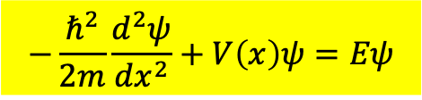
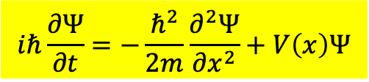

Schrodinger Wave Equation for the complex wave function $Ψ\left(x,t\right)$.
$$iℏ\frac{∂Ψ}{∂t}=−\frac{ℏ^{2}}{2m}\frac{∂^{2}Ψ}{∂x^{2}}+V\left(x\right)Ψ$$
This equation has separable stationary solutions.
$$Ψ\left(x,t\right)=ψ\left(x\right)∙φ\left(t\right)$$
The time evolution $φ\left(t\right)$ is simply a Phase factor：$e^{−i\frac{E}{ℏ}t}$。
The $x$-dependent $ψ\left(x\right)$ satisfies Time-Independent Schrodinger Equation：
$$−\frac{ℏ^{2}}{2m}\frac{d^{2}ψ}{dx^{2}}+V\left(x\right)ψ=Eψ$$

Slide 2



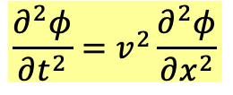



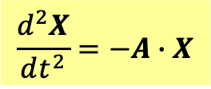
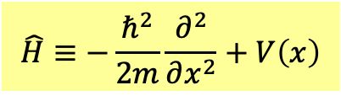


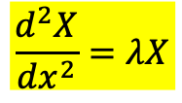
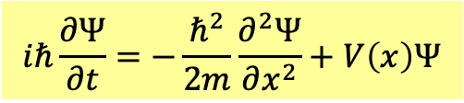




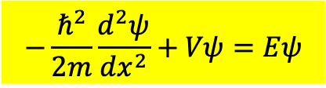
對照表
$$\frac{d^{2}X}{dt^{2}}=−A∙X$$
$$\frac{∂^{2}φ}{∂t^{2}}=v^{2}\frac{∂^{2}φ}{∂x^{2}}$$
$$iℏ\frac{∂Ψ}{∂t}=−\frac{ℏ^{2}}{2m}\frac{∂^{2}Ψ}{∂x^{2}}+V\left(x\right)Ψ$$
$$A$$
$$\frac{d^{2}}{dx^{2}}$$
微分運算稱為算子
$$\hat{H}≡−\frac{ℏ^{2}}{2m}\frac{∂^{2}}{∂x^{2}}+V\left(x\right)$$
Time Part
$$X=Reae^{iωt}=aa_{m}\cos\left(ωt+φ\right)$$
$$φ=X\left(x\right)∙\cos\left(ωt+φ\right)$$
$$Ψ=ψ\left(x\right)∙e^{−i\frac{E}{ℏ}t}$$
Space Part
$$a$$
$$X\left(x\right)$$
$$ψ\left(x\right)$$
$$\frac{d^{2}X}{dx^{2}}=λX$$
$$−\frac{ℏ^{2}}{2m}\frac{d^{2}ψ}{dx^{2}}+Vψ=Eψ$$
$$−A∙a=λa$$
矩陣$A$的本徵值方程式！
算子 $\frac{d^{2}}{dx^{2}}$的本徵值方程式！
算子$\hat{H}$的本徵值方程式！

Slide 3
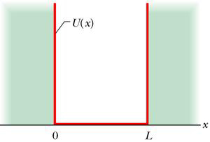
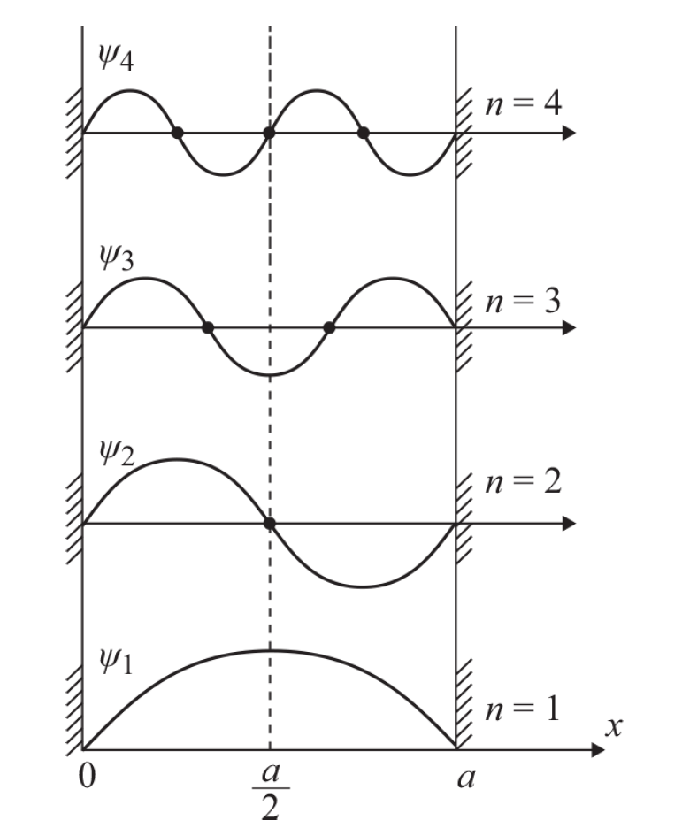
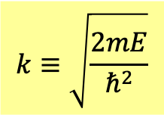
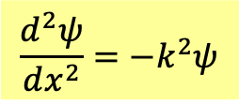

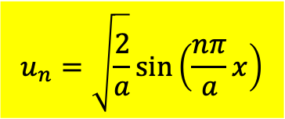
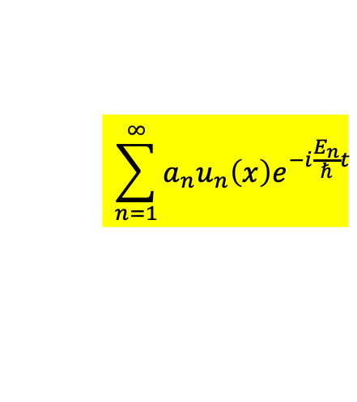
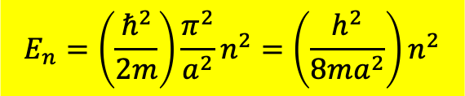


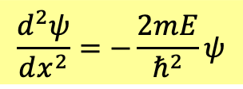



有邊界之自由電子
$$V\left(x\right)$$
在邊界內，如同自由電子：$V\left(x\right)=0$。
$$\frac{d^{2}ψ}{dx^{2}}=−\frac{2mE}{ℏ^{2}}ψ$$
$$k≡\sqrt{\frac{2mE}{ℏ^{2}}}$$
若$E>0$
$$\frac{d^{2}ψ}{dx^{2}}=−k^{2}ψ$$
$$a$$
$$ψ=Ae^{ikx}+Be^{−ikx}=C\cos{kx}+D\sin{kx}$$
邊界條件：
$$ψ\left(0\right)=0$$
$$ψ\left(a\right)=0$$
$$u_{n}=\sqrt{\frac{2}{a}}\sin\left(\frac{nπ}{a}x\right)$$
只有在$k=\frac{nπ}{a}$才有解。
$$E_{n}=\left(\frac{ℏ^{2}}{2m}\right)\frac{π^{2}}{a^{2}}n^{2}=\left(\frac{h^{2}}{8ma^{2}}\right)n^{2}$$
Linear combinations of stationay state are still solutions.
$$\sum_{n=1}^{∞}{a_{n}u_{n}\left(x\right)e^{−i\frac{E_{n}}{ℏ}t}}$$

Slide 4
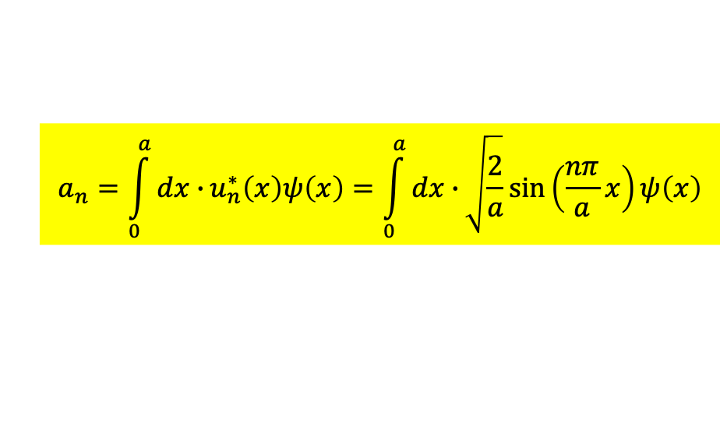
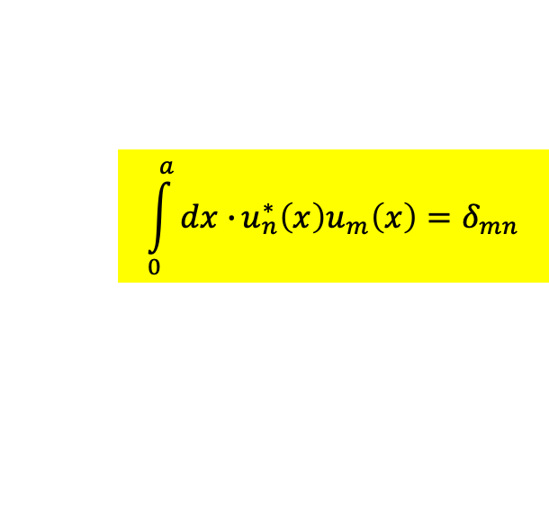

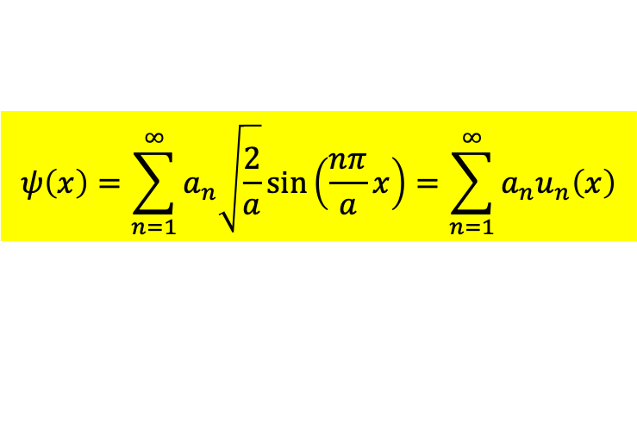
根據傅立葉分析，滿足邊界條件的任何函數$ψ\left(x\right)$，
都可以分解為正弦函數、也就是$u_{n}$的疊加！
Any function can be expanded as linear combinations of $u_{n}$, the Sine function.
This is the so-called Fourier Series. $u_{n}$, the Sine Functions are complete.
$u_{n}$具有完備性！展開定理Expansion Theorem
$$ψ\left(x\right)=\sum_{n=1}^{∞}{a_{n}\sqrt{\frac{2}{a}}\sin\left(\frac{nπ}{a}x\right)}=\sum_{n=1}^{∞}{a_{n}u_{n}\left(x\right)}$$
很容易證明正弦函數$u_{n}$滿足正交定理，
$$\int_{0}^{a}{dx∙}u_{n}^{∗}\left(x\right)u_{m}\left(x\right)=δ_{mn}$$
分量components $a_{n}$可以利用$u_{n}$彼此正交的特性計算出來：
$$a_{n}=\int_{0}^{a}{dx∙}u_{n}^{∗}\left(x\right)ψ\left(x\right)=\int_{0}^{a}{dx∙}\sqrt{\frac{2}{a}}\sin\left(\frac{nπ}{a}x\right)ψ\left(x\right)$$

Slide 5
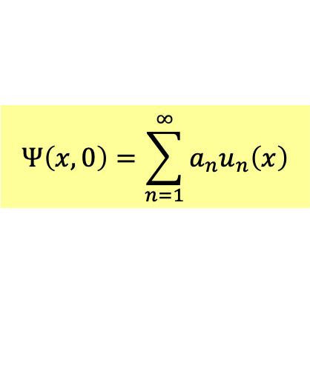
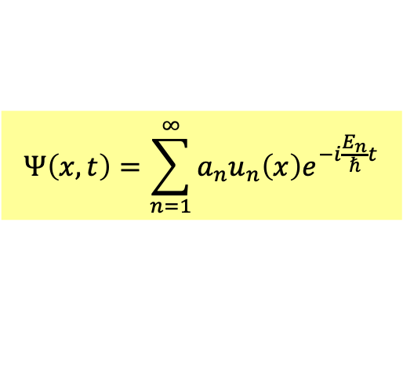
這一展開式提供對無限大位能井位能下薛丁格波方程式的普遍解法：
將$t=0$時的波函數，即起始條件，對定態解$u_{n}$展開如下：
$$Ψ\left(x,0\right)=\sum_{n=1}^{∞}{a_{n}u_{n}\left(x\right)}$$
根據展開定理，這永遠可以做到！
$t=0$時此狀態可以視為定態$u_{n}$的如上疊加，
接著定態隨時間個自演化，位能下薛丁格方程式要求$u_{n}$乘$\text{上}e^{−i\frac{E_{n}}{ℏ}t}$。
乘完之後依同樣方式疊加，整個波函數也就滿足薛丁格波方程式。
$$Ψ\left(x,t\right)=\sum_{n=1}^{∞}{a_{n}u_{n}\left(x\right)e^{−i\frac{E_{n}}{ℏ}t}}$$

Slide 6





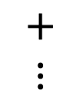


各個配料分離烹煮
$$+$$
$$＝$$
$$+$$
$$+$$
$$+$$
$$⋮$$

Slide 7
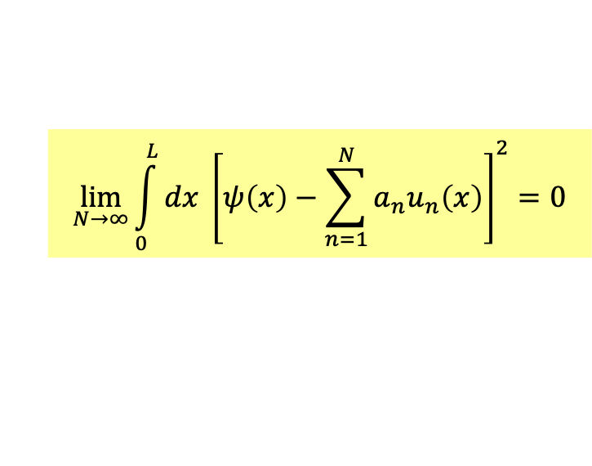
若確認任一合邊界條件的函數可以本徵函數分解，我們就能計算其分解係數$a_{n}$。
但這樣的分解真的是正確的嗎？分解所得的無限級數真的與被分解的函數相等嗎？
數學上相等與否的判準：這些係數組成的$u_{n}$的線性組合，會趨近被分解的函數。
$$\lim_{N→∞}{\int_{0}^{L}{dx {\left[ψ\left(x\right)−\sum_{n=1}^{N}{a_{n}u_{n}\left(x\right)}\right]}^{2}}}=0$$
兩者差距的平方和(積分)$N→∞$時，趨近於零。
這稱為Completeness.完備性，必須嚴格證明的。下學期將說明。

Slide 8


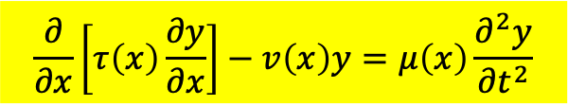
We will extend our results in the infinite quantum well in two directions:
First, you can solve more general partial differential equation in identical way:
The fact that $u_{n}$’s are orthogonal and complete is true for more general PDE.
Sturm-Liouville Problem
$$\frac{∂}{∂x}\left[τ\left(x\right)\frac{∂y}{∂x}\right]−v\left(x\right)y=μ\left(x\right)\frac{∂^{2}y}{∂t^{2}}$$
Second, let the boundary go to infinity $a→∞$.
We will find a similar formalism for the space without boundary!

Slide 9
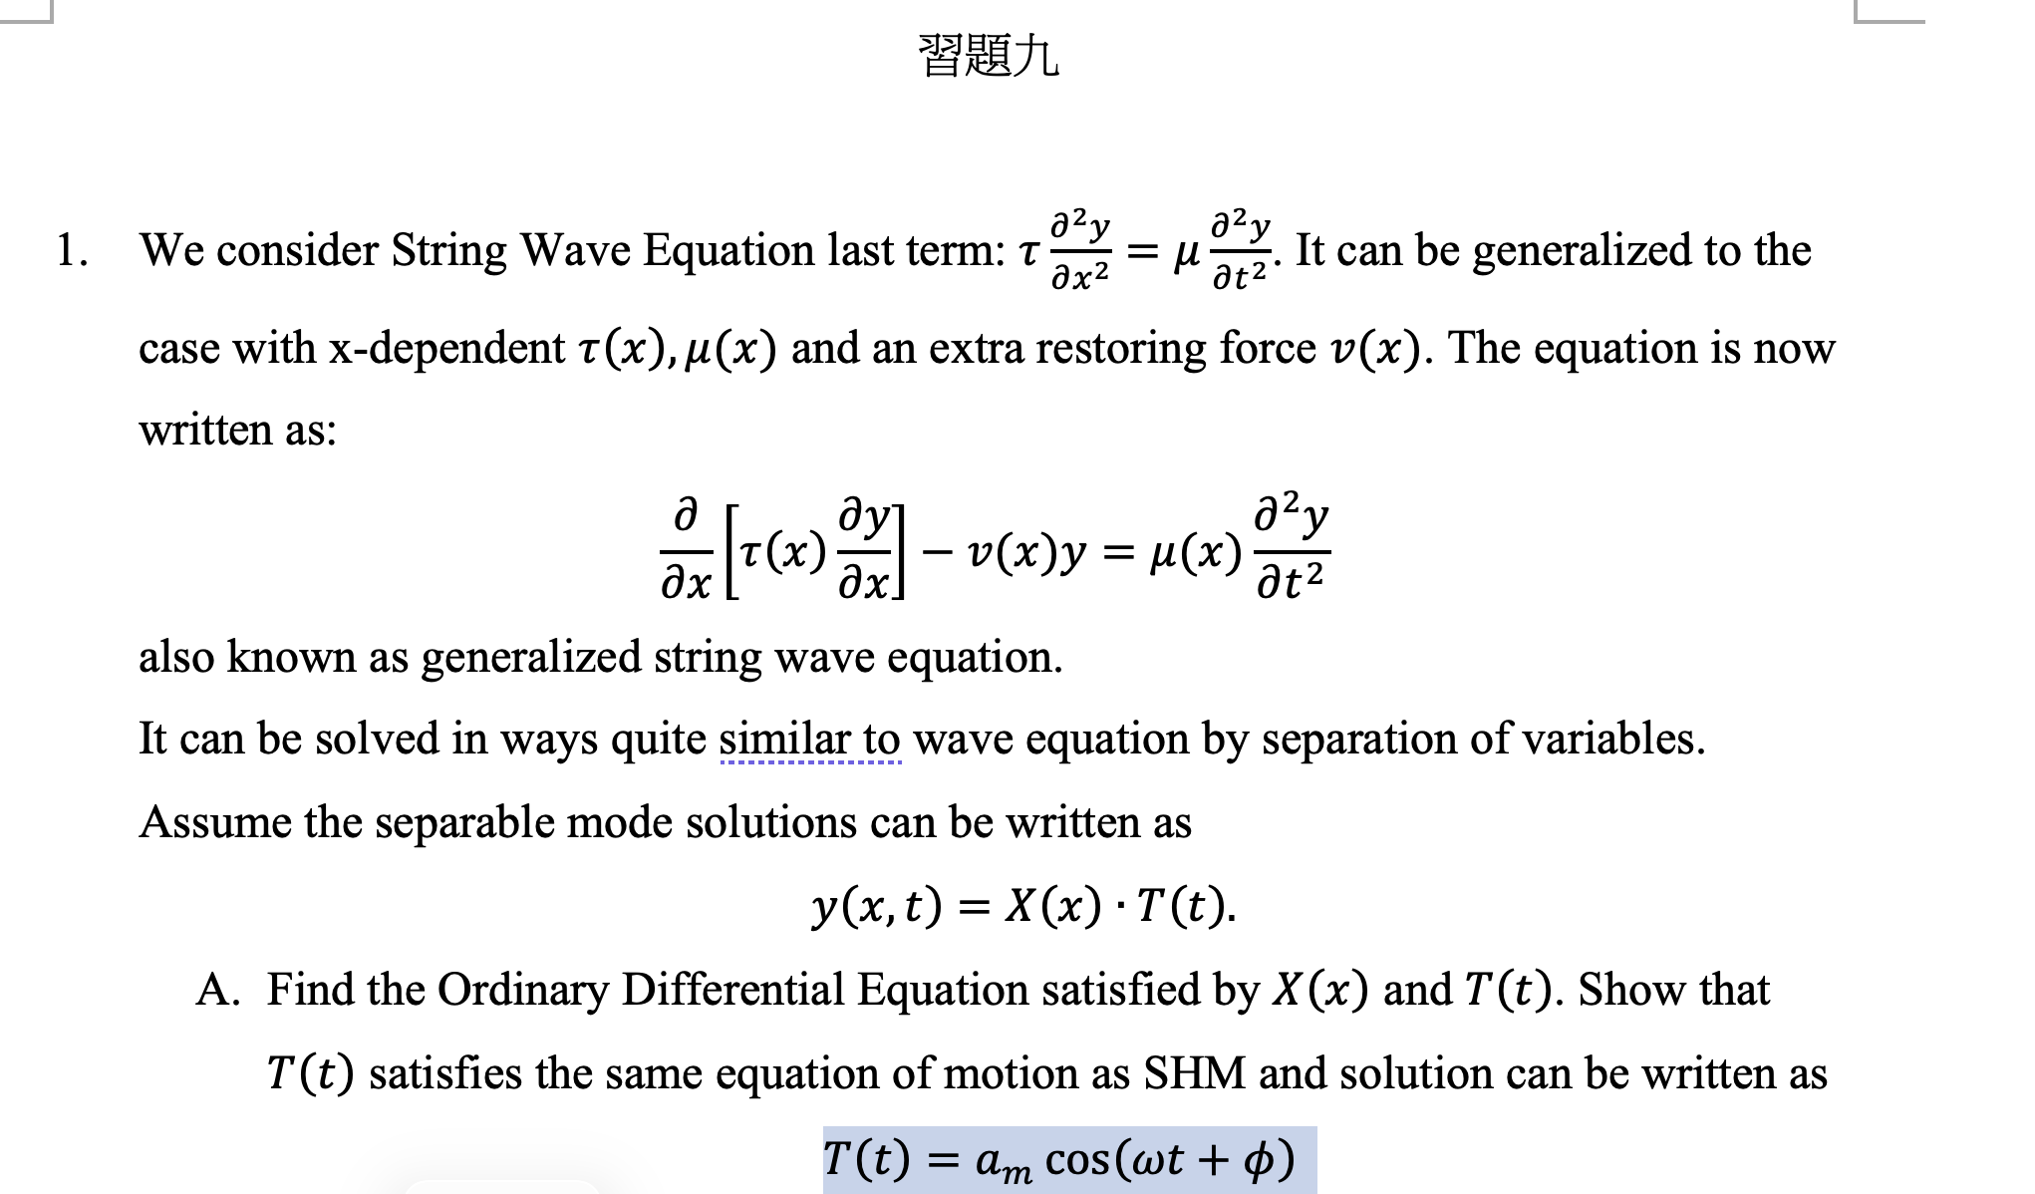
Tension $τ\left(x\right)$ and Mass density $μ\left(x\right)$ could be $x$ dependent
There could be extra external spring force $∝y$ with $x$ dependent $k=v\left(x\right).$

Slide 10
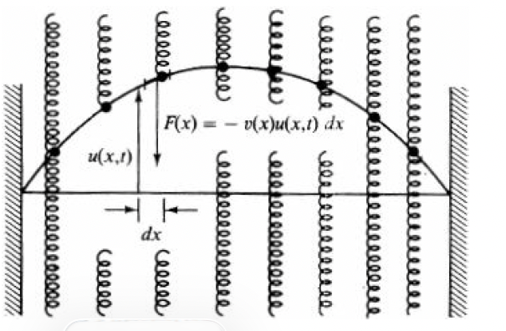

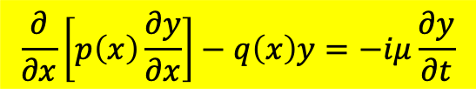
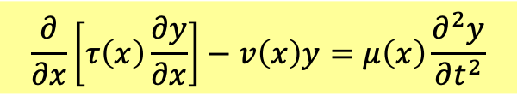

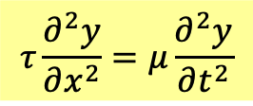

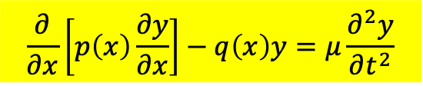
Sturm-Liouville Problem
$$\frac{∂}{∂x}\left[τ\left(x\right)\frac{∂y}{∂x}\right]−v\left(x\right)y=μ\left(x\right)\frac{∂^{2}y}{∂t^{2}}$$
$$τ\frac{∂^{2}y}{∂x^{2}}=μ\frac{∂^{2}y}{∂t^{2}}$$
Tension $τ\left(x\right)$ and Mass density $μ\left(x\right)$ could be $x$ dependent
There could be extra external spring force $∝y$ with $x$ dependent $k=v\left(x\right).$
$$\frac{∂}{∂x}\left[p\left(x\right)\frac{∂y}{∂x}\right]−q\left(x\right)y=μ\frac{∂^{2}y}{∂t^{2}}$$
$$\frac{∂}{∂x}\left[p\left(x\right)\frac{∂y}{∂x}\right]−q\left(x\right)y=−iμ\frac{∂y}{∂t}$$
or
Assume the separable mode solutions can be written as
$$y\left(x,t\right)=f\left(x\right)∙T\left(t\right)$$
Time part can be solved right away:
$$T\left(t\right)=a_{m}\cos\left(\sqrt{λ}t+φ\right)$$
or
$$T\left(t\right)=e^{i\frac{λ}{μ}t}$$

Slide 11
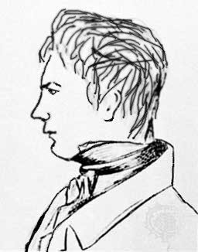
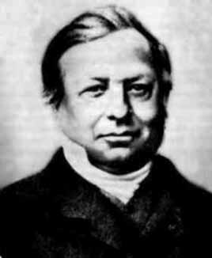
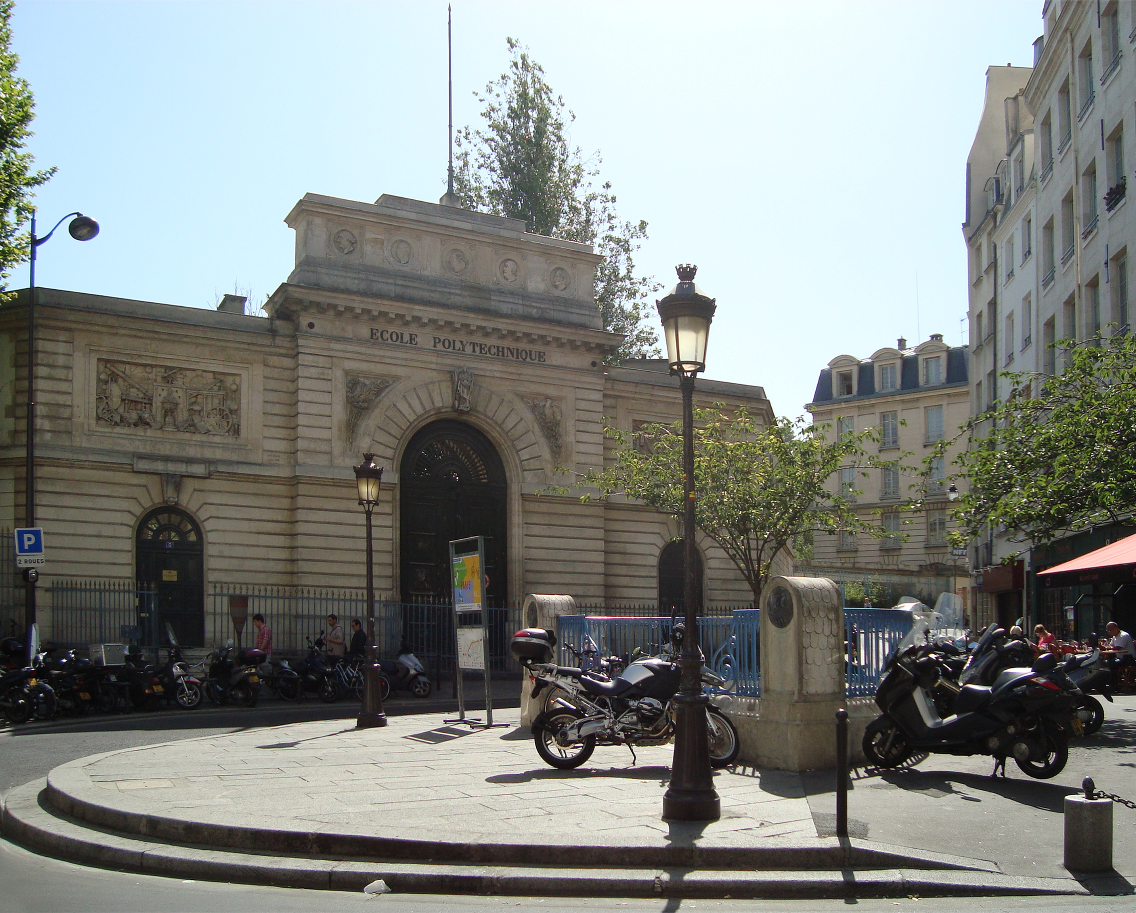
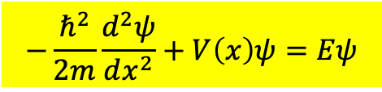
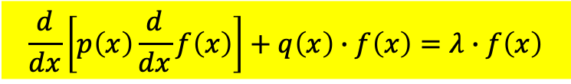

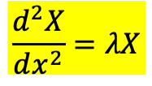

Space part satisfies the following equation:
術語稱為 Sturm-Liouville Problem 算子的本徵函數問題
$$\frac{d}{dx}\left[p\left(x\right)\frac{d}{dx}f\left(x\right)\right]+q\left(x\right)∙f\left(x\right)=λ∙f\left(x\right)$$
$λ$是數：本徵值，若加邊界條件下通常只有某些值，此式才有解。
$f\left(x\right)$ share the same ODE with Time-Independent Schrodinger Equation.
$$−\frac{ℏ^{2}}{2m}\frac{d^{2}ψ}{dx^{2}}+V\left(x\right)ψ=Eψ$$
$p\left(x\right)=−\frac{ℏ^{2}}{2m},$ $q\left(x\right)=V(x)$
and the space part of classical wave equation:
$$\frac{d^{2}X}{dx^{2}}=λX$$
$p\left(x\right)=1,$ $q\left(x\right)=0$
Jacques Sturm 1803-1855
Joseph Liouville 1809-1882
École Polytechnique

Slide 12
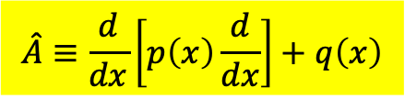

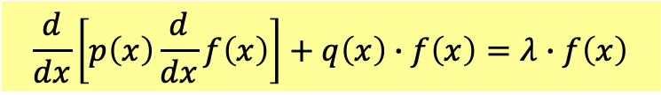

術語稱為 Sturm-Liouville Problem 算子的本徵函數問題
$$\frac{d}{dx}\left[p\left(x\right)\frac{d}{dx}f\left(x\right)\right]+q\left(x\right)∙f\left(x\right)=λ∙f\left(x\right)$$
We can denote the operation on the function $f\left(x\right)$ as an operator $\hat{A}$.
$$\hat{A}≡\frac{d}{dx}\left[p\left(x\right)\frac{d}{dx}\right]+q\left(x\right)$$
The equation can be written as:
$$\hat{A}∙f\left(x\right)=λ∙f\left(x\right)$$
$$−A∙a=λa$$
This will be called Sturm-Liouville Eigenfunction Equation of Operator $\hat{A}$.

Slide 13
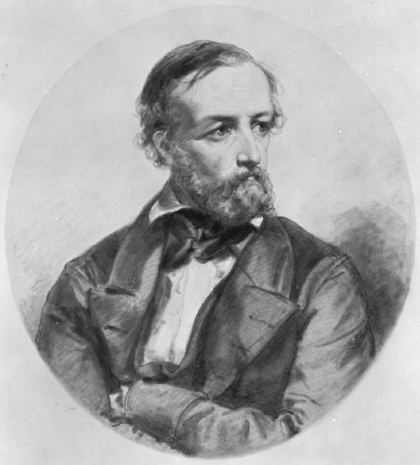
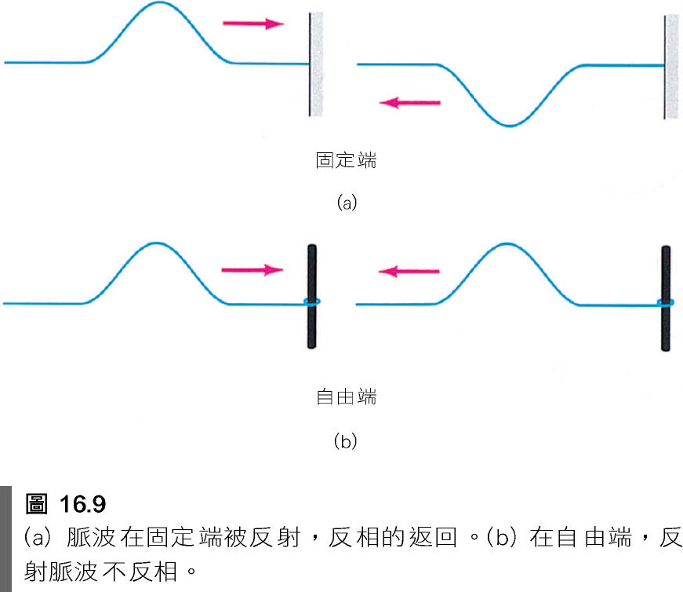



Boundary Conditions
$$V\left(x\right)$$
Johann Dirichlet 1805-1889
Dirichlet Condition
$$f\left(a\right)=f\left(b\right)=0$$
$$a$$

Slide 14
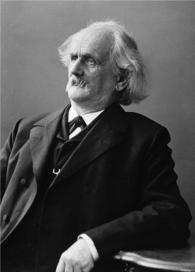

Boundary Conditions
Johann Dirichlet 1805-1889
Dirichlet Condition
$$f\left(a\right)=f\left(b\right)=0$$
Neumann Condition
$$f′\left(a\right)=f′\left(b\right)=0$$
Carl Neumann 1832-1925

Slide 15


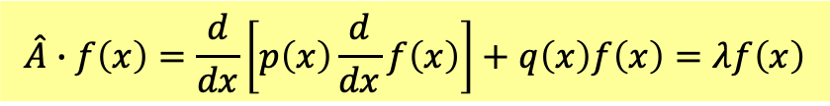


$$\hat{A}∙f\left(x\right)=\frac{d}{dx}\left[p\left(x\right)\frac{d}{dx}f\left(x\right)\right]+q\left(x\right)f\left(x\right)=λf\left(x\right)$$
Under boundary conditions, the equation has a countable set of solutions.
We can usually classify them by natural numbers: $n$.
The eigenfunctions are $u_{n}$ and their corresponding eigenvalues are $λ_{n}$.
$$\hat{A}∙u_{n}\left(x\right)=λ_{n}∙u_{n}\left(x\right)$$
本徵值皆為實數 Eignevalues are all real：
$$T\left(t\right)=e^{i\frac{λ_{n}}{μ}t}$$
$$λ_{n}^{∗}=λ_{n}$$
Time part will be oscillating:
不同本徵值的本徵函數滿足如下正交關係，因此可取為orthonomal：
Eigenfunctions of different Eignevalues are orthogonal to each other.
$$\int_{a}^{b}{dx∙}u_{n}{\left(x\right)}^{∗}∙u_{m}\left(x\right)=δ_{nm}$$

Slide 16
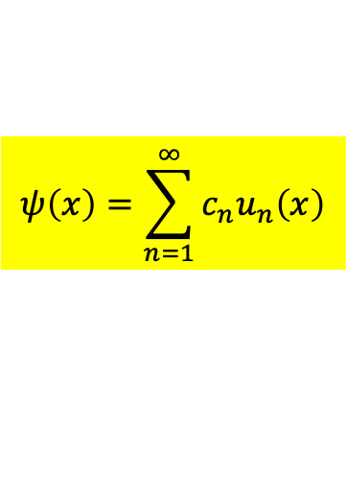
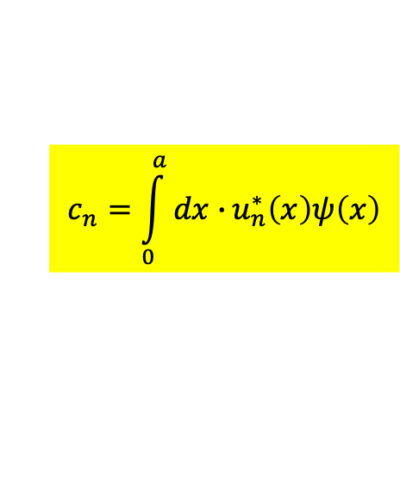

Any function can be expanded as linear combinations of $u_{n}$.
$u_{n}$, the eigenfunctions are complete.
$u_{n}$具有完備性！展開定理Expansion Theorem
$$ψ\left(x\right)=\sum_{n=1}^{∞}{c_{n}u_{n}\left(x\right)}$$
很容易證明正弦函數$u_{n}$滿足正交定理，
$$\int_{0}^{a}{dx∙}u_{n}^{∗}\left(x\right)u_{m}\left(x\right)=δ_{mn}$$
分量components $c_{n}$可以利用$u_{n}$彼此正交的特性計算出來：
$$c_{n}=\int_{0}^{a}{dx∙}u_{n}^{∗}\left(x\right)ψ\left(x\right)$$

Slide 17
$$ψ\left(x\right)=\sum_{n=1}^{∞}{c_{n}u_{n}\left(x\right)}$$
代入$ψ$的展開。
分量components $c_{n}$可以利用$u_{n}$彼此正交的特性計算出來：
$$\int_{−∞}^{∞}{dx∙}u_{n}^{∗}\left(x\right)ψ\left(x\right)=\int_{−∞}^{∞}{dx∙}u_{n}^{∗}\left(x\right)\left[\sum_{m=1}^{∞}{c_{m}u_{m}\left(x\right)}\right]$$
$$=\sum_{m=1}^{∞}{c_{m}}\int_{−∞}^{∞}{dx∙}u_{n}^{∗}\left(x\right)u_{m}\left(x\right)=\sum_{m=1}^{∞}{c_{m}δ_{mn}}=c_{n}$$
$$c_{n}=\int_{−∞}^{∞}{dx∙}u_{n}^{∗}\left(x\right)ψ\left(x\right)$$
分量$c_{a}$可以寫成態函數與本徵函數的空間積分。很像向量與基底的內積投影：

Slide 18
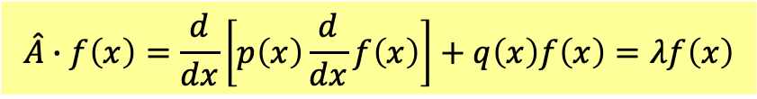
$$\hat{A}∙f\left(x\right)=\frac{d}{dx}\left[p\left(x\right)\frac{d}{dx}f\left(x\right)\right]+q\left(x\right)f\left(x\right)=λf\left(x\right)$$
The eigenfunctions are $u_{n}$ and their corresponding eigenvalues are $λ_{n}$.
$$\hat{A}∙u_{n}\left(x\right)=λ_{n}∙u_{n}\left(x\right)$$
本徵值皆為實數 Eignevalues are all real：
$$λ_{n}^{∗}=λ_{n}$$

Slide 19
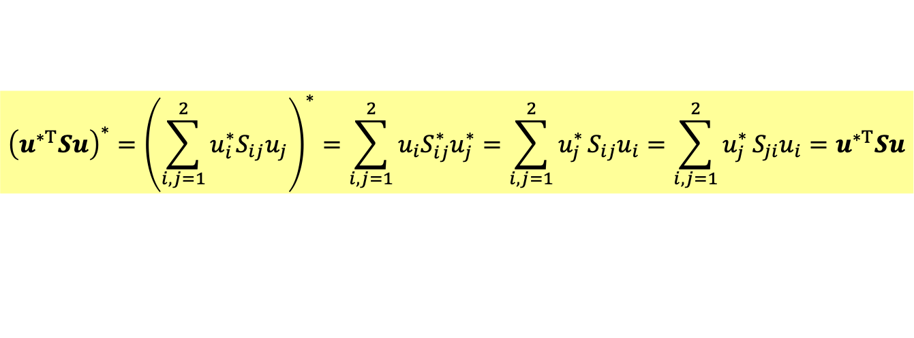




$\hat{A }的$所有本徵值$λ_{n}$都是實數！
All $n$ eigenvalues $λ$ of a symmetric matrix $S$ are real.
Proof:
$$Su=λu$$
Take a inner product of the both sides with the complex conjugate of eigenvector $u^{∗}$.
$$u^{∗T}Su=λu^{∗T}u$$
$u^{∗T}u=u_{1}^{∗}u_{1}+u_{2}^{∗}u_{2}$ is real. 這是複數行向量的內積，定義必定為實數。
要確認$u^{∗T}Su$是否是實數，取他的Complex conjugate
$${\left(u^{∗T}Su\right)}^{∗}={\left(\sum_{i,j=1}^{2}{u_{i}^{∗}S_{ij}u_{j}}\right)}^{∗}=\sum_{i,j=1}^{2}{u_{i}S_{ij}^{∗}u_{j}^{∗}}=\sum_{i,j=1}^{2}{u_{j}^{∗}}S_{ij}u_{i}=\sum_{i,j=1}^{2}{u_{j}^{∗}}S_{ji}u_{i}=u^{∗T}Su$$
$S$實數
對稱
確認$u^{∗T}Su$是實數，因此$λ$一定是實數。

Slide 20

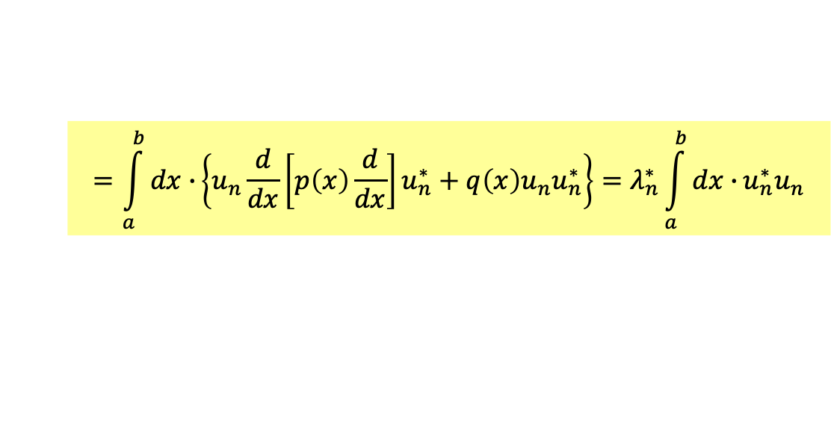
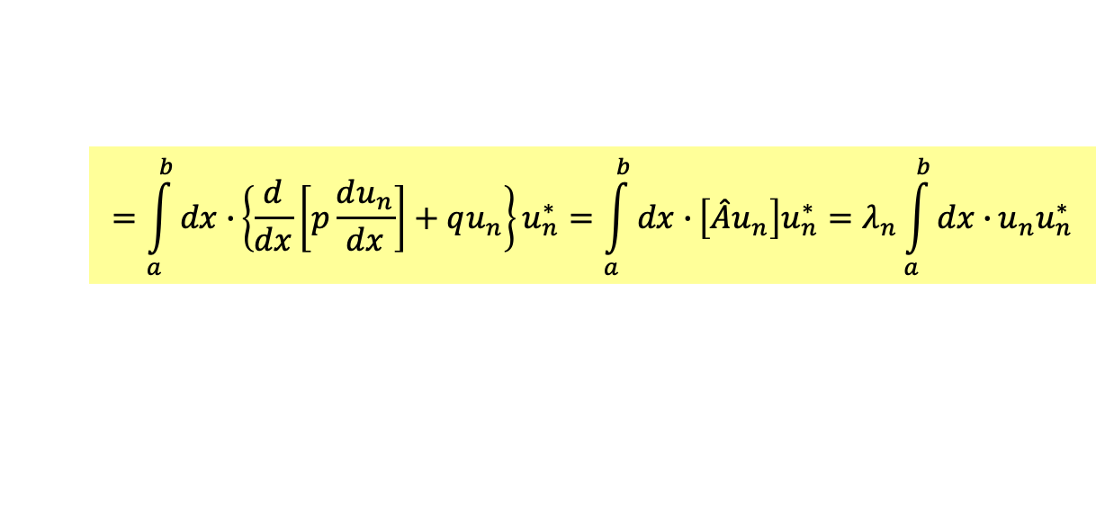

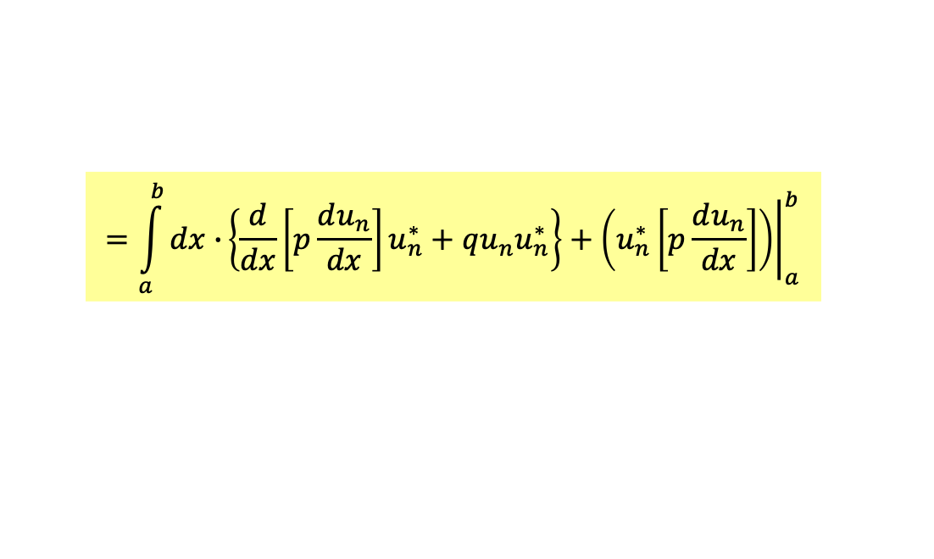
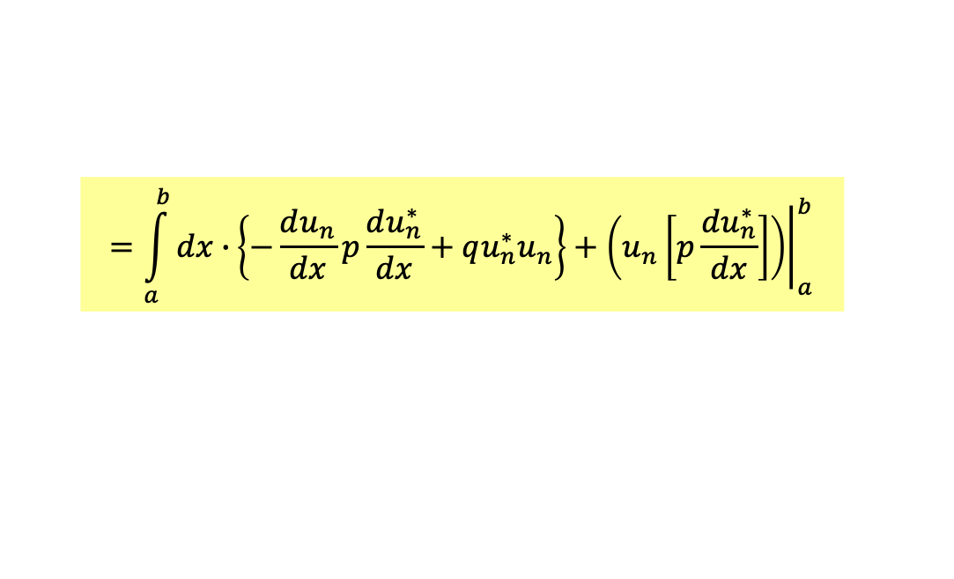

$$\int_{a}^{b}{dx∙}u_{n}{\left(x\right)}^{∗}∙\hat{A}u_{n}\left(x\right) =λ_{n}\int_{a}^{b}{dx∙}u_{n}{\left(x\right)}^{∗}∙u_{n}\left(x\right)$$
$$=\int_{a}^{b}{dx∙}\left\{u_{n}^{∗}\frac{d}{dx}\left[p\left(x\right)\frac{d}{dx}\right]u_{n}+q\left(x\right)u_{n}^{∗}u_{m}\right\}$$
Take the complex conjugate of the above equation:
$$=\int_{a}^{b}{dx∙}\left\{u_{n}\frac{d}{dx}\left[p\left(x\right)\frac{d}{dx}\right]u_{n}^{∗}+q\left(x\right)u_{n}u_{n}^{∗}\right\}=λ_{n}^{∗}\int_{a}^{b}{dx∙}u_{n}^{∗}u_{n}$$
$$=\int_{a}^{b}{dx∙}\left\{−\frac{du_{n}}{dx}p\frac{du_{n}^{∗}}{dx}+qu_{n}^{∗}u_{n}\right\}+{\left.\left(u_{n}\left[p\frac{du_{n}^{∗}}{dx}\right]\right)\right|}_{a}^{b}$$
$$=\int_{a}^{b}{dx∙}\left\{\frac{d}{dx}\left[p\frac{du_{n}}{dx}\right]u_{n}^{∗}+qu_{n}u_{n}^{∗}\right\}+{\left.\left(u_{n}^{∗}\left[p\frac{du_{n}}{dx}\right]\right)\right|}_{a}^{b}$$
$$=\int_{a}^{b}{dx∙}\left\{\frac{d}{dx}\left[p\frac{du_{n}}{dx}\right]+qu_{n}\right\}u_{n}^{∗}=\int_{a}^{b}{dx∙}\left[\hat{A}u_{n}\right]u_{n}^{∗}=λ_{n}\int_{a}^{b}{dx∙}{u_{n}u}_{n}^{∗}$$
$$λ_{n}^{∗}=λ_{n}$$

Slide 21


$$\hat{A}∙f\left(x\right)=\frac{d}{dx}\left[p\left(x\right)\frac{d}{dx}f\left(x\right)\right]+q\left(x\right)f\left(x\right)=λf\left(x\right)$$
The eigenfunctions are $u_{n}$ and their corresponding eigenvalues are $λ_{n}$.
$$\hat{A}∙u_{n}\left(x\right)=λ_{n}∙u_{n}\left(x\right)$$
不同本徵值的本徵函數滿足如下正交關係，因此可取為orthonomal：
Eigenfunctions of different Eignevalues are orthogonal to each other.
$$\int_{a}^{b}{dx∙}u_{n}{\left(x\right)}^{∗}∙u_{m}\left(x\right)=δ_{nm}$$

Slide 22












$$\int_{a}^{b}{dx∙}u_{n}{\left(x\right)}^{∗}∙u_{m}\left(x\right)=δ_{nm}$$
$\hat{A }的$所有本徵函數$u_{n}(x)$彼此正交：
The $n$ eigenvectors $u$ can be chosen to be orthogonal.
Proof:
Consider two eigenvectors with different eigenvalues:
$$Su^{\left(1\right)}=λ_{1}u^{\left(1\right)}$$
$$Su^{\left(2\right)}=λ_{2}u^{\left(2\right)}$$
將第一式與$u^{\left(2\right)}$作內積，可得：
$$u^{\left(2\right)T}Su^{\left(1\right)}=λ_{1}u^{\left(2\right)T}u^{\left(1\right)}$$
$S$作用於右邊的$u^{\left(1\right)}$，等於本徵值$λ_{1}$相乘。
左邊可以寫成:
$$S_{ij}=S_{ji}$$
也等於$S$作用於左邊的$u^{\left(2\right)}$，等於本徵值$λ_{2}$相乘。
$$u^{\left(2\right)T}Su^{\left(1\right)}=\sum_{i,j=1}^{2}{u_{2i}S_{ij}u_{1j}}=\sum_{i,j=1}^{2}{u_{1j}S_{ji}u_{2i}}=u^{\left(1\right)T}∙Su^{\left(2\right)}=u^{\left(1\right)T}λ_{2}u^{\left(2\right)}=λ_{2}u^{\left(2\right)T}u^{\left(1\right)}$$
得：
$$λ_{1}u^{\left(2\right)T}u^{\left(1\right)}=λ_{2}u^{\left(2\right)T}u^{\left(1\right)}$$
$$0=\left(λ_{1}−λ_{2}\right)u^{\left(2\right)T}u^{\left(1\right)}$$
兩式相減：
右式兩本徵向量的內積必須為零，彼此正交！
$$u^{\left(2\right)T}u^{\left(1\right)}=u^{\left(2\right)}∙u^{\left(1\right)}=0$$
本徵向量的正交性

Slide 23










證明：Prove Orthogonality!
$\hat{A}$作用於右邊的$u_{m}$，等於本徵值$λ_{m}$相乘。
$$\int_{a}^{b}{dx∙}u_{n}{\left(x\right)}^{∗}∙\hat{A}u_{m}\left(x\right) =λ_{m}\int_{a}^{b}{dx∙}u_{n}{\left(x\right)}^{∗}∙u_{m}\left(x\right)$$
$$=\int_{a}^{b}{dx∙}\left\{u_{n}^{∗}\frac{d}{dx}\left[p\left(x\right)\frac{d}{dx}\right]u_{m}+q\left(x\right)u_{n}^{∗}u_{m}\right\}$$
$$=\int_{a}^{b}{dx∙}\left\{−p\frac{du_{n}^{∗}}{dx}\frac{du_{m}}{dx}+qu_{n}^{∗}u_{m}\right\}+{\left.\left(u_{n}^{∗}\left[p\frac{du}{dx}\right]\right)\right|}_{a}^{b}$$
$$=\int_{a}^{b}{dx∙}\left\{\frac{d}{dx}\left[p\frac{du_{n}^{∗}}{dx}\right]u_{m}+qu_{n}^{∗}u_{m}\right\}+{\left.\left(\left[p\frac{du_{n}^{∗}}{dx}\right]u_{m}\right)\right|}_{a}^{b}$$
$$λ_{n}^{∗}=λ_{n}$$
$$=\int_{a}^{b}{dx∙}\left\{\frac{d}{dx}\left[p\frac{du_{n}^{∗}}{dx}\right]+qu_{n}^{∗}\right\}u_{m}=\int_{a}^{b}{dx∙}{\left[\hat{A}u_{n}\right]}^{∗}u_{m}=λ_{n}\int_{a}^{b}{dx∙}u_{n}{\left(x\right)}^{∗}u_{m}\left(x\right)$$
等於$\hat{A}$作用於左邊的$u_{m}$，等於本徵值$λ_{m}$相乘。
$$\left(λ_{m}−λ_{n}\right)\int_{a}^{b}{dx∙}u_{n}{\left(x\right)}^{∗}∙u_{m}\left(x\right)=0$$
$$\int_{a}^{b}{dx∙}u_{n}{\left(x\right)}^{∗}∙u_{m}\left(x\right)=0$$
$$λ_{m}≠λ_{n}$$

Slide 24




以上證明用到算子$\hat{A}$的這個性質：
$$\int_{a}^{b}{dx∙}u_{n}{\left(x\right)}^{∗}∙\hat{A}u_{m}\left(x\right) =\int_{a}^{b}{dx∙}{\left[\hat{A}u_{n}\left(x\right)\right]}^{∗}u_{m}\left(x\right)$$
這是對任意兩函數$φ,ψ$都對：
$$\int_{a}^{b}{dx∙}\left\{φ^{∗}\left[p\frac{d}{dx}\right]ψ+qφ^{∗}ψ\right\}=\int_{a}^{b}{dx∙}\left\{\frac{d}{dx}\left[p\frac{dφ^{∗}}{dx}\right]+qφ^{∗}\right\}ψ$$
具有這樣性質的算子稱為Hermitian：
Hermitian算子的本徵值永遠是實數!
Hermitian算子不同本徵值的本徵函數彼此正交!
Charles Hermite 1822-1901

Slide 25



Sturm-Liouville Problem 算子的本徵函數問題：
$$\hat{A}∙u_{n}\left(x\right)=\frac{d}{dx}\left[p\left(x\right)\frac{d}{dx}u_{n}\left(x\right)\right]+q\left(x\right)u_{n}\left(x\right)=λ_{n}∙u_{n}\left(x\right)$$
本徵值皆為實數：
$$λ_{n}^{∗}=λ_{n}$$
不同本徵值的本徵函數滿足如下正交關係，因此可取為orthonomal：
$$\int_{a}^{b}{dx∙}u_{n}{\left(x\right)}^{∗}∙u_{m}\left(x\right)=δ_{nm}$$

Slide 26
現在開始完備性的證明！The proof of the completeness.
若確認任一合邊界條件的函數可以本徵函數分解，我們就能計算其分解係數$a_{n}$。
但這樣的分解真的是正確的嗎？分解所得的無限級數真的與被分解的函數相等嗎？
數學上相等與否的判準：這些係數組成的$u_{n}$的線性組合，會趨近被分解的函數。
$$\lim_{N→∞}{\int_{0}^{L}{dx {\left[ψ\left(x\right)−\sum_{n=1}^{N}{a_{n}u_{n}\left(x\right)}\right]}^{2}}}=0$$
兩者差距的平方和(積分)$N→∞$時，趨近於零。
這稱為Completeness.完備性，必須嚴格證明的。下學期將說明。

Slide 27




Sturm-Liouville Problem
$$\hat{A}∙u_{n}\left(x\right)=\frac{d}{dx}\left[p\left(x\right)\frac{d}{dx}u_{n}\left(x\right)\right]+q\left(x\right)u_{n}\left(x\right)=λ_{n}∙u_{n}\left(x\right)$$
Under boundary conditions, the equation has a countable set of solutions.
We can classify them by $n$ and order them by eigenvalues from small to large:
$$λ_{1}<λ_{2}<⋯<λ_{n}<⋯$$
It could be proven that $λ_{n}$ is unbounded:
$$λ_{n}→∞, as n→∞$$
We’ll skip the proof of this crucial step since it’s too technical.
But it is reasonable and true for the examples we talked about.

Slide 28




$$λ_{1}<λ_{2}<⋯<λ_{n}<⋯$$
每一個本徵值$λ_{n}$對應一個函數$u_{n}\left(x\right)$，

Slide 29







$$λ_{1}<λ_{2}<⋯<λ_{n}<⋯$$
每一個本徵值$λ_{n}$對應一個函數$u_{n}\left(x\right)$，
用向量的類比，每一個$u_{n}\left(x\right)$都是一個彼此正交單位向量，展開一維的空間：
$u_{n}\left(x\right)$是一個彼此正交歸一的座標系統，直覺是：任一函數可以以此展開！
$$ψ\left(x\right)=\sum_{n=1}^{∞}{\left[a_{n}u_{n}(x) \right]}$$
$$u_{n}(x)$$
$$φ\left(x\right)$$
$$u_{2}(x)$$
$$u_{1}(x)$$

Slide 30




這個可以嚴格證明的數學性質稱為：$u_{n}(x)$是完備的complete。
展開定理：任一狀態函數$ψ$可以此$\hat{A}$本徵函數$u_{n}(x)$作分量展開。
$$ψ\left(x\right)=\sum_{n=1}^{∞}{\left[a_{n}u_{n}(x) \right]}$$
若是分量展開是可能的，那分量$c_{a}$可以寫成：
$$a_{n}=\int_{a}^{b}{dx∙}u_{n}{\left(x\right)}^{∗}∙ψ\left(x\right)$$
所以要證明的是：用如此分量$c_{a}$寫成的級數，會趨近正確的狀態函數：
$$\sum_{i=1}^{n}{\left[a_{i}u_{i}(x) \right]}\overset{→}{n→∞}ψ\left(x\right)$$
趨近的數學判準之一，兩者差距的平方和(積分)$N→∞$時，趨近於零。
$$\lim_{n→∞}{\int_{a}^{b}{dx {\left[φ\left(x\right)−\sum_{i=1}^{n−1}{a_{i}u_{i}(x)}\right]}^{2}}}=0$$

Slide 31











$$u_{n}$$
$$u_{n}(x)$$
$$φ\left(x\right)$$
$$a_{n}u_{n}(x)$$
$$φ\left(x\right)$$
$$φ\left(x\right)−a_{n}u_{n}(x)$$
$$φ\left(x\right)−a_{n}u_{n}(x)$$
每一個$u_{n}\left(x\right)$都是一個彼此正交單位向量，展開一維的空間：
$$a_{n}=\int_{a}^{b}{dx∙}u_{n}{\left(x\right)}^{∗}∙φ\left(x\right)$$
任一函數$φ\left(x\right)$，投影在向量$u_{n}\left(x\right)$方向的分量可以算
函數$φ\left(x\right)$扣掉此投影後，就與$u_{n}\left(x\right)$的正交：
$$φ\left(x\right)−a_{n}u_{n}(x)$$
$$\left\langle u_{n},\left[φ−a_{n}u_{n}\right]\right\rangle =\int_{−∞}^{∞}{dx∙}{u_{n}(x)}^{∗}∙\left[φ\left(x\right)−a_{n}u_{n}(x)\right]=0$$
扣掉投影$a_{n}u_{n}$的動作，壓縮此函數的空間，使只能存在於與$u_{n}$正交的平面上。

Slide 32



我們可以由下而上，一層一層將一函數$φ\left(x\right)$的投影$a_{i}u_{i}$扣掉， ，
$$g_{n−1}\left(x\right)≡φ\left(x\right)−\sum_{i=1}^{n−1}{a_{i}u_{i}(x)}$$
結果與$N$以下所有的向量$m<n$都正交：
$$\left\langle u_{m},g_{n−1}\right\rangle =\int_{a}^{b}{dx∙}{u_{m}(x)}^{∗}∙\left[φ\left(x\right)−\sum_{i=1}^{n−1}{a_{i}u_{i}(x)}\right]=0$$
如此函數被壓縮於“越來越高、越來越小”的空間中，直覺是向量長度會越來越短。
$$\lim_{n→∞}{{\left|g_{n−1}\right|}^{2}}=\lim_{n→∞}{\int_{a}^{b}{dx {\left[φ\left(x\right)−\sum_{i=1}^{n−1}{a_{i}u_{i}(x)}\right]}^{2}}}=?0$$
這正是完備性的數學判準，函數與其展開的差距的平方積分$n→∞$時，趨近於零。

Slide 33

$g_{n−1}\left(x\right)$就是函數$φ\left(x\right)$、與其展開的有限級數之間的差距：
$$g_{n−1}\left(x\right)≡φ\left(x\right)−\sum_{i=1}^{n−1}{a_{i}u_{i}(x)}$$
$g_{n−1}\left(x\right)$函數$n→∞$時，會被壓縮於越來越高、越來越限縮的空間中 ，
$g_{n−1}\left(x\right)$函數的集合，也就是這個越來越限縮的空間，給個符號$V_{n−1}$
注意$u_{m}, m<n$不在這空間中，因為$g_{n−1}\left(x\right)$與他們都正交。

Slide 34



當$n→∞$，$g_{n−1}\left(x\right)$函數被壓縮於越來越小、越來越限縮的空間$V_{n−1}$，
何謂越來越小、越來越限縮的空間？
將證明，在此空間中的向量$g_{n−1}\left(x\right)$，其向量長度小於本徵值的倒數：
$${\left|g_{n−1}\right|}^{2}<\frac{c}{λ_{n}}$$
已知：
$$λ_{n}→∞, as n→∞$$
因此：
$$\lim_{n→∞}{{\left|g_{n−1}\right|}^{2}}→0$$

Slide 35







Rayleigh quotient 瑞利之商
對任一函數$u\left(x\right)$，S-L算子$\hat{A}$，可以定義一個商：
$$R\left[u\right]=\frac{\left\langle u,\hat{A}u\right\rangle }{{\left|u\right|}^{2}}$$
定理一：
瑞利之商的極值就是$\hat{A}$的本徵值，發生在本徵函數時。
瑞利之商的最小值就是$\hat{A}$的最小本徵值$λ_{1}$。
最小值發生時的函數$u$就是本徵值$λ_{1}$對應的本徵函數$u_{1}$。
$$λ_{1}≤R\left[u\right]=\frac{\left\langle u,\hat{A}u\right\rangle }{{\left|u\right|}^{2}}$$
Lord Rayleigh 1842-1919
定理二：
若只對與$u_{m}, m<n$正交的$g_{n−1}\left(x\right)$算$R\left[g_{n−1}\right]$，最小值為次一個本徵值$λ_{n}$。
最小值發生時的函數$u$就是本徵值$λ_{n}$對應的本徵函數$u_{n}$。
$$λ_{n}≤R\left[g_{n−1}\right]=\frac{\left\langle g_{n−1},\hat{A}g_{n−1}\right\rangle }{{\left|g_{n−1}\right|}^{2}}$$
注意：
$${\left|g_{n−1}\right|}^{2}≤\frac{\left\langle g_{n−1},\hat{A}g_{n−1}\right\rangle }{λ_{n}}$$
若分子有限，
$${\left|g_{n−1}\right|}^{2}<\frac{c}{λ_{n}}$$
$$\lim_{n→∞}{{\left|g_{n−1}\right|}^{2}}→0$$
完備性就得證了！

Slide 36



Rayleigh quotient 瑞利之商有一個很簡單性質：
對任一算子$\hat{A}$的本徵函數$u_{n}\left(x\right)$，
$$\hat{A}∙u_{n}=λ_{n}∙u_{n}$$
瑞利之商就等於其本徵值：
$$R\left[u_{n}\right]=\frac{\left\langle u_{n},\hat{A}u_{n}\right\rangle }{{\left|u_{n}\right|}^{2}}=\frac{\left\langle u_{n},λ_{n}u_{n}\right\rangle }{{\left|u_{n}\right|}^{2}}=\frac{λ_{n}\left\langle u_{n}, u_{n}\right\rangle }{{\left|u_{n}\right|}^{2}}=λ_{n}$$
$$R\left[u_{n}\right]=λ_{n}$$

Slide 37




定理一證明：
瑞利之商的極值可以用常見的極值計算法找：
極值之處斜率為零，極值附近函數圖形是平的：
$$\frac{df}{dx}=0$$
現在可變的量不是變數，而是函數。
但原理相同，極值是谷底，附近函數是平坦的。假設極值發生在某函數$u_{∗}(x)$，
$u_{∗}$加上任意一點小偏移deviation $tu(x)$：$u_{∗}(x)+tu(x)$，變化率為零：
$$\frac{d}{dt}R\left[u_{∗}+tu\right]=0$$

Slide 38












$$\frac{d}{dt}R\left[u_{∗}+tu\right]=0$$
$$R\left[u\right]=\frac{\left\langle u,\hat{A}u\right\rangle }{{\left|u\right|}^{2}}$$
$$R\left[u_{∗}+tu\right]=\frac{\left\langle \left(u_{∗}+tu\right),\hat{A}\left(u_{∗}+tu\right)\right\rangle }{{\left|u_{∗}+tu\right|}^{2}}$$
注意：
$$=\frac{\left\langle u_{∗},\hat{A}u_{∗}\right\rangle +2t\left\langle u,\hat{A}u_{∗}\right\rangle +t^{2}\left\langle u,\hat{A}u\right\rangle }{{\left|u_{∗}\right|}^{2}+t^{2}{\left|u\right|}^{2}+2t\left\langle u,u_{∗}\right\rangle }$$
$$\left\langle u_{∗},\hat{A}u\right\rangle =\left\langle \hat{A}u_{∗}, u\right\rangle =\left\langle u,\hat{A}u_{∗}\right\rangle$$
在$t=0$取微分需為零：
$$\frac{dR\left[u_{∗}+tu\right]}{dt}\left(t=0\right)=\frac{2\left\langle u,\hat{A}u_{∗}\right\rangle {\left|u_{∗}\right|}^{2}−2\left\langle u_{∗},\hat{A}u_{∗}\right\rangle \left\langle u,u_{∗}\right\rangle }{{\left|u_{∗}\right|}^{4}}=0$$
$$\left\langle u,\hat{A}u_{∗}\right\rangle {\left|u_{∗}\right|}^{2}−\left\langle u_{∗},\hat{A}u_{∗}\right\rangle \left\langle u,u_{∗}\right\rangle =0$$
$$\left\langle u,\hat{A}u_{∗}\right\rangle −\frac{\left\langle u_{∗},\hat{A}u_{∗}\right\rangle }{{\left|u_{∗}\right|}^{2}}\left\langle u,u_{∗}\right\rangle =0$$
$$\left\langle u,\hat{A}u_{∗}\right\rangle −R\left[u_{∗}\right]\left\langle u,u_{∗}\right\rangle =0$$
$$\left\langle u,\hat{A}u_{∗}−R\left[u_{∗}\right]u_{∗}\right\rangle =0$$
此式對任意$u(x)$都要成立，唯一可能：內積中的右邊必須為零！
$$\hat{A}u_{∗}−R\left[u_{∗}\right]u_{∗}=0$$
$R\left[u_{∗}\right]$是一個數，因此瑞利之商的極值必須是本徵值！

Slide 39



$$\hat{A}u_{∗}−R\left[u_{∗}\right]u_{∗}=0$$
瑞利之商的極值必須是本徵值 ！
而且極值發生的函數$u_{∗}$就是本徵函數。
因為所有本徵函數的瑞利之商就等於其本徵值，
最小瑞利之商必須是最小的本徵值：$λ_{1}$！
而且極值發生的函數$u_{∗}$就是本徵函數$u_{1}$。
$$λ_{1}≤R\left[u\right]=\frac{\left\langle u,\hat{A}u\right\rangle }{{\left|u\right|}^{2}}$$
定理一得證！

Slide 40


定理二：
若只對已扣掉$n$前面本徵函數投影的$g_{n−1}\left(x\right)$，計算瑞利之商$R\left[g_{n−1}\right]$，
最小值為次一個本徵值$λ_{n}$，發生時的函數$u$就是本徵值$λ_{n}$對應的本徵函數$u_{n}$。
$$λ_{n}≤R\left[g_{n−1}\right]$$
證明：如定理一，最小值一定是一個本徵值。
$n$前面本徵函數$u_{m}, m<n$都不是$g_{n−1}\left(x\right)$，因為所有$g_{n−1}\left(x\right)$都與 $u_{m}, m<n$正交。
最小的瑞利之商$R\left[g_{n−1}\right]$只能是下一個本徵值：$λ_{n}$。
$$λ_{n}≤R\left[g_{n−1}\right]$$
定理二得證！

Slide 41







$$λ_{n}≤R\left[g_{n−1}\right]=\frac{\left\langle g_{n−1},\hat{A}g_{n−1}\right\rangle }{{\left|g_{n−1}\right|}^{2}}$$
現在只剩最後一步：
$${\left|g_{n−1}\right|}^{2}≤\frac{\left\langle g_{n−1},\hat{A}g_{n−1}\right\rangle }{λ_{n}}$$
注意：
$$\left\langle g_{n−1},\hat{A}g_{n−1}\right\rangle =\left\langle \left(φ\left(x\right)−\sum_{i=1}^{n−1}{a_{i}u_{i}(x)}\right),\hat{A}\left(φ\left(x\right)−\sum_{i=1}^{n−1}{a_{i}u_{i}(x)}\right)\right\rangle$$
$$=\left\langle φ,\hat{A}φ\right\rangle −\left\langle φ, \sum_{i=1}^{n−1}{a_{i}{\hat{A}u}_{i}}\right\rangle −\left\langle \sum_{i=1}^{n−1}{a_{i}u_{i}},\hat{A}φ \right\rangle +\sum_{j=1}^{n−1}{\sum_{i=1}^{n−1}{a_{j}^{∗}a_{i}\left\langle u_{j},\hat{A}u_{i}\right\rangle }}$$
$$=\left\langle φ,\hat{A}φ\right\rangle −\left\langle φ, \sum_{i=1}^{n−1}{a_{i}{\hat{A}u}_{i}}\right\rangle −\left\langle \sum_{i=1}^{n−1}{a_{i}{\hat{A}u}_{i}}, φ \right\rangle +\sum_{j=1}^{n−1}{\sum_{i=1}^{n−1}{a_{j}^{∗}a_{i}λ_{i}\left\langle u_{j}, u_{i}\right\rangle }}$$
$$=\left\langle φ,\hat{A}φ\right\rangle −\sum_{i=1}^{n−1}{a_{i}λ_{i}\left\langle φ, u_{i}\right\rangle }−\sum_{i=1}^{n−1}{a_{i}^{∗}λ_{i}\left\langle u_{i},φ\right\rangle }+\sum_{j=1}^{n−1}{\sum_{i=1}^{n−1}{a_{j}^{∗}a_{i}λ_{i}δ_{ij}}}$$
$$=\left\langle φ,\hat{A}φ\right\rangle −\sum_{i=1}^{n−1}{a_{i}^{∗}a_{i}λ_{i}}−\sum_{i=1}^{n−1}{a_{i}^{∗}a_{i}λ_{i}}+\sum_{i=1}^{n−1}{a_{i}^{∗}a_{i}λ_{i}}=\left\langle φ,\hat{A}φ\right\rangle −\sum_{i=1}^{n−1}{a_{i}^{∗}a_{i}λ_{i}}<\left\langle φ,\hat{A}φ\right\rangle$$

Slide 42



$${\left|g_{n−1}\right|}^{2}≤\frac{\left\langle g_{n−1},\hat{A}g_{n−1}\right\rangle }{λ_{n}}<\frac{\left\langle φ,\hat{A}φ\right\rangle }{λ_{n}}$$
分子是有限值！
$$\lim_{n→∞}{{\left|g_{n−1}\right|}^{2}}→0$$
$$g_{n−1}\left(x\right)≡φ\left(x\right)−\sum_{i=1}^{n−1}{a_{i}u_{i}(x)}$$
$g_{n−1}\left(x\right)$：函數$φ\left(x\right)$、與其展開的有限級數之間的差距趨近於零！
Sturm-Liouville 算子本徵函數的完備性就得證了！

Slide 43


任何位能薛丁格波方程式都是S-L方程式，之前的普遍解法一率適用：
將$t=0$時的波函數，即起始條件，對定態解$u_{n}$展開如下：
$$Ψ\left(x,0\right)=\sum_{n=1}^{∞}{c_{n}u_{n}\left(x\right)}$$
根據展開定理，這永遠可以做到！
$t=0$時此狀態可以視為定態$u_{n}$的如上疊加，
接著定態隨時間個自演化，位能下薛丁格方程式要求$u_{n}$乘$\text{上}e^{−i\frac{E_{n}}{ℏ}t}$。
乘完之後依同樣方式疊加，整個波函數也就滿足薛丁格波方程式。
$$Ψ\left(x,t\right)=\sum_{n=1}^{∞}{c_{n}u_{n}\left(x\right)e^{−i\frac{E_{n}}{ℏ}t}}$$
很明顯，這個程序不只適用於無限大位能井，原則上適用於任何位能。

