Slide 2
Time-Independent Perturbation 是解能量本徵態問題的一個系統的近似方法：
$$H\left|\left.ψ_{n}\right\rangle \right.=E_{n}\left|\left.ψ_{n}\right\rangle \right.$$
$H$常常可以分解為一個主要的項，稱未微擾$H_{0}$，加一個較小的微擾$λH_{1}$：
$$H=H_{0}+λH_{1}$$
$λ≪1$。
時常，$H_{0}$比較簡單，因此已經解出本徵態了：
那麼可以期待$H_{0}$的解會非常接近真實的解！
舉例來說：簡諧運動可以有一微小的Anharmonic Oscillator 非諧項。
$$H=\frac{p^{2}}{2m}−\frac{1}{2}kx^{2}+λx^{4}$$
$$H_{0}=\frac{p^{2}}{2m}−\frac{1}{2}kx^{2}$$
$$H_{1}=x^{4}$$
Stark Effect 在氫原子上加上一個常數電場
$$H_{0}=\frac{p^{2}}{2m}−\frac{e^{2}}{4πε_{0}r}$$
$$λH_{1}=e\vec{r}∙\vec{E}$$

Slide 3
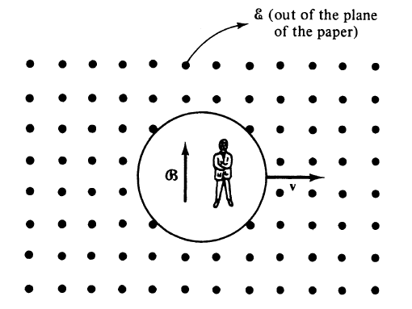
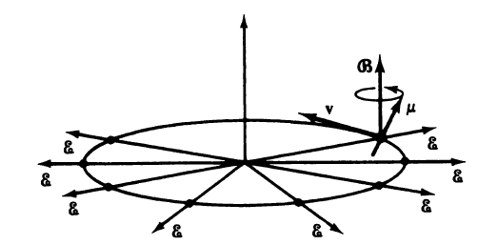
微擾論最典型的用途就是描述氫原子簡併能階的細微分裂！
$$n=2,l=0,1,s=1/2$$
$$H_{0}=\frac{p^{2}}{2m}−\frac{e^{2}}{4πε_{0}r}$$
未微擾$H_{0}$就是一般氫原子的電子動能與庫倫位能：
運動的電子會感受到原子核庫倫電場因相對論效應產生的磁場。
電子自旋的磁偶極矩會感受到此磁場的磁力。
於是能量要加上微擾項，稱為Spin-Orbit Coupling：
$$λH_{1}\sim \vec{L}∙\vec{S}$$
原來簡併的能階，精細的測量會發現細微的分裂：精細結構 Fine Structure。
計算這微擾造成的能量本徵值差距，就是微擾論的目標。

Slide 4
從電子的座標系來看，質子是在移動的！因此它的自旋會感覺到有磁場存在！
這可以在相對論中嚴格推導，在靜止的電場$\vec{E}$中移動的電荷（電子）會感覺到磁場$\vec{B}$：
$$\vec{B}=−\frac{\vec{v}}{c^{2}}×\vec{E}$$
此磁場$\vec{B}$大小$\sim v/c$，一般來說很小，屬於相對論性修正Relativistic Effect。
$$λ{\hat{H}}_{1}=\vec{μ}∙\left(\frac{\vec{v}}{c^{2}}×\vec{E}\right)\sim −\frac{\vec{μ}}{mc^{2}}∙\left(\vec{p}×\hat{r}\frac{e}{4πε_{0}r^{2}}\right)$$
自旋磁偶極會得到一個能量：
代入質子的庫倫電場：
$$=\frac{e}{4πε_{0}mc^{2}r^{3}}\vec{μ}∙\left(\vec{p}×\vec{r}\right)=\frac{e^{2}}{4πε_{0}}\frac{1}{m^{2}c^{2}}\frac{\vec{S}∙\vec{L}}{r^{3}}$$
整理後得到軌道角動量與自旋的內積！
電子的非慣性效應會再除2，最後：
$$λ{\hat{H}}_{1}=\frac{e^{2}}{4πε_{0}}\frac{1}{2m^{2}c^{2}}\frac{\vec{S}∙\vec{L}}{r^{3}}$$
此微擾項稱為Spin-Orbit Coupling。

Slide 5
與SL coupling大小接近的，還有另一個相對論效應：
相對論能量不再是$p^{2}/2m$。
$$E=\sqrt{{m^{2}c^{4}+p}^{2}c^{2}}=mc^{2}{\left(1+\frac{p^{2}}{m^{2}c^{2}}\right)}^{1/2}$$
電子速度不大時，此式可以對 $\frac{p^{2}}{m^{2}c^{2}}$展開：
$$E\sim mc^{2}+\frac{p^{2}}{2m}−\frac{{\left(p^{2}\right)}^{2}}{8m^{3}c^{2}}$$
應用於氫原子中的電子：
$${\hat{H}}_{0}=\frac{{\hat{p}}^{2}}{2m}−\frac{e^{2}}{4πε_{0}r}$$
$$λ{\hat{H}}_{1}=\frac{e^{2}}{4πε_{0}}\frac{1}{2m^{2}c^{2}}\frac{\vec{S}∙\vec{L}}{r^{3}}−\frac{{\left(p^{2}\right)}^{2}}{8m^{3}c^{2}}$$
這兩項幾乎就是所有的、領先的相對論效應。

Slide 6
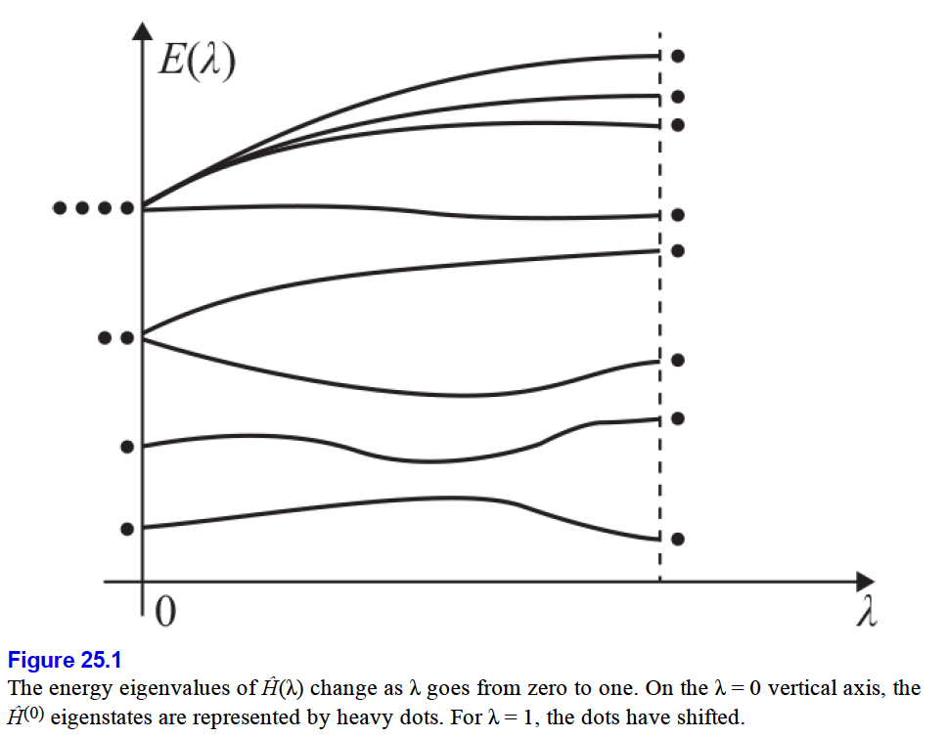
設$H$可以分解為未微擾unperturbed $H_{0}$，加一個較小的微擾 perturbation $λH_{1}$：
$$\left(H_{0}+λH_{1}\right)\left|\left.ψ_{n}\right\rangle \right.=E_{n}\left|\left.ψ_{n}\right\rangle \right.$$
$\left|\left.ψ_{n}\right\rangle \right.$是第$n$個本徵態。
$H_{0}$比較簡單，通常已經解出所有本徵態$φ_{n}$了：
$$H_{0}\left|\left.φ_{n}\right\rangle \right.=E_{n}^{\left(0\right)}\left|\left.φ_{n}\right\rangle \right.$$
假想我們讓參數$λ$連續由$0$變化至真實的值，此時本徵值為$E_{n}\left(λ\right)$本徵態為$\left|\left.ψ_{n}\left(λ\right)\right\rangle \right.$。
注意$λ=0$時，本徵值$E_{n}(0)$就是$H_{0}$的本徵值$E_{n}^{\left(0\right)}$，$\left|\left.ψ_{n}\left(0\right)\right\rangle \right.$就是$\left|\left.φ_{n}\right\rangle \right.$。
而$λ$很小時，預期$E_{n}\left(λ\right)$與$E_{n}^{\left(0\right)}$差距很小，$\left|\left.ψ_{n}\left(λ\right)\right\rangle \right.$與$\left|\left.φ_{n}\right\rangle \right.$的差距也很小。
因此未微擾的結果會是真實結果的近似。

Slide 10
未微擾$H_{0}$的第$n$個本徵態$。$
$$\left|\left.φ_{n}\right\rangle \right.$$

Slide 11
設$H$可以分解為未微擾$H_{0}$，加一個較小的微擾$λH_{1}$：
$$\left(H_{0}+λH_{1}\right)\left|\left.ψ_{n}\right\rangle \right.=E_{n}\left|\left.ψ_{n}\right\rangle \right.$$
$\left|\left.ψ_{n}\right\rangle \right.$是第$n$個本徵態。
$H_{0}$已經解出所有本徵態$φ_{n}$了：
$$H_{0}\left|\left.φ_{n}\right\rangle \right.=E_{n}^{\left(0\right)}\left|\left.φ_{n}\right\rangle \right.$$
$λ$很小時，預期$E_{n}$與$E_{n}^{\left(0\right)}$差距很小，$\left|\left.ψ_{n}\right\rangle \right.$與$\left|\left.φ_{n}\right\rangle \right.$的差距也很小。因此後者是近似。
但科學家希望估計差距多少，因此計算兩者差距至某精確度，就是我們的目標。
很合理的，我們假設差距可以如泰勒展開式，以小參數$λ$展開為一無窮級數。
$$E_{n}=E_{n}^{\left(0\right)}+λE_{n}^{\left(1\right)}+λ^{2}E_{n}^{\left(2\right)}+⋯$$
這些展開的係數$E_{n}^{\left(i\right)}$，給出真實本徵值與非微擾值的差距，就是微擾計算的目標。
真實本徵態與未微擾本徵態的差距也假設可以展開。
$$\left|\left.ψ_{n}\right\rangle \right.=\left|\left.φ_{n}\right\rangle \right.+λ\left|\left.φ_{n}^{\left(1\right)}\right\rangle \right.+λ^{2}\left|\left.φ_{n}^{\left(2\right)}\right\rangle \right.+⋯$$
這就是
$$ψ_{n}\left(x\right)\sim φ_{n}\left(x\right)+λφ_{n}^{\left(1\right)}\left(x\right)+⋯$$

Slide 12
符號 Summary
$$H_{0}→\frac{p^{2}}{2m}−\frac{1}{2}kx^{2}$$
$$H_{1}→λx^{4}$$
未微擾$H_{0}$的第$n$個本徵態$。$
$$\left|\left.φ_{n}\right\rangle \right.\sim u_{n}\left(x\right)$$
微擾能量$H_{1}$，微擾後的第$n$個本徵態。
$$\left|\left.ψ_{n}\right\rangle \right.{\sim ψ}_{n}\left(x\right)$$
兩者間的差距，稱修正，第$n$個本徵態的修正展到第$i$階：
$$\left|\left.φ_{n}^{\left(i\right)}\right\rangle \right.\sim φ_{n}^{\left(i\right)}\left(x\right)$$
本徵值的差距，稱能量修正，第$n$個本徵值的修正展到第$i$階：
$$E_{n}^{\left(i\right)}$$

Slide 13
舉例來說：Anharmonic Oscillator 非諧項
$$H=\frac{p^{2}}{2m}−\frac{1}{2}kx^{2}+λx^{4}$$
$$H_{0}=\frac{p^{2}}{2m}−\frac{1}{2}kx^{2}$$
$$H_{1}=x^{4}$$
未微擾$H_{0}$的本徵態就是量子SHO的本徵態：
$$\left|\left.φ_{n}\right\rangle \right.=\left|\left.n\right\rangle \right.$$
注意，我們假設真實本徵態$\left|\left.ψ_{n}\right\rangle \right.$會以同樣的量子數標記！但$\left|\left.ψ_{n}\right\rangle \right.≠\left|\left.n\right\rangle \right.$。
Stark Effect 在氫原子上加上一個常數電場
$$H_{0}=\frac{p^{2}}{2m}−\frac{e^{2}}{4πε_{0}r}$$
$$λH_{1}=e\vec{r}∙\vec{E}$$
未微擾$H_{0}$就是一般氫原子中的電子能量。
未微擾$H_{0}$的本徵態就是氫原子的定態 (但這裡採用新的符號$φ_{nlm}$)：
$$\left|\left.φ_{n}\right\rangle \right.=\left|\left.n,l,m\right\rangle \right. \sim φ_{nlm}=R_{nl}\left(r\right)∙P_{lm}\left(θ\right)∙Φ_{m}\left(φ\right)$$

Slide 14
微擾計算其實就是一個泰勒展開 expansion：
$$\left|\left.ψ_{n}\right\rangle \right.\sim \left|\left.φ_{n}\right\rangle \right.+λ\left|\left.φ_{n}^{\left(1\right)}\right\rangle \right.+⋯$$
$$E_{n}=E_{n}^{\left(0\right)}+λE_{n}^{\left(1\right)}+⋯$$
希望簡化以下完整方程式的解，因此第一步是把以上的展開代入此方程式：
$$\left(H_{0}+λH_{1}\right)\left|\left.ψ_{n}\right\rangle \right.=E_{n}\left|\left.ψ_{n}\right\rangle \right.$$
$$\left(H_{0}+λH_{1}\right)∙ \left( \left|\left.φ_{n}\right\rangle \right.+λ\left|\left.φ_{n}^{\left(1\right)}\right\rangle \right.+⋯\right)=\left(E_{n}^{\left(0\right)}+λE_{n}^{\left(1\right)}+⋯\right)∙\left( \left|\left.φ_{n}\right\rangle \right.+λ\left|\left.φ_{n}^{\left(1\right)}\right\rangle \right.+⋯\right)$$
各階$λ$的係數都要相等，所以可以一階一階提出來，
若$λ$很小，一般只要做到有限幾階就是很好的近似了。
首先收集到第零階，$λ^{0}$：
$$H_{0}\left|\left.φ_{n}\right\rangle \right.=E_{n}^{\left(0\right)}\left|\left.φ_{n}\right\rangle \right.$$
這是當然的。這是$λ＝0$未微擾的結果。

Slide 15
$$\left(H_{0}+λH_{1}\right)∙ \left( \left|\left.φ_{n}\right\rangle \right.+λ\left|\left.φ_{n}^{\left(1\right)}\right\rangle \right.+⋯\right)=\left(E_{n}^{\left(0\right)}+λE_{n}^{\left(1\right)}+⋯\right)∙\left( \left|\left.φ_{n}\right\rangle \right.+λ\left|\left.φ_{n}^{\left(1\right)}\right\rangle \right.+⋯\right)$$
接下來 收集到第一階$λ^{1}$：收集交差項：
$$λH_{0}\left|\left.φ_{n}^{\left(1\right)}\right\rangle \right.+λH_{1}\left|\left.φ_{n}\right\rangle \right.=λE_{n}^{\left(1\right)}\left|\left.φ_{n}\right\rangle \right.+λE_{n}^{\left(0\right)}\left|\left.φ_{n}^{\left(1\right)}\right\rangle \right.$$
$$H_{0}\left|\left.φ_{n}^{\left(1\right)}\right\rangle \right.+H_{1}\left|\left.φ_{n}\right\rangle \right.=E_{n}^{\left(1\right)}\left|\left.φ_{n}\right\rangle \right.+E_{n}^{\left(0\right)}\left|\left.φ_{n}^{\left(1\right)}\right\rangle \right.$$
這是第一階$λ^{1}$的本徵態方程式，意思是完整方程式的近似、精確到$λ^{1}$。
此方程式中，除了 精確到𝜆的能量修正$E_{n}^{\left(1\right)}$及狀態修正 $\left|\left.φ_{n}^{\left(1\right)}\right\rangle \right.$未知，其他都是已知。
我們的討論會集中，以此第一階方程式求解$E_{n}^{\left(1\right)}$及 $\left|\left.φ_{n}^{\left(1\right)}\right\rangle \right.$。
更精確的、高階的方程式也可以系統性地繼續得出。

Slide 16
解能量的一階修正$E_{n}^{\left(1\right)}$：
$$H_{0}\left|\left.φ_{n}^{\left(1\right)}\right\rangle \right.+H_{1}\left|\left.φ_{n}\right\rangle \right.=E_{n}^{\left(1\right)}\left|\left.φ_{n}\right\rangle \right.+E_{n}^{\left(0\right)}\left|\left.φ_{n}^{\left(1\right)}\right\rangle \right.$$
第三項是$\left|\left.φ_{n}\right\rangle \right.$ket，係數就是$E_{n}^{\left(1\right)}$，取此式與$\left\langle \left.φ_{n}\right|\right.$內積，即投影，第三項就得$E_{n}^{\left(1\right)}$。
$\left|\left.φ_{n}\right\rangle \right.$已歸一化：
$$\left\langle φ_{n} | φ_{n}\right\rangle =1$$
$$\left\langle φ_{n} | H_{0} | φ_{n}^{\left(1\right)}\right\rangle +\left\langle \left.φ_{n}\right|\right.H_{1}\left|\left.φ_{n}\right\rangle \right.=E_{n}^{\left(1\right)}+E_{n}^{\left(0\right)}\left\langle φ_{n} | φ_{n}^{\left(1\right)}\right\rangle$$
乍看似乎很難解，因為還不知道$\left|\left.φ_{n}^{\left(1\right)}\right\rangle \right.$。
但細看才發現，很驚奇的，左邊第一項就與右邊第二項抵消。
$\left\langle φ_{n} | H_{0} | φ_{n}^{\left(1\right)}\right\rangle =\left\langle H_{0}^{†}φ_{n} | φ_{n}^{\left(1\right)}\right\rangle =$ $\left\langle H_{0}φ_{n} | φ_{n}^{\left(1\right)}\right\rangle =\left\langle {E_{n}^{\left(0\right)}φ}_{n} | φ_{n}^{\left(1\right)}\right\rangle =E_{n}^{\left(0\right)}\left\langle φ_{n} | φ_{n}^{\left(1\right)}\right\rangle$
記得bra就是該狀態函數的複數共軛。
做部分積分！
$$以簡諧運動為例：\int_{−∞}^{∞}{dx}∙u_{n}^{∗}\left(x\right)∙\left[−\frac{ℏ^{2}}{2m}\frac{d^{2}}{dx^{2}}+\frac{1}{2}kx^{2}\right]φ_{n}^{\left(1\right)}\left(x\right)=\int_{−∞}^{∞}{dx}∙{\left[\left(−\frac{ℏ^{2}}{2m}\frac{d^{2}}{dx^{2}}+\frac{1}{2}kx^{2}\right)u_{n}\right]}^{∗}∙φ_{n}^{\left(1\right)}=\int_{−∞}^{∞}{dx}∙E_{n}^{\left(0\right)}u_{n}^{∗}∙φ_{n}^{\left(1\right)}$$
因此餘下一項：
$$\left\langle \left.φ_{n}\right|\right.H_{1}\left|\left.φ_{n}\right\rangle \right.＝E_{n}^{\left(1\right)}$$
$$E_{n}^{\left(1\right)}=\left\langle \left.φ_{n}\right|\right.H_{1}\left|\left.φ_{n}\right\rangle \right.$$

Slide 17
$$E_{n}^{\left(1\right)}=\left\langle \left.φ_{n}\right|\right.H_{1}\left|\left.φ_{n}\right\rangle \right.$$
微擾對能量本徵值的修正，等於微擾在該本徵態的期望值。
對未微擾定態$\left|\left.φ_{n}\right\rangle \right.$之能量的修正$E_{n}^{\left(1\right)}$，等於能量微擾$H_{1}$對該定態$\left|\left.φ_{n}\right\rangle \right.$的期望值。
如果狀態可以用波函數表示，此期望值可以簡單寫成波函數的積分：
$$E_{n}^{\left(1\right)}=\left\langle \left.φ_{n}\right|\right.H_{1}\left|\left.φ_{n}\right\rangle \right.=\left\langle H_{1}\right\rangle =\int_{−∞}^{∞}{dx}∙φ_{n}^{∗}\left(x\right)H_{1}\left(x\right)φ_{n}\left(x\right)$$
以簡諧運動非諧項為例：
$$→\int_{−∞}^{∞}{dx}∙u_{n}^{∗}\left(x\right)∙x^{4}u_{n}\left(x\right)$$
如果狀態是行向量，則寫成微擾項的矩陣夾在該行向量與對應的列向量間。
你不需要知道本徵態的一階修正，
只需要未微擾的零次解，就可以計算本徵值的一階修正了！

Slide 18
舉例來說： 例一： Anharmonic Oscillator 非諧震盪器
$$x=\sqrt{\frac{ℏ}{2mω}}\left(a+a^{†}\right)$$
$${\hat{H}}_{0}=\frac{p^{2}}{2m}−\frac{1}{2}kx^{2}$$
$$λ{\hat{H}}_{1}=λ\frac{1}{4}ℏω{\left(\frac{2mω}{ℏ}\right)}^{2}x^{4}$$
計算基態能量$E_{0}=\frac{1}{2}ℏω$的修正：
$$λE_{0}^{\left(1\right)}=λ\left\langle \left.0\right|\right.H_{1}\left|\left.0\right\rangle \right.$$
$$→\int_{−∞}^{∞}{dx}∙u_{0}^{∗}\left(x\right)∙x^{4}u_{0}\left(x\right)$$
$$a\left.\left|n\right.\right\rangle =\sqrt{n}∙\left.\left|n−1\right.\right\rangle$$
$$a^{†}\left.\left|n\right.\right\rangle =\sqrt{n+1}∙\left.\left|n+1\right.\right\rangle$$
$$\left[a,a^{†}\right]=aa^{†}−a^{†}a=1$$
$$E_{0}^{\left(1\right)}=\frac{1}{4}ℏω{\left(\frac{2mω}{ℏ}\right)}^{2}\left\langle \left.0\right|\right.x^{4}\left|\left.0\right\rangle \right.=\frac{1}{4}ℏω\left\langle \left.0\right|\right.{\left(a+a^{†}\right)}^{4}\left|\left.0\right\rangle \right.$$
$$\left\langle \left.0\right|\right.{\left(a+a^{†}\right)}^{4}\left|\left.0\right\rangle \right.=\left\langle \left.0\right|\right.\left(a+a^{†}\right)\left(a+a^{†}\right)\left(a+a^{†}\right)\left(a+a^{†}\right)\left|\left.0\right\rangle \right.$$
$$=\left\langle \left.0\right|\right.a\left(a+a^{†}\right)\left(a+a^{†}\right)a^{†}\left|\left.0\right\rangle \right.=\left\langle \left.0\right|\right.a\left(a^{†}a+aa^{†}\right)a^{†}\left|\left.0\right\rangle \right.=\left\langle \left.0\right|\right.a\left(2a^{†}a+1\right)a^{†}\left|\left.0\right\rangle \right.=3$$
$$E_{0}^{\left(1\right)}=\frac{3}{4}ℏω$$

Slide 19
一階還有狀態的修正$\left|\left.φ_{n}^{\left(1\right)}\right\rangle \right.$， 我們預期此修正會包含其他本徵態$\left|\left.φ_{m}\right\rangle ,m≠n\right.$，
$$\left|\left.ψ_{n}\right\rangle \right.\sim \left|\left.φ_{n}\right\rangle \right.+λ\left|\left.φ_{n}^{\left(1\right)}\right\rangle \right.+⋯$$
$$ψ_{n}\left(x\right)\sim φ_{n}\left(x\right)+λφ_{n}^{\left(1\right)}\left(x\right)+⋯$$
$$φ_{n}^{\left(1\right)}\left(x\right)\sim \sum_{m}{c_{m}∙φ_{m}\left(x\right)}$$

Slide 20
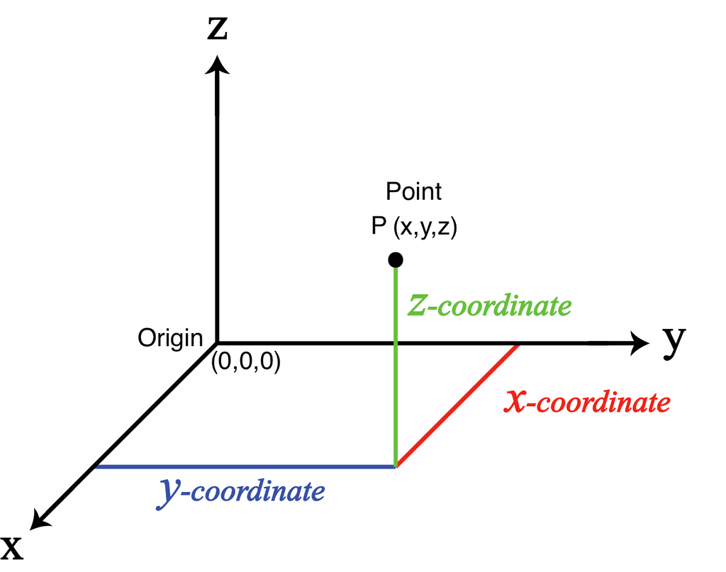
$\left|\left.φ_{n}\right\rangle \right.$組成一組正交基底
$$\left|\left.φ_{2}\right\rangle \right.$$
$$\left|\left.ψ_{1}\left(λ\right)\right\rangle \right.$$
$$\left(λ\right)$$
$$\left|\left.φ_{3}\right\rangle \right.$$
$$\left|\left.φ_{1}\right\rangle \right.$$
以空間來比諭，可以單位向量${\hat{e}}_{x},{\hat{e}}_{z}$類比未微擾本徵態$\left|\left.φ_{1}\right\rangle \right.,\left|\left.φ_{2}\right\rangle \right.$。
$λ→$0會趨近$\left|\left.φ_{1}\right\rangle \right.$的真實本徵態$\left|\left.ψ_{1}\left(λ\right)\right\rangle \right.$含有修正，在其他本徵態$\left|\left.φ_{2}\right\rangle \right.$的方向。

Slide 21
$\left|\left.φ_{n}\right\rangle \right.$組成一組正交基底。
它們雖不是真實本徵態，但數學上是成立的！
$$\int_{−∞}^{∞}{dx∙}ψ{\left(x\right)}^{∗}∙φ\left(x\right)≡\left\langle ψ | φ\right\rangle$$
用這一內積符號：
未微擾$H_{0}$的本徵態$\left|\left.φ_{n}\right\rangle \right.$滿足正交定理：
$$\int_{0}^{a}{dx∙}φ_{n}^{∗}\left(x\right)φ_{m}\left(x\right)=δ_{mn}$$
$$\left\langle φ_{n} | φ_{m}\right\rangle =δ_{mn}$$
$${\hat{e}}_{i}∙{\hat{e}}_{j}=δ_{ij}$$
任一狀態$\left|\left.ψ\right\rangle \right.$以未微擾$H_{0}$的本徵態$\left|\left.φ_{n}\right\rangle \right.$展開：
$$ψ\left(x\right)=\sum_{n}{c_{n}φ_{n}\left(x\right)}$$
$$\left|\left.ψ\right\rangle \right.＝\sum_{n}{c_{n}\left|\left.φ_{n}\right\rangle \right.}$$
分量可寫成：如向量沿軸的投影一般。
$$c_{n}=\int_{0}^{a}{dx∙}φ_{n}^{∗}\left(x\right)ψ\left(x\right)$$
$$c_{n}=\left\langle φ_{n} | ψ\right\rangle$$
$$V_{x}=\vec{V}∙{\hat{e}}_{x}$$

Slide 22
預期一階狀態的修正$\left|\left.φ_{n}^{\left(1\right)}\right\rangle \right.$，會有沿其他本徵態的投影$\left|\left.φ_{m}\right\rangle ,m≠n\right.$，
所以希望計算$\left|\left.φ_{n}^{\left(1\right)}\right\rangle \right.$沿第$m$本徵態$\left|\left.φ_{m}\right\rangle \right.$的投影分量：
$$\left\langle φ_{m} | φ_{n}^{\left(1\right)}\right\rangle$$
$$\left|\left.φ_{m}\right\rangle \right.$$
$$\left|\left.ψ_{n}\right\rangle \right.＝\left|\left.φ_{n}\right\rangle \right.+λ\left|\left.φ_{n}^{\left(1\right)}\right\rangle \right.$$
$$\left\langle φ_{m} | φ_{n}^{\left(1\right)}\right\rangle$$
$$\left|\left.φ_{3}\right\rangle \right.$$
$$\left|\left.φ_{n}\right\rangle \right.$$
我們從同樣的一階方程式出發：
$$H_{0}\left|\left.φ_{n}^{\left(1\right)}\right\rangle \right.+H_{1}\left|\left.φ_{n}\right\rangle \right.=E_{n}^{\left(1\right)}\left|\left.φ_{n}\right\rangle \right.+E_{n}^{\left(0\right)}\left|\left.φ_{n}^{\left(1\right)}\right\rangle \right.$$

Slide 23
$$H_{0}\left|\left.φ_{n}^{\left(1\right)}\right\rangle \right.+H_{1}\left|\left.φ_{n}\right\rangle \right.=E_{n}^{\left(1\right)}\left|\left.φ_{n}\right\rangle \right.+E_{n}^{\left(0\right)}\left|\left.φ_{n}^{\left(1\right)}\right\rangle \right.$$
同樣的一階方程式，這次取此式與$\left\langle \left.φ_{m}\right|\right., m≠n$的內積，
$$\left\langle φ_{m} | H_{0} | φ_{n}^{\left(1\right)}\right\rangle +\left\langle \left.φ_{m}\right|\right.H_{1}\left|\left.φ_{n}\right\rangle \right.=E_{n}^{\left(1\right)}\left\langle φ_{m} | φ_{n}\right\rangle +E_{n}^{\left(0\right)}\left\langle φ_{m} | φ_{n}^{\left(1\right)}\right\rangle$$
想計算的投影分量$\left\langle φ_{m} | φ_{n}^{\left(1\right)}\right\rangle$立刻出現在第四項。
代入$φ_{m,n}$的正交關係後，第三項為零：
第一項同樣代入bra的本徵態關係來化簡，其實它也正比於想計算的投影分量。
$\left\langle φ_{m} | H_{0} | φ_{n}^{\left(1\right)}\right\rangle =\left\langle H_{0}^{†}φ_{m} | φ_{n}^{\left(1\right)}\right\rangle =$ $\left\langle H_{0}φ_{m} | φ_{n}^{\left(1\right)}\right\rangle =\left\langle {E_{m}^{\left(0\right)}φ}_{m} | φ_{n}^{\left(1\right)}\right\rangle =E_{m}^{\left(0\right)}\left\langle φ_{m} | φ_{n}^{\left(1\right)}\right\rangle$
$$E_{m}^{\left(0\right)}\left\langle φ_{m} | φ_{n}^{\left(1\right)}\right\rangle +\left\langle \left.φ_{m}\right|\right.H_{1}\left|\left.φ_{n}\right\rangle \right.=E_{n}^{\left(0\right)}\left\langle φ_{m} | φ_{n}^{\left(1\right)}\right\rangle$$
$$\left\langle φ_{m} | φ_{n}^{\left(1\right)}\right\rangle =\frac{\left\langle \left.φ_{m}\right|\right.H_{1}\left|\left.φ_{n}\right\rangle \right.}{E_{n}^{\left(0\right)}−E_{m}^{\left(0\right)}}$$
左手的內積就是$\left|\left.φ_{n}^{\left(1\right)}\right\rangle \right.$沿$\left|\left.φ_{m}\right\rangle \right.$的投影分量了！

Slide 24
把所有本徵態$\left|\left.φ_{m}\right\rangle \right.$視為一組基底。
$\left\langle φ_{m} | φ_{n}^{\left(1\right)}\right\rangle$就是$\left|\left.φ_{n}^{\left(1\right)}\right\rangle \right.$沿$\left|\left.φ_{m}\right\rangle \right.$方向的展開的分量！
$$\left|\left.φ_{m}\right\rangle \right.$$
$$\left|\left.ψ_{n}\right\rangle \right.＝\left|\left.φ_{n}\right\rangle \right.+λ\left|\left.φ_{n}^{\left(1\right)}\right\rangle \right.$$
$$\left\langle φ_{m} | φ_{n}^{\left(1\right)}\right\rangle$$
$$\left\langle φ_{m} | φ_{n}^{\left(1\right)}\right\rangle =\frac{\left\langle \left.φ_{m}\right|\right.H_{1}\left|\left.φ_{n}\right\rangle \right.}{E_{n}^{\left(0\right)}−E_{m}^{\left(0\right)}}$$
$$\left|\left.φ_{n}\right\rangle \right.$$
就是$\left|\left.φ_{m}\right\rangle \right.$在微擾後的$\left|\left.ψ_{n}\right\rangle \right.$中佔的分量或說投影 。
$$\frac{\left\langle \left.φ_{m}\right|\right.H_{1}\left|\left.φ_{n}\right\rangle \right.}{E_{n}^{\left(0\right)}−E_{m}^{\left(0\right)}}\left|\left.φ_{m}\right\rangle \right.$$
第一階$λ^{1}，\left|\left.φ_{m}\right\rangle \right.$對本徵態$\left|\left.φ_{n}\right\rangle \right.$的修正：
把所有可能的修正加總起來，我們就得到完整第一階$λ^{1}$對本徵態的修正：
$$\left|\left.φ_{n}^{\left(1\right)}\right\rangle \right.=λ\sum_{m≠n}{\frac{\left\langle \left.φ_{m}\right|\right.H_{1}\left|\left.φ_{n}\right\rangle \right.}{E_{n}^{\left(0\right)}−E_{m}^{\left(0\right)}}\left|\left.φ_{m}\right\rangle \right.}$$
分量
單位向量
$$\left|\left.φ_{k}\right\rangle \right.$$

Slide 25
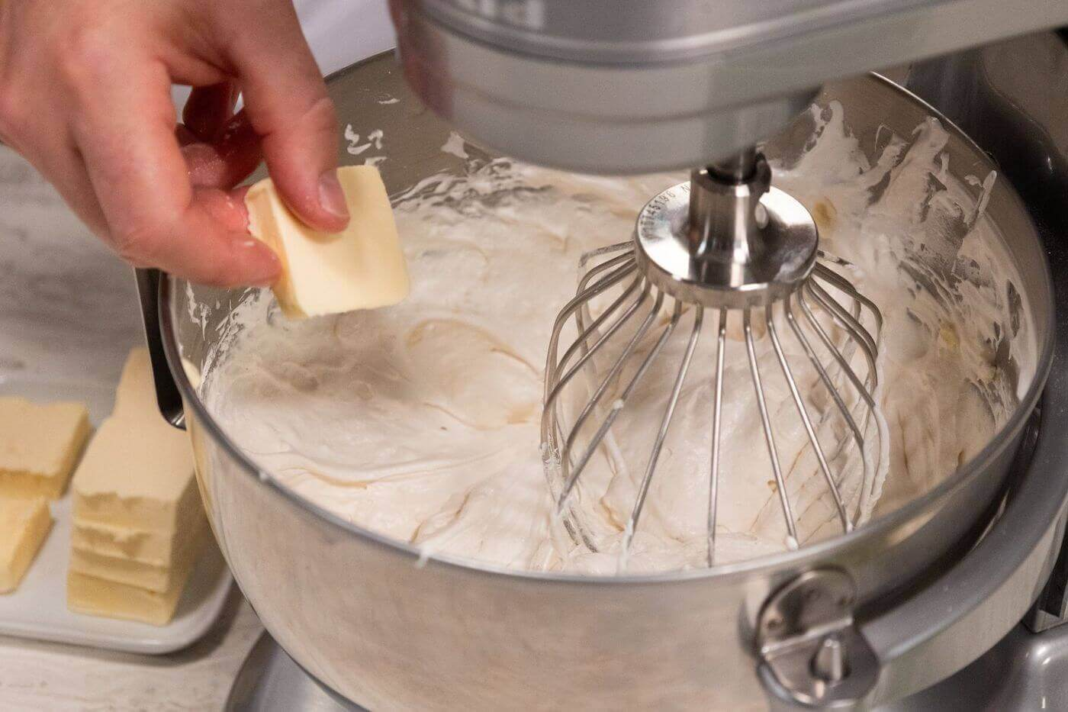
$$\left|\left.ψ_{n}\right\rangle \right.\sim \left|\left.φ_{n}\right\rangle \right.+λ\frac{\left\langle \left.φ_{m}\right|\right.H_{1}\left|\left.φ_{n}\right\rangle \right.}{E_{n}^{\left(0\right)}−E_{m}^{\left(0\right)}}\left|\left.φ_{m}\right\rangle \right.+⋯$$
如果將未微擾的$\left|\left.φ_{n}\right\rangle \right.$視為純粹的主要成分，
修正就常稱為微擾造成的$\left|\left.φ_{m}\right\rangle \right.$混雜、混合或mixing。
好似微擾在$\left|\left.φ_{n}\right\rangle \right.$混雜了$\left|\left.φ_{m}\right\rangle \right.$的配料ingredient。
能量$E_{m}^{\left(0\right)}$與$E_{n}^{\left(0\right)}$接近的態$\left|\left.φ_{m}\right\rangle \right.$，能量差較小，混雜較大。
$\left\langle \left.φ_{m}\right|\right.H_{1}\left|\left.φ_{n}\right\rangle \right.$矩陣元matrix element不為零的態$\left|\left.φ_{m}\right\rangle \right.$， 微擾就會混雜$\left|\left.φ_{m}\right\rangle \right.$與$\left|\left.φ_{n}\right\rangle \right.$！
$H_{1}\left|\left.φ_{n}\right\rangle \right.投影於\left|\left.φ_{m}\right\rangle \right.$方向分量不為零的態$\left|\left.φ_{m}\right\rangle \right.$，才有混雜 。
$$\left\langle \left.φ_{m}\right|\right.H_{1}\left|\left.φ_{n}\right\rangle \right.=\int_{−∞}^{∞}{dx}∙φ_{m}^{∗}\left(x\right)H_{1}φ_{n}\left(x\right)$$
$H_{1}φ_{n}\left(x\right)$與$φ_{m}^{∗}\left(x\right)$波函數的重疊大，混雜也會較大。
$$\left|\left.φ_{k}\right\rangle \right.$$

Slide 26
第一階$λ^{1}，\left|\left.φ_{m}\right\rangle \right.$對本徵態$\left|\left.φ_{n}\right\rangle \right.$的修正：
$$\frac{\left\langle \left.φ_{m}\right|\right.H_{1}\left|\left.φ_{n}\right\rangle \right.}{E_{n}^{\left(0\right)}−E_{m}^{\left(0\right)}}\left|\left.φ_{m}\right\rangle \right.$$
這個結果有時會出問題：
如果$φ_{m}$與$φ_{n}$是能量相等的簡併態degenerate states，
分母能量差$E_{n}^{\left(0\right)}−E_{m}^{\left(0\right)}$為零，
$\left|\left.φ_{m}\right\rangle \right.$對本徵態$\left|\left.φ_{n}\right\rangle \right.$的修正的會是無限大！
$$\frac{\left\langle \left.φ_{m}\right|\right.H_{1}\left|\left.φ_{n}\right\rangle \right.}{E_{n}^{\left(0\right)}−E_{m}^{\left(0\right)}}→∞$$
若有本徵值相等的多個簡併態，以一般微擾計算，彼此的混雜會是無限大！
簡併微擾計算必須對簡併態有前置處理，再放入一般微擾計算！

Slide 27
$$a\left.\left|n\right.\right\rangle =\sqrt{n}∙\left.\left|n−1\right.\right\rangle$$
計算 Anharmonic Oscillator 基態的一階修正：
$$\left|\left.ψ_{0}\right\rangle \right.=\left|\left.0\right\rangle \right.+λ\sum_{k≠0}{\frac{\left\langle \left.k\right|\right.H_{1}\left|\left.0\right\rangle \right.}{E_{n}^{\left(0\right)}−E_{k}^{\left(0\right)}}\left|\left.k\right\rangle \right.}$$
$$a^{†}\left.\left|n\right.\right\rangle =\sqrt{n+1}∙\left.\left|n+1\right.\right\rangle$$
$$\left\langle \left.k\right|\right.{\left(a+a^{†}\right)}^{4}\left|\left.0\right\rangle \right.=\left\langle \left.k\right|\right.\left(a+a^{†}\right)\left(a+a^{†}\right)\left(a+a^{†}\right)\left(a+a^{†}\right)\left|\left.0\right\rangle \right.$$
$$=\left\langle \left.k\right|\right.\left(a+a^{†}\right)\left(a+a^{†}\right)\left(a+a^{†}\right)a^{†}\left|\left.0\right\rangle \right.$$
零個$a$，$k=4$
$$\left\langle \left.4\right|\right.a^{†}a^{†}a^{†}a^{†}\left|\left.0\right\rangle \right.=\sqrt{4}\sqrt{3}\sqrt{2}\sqrt{1}=2\sqrt{6}$$
一個$a$，$k=2$
$$\left\langle \left.2\right|\right.aa^{†}a^{†}a^{†}\left|\left.0\right\rangle \right.+\left\langle \left.2\right|\right.a^{†}aa^{†}a^{†}\left|\left.0\right\rangle \right.+\left\langle \left.2\right|\right.a^{†}a^{†}aa^{†}\left|\left.0\right\rangle \right.=\sqrt{18}+\sqrt{8}+\sqrt{2}=6\sqrt{2}$$
二個$a$，$k=0$
三個$a$，$k=−2$
$$\left\langle \left.4\right|\right.H_{1}\left|\left.0\right\rangle \right.=\frac{1}{4}ℏω2\sqrt{6}=\frac{\sqrt{6}}{2}ℏω$$
$$\left\langle \left.2\right|\right.H_{1}\left|\left.0\right\rangle \right.=\frac{3\sqrt{2}}{2}ℏω$$
$$\left|\left.ψ_{0}\right\rangle \right.=\left|\left.0\right\rangle \right.−\frac{1}{2ℏω}\frac{3\sqrt{2}}{2}ℏω\left|\left.2\right\rangle \right.−\frac{1}{4ℏω}\frac{\sqrt{6}}{2}ℏω\left|\left.4\right\rangle \right.$$
$$=\left|\left.0\right\rangle \right.−\frac{3\sqrt{2}}{4}\left|\left.2\right\rangle \right.−\frac{\sqrt{6}}{8}\left|\left.4\right\rangle \right.$$

Slide 28
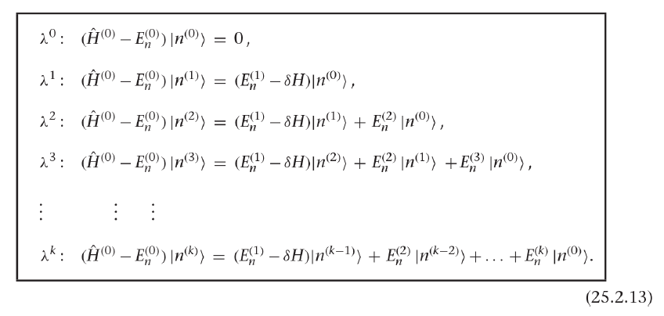
$$\left(H_{0}+λH_{1}\right)\left\{\left|\left.φ_{n}\right\rangle \right.+λ\left|\left.φ_{n}^{\left(1\right)}\right\rangle \right.+⋯\right\}=\left(E_{n}^{\left(0\right)}+λE_{n}^{\left(1\right)}+⋯\right)\left\{\left|\left.φ_{n}\right\rangle \right.+λ\left|\left.φ_{n}^{\left(1\right)}\right\rangle \right.+⋯\right\}$$
把$λH_{1}$移到右邊，$E_{n}^{\left(0\right)}$移到左邊，對更高階微擾運算更加方便。
$$\left(H_{0}−E_{n}^{\left(0\right)}\right)\left\{\left|\left.φ_{n}\right\rangle \right.+λ\left|\left.φ_{n}^{\left(1\right)}\right\rangle \right.+λ^{2}\left|\left.φ_{n}^{\left(2\right)}\right\rangle \right.+⋯\right\}$$
補充材料
$$=\left(−λH_{1}+λE_{n}^{\left(1\right)}+λ^{2}E_{n}^{\left(2\right)}+⋯\right)\left\{\left|\left.φ_{n}\right\rangle \right.+λ\left|\left.φ_{n}^{\left(1\right)}\right\rangle \right.+λ^{2}\left|\left.φ_{n}^{\left(2\right)}\right\rangle \right.+⋯\right\}$$
現在收集到第二階，$λ^{2}$：左手邊還是只有一項，右手邊有三項 ：
$$λ^{2}\left({\hat{H}}_{0}−E_{n}^{\left(0\right)}\right)\left|\left.φ_{n}^{\left(2\right)}\right\rangle \right.=λ^{2}E_{n}^{\left(2\right)}\left|\left.φ_{n}\right\rangle \right.+λ^{2}E_{n}^{\left(1\right)}\left|\left.φ_{n}^{\left(1\right)}\right\rangle \right.−λ^{2}{\hat{H}}_{1}\left|\left.φ_{n}^{\left(1\right)}\right\rangle \right.$$
事實上更高階的展開，方程式都有非常類似的架構，

Slide 29
補充材料
$${\hat{H}}_{0}\left|\left.φ_{n}^{\left(2\right)}\right\rangle \right.−E_{n}^{\left(0\right)}\left|\left.φ_{n}^{\left(2\right)}\right\rangle \right.=E_{n}^{\left(2\right)}\left|\left.φ_{n}\right\rangle \right.+E_{n}^{\left(1\right)}\left|\left.φ_{n}^{\left(1\right)}\right\rangle \right.−{\hat{H}}_{1}\left|\left.φ_{n}^{\left(1\right)}\right\rangle \right.$$
$$\left.\left\langle φ_{n}\right.\right|{\hat{H}}_{0}=\left.\left\langle φ_{n}\right.\right|E_{n}^{\left(0\right)}$$
如同第一階，取此式與$\left\langle \left.φ_{n}\right|\right.$的內積，左手邊如同第一階，依舊又為零：
$$0=E_{n}^{\left(2\right)}\left\langle φ_{n} | φ_{n}\right\rangle +E_{n}^{\left(1\right)}\left\langle φ_{n} | φ_{n}^{\left(1\right)}\right\rangle −\left\langle φ_{n} | {\hat{H}}_{1} | φ_{n}^{\left(1\right)}\right\rangle$$
$$\left\langle φ_{n} | φ_{n}^{\left(1\right)}\right\rangle =0$$
已安排所有修正$\left|\left.φ_{n}^{\left(i\right)}\right\rangle \right.$都與被修正的$\left|\left.φ_{n}\right\rangle \right.$正交，因此第二項為零！
可以得到：
$$E_{n}^{\left(2\right)}=\left\langle φ_{n} | {\hat{H}}_{1} | φ_{n}^{\left(1\right)}\right\rangle$$
從第一階微擾計算，已經解出$\left|\left.φ_{n}^{\left(1\right)}\right\rangle \right.$：代入即可！
$$\left|\left.φ_{n}^{\left(1\right)}\right\rangle \right.=\sum_{k≠n}{\frac{\left\langle \left.φ_{k}\right|\right.{\hat{H}}_{1}\left|\left.φ_{n}\right\rangle \right.}{E_{n}^{\left(0\right)}−E_{k}^{\left(0\right)}}\left|\left.φ_{k}\right\rangle \right.}$$
$$E_{n}^{\left(2\right)}=\left.\left\langle φ_{n}\right.\right|{\hat{H}}_{1}\sum_{k≠n}{\frac{\left\langle \left.φ_{k}\right|\right.{\hat{H}}_{1}\left|\left.φ_{n}\right\rangle \right.}{E_{n}^{\left(0\right)}−E_{k}^{\left(0\right)}}\left|\left.φ_{k}\right\rangle \right.}=\sum_{k≠n}{\frac{\left\langle \left.φ_{k}\right|\right.{\hat{H}}_{1}\left|\left.φ_{n}\right\rangle \right.}{E_{n}^{\left(0\right)}−E_{k}^{\left(0\right)}}\left\langle \left.φ_{n}\right|\right.{\hat{H}}_{1}\left|\left.φ_{k}\right\rangle \right.}$$
$$=\sum_{k≠n}{\frac{\left\langle \left.φ_{k}\right|\right.H_{1}\left|\left.φ_{n}\right\rangle \right.}{E_{n}^{\left(0\right)}−E_{k}^{\left(0\right)}}{\left\langle \left.φ_{k}\right|\right.H_{1}\left|\left.φ_{n}\right\rangle \right.}^{∗}=}\sum_{k≠n}{\frac{{\left|\left\langle \left.φ_{k}\right|\right.H_{1}\left|\left.φ_{n}\right\rangle \right.\right|}^{2}}{E_{n}^{\left(0\right)}−E_{k}^{\left(0\right)}}}$$

Slide 30
補充材料
還有一個有用的公式：
$$\left\langle φ\right.\left|\hat{A}\left.ψ\right\rangle \right.≡\left\langle \left.φ\right|\right.\hat{A}\left|\left.ψ\right\rangle \right.$$
此內積或$\hat{A}$矩陣元取複數共軛，可以表示為${\hat{A}}^{†}$的矩陣元，兩邊態對調。
$${\left\langle \left.φ\right|\right.\hat{A}\left|\left.ψ\right\rangle \right.}^{∗}={\left\langle φ\right.\left|\hat{A}\left.ψ\right\rangle \right.}^{∗}=\left(\left\langle \left.\hat{A}ψ\right|\right.\right)∙\left|\left.φ\right\rangle \right.=\left(\left\langle ψ\right.\right)∙{\hat{A}}^{†}\left|\left.φ\right\rangle \right.=\left\langle \left.ψ\right|\right.{\hat{A}}^{†}\left|\left.φ\right\rangle \right.$$

Slide 31
$$E_{n}^{\left(2\right)}=\sum_{k≠n}{\frac{{\left|\left\langle \left.φ_{k}\right|\right.H_{1}\left|\left.φ_{n}\right\rangle \right.\right|}^{2}}{E_{n}^{\left(0\right)}−E_{k}^{\left(0\right)}}}$$
補充材料
這是第二階$λ^{2}$對能量本徵值的修正。與一階本徵態修正相關聯！
$E_{n}^{\left(2\right)}$等於能量微擾$H_{1}$的矩陣元，夾在$\left|\left.φ_{n}\right\rangle \right.$與任一其他定態，絕對值平方後，
以$\left|\left.φ_{n}\right\rangle \right.$與此其他定態的能量差的倒數為權重，對所有其他定態求和！
1. $\left\langle \left.φ_{k}\right|\right.H_{1}\left|\left.φ_{n}\right\rangle \right.$矩陣元matrix element不為零的態$\left|\left.φ_{k}\right\rangle \right.$，才有貢獻。
2. 能量與$\left|\left.φ_{n}\right\rangle \right.$越靠近的其他定態$\left|\left.φ_{k}\right\rangle \right.$，貢獻會越大！
一般來說，能量差距越大的態，越不重要。
$$\left\langle \left.φ_{n}\right|\right.H_{1}\left|\left.φ_{k}\right\rangle \right.=\int_{−∞}^{∞}{dx}∙φ_{n}^{∗}\left(x\right){\hat{H}}_{1}\left(x\right)φ_{k}\left(x\right)$$
若是波函數描述的系統，能量差距越大，波函數的重疊越少，矩陣元也較小。

Slide 32
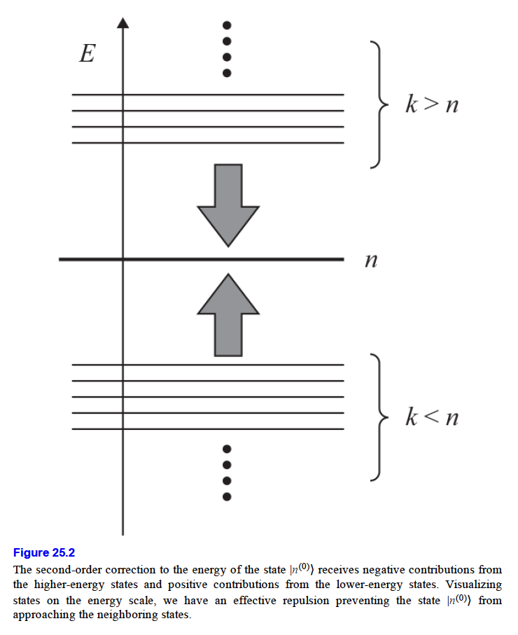
3. 絕對值平方恆正，未微擾$E_{k}^{\left(0\right)}$高於$E_{n}^{\left(0\right)}$的定態，對修正的貢獻永遠是向下的。
未微擾能量$E_{k}^{\left(0\right)}$低於$E_{n}^{\left(0\right)}$的定態，對修正的貢獻永遠是向上的。
微擾永遠擴大兩個態的能量差距，擴大不均！Inequality is always enlarged.
$$E_{n}^{\left(2\right)}=\sum_{k≠n}{\frac{{\left|\left\langle \left.φ_{k}\right|\right.H_{1}\left|\left.φ_{n}\right\rangle \right.\right|}^{2}}{E_{n}^{\left(0\right)}−E_{k}^{\left(0\right)}}}$$
補充材料

Slide 33
計算 Anharmonic Oscillator 基態能量的二階修正：
$$E_{0}^{\left(2\right)}=\sum_{k≠0}{\frac{{\left|\left\langle \left.0\right|\right.H_{1}\left|\left.k\right\rangle \right.\right|}^{2}}{E_{0}^{\left(0\right)}−E_{k}^{\left(0\right)}}}$$
$$\left\langle \left.4\right|\right.H_{1}\left|\left.0\right\rangle \right.=\frac{1}{4}ℏω2\sqrt{6}=\frac{\sqrt{6}}{2}ℏω$$
$$\left\langle \left.2\right|\right.H_{1}\left|\left.0\right\rangle \right.=\frac{3\sqrt{2}}{2}ℏω$$
$$E_{0}^{\left(2\right)}=\sum_{k≠0}{\frac{{\left|\left\langle \left.0\right|\right.H_{1}\left|\left.k\right\rangle \right.\right|}^{2}}{E_{0}^{\left(0\right)}−E_{k}^{\left(0\right)}}}=−\frac{{\left(ℏω\right)}^{2}}{2ℏω}\frac{9}{2}−\frac{{\left(ℏω\right)}^{2}}{4ℏω}\frac{3}{2}=−\frac{21}{8}ℏω$$

Slide 34
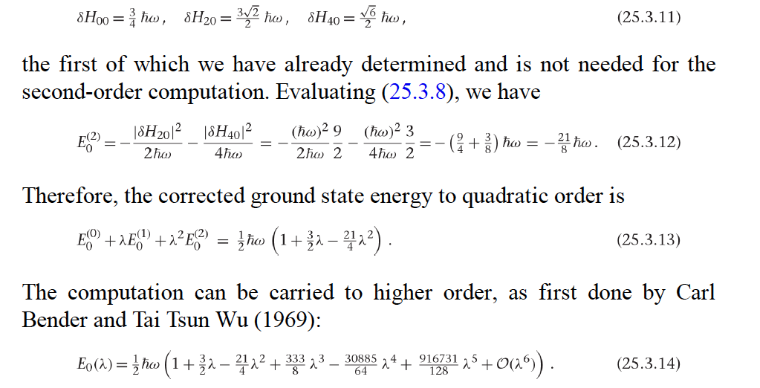

Slide 35
$$E_{n}^{\left(1\right)}=\left\langle \left.φ_{n}\right|\right.H_{1}\left|\left.φ_{n}\right\rangle \right.$$
$$E_{n}^{\left(2\right)}=\sum_{k≠n}{\frac{{\left|\left\langle \left.φ_{n}\right|\right.H_{1}\left|\left.φ_{k}\right\rangle \right.\right|}^{2}}{E_{n}^{\left(0\right)}−E_{k}^{\left(0\right)}}}$$
注意這些表示式與參數$λ$無關，$λ$已經被提出來了！
$$\left|\left.ψ_{n}\right\rangle \right.\sim \left|\left.φ_{n}\right\rangle \right.+λ\sum_{k≠n}{\frac{\left\langle \left.φ_{k}\right|\right.H_{1}\left|\left.φ_{n}\right\rangle \right.}{E_{n}^{\left(0\right)}−E_{k}^{\left(0\right)}}\left|\left.φ_{k}\right\rangle \right.}$$
二階狀態修正原則上也可算，但比複雜，在此從略。
這些修正都由微擾項$H_{1}$在未微擾本徵態$\left|\left.φ_{n,k}\right\rangle \right.$之間的矩陣元matrix element 計算。
能量的一階修正是對角矩陣元、二階能量與一階態修正則是非對角矩陣元。

Slide 37
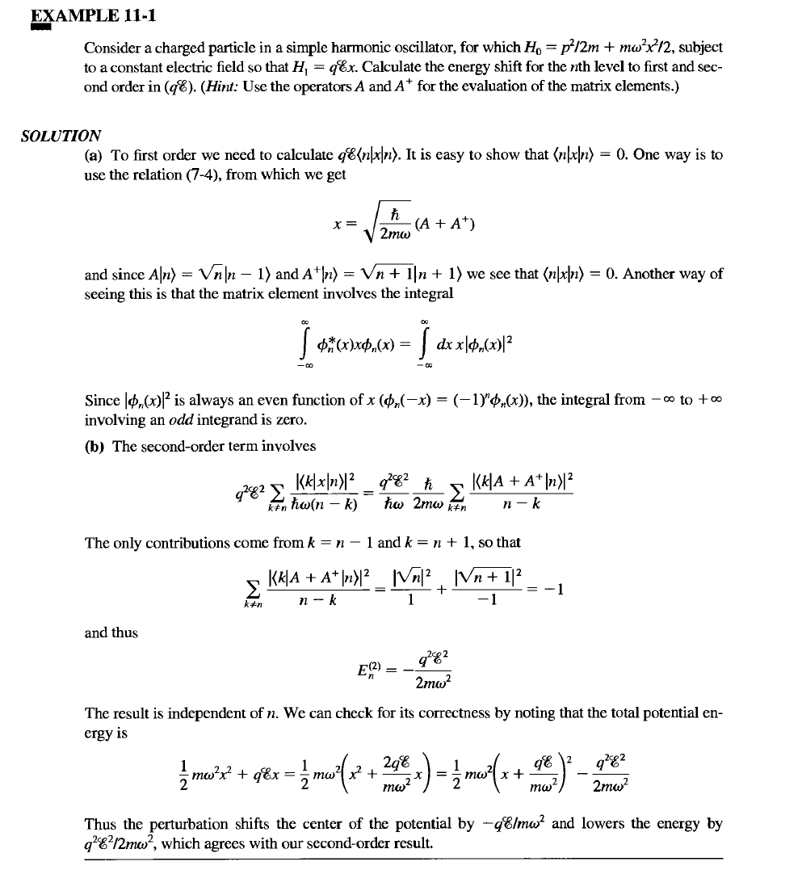

Slide 39
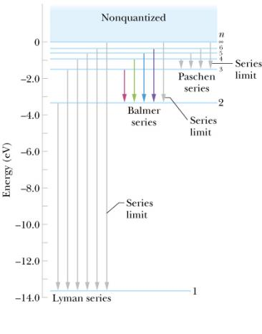
例二：Stark Effect 在氫原子上加上一個常數電場沿z方向，
$${\hat{H}}_{0}=\frac{{\hat{p}}^{2}}{2m}−\frac{e^{2}}{4πε_{0}r}$$
$$λ{\hat{H}}_{1}=e\vec{r}∙\vec{E}=eE\hat{z}$$
未微擾$H_{0}$就是一般氫原子能階計算。
${\hat{H}}_{0}$的本徵值與本徵態：
$$E_{n}=\left(−13.6\text{eV}\right)\left(\frac{1}{n^{2}}\right)$$
$$φ_{nlm}=R_{nl}\left(r\right)∙P_{lm}\left(θ\right)∙Φ_{m}\left(φ\right)$$
計算基態本徵值的第一階修正：
$$λE_{n}^{\left(1\right)}=λ\left\langle \left.φ_{100}\right|\right.H_{1}\left|\left.φ_{100}\right\rangle \right.=eE\left\langle \left.φ_{100}\right|\right.z\left|\left.φ_{100}\right\rangle \right.$$
$$=eE\int_{−∞}^{∞}{d{\vec{r}}^{3}}∙φ_{100}^{∗}\left(\vec{r}\right)zφ_{100}\left(\vec{r}\right)=eE\left\langle z\right\rangle =0$$
基態的z座標期望值為零！
必須計算基態本徵值的第二階修正：
$$E_{1}^{\left(2\right)}=\sum_{lm,k≠1}{\frac{{\left|\left\langle \left.φ_{100}\right|\right.z\left|\left.φ_{klm}\right\rangle \right.\right|}^{2}}{E_{1}^{\left(0\right)}−E_{k}^{\left(0\right)}}}$$
能量差距越大的態，越不重要。
而且波函數的重疊少，矩陣元也較小。

Slide 40
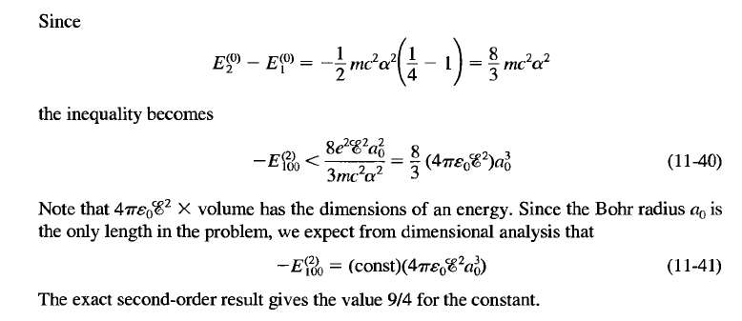
我們可以得到$E_{1}^{\left(2\right)}$的上限：
$$E_{1}^{\left(2\right)}=\sum_{lm,k≠1}{\frac{{\left|\left\langle \left.φ_{100}\right|\right.z\left|\left.φ_{klm}\right\rangle \right.\right|}^{2}}{E_{1}^{\left(0\right)}−E_{k}^{\left(0\right)}}}<\frac{1}{E_{1}^{\left(0\right)}−E_{2}^{\left(0\right)}}\sum_{lm,k≠1}{{\left|\left\langle \left.φ_{100}\right|\right.z\left|\left.φ_{klm}\right\rangle \right.\right|}^{2}}$$
$$=\frac{1}{E_{1}^{\left(0\right)}−E_{2}^{\left(0\right)}}\sum_{lmk}{\left\langle \left.φ_{100}\right|\right.z\left|\left.φ_{klm}\right\rangle \right.\left\langle \left.φ_{klm}\right|\right.z\left|\left.φ_{100}\right\rangle \right.}=\frac{1}{E_{1}^{\left(0\right)}−E_{2}^{\left(0\right)}}\left\langle \left.φ_{100}\right|\right.z^{2}\left|\left.φ_{100}\right\rangle \right.$$

Slide 41
$$λ{\hat{H}}_{1}=ezE$$
Stark Effect：外加電場，計算激發態$2s$ $φ_{200}$的狀態修正，
我們猜測其他$n=2$的定態貢獻最大，
$n=2$的定態有四個，而且是本徵值相等的簡併態：
$$φ_{200}\left(2s\right),φ_{210},φ_{211}φ_{21−1}\left(2p\right)$$
$\left\langle \left.φ_{m}\right|\right.H_{1}\left|\left.φ_{n}=200\right\rangle \right.$若不為零，電場微擾位能就會在$\left|\left.φ_{n}=200\right\rangle \right.$，混雜$\left|\left.φ_{m}\right\rangle \right.$！
可以證明：$φ_{200}$不會與$φ_{21±1}$混雜！
$$\left\langle \left.φ_{211}\right|\right.z\left|\left.φ_{200}\right\rangle \right.=\left\langle \left.φ_{21−1}\right|\right.z\left|\left.φ_{200}\right\rangle \right.=0$$
$$\left\langle \left.φ_{211}\right|\right.z\left|\left.φ_{200}\right\rangle \right.=\int{r^{2}\cos{θ}drdθdφ∙ φ_{211}^{∗}∙r\cos{θ}∙φ_{200}}$$
$$⊃\int{dφ∙ Φ_{1}^{∗}∙Φ_{0}}\sim \int{dφ∙ e^{−iφ}}=0$$
$$Φ_{m}\left(φ\right)=\frac{1}{\sqrt{2π}}e^{imφ}$$
$z$與$φ$角無關，以上結果可推廣到任意兩個$m_{z}$不相等的態，在此是不混雜的。
$φ_{200}\left(2s\right)$只會與$m_{z}$相等的態：$φ_{210}\left(2p\right)$混雜！

Slide 42
$φ_{200}\left(2s\right)$只會與$φ_{210}\left(2p\right)$混雜！
但因為分母能量差$E_{200}^{\left(0\right)}−E_{210}^{\left(0\right)}$為零，
$\left|\left.φ_{210}\right\rangle \right.$對本徵態$2s$的一階修正的貢獻會是無限大！
$$\frac{\left\langle \left.φ_{210}\right|\right.H_{1}\left|\left.φ_{200}\right\rangle \right.}{E_{200}^{\left(0\right)}−E_{210}^{\left(0\right)}}\left|\left.φ_{210}\right\rangle \right.→∞$$
$\left|\left.φ_{210}\right\rangle \right.$對二階能量修正$E_{n}^{\left(2\right)}$的貢獻也是無限大！
$$E_{n}^{\left(2\right)}=\frac{{\left|\left\langle \left.φ_{210}\right|\right.H_{1}\left|\left.φ_{200}\right\rangle \right.\right|}^{2}}{E_{200}^{\left(0\right)}−E_{210}^{\left(0\right)}}$$
很明顯的，問題來自$φ_{200}\left(2s\right)$與$φ_{210}\left(2p\right)$是能量相等的兩個簡併態degenerate！
若有本徵值相等的多個簡併態，以一般微擾計算，彼此的混雜會是無限大！
簡併微擾計算必須對簡併態有前置處理，再放入一般微擾計算！

Slide 43
Degenerate Perturbation Theory
從一個兩態系統的玩具模型開始：
$${\hat{H}}_{0}=\left(\begin{matrix}1 & 0 \\ 0 & 1\end{matrix}\right)$$
${\hat{H}}_{0}$是對角矩陣，自然基底的兩個態就是${\hat{H}}_{0}$的本徵態，兩者能量簡併。
$$\left(\begin{matrix}1 \\ 0\end{matrix}\right)$$
$$\left(\begin{matrix}0 \\ 1\end{matrix}\right)$$
$$E_{1}^{\left(0\right)}=E_{2}^{\left(0\right)}=1$$
這可以理解為來自一個常數的電位能。當然這實質上等於沒有電位。
假設加上一微擾項，正比於$σ_{x}$：
$$λ{\hat{H}}_{1}=λσ_{x}=λ\left(\begin{matrix}0 & 1 \\ 1 & 0\end{matrix}\right)$$
$$\hat{H}={\hat{H}}_{0}+λ{\hat{H}}_{1}=\left(\begin{matrix}1 & λ \\ λ & 1\end{matrix}\right)$$
這可以理解為來自一個沿$x$方向的磁場。

Slide 44
使用微擾公式計算，一階能量修正為零：
$$E_{1}^{\left(1\right)}=\left\langle H_{1}\right\rangle =\left(1,0\right)\left(\begin{matrix}0 & 1 \\ 1 & 0\end{matrix}\right)\left(\begin{matrix}1 \\ 0\end{matrix}\right)＝\left(1,0\right)\left(\begin{matrix}0 \\ 1\end{matrix}\right)=0$$
$$E_{2}^{\left(1\right)}=\left(0,1\right)\left(\begin{matrix}0 & 1 \\ 1 & 0\end{matrix}\right)\left(\begin{matrix}0 \\ 1\end{matrix}\right)=0$$
但這個模型是可以直接解出$\hat{H}={\hat{H}}_{0}+λ{\hat{H}}_{1}=\left(\begin{matrix}1 & 0 \\ 0 & 1\end{matrix}\right)+\left(\begin{matrix}0 & λ \\ λ & 0\end{matrix}\right)$的本徵值：
注意：${\hat{H}}_{0}=\left(\begin{matrix}1 & 0 \\ 0 & 1\end{matrix}\right)$是Identity矩陣，任何行向量，都是它的本徵向量：
$$\left(\begin{matrix}1 & 0 \\ 0 & 1\end{matrix}\right)\left(\begin{matrix}a \\ b\end{matrix}\right)=\left(\begin{matrix}a \\ b\end{matrix}\right)$$
因此只要找$λ{\hat{H}}_{1}=\left(\begin{matrix}0 & λ \\ λ & 0\end{matrix}\right)$的本徵態即可。
而$λ{\hat{H}}_{1}$就是$λσ_{x}$，我們前面已經解出了它的本徵值$±λ$與本徵態： $\frac{1}{\sqrt{2}}\left(\begin{matrix}1 \\ 1\end{matrix}\right)$, $\frac{1}{\sqrt{2}}\left(\begin{matrix}1 \\ −1\end{matrix}\right)$
因此能量的本徵值是可解的：
$$E=1±λ$$
一階能量修正應該是$E_{1,2}^{\left(1\right)}=±1$，單純的微擾計算得到錯誤的能量修正答案，
如果進一步算狀態修正，微擾公式甚至會發散！
$$λ\sum_{k≠n}{\frac{\left\langle \left.φ_{k}\right|\right.H_{1}\left|\left.φ_{n}\right\rangle \right.}{E_{n}^{\left(0\right)}−E_{k}^{\left(0\right)}}\left|\left.φ_{k}\right\rangle \right.}$$
$$\left|\left.1\right\rangle \right.\sim \left|\left.1^{\left(0\right)}\right\rangle \right.+λ\frac{\left\langle \left.2^{\left(0\right)}\right|\right.H_{1}\left|\left.1^{\left(0\right)}\right\rangle \right.}{E_{1}^{\left(0\right)}−E_{2}^{\left(0\right)}}\left|\left.2^{\left(0\right)}\right\rangle \right.→∞$$

Slide 45
$$\left(\begin{matrix}0 & λ \\ λ & 0\end{matrix}\right)$$
設本徵值為$c$：
本徵態：$\left(\begin{matrix}a \\ b\end{matrix}\right)$
$$\left(\begin{matrix}0 & λ \\ λ & 0\end{matrix}\right)\left(\begin{matrix}a \\ b\end{matrix}\right)=c\left(\begin{matrix}a \\ b\end{matrix}\right)$$
$$\left(\begin{matrix}0 & λ \\ λ & 0\end{matrix}\right)\left(\begin{matrix}a \\ b\end{matrix}\right)−c\left(\begin{matrix}1 & 0 \\ 0 & 1\end{matrix}\right)\left(\begin{matrix}a \\ b\end{matrix}\right)=\left(\begin{matrix}−c & λ \\ λ & −c\end{matrix}\right)\left(\begin{matrix}a \\ b\end{matrix}\right)=0$$
此式要有非零解，矩陣的行列式必須為零！
$$\left|\begin{matrix}−c & λ \\ λ & −c\end{matrix}\right|=0$$
本徵值，
$$c=±λ$$
當
$$c=λ$$
$$λ\left(\begin{matrix}−1 & 1 \\ 1 & −1\end{matrix}\right)\left(\begin{matrix}a \\ b\end{matrix}\right)=0$$
$$−a+b=0$$
$$a\left(\begin{matrix}1 \\ 1\end{matrix}\right)=\frac{1}{\sqrt{2}}\left(\begin{matrix}1 \\ 1\end{matrix}\right)≡\left|\left.1^{\left(0\right)}\right\rangle \right.$$
當
$$c=−λ$$
$$λ\left(\begin{matrix}1 & 1 \\ 1 & 1\end{matrix}\right)\left(\begin{matrix}a \\ b\end{matrix}\right)=0$$
$$a+b=0$$
$$a\left(\begin{matrix}1 \\ −1\end{matrix}\right)=\frac{1}{\sqrt{2}}\left(\begin{matrix}1 \\ −1\end{matrix}\right)≡\left|\left.2^{\left(0\right)}\right\rangle \right.$$

Slide 46
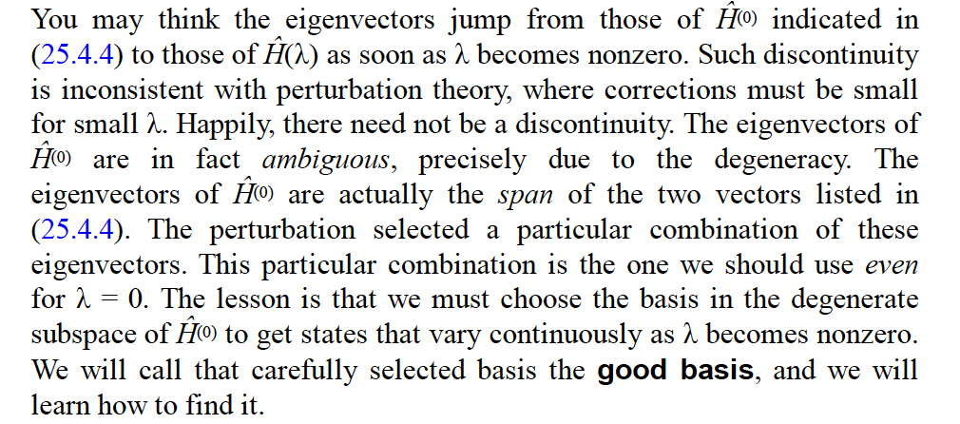
直接解得到的兩個本徵態：
$$\frac{1}{\sqrt{2}}\left(\begin{matrix}1 \\ 1\end{matrix}\right)$$
$$\frac{1}{\sqrt{2}}\left(\begin{matrix}1 \\ −1\end{matrix}\right)$$
$σ_{x}$的本徵態！
注意這兩個本徵態完全與$λ$無關，且適用於任何$λ$，因此即使$λ→0$都成立！
所以原來的零次解 $\left(\begin{matrix}1 \\ 0\end{matrix}\right) \left(\begin{matrix}0 \\ 1\end{matrix}\right)$並不是好的選擇！
因為真實本徵態在微擾消失後不會趨近這個選擇$\left(\begin{matrix}1 \\ 0\end{matrix}\right) \left(\begin{matrix}0 \\ 1\end{matrix}\right)$！而是 $\frac{1}{\sqrt{2}}\left(\begin{matrix}1 \\ ±1\end{matrix}\right)$。
可見我們在簡併情況下，對零次解的選擇必須顧慮到微擾項！

Slide 47
若我們一開始就使用 $\left(\begin{matrix}1 \\ ±1\end{matrix}\right)$作為零次項，而使用微擾計算結果：
$$E_{1}^{\left(1\right)}=\left\langle H_{1}\right\rangle =\frac{1}{2}\left(1,1\right)\left(\begin{matrix}0 & 1 \\ 1 & 0\end{matrix}\right)\left(\begin{matrix}1 \\ 1\end{matrix}\right)=1$$
$$E_{2}^{\left(1\right)}=\frac{1}{2}\left(1,−1\right)\left(\begin{matrix}0 & 1 \\ 1 & 0\end{matrix}\right)\left(\begin{matrix}1 \\ −1\end{matrix}\right)=\frac{1}{2}\left(1,−1\right)\left(\begin{matrix}−1 \\ 1\end{matrix}\right)=1$$
這是正確的！
更進一步：$H_{1}$在兩個新的零次項間的矩陣元為零，因此兩個態不混雜。
$$\left\langle \left.2^{′\left(0\right)}\right|\right.H_{1}\left|\left.1^{′\left(0\right)}\right\rangle \right.=\frac{1}{2}\left(1,−1\right)\left(\begin{matrix}0 & 1 \\ 1 & 0\end{matrix}\right)\left(\begin{matrix}1 \\ 1\end{matrix}\right)=\frac{1}{2}\left(1,−1\right)\left(\begin{matrix}1 \\ 1\end{matrix}\right)=0$$
可以推測，二次以上能量修正，以及所有狀態修正都是零：
$$E_{1}^{\left(i>1\right)}=E_{2}^{\left(i>1\right)}=0$$
可見在如此新的選擇下，微擾計算就會得到完全正確的答案。
$$E=1±λ$$
$$\frac{1}{\sqrt{2}}\left(\begin{matrix}1 \\ ±1\end{matrix}\right)$$
可見我們在簡併情況下，對零次解的選擇必須顧慮到微擾項！
選擇的條件似乎是：零次項應該選微擾項的本徵態。

Slide 48
Degenerate Perturbation Theory
如果$未微擾能量有\text{兩個}本徵值相同的、\text{簡併}\text{degenerate}\text{的本徵態}\left|\left.φ_{1}\right\rangle \right.,\left|\left.φ_{2}\right\rangle \right.$。
$H_{0}\left|\left.φ_{1}\right\rangle \right.−E^{(0)}\left|\left.φ_{1}\right\rangle \right.=0$
$H_{0}\left|\left.φ_{2}\right\rangle \right.−E^{(0)}\left|\left.φ_{2}\right\rangle \right.=0$
那麼$\left|\left.φ_{2}\right\rangle \right.$對$\left|\left.φ_{1}\right\rangle \right.$的微擾一階本徵態修正貢獻：
$$\frac{\left\langle \left.φ_{2}\right|\right.H_{1}\left|\left.φ_{1}\right\rangle \right.}{E^{(0)}−E^{(0)}}\left|\left.φ_{2}\right\rangle \right.=∞$$
上式分母能量差$E^{(0)}−E^{(0)}$為零，$\left|\left.φ_{2}\right\rangle \right.$對$\left|\left.φ_{1}\right\rangle \right.$的一階混雜會是無限大！
除非分子的矩陣元 $\left\langle \left.φ_{2}\right|\right.H_{1}\left|\left.φ_{1}\right\rangle \right.$也是零。
可見簡併微擾計算必須對簡併態有前置處理，再放入正常的微擾計算！
我們要找出適當的$\left|\left.φ_{1}\right\rangle \right.,\left|\left.φ_{2}\right\rangle \right.$使分子的矩陣元$\left\langle \left.φ_{2}\right|\right.H_{1}\left|\left.φ_{1}\right\rangle \right.$也是零。
這真的可能嗎？這是可能的，原因是$\left|\left.φ_{1}\right\rangle \right.,\left|\left.φ_{2}\right\rangle \right.$並不是未微擾態的唯一選擇。
對簡併態自由度較大！

Slide 49
如果$\text{兩個簡併}\text{degenerate}\text{的本徵態}\left|\left.φ_{1}\right\rangle \right.,\left|\left.φ_{2}\right\rangle \right.$。
$H_{0}\left|\left.φ_{1}\right\rangle \right.−E^{(0)}\left|\left.φ_{1}\right\rangle \right.=0$
$H_{0}\left|\left.φ_{2}\right\rangle \right.−E^{(0)}\left|\left.φ_{2}\right\rangle \right.=0$
兩個態的線性組合$a\left|\left.φ_{1}\right\rangle \right.+b\left|\left.φ_{2}\right\rangle \right.$依舊是同一本徵值的本徵態，稱簡併態空間。
或許$λ→0$時，一個真實的能量本徵態可能不會趨近於原來的選擇$\left|\left.φ_{1,2}\right\rangle \right.$，
而是趨近$\left|\left.φ_{i}\right\rangle \right.$的線性組合，這或許才是正確的未微擾零次項。
$$λ→0\text{時}, \left|\left.ψ\left(λ\right)\right\rangle \right.→\left|\left.ψ\left(0\right)\right\rangle \right.=a\left|\left.φ_{1}\right\rangle \right.+b\left|\left.φ_{2}\right\rangle \right.$$
策略是：微擾計算必須容許這樣的選擇！以$a\left|\left.φ_{1}\right\rangle \right.+b\left|\left.φ_{2}\right\rangle \right.$為零階本徵態。
我們要找出兩個適當的$\left|\left.φ_{1}\right\rangle \right.,\left|\left.φ_{2}\right\rangle \right.$之線性組合，
來取代原來的$\left|\left.φ_{1}\right\rangle \right.,\left|\left.φ_{2}\right\rangle \right.$作為微擾的起點，使公式中分子的矩陣元也是零。

Slide 50
$$\left|\left.φ_{n2}\right\rangle \right.$$
$$\left|\left.ψ_{n1}\left(λ\right)\right\rangle \right.$$
$$\left|\left.ψ_{n1}\left(0\right)\right\rangle \right.$$
$$\left|\left.φ_{n1}\right\rangle \right.$$
以空間來比諭，設${\hat{e}}_{x},{\hat{e}}_{y}$類比簡併態$\left|\left.φ_{n1}\right\rangle \right.,\left|\left.φ_{n2}\right\rangle \right.$，簡併態空間就是$x−z$平面。
一個真實本徵態$\left|\left.ψ_{n1,2}\left(λ\right)\right\rangle \right.$，可能趨近 $xz$平面 上的另一狀態$\left|\left.ψ_{n1,2}\left(0\right)\right\rangle \right.$。

Slide 51
設$λ→0$一真實本徵態趨近於$\left|\left.φ^{(0)}\right\rangle \right.=\left|\left.ψ\left(λ=0\right)\right\rangle ≡\right.a\left|\left.φ_{1}\right\rangle \right.+b\left|\left.φ_{2}\right\rangle \right.$。
那它的微擾展開應該改為：
$$\left|\left.ψ\right\rangle \right.=\left(a\left|\left.φ_{1}\right\rangle \right.+b\left|\left.φ_{2}\right\rangle \right.\right)+λ\left|\left.φ^{(1)}\right\rangle \right.+⋯$$
之前已經推導出一階的本徵態方程式，只要代入更新的$\left|\left.φ^{(0)}\right\rangle \right.$即可。
$$H_{0}\left|\left.φ_{n}^{\left(1\right)}\right\rangle \right.+H_{1}\left|\left.φ_{n}\right\rangle \right.=E_{n}^{\left(1\right)}\left|\left.φ_{n}\right\rangle \right.+E_{n}^{\left(0\right)}\left|\left.φ_{n}^{\left(1\right)}\right\rangle \right.$$
$$\left|\left.φ_{n}\right\rangle →a\left|\left.φ_{1}\right\rangle \right.+b\left|\left.φ_{2}\right\rangle \right.\right.$$
$$H_{0}\left|\left.φ^{(1)}\right\rangle \right.+H_{1}\left(a\left|\left.φ_{1}\right\rangle \right.+b\left|\left.φ_{2}\right\rangle \right.\right)=E^{(1)}\left(a\left|\left.φ_{1}\right\rangle \right.+b\left|\left.φ_{2}\right\rangle \right.\right)+E^{(0)}\left|\left.φ^{(1)}\right\rangle \right.$$

Slide 52
$$H_{0}\left|\left.φ^{(1)}\right\rangle \right.+H_{1}\left(a\left|\left.φ_{1}\right\rangle \right.+b\left|\left.φ_{2}\right\rangle \right.\right)=E^{(1)}\left(a\left|\left.φ_{1}\right\rangle \right.+b\left|\left.φ_{2}\right\rangle \right.\right)+E^{(0)}\left|\left.φ^{(1)}\right\rangle \right.$$
與一般微擾進行同樣的操作：
取此式與$\left\langle \left.φ_{1}\right|\right.$內積，左邊第一項就與右邊最後一項還是抵消。
$\left\langle \left.φ_{1}\right|\right.H_{0}\left|\left.φ^{(1)}\right\rangle \right.＋a\left\langle \left.φ_{1}\right|\right.H_{1}\left|\left.φ_{1}\right\rangle \right.+b\left\langle \left.φ_{1}\right|\right.H_{1}\left|\left.φ_{2}\right\rangle \right.=E^{(1)}a\left\langle φ_{1} | φ_{1}\right\rangle +E^{(1)}b\left\langle φ_{1} | φ_{2}\right\rangle +$ $E^{(0)}\left\langle φ_{1} | φ_{1}\right\rangle$
可得 ：
正交
$$a\left\langle \left.φ_{1}\right|\right.H_{1}\left|\left.φ_{1}\right\rangle \right.+b\left\langle \left.φ_{1}\right|\right.H_{1}\left|\left.φ_{2}\right\rangle \right.=E^{(1)}a$$
多了一項。
與另一簡併態$\left\langle \left.φ_{2}\right|\right.$的內積，可得 ：
$$a\left\langle \left.φ_{2}\right|\right.H_{1}\left|\left.φ_{1}\right\rangle \right.+b\left\langle \left.φ_{2}\right|\right.H_{1}\left|\left.φ_{2}\right\rangle \right.=E^{(1)}b$$
將上兩式中的矩陣元$\left\langle \left.φ_{j}\right|\right.H_{1}\left|\left.φ_{i}\right\rangle \right.≡h_{ij}$收集為一矩陣，係數$a,b$收集為行向量後，
這兩式可以以一個矩陣方程式表示：
$$\left(\begin{matrix}\left\langle \left.φ_{1}\right|\right.H_{1}\left|\left.φ_{1}\right\rangle \right. & \left\langle \left.φ_{1}\right|\right.H_{1}\left|\left.φ_{2}\right\rangle \right. \\ \left\langle \left.φ_{2}\right|\right.H_{1}\left|\left.φ_{1}\right\rangle \right. & \left\langle \left.φ_{2}\right|\right.H_{1}\left|\left.φ_{2}\right\rangle \right.\end{matrix}\right)\left(\begin{matrix}a \\ b\end{matrix}\right)=\left(\begin{matrix}h_{11} & h_{12} \\ h_{21} & h_{22}\end{matrix}\right)\left(\begin{matrix}a \\ b\end{matrix}\right)=E_{n}^{\left(1\right)}\left(\begin{matrix}a \\ b\end{matrix}\right)$$
$\left|\left.φ_{1}\right\rangle \right.,\left|\left.φ_{2}\right\rangle \right.$組成一組基底，這個矩陣就正是$H_{1}$在此二維簡併空間內的表現。
此式即是$\text{這個矩陣}\left(\begin{matrix}h_{11} & h_{12} \\ h_{21} & h_{22}\end{matrix}\right)$的本徵向量方程式！

Slide 53
一個真實本徵態趨近的$\text{零階項}a\left|\left.φ_{1}\right\rangle \right.+b\left|\left.φ_{2}\right\rangle \right.≡$ $\left|\left.φ^{(0)}\right\rangle \right.$，滿足以下矩陣方程式：
$$\left(\begin{matrix}h_{11} & h_{12} \\ h_{21} & h_{22}\end{matrix}\right)\left(\begin{matrix}a \\ b\end{matrix}\right)=E^{(1)}\left(\begin{matrix}a \\ b\end{matrix}\right)$$
此式即是$\text{這個矩陣}\left(\begin{matrix}h_{11} & h_{12} \\ h_{21} & h_{22}\end{matrix}\right)$的本徵向量方程式。
一階能量修正$E^{(1)}$就是本徵值。
零階本徵態 $a\left|\left.φ_{1}\right\rangle \right.+b\left|\left.φ_{2}\right\rangle \right.$，就是此矩陣的本徵向量。
微擾能量$H_{1}$會決定微擾時適當的第零階未微擾本徵態！真令人驚訝！
如果把$λ$比喻為時間，這有點是未來$λ≠0$可以決定過去$λ=0$！
但應該說是未來，決定了過去$λ=0$跨向未來$λ≠0$的第一步。

Slide 54
1. $λ→0$時，真實解會趨近微擾項矩陣的本徵向量所代表的狀態，本徵向量有兩個。
$$H_{1}\left|\left.φ_{1}^{\left(0\right)}\right\rangle \right.=E_{1}^{\left(1\right)}\left|\left.φ_{1}^{\left(0\right)}\right\rangle \right.$$
$$H_{1}\left|\left.φ_{2}^{\left(0\right)}\right\rangle \right.=E_{2}^{\left(1\right)}\left|\left.φ_{2}^{\left(0\right)}\right\rangle \right.$$
$$\left|\left.ψ_{i}\right\rangle \right.→ \left|\left.φ_{i}^{\left(0\right)}\right\rangle \right.=a_{i}\left|\left.φ_{1}\right\rangle \right.+b_{i}\left|\left.φ_{2}\right\rangle \right. i=1,2$$
圖中這兩個狀態的身份就近似找到了！
$\text{2}\text{. }\text{兩個本徵值就是}\left|\left.ψ_{1,2}\right\rangle \right.$的能量一階修正$E_{1,2}^{\left(1\right)}$！
這兩個狀態分裂的能隙就找到了！
3. 兩本徵值通常不同，因此能量的一階修正$E_{1,2}^{\left(1\right)}$不相等，兩個態的簡併就被破壞了。
一般就說：微擾$H_{1}$破壞了這兩個態的簡併。Lift the degeneracies.
可以證明這樣選零階項後，微擾的無限大就可以避免了。

Slide 55
一般來說，微擾不會改變定性的樣貌，畢竟是微小的效應。
簡併態的微擾卻會破壞簡併，完全改變系統的外在性質。
或許當你造訪桂川的那一天，微風特別涼爽，溪水特別溫柔。
你會發現那一天嵐山分外怡人。真是一期一會。

Slide 56
Stark Effect 計算激發態$2s$的修正，$n=2$有四個本徵值相等的簡併態：
但$φ_{200}\left(2s\right)$只會與$φ_{210}\left(2p\right)$混雜！因此只需考慮二維簡併空間：
$$α_{1}\left|\left.φ_{200}\right\rangle \right.+α_{2}\left|\left.φ_{210}\right\rangle \right.\sim \left(\begin{matrix}α_{1} \\ α_{2}\end{matrix}\right)$$
$H_{1}$本徵態方程式；
$$λ\left(\begin{matrix}\left\langle \left.φ_{200}\right|\right.H_{1}\left|\left.φ_{200}\right\rangle \right. & \left\langle \left.φ_{200}\right|\right.H_{1}\left|\left.φ_{210}\right\rangle \right. \\ \left\langle \left.φ_{210}\right|\right.H_{1}\left|\left.φ_{200}\right\rangle \right. & \left\langle \left.φ_{210}\right|\right.H_{1}\left|\left.φ_{210}\right\rangle \right.\end{matrix}\right)\left(\begin{matrix}α_{1} \\ α_{2}\end{matrix}\right)=E_{n}^{\left(1\right)}\left(\begin{matrix}α_{1} \\ α_{2}\end{matrix}\right)$$
$$λ{\hat{H}}_{1}=ezE$$
$$eE\left(\begin{matrix}\left\langle \left.φ_{200}\right|\right.z\left|\left.φ_{200}\right\rangle \right. & \left\langle \left.φ_{200}\right|\right.z\left|\left.φ_{210}\right\rangle \right. \\ \left\langle \left.φ_{210}\right|\right.z\left|\left.φ_{200}\right\rangle \right. & \left\langle \left.φ_{210}\right|\right.z\left|\left.φ_{210}\right\rangle \right.\end{matrix}\right)\left(\begin{matrix}α_{1} \\ α_{2}\end{matrix}\right)=E_{n}^{\left(1\right)}\left(\begin{matrix}α_{1} \\ α_{2}\end{matrix}\right)$$
$$\left\langle \left.φ_{200}\right|\right.z\left|\left.φ_{200}\right\rangle \right.=\left\langle \left.φ_{210}\right|\right.z\left|\left.φ_{210}\right\rangle \right.=0$$
$\left\langle \left.φ_{200}\right|\right.z\left|\left.φ_{210}\right\rangle \right.={\left\langle \left.φ_{210}\right|\right.z\left|\left.φ_{200}\right\rangle \right.}^{∗}$= $=−3a_{0}$
$$\left(\begin{matrix}0 & −3eEa_{0} \\ −3eEa_{0} & 0\end{matrix}\right)\left(\begin{matrix}α_{1} \\ α_{2}\end{matrix}\right)=−3eEa_{0}\left(\begin{matrix}0 & 1 \\ 1 & 0\end{matrix}\right)\left(\begin{matrix}α_{1} \\ α_{2}\end{matrix}\right)=E_{n}^{\left(1\right)}\left(\begin{matrix}α_{1} \\ α_{2}\end{matrix}\right)$$
這就是已經解過：$σ_{x}$的本徵態問題。

Slide 57
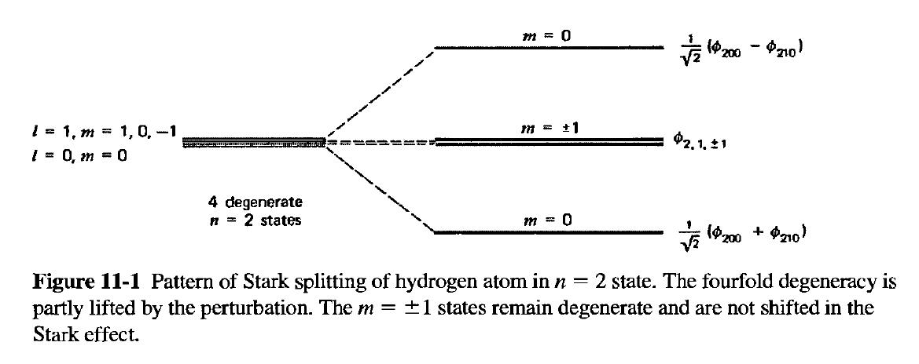
$$−3eEa_{0}\left(\begin{matrix}0 & 1 \\ 1 & 0\end{matrix}\right)\left(\begin{matrix}α_{1} \\ α_{2}\end{matrix}\right)=E_{n}^{\left(1\right)}\left(\begin{matrix}α_{1} \\ α_{2}\end{matrix}\right)$$
$$\left(\begin{matrix}E_{n}^{\left(1\right)} & 3eEa_{0} \\ 3eEa_{0} & E_{n}^{\left(1\right)}\end{matrix}\right)\left(\begin{matrix}α_{1} \\ α_{2}\end{matrix}\right)=0$$
本徵值與本徵態如預期有兩組。
$$E_{n}^{\left(1\right)}=3eEa_{0}$$
$$\left(\begin{matrix}α_{1} \\ α_{2}\end{matrix}\right)=\frac{1}{\sqrt{2}}\left(\begin{matrix}1 \\ −1\end{matrix}\right)$$
$$\left|\left.ψ_{2−}\right\rangle \right.→\frac{1}{\sqrt{2}}\left(\left|\left.φ_{200}\right\rangle \right.−\left|\left.φ_{210}\right\rangle \right.\right)$$
$$E_{n}^{\left(1\right)}=−3eEa_{0}$$
$$\left(\begin{matrix}α_{1} \\ α_{2}\end{matrix}\right)=\frac{1}{\sqrt{2}}\left(\begin{matrix}1 \\ 1\end{matrix}\right)$$
$$\left|\left.ψ_{2+}\right\rangle \right.→\frac{1}{\sqrt{2}}\left(\left|\left.φ_{200}\right\rangle \right.+\left|\left.φ_{210}\right\rangle \right.\right)$$
注意：現在能量本徵值已不同，微擾項在一階修正將簡併部分移除。
Perturbation lifts the degeneracy.

Slide 58
找到適當的零階項後，微擾展開就可以繼續展開！以第一本徵態的修正$\left|\left.φ_{n1}^{\left(1\right)}\right\rangle \right.$為例：
$$\left(H_{0}−E_{n}^{\left(0\right)}\right)\left|\left.φ_{n1}^{\left(1\right)}\right\rangle \right.+H_{1}\left|\left.φ_{n1}^{\left(0\right)}\right\rangle \right.=E_{n}^{\left(1\right)}\left|\left.φ_{n1}^{\left(0\right)}\right\rangle \right.$$
現在取此式與$\left\langle \left.φ_{m}\right|\right., m≠n$的內積，代入正交關係：
$$\left\langle φ_{m} | φ_{n}\right\rangle =0$$
$$\left(E_{m}^{\left(0\right)}−E_{n}^{\left(0\right)}\right)\left\langle φ_{m} | φ_{n1}^{\left(1\right)}\right\rangle =λ\left\langle \left.φ_{m}\right|\right.{\hat{H}}_{1}\left|\left.φ_{n1}\right\rangle \right.$$
$$\left\langle φ_{m} | φ_{n1}^{\left(1\right)}\right\rangle =\frac{\left\langle \left.φ_{m}\right|\right.H_{1}\left|\left.φ_{n1}\right\rangle \right.}{E_{n}^{\left(0\right)}−E_{m}^{\left(0\right)}}$$
一階狀態修正$\left|\left.φ_{n1}^{\left(1\right)}\right\rangle \right.$，與其他不同能量狀態的內積，公式與非簡併微擾完全相同！
$$\left|\left.ψ_{n}\right\rangle \right.\sim \left|\left.φ_{n1}^{\left(0\right)}\right\rangle \right.+λ\sum_{m≠n}{\frac{\left\langle \left.φ_{m}\right|\right.H_{1}\left|\left.φ_{n1}\right\rangle \right.}{E_{n}^{\left(0\right)}−E_{m}^{\left(0\right)}}\left|\left.φ_{m}\right\rangle \right.}+d\left|\left.φ_{n2}^{\left(0\right)}\right\rangle \right.$$
但此時，一階狀態修正$\left|\left.φ_{n1}^{\left(1\right)}\right\rangle \right.$內，還有其他簡併態$\left|\left.φ_{n2}^{\left(0\right)}\right\rangle \right.$的貢獻，比較複雜，
必須用到二階能量修正才可以計算！我們略過。可以見Zweibach。

Slide 59
以上推導很容易推廣到$N>2$時：
$$\left|\left.ψ_{n}\right\rangle \right.=\sum_{i=1}^{N}{α_{i}\left|\left.φ_{ni}\right\rangle \right.}+o(λ)$$
代入本徵態方程式：
$$\left(H_{0}−E_{n}^{\left(0\right)}\right)\left\{\sum_{i=1}^{N}{α_{i}\left|\left.φ_{ni}\right\rangle \right.}+λ\left|\left.φ_{n}^{\left(1\right)}\right\rangle \right.+⋯\right\}$$
$$=\left(−λH_{1}+λE_{n}^{\left(1\right)}+⋯\right)\left\{\sum_{i=1}^{N}{α_{i}\left|\left.φ_{ni}\right\rangle \right.}+λ\left|\left.φ_{n}^{\left(1\right)}\right\rangle \right.+⋯\right\}$$
取到一階：
$$\left(H_{0}−E_{n}^{\left(0\right)}+λH_{1}\right)\sum_{i=1}^{N}{α_{i}\left|\left.φ_{ni}\right\rangle \right.}=λE_{n}^{\left(1\right)}\sum_{i=1}^{N}{α_{i}\left|\left.φ_{ni}\right\rangle \right.}$$
$${\hat{H}}_{1}\sum_{i=1}^{N}{α_{i}\left|\left.φ_{ni}\right\rangle \right.}=E_{n}^{\left(1\right)}\sum_{i=1}^{N}{α_{i}\left|\left.φ_{ni}\right\rangle \right.}$$
取此式與$\left\langle \left.φ_{nj}\right|\right.$的內積，可得：
$$\sum_{i=1}^{N}{\left\langle \left.φ_{nj}\right|\right.H_{1}\left|\left.φ_{ni}\right\rangle \right.α_{i}}=E_{n}^{\left(1\right)}α_{i}$$
可見：零階項$\sum_{i=1}^{N}{α_{i}\left|\left.φ_{ni}\right\rangle \right.}$在簡併的$N$維子空間內是${\hat{H}}_{1}$的本徵態！

Slide 60
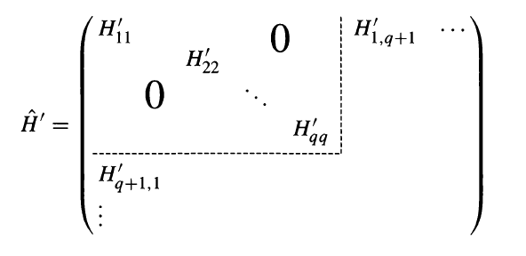
找到$H_{0}$的$N$個簡併態，
在以它們為基底的$N$維線性空間，寫下$H_{1}$的矩陣$\left\langle \left.φ_{nj}\right|\right.H_{1}\left|\left.φ_{ni}\right\rangle \right.≡h_{ij}$。
將矩陣對角化，即是求此矩陣的本徵向量與本徵值！本徵向量即零次項。
若以本徵態為基底，${\hat{H}}_{1}$矩陣將是對角的。
對角的element，也就是本徵值，就是能量一階微擾修正Energy Shift。

Slide 61
$$\left(H_{0}−E_{n}^{\left(0\right)}\right)\left\{\left(a\left|\left.φ_{n1}\right\rangle \right.+b\left|\left.φ_{n2}\right\rangle \right.\right)+λ\left|\left.φ_{n}^{\left(1\right)}\right\rangle \right.++λ^{2}\left|\left.φ_{n}^{\left(2\right)}\right\rangle \right.⋯\right\}$$
$$=\left(−λH_{1}+λE_{n}^{\left(1\right)}+λ^{2}E_{n}^{\left(2\right)}⋯\right)\left\{\left(a\left|\left.φ_{n1}\right\rangle \right.+b\left|\left.φ_{n2}\right\rangle \right.\right)+λ\left|\left.φ_{n}^{\left(1\right)}\right\rangle \right.+⋯\right\}$$
取到二階：
$$λ^{2}\left(H_{0}−E_{n}^{\left(0\right)}\right)\left|\left.φ_{n}^{\left(2\right)}\right\rangle \right.=λ^{2}E_{n}^{\left(2\right)}\left|\left.φ_{n}^{\left(0\right)}\right\rangle \right.+λ^{2}\left(E_{n}^{\left(1\right)}−{\hat{H}}_{1}\right)\left|\left.φ_{n}^{\left(1\right)}\right\rangle \right.$$
如同第一階，取此式與$\left\langle \left.φ_{n}^{\left(0\right)}\right|\right.$的內積，左手邊如同第一階，依舊又為零：
$$0=E_{n}^{\left(2\right)}\left\langle φ_{n}^{\left(0\right)} | φ_{n}^{\left(0\right)}\right\rangle +E_{n}^{\left(1\right)}\left\langle φ_{n}^{\left(0\right)} | φ_{n}^{\left(1\right)}\right\rangle −\left\langle φ_{n}^{\left(0\right)} | {\hat{H}}_{1} | φ_{n}^{\left(1\right)}\right\rangle$$
$$\left.\left\langle φ_{n}\right.\right|\left({\hat{H}}_{0}−E_{n}^{\left(0\right)}\right)=0$$
第二項為零！因此得到：
$$E_{n}^{\left(2\right)}=\left\langle φ_{n}^{\left(0\right)} | {\hat{H}}_{1} | φ_{n}^{\left(1\right)}\right\rangle$$
$$\left\langle φ_{n}^{\left(0\right)} | φ_{n}^{\left(1,2,…\right)}\right\rangle =0$$

