Slide 1
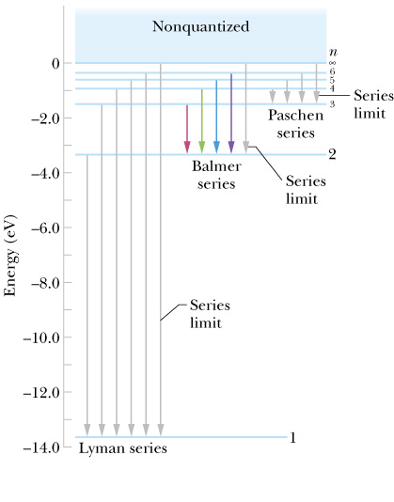
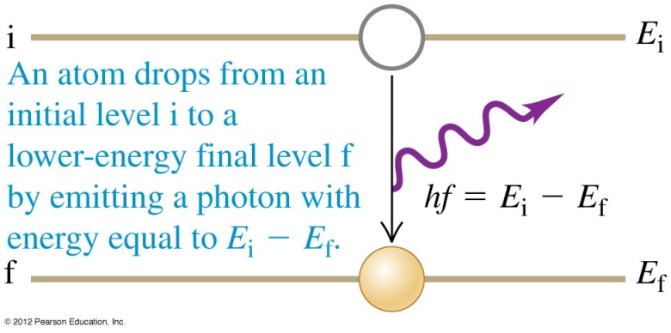
我只考慮躍遷前後的兩個定態，
躍遷前後，其他定態只是旁觀者！
讓我把它們寫成$\left|\left.1\right\rangle \right.,\left|\left.2\right\rangle \right.$
$$\left|\left.1s\right\rangle \right.≡\left|\left.1\right\rangle \right.,\left|\left.2p\right\rangle \right.≡\left|\left.2\right\rangle \right.$$
$$E_{1}$$
$ℏω_{0}=E_{1}$- $E_{2}$
$$E_{2}$$

Slide 2
$$\hat{H}\left|\left.ψ(t)\right\rangle \right.=iℏ\frac{∂\left|\left.ψ(t)\right\rangle \right.}{∂t}$$
$$\left|\left.ψ(t)\right\rangle \right.≡a(t)\left|\left.1\right\rangle \right.+b(t)\left|\left.2\right\rangle \right.$$
$$H\left(a\left|\left.1\right\rangle \right.+b\left|\left.2\right\rangle \right.\right)=iℏ\frac{da}{dt}\left|\left.1\right\rangle \right.+iℏ\frac{db}{dt}\left|\left.2\right\rangle \right.$$
取此式與$\left\langle \left.1\right|\right.$的內積，已知可得：
$$a\left\langle \left.1\right|\right.H\left|\left.1\right\rangle \right.+b\left\langle \left.1\right|\right.H\left|\left.2\right\rangle \right.=iℏ\frac{da}{dt}$$
取此式與$\left\langle \left.2\right|\right.$的內積，已知可得：
$$a\left\langle \left.2\right|\right.H\left|\left.1\right\rangle \right.+b\left\langle \left.2\right|\right.H\left|\left.2\right\rangle \right.=iℏ\frac{db}{dt}$$
這兩式可以以一個矩陣方程式表示：
$$\left(\begin{matrix}\left\langle \left.1\right|\right.H\left|\left.1\right\rangle \right. & \left\langle \left.1\right|\right.H\left|\left.2\right\rangle \right. \\ \left\langle \left.2\right|\right.H\left|\left.1\right\rangle \right. & \left\langle \left.2\right|\right.H\left|\left.2\right\rangle \right.\end{matrix}\right)\left(\begin{matrix}a \\ b\end{matrix}\right)=\left(\begin{matrix}h_{11} & h_{12} \\ h_{21} & h_{22}\end{matrix}\right)\left(\begin{matrix}a \\ b\end{matrix}\right)=iℏ\frac{d}{dt}\left(\begin{matrix}a(t) \\ b(t)\end{matrix}\right)$$
代表能量的$2×2$矩陣$\left(\begin{matrix}h_{11} & h_{12} \\ h_{21} & h_{22}\end{matrix}\right)給出\left(\begin{matrix}a \\ b\end{matrix}\right)$的變化率。

Slide 3
$$H_{0}=\left(\begin{matrix}E_{1} & 0 \\ 0 & E_{2}\end{matrix}\right)$$
$\left(\begin{matrix}1 \\ 0\end{matrix}\right), \left(\begin{matrix}0 \\ 1\end{matrix}\right)$就是$H_{0}$的本徵態！本徵值就是$E_{1},E_{2}$。
$$E_{1}$$
$$−\frac{eBℏ}{2m}$$
$$E_{2}$$
如果能量就是$H_{0}$，其本徵態，即定態，隨時間演化就是乘上一個數：$e^{−iEt/ℏ}$。
狀態不會改變。
現在打入一道角頻率$ω_{0}$的電磁波，此原子會多一個能量：
$$H_{1}=qE_{0}z\cos{ωt}$$
此能量將視為微擾，與時間有關，因此原本的定態會隨時間演化$\left|\left.ψ(t)\right\rangle \right.$！
我們可以計算一段時間後，一個定態例如$\left(\begin{matrix}1 \\ 0\end{matrix}\right)$有多少機率演化為其他定態$\left(\begin{matrix}0 \\ 1\end{matrix}\right)$，
這稱為與時間有關的微擾計算。

Slide 4
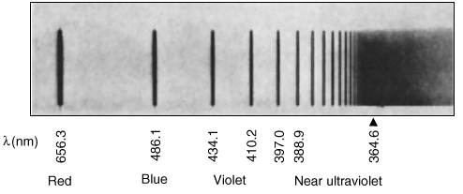
原子內的電子軌跡是無法觀察的。
對原子中電子唯一的觀察，就是以電磁波的吸收與放射來探測電子
$$E(x), B(x)$$
電磁場探測的是電子的電偶極，也就是電子的”位置”
原子躍遷發出的電磁波強度即是電子量子位置的表現：
$$a∝r$$
因此我們可以由一個可觀測量來定義原子中電子的位置。

Slide 5
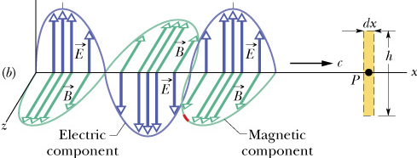
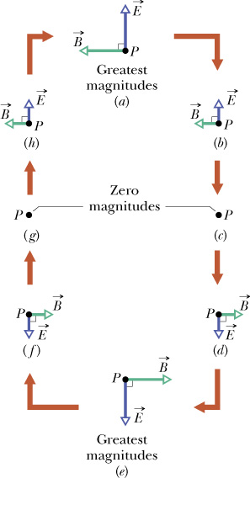
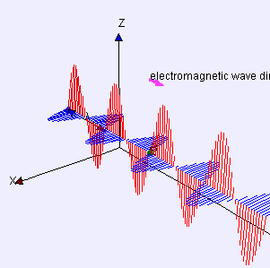
電磁波打在一個點電荷上
點電荷處的電磁場
點電荷處的電場
$$E\left(t\right)=E_{0}\cos{ωt}$$
點電荷受的電力
$$U\left(t\right)=pE=qE_{0}z\cos{ωt}$$

Slide 6
$$\left\langle \left.1\right|\right.{\hat{H}}_{1}\left|\left.1\right\rangle \right.=qE_{0}\cos{ωt}\left\langle \left.1\right|\right.\hat{z}\left|\left.1\right\rangle \right.$$
$\left\langle \left.1\right|\right.\hat{z}\left|\left.1\right\rangle \right.$就是在狀態$\left|\left.1\right\rangle \right.$時，$z$的平均值，一般都是零。
$$\left\langle \left.1\right|\right.\hat{z}\left|\left.1\right\rangle \right.=\left\langle z\right\rangle =0$$
因此：
$$\left\langle \left.1\right|\right.H_{1}\left|\left.1\right\rangle \right.=\left\langle \left.2\right|\right.H_{1}\left|\left.2\right\rangle \right.=0$$
代表微擾項$H_{1}$的矩陣是Off-Diagonal Matrix。
$$H_{1}=\left(\begin{matrix}0 & V_{12}\left(t\right) \\ V_{12}\left(t\right) & 0\end{matrix}\right)$$
$$\left\langle \left.1\right|\right.H_{1}\left|\left.2\right\rangle \right.=\left\langle \left.2\right|\right.H_{1}\left|\left.1\right\rangle \right.≡V_{12}\left(t\right)=qE_{0}\cos{ωt}\left\langle \left.1\right|\right.\hat{z}\left|\left.2\right\rangle \right.$$
我們可以開始微擾計算了！

Slide 7
$$\hat{H}\left(\begin{matrix}a(t) \\ b(t)\end{matrix}\right)=H_{0}\left(\begin{matrix}a \\ b\end{matrix}\right)+H_{1}\left(\begin{matrix}a \\ b\end{matrix}\right)=iℏ\frac{d}{dt}\left(\begin{matrix}a(t) \\ b(t)\end{matrix}\right)$$
薛丁格方程式。
$$\left(\begin{matrix}a\left(t\right) \\ b\left(t\right)\end{matrix}\right)≡\left(\begin{matrix}e^{−i\frac{E_{1}}{ℏ}t} & 0 \\ 0 & e^{−i\frac{E_{2}}{ℏ}t}\end{matrix}\right)\left(\begin{matrix}c_{1}\left(t\right) \\ c_{2}\left(t\right)\end{matrix}\right)≡\left(\begin{matrix}e^{−i\frac{E_{1}}{ℏ}t} & 0 \\ 0 & e^{−i\frac{E_{2}}{ℏ}t}\end{matrix}\right)\left(\begin{matrix}c_{1}^{(0)}+c_{1}^{(1)} \\ c_{2}^{(0)}+c_{2}^{(1)}\end{matrix}\right)$$
$\left(\begin{matrix}c_{1}^{(0)} \\ c_{2}^{(0)}\end{matrix}\right)$就會是原子的起始條件！
取到第零階：
$$iℏ\frac{d}{dt}\left(\begin{matrix}a \\ b\end{matrix}\right)=iℏ\left(\begin{matrix}E_{1} & 0 \\ 0 & E_{2}\end{matrix}\right)\left(\begin{matrix}e^{−i\frac{E_{1}}{ℏ}t} & 0 \\ 0 & e^{−i\frac{E_{2}}{ℏ}t}\end{matrix}\right)\left(\begin{matrix}{c_{1}}^{(0)} \\ {c_{2}}^{(0)}\end{matrix}\right)=H_{0}\left(\begin{matrix}a \\ b\end{matrix}\right)$$
自動成立！

Slide 8
$$\hat{H}\left(\begin{matrix}a(t) \\ b(t)\end{matrix}\right)=H_{0}\left(\begin{matrix}a \\ b\end{matrix}\right)+H_{1}\left(\begin{matrix}a \\ b\end{matrix}\right)=iℏ\frac{d}{dt}\left(\begin{matrix}a(t) \\ b(t)\end{matrix}\right)$$
薛丁格方程式。
$$\left(\begin{matrix}a\left(t\right) \\ b\left(t\right)\end{matrix}\right)≡\left(\begin{matrix}e^{−i\frac{E_{1}}{ℏ}t} & 0 \\ 0 & e^{−i\frac{E_{2}}{ℏ}t}\end{matrix}\right)\left(\begin{matrix}c_{1}^{(1)} \\ 1+c_{2}^{(1)}\end{matrix}\right)$$
$$\left(\begin{matrix}c_{1}^{(0)} \\ c_{2}^{(0)}\end{matrix}\right)=\left(\begin{matrix}0 \\ 1\end{matrix}\right)$$
設起始條件：
取到第一階：
$$H_{0}\left(\begin{matrix}e^{−i\frac{E_{1}}{ℏ}t} & 0 \\ 0 & e^{−i\frac{E_{2}}{ℏ}t}\end{matrix}\right)\left(\begin{matrix}c_{1}^{(1)}\left(t\right) \\ c_{2}^{(1)}\left(t\right)\end{matrix}\right)+H_{1}\left(\begin{matrix}0 \\ e^{−i\frac{E_{2}}{ℏ}t}\end{matrix}\right)=iℏ\frac{d}{dt}\left(\begin{matrix}e^{−i\frac{E_{1}}{ℏ}t} & 0 \\ 0 & e^{−i\frac{E_{2}}{ℏ}t}\end{matrix}\right)\left(\begin{matrix}c_{1}^{(1)}\left(t\right) \\ c_{2}^{(1)}\left(t\right)\end{matrix}\right)$$
$$iℏ\frac{d}{dt}\left(\begin{matrix}e^{−i\frac{E_{1}}{ℏ}t} & 0 \\ 0 & e^{−i\frac{E_{2}}{ℏ}t}\end{matrix}\right)\left(\begin{matrix}c_{1}^{(1)}\left(t\right) \\ c_{2}^{(1)}\left(t\right)\end{matrix}\right)=\left(\begin{matrix}E_{1} & 0 \\ 0 & E_{2}\end{matrix}\right)\left(\begin{matrix}e^{−i\frac{E_{1}}{ℏ}t} & 0 \\ 0 & e^{−i\frac{E_{2}}{ℏ}t}\end{matrix}\right)\left(\begin{matrix}c_{1}^{(1)} \\ c_{2}^{(1)}\end{matrix}\right)+iℏ\left(\begin{matrix}e^{−i\frac{E_{1}}{ℏ}t} & 0 \\ 0 & e^{−i\frac{E_{2}}{ℏ}t}\end{matrix}\right)\frac{d}{dt}\left(\begin{matrix}c_{1}^{(1)} \\ c_{2}^{(1)}\end{matrix}\right)$$
$$iℏ\left(\begin{matrix}e^{−i\frac{E_{1}}{ℏ}t}\frac{d}{dt}c_{1}^{(1)} \\ e^{−i\frac{E_{2}}{ℏ}t}\frac{d}{dt}b^{(1)}\end{matrix}\right)=H_{1}\left(\begin{matrix}0 \\ e^{−i\frac{E_{2}}{ℏ}t}\end{matrix}\right)=\left(\begin{matrix}0 & V_{12}\left(t\right) \\ V_{12}\left(t\right) & 0\end{matrix}\right)\left(\begin{matrix}0 \\ e^{−i\frac{E_{2}}{ℏ}t}\end{matrix}\right)=\left(\begin{matrix}V_{12}e^{−i\frac{E_{2}}{ℏ}t} \\ 0\end{matrix}\right)$$
$$\frac{d}{dt}c_{2}^{(1)}=0$$
$$\frac{d}{dt}c_{1}^{(1)}=V_{12}e^{i\frac{\left(E_{1}−E_{2}\right)}{ℏ}t}=V_{12}e^{iω_{0}t}$$

Slide 9
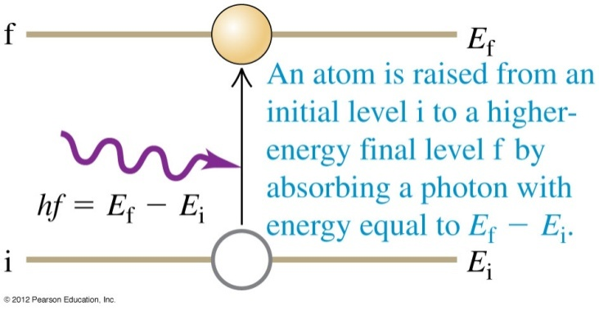
$$\frac{d}{dt}c_{2}^{(1)}=0$$
$$\frac{d}{dt}c_{1}^{(1)}=V_{12}e^{−i\frac{\left(E_{1}−E_{2}\right)}{ℏ}t}=V_{12}e^{−iω_{0}t}$$
$$c_{2}^{(0)}=1$$
$$c_{2}^{(1)}=0$$
$$c_{1}^{(1)}=\int_{0}^{t}{dt′}V_{12}\left(t′\right)e^{−iω_{0}t^{′}}$$
電磁波帶動了電子躍遷的機率！
$$E_{1}$$
$ℏω_{0}=E_{1}$- $E_{2}$
$$E_{2}$$

Slide 10
$$\frac{d}{dt}c_{1}^{(1)}=0$$
$$E_{1}$$
$$\frac{d}{dt}c_{2}^{(1)}=V_{12}e^{−i\frac{\left(E_{1}−E_{2}\right)}{ℏ}t}=V_{12}e^{−iω_{0}t}$$
$ℏω_{0}=E_{1}$- $E_{2}$
$$E_{2}$$
$$c_{1}^{(0)}=1$$
$$c_{1}^{(1)}=0$$
$$c_{2}^{(1)}=\int_{0}^{t}{dt′}V_{12}\left(t′\right)e^{−iω_{0}t^{′}}$$
電磁波帶動了電子躍遷的機率！
$$E_{1}$$
$ℏω_{0}=E_{1}$- $E_{2}$
$$E_{2}$$

Slide 11
$$c_{2}^{(1)}=\int_{0}^{t}{dt′}V_{12}\left(t′\right)e^{−iω_{0}t^{′}}=\int_{0}^{t}{dt′}\left(qE_{0}\cos{ωt′}\left\langle \left.1\right|\right.\hat{z}\left|\left.2\right\rangle \right. \right)e^{−iω_{0}t^{′}}$$
$$=qE_{0}\left\langle \left.1\right|\right.\hat{z}\left|\left.2\right\rangle \right.∙\int_{0}^{t}{dt′}\left(\cos{ωt′} \right)e^{−iω_{0}t^{′}}$$

Slide 12
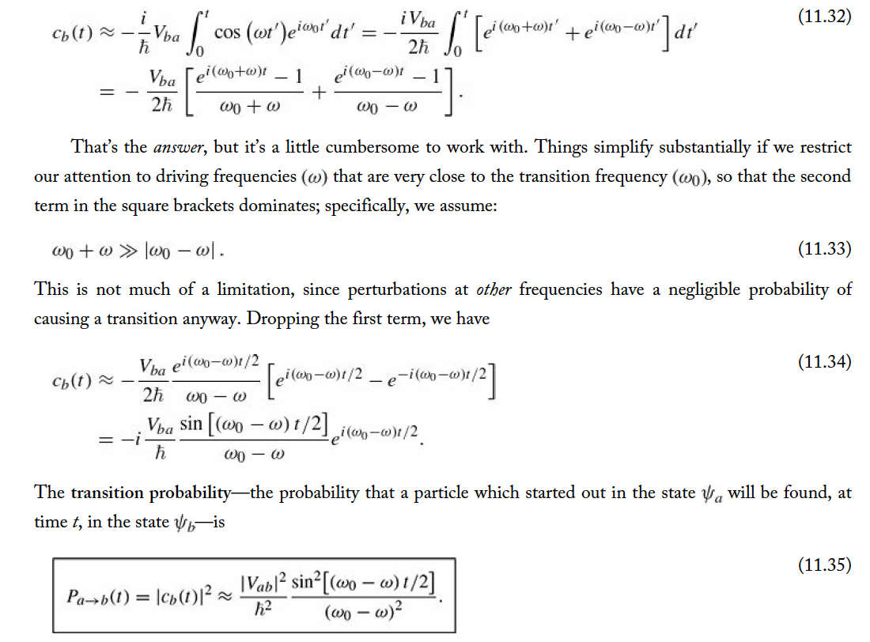
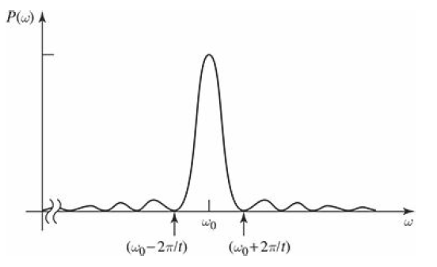

Slide 13
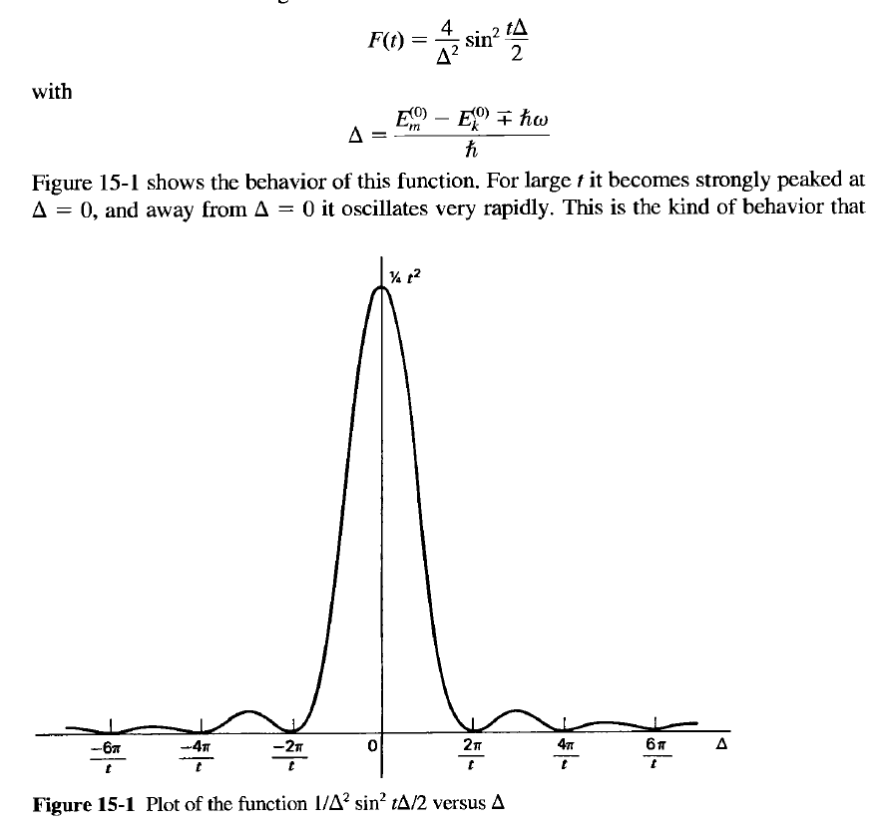

Slide 14
